Slide 1
Home Characteristics and Asthma Triggers
Training for Home Visitors
This training covers some of the most common
asthma triggers found inside homes. The training can guide users of this checklist to understand triggers.
Learning Objectives
To understand how exposure to common asthma triggers occurs in homes.
To help residents find ways to reduce and remove triggers in their homes.
Version 1.0, publication date June 2020
Notes:
This training covers some of the most common asthma triggers found inside homes. This training supplements information in the Home Characteristics and Asthma Triggers: Assessment Checklist for Home Visitors. The Centers for Disease Control and Prevention (CDC), the Environmental Protection Agency (EPA), and the U.S. Department of Housing and Urban Development (HUD) developed the checklist, which is available on their websites:
www.epa.gov/sites/production/files/2018-05/documents/asthma_home_environment_checklist.pdf
www.cdc.gov/asthma/pdfs/home_assess_checklist_P.pdf
www.hud.gov/sites/dfiles/HH/documents/17_287251A_CHEW_HomeAssessCHECKLISTFINALnot508.pdf
By completing this training, you will be able to:
Understand how exposure to common asthma triggers occurs in homes, and
Help residents find ways to identify, reduce, and remove triggers in their homes

Slide 2

Outline of training
Glossary
Introduction (allergens,
irritants, allergy, and particles)
Building information
Heating and cooling
Cooking
Smoking
Pets
VOCs
Pests
Moisture and Mold
Dust mites
Notes:
This training follows the general order of the Home Characteristics and Asthma Triggers: Assessment Checklist for Home Visitors.
The front page of the checklist contains a glossary of terms that can be used as a reference. However, the training goes into more detail than the glossary used in the Checklist. For example, some triggers can affect asthma by being an allergen, an irritant, or both. The next two slides describe allergies and the difference between allergens and irritants.

Slide 3


Allergy assessment
???
Skin Prick Test
Blood Sample
Question:
Are you allergic?
Notes:
We can check for allergies in several ways. Common ways to check are to use a skin prick test or take a blood sample and measure for antibodies to certain allergens. Information gathered by asking questions about allergies can help identify some allergens, such as cats, but are less helpful for others, such as dust mites.
Allergen avoidance strategies are most effective when they can be tailored to a person’s allergies and their asthma triggers.

Slide 4
What are allergens and irritants?
Allergens
  Affect people with specific sensitivity to a certain substance.
  Can be found on particles.
  Include dust mite droppings, mold spores, pet skin flakes (dander), cockroach droppings, and dried rodent urine.
Irritants
  Affect people with asthma even without a specific allergy.
  Can be found in particles, vapors, and gases.
  Include smoke, mold spores and odors, secondhand smoke, and cat urine odor.
Notes:
Some people are sensitive to allergens (such as dust mites, mold, pests, and pets with fur). For these people, exposure to allergens on particles in the air can lead to symptoms such as stuffy nose, wheezing, and red or itchy eyes. With repeated exposure to the allergens, such as cat allergen for some people, the symptoms occur faster and can be more intense.
People with allergies can develop asthma. For many people who have asthma, allergens can trigger an asthma attack.
Some particles in the air can act as irritants:
Volatile organic compounds (VOCs) are vapors that act as irritants.
Combustion by-products such as smoke and secondhand smoke also can be irritants.
Irritation from inhaling particles, gases, or vapors into the airways can trigger asthma attacks, whether the person is allergic or not.

Slide 5
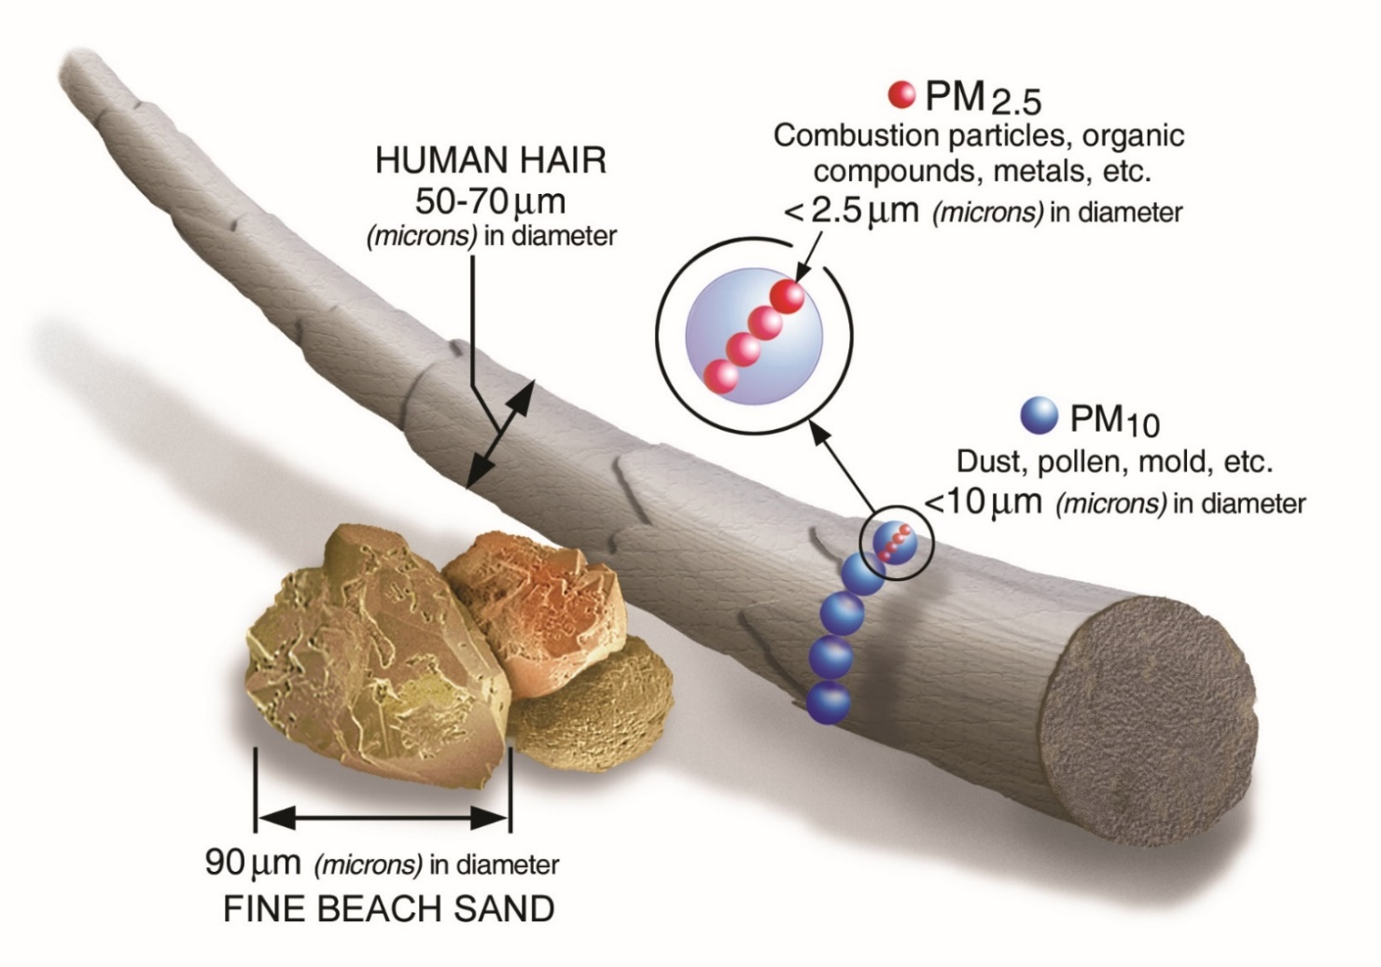

Particle sizes
(such as secondhand smoke particles)
Notes:
This graphic compares sizes of common particles found indoors. These particles are measured in microns. A micron is a very small unit of length. One micron is equal to 1 millionth of a meter. The width of a human hair is about 50-70 microns. Beach sand can be about 90 microns.
Particulate matter, or PM, makes up what we commonly think of as part of air pollution. It is a mixture of solid and liquid particles. PM 2.5 and PM 10 are commonly measured particle sizes in indoor and outdoor air. PM 2.5 means the particle is 2.5 microns or less. PM 10 particles are 10 microns or less. Common asthma triggers are the particles from secondhand smoke; these are smaller than PM 2.5.

Slide 6
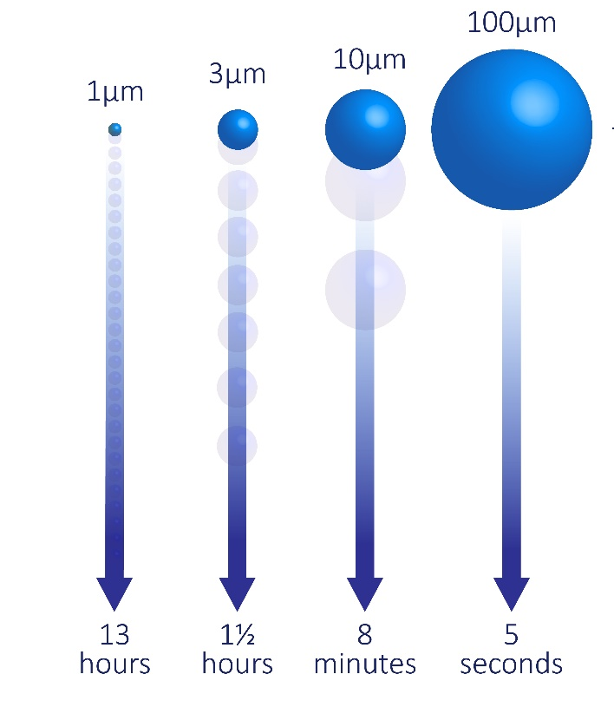
Small particles stay in the air for hours
Large particles settle quickly
Time to settle
from 5 feet
Notes:
The size of the particle affects how long it stays in the air. In an empty room, larger particles can quickly settle out of the air. Very small particles can stay in the air for hours. Activity in a room or air movement can affect these settling times.

Slide 7
Size range of asthma trigger particles in air
Small
Medium
Large
Secondhand smoke
Cat/dog allergen
Mouse allergen
Dust mite allergen
Cockroach allergen
Mold spores
Pollen grains
5
10
15
20
25
30
40
Particle size (microns)
Notes:
Several studies measured particle sizes of asthma triggers. Secondhand smoke has the smallest particles compared with those of other asthma triggers on this slide.
Cat and dog allergens have small, medium, and large particles. Small particles are less than 2.5 microns, medium are 2.5 to 10 microns, and large are more than 10 microns in size. The small particles of cat and dog allergens stay in the air for a long time and can be easily spread throughout a home. Because of that, people who are allergic to cats or dogs often begin to have symptoms within minutes of walking into a home.
Dust mite and cockroach allergens are mainly on large particles, which settle out of the air quickly. Therefore, people who are allergic to dust mites and cockroaches might not experience symptoms when they first enter a home.
Mold and pollens are medium to large, but smaller fragments of those can stay airborne for a long time and still be asthma triggers.

Slide 8

Why does particle size matter?
Small
Medium
Large
Secondhand smoke
Cat/dog allergen
Mouse allergen
Dust mite allergen
Cockroach allergen
Mold spores
Pollen grains
5
10
15
20
25
30
40
Particle size (microns)
Size range of asthma trigger particles in air
Notes:
Many of the large particles associated with dust mites, cockroaches, mold, and pollen can settle out of the air quickly. However, they can also be re-suspended in the air by various activities. That can happen when vacuuming, sweeping, cleaning, playing on carpeted floors, using fans, and tossing and turning in bed.
Portable air cleaners will not “clean” the air of the large particles that are briefly re-suspended, but they can remove small and medium particles that tend to stay in the air. For example, a person with dust mite allergy would not be helped by trying to remove dust mite allergens with an air cleaner. That person might benefit more by using dust mite mattress covers to keep the large particles from being inhaled while sleeping. On the other hand, an air cleaner could help with removing small particles such as those containing allergens from mice.
Vacuum cleaners with high-efficiency (HEPA) filters can remove a wide range of particle sizes and should be considered for persons with asthma or allergies. Cleaning out filters and vacuum bags can lead to exposure, so appropriate precautions should be taken. Bags are best emptied in an area away from the main living space, such as a garage.

Slide 9
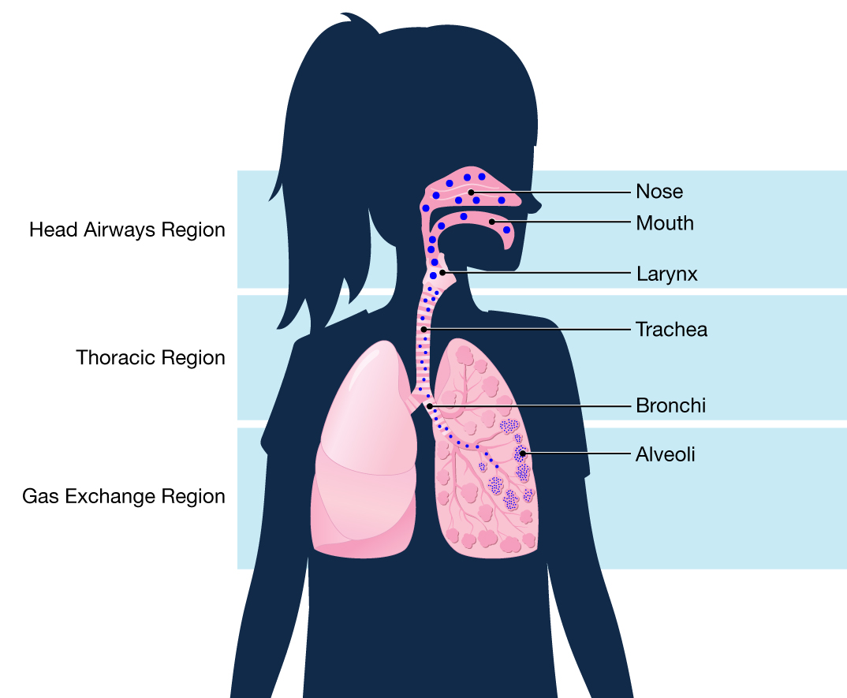
Where do particles go in the airways?
Large
Medium
Small
Notes:
Particle size can also affect where the particles go in the airways, and thus, how long a person is exposed to the particle.
Inhaled large particles are mainly caught in the nasal passages and are sneezed or coughed out.
Medium particles go deeper in the airways but can still be coughed out.
Smaller particles, such as secondhand smoke, go deep into the lungs and can stay there for a while, meaning they have a longer residence time in the body. Because gas exchange also occurs in the small airways, some of the chemicals, such as those from secondhand smoke, enter the bloodstream, resulting in longer exposure compared with large particles.

Slide 10
BUILDING INFORMATION and
HOME INTERIOR
Notes:
Now that we understand allergens and irritants, and how the particle size affects exposure, we can begin reviewing items in the Core Assessment

Slide 11

Building information
Type of home
  Single (detached)
  Attached to other homes
  Manufactured/Mobile home
Rental vs. owned
Number of stories in building
Notes:
Type of home
Where people live influences which allergens they might encounter. The type of home they live in is associated with different risk factors for asthma triggers, and with the resident’s ability to control them in their own home.
Single (detached)
Single-family homes are one-unit buildings, detached from any other building. People who live in single- family homes might have more control over some asthma triggers than do people in multi-family buildings.
However, single-family homes can have different points of entry for pests and places for these pests to hide. Also, the house might have an attached garage from which car exhaust could enter the home. The house also might have a crawl space. Poorly designed or maintained crawl spaces can be damp and hide mold damage that affects the occupied space.
Attached to other homes
Apartments, Row homes, duplexes, condominiums, and other types of multi-family homes can be prone to infiltration of asthma triggers from neighbors directly or from common spaces such as hallways and laundry rooms.
Manufactured and mobile homes
Manufactured and mobile homes are usually small; therefore, indoor air is easily affected by outdoor air. Condensation can easily occur if these homes are located in warm areas of the country, with humid air entering the home and condensing on surfaces. Like any new home, off-gassing of building materials in manufactured homes releases VOCs and can trigger asthma symptoms, but over time, the off-gassing will subside.
Rental vs. owned
People who rent their homes might have less control over some asthma triggers. Common areas, for example, might be used by many people. Tenants also might need landlord approval or commitment for major building repairs to remove moldy drywall or carpet with allergens.
Consider providing a list of local resources available from public health departments or reach out to local tenant’s rights groups for assistance.
Number of stories
The number of stories in a building also can affect asthma triggers. Multi-story buildings often have pipes, trash chutes, and ductwork that carry asthma triggers throughout the building and give pests easy access. Basements are often damp, which can lead to mold growth.

Slide 12
HeatING and cooling
Notes:
To help reduce particles in the air, there are three areas to focus on:
source control (limiting the amount of pollutants brought in or created inside),
ventilation, and
filtration (or air cleaning).
In this section of the training, we’ll focus on ventilation and filtration. Filters are available for heating, ventilation, and air conditioning (HVAC) systems that help reduce some common asthma triggers.

Slide 13
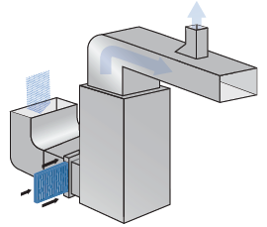
Heating, ventilation, and air conditioning (HVAC)
Heating, ventilating, and air conditioning (HVAC) systems and some appliances can circulate pollutants.
Indoor air pollutants can enter living areas from crawl spaces, basements, attics, and wall cavities.
Notes:
Indoor air quality can be affected by pollutants brought in or circulated by HVAC systems, as well as a number of appliances and fixtures used indoors.
Sometimes, air with indoor air pollutants pass from “unoccupied spaces” in a home, such as crawl spaces, basements, attics, and wall cavities, into areas where people live.

Slide 14
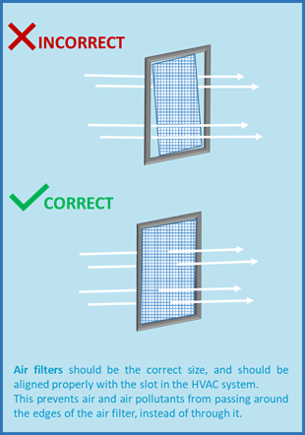
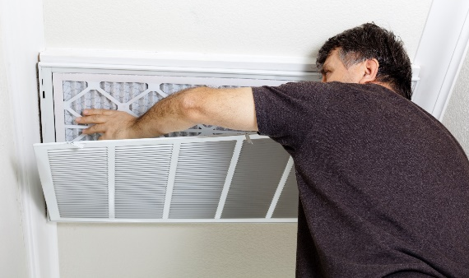
HVAC maintenance and filters
To help maintain indoor air quality, follow manufacturers’ instructions for routine HVAC maintenance.
Air filters that reduce indoor pollutants can be installed correctly by a professional.
Use correct size air filters.
Align filter properly in HVAC system slot.
Notes:
Generally, for all sources of heat in a home, residents should review the manufacturer’s instructions to make sure all devices and appliances are properly installed, inspected, adjusted, and maintained so that they operate properly and do not cause indoor air problems. This might not be possible if the resident doesn’t have access to the HVAC system or is not responsible for maintenance because they live in a multi-family building. Regular cleaning or inspections may be required, and this can help control asthma and allergies.
High-efficiency pleated filters should be installed within the HVAC system, initially by a professional, if possible.
Residents can usually replace filters if they carefully follow the manufacturer’s instructions. High-efficiency pleated filters can be found at local hardware stores for future replacements.
Keep in mind that if the filter(s) are not fitted correctly, indoor pollutants can still enter the living space. If filters are installed incorrectly, as shown in the top image in the graphic, air can pass around the sides of the filters, allowing particles to be carried into the living spaces. The bottom image in the graphic shows air passing through a properly fitted filter.

Slide 15

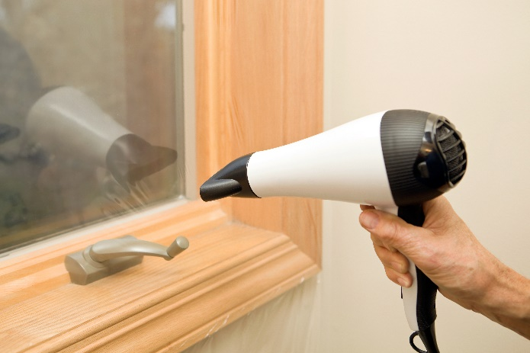
Asthma triggers and heating
Ways people heat their homes
Heating systems and appliances
Insulation
Closing windows and doors
Example of plastic sheeting used as insulation over a window
Notes:
Some people have whole house heating systems, while others use space heaters or other means to heat individual rooms. These choices might be based on the functional condition of the system, cost, climate, or age of the building.
During winter and cold weather, people use heating devices and close their windows to keep their homes warm. They might put plastic sheeting on windows or use other insulation methods to help retain heat. In many cases, intake of fresh air is limited.
Limiting the amount of outdoor air that comes in may help with home heating, but it can present problems. Pollution created inside can build up, including indoor particles and gases that can trigger asthma or allergic reactions.
To begin addressing possible asthma triggers related to heating, consider first addressing what the resident uses as the primary heating source. The primary heating source is the one that the residents use most of the time.
Take appropriate steps to make sure that any potential indoor air quality problems related to the primary heating source are addressed (to be discussed in next slide). If time and resources are available, continue to address secondary heating sources.
Check the primary and secondary heating sources for each room. Make sure that the rooms are well-ventilated (as described on the next slide).

Slide 16


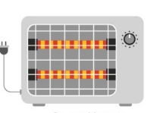

Heating
Checklist questions
During the winter, what is the primary way your home is heated?
In addition to the main source of heat, do you use any other source(s)?
Potential action steps
Properly ventilate the room where a fuel- or wood-burning appliance is used.
Never use a gas cooking appliance as a heating source.
Use proper fuel and follow instructions when using an unvented kerosene or gas space heater.
Radiator
Fireplace
Space Heater
Baseboard Heater
Notes:
Asthma management may include addressing indoor pollutants from the primary source of heating, ventilation, and cooling. Secondary heating sources also might be a concern.
Unvented combustion appliances, such as unvented and kerosene space heaters, are not recommended. Such fuel-burning appliances can create particulate matter and gaseous pollutants. If used, all fuel-burning appliances should be vented to the outside. If they cannot be vented to the outside, as in the case of portable units, it is important to have good ventilation and to bring in fresh air.
Radiators and Baseboard Heaters: These don’t have air filters, so the benefit of air filtration is not possible unless portable air cleaners are used to provide supplemental air filtration. For older radiators, steam leaks can lead to possible mold on surfaces near those leaks.
Forced hot air vents: Consider using filters that can be inserted into the vents or work with a professional to make sure that filters in the HVAC system are appropriate for the needs of the residents.
Space heaters: If using an unvented kerosene or gas space heater, follow the manufacturer’s instructions for proper fuel to use and keep the heater properly adjusted, cleaned, and maintained.
Fireplace/Wood-Burning Stove: If using a fireplace, make sure it is properly vented to help ensure smoke escapes through the chimney. If a wood-burning stove is used, make sure that doors are tight-fitting. Use aged or cured wood only and follow the manufacturer’s instructions for starting, stoking, and putting out the fire.
Combustion gases and particles can come from improperly installed or maintained chimneys and flues and cracked furnace heat exchangers. Pollutants from fireplaces and woodstoves with no dedicated outdoor air supply can be "back-drafted" from the chimney into the living space, particularly in weatherized homes.
The use of wood stoves or fireplaces increases the risk for mold growth for several reasons, including excess storage of wood indoors. Like wood stoves and fireplaces, space heater use can overheat one room, which can result in other rooms being colder and thus increasing the risk for condensation and mold growth.
Gas cooking: Never use a gas-cooking appliance as a heating source.

Slide 17
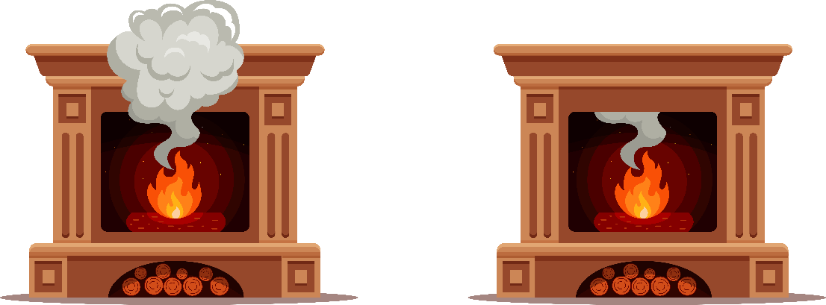
Fuel-burning heat sources
Fireplaces, wood burning stoves, or other fuel-burning appliances can trigger asthma if not properly ventilated.
Caution: Ventilate safely! Make sure the flue (chimney opening) is open to prevent backdraft (see figures).
Be sure to have working smoke alarm(s) and CO detector(s).
Flue open
Properly ventilated
Flue closed
Improperly ventilated
* Check with a professional to inspect chimney every year.
Notes:
Pollutants from fireplaces and woodstoves with no dedicated outdoor air supply can be "back-drafted" from the chimney into the living space, particularly in weather-proofed homes.
This can be challenging. Opening windows in winter can create a cold draft and might make an unventilated space less comfortable. This also might be challenging if there are outdoor air or safety concerns.
Caution: Ventilate safely! To prevent fire hazards, make sure doors and shutters to appliances are firmly closed before to ventilating the space.
Note: Just because a smoke alarm isn’t going off, doesn’t mean indoor pollutants from combustion are below the threshold of triggering asthma.

Slide 18


Cooling
Central A/C units
  Replace filters every 3 months or as recommended.
  Use filters with higher efficiency than standard, if specifications allow.
  Schedule annual inspection of HVAC system by a professional.
  Promptly repair damaged parts.
Window A/C units
  Keep drip pans clean and the drain lines flowing properly.
  Follow the manufacturer’s instructions for cleaning or replacing filters.
Evaporative coolers (often used in very dry climates)
  Follow the manufacturer’s instructions for cleaning.
Window A/C unit
Fan
Portable free-standing unit
Notes:
Air conditioning units can keep some outdoor asthma triggers, such as pollen and other particles, from entering the home. However, if residents have a window air conditioning unit, they should keep drip pans and drain lines clean and in good working order so that mold and other microorganisms aren’t carried into the room along with the cold air.
For more complicated HVAC systems, make sure to clean coils and drain pans, and make sure that the system is annually inspected and adjusted by a professional, and is operating efficiently.
Without a home assessment, it is difficult to determine if air conditioning is helping to decrease humidity or adding to mold and dampness problems.
Evaporative coolers are common in some parts of the country. Those are especially difficult to maintain properly without increasing relative humidity in the home, which can lead to mold growth.

Slide 19
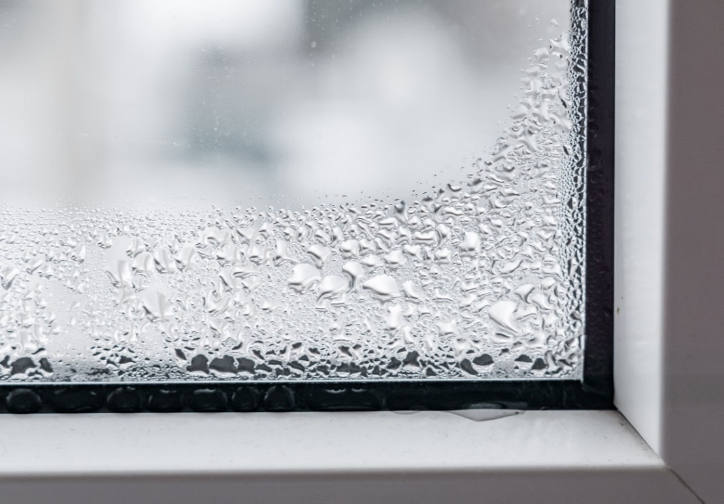
Asthma triggers and cooling
Excess cooling can create condensation, which can damage home furnishings and lead to mold, a common asthma trigger.
If you see condensation or moisture on windows, walls, or pipes act quickly to dry the wet surface and reduce the moisture/water source.
Condensation can be a sign of high humidity.
Notes:
To help prevent asthma symptoms when cooling a home, several factors need to be considered.
Cooling a home has the potential to create water problems, which can lead to mold growth.
Condensation can occur when the temperatures of the room air and surfaces in contact with the air greatly differ. Condensation on surfaces can affect materials that are susceptible to water, such as wood, wallboard, ceiling tiles, cabinetry, and cardboard. Condensation can drip from window panels, damaging wood frames and potentially creating mold problems near and around windows.
If residents see condensation or moisture collecting on windows, walls, or pipes, they need to act quickly to dry the wet surface, reduce the moisture, and address the water source.
Condensation can also be a sign of high humidity. People who live in a humid environment might consider using a dehumidifier to keep humidity within the appropriate range (between 30%-50%).

Slide 20
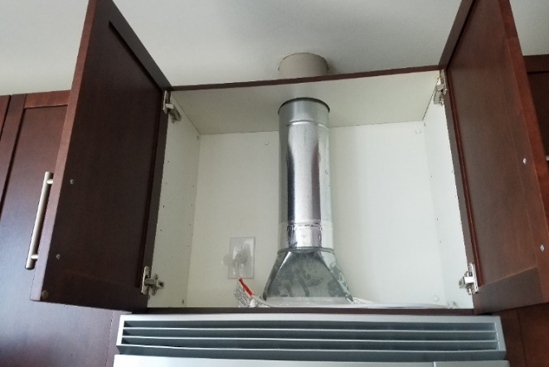
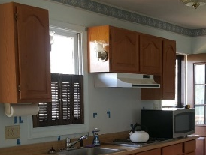
Cooking
Cooking can create indoor air pollutants, such as gases and particles.
Cooking can also increase moisture in the air.
Use exhaust fans or range hoods that vent to the outside, or open windows when cooking.
Exhaust duct
No exhaust duct
Notes:
Cooking can increase moisture and generate indoor air pollutants, including gases and particles. For people with asthma, indoor air pollutants from cooking can be irritants or worsen asthma symptoms. Moisture from cooking can accumulate and cause mold problems if wet materials, such as kitchen cabinets, are not able to dry out.
Use exhaust fans that exhaust to the outside or open windows when cooking.
This slide shows two exhaust hoods. The one at the top vents to the outdoors. The one below vents back into the kitchen. If the home’s exhaust hood looks like the one at the bottom, the resident might consider replacing or fixing the range hood so that it vents to the outdoors. Other options for reducing indoor pollutants generated by cooking include opening windows.

Slide 21
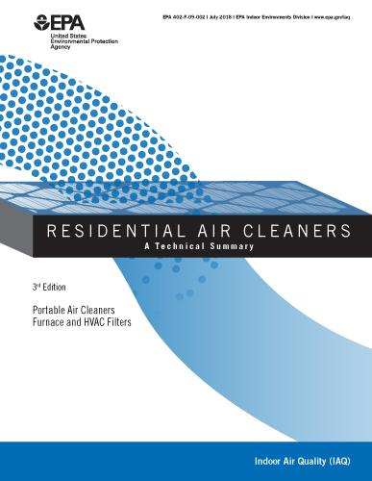
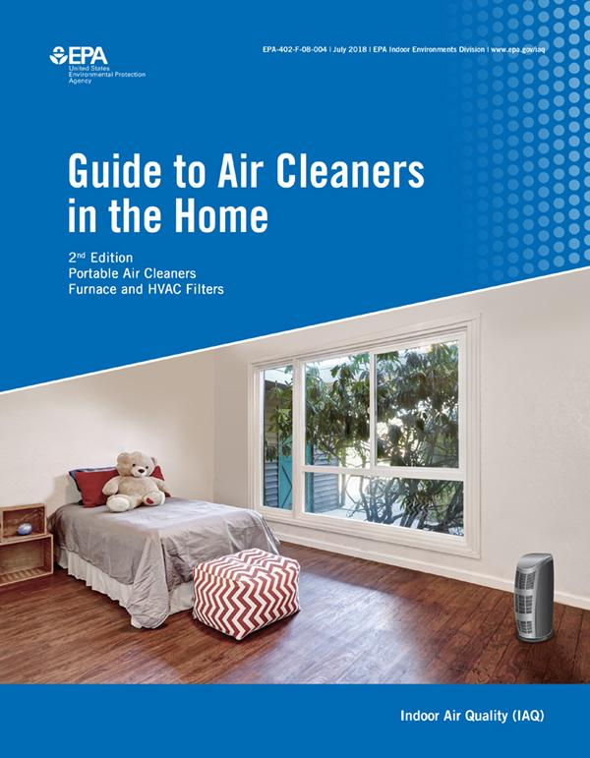
Air Cleaners
Eliminating sources of asthma triggers such as candles, cigarettes, perfumes, air fresheners, etc. is the best method for controlling indoor air quality.
Ventilation and air cleaning help remove particles and gases.
EPA has a consumer guide, and a more technical summary about using air cleaners at home (https://www.epa.gov/indoor-air-quality-iaq/air-cleaners-and-air-filters-home).
Notes:
Sometime, residents choose to use air cleaners to remove asthma triggers in their homes.
Eliminating sources of asthma triggers such as candles, cigarettes, perfumes, and air fresheners is the best method for controlling indoor air quality.
Ventilation and air cleaning are used to help remove particles and gases
EPA has a consumer guide, and a more technical summary about using air cleaners at home.

Slide 22
smoking
Notes:
The next section is about smoke exposure in the home.

Slide 23
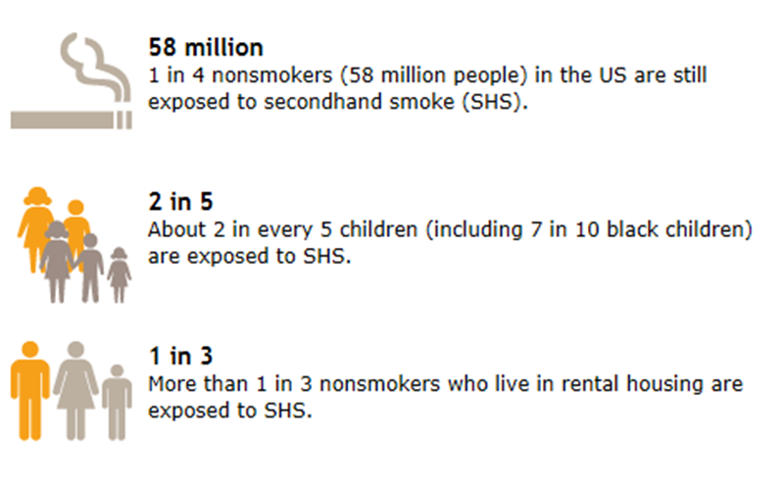

Secondhand smoke exposure in the United States
Notes:
Secondhand smoke is the smoke in air from a cigarette, cigar, or pipe, and the smoke exhaled by a smoker.
Secondhand smoke contains more than 4,000 substances, including several compounds that cause cancer.
Secondhand smoke can trigger asthma episodes and increase the severity of attacks. Secondhand smoke is also a risk factor for new cases of asthma in preschool-aged children. Children's developing bodies make them more susceptible to the effects of secondhand smoke and, due to their small size, they breathe more rapidly than adults, thereby taking in more secondhand smoke.
Children receiving high doses of secondhand smoke, such as those with smoking parents, run the greatest relative risk of experiencing damaging health effects.
Home is the main place where many children and adults breathe secondhand smoke.

Slide 24
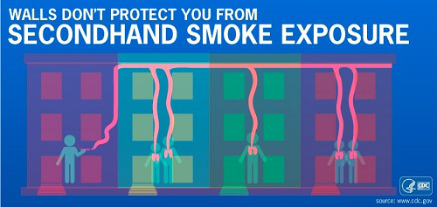
“Separating smokers from non-smokers, cleaning the air, and ventilating buildings cannot eliminate exposure of nonsmokers to SHS…”
— Surgeon General, 2006
Secondhand smoke (SHS) is a universal asthma trigger.
There is no safe amount of SHS.
Smoke-free policies benefit tenants and property owners.*
* To learn how to start a smoke-free policy, go to
www.hud.gov/program_offices/healthy_homes/smokefree2
Notes:
Each year, an estimated 28 million multi-unit housing residents are exposed to secondhand smoke in their home or apartment that came from somewhere else in their building, such as a nearby apartment.
100% smoke-free policies are the only effective way to fully eliminate secondhand smoke exposure.
In the meantime
Encourage and support families with asthma to take action and not allow smoking in their home or car.
Connect people who smoke to a smoking cessation program, such as their state quitline (1-800-QUIT-NOW).

Slide 25

E-cigarettes
E-cigarettes create an aerosol that can contain toxic chemicals.
Risks that secondhand aerosol might trigger asthma symptoms are unknown.
Other concerns
  Dramatic increase in use of e-cigarettes by young people
  Possible path to traditional smoking among youth
Notes:
E-cigarettes create an aerosol that can contain toxic chemicals. Both tobacco smoke and marijuana smoke contain particles and combustion by-products.
We do not yet have enough research to tell us if secondhand aerosol from e-cigarettes triggers asthma symptoms. However, we know that nicotine is harmful to the developing brain.
Also, the Surgeon General, CDC, and many public health advocates recommend including all tobacco products, including e-cigarettes, in smoke-free rules.

Slide 26
Pets
Notes:
The next section is about pet allergens.

Slide 27
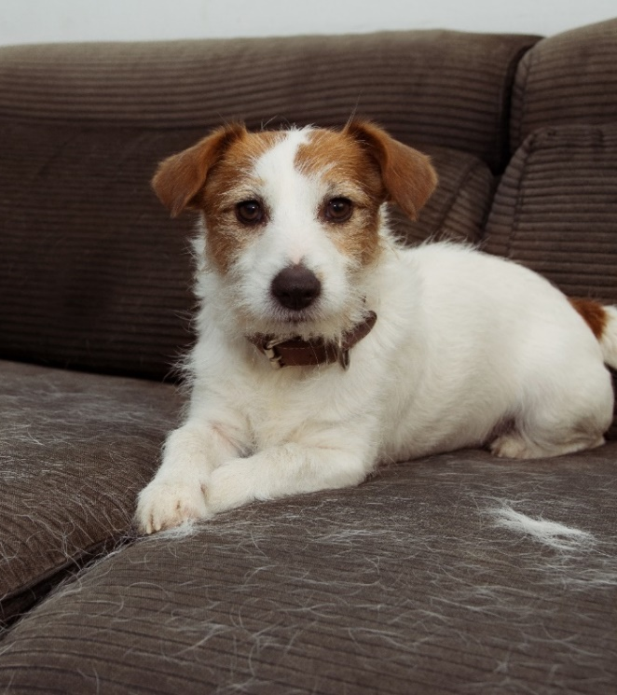
Pets with fur: allergen characteristics
Cat and dog allergens
  Mainly skin flakes and saliva
  Found in a range of particle sizes
    Small (<2.5 microns)
    Medium (2.5-10 microns)
    Large (>10 microns)
  Small particles can remain airborne for hours
  Easily carried on clothes to other places
*Allergen avoidance should focus on removing allergens from surfaces and air
Notes:
Cat and dog allergens are found mainly on skin flakes and saliva. The allergens can be found on small, medium, and large particles. As a reminder, small particles are less than 2.5 microns in size. Medium particles range from 2.5 microns to 10 microns . Large particles are bigger than 10 microns.
Small particles can remain airborne for hours.
Cat and dog allergen particles can easily be carried on clothes into other locations.
Allergen avoidance for cats and dogs should focus on removing particles from surfaces and air.

Slide 28
Pets with fur
Action steps to decrease exposures and symptoms
Find a new home for the pet and thoroughly clean all surfaces
  OR
For pets still in home
keep pet out of bedroom
wash furry pets
use air cleaner with HEPA filter
use allergen-proof mattress and pillow covers
Notes:
The most effective way to decrease asthma symptoms from dog or cat allergens is to remove the pet from the home. If the pet is still in the home, several action steps can be used to help decrease pet allergen exposure and symptoms. Taking only one action rather than a combination of actions might not decrease asthma symptoms.
For several years, clinicians have advised keeping pets out of bedrooms to decrease exposure to allergens. From the previous slides on particle sizes, it is clear that pet allergens on small particles can flow through the home. Plus, pet allergen can be on clothes and inadvertently carried into the bedroom.
In terms of health promotion, people with asthma living in homes with pets can try to incrementally increase the number of action steps to ultimately accomplish all action steps. However, the resident should keep in mind that the best way to avoid the asthma trigger is to remove the pet and thoroughly clean all surfaces. Even with pet removal, it can take several months to a year to achieve low pet allergen levels similar to those of homes that never had a pet.

Slide 29
Cat allergens in homes
10 out of 10 homes had high levels
3 out of 10 homes had high levels
Notes:
In a study of cat allergens in homes, all homes that had a cat had high levels of cat allergen in the home. Even in homes that did not currently have a cat living in the home, 30% of the homes had high cat allergen. If the resident has cat allergies, is still having symptoms, and doesn’t have a cat, then maybe this could be explained by the potentially high levels even without a pet.

Slide 30
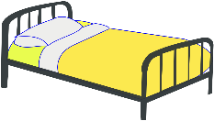
Cat allergens in bedrooms
10 out of 10 bedrooms had high levels
4 out of 10 bedrooms had high levels
Notes:
In homes with a cat, all levels of cat allergens were high in the bedroom if the cat was allowed in that room. However, even if the cat was not allowed into the bedroom, 40% of the homes had high cat allergen levels. So just keeping the cat out of the bedroom is not enough to decrease exposure to cat allergens. Even if the resident keeps the cat out of the bedroom, the resident needs to do all of the other three steps in the checklist:
1. Wash furry pets
2. Use an air cleaner with a HEPA filter
3. Use allergen-proof mattress and pillow covers

Slide 31

Changes that can affect pet allergen levels
Changes by the residents (new furniture, new carpet, new pet).
Changes in living situation (daycare, relative’s home, vacation).
Notes:
Even people who don’t have furry pets can be exposed to pet allergens in their homes and elsewhere. For example, bringing in used furniture from a home that had pets can also introduce pet allergen into the home. Pet allergens can be carried into the home on clothes and other soft furnishings, and from other locations, such as a daycare or a friend’s home. Exposure might be greater in homes with carpet, which can hold more pet allergen than a smooth-surfaced floor. Therefore, just because a pet is not living inside the home, we should not assume pet allergens are not in that home.

Slide 32

Other pets
Things to consider
Other pets have allergens, too
Pet food and water can attract and nourish bugs and rodents
Litter boxes and cages can cause odors and mold growth that can irritate the lungs
Notes:
Along with cats and dogs, other animals in the home can be a source of allergens and irritants. These include furry pets, such as hamsters, gerbils, guinea pigs, rabbits, and ferrets. Birds have allergens, too. Pet food can attract cockroaches, rodents, and other pests.
All cages and litter boxes of pets should be cleaned regularly. Preferably, the person with asthma should not be doing this cleaning. The cleaning should be done with proper ventilation while the person with asthma is away from the area.

Slide 33
PesTs
Notes:
The next section is about pests and their allergens.

Slide 34
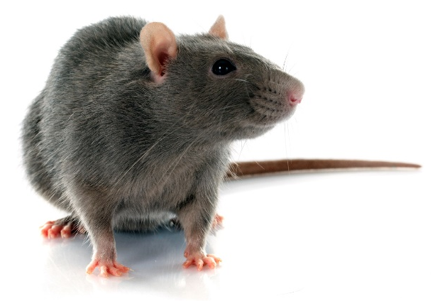
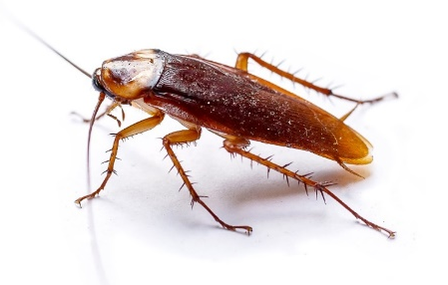

Types of pests
Notes:
Different types of cockroaches are found in different climates. American cockroaches are common in the southern United States and in basements throughout the United States. German cockroaches are common in single-family and multi-family homes that have pest infestations. In some places, cockroaches might be called water bugs or palmetto bugs. These are still cockroaches.
Mice also differ. Field mice, for example, might only enter a home when it’s cold outside. Other mice might live year-round in the house or multi-family building.
Rats are rarely found in homes; therefore, rat allergen in homes is rare. However, many people really can’t tell the difference between rats and mice, so that is why we ask about both.

Slide 35
Pests: Allergen characteristics
Mouse and rat allergens
Mainly urine (but also in dander).
Airborne allergens on a range of microscopic particles (<10 and ≥10 microns).
Can remain airborne
for hours.
Cockroach allergens
Mainly fecal pellets (but also in dried body parts).
Airborne allergens on larger, but still microscopic particles (mainly >10 microns).
Settle out of air quickly.
Notes:
Mouse and rat allergens are found mainly in urine (but also in dander, which is another term for skin flakes). The airborne allergens can be found on small, medium, and large particles, but the small particles (those less than 2.5 microns in size) can remain airborne for hours.
On the other hand, cockroach allergens are found mainly on fecal pellets or droppings (but also in dried body parts). The cockroach allergens are found on larger particles (mainly those larger than 10 microns), which settle out of the air quicker than mouse or rat allergen particles.

Slide 36
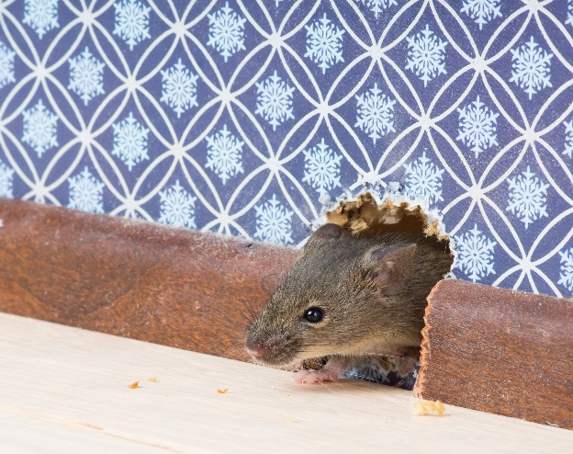
Things that affect pest allergen levels
Changes within the home — new roommates, parties with a lot of food, new pet.
Changes in the building — new holes, recent pesticide application in neighboring buildings.
Changes in weather — cold temperatures can drive pests indoors.
Notes:
Several things can affect pests and their allergens.
Changes by residents in the home (new roommates, parties with a lot of food, new pet)
Changes in the building (new holes, recent pesticide application in neighboring buildings)
Seasonal changes (cold weather can drive pests indoors)
The next slide shows examples of changes inside and outside the home that can affect pests and their allergens.

Slide 37

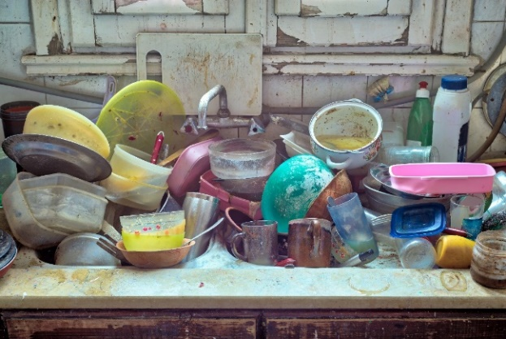

Specific examples of things that attract pests
Notes:
Leaving trash next to buildings can attract pests such as cockroaches and rodents. Subsequently, the pests can enter the buildings to find other sources of food and shelter. Leaving dirty dishes in the sink or on the table can also attract pests and if left overnight, mold can begin to grow too.

Slide 38
What is Integrated Pest Management (IPM)?
Integrated: Using multiple approaches that work together.
Pest: Unwanted rodents and bugs in the home.
Management: Effective methods with the least possible hazard to people, property, and the environment.
Notes:
Integrated Pest Management (IPM) is best described by its component words:
Integrated means it uses multiple approaches that work together.
Pest Unwanted rodents and bugs in the home
Management means it uses effective methods for pest control, with the least possible hazard to people, property, and the environment.

Slide 39
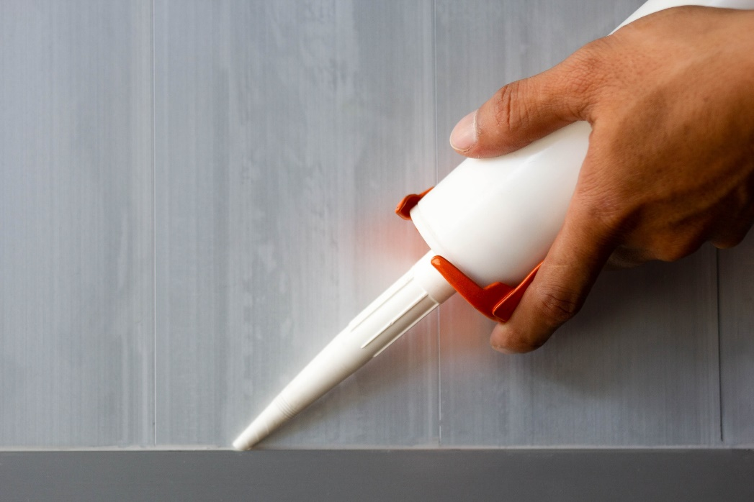
Integrated Pest Management (IPM)
Physical changes in home
Cleaning
Sealing cracks and holes
Education
Clean up spills
Eat only in dining area
Use sealed food containers
Dispose of trash frequently
Notes:
Two main concepts of IPM are:
1. Make physical changes in home, such as cleaning and sealing cracks and holes
2. Educate residents to clean up spills, eat only in the kitchen or dining room, use sealed food containers to keep pests out, and dispose of trash often

Slide 40
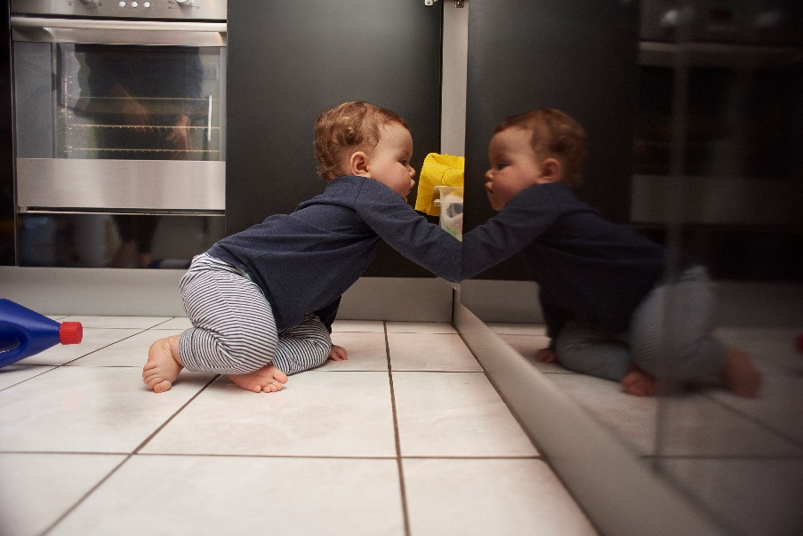
Keep pesticides and traps away from children and pets
Use gel bait application for insects (such as cockroaches).
Use snap traps for mice and rats.
Avoid spray pesticides, bombs, and foggers (these are asthma triggers).
Notes:
Various methods are available to control pests:
Gel bait application for insects (such as cockroaches)
Snap traps are used for mice and rats
However, spray pesticides, bombs, and foggers are asthma triggers. Avoid using them.
Also be sure to keep pesticides and traps away from children and pets.

Slide 41
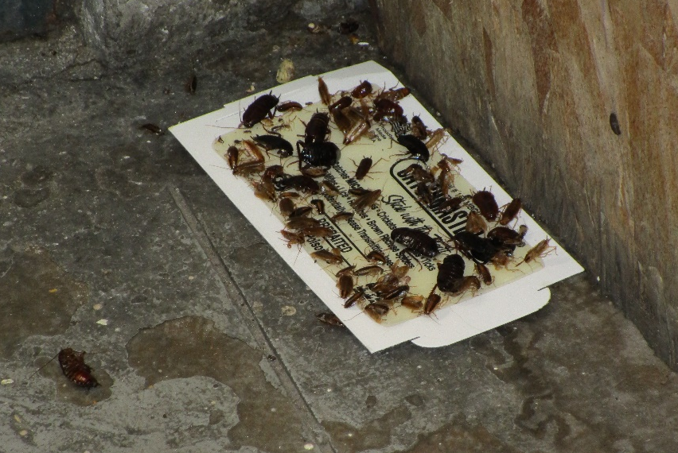
Cockroach monitoring trap
Notes:
Cockroaches don’t just crawl on floors, they crawl on walls and ceilings, too. First placing sticky traps or monitors throughout the home will help show where cockroaches live and pathways they follow throughout the home. Those are the ideal spots to place bait.
Common places for traps are under kitchen and bathroom sinks, and on kitchen counters where food is stored. The traps have a sticky substance with natural chemical attractant (pheromone) inside the trap. We use these to monitor the cockroach population; the traps are not used as a pest control method.
Home visitors, residents, or professionals can place these easy-to-use monitors around the home in areas where cockroaches travel to find food, water, and shelter. Monitoring can help guide where residents should focus their IPM efforts, such as where to place gel baits for cockroaches.

Slide 42
Pests: Action steps
To decrease exposure and symptoms
  Clean or remove pest reservoirs to prevent exposure
  Use integrated pest management (IPM)
Other considerations
In multi-family buildings, infestation can spread from other units and common areas.
Building-wide approaches might be needed, with help from the landlord and other tenants.
IPM is an ongoing process for homes that have pest problems. It is not a one-time fix.
Notes:
The most recent evidence by expert panels supports using IPM to decrease exposure, asthma symptoms, and emergency department visits.
In multifamily buildings, infestation from other apartments can occur inside the unit and in common areas, so building-wide approaches might be necessary. That might require engaging the landlord and other tenants in the process.
IPM is an ongoing process for homes that have pest problems. It is not a one-time fix.
IPM can prevent infestations.

Slide 43
Mold
Notes:
The next section is about mold exposure in the home.

Slide 44
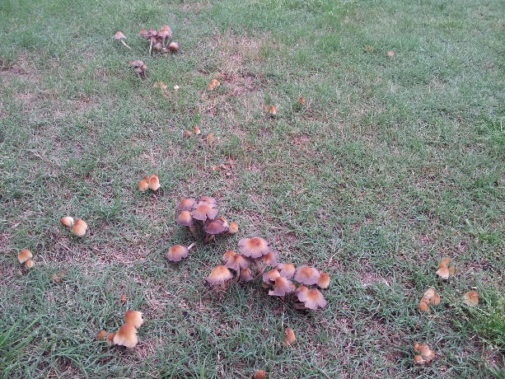
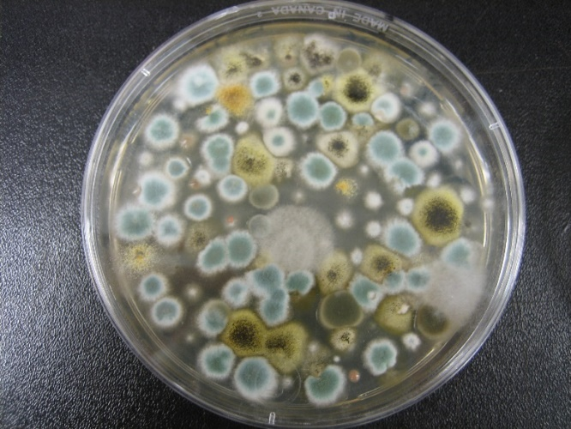

What is mold?
All types of mold are considered fungi
Mushrooms and puffballs are fungi
Typical types of mold in homes
Notes:
Molds are a types of fungi. They are related to, but different from mushrooms and yeasts.
Mold is a general term for types of fungi that are velvety, fluffy, or cotton-like (unlike yeasts, which are slimy or wax-like). Mold can grow on organic surfaces such as wood, fabric, or paper if they are damp.
Outdoors, mold plays an important role in nature by breaking down organic matter, such as dead trees and leaves.
Indoors, however, mold and yeast growth (all types regardless of color) should be avoided.

Slide 45

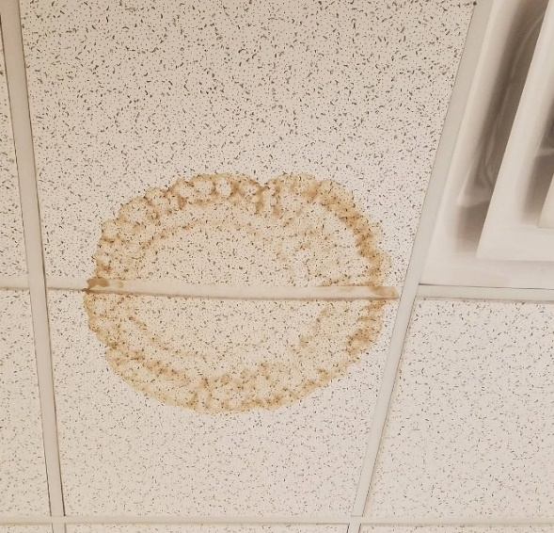

Other signs of moisture
Rust
Water stains (but could be mold on the other side)
Algae
Notes:
Here are some examples of things that are not mold.
Rust can result from water damage, but it is not mold. Nonetheless, it could be a marker for where mold might grow.
Likewise, water-damaged ceiling tile is not mold, but it could be a marker for potential mold growth on the other side of the tile.
Like mold, you can find algae where there is a lot of water. However, it is different from mold.

Slide 46
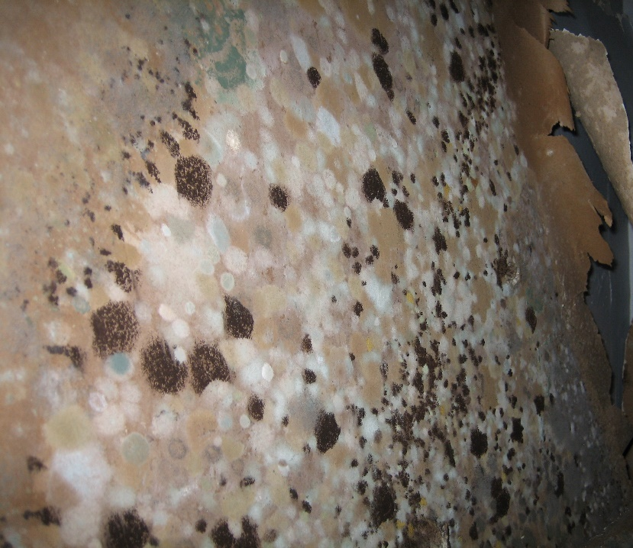
Where does mold grow?
Anywhere it has
Water — from leaks, condensation on surfaces, etc.
and
Sufficient nutrient — food, dust in carpet, paper in gypsum board or drywall, wood, etc.
Notes:
Mold is found in virtually every environment. It can be detected indoors and outdoors, year-round. Mold growth is encouraged by warm and humid conditions. Outdoors, molds can be found in damp areas or places where leaves or other vegetation are decomposing. Indoors, mold can be found where humidity levels are high, such as showers.
It is impossible to eliminate all mold and mold spores in the indoor environment. However, mold growth can be restricted by controlling moisture indoors.
Common sources or causes of water or moisture problems include:
Roof leaks
Leaks from plumbing, window air conditioners, and other appliances
Condensation associated with high humidity or cold spots in the building
Localized flooding
Uncontrolled humidity

Slide 47
Typical indoor locations for mold
Bathroom tile
Basement walls
Window areas where moisture condenses
Under leaky sinks
Leaking or condensing pipes
Walls behind furniture
Drain pans inside air handling units
Ductwork*
Roof materials above ceiling tiles (due to roof leaks or insufficient insulation)
* For more information see EPA’s Should You Have Your Ducts Cleaned? publication in slide “Additional Resources”
Notes:
Common sites for indoor mold growth include:
Bathroom tiles
Basement walls
Areas around windows where moisture condenses
Under leaky sinks
Possible locations of hidden mold can include:
Leaking or condensing pipes
Walls behind furniture (where condensation forms). This can occur especially if furniture is pushed against cold exterior walls of the home
Drain pans inside air handling units
Ductwork (for more information see EPA’s Should You Have Your Ducts Cleaned? publication in slide “Additional Resources”)
Roof materials above ceiling tiles (if the roof leaks or is poorly insulated)

Slide 48
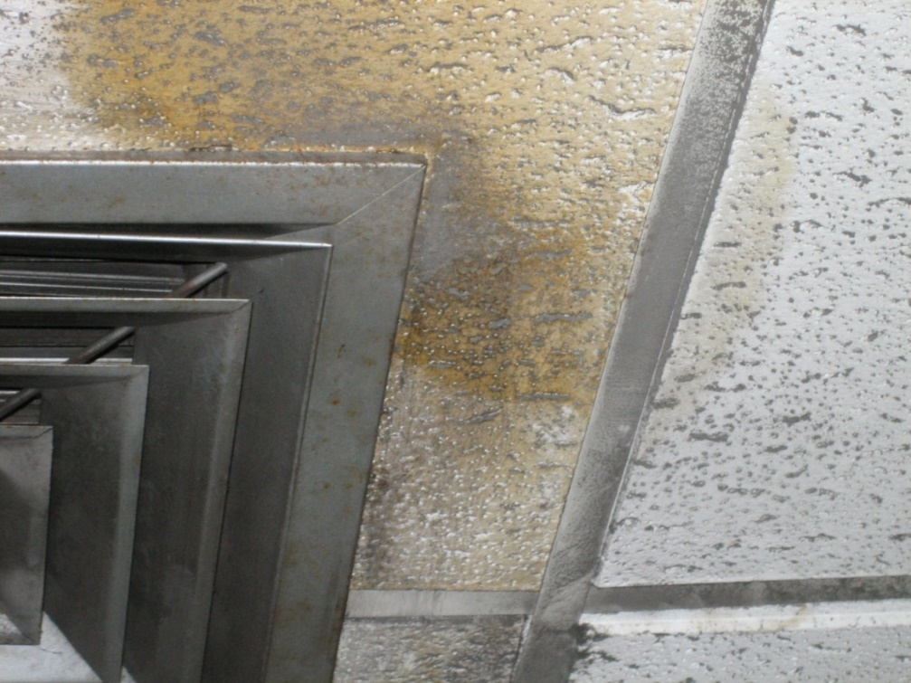
Mold growing on ceiling tile
Notes:
This is a photo of mold growing on a ceiling tile.

Slide 49
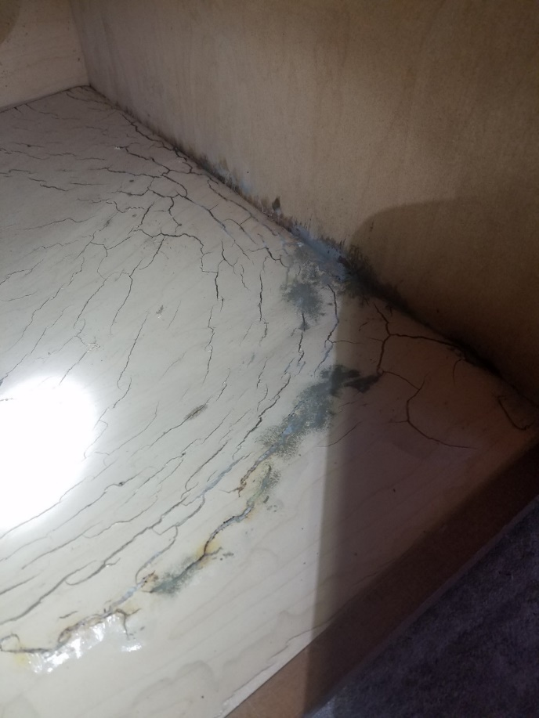
Water leak under kitchen sink
Mold
Notes:
.
This mold growth occurred after a plumbing leak.

Slide 50
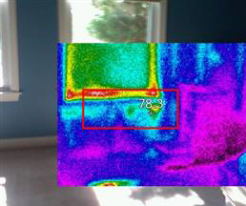
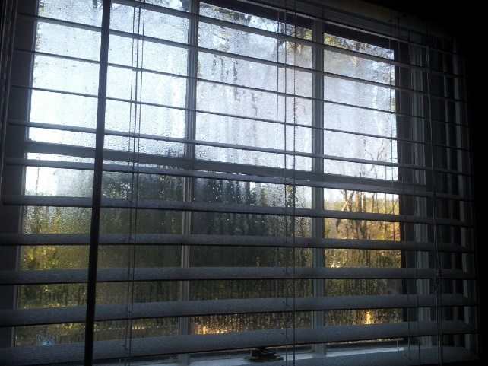
Condensation
Surfaces can have different temperatures
Colder surfaces in contact with warm air leads to condensation
Notes:
This slide shows an infrared photo of the temperatures of different surfaces in the home. The box shows temperature differences around a window. The red and yellow are hotter areas next to the cooler blue area below the windowsill.
Large differences in temperature on surfaces can lead to condensation.

Slide 51
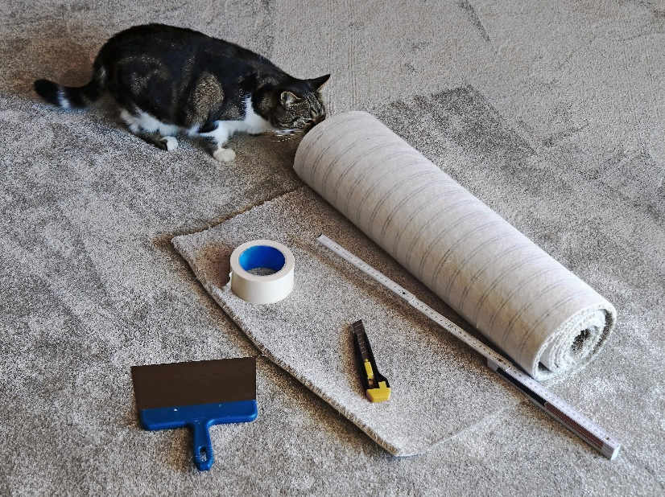
Other than water leaks and condensation, how can mold get into a home?
Changes by the residents (new pillows, new carpet, old pillows, old carpet)
Seasonal differences
Pets
Notes:
Many things can change the conditions that give rise to mold.
When residents change their furnishings, such as pillows, carpet, mattresses, or furniture, the mold exposure can change. Donated and even new materials can have mold, depending upon where the materials had been stored. Home visitors might consider this when they see new or different furnishings in the home.
In some regions of the country, people live in their homes differently according to the season. For example, in hot summer months, the air conditioning might be used a lot and windows and doors are closed. Any asthma triggers in the home can get sealed indoors. Likewise, in the cold winter months, the home can get sealed and the asthma triggers in the home are sealed in too. In fall, raking and walking around outside can bring mold inside from leaves.
Pets can also change the mold levels in the home; they might bring in mold from the outside then jump onto furniture and beds. This increases the concentration of mold spores in the home, although it might not necessarily lead to mold growth on a surface.
Frequent vacuuming with a HEPA filter might help remove mold brought into the home. Cleaning out filters and vacuum bags can lead to exposure, so appropriate precautions should be taken. Bags should be emptied in an area away from the main living space, such as a garage.

Slide 52

Humidifiers
Some residents use humidifiers when air is very dry.
Humidifier use can cause moisture on walls and ceilings.
Keep humidity between 30%-50%.
Keep moisture from building up on surfaces.
Clean humidifier often.
Follow manufacturer's instructions, to prevent growth of mold and other microbes.
Notes:
Use of humidifiers usually means the air is dry and people are trying to make it more comfortable. However, if the humidifier is located near a wall or close to the ceiling, moisture can build up on surfaces and lead to mold growth. Humidifiers should be cleaned frequently, following manufacturer's instructions, to make sure that mold is not growing inside the appliance.

Slide 53
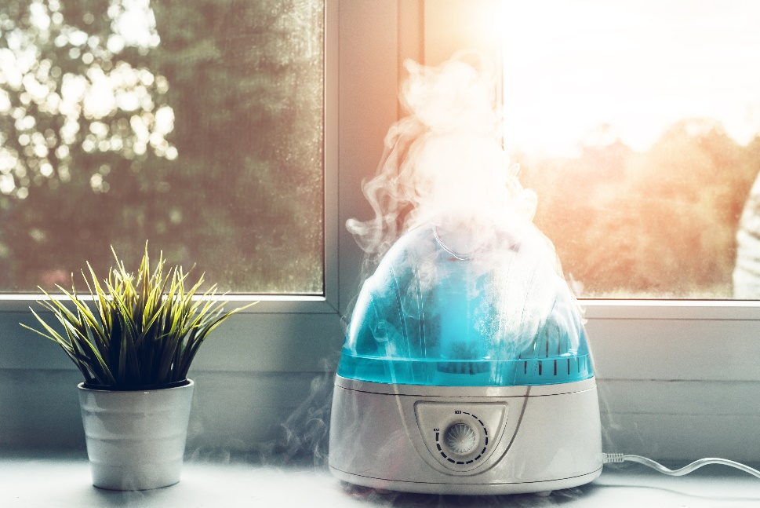
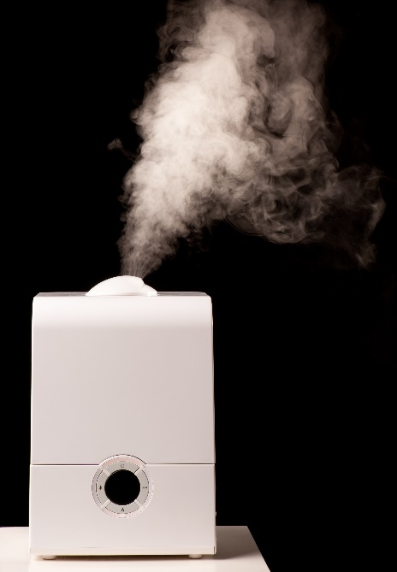
Types of humidifiers
Warm mist (vaporizer)
Cool mist
Notes:
There are different types of humidifiers. All of them add humidity to the air.
Sometimes, a humidifier is called by other names such as vaporizer.

Slide 54
How to reduce mold growth
Fix any water or moisture problems.
Control humidity levels and increase ventilation.
Clean up areas that have mold growth.
Notes:
How to reduce mold growth:
Fix leaky plumbing and leaks in the building envelope as soon as possible.
Watch for condensation and wet spots and fix sources of moisture problems as soon as possible.
Keep HVAC drip pans clean, flowing properly, and unobstructed.
Vent moisture-generating appliances, such as dryers, to the outside.
Use exhaust fans when showering and cooking.
Maintain low indoor humidity, below 50% relative humidity, ideally 30%-50%, if possible. Residents can use an inexpensive device (hygrometer) to measure relative humidity in the home.
Perform regular building and HVAC inspections and maintenance, as scheduled.
Clean and dry wet or damp spots within 48 hours.
Replace absorbent materials such as ceiling tiles and carpet if moldy.

Slide 55
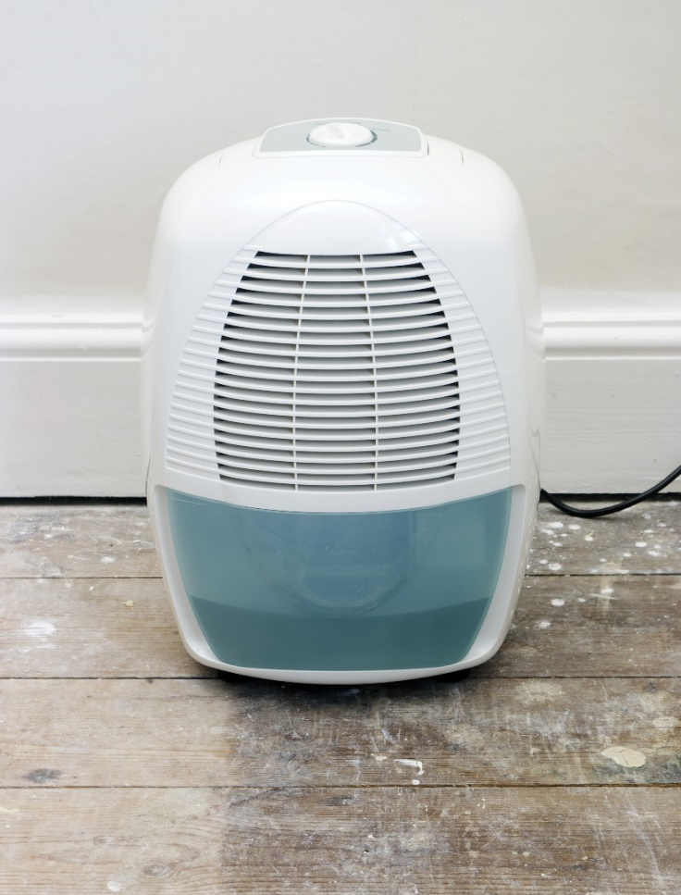
Dehumidifiers
Basements and crawl spaces can be damp.
Dehumidifiers can help reduce moisture.
The indoor humidity should be kept between 30%-50%.
Notes:
Residents might consider using a dehumidifier in homes with high humidity. Dehumidifiers should be placed in the room or rooms with the highest humidity. The target range for indoor humidity is 30%–50%.
If a home has a crawl space, extra steps might be required to reduce humidity. After being cleaned, exposed ground within the crawlspace should be covered with plastic sheeting to limit potential mold growth and moisture migration into the house. Then, using a dehumidifier inside the home (not the crawl space) might decrease residual moisture that gets into the home.

Slide 56
Cleaning mold
If you have asthma, you probably shouldn't be
doing this yourself.
Ventilate area well.
If larger than 10 square feet, consider getting
professional help.
Scrub with soapy water to remove mold growth.
Dry quickly.
Clean and dry wet or damp spots within 48 hours.
Notes:
Preferably, the person with asthma should not be cleaning mold. The cleaning should be done with proper ventilation while the person with asthma is away from the area.
If the area with mold is larger than 10 square feet, consider getting a professional to help.
Scrub with soapy water to remove mold growth. Dry quickly.
Avoid using cleaners with irritants around those with asthma.
Clean and dry wet or damp spots within 48 hours.

Slide 57
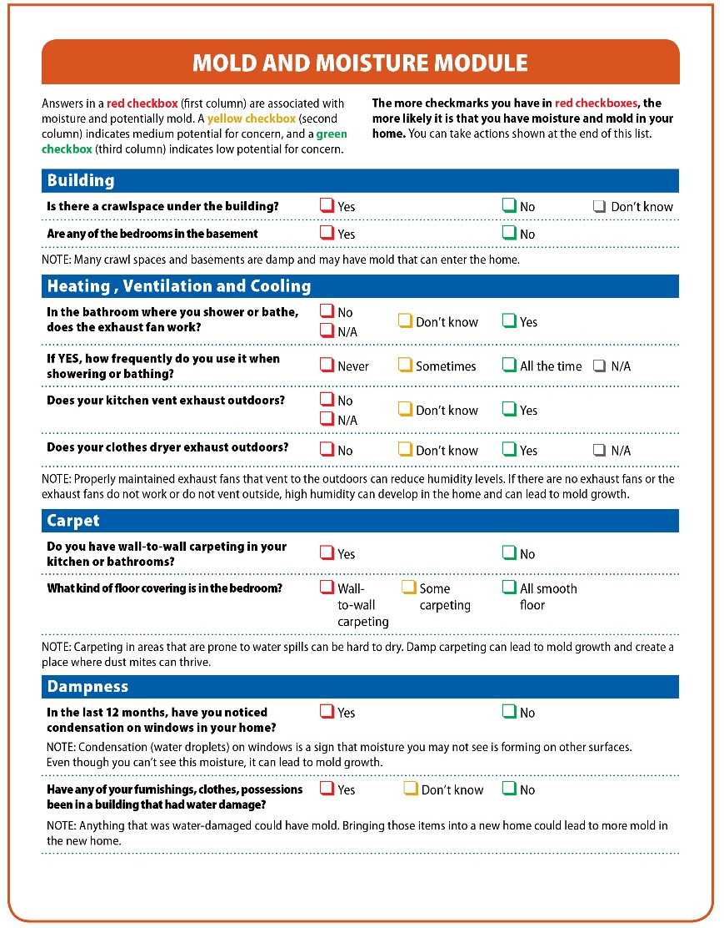
The goal of the Mold and Moisture Module is to find ways to reduce moisture and mold
Notes:
The goal of the Mold and Moisture Module is to focus on ways to reduce mold. While the Core assessment of the Checklist should be used for all types of housing, the mold and moisture module should be used if mold/moisture issues are suspected.

Slide 58
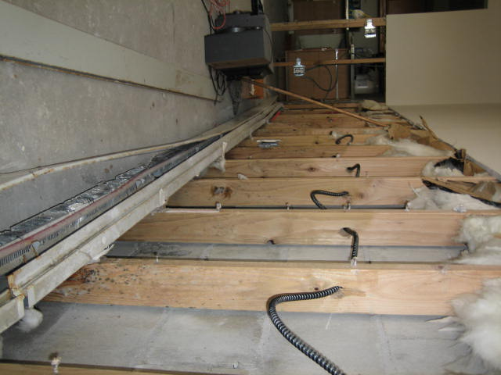
Mold growth on wooden studs after a hurricane
Notes:
One of the questions in the Mold and Moisture Module addresses building-wide water damage. The question is: Have any of your furnishings, clothes, possessions been in a building that had water damage?
During major flood events, mold growth can be prevented by removing water-damaged belongings, walls, and flooring, and quickly drying the building. This photo shows what can happen if these steps are not done fast enough, leading to mold growth on wood studs.

Slide 59
Volatile organic compounds
(VOCs)
Notes:
The next section is about VOCs in the home.

Slide 60
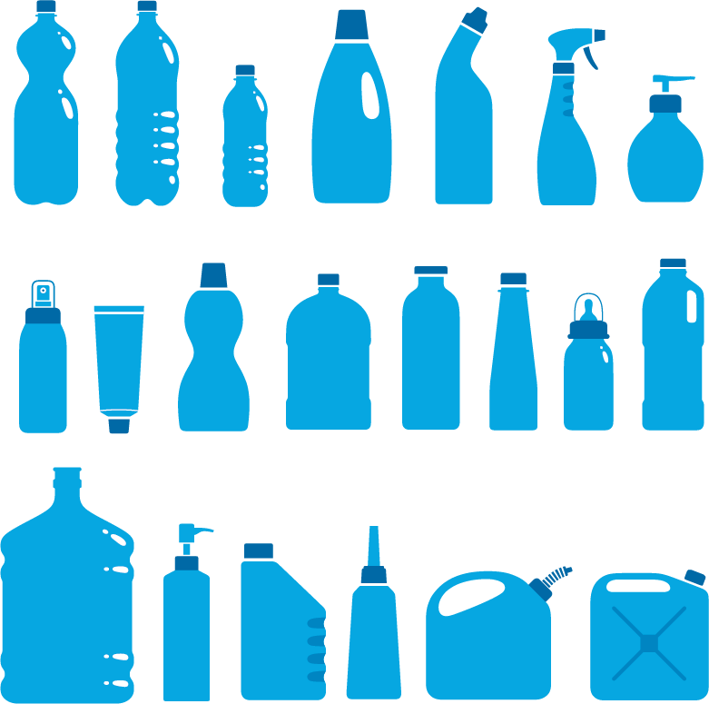

Volatile organic compounds (VOCs)
Chemicals commonly found in many household products
Wood preservatives
Aerosol sprays
Cleansers and disinfectants
Moth repellents and air fresheners
Fuels and automotive products
Hobby and craft materials supplies
Paints, paint strippers, and solvents
Dry-cleaned clothing
Pesticides
Building materials and furnishings
Glues, adhesives, permanent markers, and photo chemicals
Notes:
Volatile organic compounds (VOCs) are emitted as gases from certain solids or liquids. VOCs include a variety of chemicals, some of which have short-term or long-term adverse health effects and can irritate airways of persons with asthma.
Concentrations of many VOCs can be higher indoors than outdoors.

Slide 61
VOCs can be irritating and harmful to all people with asthma
Limit exposure by minimizing product use.
Use products only when person with asthma is not present, or use
alternative products.
Follow manufacturer’s instructions for use and storage.
If using products, carefully follow manufacturer’s instructions and make sure the area is well-ventilated.
Never mix household care products unless directed on the label.
Do not store opened containers of unused paints and similar materials.*
Keep products out of reach of children and pets.
When buying supplies and cleaners, favor those certified by programs such as Green Seal or EPA’s Safer Choice.
* https://www.epa.gov/indoor-air-quality-iaq/volatile-organic-compounds-impact-indoor-air-quality
Notes:
VOCs can be irritating and harmful to all people with asthma.
Limit exposure to VOCs as much as possible by
minimizing product use,
using products only when persons with asthma are not present, or
trying less-irritating products.
EPA provides information online about proper storage of products that release VOCs: https://www.epa.gov/indoor-air-quality-iaq/volatile-organic-compounds-impact-indoor-air-quality
Follow manufacturer’s instructions for use and storage of products with VOCs.
If products that release VOCs are used, carefully follow manufacturer’s instructions on the label and make sure the area is well-ventilated.
Never mix household care products unless directed on the label.
Do not store opened containers of unused paints and similar materials
Keep products out of reach of children and pets.
When purchasing supplies and cleaners, give preference to those that are third-party certified by programs such as Green Seal or EPA’s Safer Choice.

Slide 62
Dust mites (section break)
Dust mites
Notes:
The next section is about dust mites and their allergens.

Slide 63
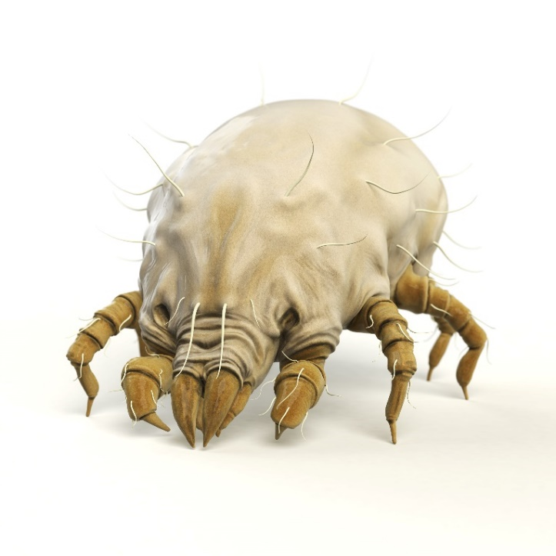
Dust mites
Dust mites burrow into textile furniture and bedding.
They are microscopic and cannot be easily seen.
Notes:
Dust mites are microscopic. They burrow into textile furniture and bedding and cannot be seen easily.
Two of the most common types of allergies to dust mites come from reactions to two types of dust mites, Dermatophagoides farinae and Dermatophagoides pteronyssinus. If you have heard of allergy testing for Der f or Der p, these are the mixtures of allergens from those two common types of dust mites.

Slide 64

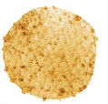


What are dust mite allergens?
Dust mite allergens are proteins found in fragments of body parts and droppings.
Allergens are too small to be measured by microscope
Allergens
Der f 1, Der p 1, Blo t 5
(much less than 1 micron)
Dust mite
(200-300 microns)
Dust mite droppings
(about 10-40 microns)
Notes:
Although the exposure source is the dust mite, the allergens are found on much smaller particles people inhale. Allergens are found in fragments of dust mite body parts and dust mite droppings. The allergens can trigger an allergic reaction in some people.
This slide shows examples of some types of allergens. Der f 1 comes from one type of dust mite, Der p 1 comes from another type of dust mite, and so on.

Slide 65
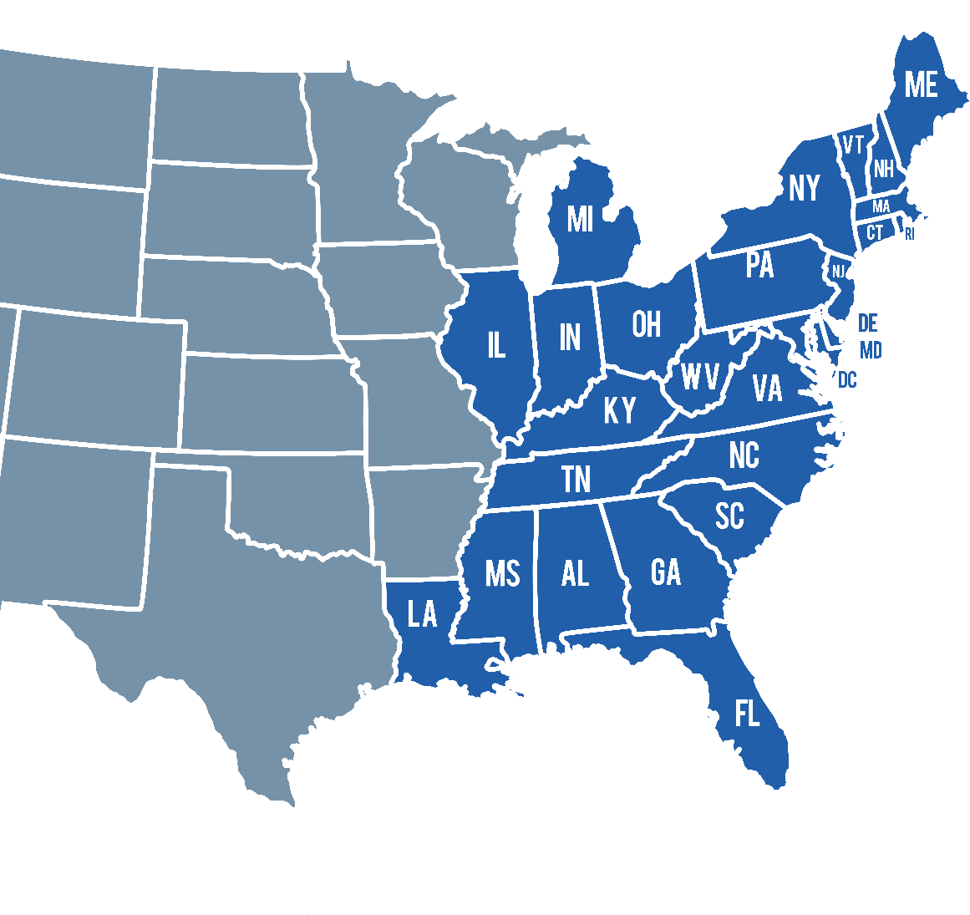
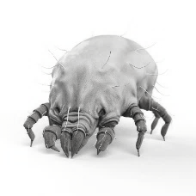
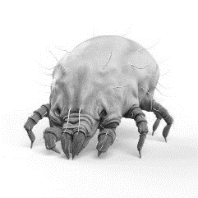
Dust mite distribution: the East Coast
Der f 1
Der p 1
Blo t 5
Notes:
All types of dust mites like the warm, humid conditions found in some homes, but some dust mites can survive in colder and drier conditions. For example, the dust mite that produces the Der f 1 allergen can survive well in the Northeast, but the tropical dust mite (Blomia tropicalis) has higher humidity requirements. Therefore, it is unusual to find the tropical dust mite in the North, much less the allergens it can produce. People who are allergic to one type of dust mite can be allergic to other types too; this is called cross-reactivity.

Slide 66
Dust mite allergen characteristics
Dust mite allergen
  Mainly droppings (fecal pellets)
  Airborne particles > 10 microns
  Settle out of air quickly
  Mainly exposed by breathing near surfaces with dust mites
  Not easily transferred passively (e.g. from clothes to sofa)
  Mainly found in soft fabric furnishings
Therefore
  Allergen avoidance often focuses on the surfaces rather than the air
    Wash bedding regularly
    Remove carpet if possible or vacuum regularly
    Use allergen-proof mattress and pillow covers
Notes:
To decrease exposure to dust mites, residents should
Wash bedding regularly
Remove carpeting, if possible, or vacuum regularly
Use allergen-proof mattress and pillow covers.
These strategies work better than others, such as opening a window or using an air filter. Particles associated with dust mites can settle out of the air quickly and attempts to “clean” the air might not remove the greatest sources of exposure, disturbance of dust. Most studies have shown that dust mite allergens don’t stay in the air for a long time.

Slide 67
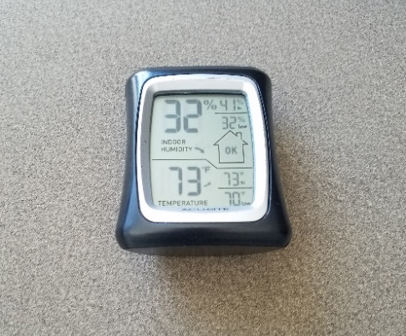
Dust mite intervention
Removing the allergens is not the same as decreasing the dust mite population.
Use a device (hygrometer) to measure relative humidity.
Keep relative humidity 30%-50%* to help keep dust mite population low.
Measure humidity in several locations in home throughout the year.
* Less than 30% can dry out mucus membranes and promote respiratory infections.
Notes:
It is difficult to get rid of dust mites in homes because they burrow into upholstered furniture, mattresses, and bedding. However, by washing bedding frequently, residents can decrease their exposure to dust mite allergens. Residents don’t need to use hot water for washing bedding. Warm water is fine to get rid of the dust mites and remove their allergens.
As mentioned previously, all dust mites need humidity. Residents can use try using a device (hygrometer) to measure relative humidity in the home. Dehumidifiers can decrease the humidity and make it difficult for dust mites to survive. Residents should be careful not to dry out the air too much because it also can dry out a person’s mucus membranes.

Slide 68
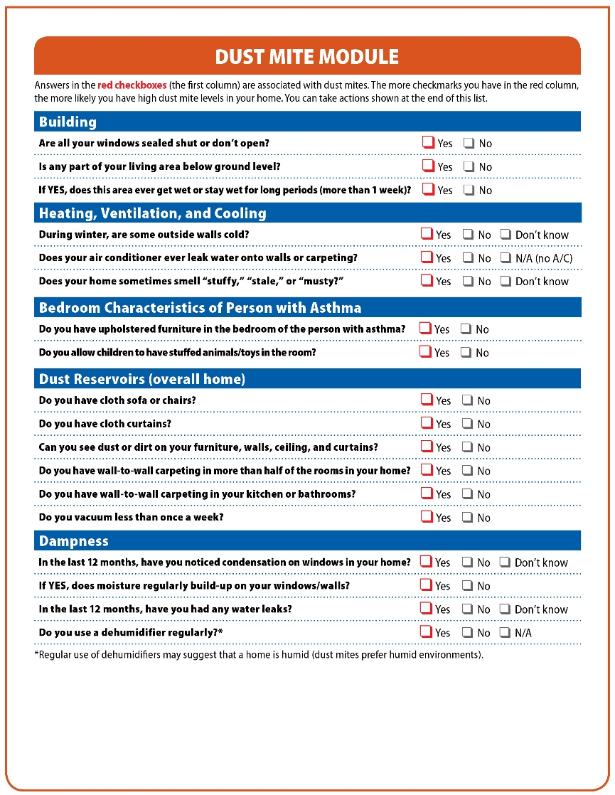
The goal of the Dust Mite Module is to find ways to reduce exposures to dust mite allergens
Notes:
The goal of the Dust Mite Module is to focus on ways to reduce exposures to dust mite allergens. While the Core assessment of the Checklist should be used for all types of housing, the Dust Mite Module should be used if dust mite issues are suspected.

Slide 69
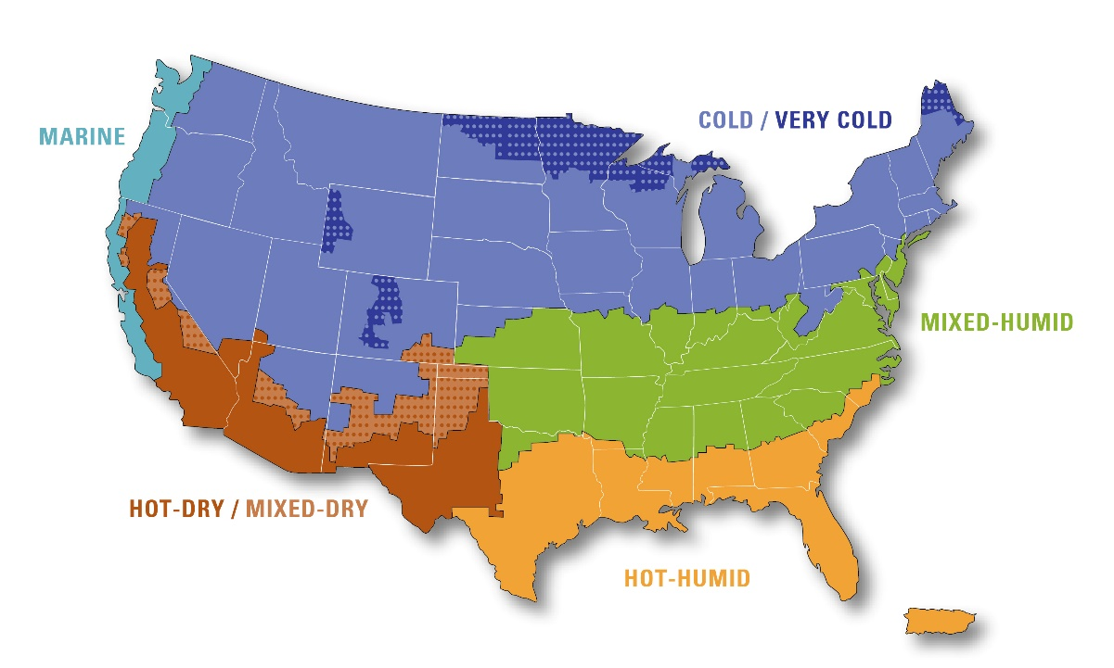
Where you live could affect dust mite avoidance strategies
COOL/ HUMID
Hot and dry areas tend to have the lowest dust mite levels
Hot and humid areas tend to have the highest dust mite levels
Alaska= Cold/Very cold
Hawaii = Hot-humid
Notes:
The Dust Mite Module might not be useful for very dry parts of the country. As mentioned earlier, dust mites need high humidity (above 50% relative humidity), so not all places have dust mites. Studies show that areas with very dry climates, such as deserts, don’t have dust mites or their allergens. In these very dry places, the home visit would likely focus on other asthma triggers.
However, some places with higher humidity, such as the southern coast, might be so humid that dust mites thrive. In such areas, it will be difficult to control the dust mites themselves. Instead, the home visit should focus on trying to decrease the allergens. For example, residents should try washing bedding, avoiding carpet, and decreasing red check box factors indicated in the Dust Mite Module.

Slide 70
Additional resources (section Break)
Additional resources
Notes:
The next section contains additional resources.

Slide 71
Additional Resources
Asthma
CDC: www.cdc.gov/asthma/triggers.html
EPA: www.epa.gov/asthma/asthma-triggers-gain-control
HUD: www.hud.gov/program_offices/healthy_homes/healthyhomes/asthma
Particles
EPA’s Air Cleaners in the Home: www.epa.gov/indoor-air-quality-iaq/air-cleaners-and-air-filters-home
Renters
Tenant’s right groups by state: https://www.hud.gov/topics/rental_assistance/tenantrights
Smoking
How to stop smoking
Free Help Talk to a trained coach who can help you quit. Call 1-800-QUIT-NOW (1-800-784-8669)
Go to www.smokefree.gov if someone you know smokes and wants to quit.
How to set up a smoke-free policy for your home:
https://www.hud.gov/program_offices/healthy_homes/smokefree2
Notes:
Here are some additional resources that might be helpful for the home visitor or the resident. We suggest giving the resident a copy of these resources and other local resources that might help them control indoor allergens.

Slide 72
Additional resources (cont’d)
Moisture and mold
A Brief Guide to Mold, Moisture and Your Home: www.epa.gov/mold/brief-guide-mold-moisture-and-your-home
EPA’s Should You Have Your Ducts Cleaned? www.epa.gov/indoor-air-quality-iaq/should-you-have-air-ducts-your-home-cleaned
Outdoor air
www.epa.gov/airnow
Notes:
Here are additional resources from EPA about moisture and mold, duct cleaning, and outdoor air.
A Brief Guide to Mold, Moisture and Your Home: www.epa.gov/mold/brief-guide-mold-moisture-and-your-home
EPA’s Should You Have Your Ducts Cleaned? www.epa.gov/indoor-air-quality-iaq/should-you-have-air-ducts-your-home-cleaned
AirNow: www.epa.gov/airnow

Slide 73
BACK-UP Slides: for Heating, Ventilation, and Air Conditioning section
Notes:
Extra slides are included for more information for home visitors.

Slide 74
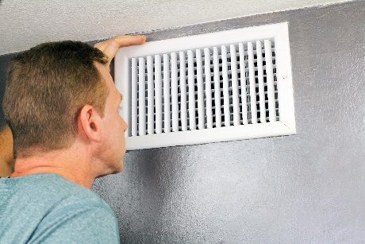
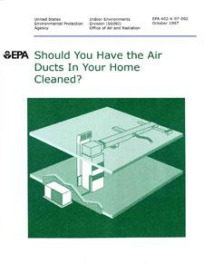

Reduce asthma triggers when heating and cooling
Reduce dust from HVAC systems
Seal holes around room vents.
Have a HVAC professional initially install a filter appropriate for the system, if possible. Replace filters every 3 months, or as needed.
Read EPA’s “Should You Have the Air Ducts in Your Home Cleaned?”
Notes:
All heating ventilation and air conditioning (HVAC) units should come with manufacturer's instructions. Read those or find them online. The units might require regular cleaning or inspections, which can help control asthma and allergies.
To help prevent asthma triggers such as dust from entering the living space through the HVAC system,
Seal holes around the room vents
Install filters that are appropriate for the system, if possible. Initial filter installation should be addressed by an HVAC professional. Keep in mind that filters may need to be replaced, in many cases, about every 3 months. Residents can refer to the manufacturer’s instructions for the HVAC unit to replace the filters.
Read EPA’s “Should You Have Your Ducts Cleaned?”

Slide 75



Reduce asthma triggers when heating your home
Fuel-burning appliances
Vent fuel-burning appliances to the outdoors.
Open windows or doors to ventilate rooms.
People may not want to open windows and doors because of draft and heat loss.
Consider how to find a solution that works for the resident.
CAUTION!
Prevent fire hazards by ventilating safely!
Make sure doors and shutters to appliances are firmly closed before you ventilate the space.
Notes:
Fuel burning appliances: The most important thing to do when using any type of heating appliance that uses a fuel, such as wood, gas, or kerosene, is to ventilate! Make sure that
the appliance is vented to the outdoors, or
the room is ventilated by opening windows or doors.
In many cases, ventilating a room may be challenging because heat will be lost, so find a solution that works for the resident.
Caution: Ventilate safely! To prevent fire hazards, make sure doors and shutters to appliances are firmly closed before ventilating the space.

Slide 76



Reduce asthma triggers when heating and cooling your home
Non-fuel-burning appliances or fixtures
Can produce or react with indoor air pollutants, such as dust and other pollutants.
To help reduce indoor pollutants, a resident can
Ventilate the room
Keep appliances, vents, and surfaces uncluttered and free of dust
Use air cleaners or filters when possible
Read EPA’s Air Cleaners and Air Filters in the Home
Radiators
Baseboard heater
Electric space heater
Notes:
Heat sources that do not involve fuel-burning, such as radiators, baseboard heaters, and space heaters, all can produce, transmit, emit, or cause reactions with indoor air pollutants, such as dust, nitrogen dioxide (which is a combustion by-product), and other pollutants. To help reduce indoor pollutants, a resident can
Ventilate the room and consider wearing warm clothes or blankets
Keep appliances, especially appliance vents, free of dust and debris
Keep area surrounding the heating appliance free of clutter and debris
When possible, use air cleaners or filters along with the specific device. Keep heater surfaces clean and free of dust and debris. Also keep heater surfaces away from materials that might be heat sensitive to avoid fires or chemical reactions that emit VOCs.

Slide 77
BACK-UP SLIDE:
Secondhand Smoke

Slide 78
How to create a smoke-free policy
(Information for building owners and managers)
Get started
Create and adopt policy
Enforce policy
  Learn about policy
  Develop steps for action
  Identify community partnerships
  Educate staff, board, and resident council about policy
  Develop and finalize policy with staff and residents
  Conduct outreach to residents – conduct listening sessions, distribute printed material, display posters in common areas, etc.
  Set clear, consistent, and fair enforcement procedures
  Follow up on all complaints and non-compliance to ensure fair and consistent enforcement
Notes:
Smoke-free polices are important for residents with asthma and creates a healthier environment for all residents. Here is detailed information about how to start a smoke-free housing policy.

Slide 79
Back-up slide:
Furry Pets

Slide 80

What is the “Pet protective effect?”
Living in a home with a cat or dog may protect against allergy and asthma
Perhaps living with more than one pet
Early life exposure (less than age 2 years)
Notes:
Exposure to high levels of cat or dog allergens, such as those in homes where a cat or dog lives, has been associated with decreased prevalence of allergy and asthma in some communities. However, the exposure must have occurred early in life and at high enough levels to essentially change the immune response of infants and toddlers.
If a person is already allergic to cats or dogs, merely being in the home with a cat or dog can trigger allergic symptoms and potentially an asthma attack. Once allergic to pets, the best way to avoid symptoms is to avoid cats or dogs.

Slide 81
Back-up slide:
Pests

Slide 82


Pests: Common cockroaches
German cockroaches
0.5 inch
(four blocks)
American cockroaches
Egg cases
1.5 inch
(12 blocks)
Notes:
This is a detailed slide that shows two common types of cockroaches and their egg sacs.

Slide 83
How to stop cockroaches and other pests from entering
Block entry points
Keep away water and food
Get rid of places they can hide
  Seal cracks with caulk and repair holes in the building’s exterior
  Install door sweeps and weather-proof seals on doors (including garage doors)
  Weather-proof windows and place screens on windows and attic vents
  Prune branches and shrubs that touch the building
  Store food in sealed containers
  Clean regularly
  Throw trash away regularly
  Repair water leaks
  Place stoppers in all drains
  Wipe up spills quickly
  Keep firewood and trash cans away from the building
  Remove clutter from basements and crawl spaces
  Clean gutters
Notes:
Here are ways to keep cockroaches and other pests from entering the home:
1. Block entry points
Seal cracks with caulk and repair holes in the building’s exterior
Install door sweeps and weather-proof seals on doors (including garage doors)
Weather-proof windows and place screens on windows and attic vents
Prune branches and shrubs that touch the building.
2. Keep water and food out of reach
Store food in sealed containers
Clean regularly
Throw trash away regularly
Repair water leaks
Place stoppers in all drains
Wipe up spills quickly
3. Get rid of places where pests can hide
Keep firewood and trash cans away from the building
Remove clutter from basements and crawl spaces
Clean gutters

Slide 84
BACK-UP SLIDE:
Mold

Slide 85

Tips for cleaning mold after a disaster
Notes:
The Homeowner’s and Renter’s Guide to Mold Cleanup After a Disaster tells how to safely address severe mold issues after a disaster. This document was developed by several federal agencies including CDC, EPA, and HUD, among others.
It is available on these websites:
https://www.cdc.gov/mold/cleanup-guide.html
https://www.epa.gov/sites/production/files/2017-08/documents/mold._homeowners_and_renters_guide_to_cleanup_after_disasters.pdf
https://www.hud.gov/sites/documents/IEPWG_MOLD_CONS.PDF
Mold is an asthma trigger, so persons with asthma should not be involved with clean-up.

