Slide 1
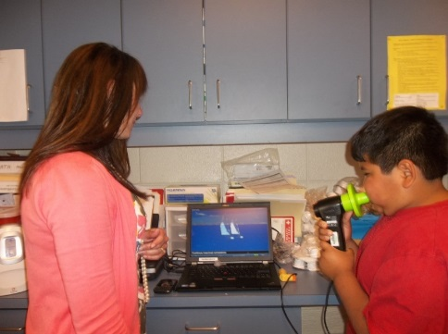

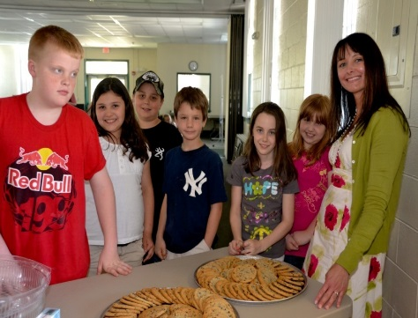

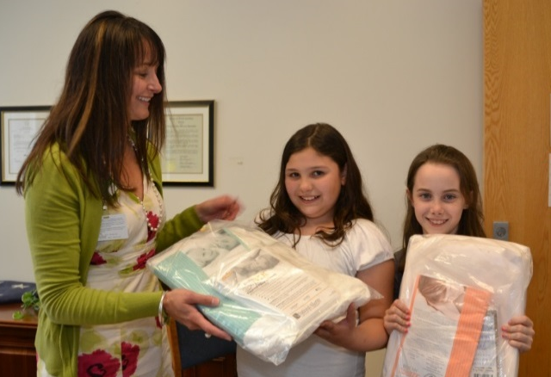
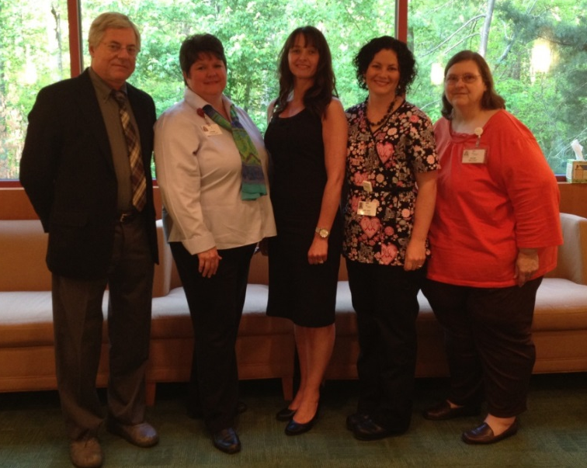
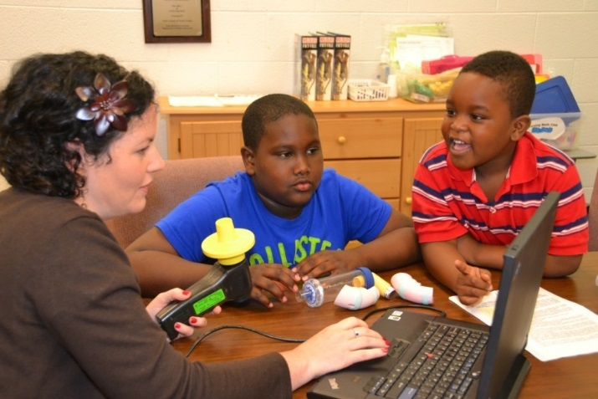

Slide 3
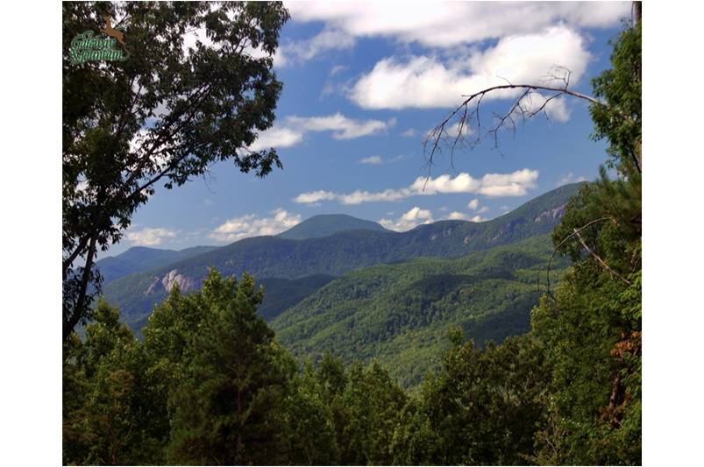
Location: Asheville, North Carolina
Type of Program: Non-profit Community Health System
Service Area: 21 counties in Western North Carolina, including the Eastern Band of the Cherokee Indians
Population Served: Remote, rural; Urban; Latino and Slavic communities

Slide 4
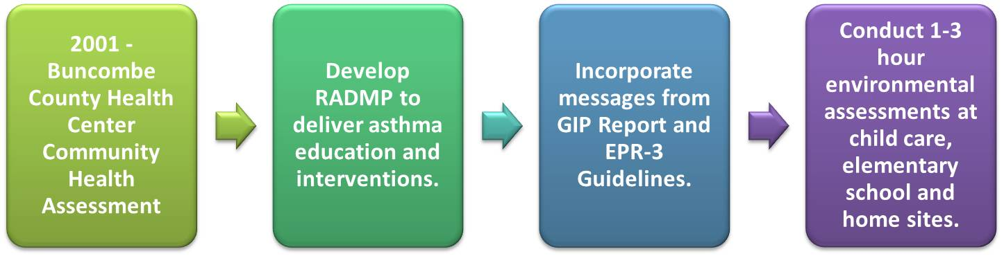
Building the System
Conduct Needs Based Planning:

Slide 5
Building the System
Focus on Resource Strategy at Every Step
  Utilize Community Partnerships:
    Faith-based organizations
    WNC School systems
    WNC Child care centers
    Charitable community partners
  State Partnerships:
    NC Division of Public Health
    NC Asthma Program
    Asthma Alliance of NC
  National Partnerships:
    National Heart, Lung, and Blood Institute
    Asthma Allergy Foundation of America
    National Environmental Health Association
    National Center for Healthy Housing

Slide 6
Our Typical Patient
Uninsured or underinsured
Poor socioeconomic status
Average patient age 8
Variety of ethnic groups
Single parent home

Slide 8
Clinical Assessment
Lung Spirometry with pre/post bronchodilator
FeNO (a measurement of inflammation by assessment of nitric oxide concentrations)
Exercise Challenge
Peak Flow Meter Monitoring
Symptom Diary Usage
Quality of Life questionnaire
Vital signs

Slide 9
Patient Education
Pathophysiology of asthma
Identification of triggers and avoidance measures
Identification of early and/or late warning signs
Appropriate use of device(s)
Empowering the patient self-manage

Slide 10
Environmental Assessment

Slide 11

Social Determinants of Health
Environmental
Financial
Social
Community Resources

Slide 12
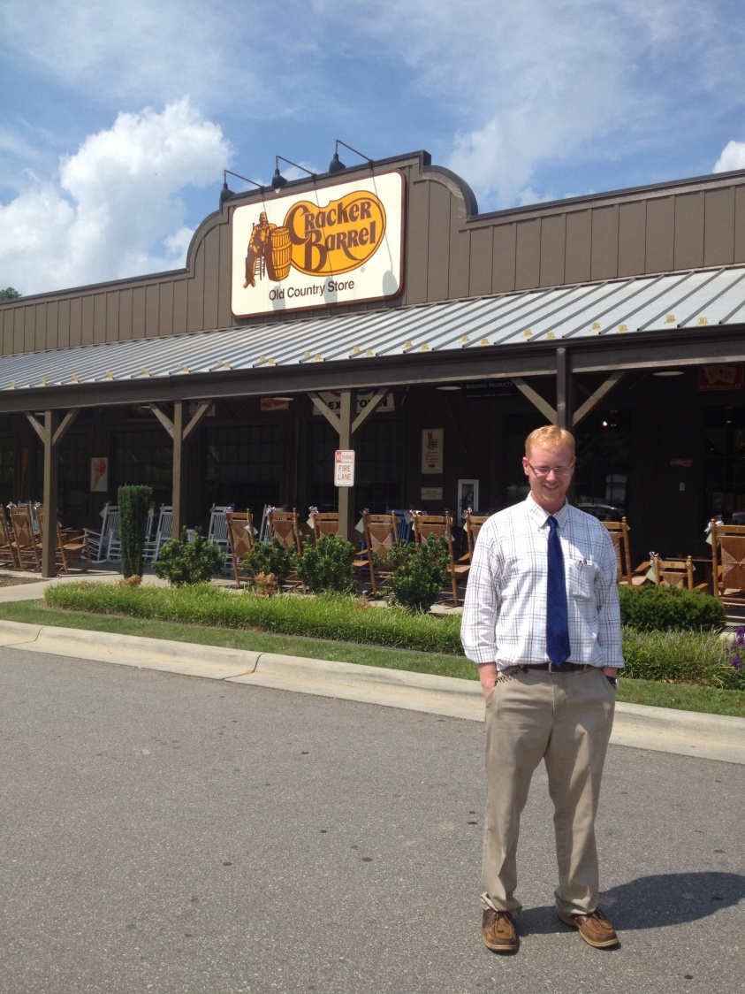
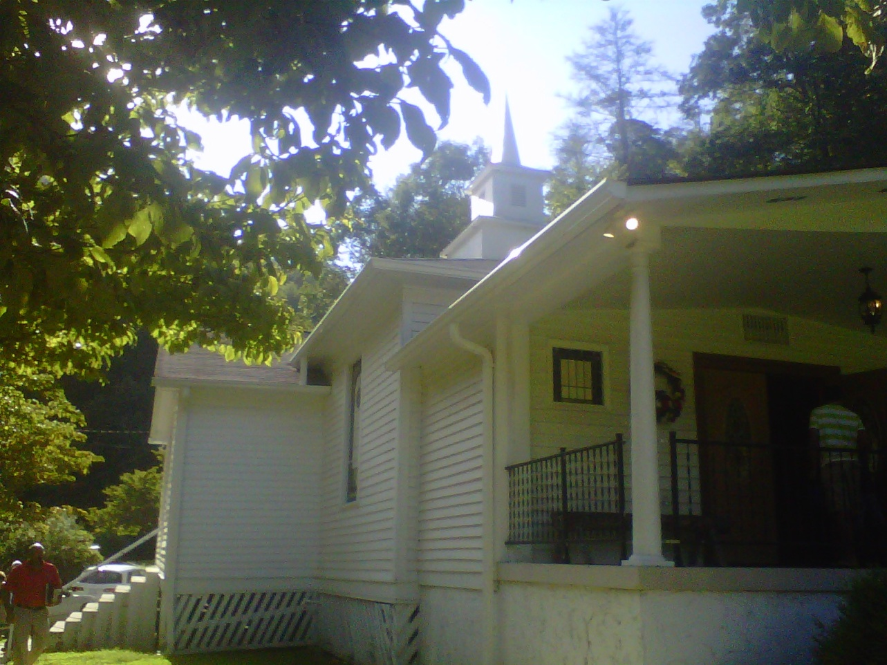
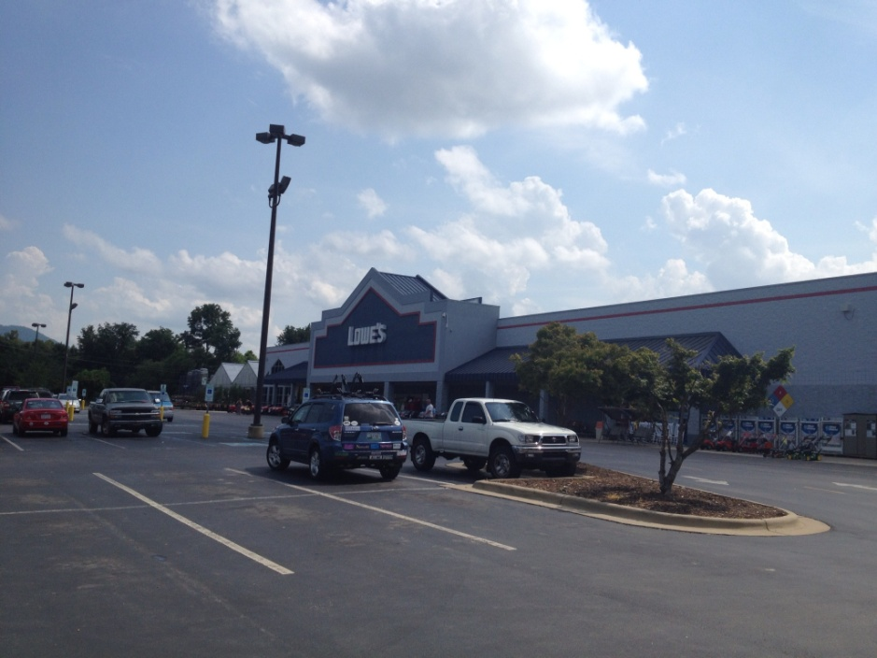
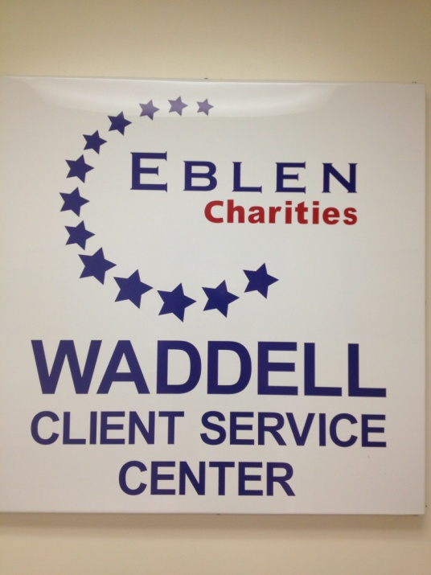
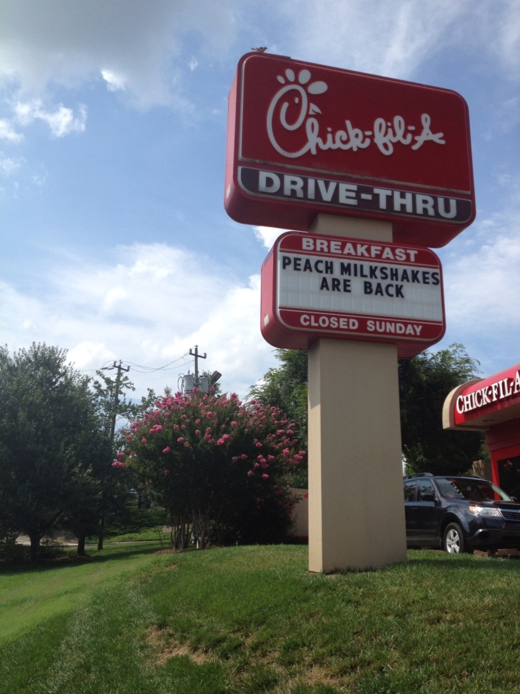
Notes:
Active listening and compassion are utilized to identify potential barriers to education and care plan development. Collaborations with various community organizations (local churches, Eblen Foundation, Food Services, Pest Management entities, social services, and others) are utilized to address other socioeconomic barriers and implement solutions.
Once an individual’s basic needs have been met, we actively participate with the family to move them towards behavior changes that will achieve optimal patient success.
Each patient is treated individually, recognizing there are differences in learning style coping strategies.
RADMP utilizes charitable community partners and faith-based organizations to provide cleaning supplies, pest control services, home remediation needs and to address psychosocial issues for 100% of its caseload.

Slide 13
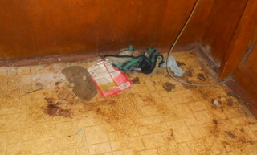
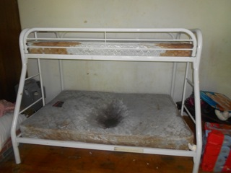
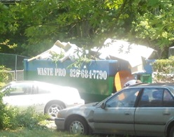
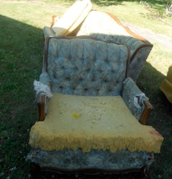


Slide 14
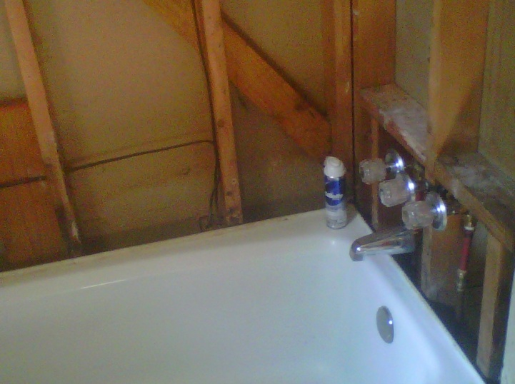
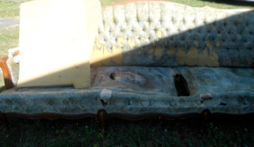
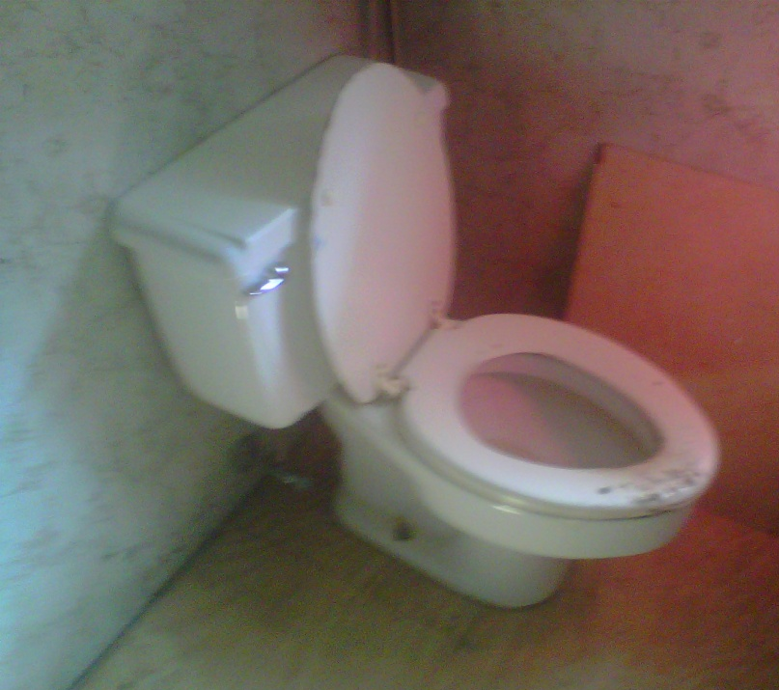
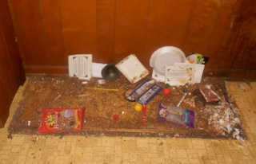

Slide 15
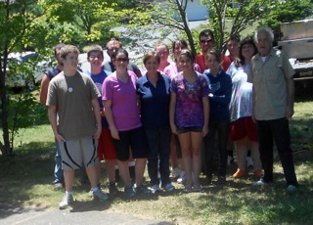

Slide 16
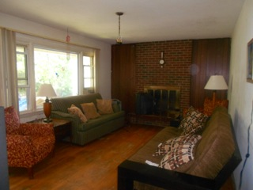

Slide 17
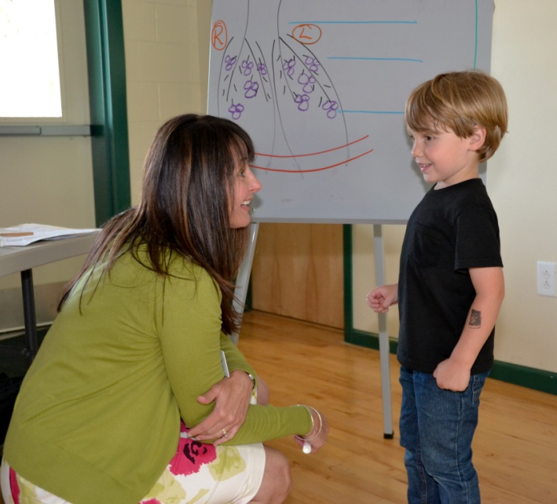
Health Promotion
World Asthma Day
Fit Together
Environmental
Assessments
Health Fairs
Asthma In-services
Notes:
Community outreach and overall health promotion is another integral part of our program.
The RADMP also takes its message of asthma awareness into the rest of the community through regional workshops on asthma and the identification of indoor and outdoor environmental triggers. These workshops are usually held in elementary schools, childcare centers and primary care offices, and residents throughout Western North Carolina are invited to attend.

Slide 18
Evaluating the System
Collect health data
  Level of Severity
  Level of Control
  Environmental trigger exposure
  ED visits
  Hospitalizations
  Lung spirometry and exhaled nitric oxide
  Quality of Life Questionnaires
  Missed school days
  ACT score
Notes:
Health data collected includes the level of severity, Level of Control, exposures to environmental triggers including tobacco smoke, allergens and chemical irritants, ED visits, Hospitalizations, School Absences, and Quality of Life Questionnaires.
The program also encourages people to pledge to create an “asthma friendly” environment; these pledges are tracked as a part of the program’s evaluation efforts.
.

Slide 19
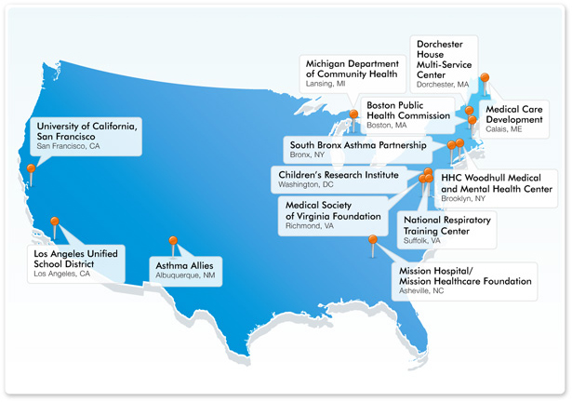
National Asthma Control Initiative (NACI)
Funded by the National Heart, Lung, and Blood Institute (NHLBI) of the National Institute of Health.

Slide 20
Demographics
Number | n=50
Average Age | 8 years
Age Range | 3-12 years
Male | 56%
Female | 44%
Caucasian | 38%
American Indian | 28%
Hispanic | 6%
Mexican American | 4%
African American | 24%

Slide 21
NACI ASTHMA GRANT DIAGNOSTICS AND COST ANALYSIS
 |  | 12 Months Prior to Intervention | 24 Months Post Intervention | 24 Months Cost Avoidance
 | ED Utilization
 | Total Visits | 158 | 9
IMPACT | Total Costs | $ 150, 583 | $ 8,577 | $ 142,006
HOSPITALIZATION/
ED | Hospitalizations
 | Total Hospitalizations | 60 | 3
 | Total Charges | $ 723,660 | $ 36,183 | $ 687,477
 | Total |  |  | $745,067.92
QUALITY OF LIFE | School Absences
 | Average missed days | 17 | 9 | 10**
 | MEASUREMENT | BASELINE*** | POST | Avg. Improvement
CLINICAL | FVC | 95.2 | 102.5 | 7.2**
OUTCOMES | FEV1 | 85.6 | 98.7 | 13.1**
 | FEF25-75 | 67.5 | 88.4 | 21.1**
 | FeNO | 23.9 | 21.1 | 3.4**
 | Source: Decision Support 2011 Data: $ 953.06/ ED Visit
 | Source: NC State Center for Health Statistics, 2009 Provisional Hospital Discharge Data: $12,061
 | *** Inclusive of all subjects--SABA, Oral Steroids, Air-trapping
 | Statistically Significant denoted as * p<0.05 and ** p<0.01 by parametric
 | (paired t-test) and by non-parametric (Wilcoxon Signed Rank) tests
 | SAS/STAT®. SAS Institute Inc., SAS Campus Drive, Cary, NC 27513

Slide 22
NACI SOCIAL DETERMINANTS OF HEALTH -- Asthmatic Children
Approximate Value | Social Determinants of Health
$3,800 | Bedding encasement ($76 per person)
$1,940 | Dodson Pest Control ( $125 per visit) Waste Pro Large dumpster
$2,500 | HVAC System (1 family)
$3,000 | Flooring, windows, doors,…
$960 | Plumber (12 hours at $80 per hour)
$4,920 | Bathroom replacement (4 homes)
$1,350 | Roof repair/replacement/sealant
$5,800 | Furniture-beds, sofa, chairs, end tables, lamps, TVs
$180 | Pillows, sheets
$12,384 | Food referrals--Hearts with Hands, Manna, Upward Ministries, $1.72 x 20 pound box = $34.40 (Feeding America National Average) (30 families-12 boxes per family)
$8,400 | Heating Assistance, $600 per family
$5,100 | Emergency Assistance, $300 per family
$1,200 | Christmas - toys, clothes, and presents (4 families)
$180 | Car Seats ($60 each)
$2,000 | Clothing Referrals ($100 each)
$240 | Dehumidifier (2)
 | Donations:
$200 | Target
$575 | Wal Mart
$200 | Sam's Club
$1,024 | Cracker Barrel - 16 family pack dinners at $64 each
$900 | Chic-Fil-A - 300 gift cards for Kid's meal
$600 | Belks - clothing for two 4-person families
$400 | Dillards - shoes for two 4-person families
$7,792 | Volunteer hours--assistance with home remediation, cleaning, etc.; 20 volunteers X 20 hours each = 400 hours X $19.48 per hour
$300 | Back to school assistance
$66,341 | TOTAL
Notes:
Local churches, youth groups and charitable community partners were utilized to provide home remediation to our underserved asthmatic children and families throughout the western region of NC.
Approximately, $66,000 dollars were provided in-kind over a 2 year period.

Slide 23
Notes:
Local churches, youth groups and charitable community partners were utilized to provide home remediation to our underserved asthmatic children and families throughout the western region of NC.
Approximately, $66,000 dollars were provided in-kind over a 2 year period.

Slide 24
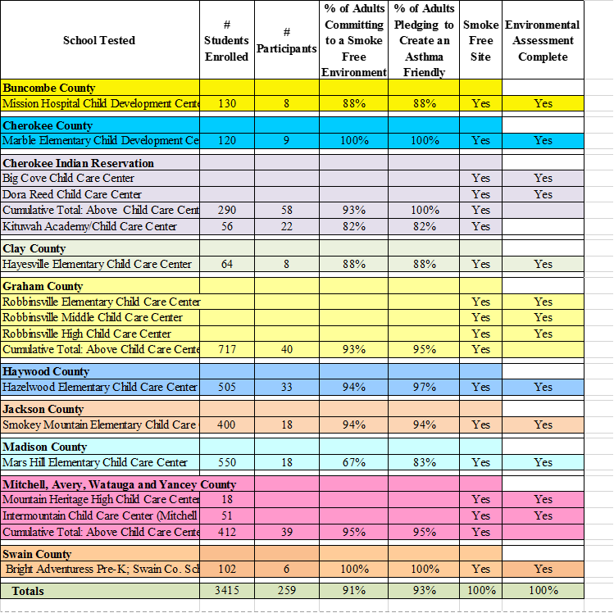
NACI Summary of Outcomes 2009-2011
Environmental Assessments/Asthma In-services
Notes:
The second prong of the study involved EA conducted in child care centers and Asthma In-Services.
From 2009-2011, approximately 3,500 children received “asthma friendly” environmental interventions, and 259 staff members were educated. Of those, 93% pledged to create an “asthma friendly” environment for our children of WNC.

Slide 25
Specific Program Activities
2009 - 2011
Event Name | Description | Target Audience | Number of People impacted | Location
World Asthma Day | Asthma education and in-service for elementary- age children | Elementary-age children, school teachers and principles throughout WNC | 1,840 | School systems in WNC
WNC School Nurse Asthma In-service | Workshop, presentation and training in regards to asthma | School nurses of WNC | 120 | Western Region of North Carolina
NC Asthma Summit | Asthma Conference | Health Care Providers | 530 | Research Triangle Park
Physician In-service | Presentation of EPR - 3 Guidelines and GIP (Guidelines Implementation Panel); NACI Demonstration Project | PCP's from Cherokee Indian Reservation (Tallulah Valley Health Center and Snowbird Clinic); Macon County (Angel Medical Center); Haywood County; Mission Children's Specialist | ~ 250 | Cherokee Indian Hospital; Mission Children's Rueter Outpatient Center
Mission Children's Specialist "Lunch and Learn" | Presentation in regards to asthma | Nurses at Mission Children's. | 15 | Mission Children's Specialist
Health Professional Asthma In-service | Workshop, presentation and training in regards to asthma | Social Workers | 12 | Mission Hospital
Notes:
In addition, approximately 3,000 health care professionals, children and families received asthma education over the 2 year period.

Slide 26

National Environmental Leadership Award in Asthma Management
2012 Health Care Provider Recipient
This award is EPA's highest recognition a program and its leaders can receive for delivering excellent environmental asthma management as part of their comprehensive asthma care services. Each year, EPA honors exceptional health plans, health care providers and communities in action.
Notes:
The RADMP was the 2012 Premier Health Care Provider Recipient of the Environmental Protection Agency’s National Leadership Award in Asthma Management. This award is the EPA’s highest recognition a program and its leaders can receive for delivering excellent environmental asthma management as part of their comprehensive asthma care services.

Slide 27
US EPA Asthma Grant Demographics
October 1, 2012 - September 30, 2014
N = 61
Age
Average Age 8.4
Age Range 1 - 17
Gender
Male 57%
Female 43%
Ethnicity
American Indian 23%
Caucasian 54%
African American 10%
Hispanic 8%
Hispanic-American Indian 5%
Insurance
Coventry 2%
Medicaid 97%
Unknown 1%
*SAS/STAT®. SAS Institute Inc., SAS Campus Drive,
Cary, NC 27513.

Slide 28
US EPA Asthma Grant 2012-2014
Asthma Severity and Control
Level of Severity (at Baseline)
Intermittent 2%
Mild Persistent 16 %
Moderate Persistent 69%
Severe Persistent 13%
Level of Control (at Baseline)
Controlled 5%
Not well controlled 34%
Very poorly controlled 61%

Slide 29
US EPA ASTHMA GRANT DIAGNOSTICS AND COST ANALYSIS
 |  | 12 Months Prior to Intervention | Intervention | Cost Avoidance
 | ED Utilization
 | Total Visits | 102 | 8
IMPACT | Total Costs | $107.322.36 | $8,417.44 | $98,904.92
HOSPITALIZATION/
ED | Hospitalizations
 | Total Hospitalizations | 56 | 7
 | Total Charges | $ 738,472 | $92,309 | $646,163
 | Total |  |  | $745,067.92
QUALITY OF LIFE | School Absences
 | Average missed days | 13.1 | 3.7 | 9.6**
 | ACT | 15.7 | 22.7 | 7.1**
 | MEASUREMENT | BASELINE*** | POST | Avg. Improvement
CLINICAL | FVC | 94.4 | 103.9 | 9.6**
OUTCOMES | FEV1 | 90.5 | 99.5 | 9.0**
 | FEF25-75 | 80.8 | 92.5 | 7.6*
 | eNO | 17.5 | 20.5 | 3.2
 | Source: Decision Support 2014 Data: $1052.18/ ED Visit
 | Source: NC State Center for Health Statistics, 2012 Provisional Hospital Discharge Data: $13,187
 | *** Inclusive of all subjects--SABA, Oral Steroids, Air-trapping
 | Statistically Significant denoted as * p<0.05 and ** p<0.01 by parametric
 | (paired t-test) and by non-parametric (Wilcoxon Signed Rank) tests
 | SAS/STAT®. SAS Institute Inc., SAS Campus Drive, Cary, NC 27513

Slide 30
US EPA Asthma Grant 2012-2014 Environmental - Home Assessments
Average Number in Household | 5
Home Assessments
Smoke in Home | 46%
Pets Inside Home | 61%
Pest Infestation Inside Home | 51%
Carpet in Home | 62%
Water Leak in Home | 38%
Water Leak Outside Home | 41%
Fungal Growth Inside Home | 41%
Heat Source
Vented | 82%
Un-vented | 16%
Unknown | 2%
Air Conditioning
None | 18%
Window Unit | 30%
Central | 49%
Unknown | 3%
Bed Encasement Present (prior to intervention) | 100%

Slide 31
US EPA – Social Determinants of Health
Approximate Value | Social Determinants of Health
$4,636 | Bedding encasement ($76 per person)
$1,500 | Dodson Pest Control ( $125 per visit)
$2,500 | HVAC System (1 family)
$3,000 | Flooring, windows, doors,…
$960 | Plumber (12 hours at $80 per hour)
$4,920 | Bathroom replacement (4 homes)
$1,350 | Roof repair/replacement/sealant
$5,800 | Furniture-beds, sofa, chairs, end tables, lamps, TVs
$180 | Pillows, sheets
$12,384 | Food referrals--Hearts with Hands, Manna, Upward Ministries, $1.72 x 20 pound box = $34.40 (Feeding America National Average) (30 families-12 boxes per family)
$8,400 | Heating Assistance, $600 per family
$5,100 | Emergency Assistance, $300 per family
$1,200 | Christmas - toys, clothes, and presents (4 families)
$180 | Car Seats ($60 each)
$2,000 | Clothing Referrals ($100 each)
$240 | Dehumidifier (2)
 | Donations:
$200 | Target
$575 | Wal Mart
$200 | Sam's Club
$1,024 | Cracker Barrel - 16 family pack dinners at $64 each
$900 | Chic-Fil-A - 300 gift cards for Kid's meal
$600 | Belks - clothing for two 4-person families
$400 | Dillards - shoes for two 4-person families
$7,792 | Volunteer hours--assistance with home remediation, cleaning, etc.; 20 volunteers X 20 hours each = 400 hours X $19.48 per hour
$300 | Back to school assistance
$66,341 | TOTAL

Slide 32
US EPA Asthma Grant Summary of Outcomes 2012-2014 Environmental Assessments/Asthma In-Services
School Tested | # Students Enrolled | # Staff | Demonstrated Excellent or Improved Knowledge |  | Adults Committing to a Smoke Free Environment | Adults Pledging to Create an Asthma Friendly Environment | Smoke Free Site | Environ-mental Assessment Complete
 |  |  | # of Parti-cipants | %
Buncombe County
Emma Elementary School | 412 | 85 | 27 | 88.40% | 30 | 28 | Yes | Yes
Cherokee County
Marble Elementary School | 138 | 20 | 12 | 100.00% | 16 | 16 | Yes | Yes
Cherokee Indian Reservation
Kituwah Academy/Child Care | 106 | 35 | 17 | 92.80% | 0 | 21 | Yes | Yes
Clay County
Hayesville Middle School | 400 | 30 | 13 | 100.00% | 23 | 22 | Yes | Yes
Graham County
Robbinsville Middle School | 218 | 20 | 19 | 94.50% | 15 | 20 | Yes | Yes
Haywood County
Junaluska Elementary School | 345 | 72 | 27 | 100.00% | 12 | 12 | Yes | Yes
Henderson County
Mills River Elementary School | 550 | 35 | 36 | 65.70% | 15 | 15 | Yes | Yes
Jackson County
Cullowhee Valley Elem. | 750 | 100 | 21 | 100.00% | 13 | 13 | Yes | Yes
Macon County
Nantahala School | 109 | 28 | 18 | 85.60% | 17 | 17 | Yes | Yes
Swain County
East Elementary School | 425 | 55 |  |  |  |  |  | Yes
West Elementary School | 418 | 55 |  |  |  |  |  | Yes
Total for above schools | 843 | 110 | 23 | 100.00% | 38 | 38 | Yes
Yancey County
East Yancey Middle School | 309 | 40 | 4 | 100.00% | 2 | 2 | Yes | Yes
Totals | 4180 | 575 | 217 | 100.00% | 166 | 168

Slide 33
US EPA Asthma Grant Activities - October 1, 2012 - September 30, 2014
Event Name | Description | Target Audience | Number of People Impacted | Location
World Asthma Day | Asthma education and in-service for elementary age children | Elementary-age children, school teachers, and principals throughout WNC | 1,762 | School systems in WNC
WNC School Nurse Asthma In-Service | Workshop, presentation, and training in regards to asthma | School Nurses of WNC | 110 | Western Region of North Carolina
NC Asthma Summit | Asthma Conference | Health Care Providers | 293 | Research Triangle Park
Children's Environmental Health Western Regional Meeting | Asthma as a Disease State and Creating an Asthma-friendly Environment | Heath Care Providers and Environmental Specialists | 40 | Mission Health System
Health Professional Asthma In-Service | Workshop, presentation, and training in regards to asthma | Health Care Providers | 1413 | Western Region of North Carolina
Health Initiatives | Asthma Education and Health Initiatives | School-age children, principals, teachers, parents and other professionals | 774 | Western Region of North Carolina
Mountain Air Conference | Asthma as a Disease State and Creating an Asthma-friendly Environment | Health Care Providers | 40 | MAHEC
CHEST | Regional Asthma Disease Management Program presentation | Health Care Providers | 100 | Atlanta, Georgia
AARC Congress | Regional Asthma Disease Management Program Asthma Abstract Presentation | Health Care Providers | 5491 | New Orleans, Louisiana
Pediatric/Neonatal Conference - Child and Family Together | Asthma as a Disease State and Creating an Asthma-friendly Environment | Health Care Providers | 120 | MAHEC
NC Society of Respiratory Care Symposium 2013 | Asthma as a Disease State and Creating an Asthma-friendly Environment | Health Care Providers | 100 | Wilmington, NC
Mission Children's Radiothon | Environmental and asthma educational materials | Children, parents, and community partners | 2000 | Reuter YMCA
 |  | Total | 12,243

Slide 34
Regional Asthma Disease Management Program
Population-Based Healthcare
Grant Outcomes Summary
Cost Avoidance $23,827
*Results compiled by Mission Health System Research Institute
Notes:
We have had the opportunity to implement 3 national asthma grant initiatives, beginning in 2007 and have had statistically significant improvements across all variables. Including ED visits…

Slide 35
Regional Asthma Disease Management Program
Population-Based Healthcare
Grant Outcomes Summary
Cost Avoidance $648,477
Notes:
Hospitalizations

Slide 36
Regional Asthma Disease Management Program
Population-Based Healthcare
Grant Outcomes Summary

Slide 37
Regional Asthma Disease Management Program
Population-Based Healthcare
Grant Outcomes Summary

Slide 38
Regional Asthma Disease Management Program
Population-Based Healthcare
Grant Outcomes Summary

Slide 39
Regional Asthma Disease Management Program
Population-Based Healthcare
Grant Outcomes Summary
Social Determinants of Health
Collaborations with various community organizations are utilized to address other socioeconomic barriers and implement solutions:
Regional churches
Youth Groups
Eblen Foundation
Food Services
Pest Management entities
Social Services
Non-profit organizations
$88,901 + medications

Slide 40
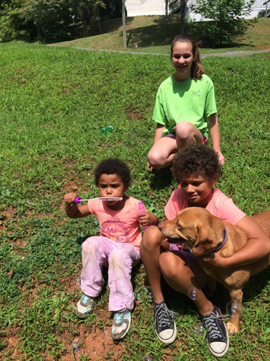
The Regional Asthma Disease Management Program embraces the holistic approach to patient care through compassion and patient advocacy.
Notes:
The RADMP embraces the “holistic approach” to patient care through compassion and patient advocacy. Thank you!

