Slide 1
Welcome to the Webinar
A New Tool for Asthma Home Visiting Programs:
The Environmental Scoring System
Moderator
Tracey Mitchell, RRT, AE-C, U.S. Environmental Protection Agency (EPA)
Presenters
Erica Marshall, MPH, Massachusetts Department of Public Health
Anjali Nath, MPH, Boston Public Health Commission
Tuesday, September 11, 2018 Webinar: 1:00 p.m. – 2:00 p.m. EDT Live Online Q&A: 2:00 p.m. – 2:30 p.m. EDT on AsthmaCommunityNetwork.org
Operator-Assisted Toll-Free Dial-In Number: (866) 527-8921
Conference ID: 8988036
Indoor Air Quality (IAQ)
Notes:
Tracey’s Talking Points:
Thank you for joining us today for ”A New Tool for Asthma Home Visiting Programs: The Environmental Scoring System” a web-based presentation sponsored by the Environmental Protection Agency.

Slide 2
Polling Question 1
Which type of organization do you represent?
Federal, state or local agency
Health care provider
Health plan
Community asthma program
Other
Indoor Air Quality (IAQ)
Notes:
Tracey’s Talking Points:
Before we dive into today’s presentations, let’s get a sense for who’s with us today. To do that, please take a moment to answer the polling question on your screen: “What type of organization do you represent?”
Polling Question #1

Slide 3
Learning Objectives
Participants will learn—
What the Environmental Scoring System is and how it was developed
How the Massachusetts Department of Public Health and the Boston Public Health Commission have used and evaluated this tool
How you can apply the Environmental Scoring System in your asthma home visiting program
Indoor Air Quality (IAQ)
Notes:
Tracey’s Talking Points:

Slide 4
Polling Question 2
Which part of today’s webinar will be most valuable to you and your work?
What the Environmental Scoring System is and how it was developed
How the Environmental Scoring System was evaluated
How to apply the Environmental Scoring System in my own asthma home visiting program
Other
Indoor Air Quality (IAQ)
Notes:
Tracey’s Talking Points:
Based on the learning objectives you just heard,
Polling Question #2: “What are you most you interested in hearing more about today?”
Great – [provide overview of responses] Our speakers will touch all of these topics in their presentation.

Slide 5
Question & Answer Session on
AsthmaCommunityNetwork.org Discussion Forum
Immediately after the webinar, join us in the AsthmaCommunityNetwork.org Discussion Forum for a live online Q&A Session:
2:00 p.m. – 2:30 p.m. EDT
To post a question in the Discussion Forum, follow these directions:
If you are a Network member, log in to your AsthmaCommunityNetwork.org account.
Click on the “Discussion Forum” button on the home page.
Click on the “Live Online Q&A for 9/11/18 Webinar” link.
Click on the “Post to the Forum” link to post your question.
Enter your question and click the “Save” button at the bottom of the page.
Not a member? Create an account at AsthmaCommunityNetwork.org by clicking the “Join Now” link at the top of the page. Your account will be approved momentarily and you can begin posting questions.
Indoor Air Quality (IAQ)
Notes:
Tracey’s Talking Points:
Our Q&A will take place on the Discussion Forum on AsthmaCommunityNetwork.org.
To see the discussion forum directly, please click the link that we just sent you via the chat function.
To ask questions, you must first be a member of AsthmaCommunityNetwork.org, so please take a minute to join so that you can post questions throughout the webinar—it is a simple and quick process. The Site Administrator will be approving memberships as they are submitted.
After the Q&A period is closed, please visit the Discussion Forum often to see other contributions as well as to make your own!

Slide 6
Supporting States and Communities to Deliver High-Value, Comprehensive Asthma Care
Tracey Mitchell, RRT, AE-C
U.S. Environmental Protection Agency (EPA)
Indoor Air Quality (IAQ)
Notes:
Tracey’s Talking Points:
Internal Outline for Tracey
Introduction/Welcome
Polling Qs
Setting the Stage: Background on EPA’s asthma program and our focus on reimbursement and financing of in-home asthma interventions
Background on EPA’s partnership with BPHC
Introduction of speaker: Erica Marshall
Erica
The Environmental Scoring System, its history and how it was developed
ESS evaluation and use
Recap and introduction of next speaker: Anjali Nath
Anjali
Overview of the evaluation and outcomes
Value of ESS
Demonstration of ESS tool
Discussion: Examples of use by programs and/or thoughts on future uses
Recap, summary, transition to Discussion Forum

Slide 7
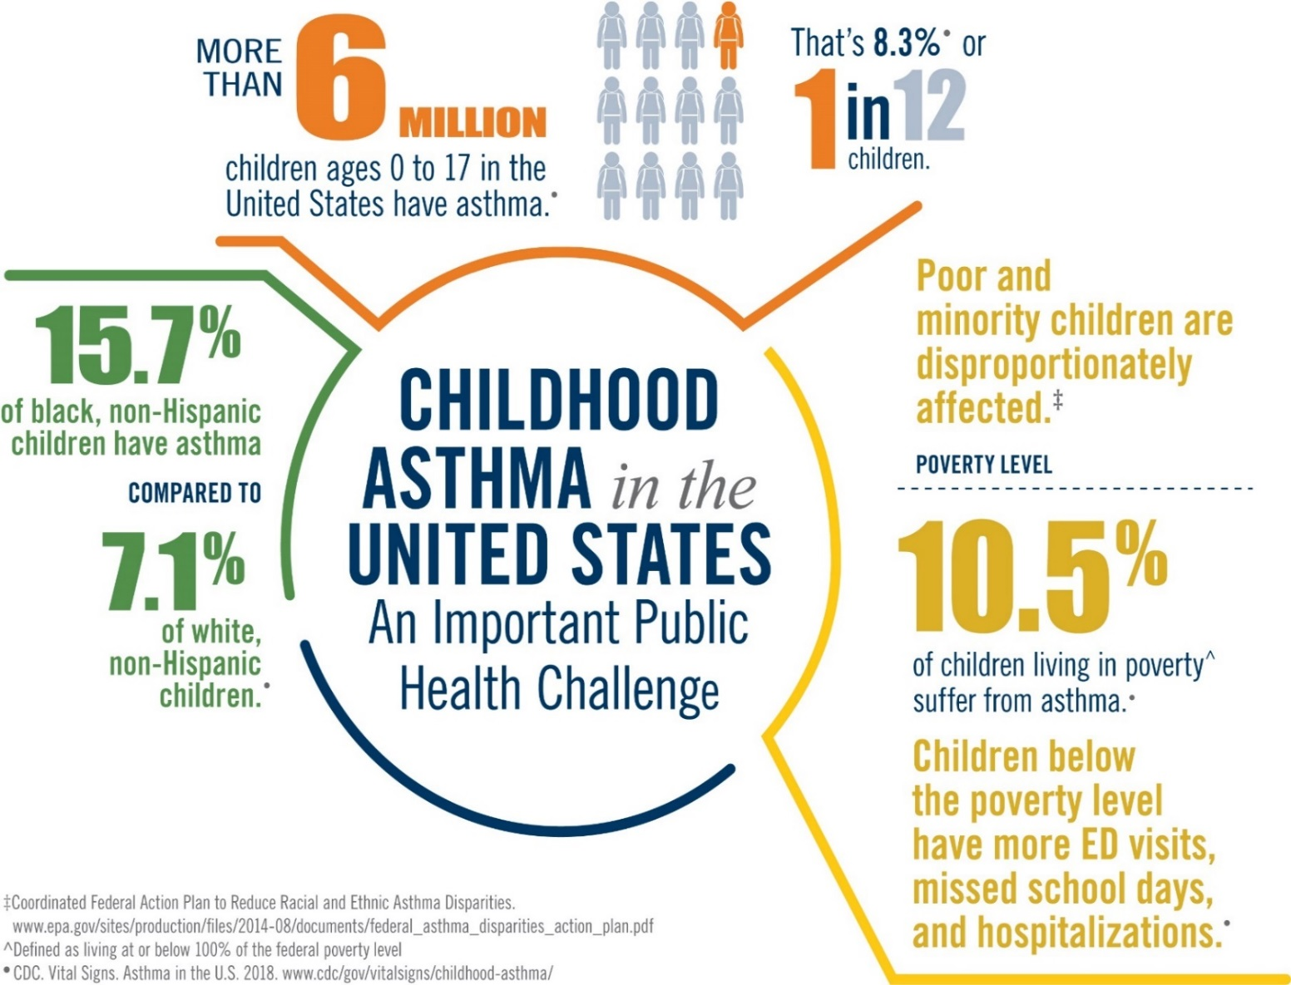
Asthma Is a Public Health Challenge Characterized by Disparities
Indoor Air Quality (IAQ)
Notes:
Tracey’s Talking Points:
Asthma remains an important public health challenge characterized by disparities.
We have made progress to decrease asthma prevalence, yet there is still a critical need for solutions focused at the state and community levels to address out-of-control asthma, which leads to increased costs.
Some national indicators improving:
Asthma prevalence among children has decreased slightly
Asthma attacks have decreased in children of all races and ethnicities
Asthma-related hospitalizations and missed school days were fewer in 2013 than in 2003
Utilization of asthma action plans was higher in 2013 than in 2003
Yet important disparities continue:
Children living below the poverty line experience the most ED visits, missed school days, and hospitalizations
These “high utilizers” with uncontrolled asthma drive up costs
And we already know that asthma costs the U.S. over $50B each year, and Medicaid spends more than $10B annually to treat asthma in children and adults.
EPA supports the widespread delivery of in-home environmental asthma interventions because it reduces health care costs, increases savings, and expands the health care workforce.
As the technical experts on the built environment and health, EPA has led the federal effort through non-regulatory strategies that enable communities to deliver and sustain in-home environmental asthma care, and has established a flagship Community of Practice aimed at ensuring access.
EPA is making unique contributions to this work:
We host an online platform of 1000+ community programs leveraged by other feds, nonprofits, and states.
We are convening stakeholders, synthesizing cutting-edge learning, and translating it to the field.
*We know how to make an impact on uncontrolled asthma, and we’re committed to spreading that capacity nationwide.

Slide 8
Environment Plays a Critical Role in Asthma Control
Federal asthma guidelines recognize environmental trigger reduction as a critical component of comprehensive asthma care.*
The evidence base demonstrates that in-home environmental interventions are effective at improving asthma control in children and adolescents.†
EPA is a federal lead for integration of environmental risk reduction into standards of care.
NHLBI. Guidelines for the Diagnosis and Management of Asthma (EPR-3). 2007. www.nhlbi.nih.gov/health-pro/guidelines/current/asthma-guidelines
CDC. The Guide to Community Preventive Services. 2005. www.thecommunityguide.org
Indoor Air Quality (IAQ)
Notes:
Tracey’s Talking Points:
Why EPA is invested in asthma and sustainable financing of in-home interventions – this is why we’re here.

Slide 9
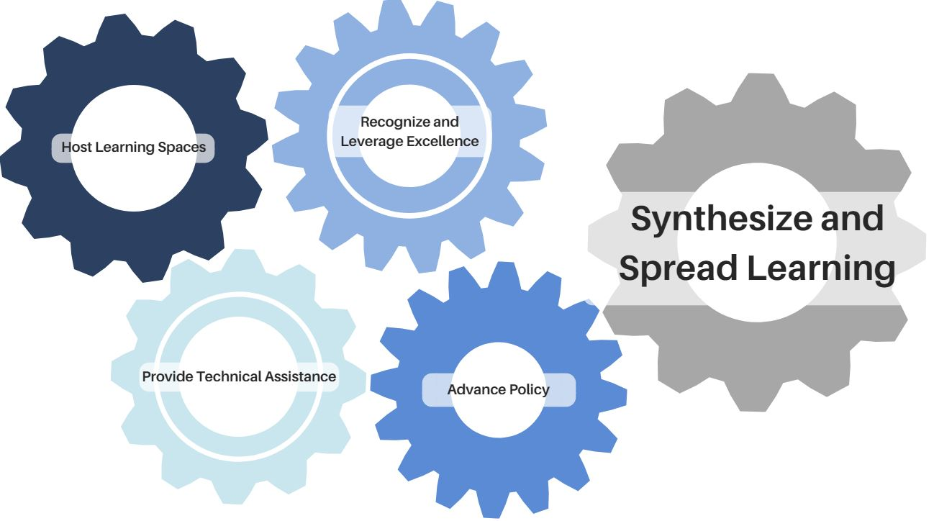
Supporting In-Home Interventions to Bring Asthma Under Control
Indoor Air Quality (IAQ)
Notes:
Tracey’s Talking Points:
How We Work: EPA meeting communities where they are. 5 program areas that work together. You may be familiar with one or two of these areas and not know about our other programs. I’d like to take a minute to share them.
Host learning spaces to share, learn and connect through AsthmaCommunityNetwork.org and national media campaigns
Provide technical assistance through cooperative agreements and partnerships
Recognize and leverage excellence through our National Environmental Leadership Award in Asthma Management
Advance policy nationally through collaboration with Asthma Disparities Working Group partners and advance policy locally through asthma summits
Synthesize and spread learning with the Community of Practice
2020 Goal
By 2020, we will equip 1,000 health insurance, housing, and environmental programs with delivery, infrastructure, and sustainability support for in-home environmental asthma interventions.
These interventions are a critical and high-value component of comprehensive asthma care that improves asthma control and leads to thousands of dollars saved in avoided health care costs per child per year.

Slide 10
EPA-BPHC Partnership
Technical Assistance to Promote In-Home Interventions
Build capacity
Educate families, healthcare providers and payers
Disseminate models for improving asthma outcomes and reducing asthma triggers
Evaluate Environmental Scoring System tool
BPHC and Boston Medical Center were recipients of the National Environmental Leadership Award in Asthma Management in 2009 and BPHC later became a cooperative agreement partner to–
Indoor Air Quality (IAQ)
Notes:
Tracey’s Talking Points:
Here is an example of how we “provide technical assistance” – our partnership with BPHC
Over many years, EPA, through a cooperative agreement, has supported the work of the Boston Public Health Commission to:
(1) Build capacity for community programs to implement effective, comprehensive asthma home visiting programs;
(2) Provide education to families with asthma on environmental asthma trigger reduction strategies;
(3) Educate healthcare providers and payers to incorporate environmental controls for asthma into standards of care; and
(4) Disseminate successful models for improving asthma outcomes and reducing environmental asthma triggers, by linking healthcare, public health and housing institutions and organizations.
One of the activities under the agreement was the validation of a standardized environmental scoring system (ESS) that was already in use throughout New England and has the potential for national significance.

Slide 11
Environmental Scoring System (ESS) Past, Present and Future
Erica Marshall, MPH
Director – Asthma Prevention and Control Program
Massachusetts Department of Public Health
Anjali Nath, MPH
Director – Asthma Prevention and Control Program
Boston Public Health Commission
With special thanks to
Dr. Jing Guo, PhD, MDPH Asthma Program &
Zhao Dong, MS, ScD, Harvard T.H. Chan School of Public Health
Notes:
Agenda:
-Brief history of the development and use of the ESS
-Application of ESS to broader set of interventions and Dong paper
-Future plans for validation of the ESS by DPH

Slide 12
READY Study Specifics
Principal Investigators
Lauren Smith, MD, MPH
Cheryl Bartlett, RN, MDPH
Jean Zotter, JD, MDPH
Megan Sandel, MD, MPH, Boston Medical Center
Matthew Sadof, MD, Baystate Medical Center
Funding
American Recovery and Reinvestment Act (ARRA) NIEHS R01 grant ( #5R01ES017407-02)
HUD Healthy Homes Technical Studies (#MALHH0227-10)
4½ year timeline (October 2009 – April 2014)
Enrollment target: 260 pairs (caregiver and child)

Slide 13
Data Collection
Activity | Visit 1 | Visit 2 | Visit 3 | Visit 4 | Visit 5 | Follow up Phone Call
Time | 0 | 0.5 | 1 | 2 | 4-6 | 8-12
Asthma Control | X | X | X | X | X | X
Asthma Related Health Outcomes | X |  |  |  | X | X
Asthma Caregiver’s Quality of Life | X |  |  |  | X | X
Environmental Home Walk Through/Asthma Trigger |  | X |  |  | X
Parental Expectations |  | X |  |  | X | X
Parental Family Priorities |  | X |  |  | X | X
Notes:
The READY study conducts 5 home visits:
Visit 1 and 2 collect baseline measures of outcomes
Visit 5 collect all post-intervention measure of outcomes
Visit 3 and 4 only ask two-week recall asthma control questions
We also conduct a 12 month phone interview to ask all questions except CHWs walk through home assessment.
Urgent care use
Number of symptom days
Use of rescue medication
Number of exacerbations requiring oral steroids
Pediatric asthma parent/caregiver quality of life scores
-- developed by Elizabeth Juniper
Environmental measures
Competing Priorities and Parental Expectations for Control

Slide 14
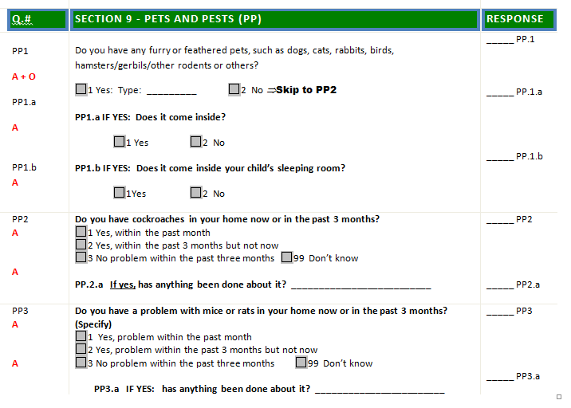
READY1 Questionnaire – 2010

Slide 15
READY Environmental Factors – Pre vs Post
Percentage (%)
*
Notes:
During READY home visits, parents were asked to report whether they have exposures to any one of the following six asthma triggers: dust, mold, pests, smoke, pets, and chemicals in the home. Additionally, Community Health Workers (CHWs) walked through rooms to observe evidence of these six triggers in home.
Based on these self-reports and observations, six indicators (1 = present and 0 = not) have been created to indicate whether each trigger is present or not for each family.
The figure shows that chemicals are a common trigger most families are exposed to at home.
The results showed that Dust, Mold, and chemical usage significantly decreased after the intervention (p= 0.0183, p=0.0014, and p-value < .0001, respectively).
This allows us to assess changes in individual environmental triggers pre and post intervention, but it did not give us a sense of overall “trigger burden” for participants and

Slide 16
Environmental Scoring System
Used to assess cumulative trigger burden in a home.
The Environmental Composite Score is calculated based on both self-report or CHW observation of the following six asthma triggers: dust, mold, pests, smoke, pets, and chemicals in the home.
Dummy variables (1 = present and 0 = not) are created to indicate whether each trigger is present or not for each family.
The composite score is then calculated by summing these six dummy variables.
Range of score is zero to six.

Slide 17
Evolution of Environmental Assessments
 | Number of Sections Containing Environmental Trigger Questions | Number of Questions about Environmental Triggers
READY1 | 5 Trigger-based 4 Room-based CHW walk through | 47 self-report 185 walk through
READY2 | 5 Trigger-based CHW Walk through | 21 self-report 84 walk through
Reducing Older Adult Asthma Disparities (ROAAD) | 4 Trigger-based CHW Walk through | 15 self-report (includes 8 on tobacco) 56 walk through
Notes:
During this time, coordinated with multiple home visiting programs across MA, including NEAIC, on standardizing data collection.
Reduced the number of environmental questions on each subsequent questionnaire b/c
Onerous for CHWs to ask families (questions about quality of data collected)
Worked to standardize question to collect meaningful information with fewest possible questions
Balance between granular data collection and absolute status (Y v N) of triggers in the home

Slide 18
ESS Tool Overview
Environmental Triggers | Questionnaire | Walk-through Assessment (Living room/Child’s bedroom/Kitchen/Bathroom) | Decision Rules
Dust | No question from questionnaire used | Level of dust on surface in room: Values: 1 – none 2 – slight 3 – Moderate 4 – Heavy | Exposure to dust (dust = 1), if: Level of dust on surfaces in a room is Moderate or Heavy
Mold | No question from questionnaire used | Mold/Mildew observed Past 30 days, smelled mold or musty smell in home? Water damage/leaking/drips observed | Exposure to mold (mold = 1), if Any evidence from walk through for mold/mildew or water leaking/dripping
Pests | Do you have a problem with mice or rats in your home now or in the past 3 months? Do you have cockroaches in your home now or in the past 3 months? | Evidence of cockroaches or rodents observed | Exposure to pests (pests = 1), if Yes, within the past month, or Yes, within the past 3 months but not now, or Any evidence from walk through
Notes:
BPHC approached us – we were not lead on the analysis
Our data not included b/c of IRB/reconsenting concerns
Which data sets/projects were included
Want to answer the question: Given the diversity of settings, staffing, patient populations, and administration across programs in Boston, is ESS broadly applicable?
Their goal: Determine if the ESS could be used across a variety of intervention settings/models/patient populations and still detect changes in environmental trigger “burden”
Also examine relationship between ESS and health outcomes, including asthma control

Slide 19
ESS Tool Overview
Smoke | On how many of the past 7 days has anyone, including you, smoked anywhere inside your home? On how many of the past 7 days have you noticed/smelled tobacco smoke that comes from your neighbors’ units or other areas in your building anywhere inside your home? | Cigarette butts or ashtrays with ash observed Tobacco odor observed | Exposure to smoke (smoke = 1), if # of days > 0, or, Any evidence from walk through
Pets | Do you have any furry or feathered pets? | NA | Exposure to pets (pets = 1), if Yes, or Types of pets listed
Chemicals | Do any of the following chemicals in your home have a strong odor that irritates your child’s asthma or makes the asthma worse? Cleaning products that contain bleach or ammonia Paint products, solvents, glue Air fresheners, scented candles, incense Pesticides | Odor observed | Exposure to chemical (chemical = 1), if If any one specific type has been checked, or, Other odor from walk-through assessment will be based on the text field CHW’s filled in. (Do NOT count burning or cooking odors)
Notes:
BPHC approached us – we were not lead on the analysis
Our data not included b/c of IRB/reconsenting concerns
Which data sets/projects were included
Want to answer the question: Given the diversity of settings, staffing, patient populations, and administration across programs in Boston, is ESS broadly applicable?
Their goal: Determine if the ESS could be used across a variety of intervention settings/models/patient populations and still detect changes in environmental trigger “burden”
Also examine relationship between ESS and health outcomes, including asthma control

Slide 20
READY ESS Pre vs Post
Percentage (%)
ESS Score
Notes:
Average Environmental Composite Score (maximum score = 6)
Pre = 2.5 (SD = 1.26), Post = 1.8 (SD = 1.31)
The figure on this slide shows the distribution of the asthma trigger composite scores shifted toward a lower score. This shows that the overall indoor environment condition had been improved. At baseline, less 5% of families did not have exposures to any asthma triggers. The percentage increased to 20% after intervention.
Similarly, the percentages on score 5 and 6 can not be reported due to small sample size.
The average asthma trigger composite score significantly decreased from 2.5 to 1.8 (p <0.0001) which means the families, on average, eliminated about one trigger in their home.

Slide 21
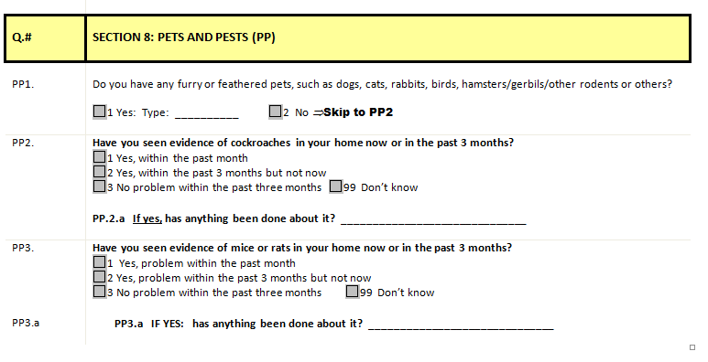
ROAAD Questionnaire – 2015

Slide 22
ROAAD Interim ESS Pre vs Post
Percentage (%)
<5
<5
ESS Score

Slide 23
ESS Tool Evaluation Process
EPA funding awarded to Boston Public Health Commission (BPHC)
Research Team
BPHC
Margaret Reid, MPA, RN (PI)
Anjali Nath, MPH
Ervin Rivera, MPH candidate, Intern
MA Dept. of Public Health
Erica Marshall, MPH
Jing Guo, PhD
Sanouri Ursprung, PhD
Elizabeth Flood, MPH
Harvard T.H. Chan School of Public Health
Gary Adamkiewicz, MPH, PhD, Senior Researcher
Zhao Dong, MS, ScD, Analyst
Marty M. Alvarez, Project Coordinator
Notes:
Thank you Erica, and hello everyone. Again my name is Anjali and it is exciting to be able to speak about the collective process of evaluating the ESS Tool for a number of reasons. As Erica mentioned, it not only was an opportunity to quantify trigger burden but to also look at the quantitative impact of our program and partner programs.
Grateful that the EPA awarded funding to the BPHC to carry out this evaluation process. The Commission administered the funds and was responsible for convening and coordinating the research team for the evaluation which included the BPHC, MDPH, HTHCSPH.
Internally, our visionary Division Director, Margaret Reid served as PI. I spearheaded the project and data pooling with our very capable intern at the time, Ervin Rivera, who contributed greatly to this project. We met regularly with the MDPH team initially to determined options for evaluation and validation, which was the initial goal. The process was refined and defined as we brought the Harvard SPH team on -
Gary Adamkiewicz
Assistant Professor of Environmental Health and Exposure Disparities
Department of Environmental Health
where much of his work focuses on the connections between housing and health, especially within low-income communities.
Zhao Dong who conducted the analysis and produced the manuscript for publication.
Lots of support from Marty Alvarez to pull it all together.

Slide 24
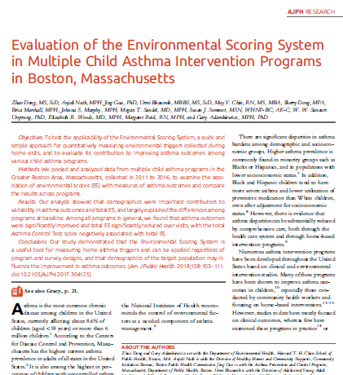
Evaluation of ESS by Dong et. al
Objective of analysis.
To determine, “whether ESS would be a good approach for measuring environmental triggers and predicting asthma outcomes across different programs and populations.”
Conclusions. ESS “is a useful tool for measuring home asthma triggers and can be applied regardless of program and survey designs, and that demographics of the target population may influence the improvement in asthma outcomes. (Am J Public Health. 2018;108:103–111. doi:10.2105/AJPH.2017.304125)”
Notes:
(Read left side of slide)
We are thrilled that this resulted in publication and the opportunity to share our findings broadly and with all of you.

Slide 25
Value of the ESS Tool Evaluation
Boston Asthma Home Visit Collaborative (BAHVC)
BPHC has convened the BAHVC since 2011 with support from the EPA .
5 Asthma Home Visit Programs
Trained CHWs
Standardized home visit questionnaire and protocols (revisions)
Collect monthly data
Serve in multiple languages
Notes:
I’m hoping these next few slides provide some context for the value we see in this ESS tool based on the work we do serving clients through asthma home visits.
EPA has been a great supporter of our work related to the priorities Tracey mentioned at the top, and provided funding to BPHC in 2011 to convene the Boston Asthma Home Visit Collaborative (BAHVC)
1) BPHC has convened the Boston Asthma Home Visit Collaborative since 2011
5 Asthma Home Visit Programs serving Boston residents through trained CHWs. Members are BPHC, Boston Children’s Hospital, Tufts Medical Center, PAC, NHP
It was really Margaret Reid and partners who envisioned convening a collaborative of these programs to create more formal support systems, leverage pooled resources and standardize protocols and processes to increase the effectiveness of the individual programs.
With EPA’s support we have been successful in achieving our goals and..
As part of this work, the Collaborative standardized their data collection questionnaire used during home visits in the hopes of eventually being able to pool data for analysis.

Slide 26
Value of the ESS Tool Evaluation
Opportunities
Analyze BAHVC data for the first time
Assess impact of our services
Decrease in triggers
Improved asthma outcomes
Possibility of validation/standardization of tool
Potential for national use
Notes:
-Through Harvard’s analysis of our collective data with the ESS Tool we saw the opportunities to:
-Analyze BAHVC data for the first time
-Quantitatively assess the impact of our services - including decrease in triggers and ideally asthma outcomes
-Determine if ESS the tool could be validated or at least standardized
-As there is no such known tool in existence we saw the potential for broad use nationally

Slide 27
ESS Tool Evaluation Process
Pooled 6 data sets from 4 existing asthma home visiting programs in Boston area from 2011 to 2016.
Assigned an Environmental Score using the methodology developed by Dr. Guo described previously looking at the 6 trigger areas: mold, pet, pest, smoke, dust, and chemical exposures.
Looked at changes in ES over the course of the interventions relative to ACT scores and ED visits.
Notes:
So, what did Dr. Dong and her team do?
Pooled 6 data sets from 4 existing asthma home visiting programs in Boston area from 2011 to 2016.
Program Data from:
Boston Public Health Commission
Boston Children’s Hospital Community Asthma Initiative
Tufts Medical Center Floating Hospital for Children Asthma Prevention and Management Initiative
New England Asthma Innovations Collaborative
2) They then assigned an Environmental Score using the methodology developed by Dr. Guo described previously looking at the 6 trigger areas: mold, pet, pest, smoke, dust, and chemical exposures.
3) They then looked at changes in ES over the course of the interventions and were, again, thrilled to know we could look at asthma outcomes using ACT scores and ED visits.

Slide 28
Findings

Slide 29
Findings

Slide 30
Evaluation of ESS by Dong, et. al
Results: Generally, total asthma outcomes were significantly improved and total ES significantly reduced over visits, across various programs.
Conclusions: The ESS tool appeared to be implementable across program, showing consistent trends regardless of program and survey designs. Demographics of target population/clients does impact improvement in asthma outcomes.
Implications: Given the practical difficulty to standardize survey designs and other elements among programs, ESS would be a useful tool that may be applied broadly to different programs in the future.
Notes:
ADD SLIDES WITH GRAPHS

Slide 31
Using the ESS Tool
Resources
Read the AJPH Study: Evaluation of the Environmental Scoring System in Multiple Child Asthma Intervention Programs in Boston, Massachusetts.
Download ESS Tool from AsthmaCommunityNetwork.org.
Request BPHC Questionnaire and DPH’s READY Questionnaire.
Data Recommendations
Practice strong/consistent data collection and management within and across programs.
Track specific dates and changes made to your program tools and practices to support data analysis.
Notes:
ADD HV QUESTIONNAIRES TO CAN
Read slide and turn back over to Erica

Slide 32
Limitations & Potential of the ESS
ESS was not developed to be a validated or universal tool, but it has the potential to be successfully used that way.
Blunt instrument, but potential to be refined.
Does not capture variability of trigger levels
Does not capture fluctuations of triggers (e.g., some eliminated, others emerge) over course of intervention

Slide 33
Next Steps for the ESS
Validation
Evaluate ESS’s construct validity
Contrast ESS scores calculated using participants self-report only with scores calculated based on the CHWs’ assessment only
Examine internal consistency of reliability
Correlation
Explore what, if any, correlation exists between environmental triggers and asthma and exacerbations or increased symptoms and the effectiveness of environmental triggers reduction in reducing exacerbations
Potential for validation using national data
Notes:
Validation: The ESS is the first tool developed in the nation to quantify indoor asthma/COPD environmental triggers. We hope the ESS score can become a standard measure for evaluating asthma/COPD indoor environmental triggers. Therefore, a validation test on the ESS score is important and will be performed to evaluate the ESS’s construct validity. We will contrast ESS scores calculated using participants self-report only with scores calculated based on the CHWs’ assessment only using independent sample t-test or the Mann–Whitney non-parametric test, as appropriate. Test–retest reliability will be assessed with the intra-class correlation coefficient (ICC) and sensitivity of the ESS score will be determined by comparing ESS scores at baseline and follow-up with the paired Student t-test or the Wilcoxon signed rank test, as appropriate. Internal consistency of reliability will be also examined using Cronbach’s alpha coefficient.
Correlation: We will explore a correlation between environmental triggers and asthma and/or COPD exacerbations or increased symptoms in older adults and the effectiveness of environmental triggers reduction in reducing exacerbations and/or COPD symptoms. Multivariate analyses will be applied to examine whether indoor environmental trigger reduction is associated with reduced asthma and/or COPD participants’ healthcare utilization. Moreover, we will examine the impact of the environmental triggers reduction on exacerbations and/or symptom improvement.

Slide 34
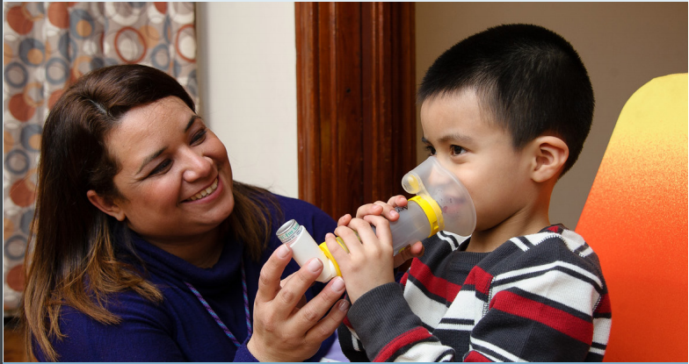
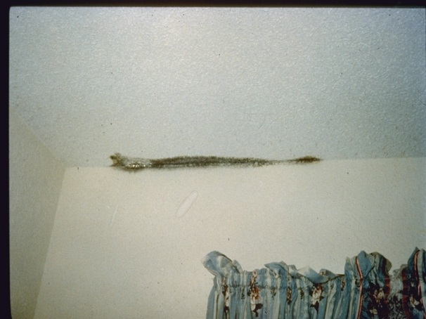
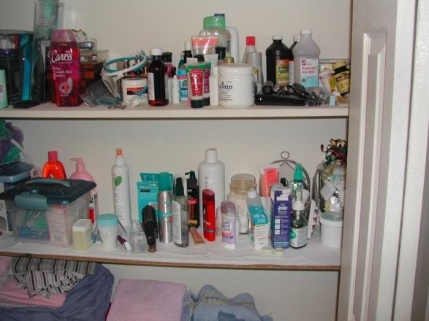
Practical Application of the ESS

Slide 35
Pets | Do you have any furry or feathered pets? | NA | Exposure to pets (pets = 1), if Yes, or Types of pets listed
ESS Score = 1
Notes:
Remind folks of column headings

Slide 36
Mold | No question from questionnaire used | Mold/Mildew observed Past 30 days, smelled mold or musty smell in home? Water damage/leaking/drips observed | Exposure to mold (mold = 1), if Any evidence from walk through for mold/mildew or water leaking/dripping
Cumulative ESS Score = 2

Slide 37
Chemicals | Do any of the following chemicals in your home have a strong odor that irritates your child’s asthma or makes the asthma worse? Cleaning products that contain bleach or ammonia Paint products, solvents, glue Air fresheners, scented candles, incense Pesticides | Odor observed | Exposure to chemical (chemical = 1), if If any one specific type has been checked, or, Other odor from walk-through assessment will be based on the text field CHW’s filled in. (Do NOT count burning or cooking odors)
Cumulative ESS Score = 3

Slide 38
For more information
MA Dept of Public Health
Erica Marshall
erica.marshall@state.ma.us
Jing Guo
Jing.Guo@state.ma.us
Boston Public Health Commission
Anjali Nath
anath@bphc.org
Harvard T.H. Chan School of Public Health
Zhao Dong
zdong@hsph.harvard.edu

Slide 39
Polling Question 3
Based on what you have learned today, which action are you most likely to pursue?
Learn more about the Environmental Scoring System by accessing resources on AsthmaCommunityNetwork.org
Find out more about using data to quantitatively assess asthma triggers
Share the Environmental Scoring System with my partner organizations and consider adopting in my program
Explore incorporating environmental trigger remediation into my in-home asthma education program
Other
Indoor Air Quality (IAQ)
Notes:
Tracey’s Talking Points:
Thank you to our speakers for a terrific presentation.
Before we head into the Q&A on the discussion forum, I would like to take this opportunity to learn from you, our asthma community, on what actions you feel equipped to perform based on what you have learned in the webinar.
Polling Question #3
Great, thank you for your participation.

Slide 40
Question & Answer Session on
AsthmaCommunityNetwork.org Discussion Forum
Immediately after the webinar, join us in the AsthmaCommunityNetwork.org Discussion Forum for a live online Q&A Session:
2:00 p.m. – 2:30 p.m. EDT
To post a question in the Discussion Forum, follow these directions:
If you are a Network member, log in to your AsthmaCommunityNetwork.org account.
Click on the “Discussion Forum” button on the home page.
Click on the “Live Online Q&A for 9/11/18 Webinar” link.
Click on the “Post to the Forum” link to post your question.
Enter your question and click the “Save” button at the bottom of the page.
Not a member? Create an account at AsthmaCommunityNetwork.org by clicking the “Join Now” link at the top of the page. Your account will be approved momentarily and you can begin posting questions.
Indoor Air Quality (IAQ)
Notes:
Tracey’s Talking Points:
Our Q&A will take place on the Discussion Forum on AsthmaCommunityNetwork.org.
To see the discussion forum directly, please click the link that we just sent you via the chat function.
To ask questions, you must first be a member of AsthmaCommunityNetwork.org, so please take a minute to join so that you can post questions throughout the webinar—it is a simple and quick process. The Site Administrator will be approving memberships as they are submitted.
After the Q&A period is closed, please visit the Discussion Forum often to see other contributions as well as to make your own!

