Slide 1
Reflecting on a Decade of Growth: How IMPACT DC Has Evolved Since Winning the 2006 National Environmental Leadership Award
Welcome to the Webinar
Moderator:
Tracey Mitchell, U.S. Environmental Protection Agency
Presenters:
Deborah Quint Shelef, MPH, CCRP, AE-C, Program Director, IMPACT DC
Candice Pantor, MS, Outreach Coordinator, IMPACT DC
Wednesday, January 25, 2017 Webinar 2:00 p.m. – 3:00 p.m. ET Live Online Q&A 3:00 p.m. – 3:30 p.m. ET on AsthmaCommunityNetwork.org
Operator-Assisted Toll-Free Dial-In Number: (800) 374-0278
Conference ID: 51684047
Notes:
Tracey’s Talking Points:
Good morning or good afternoon, depending on where you are located.
Welcome to “Reflecting on a Decade of Growth: How IMPACT DC Has Evolved Since Winning the 2006 National Environmental Leadership Award,” a Web-based presentation sponsored by the Environmental Protection Agency.
We’re glad you can join us today!
Since we have a lot of material to cover, we’ll go ahead and get started.

Slide 2
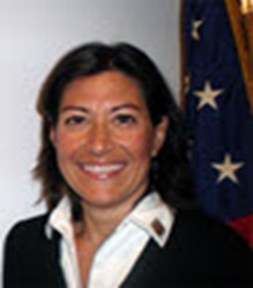
Introduction
Tracey Mitchell, RRT, AE-C
U.S. Environmental Protection Agency
mitchell.tracey@epa.gov
202.343.9446
Notes:
Tracey’s Talking Point(s):
I’m Tracey Mitchell from EPA. I’m going to give a quick overview of this webinar and walk through some housekeeping items.
Then I’ll turn it over to our featured presenters, who will introduce themselves and start the presentation.

Slide 3
Polling Question 1
What type of organization do you represent?
Government agency
Health care provider
Health plan
Community-based program
Other
Notes:
Tracey’s Talking Points:
Before we dive into today’s presentations, let’s get a sense for who’s with us today. To do that, please take a moment to answer the polling question on your screen: “What type of organization do you represent?”
Polling Question #1

Slide 4
Polling Question 2
What are you most you interested in hearing more about today?
Developing patient-centered care initiatives
Tracking data and results
Building community partnerships
Pursuing sustainable funding
Notes:
Tracey’s Talking Points:
Looks like we have a great audience today. We have one more question for you…
Polling Question #2: “What are you most you interested in hearing more about today?”
Great – [provide overview of responses] Our speakers will touch all of these topics in their presentation.

Slide 5
Agenda
EPA’s National Environmental Leadership Award in Asthma Management
Hear From Speakers on IMPACT DC’s Evolution Since Winning the 2006 Award
Deborah Quint Shelef
Candice Pantor
Q&A Session in AsthmaCommunityNetwork.org Discussion Forum
Notes:
Tracey’s Talking Points:
Our plan for today is to discuss the National Environmental Leadership Award in Asthma Management. I will begin by presenting information about the Awards Program and a framework that many of our award winners have used, EPA’s System for Delivering High Quality Asthma Care. Then, our 2006 award winner, will tell us about their program and the outstanding results they have achieved.
After the webinar, each of our presenters will be available on AsthmaCommunityNetwork.org for 30 minutes to respond to your questions.

Slide 6
Question & Answer Session on
AsthmaCommunityNetwork.org Discussion Forum
Immediately after the webinar, join us in the AsthmaCommunityNetwork.org Discussion Forum for a live online Q&A Session from
3:00 p.m. to 3:30 p.m. ET.
To post a question in the Discussion Forum, follow these directions:
If you are a Network member, log in to your AsthmaCommunityNetwork.org account.
Click on the “Discussion Forum” button on the home page.
Click on the “Live Online Q&A for 1/25/17 Webinar” link.
Click on the “Post to the Forum” link to post your question.
Enter your question and click the “Save” button at the bottom of the page.
Not a member? Create an account at AsthmaCommunityNetwork.org by clicking the “Join Now” link at the top of the page. Your account will be approved momentarily and you can begin posting questions.
Notes:
Tracey’s Talking Points:
Our Q&A will take place on the Discussion Forum on AsthmaCommunityNetwork.org.
To see the discussion forum directly, please click the link that we just sent you via the chat function.
To ask questions, you must first be a member of AsthmaCommunityNetwork.org, so please take a minute to join so that you can post questions throughout the webinar – it is a simple and quick process. The Site Administrator will be approving memberships as they are submitted.
After the Q&A period is closed, please visit the Discussion Forum often to see other contributions as well as to make your own!

Slide 7
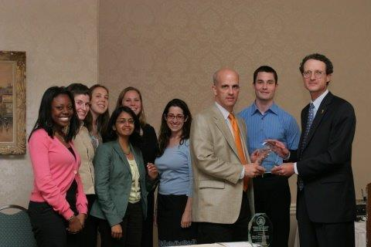
About the Award
It is the nation’s highest honor for exceptional asthma management programs.
The goal of the Awards program is to showcase best practices in asthma care and management.
To be eligible, applicants must use: the National Institutes of Health (NIH) Expert Panel Report 3 (EPR-3): Guidelines for the Diagnosis and Management of Asthma, and meet the published criteria.
Join the Hall of Fame: Apply by Feb. 1, 2017!
www.asthmacommunitynetwork.org/awards
Notes:
Tracey’s Talking Points:
The National Environmental Leadership Award in Asthma Management is the highest recognition in the country that a program and its leaders can receive for delivering excellent environmental asthma management.
Winners receive a place in the National Environmental Leadership Award in Asthma Management Hall of Fame; national recognition through a press release, blogs, a crystal award; and the opportunity to serve as mentors to help other programs achieve impactful results.

Slide 8
Award Winners Hall of Fame
Notes:
Tracey’s Talking Points:
Since 2005, EPA has recognized health plans, health care providers and communities in action for their best practice approaches to delivery of comprehensive asthma care.

Slide 9
Evolution of the Award
2005: The National Environmental Leadership Award in Asthma Management launched with two initial winners
2008: New category – Community in Action added
Organizations responsible for coordinating and overseeing the delivery of asthma services within a community setting at the state, regional and local level
Winners have included community asthma programs, health departments, and schools
2016: A total of 38 health plans, health care providers and communities in action officially recognized
Notes:
Tracey’s Talking Points:
The National Environmental Leadership Award in Asthma Management has evolved quite a bit. Initially, there were only two categories, health plan and healthcare provider.
IMPACT DC was one of the earliest winners of the Award, receiving recognition as a healthcare provider in 2006.
In 2008 EPA added a new category, Community in Action, to recognize organizations responsible for coordinating and overseeing the delivery of asthma services within a community setting at the state, regional and local level. This award acknowledges the work being done by health departments, community asthma programs and schools to improve the lives of those with asthma.
EPA is proud to have recognized a total of 38 health plans, health care providers and communities in action since 2005.

Slide 10
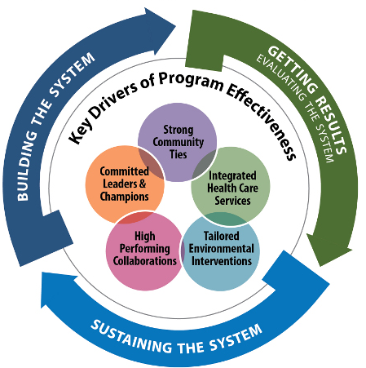
The System for Delivering High-Quality Asthma Care
Notes:
Tracey’s Talking Points:
As I mentioned earlier, many of our award winners have used EPA’s System for Delivering High Quality Asthma Care, which features essential components to developing an effective and sustainable asthma program.
The System is a conceptual framework, based on results of the Asthma Health Outcomes Project, conducted by University of Michigan, which identifies the core elements of successful asthma programs and the processes that drive their implementation, continuous improvement, and endurance. The five key drivers of the System include: committed leaders and champions, strong community ties, integrated health care services, tailored environmental interventions, and high-performing collaborations.
The System is flexible and any asthma program, regardless of its size, institutional home (e.g., health plan, health care provider, community program), budget, target community, or level of development, can use the System to guide its work.

Slide 11
Connecting to the System
High-Performing Collaborations
Notes:
Tracey’s Talking Points:
I’d like to talk a little more about the High Performing Collaborations key driver. Partner organizations are key to providing a high level of asthma care. One of the exciting things you’ll hear today is how IMPACT DC has connected with other organizations to access additional services in order to deliver comprehensive care.
Two key aspects of the high-performing collaborations driver are:
Building on What Works:
Build partnerships with organizations that are active in your target community and seek out organizations providing complementary services to foster strong collaborations.
Collaborating to Build Credibility:
Collaborate with established organizations to build the social capital and local infrastructure of your program.
Today, IMPACT DC will describe how they reached out to other organizations in their community to collaborate on targeting underserved populations. You’ll hear some innovative and creative solutions that demonstrate the value of thinking outside the box and how to build community support and buy-in.
So now I’d like to turn it over to our guest speakers –
Deborah Quint Shelef
Candice Pantor
Improving Pediatric Asthma Care in the District of Columbia (IMPACT DC) Asthma Clinic targets inner-city, minority and disadvantaged children who suffer disproportionate asthma morbidity and mortality. Most live with challenging social and environmental circumstances with daily exposure to multiple asthma triggers and are frequent fliers from a large urban ED-- Children's National Medical Center. IMPACT DC focuses on three distinct domains: environmental control, medical management, and longitudinal care.

Slide 12
Reflecting on a Decade of Growth: How IMPACT DC Has Evolved Since Winning the 2006 National Environmental Leadership Award in Asthma Management
Notes:
Thank you for the introduction.
I am happy to speak today about IMPACT DC and our program’s evolution over the past decade.

Slide 13
Presenters-Nothing to disclose
Deborah Quint Shelef, MPH, CCRP, AE-C
Program Director
Candice Pantor, MS, AE-C
Outreach Coordinator
Notes:
Candice and I have nothing to disclose.

Slide 14
Outline
About the IMPACT DC Asthma Program
Clinical Care, Research, Outreach & Advocacy
Winning the 2006 National Environmental Leadership Award in Asthma Management
Significance to program
IMPACT DC Program Evolution
Growth since 2006
Advice to Future Applicants
Notes:
In today’s webinar, we will describe the IMPACT DC asthma program, share our experience winning the EPA’s National Environmental Leadership Award in Asthma Management, and describe our programs subsequent growth and evolution. We will end with sharing some advice for programs that are considering applying for this award.

Slide 15
Impact Dc Asthma program
Improving Pediatric Asthma Care in the District of Columbia

Slide 16
IMPACT DC Mission Statement
To improve the care and outcomes of disadvantaged, urban, and largely minority children and adolescents with asthma in the DC metro region while serving as a model program for the nation.
Notes:
IMPACT DC stands for “Improving Pediatric Asthma Care in the District of Columbia”.
We are a mission-drive program, and are committed to improving the care and outcomes of underserved children in our local community, while developing best practices that can be implemented nationally.

Slide 17
IMPACT DC History
Founded in 2001 with funding from the Robert Wood Johnson Foundation for ED-based demonstration project
Focused on urban kids with high ED recidivism for asthma
Evolved into a highly collaborative program:
Clinical Care
Clinical & Translational Research
Surveillance
Outreach & Advocacy
Notes:
IMPACT DC was initially funded in 2001 by the Robert Wood Johnson Foundation. We had two projects funded initially: the collection of emergency department and hospital data from all non-military hospitals in DC, and the development and evaluation of an emergency department-based intervention aimed at improving asthma outcomes.
From the very beginning, our focus was on underserved children with high morbidity that rely heavily on urban emergency departments for care.
This focus has remained unchanged as we have grown into a broad-based program with activities focused on clinical care, clinical and translational research, asthma surveillance, outreach and advocacy.
- Two guiding principles of our initiatives are that they are data driven and patient-centered. The development of the IMPACT DC Asthma Clinic addressed an unmet need in our community, and sought to meet families where they were – in our own Emergency Department.

Slide 18
Pediatric ED Visit Rates for Asthma
4.3x
Akinbami L. Pediatrics 2009.
IMPACT DC, 2012.
Notes:
Asthma is the most common chronic pediatric disease, affecting over 6 million children, and accounting for more than 600,000 emergency department visits each year. With over 6000 visits per year, we estimate that our own emergency department at Children’s National sees about 1% of all ED visits for children.
The first bar in this graph shows national data. The rate of emergency department visits for asthma was just over 100 visits per 10,000 children. The second and third bars show the national rates for Caucasian and African American children, revealing a striking disparity. The final bar shows local data we collected in DC, revealing a visit rate more than 4 times the national rate.

Slide 19
Traditional Paradigm
Child in with Acute Asthma Symptoms
ED Visit
21% within 30 days
Primary Care Follow-up
Liberman D. Ped Emerg Care 2012.
Opportunities for Improved Care
Notes:
In the traditional paradigm, a child experiencing asthma symptoms comes to the emergency department. The child is then typically discharged home, with the recommendation to follow up with their primary care provide to receive ongoing care.
ADVANCE
Yet studies have shown that children often do not receive follow-up care after an exacerbation. Our own data showed that just over 20% of children returned to primary care within 30d of an ED visit. This then leads to a cycle of continued reliance on the emergency department for episodic care, with little emphasis on longitudinal management.

Slide 20
IMPACT DC’s Conceptual Model
Child with Acute Symptoms
ED Visit
>70% within 15 days
Teach SJ. Arch Ped Adol Med 2006.
Primary Care Follow-up
Opportunities for Improved Care
Notes:
IMPACT DC’s “big idea” was that the urban emergency department should be a part of the solution, rather than just a barometer of the problem.
We developed the IMPACT DC Asthma Clinic as an alternative for follow-up care following an emergency department visit for asthma.
ADVANCE
In contrast to the low observed rates of primary care follow up, over 70% of referred families attended the IMPACT DC Asthma Clinic within 15 days of ED discharge.
ADVANCE
IMPACT DC then helps to transition the family to their primary care provider for ongoing care.

Slide 21
IMPACT DC Clinic: Nuts & Bolts
Occurs within 2-4 weeks of hospital visit… leveraging the teachable moment
Based on NIH Guidelines for Asthma Care
Education, Environmental Management and Clinical Care
Patient-centered approach
Notes:
The IMPACT DC Asthma Clinic leverages the teachable moment of a recent exacerbation. Families were initially recruited directly from the emergency department at the time of an acute exacerbation, and invited to RETURN to the emergency department for follow-up care.
All aspects of care are based on the NIH guidelines, and the clinic provides tailored education, environmental management, and clinical care. The clinic was developed to be patient-centered, meeting families “where they are,” leveraging the familiar and trusted environment of the emergency department. The clinic recognizes the health belief model and emphasizes shared goal setting, in addition to using motivational interviewing techniques. Candice will describe the clinic in greater detail later in this presentation.

Slide 22
Randomized Controlled Trial
488 Patients Enrolled
244 Intervention Group
244 Control Group
244 Control Group
Intervention
Usual Care
Outcomes assessed at 1, 3, and 6m and analyzed by intention-to-treat
Notes:
We studied this approach in a large randomized controlled trial.
Nearly 500 participants were enrolled in the trial. Half were randomized to receive the intervention, and half were randomized to the control group. Intervention participants were invited to attend a single visit in the IMPACT DC Asthma Clinic within 15d of ED discharge, and the Control Group participants received written materials about asthma at ED discharge. Blinded research assistants assessed outcomes for six months.

Slide 23
ED Visits in First Six Months after Intervention
RR=0.54 (0.40, 0.72)
Notes:
The results of this study were very positive. Our primary outcome was the rate of emergency department visits over six months. This graph shows a dramatic and statistically significant difference between groups. The blue bar is the control group, and the red bar is the intervention group. I want to note that the analysis was conducted by intention to treat, meaning that all children randomized to the intervention group are included in the analysis, even if they did not attend the clinic.

Slide 24
Compliance with Inhaled Corticosteroids
adjRR=2.03 (1.57, 2.63)
Teach SJ. Arch Ped Adol Med. May 2006.
Notes:
We similarly observed significant changes in a number of health-related behaviors. For example, the intervention increased use of inhaled corticosteroids, with the improvement decreasing slightly over time but persisting at 6m FU.

Slide 25
Health Outcomes from Clinic
Decreased ED utilization
Increased use of controller medications, asthma action plans, and trigger avoidance behaviors
Identified challenge of transition to primary care
Sample of 2016 Patients Post IMPACT DC
Number of ED Visits for Asthma | Number of IP for Asthma | Number of PCP Visits for Asthma
-75% | -67% | 17%
Notes:
In terms of health outcomes, the intervention improved both health care utilization and a number of asthma-related behaviors. However, we identified a significant challenge in increasing follow-up with primary care. As we will describe later, this led to new research and programmatic initiatives, as the transition to primary care is a core priority of our program.
The randomized trial provided very strong data in support of the IMPACT DC Asthma Clinic. This high quality and published data has been essential in our efforts to sustain and expand our program.
- We continue to track a range of metrics from our clinic, including health outcomes, and our data continues to show dramatic improvements after a single visit to the clinic. For example, in a recent sample of patients seen in 2016, we observed a 75% reduction in ED visits, 67% reduction in hospital admissions, and 17% increase in primary care visits.

Slide 26
IMPACT DC 2006
Winning the National Environmental Leadership Award in Asthma Management
Notes:
IMPACT DC was honored to receive EPA’s National Environmental Leadership award in 2006.

Slide 27
IMPACT DC Asthma Program 2006
Clinic
Medical Consultation
Self-Management
Education
Research
Inner City Asthma Consortium
Care Coordination
Notes:
As referenced on the previous slides, we published the results of the original trial in 2006. Building on this initial success, our program was focused on fully implementing the IMPACT DC Asthma Clinic locally.
An early program expansion was our participation in the Inner City Asthma Consortium, beginning in 2005. This multi-site research network studies the causes of the urban asthma epidemic and develops treatments to improve control of asthma in this at-risk population.

Slide 28
IMPACT DC Asthma Program
Research
Outreach
Advocacy
Clinic
IMPACT DC
Notes:
We were also focused on developing new initiatives in outreach and advocacy to continue addressing the needs of our community.

Slide 29
Winning the 2006 National Environmental Leadership Award in Asthma Management
National recognition
Leverage for additional support
New opportunities for collaboration
Notes:
Receiving the EPA award was a key moment for our program, as it indicated national recognition for our model. Providing asthma care and education within the emergency department was a new and innovative approach. This highly prestigious national award validated and recognized the success of this model.
This recognition was instrumental in securing additional funding for our program, as well as developing new partnerships.
Participating in the EPA’s national conference also introduced us to other successful programs, which gave us both new ideas and helpful resources.

Slide 30
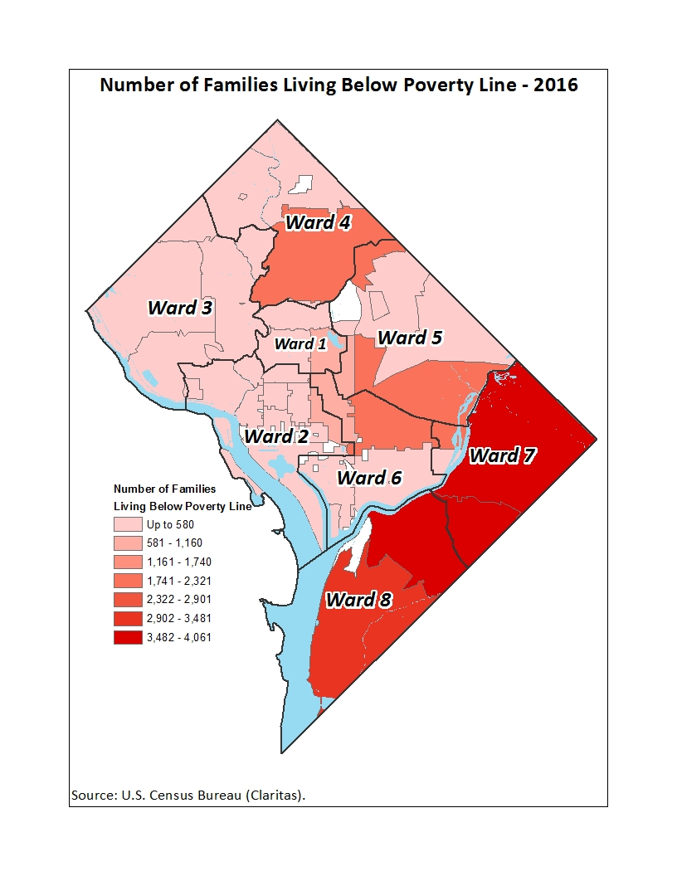
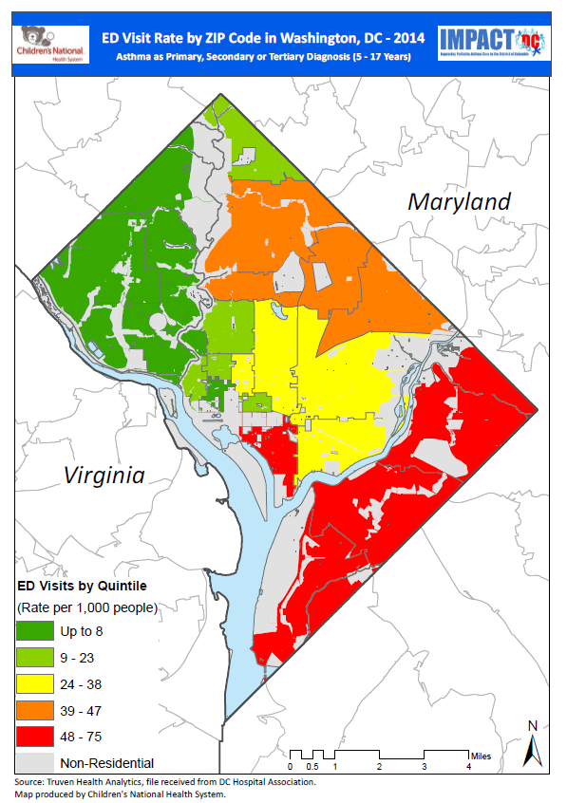
ED Visits for Asthma
Poverty in DC
Notes:
One of our essential partnerships is with the DC Department of Health, which supports our collection and analysis of citywide surveillance data.
The map on the left side of this slide shows the rate of ED visits made by children age 5-17 years to all DC hospitals. Of note, more than 85% of these visits are to the Children’s ED.
As you can see, the disparities are quite stark, with residents of the Southeast portion of the city making far more visits than those in the northwest areas.
The geographic distribution of ED visits for asthma closely mirror’s the city’s distribution of poverty, shown on the right-hand side of the slide.
Our most recent data showed a twenty-fold disparity in the ED visit rate between the highest and lowest zip codes in the city.
As Candice will show you later, we’ve used this data to prioritize new locations for our clinic.

Slide 31
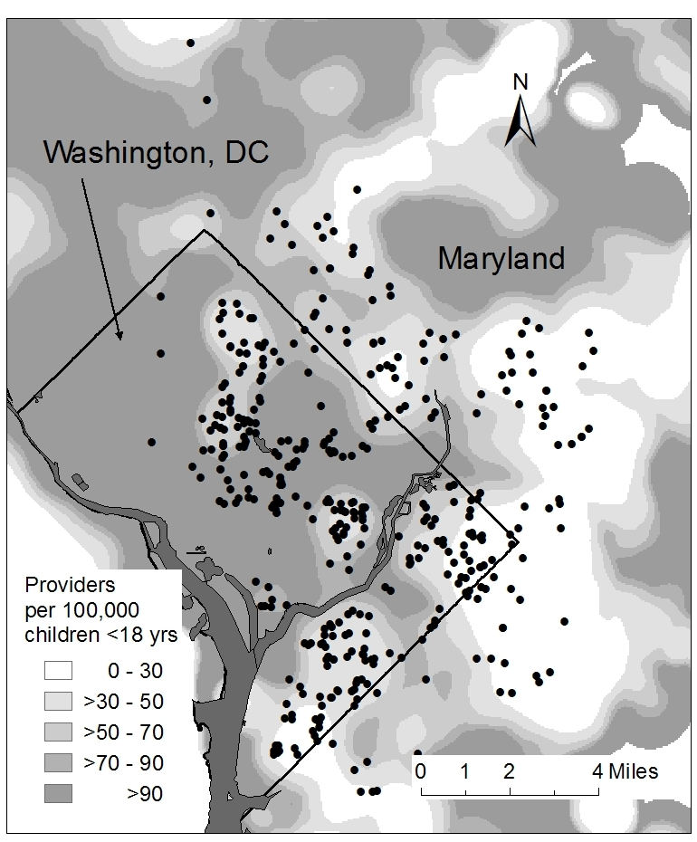
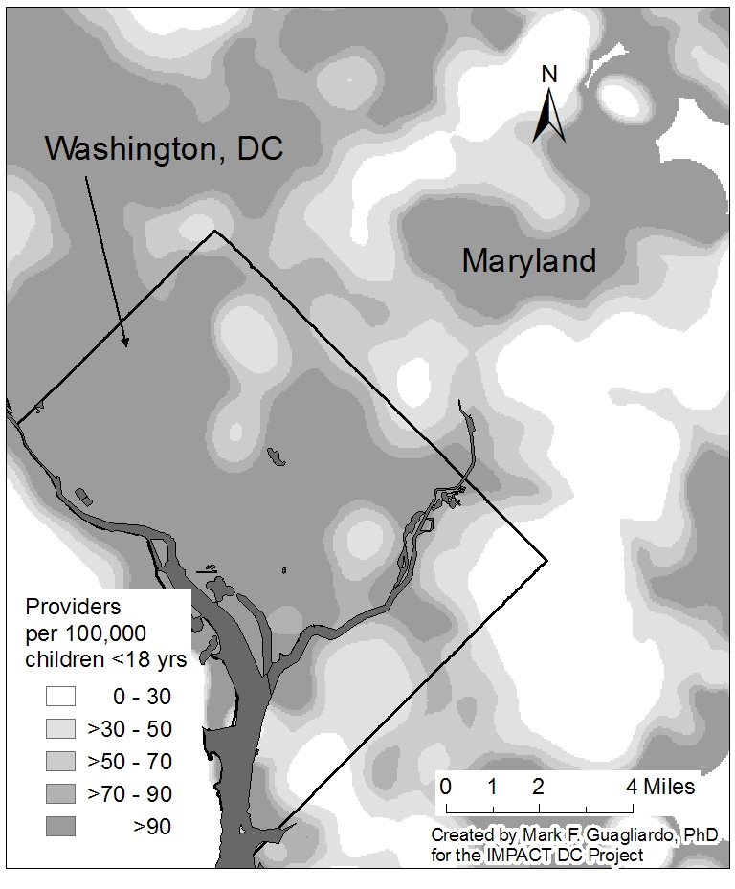
ED Visits for Asthma
Visit Rate by Zip Code, 2006
Primary Care Access, 2005
Notes:
We also looked at access to primary care services to see how that associated with the areas with high ED utilization.
In the map on the right, the dark grey areas have high density of primary care services, while the lighter grey and white areas have fewer pediatric primary care providers. As you can see, many of the lighter areas are the same areas with high rates of ED visits for asthma.
ADVANCE SLIDE
We then superimposed the addresses of a sample of children seen in our own ED, and found that they were highly concentrated in the areas with fewer primary care resources.
Citywide data has told a number of different stories in recent years. For many years we observed decreases in citywide ED visits, but more recently we have seen an increase in visits for ALL conditions, including asthma. Similarly, we track hospital admissions, which are less impacted by healthcare seeking behavior and may be a better marker of disease severity. Recent analyses have shown a decrease in the rate of hospital admissions for asthma.

Slide 32
18%
DC
US
Asthma Prevalence among Children 2010
Notes:
And a challenge that continues to face DC is the high asthma prevalence, which reached 18% in 2010.
ADVANCE SLIDE
The pediatric asthma prevalence in DC remains much higher than the national level.
Candice will now tell you about our program’s growth and evolution over the past decade, and how we have developed and implemented new initiatives in our community.

Slide 33
IMPACT DC Since 2006
Program Evolution
Notes:
I will take us through some of our program expansion since 2006.
Next slide

Slide 34
IMPACT DC Asthma Program
Clinic
Medical Consultation
Self-Management
Education
Research
Inner City Asthma Consortium
Breathe with Ease
A Unique Approach to Managing Stress
Outreach
Health Care Providers
Community Events
Advocacy
Childhood Asthma Leadership Coalition
DC Asthma Coalition
Asthma Disease Management Team
Care Coordination
Community Asthma Navigator Program for DC
Schools/Daycares
ORBEX
Primary Prevention Trial
Notes:
This is an overview of our program today.
Since 2006, IMPACT DC has grown significantly to include outreach and advocacy work, in addition to an expanded research portfolio.
We will go into more detail on each of these individual components over the next few slides.
Our clinic remains a core part of our program and next I will go into more detail regarding our clinic structure, staffing model and growth.
Next slide.

Slide 35
IMPACT DC Clinic: Nuts & Bolts
One time: 1 ½ hour visit
Based on NIH Guidelines for Asthma Care
Three areas of focus
Education: asthma and control of environmental triggers
Clinical Care: medications and written plan
Care Coordination: linkages to primary care, school nurses, and community resources
Patient-centered approach
Notes:
The nuts and bolts of our clinic.
We receive referrals from the emergency room, inpatient providers, primary care providers, school nurses, and DC Medicaid groups.
We try our best to schedule patients with-in 2-4 weeks of emergency room or inpatient discharge.
Our visits lasts about 1 ½ to 2 hours and are based on NIH Guidelines for Asthma Care
Families meet with an asthma educator, a clinician and a care coordinator.
We have 3 areas of focus: Education; discussing environmental trigger management and proper use of asthma medications.
Clinical Care; the family meets with one of our clinicians, we complete prescriptions, an asthma action plan and any necessary referrals to specialist.
And Care Coordination; all families meet with our care coordinators and they focus on social needs of the family.
The care coordinate writes landlord letters, completes community referrals, and assists with scheduling follow up appointments. Additionally, the care coordinator calls all families two weeks after our visit to check-in and make sure they are linked back to their primary care or the designated long term asthma care home.
We are designed as a one-time follow up visit and do not take over long term care but we always remain extremely patient centered!
Next slide

Slide 36
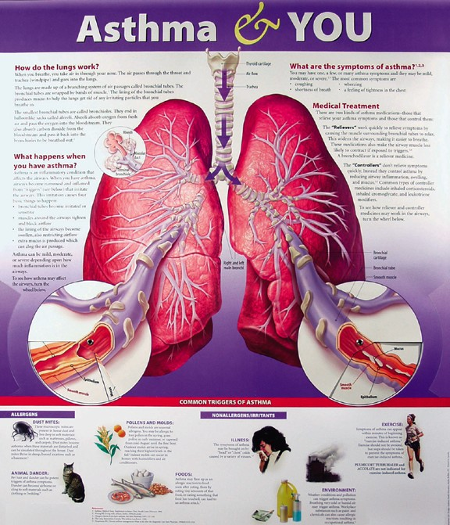
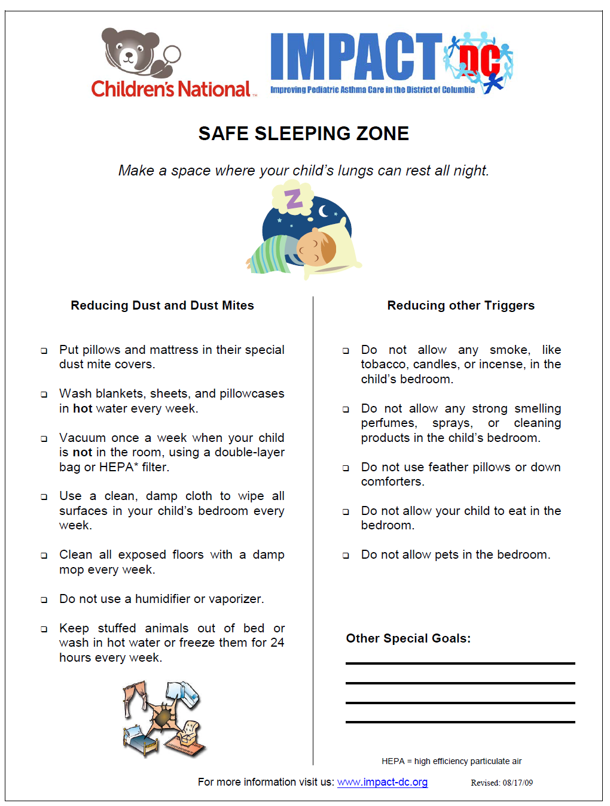
Asthma Education
Notes:
A large component of our visit is the Asthma Education, families spend about 45 minutes to an hour, one-on-one, with the asthma educators.
Our educators complete an intake and provides individualized education.
Staff is trained to utilize motivational interviewing techniques, such as active, reflective listening and having families identify goals.
We extensively discuss environmental trigger management and asthma pathophysiology using the lung poster here.
Making sure to use plan language, for example, comparing the tubes of the lungs to tree branches and focusing on the 3 changes in the lungs with asthma.
On the next slide I will talk a little more about the tools we provide families.

Slide 37
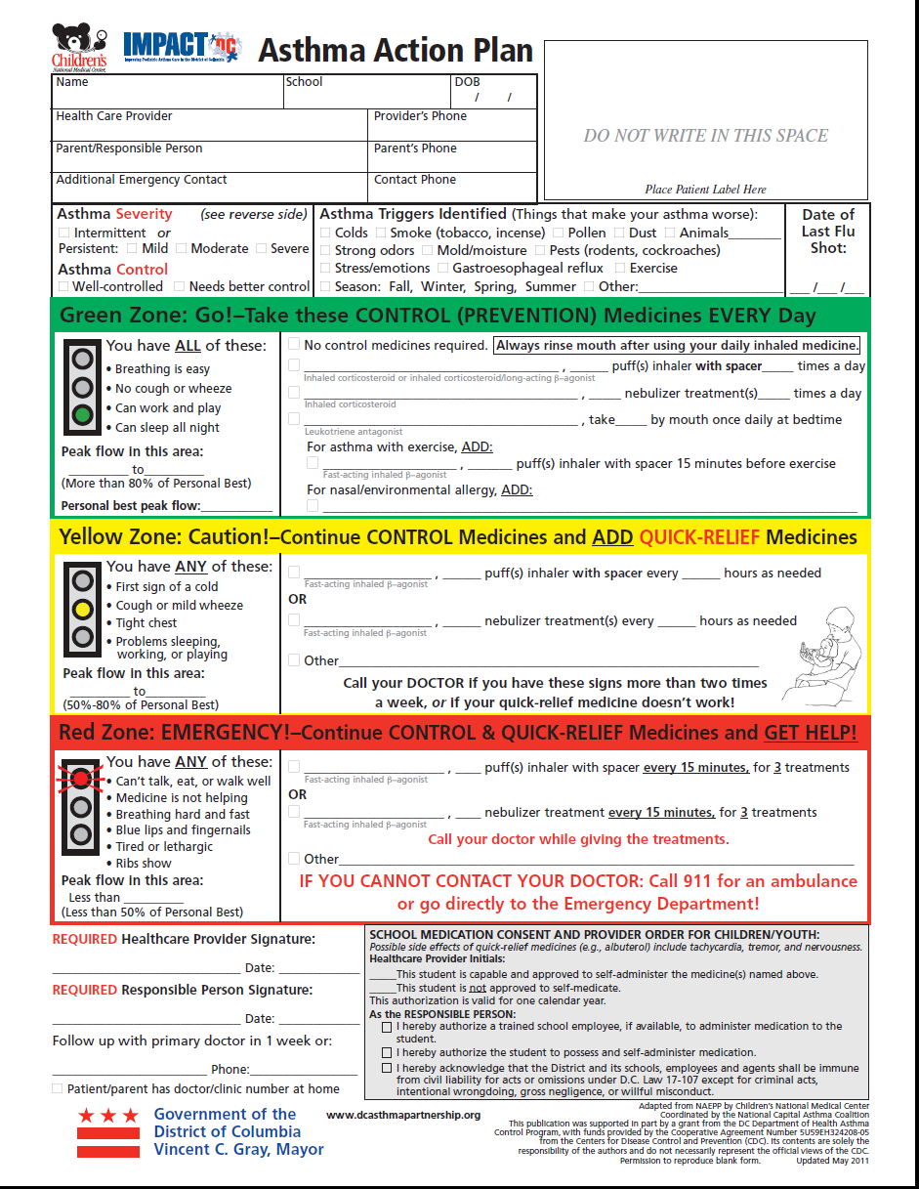
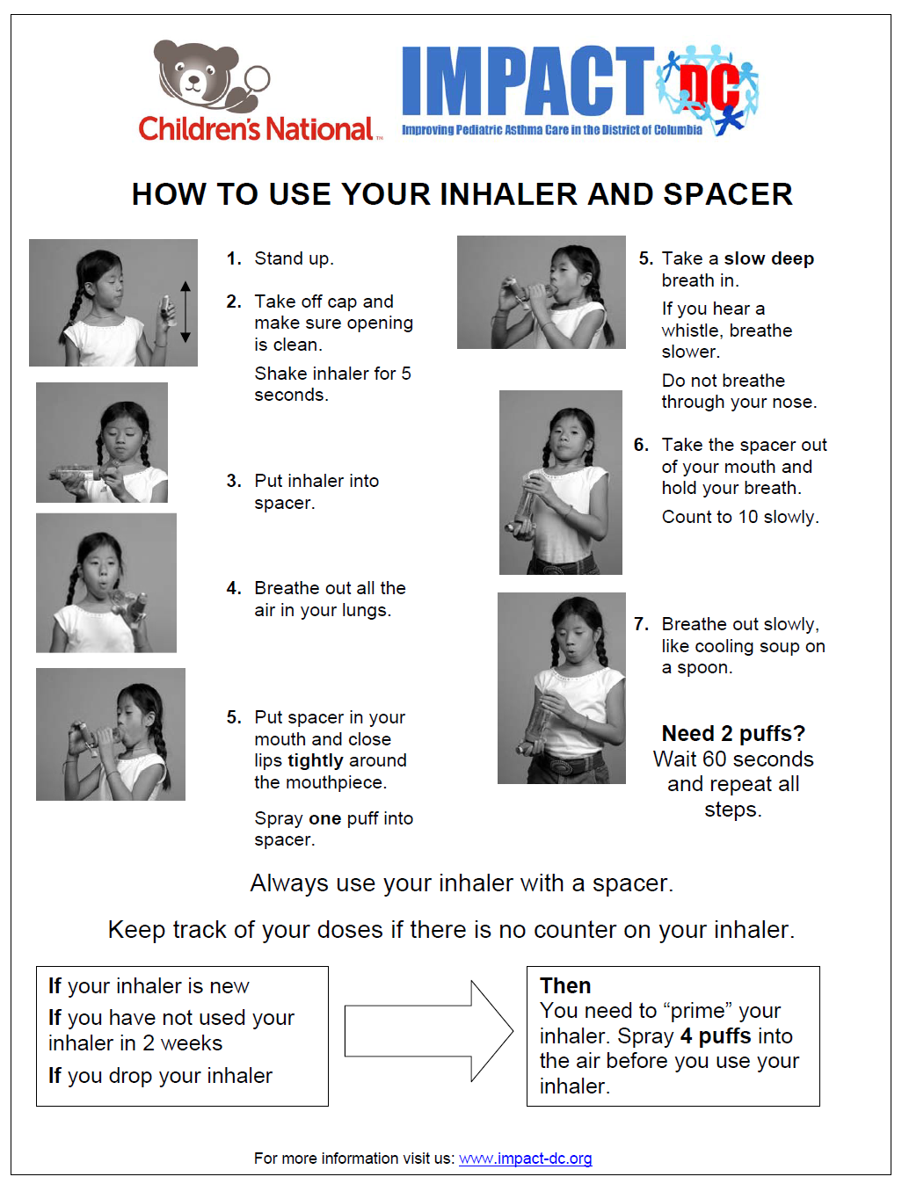
Personalized Asthma Tools
Notes:
As just mentioned, our visit is education focused but is still a clinical visit for the child.
Our trigger education and medication device teaching is tailored to the family to go over their specific triggers, medications, and device and we discuss an individualized management plan.
The family leaves with prescriptions, a completed asthma action plan, a pillow case cover and mattress cover if needed.
We send families home with handouts to reinforce the education worked on in clinic; like the safe sleep zone handout on the previous slide and this device instruction sheet here.
Next slide

Slide 38
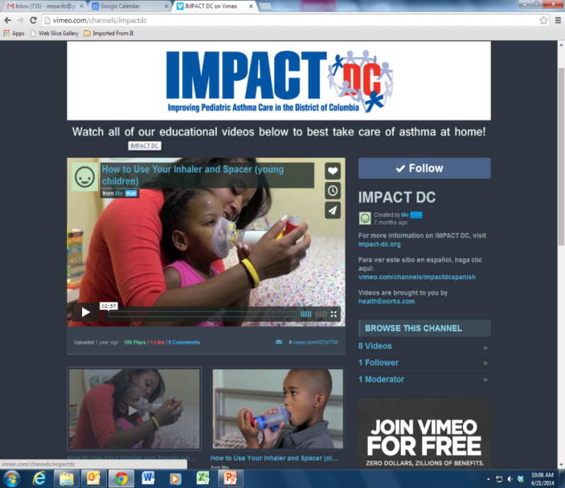
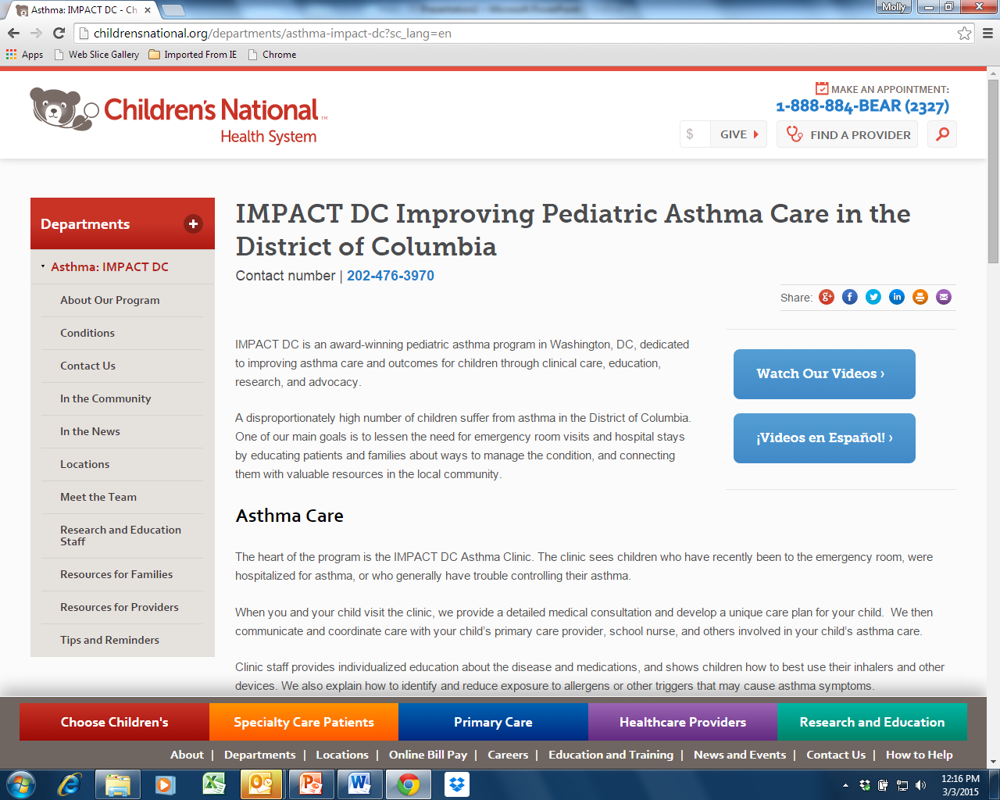
Website: www.impact-dc.org
Notes:
After our visit we send videos to all our families which you can see on our website.
The videos are less than 2 minutes and can stream on mobile devices.
These videos include how to use devices such as the inhaler and spacer, the difference between controllers and quick relievers, and managing an asthma flare-up.
We provide education and teaching using different modes to be mindful of various learning styles.
Our website also has a lot of information about our clinical program and the various asthma education materials used in our clinic.
Next slide

Slide 39
Clinic Staffing
Clinician staffing:
Emergency Medicine
Pulmonology
Hospitalist Medicine
Primary care
Asthma educators
Care coordinators
Notes:
We have a diverse clinical staff from a variety of specialties including emergency medicine, pulmonary medicine, hospitalist medicine and primary care.
Our staffing model is unique where our asthma educators are non-licensed, internally trained staff with opportunities for certification and professional development.
We have a structured curriculum for training and the education provided to families in order to main a consistent message based on the guidelines.
Our care coordinators are trained first as asthma educators then complete additional training to provide coordination of care for families.
Next slide

Slide 40
IMPACT DC Clinic Locations
Emergency Departments:
Main Sheikh Zayed Campus
United Medical Center
Children’s Health Center primary care clinics:
Anacostia
THEARC (future site)
Notes:
We currently run our clinic out of 3 different locations in DC.
We have 2 locations based out of Children’s National Emergency Rooms, the red locations on the map.
One out of primary care, at the Children’s Health Center at Anacostia with plans to expand to an additional Children’s primary care location at THEARC, shown by the blue locations.
We operate our clinic 4 days a week with a total of 6 clinic shifts.
We are at the Main Children’s ED Tuesday through Friday and Wednesday at the CHCA and Thursday at UMC, running clinic at the two different locations both days.
And you can see here, our clinic locations are concentrated in the areas of the city with the highest ED visit rates, ensuring access to our clinic for the highest risk children in DC.
Next slide

Slide 41
New Patients by Year
Notes:
With this physical expansion of our clinic locations you can see we have had a substantial increase in patient volume.
This graph represents our new patient visits by calendar year.
We have had significant growth in our clinic numbers since 2006.
Where we saw 349 new patients and for 2016 we finished at 1385 new patients.
Next slide

Slide 42
IMPACT DC Outreach and Advocacy
Community Outreach
Health fairs and community events
Health Professional
Primary Care Office Trainings
Resident/Nurse Trainings
Advocacy
Schools and Daycares
DC Asthma Coalition
Breathing Easy Asthma Trainings
Shadow in clinic
Back to School Nights
Parent Sessions
Increasing clinic access
Health Services Advisory Committees
Government Affairs
Childhood Asthma Leadership Coalition
Notes:
Here is an overview of the outreach and advocacy portion of our program.
We focus efforts on a few areas: community outreach, schools and daycares, health professionals and advocacy work.
We attend events in the community, conduct provider trainings for daycare providers, school nurses and primary care providers and work with different groups to drive asthma policy and change.
We have found it challenging to measure outcomes for our community outreach work but I will highlight efforts with measureable outcomes and successful partnerships on the next few slides.

Slide 43
Asthma QI Learning Collaborative 2012-present
Partnership with DC PICHQ
> 300 providers & 75 practice sites
Office asthma management focus 2012-14
Population approach 2014-17
Notes:
A highlight of one of our major partnerships and initiatives to improve asthma care beyond our clinic is the asthma quality improvement learning collaborative.
We have been working with the DC Partnership to Improve Children's Health Care Quality since 2012 and the goal is to build capacity in primary care settings.
This project included on-site quality improvement coaching, monthly team meetings and leader calls, virtual learning sessions (or webinars) focused on best practices in asthma care and education,
Three plan-do-study-act cycles, chart audits, and comprehensive data sharing on a customized on-line project platform.
Over 300 primary care providers have participated in this effort at over 75 practice sites across the region.
Next slide

Slide 44
QI Learning Collaborative Results - Summary
Notes:
Here is a summary of some of the data from the QI Learning Collaborative collected from October 2012 through June 2013.
Providers did baseline and monthly chart review of a random selection of patients noting implementation of guideline-based asthma care, specifically the documentation of severity classification and assessment of control, assessment and counseling about asthma triggers, scheduled follow-up asthma visits, controller therapy for persistent asthma and providing a written asthma action plan.
The percentage of visits at which the selected best practices were implemented continuously increased over the time frame. By the end of the project year, providers reported, assessment of asthma severity and control, and ICS prescribed when indicated at over 90% of visits!
We aligned this project with maintenance of certification requirements for pediatricians and family practice physicians, and offered continuing medical education credits to support provider involvement.
Next slide.

Slide 45
QI Learning Collaborative Results
Notes:
This slide shows a side-by-side comparison of the measured outcomes from baseline in October 2012 shown by the blue bar to June of 2013, the red bar.
You can see the significant increase across measures from baseline. There were noteworthy increases in providers assessing environmental trigger assessment at 88% of visits in June 2013 up from 45% at baseline
And completed Asthma Action Plans at 81% of visits up from 24% at baseline.
We saw similar improvements in office asthma management in the second year of the learning collaborative, and since then we have worked with sites to develop more of a population health approach to asthma, in which clinic teams identify and proactively manage all of the children with asthma in their practices.
Next slide

Slide 46
Nurse Asthma Educator Program
Primary care nurses trained as asthma educators
Will lead asthma visits and coordinate services as part of primary care teams
Nurses preparing for national certification exam
Notes:
This past year we have done a great deal with the primary care nurses here at Children’s National Health System. This map on the left shows the Children’s primary care health center locations.
We have trained several primary care nurses in these community clinic settings to be asthma educators, and to take on an expanded role within their practices.
These nurses will lead asthma visits and coordinate services for patients with asthma in their primary care setting.
The nurses will be able to offer families enhanced education in asthma self-management, and serve as resources for the entire care team in communities with the greatest asthma burden.
Next slide

Slide 47
Advocacy: From Program to Policy
Qualitative Research
Partners in Policy
Patients need:
Communication and care coordination
Access to care
Social and financial support
DC Managed Care Organizations Chronic Condition Collaborative
Government Affairs Council
Childhood Asthma Leadership Coalition
Notes:
Our advocacy work is very important to our program and involves a great deal of collaboration and partnership.
We were involved in a qualitative research study which published a white paper identifying patients needs and barriers to good asthma outcomes.
These findings included enhanced communication and care coordination, access to the appropriate care,
And social, emotional and financial support to address the challenges of managing a chronic illness without economic security.
These findings were significant to our work with the DC Managed Care Organizations removing the pharmacy override for dispensing two quick relief inhalers for patients to have one at home and one at school.
Finishing on that significant accomplishment I will pass things back to Debbie to discuss our research work, program support and sustainability.

Slide 48
Research: Clinical and Translational
Community Asthma Navigator for DC (CAN-DC)
Integration of existing community-based programs addressing the medical, family, home, and community needs of children with asthma utilizing a community asthma navigator to coordinate services
Breathe with Ease: A Unique Approach to Managing Stress (BEAMS)
Aims to improve asthma outcomes among African American children in DC by studying the impact of a stress management program for parents of children with asthma
Inner City Asthma Consortium (ICAC)
Immunomodulator trials and asthma characterization studies
Oral Bacterial Extract (ORBEX)
Randomized clinical trial of a bacterial extract given to infants for the primary prevention of wheezing and asthma
Notes:
Thanks, Candice.
Our program remains highly focused on scientific discovery through clinical and translational research.
We are working on a number of multi-site and single-site initiatives to better understand asthma phenotypes, develop treatment and prevention strategies, and explore enhanced community-based models to address asthma disparities.
Through the Inner City Asthma Consortium, we have participated in large national trials of different immune-based approaches to asthma treatments.
Two exciting current studies are the ORBEX and BEAMS studies.
ORBEX is a multi-site study, and is the first effort we have participated in that aims at primary prevention, meaning preventing the onset of asthma in at-risk healthy babies.
And the BEAMS study is funded by the Patient Centered Outcomes Research Institute (PCORI), and studies an intervention to address the link between parental stress and a child’s asthma outcomes. This award supported a broad-based stakeholder engagement process to develop the intervention, and was the first time our research team worked so closely with parents and other local and national partners to develop a highly patient and family centered intervention and study design. The December issue of the Journal of Allergy and Clinical Immunology describes our efforts, as well as those of other PCORI awardees that applied this engagement paradigm to their research.
Some other examples of our past studies include an intervention to partner with school nurses to provide daily inhaled asthma medicines in the schools, training community pharmacists to provide asthma education at the time of medication refills, to empower parents to improve their communication with doctors regarding their child’s asthma, and to conduct focus groups and qualitative interviews with parents and other stakeholders to understand barriers to care as well as intervention preferences.
Our research efforts continue to focus on identifying the most high-risk children and exploring appropriate treatment strategies, whether through medications, behavioral interventions, or improved health service delivery.

Slide 49
Program Support
Federal Government
Local Government
Foundations
Philanthropy
Clinical Revenue
Notes:
- A key element of our program’s success has been the breadth of our funding mechanisms.
Much of our research funding is from NIH, and we’ve also had over a decade of programmatic support from the local health department. In addition, we have had both research and programmatic efforts supported by many private foundations.
Two areas of recent growth for our program have been private philanthropy and clinical revenue.

Slide 50
Sustainability
IMPACT DC selected as system-wide intervention by Chronic Condition Collaborative.
High risk patients identified and referred
Contracts with all four DC Medicaid Managed Care Organizations
Enhanced fee-for-service payments and shared savings for reduced ED visits
Informed by data: patient utilization/risk and cost-effectiveness of intervention
Notes:
- From a sustainability perspective, our success at increasing our clinical revenue has been essential.
A unique opportunity was IMPACT DC’s selection as the system-wide intervention by the Dept of Healthcare Finance’s Chronic Condition Collaborative.
Through this initiative, all DC Medicaid MCOs refer high risk patients for our services.
The referrals from the MCOs were a key driver in our recent growth, as well as our financial sustainability.
This facilitated contracts with all of the MCOs which provide enhanced fee for service payments, and shared savings for reduced ED costs.
This opportunity was only possible due to our strong data showing the effectiveness of the IMPACT DC Asthma Clinic, as well as our long-standing partnerships that put us at the “right place at the right time” for this unique opportunity.
And I want to emphasize that it took us nearly 10 years from the documentation of improved outcomes in the IMPACT DC Asthma Clinic to our robust plan for sustainability.
- Our program’s evolution occurred against a backdrop of dramatic changes in the healthcare landscape. Our data-driven, patient-centered programs are well aligned with the current focus on value-based care and the search for innovative models to meet the triple aim of improving the patient experience, improving population health, and reducing costs.

Slide 51
Advice for future applicants
Notes:
We’ll end today’s presentation with advice for future applicants.

Slide 52
Applying: It’s a good idea
National recognition
Reflect on work of program
Future applications
Notes:
- We strongly recommend applying for the EPA’s National Environmental Leadership award.
The national recognition was instrumental in our program’s success, as we moved from a small demonstration project to a well-established program of clinical care, research, outreach and advocacy.
In addition, applying for the award can be a helpful process in reflecting on your work. We appreciated the opportunity to present our program and develop language about our approach and impact.
Finally, applicants receive feedback on their program’s strengths and weaknesses. This feedback can help programs improve their work, and prepare for future applications.

Slide 53
Questions
Notes:
I’ll now transition back to Tracey for closing remarks before we transition to the Question and Answer portion of the webinar.

Slide 54
Polling Question 3
Based on what you have learned today, what actions do you feel equipped to perform?
Join AsthmaCommunityNetwork.org
View tools and resources on AsthmaCommunityNetwork.org
Request a Mentor
Consider applying for the National Environmental Leadership Award in Asthma Management
Other
Notes:
Tracey’s Talking Points:
Thank you Deborah and Candice for a terrific presentation.
Before we head into the Q&A on the discussion forum, I would like to take this opportunity to learn from you, our asthma community, on what actions you plan on taking after this webinar.
Polling Question #3: “Based on what you have learned today, what actions do you feel equipped to perform?”
Great, thank you for your participation. Also, as another opportunity for sharing your ideas with us, please be on the lookout for a brief feedback form in your email following today’s webinar.
It will only take five minutes to complete and it will greatly help us in planning our future webinar activities.

Slide 55
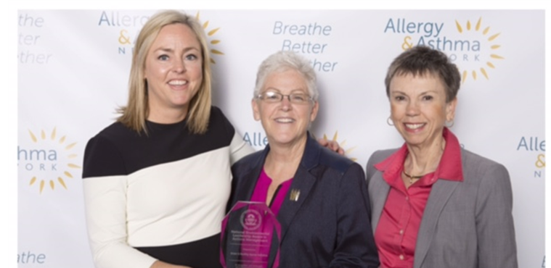
http://asthmacommunitynetwork.org/awards
Deadline for submission: February 1, 2017 (11:59 pm EST)

Slide 56
Question & Answer Session on
AsthmaCommunityNetwork.org Discussion Forum
Immediately after the webinar, join us in the AsthmaCommunityNetwork.org Discussion Forum for a live online Q&A Session.
3:00 p.m. – 3:30 p.m. ET
To post a question in the Discussion Forum, follow these directions:
If you are a Network member, log in to your AsthmaCommunityNetwork.org account.
Click on the “Discussion Forum” button on the home page.
Click on the “Live Online Q&A for 1/25/17 Webinar” link.
Click on the “Post to the Forum” link to post your question.
Enter your question and click the “Save” button at the bottom of the page.
Not a member? Create an account at AsthmaCommunityNetwork.org by clicking the “Join Now” link at the top of the page. Your account will be approved momentarily and you can begin posting questions.
Notes:
Tracey’s Talking Point(s):
Here are some directions for how to post a question in the Discussion Forum on AsthmaCommunityNetwork.org.
You will need to log-in to your Network account to post questions.
If you are not a member yet, you can join the Network today by clicking the “Join Now” link at the top of the AsthmaCommunityNetwork.org homepage.
Your account will be approved momentarily and you can begin posting questions.
Thanks again for joining us, and we look forward to chatting with you in the discussion forum.

