Slide 2
Breathing Easy at Home: Partnering to Increase Smoke-Free Policies in Federally Assisted Housing
Welcome to the Webinar
Featuring:
Kara Skahen, Program Director, Live Smoke Free, Association for Nonsmokers-Minnesota
Patricia Baines-Lake, Executive Director, Lansing Housing Commission, Michigan
Amy Moore, Health Educator, Ingham County Health Department, Michigan
Moderator: Rachel Cumberbatch, AAAS Science & Technology Policy Fellow, U.S. Environmental Protection Agency
Wednesday, August 5, 2015
Notes:
Good afternoon. Welcome to “Breathing Easy at Home: Partnering to Increase Smoke-Free Policies in Federally Assisted Housing.” This is a Web-based presentation hosted by the U.S. Environmental Protection Agency.
We’re glad you can join us today.
I’m Rachel Cumberbatch from EPA. I’m going to give a quick overview of this webinar and then I’ll turn it over to our featured presenters.
Please also note that this webinar will be archived and will be made available for viewing online at the AsthmaCommunityNetwork.org website.

Slide 3
Learning Objectives
Participants will learn how to—
Take action to promote and implement smoke-free policies in multi-unit housing.
Communicate the importance and feasibility of smoke-free policy implementation and enforcement in multi-unit housing, particularly public housing.
Partner with public housing authorities (PHAs) and privately owned multi-unit properties to adopt a smoke-free policy.
Overcome barriers and offer support to property managers when implementing a smoke-free policy.
Notes:
Our audience today represents a variety of organizations, from housing officials to community asthma programs to local and state health departments. Our goal for this webinar is to bring this diverse group together in order to take action on smoke-free housing.
This webinar will equip you with knowledge to promote the importance of smoke-free policies as THE way to reduced exposure to secondhand smoke in housing. You will also learn how public health, tobacco control and housing officials can collaborate to provide support to the housing community and residents before and after transitioning to smoke-free.

Slide 4
Agenda
Describe the benefits of smoke-free housing policies and EPA’s commitment to reducing asthma disparities through healthy housing.
Hear from experts in the field.
Kara Skahen, Program Director, Live Smoke Free, The Association for Nonsmokers-Minnesota
Patricia Baines-Lake, Executive Director, Lansing Housing Commission, Michigan
Amy Moore, Health Educator, Ingham County Health Department, Michigan
Notes:
Today we bring you three speakers who will share their stories and strategies for success in improving indoor air quality through the implementation of smoke-free housing policies.
Kara Skahen is program director for the Live Smoke Free program in Minnesota. Kara will help us begin to explore this issue broadly and will examine the strong momentum towards smoke-free housing across the country.
We will also hear stories of local partnerships and success as Ms. Patricia Baines- Lake from the Lansing Housing Commission and Ms. Amy Moore from the Ingham County Health Department discuss their work surrounding smoke-free housing.
I am looking forward to facilitating a conversation between these great speakers.
And, lastly, we will have our Q&A session in the AsthmaCommunityNetwork.org discussion forum. Let’s look at some brief instructions for how you can participate in this. (This section can be edited out)

Slide 5
Why Smoke-Free Matters: Health Disparities
The Surgeon General has concluded that there is no risk-free level of exposure to secondhand smoke (SHS).¹
SHS is a universal asthma trigger, and more than half of children with asthma are exposed to SHS.
SHS affects minorities and the poor disproportionately.³
Among children with asthma, 53.2% were exposed to SHS in 2005–2010.²
Among low-income children with asthma, 79.1% were exposed to SHS.²
¹ The Health Consequences of Involuntary Exposure to Tobacco Smoke: A Report of the Surgeon General. 2006.
² Kit et al. 2013.
³ CDC. Vital Signs: SHS An Unequal Danger. 2015.
Notes:
Since the 1992 risk assessment on secondhand smoke, the EPA has had a leadership role in reducing exposure to SHS in buildings, particularly the home environment. Together with federal partners, state and local partners we have made profound progress towards reducing involuntary exposure to SHS and improving IAQ. Still disparities in exposure continue to exist and contribute to a disproportionate disease burden in minority and low income populations.
SHS is a universal asthma trigger. The Surgeon general has concluded that there is no risk-free level of exposure to SHS. Still over half of children with asthma continue to be exposed to SHS. Exposure rates are even higher for low-income children with asthma where nearly 8 in 10 children are exposed to SHS.

Slide 6
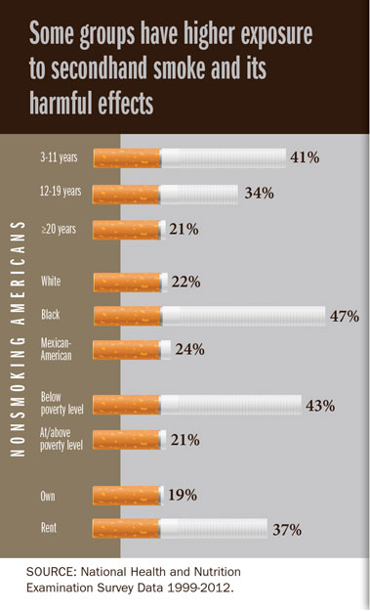
SHS: An Unequal Danger
One in 4 nonsmokers (58 million people) in the United States are still exposed to SHS.¹
About 2 of every 5 children (15 million) are exposed to SHS.¹
More than 1 in 3 nonsmokers who live in rental housing are exposed to SHS.¹
¹CDC. Vital Signs: SHS An Unequal Danger. 2015.
Notes:
Despite great progress 58 million nonsmokers continue to be exposed to SHS in the US, a large portion of these individuals are exposed in the home environment. Furthermore, exposure occurs disproportionately contributing to the disease disparities in minority and low income populations.
2 out of 5 children are exposed to SHS. Children can be exposed due to someone smoking in the home, daycare or car, but many are exposed due to infiltration of SHS into their home.
Despite having smoke-free rules for your own home, infiltration of SHS cannot be fully eliminated. This helps us understand how 1 in 3 nonsmokers in rental housing are exposed to SHS as MUH makes up a large portion of the rental market.
The picture gets worse for poor and minority children:
7 of every 10 black children are exposed to SHS.
For children in low-income households, the number is 3 of every 4 children
The disparity of exposure contributes to the disparity of disease burden.

Slide 7
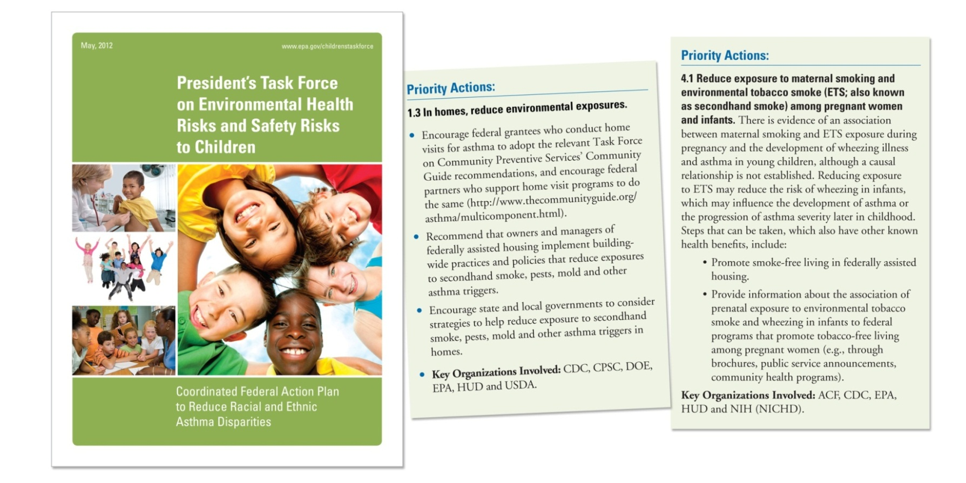
EPA’s Commitment to Addressing Health Disparities
Recommend that owners and managers of federally assisted housing implement building-wide practices and policies that reduce exposures to secondhand smoke, pests, mold and asthma triggers.
Notes:
Addressing asthma disparities is a priority for EPA.
In 2012, as part of the President’s Task Force on Environmental Health Risks and Safety Risks to Children, the EPA and federal partners, released the Coordinated Federal Action Plan to Reduce Racial and Ethnic Asthma Disparities.
A priority action of this report is to reduce environmental triggers in the home through the implementation of policies that promote healthy housing. Smoke-free policies are important for a healthy home.

Slide 8
Kara Skahen
Program Director Live Smoke Free Association for Nonsmokers-Minnesota
Notes:
We are lucky to be joined today by three presenters whose work improves the home environment for our country’s most vulnerable. To begin, I would like turn it over to our first speaker, Kara Skahen.
Kara is program director for the Live Smoke Free program, which promotes smoke-free multi-unit housing throughout Minnesota. For more than four years, Ms. Skahen has helped Live Smoke Free provide educational resources and technical support to building owners, managers, local policy makers, and residents. Kara also provides technical assistance to smoke-free housing advocates at the state and national levels. Ms. Skahen has also given numerous presentations on smoke-free housing at the local, state, and national levels. We are privileged to have her join us today.

Slide 9
Smoke-Free Multi-Unit Housing Partnering to Increase Healthy, Safe and Clean Housing Opportunities
August 5, 2015
Kara Skahen, M.S.W., M.P.P.
Program Director
Notes:
9

Slide 10
Live Smoke Free Program
A program of the Association for Nonsmokers-Minnesota.
Based in St. Paul, Minnesota.
The program has been working on smoke-free housing full time since 2007.
Educates and assists building owners, managers, local policy makers, residents and housing industry professionals on smoke-free housing issues.

Slide 11
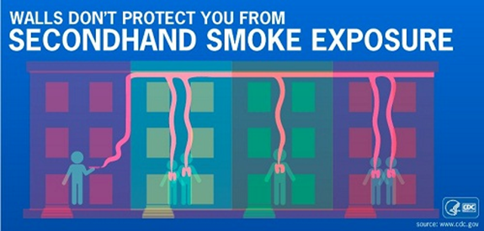
Secondhand Smoke
Secondhand smoke contains more than 7,000 chemicals, including about 70 that cause cancer.
Secondhand smoke is a known asthma trigger.
The 2006 Surgeon General’s Report concluded that there is no risk-free level of secondhand smoke exposure.
In multi-unit housing, smoke can move easily through cracks in walls, electrical systems, ventilation, etc.
Source: Centers for Disease Control and Prevention, 2015

Slide 12
Secondhand Smoke Exposure and Disparities
Exposure can be measured by testing body fluids for a biomarker called cotinine.
Exposure can cause asthma attacks, ear infections, respiratory symptoms/infections, heart disease, lung cancer and stroke.
Symptoms from exposure can limit one’s ability to lead a normal, active life.
Source: Centers for Disease Control and Prevention, 2015

Slide 13
Why Is Smoke-Free Multi-Unit Housing Important?
Residents of multi-unit housing are disproportionately
Low-wage workers, people of color, the elderly and the young
(under age 18)
Struggling with poverty, chronic disease, mental illness and chemical dependency
Exposed to secondhand smoke at disproportionately high rates
Members of these special populations often have
Limited housing options
Limited resources to move
Limited access to health care
Everyone deserves to have a
healthy, safe and clean place to call home.

Slide 14
Smoke-Free Housing Benefits
Protects priority populations from second- and third-hand smoke exposure.
Encourages people who smoke to reduce their consumption or quit.
Reduces cigarette-caused fires.
Protects housing investments.
Saves money for residents, property owners and taxpayers—smoke-free subsidized housing would save $521 million a year.
(Centers for Disease Control and Prevention, 2013)

Slide 15
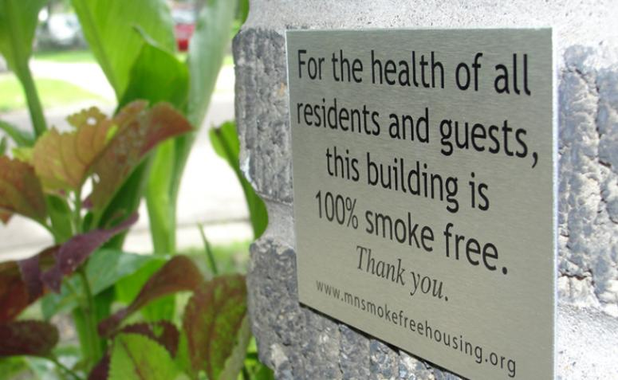
Smoke-Free Housing Is Gaining Momentum
Who is going smoke-free?
Market-rate rental properties
Affordable rental properties
Public housing
Common interest communities (condos, townhomes, cooperatives)
Smoke-free apartment buildings in the United States—
More than 600 public housing authorities
Boston, Minneapolis, Maine (statewide), etc.
Thousands of market-rate and affordable buildings
Many management companies are transitioning their entire portfolios

Slide 16
Smoke-Free Housing Is Gaining Momentum
349 members of an online global coalition of smoke-free housing advocates
Advocates include:
Public health professionals
Private nonprofit organizations
Students
Social workers
Chemical dependency counselors
Asthma programs
Nurses
Medical professionals
Researchers

Slide 17
The Asthma Community and Smoke-Free Housing Policies: A Natural Partnership!
Smoke-free multi-unit housing policies
Reduce or eliminate a common trigger of asthma in and around the home.
Promote healthy in-home behaviors.
Encourage cessation.
Improve health outcomes for children and adults with asthma.

Slide 18
Case Study: MN Department of Health
Completed a 3-year HUD-RETA (Reducing Environmental Triggers of Asthma) grant project to deliver asthma home-based services to 219 children living in low-income, multifamily housing throughout the Twin Cities.
Goals
Reduce or eliminate triggers of asthma found in the home.
Improve asthma self-management skills.
Improve health outcomes for children who have asthma.
Method 1
Conducted a series of in-home nurse visits.
Inquired about asthma triggers in the home.
Secondhand tobacco smoke was reported as a trigger for 66.7% of participants in Minneapolis.
Recommended no- or low-cost interventions that included encouraging smokers to quit and, when possible, the implementation of smoke-free building policies.

Slide 19
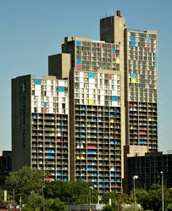
Case Study: MN Department of Health
Method 2
Funded a community partner to help successfully promote a smoke-free apartment policy in a very large, diverse apartment complex.
Results (metro-wide)—
More symptom-free children
Improved asthma control
Fewer missed school/work days
Decline in health case service use and hospitalizations
Positive return on investment
Improved quality of life for children and their families

Slide 20
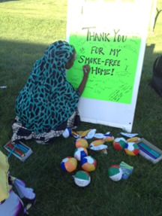
How Can I Support Smoke-Free Policies?
Be knowledgeable about the smoke-free housing and cessation resources in your area.
If available, connect clients to pre-existing programs for resources and support.
Partner with renters to promote a smoke-free policy at their property.
Local and national resources are available to help
Speak with the property manager, owner, or
Board of Directors about adopting a policy.
Track your smoke-free housing work.

Slide 21
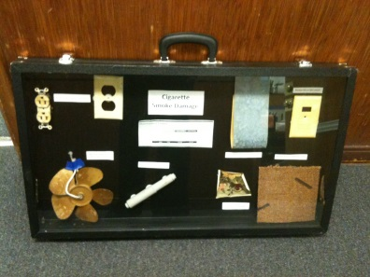
Tips for Outreach to Property Managers
Know your audience.
Market rate (not subsidized) versus affordable or
non-profit (subsidized)
Emphasize the benefits of smoke-free policies for management.
Cost savings, protected investments, reduced fire risk
Health benefits for residents and staff
Utilize testimonials and visuals.
Highlight the FREE resources available.
Offer consultations, sample materials, signage, etc.

Slide 22
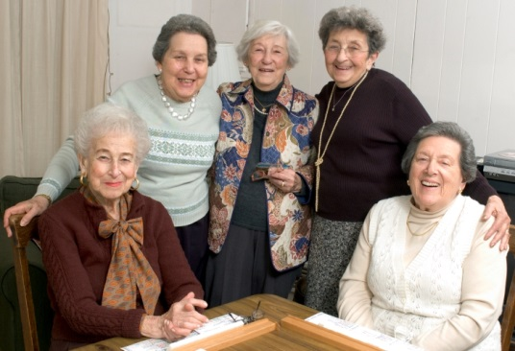
Tips for Working with Residents on Smoke-Free Policy Issues
Seek input.
Acknowledge and address resident concerns.
Be positive and compassionate.
Utilize culturally-appropriate messaging.
Provide cessation resources.
Engage social service providers and
resident associations.

Slide 23
How Can I Support the Movement?
Connect with a local smoke-free housing program.
Incorporate efforts into current work, or start a local initiative.
Participate in events that promote smoke-free policies.
Fund community partners already working on smoke-free housing initiatives.
Participate in, or create, a smoke-free housing coalition.
Distribute information about the benefits to your colleagues and broader asthma networks.
Educate property managers on healthy housing issues.

Slide 24
Connect With a Smoke-Free Housing Program Near You!
(1) Global Directory of Smoke-Free Multi-Housing Programs:
www.mnsmokefreehousing.org/organizations/Resources
(2) National Smoke-Free Housing Listserv:
Contact: tcsg@tcsg.org

Slide 25
Learn More: Free Webinars on Program Development
View archives and recorded webinars at: http://www.mnsmokefreehousing.org/organizations/archivedweb
View archives and recorded webinars at www.mnsmokefreehousing.org/organizations/archivedweb

Slide 26
Resources to Help Build Your Program
Developing a Smoke-Free
Multi-Unit Housing Program:
A Guide for Tobacco Control Professionals
www.mnsmokefreehousing.org
HUD’s Smoke-Free Housing Toolkits
for Residents, Owners and Managers

Slide 27
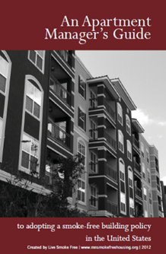
Resources for Smoke-Free Housing Advocates
An Apartment Manager’s Guide to Adopting a
Smoke-Free Building Policy in the United States
Smoking & Special Populations: Addressing Myths & Reducing Barriers to Providing Smoke-Free
Housing for Individuals with Mental Illness, Chemical Dependency or Those Who are Homeless
www.mnsmokefreehousing.org

Slide 28
Contact Information
Kara Skahen, M.S.W., M.P.P.
Program Director
Live Smoke Free: Smoke-Free Multi-Housing
Association for Nonsmokers-MN
2395 University Avenue West, Suite 310
St. Paul, MN 55114
kara@ansrmn.org
Phone: 651-646-3005 x301
Fax: 651-646-0142
www.mnsmokefreehousing.org

Slide 29
Patricia Baines-Lake
Executive Director
Lansing Housing Commission
Notes:
Thanks so much Kara.
Kara shared exciting news on the national momentum towards smoke-free housing and gave us very useful advice for how we can advocate for smoke-free housing policies.
We now have the privilege of hearing from a smoke-free champion and early implementer from the housing Community.
It is a pleasure for me to introduce Ms. Patricia Baines-Lake from the Lansing Housing Commission. Ms. Baines-Lake has worked in the field of assisted housing for more than 40 years. She became the Executive Director of the Lansing Housing Commission in 2009. Prior to joining the Lansing Housing Commission, she worked at the Detroit Housing Commission for 6 years and the Michigan State Housing Development Authority for 32 years.

Slide 30
Overview: Lansing Housing Commission
The Lansing Housing Commission manages 833 multifamily rental units. There are 5 townhouse multifamily properties, one midrise (6 stories) and 235 scattered site—single family and duplex—units.
The portfolio consists of 262 one-bedroom units, 200 two-bedroom units, 242 three-bedroom units, 97 four bedroom units and 32 five-bedroom units.

Slide 31
Why a Smoke-Free Policy?
The Lansing Housing Commission was motivated to develop a smoke- free policy in its public housing properties to address the—
Adverse health effects of smoking
Improve the internal unit environment
Reduce the adverse effects smoking has on people with asthma (particularly children) (as highlighted by the Healthy Homes Grant)
Address the disproportionate adverse affects smoking has on low- income households
Unit turn costs
Operating costs
HUD encouraged Public Housing Agencies to adopt a smoke-free policy
Prevent fire damage

Slide 32
What Is the Lansing Housing Commission Smoke-Free Policy?
Effective July 1, 2011, smoking was prohibited in all property owned and operated by the Lansing Housing Commission (“LHC”).
The Policy applies to 100% of LHC’s portfolio.
The Policy was first introduced during our Annual Plan Process. Comments were received from the public that included concern about ability to stop the addictive behavior and evictions.
The smoking ban is intended to improve the quality of air and the safety of residents and employees.
Smoking is only permitted in specifically designated outside areas.
Smoking outside of LHC-owned buildings shall be permitted only in designated smoking areas, which shall be at least 15 feet from a door, walkway, window or ventilation system.

Slide 33
What Is the Lansing Housing Commission Smoke-Free Policy?
The policy became effective 1 year after Board approval.
LHC partnered with the State of Michigan Health Department to offer smoking cessation classes.
In addition to classes, interested parties were connected to free options for receiving smoking cessation medical support, including patches.
An additional highlight extends to the exterior of buildings and states:
“Smoking outside of LHC owned buildings shall be permitted only in designated smoking areas, which shall be at least 15 feet from a door, walkway, window or ventilation system. In addition, smoking areas shall be located sufficient distances from the buildings and walkways so that secondhand tobacco smoke does not enter the buildings and to ensure residents and guests can avoid walking through secondhand tobacco smoke to enter or leave LHC owned properties.”
The Policy will be expanded to specifically address—
E-cigarettes
Marijuana (currently addressed in our drug prohibition policy)

Slide 34
Enforcement Approach
LHC’s Policy states—
Employees and residents who smell tobacco smoke from the inside of LHC-owned buildings are to report this to the office as soon as possible. LHC’s management staff will identify the source of the smoke and take appropriate action when deemed necessary.
Each resident signs a copy of LHC’s Smoke-Free Policy, which states—
TENANT CERTIFICATION
I have read and understand the above smoking policy and I agree to comply fully with the provisions. I understand that failure to comply may constitute reason for termination of my lease.
We approach enforcement by—
Providing options to eliminate the unacceptable behavior
Educating the residents of LHC properties
Site Managers issuing verbal then written warnings

Slide 35
Enforcement Approach
LHC seeks to avoid evictions whenever possible by using a combination of the following—
Meeting with the court to educate the judges on the policy
Meeting with Legal Aid to explain the policy objective
Arriving at court-ordered solutions. For example, in conjunction with Legal Aid, we reached an agreement with a resident who scrubbed their walls and agreed to stop smoking in their unit, and a community group repainted the unit as the settlement.
As a last resort, LHC evicts policy offenders. Three households have been evicted because of smoking violations.

Slide 36
What Is Working
The policy has been effective because of resident and staff support of the policy.
Residents quickly realized the importance of Heathy Smoke-Free Homes based on education provided by the State Department of Health and a Healthy Homes Grant.
Children became the champions of the Policy because they want to live healthily.
LHC has assessed the effectiveness of the policy for all properties by—
The reduction in rehab costs
Observing ashtrays are largely a decorating phenomena of the past
Declining complaints regarding tobacco smoke

Slide 37
1st and 2nd Hand Smoke Is a Public Health Threat
Why Is Smoke-Free HOUSING Important?
HEALTH BENEFITS
The State of Michigan’s Health Department indicates smoking adversely affects children and adult health outcomes, specifically:
Children and adults with asthma;
Respiratory challenges; and
Allergies.
Living in a smoking environment increases hospital stays and hospital readmissions.

Slide 38
1st and 2nd Hand Smoke Is a Public Health Threat
The Lansing Housing Commission (“LHC”) entered into a contract with the Department of Public Health to provide services for households adversely affected by asthma approximately 5 years ago.
The Health Department enlightened LHC on the adverse health consequences smoking has on asthma suffers. The Department of Health—
Encouraged LHC to adopt a smoke-free policy;
Spoke in favor of adoption of the smoke-free policy at LHC’s board meeting; and
Provided data to residents and the board on the adverse health effects of 1st and 2nd hand smoking.

Slide 39
1st and 2nd Hand Smoke Is a Public Health Threat
LHC has benefited from the partnership with public health, and citizens have also benefited. The policy has been effective because of resident and staff support of the policy.
Residents quickly realized the importance of Heathy Smoke-Free Homes based on education provided by State.
Children became the champions of the Policy because they want to live healthily;
Department of Health and a Healthy Homes Grant.
Residents are more educated about smoking hazards.
Residents have embraced smoke-free policy.
Residents report violators.
LHC has assessed the effectiveness of the policy for all properties by:
The reduction in rehab costs.
Observing ashtrays are largely a decorating phenomena of the past.
Declining complaints regarding tobacco smoke.

Slide 40
Property Managers State: “Smoking inside of buildings is costly.”
The cost of turning a unit and maintaining a unit with an occupant who smokes is costly.
Employees are adversely affected by 2nd hand smoke, resulting in absenteeism.
It costs twice as much—sometimes 75% more—to rehab a unit occupied by a smoker.
It is more difficult to rent a unit previously occupied by a smoker.

Slide 41
Benefits of Smoke-Free Living
Nonsmoking and smoking residents support the Smoke-Free Policy.
The cost of unit turns has been reduced more than expected. LHC has reduced the cost of painting and unit prep (reduction = $1500–$2,000 per unit) since the nonsmoking policy went into effect.
LHC has a long-term partnership with the State Department of Health which results in green approaches to extermination and maintenance.
Children with asthma residing in LHC properties have free access to public health resources.
Children who live in a smoke-free environment have less allergic and breathing issues.
Residents of high rise buildings can exit and enter free from exposure to secondhand smoke.

Slide 42
Why Should You Support Smoke-Free Housing
Smoking adversely affects everyone! Those who do not want to breathe smoke, taxpayers and children! You can help to reduce the public health impact of smoking by policy changes and advocacy. Nonsmoking policies have positive results:
Healthier citizens
Fewer hospitalizations
Shorter hospital stays
Less costly medical expenses
Lower operating expenses

Slide 43
Contact Information
Patricia Baines-Lake
patbl@lanshc.org
517-372-7996

Slide 44
Amy Moore
Certified Prevention Specialist
Ingham County Health Department
Notes:
Thank you, Patricia.
“LHC benefited from partnerships and the policy has been effective because residents and staff support it.” I think this is a very profound statement and is one I hear time and time again. Community programs play a large role in helping to foster this support and understanding.
Our next speaker is Amy Moore. Ms. Amy Moore has worked in drug prevention for 25 years and is a certified prevention specialist. Ms. Moore runs prevention program for the Ingham County Health Department in Lansing, Michigan. She has worked at the Ingham County Health Department for 20 years, and before that was at the American Cancer Society. Ms. Moore became passionate in addressing the topic of smoke-free multiunit housing when she was approached by the mom of an asthmatic infant, to help her after her baby was hospitalized twice from smoke exposure by an apartment neighbor.

Slide 45
Ingham County Health Department
Located in Lansing, Michigan, and covers the seventh largest population center in Michigan
Federally qualified health center (FQHC)
Runs 12 medical clinics and supports 16 different languages
Preferred refugee community and serves a large and diverse refugee population
Clinics serve more than 20,000 clients per year and public health division serves the entire community
Agency has made it a priority to alleviate the burden of preventable chronic conditions and high ER utilization rates

Slide 46
Property Management Outreach Suggestions
Assess data using RentLinx website advanced search.
Compare market-rate, subsidized, elderly and disabled.
Intervene with property management coalitions.
Create targeted strategies using community feedback and data.

Slide 47
Smoke-Free Housing; Legal and Easier Than You Thought!
Is it legal?
Will I lose tenants?
How is it enforced?

Slide 48
What Resonates With Housing Providers: Tobacco Use Trends 2010 Smoking Rate in the Capital Area
Notes:
Capital Area: Smoking Status. 55.8% Non-Smoker. 22.5% Former Smoker. 21.8% Current Smokers.

Slide 49
What Resonates With Housing Providers: Tobacco Use Trends 2010 Smoking Rate by Education
Notes:
28.7% Less than high school; 28.3% High school graduate; 21.4% Some college; 11.6% College degree or more

Slide 50
What Resonates With Housing Providers: Tobacco Use Trends 2010 Smoking Rules in the Home
Notes:
Capital Area: Clinton, Eaton and Ingham. 74.9% No smoking ever in home; 10.6% No rules about smoking in my home; 8.1% Smoking allowed in some place or some times; 5.8% Smoking is always allowed inside my home.
Question is: Which Statement best describes the rules about smoking inside your home? Do not include decks, garages or porches.

Slide 51
What Resonates With Housing Providers: Tobacco Use Trends Smoking in Home by Smoking Status
Notes:
Smoking in the home: 2.1% Non-smokers; 1.7% Former Smokers; 15.7% Current Smokers

Slide 52
Public Health Partnering With Asthma Programs
Promotion of cessation opportunities
Other common interests, such as bedbug presentation, pest management, walking programs and insurance enrollment
Case management/patient navigation
Attorney General opinion: medical marijuana laws

Slide 53
Contact Information
Amy Ann Moore
Certified Prevention Specialist
Ingham County Health Department
amoore@ingham.org
517-887-4586

Slide 54
Additional Resources
RentLinx website: www.rentlinx.com
MISmokeFreeApartments website: www.mismokefreeapartment.org
“Model Lease Provisions” in the AsthmaCommunityNetwork.org Resource Bank
“Smoke-Free Air Law: Attorney General Opinion” in the AsthmaCommunityNetwork.org Resource Bank
“Smoke-Free Housing; Legal and Easier Than You Thought!” in the AsthmaCommunityNetwork.org Resource Bank

Slide 55
Breathing Easy at Home: Partnering to Increase Smoke-Free Policies in Federally Assisted Housing
Conclusion of the Webinar
Moderator: Rachel Cumberbatch, AAAS Science & Technology Policy Fellow, U.S. EPA
Presenters:
Kara Skahen, Program Director, Live Smoke Free, Association for Nonsmokers-Minnesota
Patricia Baines-Lake, Executive Director, Lansing Housing Commission, Michigan
Amy Moore, Health Educator, Ingham County Health Department, Michigan
Notes:
Thank you to our fantastic speakers and to you for joining us today for this informative webinar!
Please be on the lookout for a brief feedback survey in your email inbox following the webinar.
It will take only five minutes to complete the survey, and it will greatly help us in planning our future webinar activities.
We look forward to seeing you in the discussion forum on AsthmaCommunityNetwork.org in just a minute!

