Slide 1
Promoting Sustainability for Community Health Worker-led Asthma Home Visiting Lessons from the New England Asthma Innovations Collaborative
Presented at the North Carolina Forum on Sustainable In-Home Asthma Management
Stacey Chacker
September 13, 2016
NEIAC is an initiative of Health Resources in Action’s Asthma Regional Council of New England

Slide 2
New England Asthma Innovation Collaborative Controlling Asthma, Controlling Costs
NEAIC is a project of the Asthma Regional Council of New England, a program of Health Resources in Action
Established in July 2012 with a $4.2 million Award from Centers for Medicare and Medicaid Innovation.
The project (NEAIC) described was supported by Grant Number 1C1CMS331039 from the Department of Health and Human Services, Center for Medicare & Medicaid Services. The contents of this publication are solely the responsibility of the authors and do not necessarily represent the official views of the U.S. Department of Health and Human Services or any of its agencies.

Slide 3
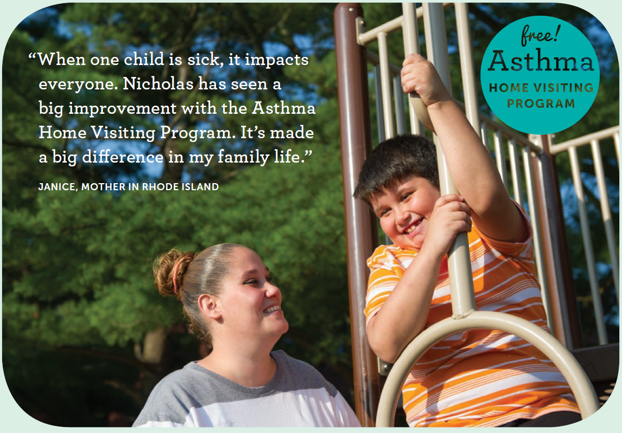
New England Asthma Innovation Collaborative Goals and Partners
For children with poorly controlled asthma:
Improve quality of care
Improve health and quality of life outcomes
Decrease health care utilization costs
Advance sustainable payment systems
In four states:
Nine Health Care Providers
Policy and Training Partners
Seven Medicaid Payers
MMCOs
State Medicaid Offices

Slide 4
NEAIC Intervention: CHW- Led Asthma Home Visits
1145 participants from January 2013 – June 2015,
Assess patients’ needs and home environment
Provide asthma self-management education
Deliver cost-effective environmental supplies
Improve quality and experience of care:
Client-centered, use of motivational interviewing
Promote asthma action plans
Promote connections to primary care & prevention
Referrals for social services
Target Population
Aged 2 – 17 years old
Medicaid or CHIP beneficiary
A diagnosis of asthma from an authorized clinician
Poorly controlled asthma

Slide 5
Community Heath Workers
Frontline public health worker
Understanding of the experience, language, and/or culture
Liaison between healthcare and community
Culturally competent service delivery
Advocate for individual and community needs.
Peer education
Social support and advocacy
Access to services

Slide 6
Evaluation
Intervention: home visit / follow-up phone call data
Caregiver self-report (44Qs)
- 1st, last home visit, 6, 12 mos.
Environmental observations (36 items)
- 1st & last home visit
Parent/Guardian focus groups
Claims and encounter data:
All claims
12 months pre/post
Comparison population from claims
Health Resources in Action

Slide 7
The Intervention Works!
Data from home intervention shows
Improvements to the home environment
Improved Quality of Life
Improved Asthma Control
Decreased number of ER visits, number
and length of hospital stays = cost savings!
Parent, “my son hasn’t been to the
hospital in eight months!” and
“I don’t know why health insurance doesn’t pay for this!”
Health Resources in Action

Slide 8
Health Care Utilization – Caregiver Report
Note: For each health care utilization measure, differences between time intervals are statistically significant (p <.05*).
Health Resources in Action

Slide 9
Missed Work & School Days Due to Asthma Caregiver Report
“He missed 20-30 days of school a year before the program. He hasn’t missed any school since the program.” – Focus Group Participant
Note: Differences between time intervals are statistically significant (p =.000*).
Health Resources in Action

Slide 10
Asthma Control and Environmental Triggers
Asthma Control Categories | Cumulative
 | Visit 1 | Visit 3
Well controlled | 22.9% | 51.0%
Not well controlled | 45.3% | 39.1%
Very Poorly controlled | 31.7% | 9.9%
Environmental Factor | Cumulative
 | Visit 1 | Visit 3
Mold | 46.6% | 34.2%
Pests | 36.1% | 25.6%
Smoke | 36.6% | 25.8%
Pets | 31.3% | 32.7%
Chemicals | 84.3% | 48.2%
Dust | 69.0% | 38.4%
Environmental Factor | Cumulative
 | Visit 1 | Visit 3
Mold | 46.6% | 34.2%
Pests | 36.1% | 25.6%
Smoke | 36.6% | 25.8%
Pets | 31.3% | 32.7%
Chemicals | 84.3% | 48.2%
Dust | 69.0% | 38.4%
Environmental Factor | Cumulative
 | Visit 1 | Visit 3
Mold | 46.6% | 34.2%
Pests | 36.1% | 25.6%
Smoke | 36.6% | 25.8%
Pets | 31.3% | 32.7%
Chemicals | 84.3% | 48.2%
Dust | 69.0% | 38.4%
Note: Differences between time intervals are statistically significant (p =.000*).
Notes:
Additionally, there have been improvements in all of the environmental factors measured by the CHWs during the first and last home visit. The presence or absence of the six environmental factors measured is used to calculate a composite environmental score, this is on a scale of 0-6. The mean environmental composite score at home visit 1 is 3.01, at home visit 3 the score is reduced to 2.32. This decrease is statistically significant (p <.05). The determination of the dust score has been altered slightly this quarter so that it matches how the MA Department of Public Health calculates the presence of dust. The presence of dust is measured as: None, Slight, Moderate, or Heavy; previously we had turned this into a binary result with only Moderate and Heavy dust prompting a presence of dust. The score now includes Slight dust as a positive presence as well.
There have been improvements to several intermediate factors that may explain the reported decreases in health care utilization. From home visit 1 to home visit 3 NEIAC participants have seen statistically significant improvements in asthma control scores. Although there has only been a subtle change from visit 1 to visit 3 for those in the “not well controlled” category, by the end of the intervention, over 50% of participants have “well controlled” asthma compared to 20% before the intervention. The “poorly controlled” category decreases to only 9.9% at the last home visit.

Slide 11
Preliminary Economic Evaluation
Claims and Encounter Data shows Decreases:
90% in asthma-related ER visits (26% greater than comparison)
60% in overall ER visits (14% greater than comparison)
80% in use of oral corticosteroid (23% greater than comparison)
$1104 in total health care costs
Note: These results have not been verified by CMMI’s evaluator, and are based on
six months pre-post for 51 patients
Final economic analysis for 12 months
pre-post in progress. Anticipate
data for 600 patients.
Health Resources in Action

Slide 12
Other Program Benefits
Better understanding of asthma and asthma meds
Increase of use of Asthma Action Plans
High caregiver satisfaction
Families receive referrals for social services
Benefits may extend to all household members from participation
Health Resources in Action

Slide 13
Payers as Partners
Invite/recruit early in process - start with Medical Directors
Outline problem and program goal
Emphasize possible benefits – e.g.
Members receive high-quality services, reducing utilization
Capacity built in payer’s service area
May compliment payer’s case management services
Payer gets data on health outcomes, quality of life and cost
Recognition
Specify the “ask” – e.g.
Meetings
Claims data
Referrals
Discussing piloting new payment models and policy change

Slide 14
Securing Claims and Encounter Data
Health economist: specify data needed & time period.
NEAIC request: All claims and encounter data for all pediatric patients ages 2 – 17 years old with diagnosis of asthma – for intervention population and to develop comparison group
Assure HIPAA compliant environment
Develop secure data transfer protocols
Be sure to include all which will need access to data (for NEAIC – CMS)
Patient Consent Forms – specifying purpose for sharing data, and entities it will be shared with.

Slide 15
Securing Claims and Encounter Data
Work with Payer Compliance Offices to determine and draft necessary agreements (usually Data Use Agreements (DUA)); budget for legal review.
Develop specifications.
Comparison group (beware of other existing interventions that may impact findings)
Remind payers in advance for data draw.
Review all data for completeness as soon as receive.
Be prepared to negotiate and problem solve.
Relationship building is important and ongoing!

Slide 16
NEAIC Payer Assessment
Purpose: To gain a better understanding of:
Factors important to payers when considering providing/paying for home-based asthma interventions
Views about supporting CHWs as part of clinical teams for asthma

Slide 17
Assessment Key Findings
New England Payers are receptive to asthma home visiting programs and CHW workforce. Need assurances of standards in training and qualifications.
Payers and providers both need information re: CHW field and how to implement the pediatric asthma intervention effectively.
Priority for evidence needed to promote financing:
Cost-benefit and improved health outcomes.
Need, especially among a payers’ membership
Impact on QI measures and patient satisfaction.

Slide 18
Factors Influencing Decision Making for
Reimbursement of Asthma Home Visiting
Evidence of clinical effectiveness and an adequate cost-benefit ratio are central.
Cost alone will not drive the decision.
Improvements in health care quality, patient experience of care, and meeting HEDIS measures important.
Compelling if clinical improvements and savings are shown for payer’s members or service area and linked to evidence of need.
Notes:
Benefit –Cost ratio are central to making a case for coverage of any new service to both public and commercial payers.
Cost-benefit analyses provided for high utilizers would be especially helpful, given the concerns payers expressed about shrinking Medicaid budgets and competing demands for new services.
Medication adherence is a new HEDIS quality measure for asthma care. ‘slight’ increase in expenses would not weigh heavily if the intervention improved care.

Slide 19
Other Learnings
Accountable Care Organizations or “Provider-led Entities” (aka Providers) - becoming key decision makers in coverage of services
Payers and/or ACOS may “buy” or “build” services
In-home interventions may benefit a family – promote, and if possible measure.
Emphasize - Social Determinants of Health
Deploy “right size” intervention – based on risk
Notes:
Benefit –Cost ratio are central to making a case for coverage of any new service to both public and commercial payers.
Cost-benefit analyses provided for high utilizers would be especially helpful, given the concerns payers expressed about shrinking Medicaid budgets and competing demands for new services.
Medication adherence is a new HEDIS quality measure for asthma care. ‘slight’ increase in expenses would not weigh heavily if the intervention improved care.

Slide 20
Pursuing Sustainable Financing and Spread
Current sustainability and spread:
Community benefits
Departments of Public Health
Donor funding
MMCO
Boards of Health
Continuing efforts/opportunities:
Accountable Care Organizations
CDC 6|18 Initiative
MMCO
1115 Waivers
Delivery Systems Reform Incentive Payment Programs
Pay for Performance (or Social Impact)
Health Resources in Action
Notes:
MCO’s have flexibility: Short term contracts, pilot projects, policy change.
Accountable Care Organizations/Accountable Health Communities
Community Benefits funding
Payment models: a) bundled payment or enhanced FFS payment; b) “case rate”; c) partial Accountable Care Organization/FFS model (shared risk – as part of global or capitated payment ); d) global payments.
Chronic Care Teams (VT)

Slide 21
Questions and Thank You!
Stacey Chacker, Co-PI Project Director schacker@hria.org
Heather Nelson, PhD, MPH, Co-PI and Evaluator
hnelson@hria.org
“The project described is supported by Grant Number 1C1CMS331039 from the Department of Health and Human Services, Centers for Medicare & Medicaid Services. The contents of this publication are solely the responsibility of the authors and do not necessarily represent the official views of the U.S. Department of Health and Human Services or any of its agencies.”

