Slide 1



Reducing Asthma among Rural and Underserved Populations in Eastern NC
Greg Kearney, DrPH, MPH, REHS
Assistant Professor
East Carolina University,
Department of Public Health, Brody School of Medicine
Theresa Blount, RN, BSN, AE-C
Asthma Coordinator, Pediatric Asthma Program
Vidant Medical Center
North Carolina Forum on Sustainable In-Home Asthma Management
North Carolina – State of the State and Open Discussion
William Friday Center - UNC
September 13, 2016

Slide 3
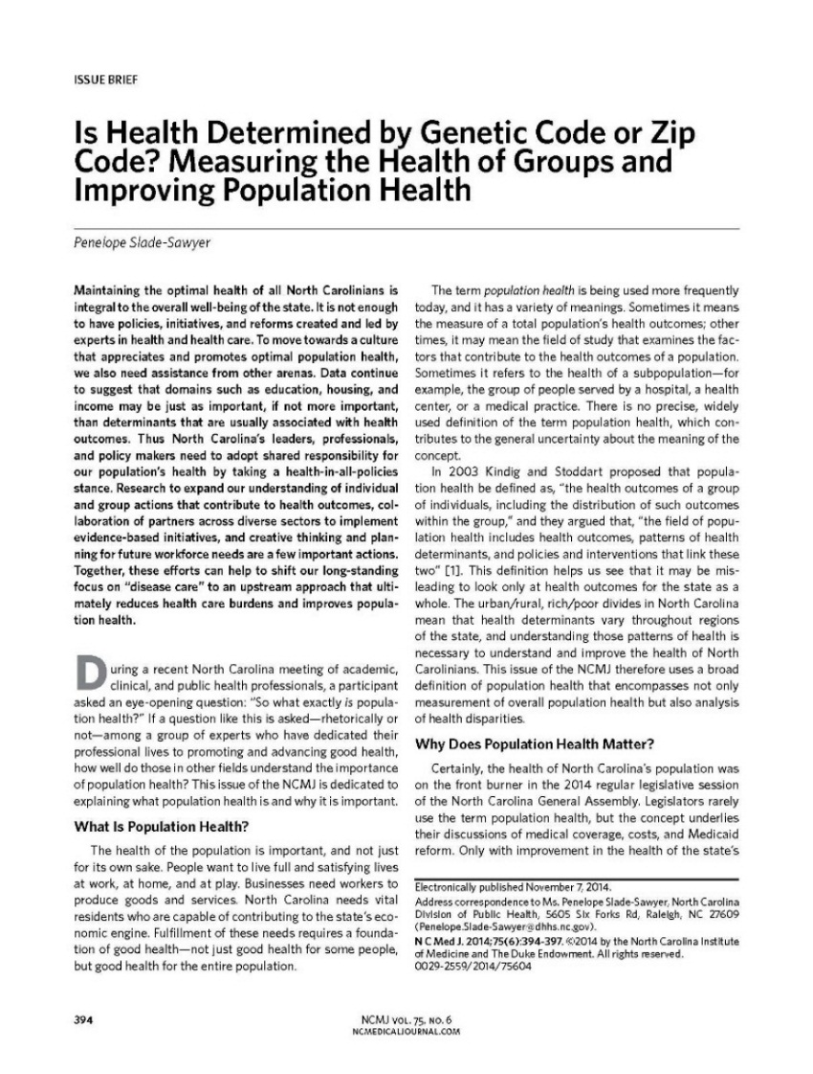

Take a few seconds to reflect on “The River” story
References:
Slade-Sawyer P. ,2014. North Carolina Med Journal
TIME Wednesday, Jan 06, 2010

Slide 4
Our Story
The Eastern Carolina Asthma Prevention Program (ECAPP) developed as a community based, collaborative research project in 2012 between an environmental public health professor at East Carolina University and Peds Asthma Program at Vidant Medical Center in Greenville, N.C.
Our Goal
Reduce asthma and asthma symptoms among rural, low income families that have children with moderate to severe asthma (age 5-17 years) in Eastern North Carolina.
What We Do
Focus on children (5-17 years) with moderate to severe asthma.
Our emphasis is on education and prevention with a research component.
We use targeted, multi-component intervention strategies – Kings County, Seattle WA model.
Follow NHLBI guidelines to reduce environmental exposures
Provide guidance and resources to help ﻿families that have children with asthma.
Work to improve respiratory health, reduce emergency department visits of children with asthma in Eastern N.C.
Conducted over 50 individual home-based visits - Reference:
Kearney GD, Johnson LC, Xu X, Balanay JA, Lamm KM, Allen DL. Eastern Carolina asthma prevention program (ECAPP): An environmental intervention study among rural and underserved children with asthma in Eastern North Carolina. Environ Health Insights. 2014;8:27-37.

Slide 5
Our Target Area
The 29-County region in eastern North Carolina; Our primary emphasis has been on African-Americans in rural and underserved areas.
Funding Sources:
East Carolina University (Community Partnership) - $8,000 – Develop Program (ECAPP)
Vidant Medical Center, Edgecombe - $9,500 – Asthma Interventions
Vidant Medical Center - Pitt - $5,000 – Asthma Interventions
Brody School of Medicine - $43,500 - Indoor Air Testing, Personal Monitors, Bio-markers (N=25)
Recent Additions to ECAPP
Development of the Eastern Carolina Asthma Consortium (ECAC)
Sampling Indoor Environments

Slide 6
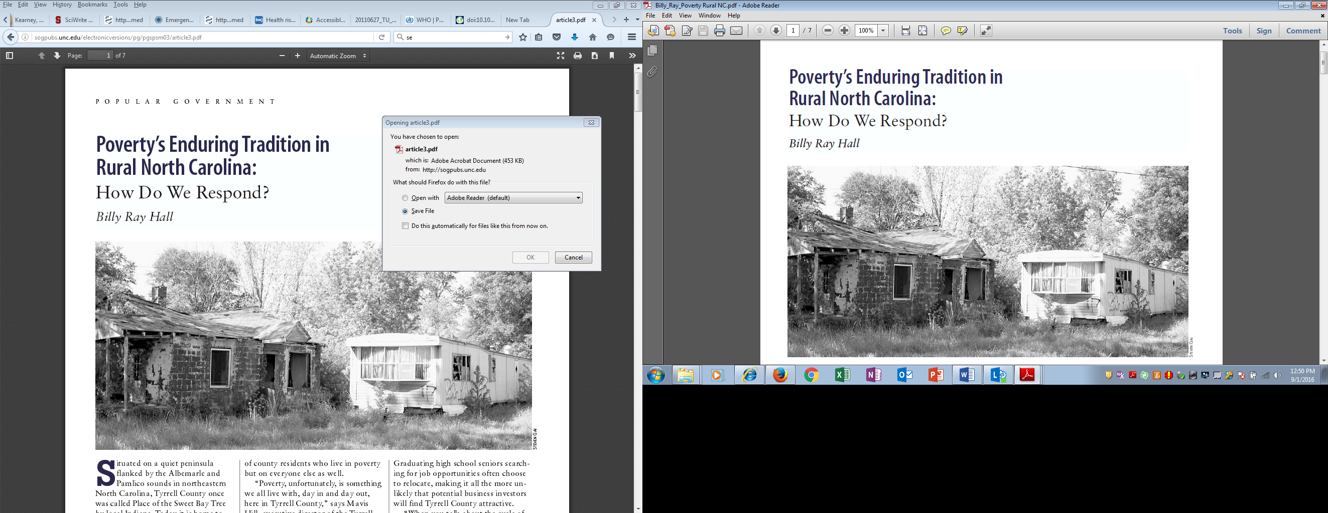
Hall BR, Popular Government Spring/Summer, 2003 http://sogpubs.unc.edu/electronicversions/pg/pgspsm03/article3.pdf
Fewer than 49% of rural NC are homeowners

Slide 7
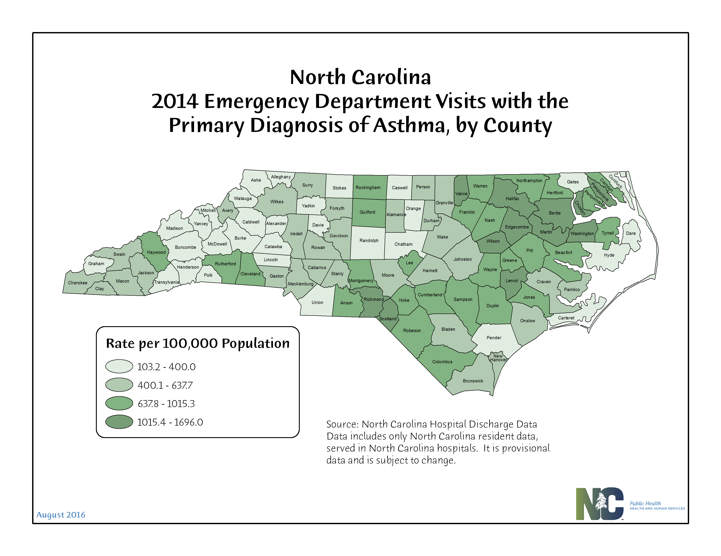
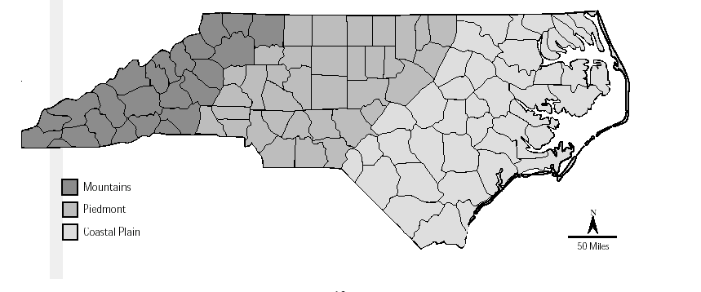

Slide 8
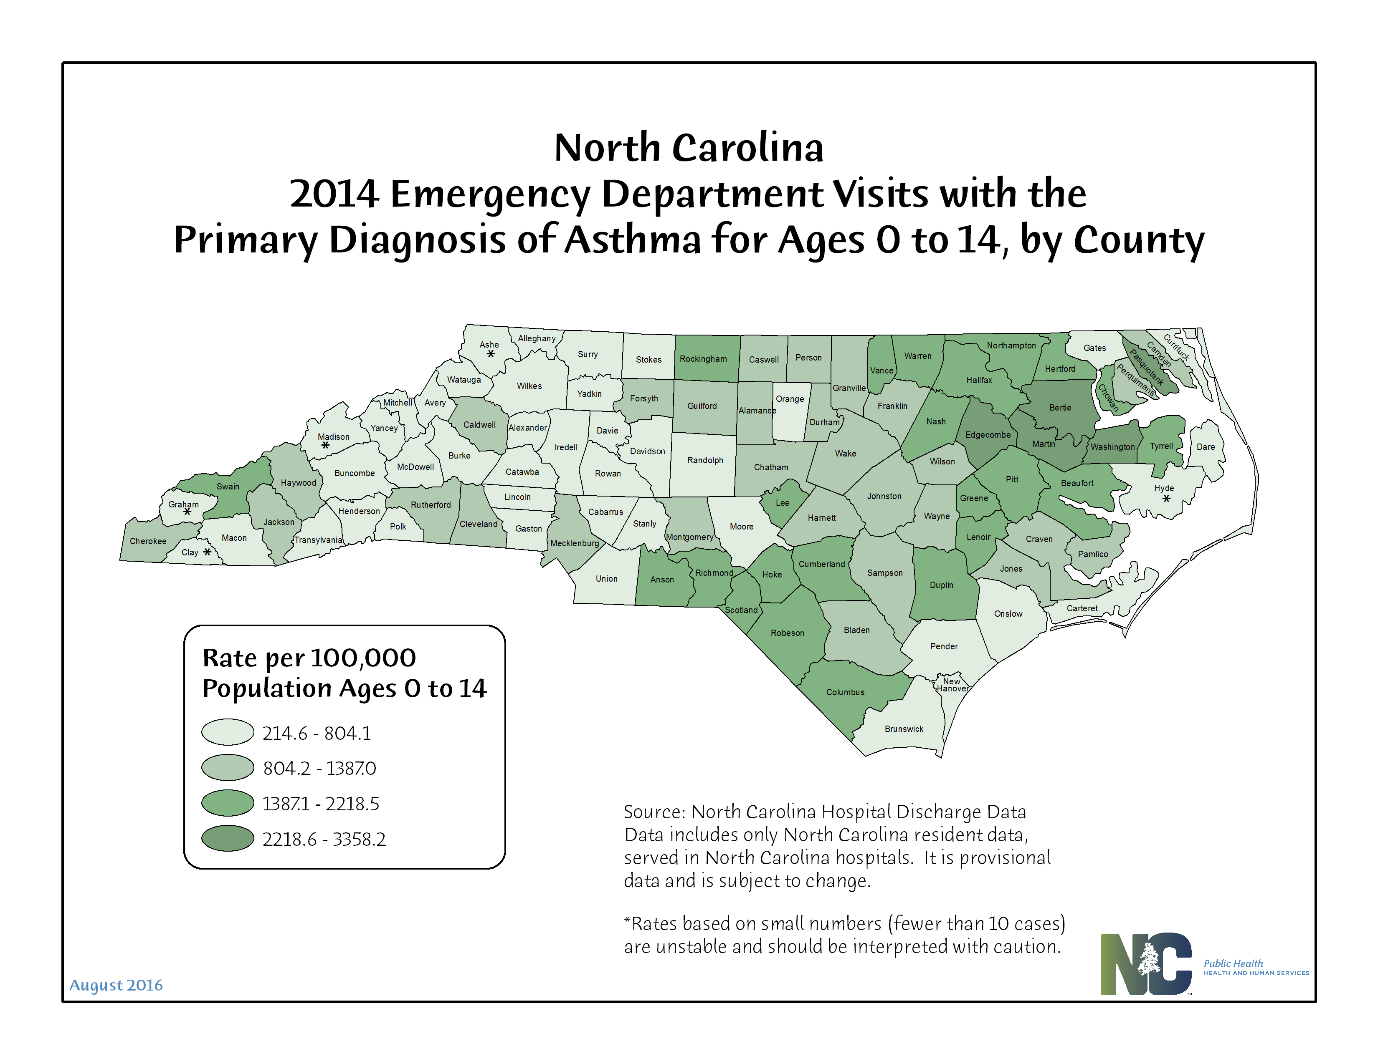

Slide 9


Slide 10
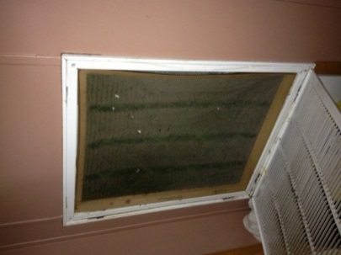
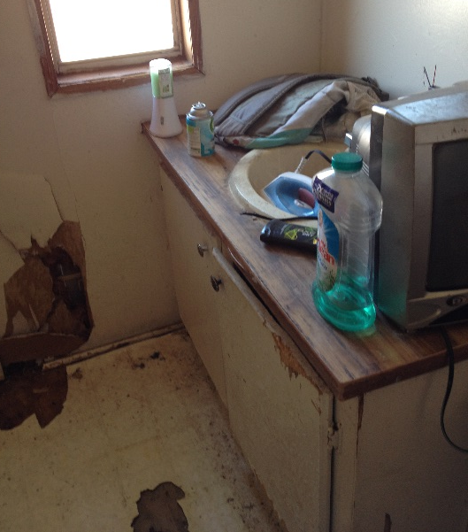
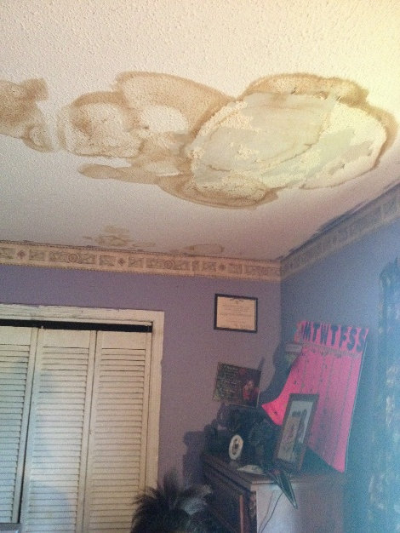
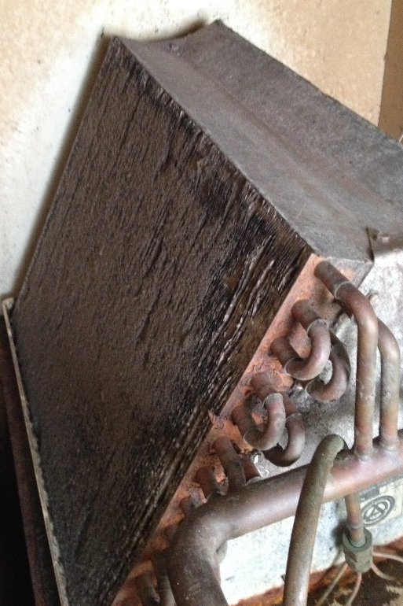
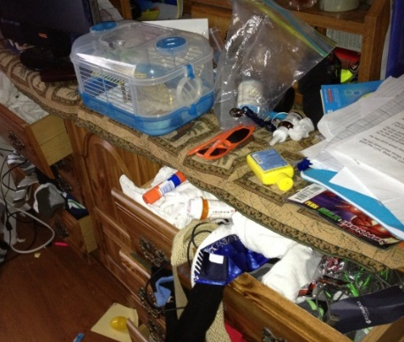
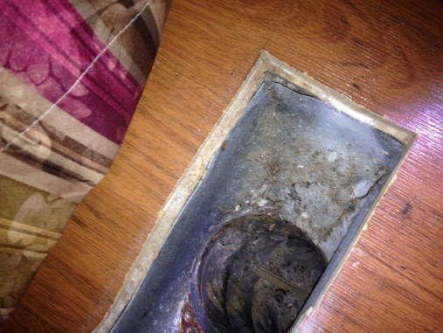
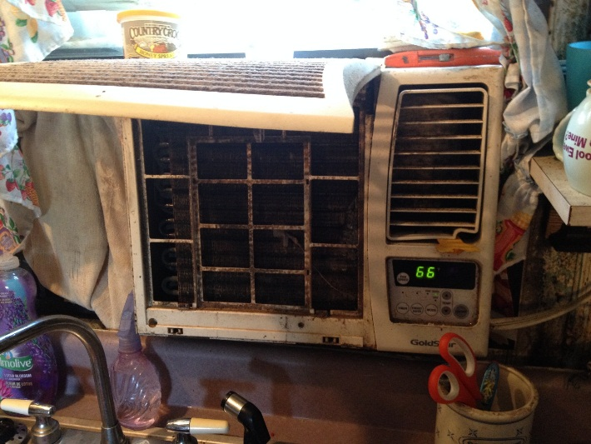
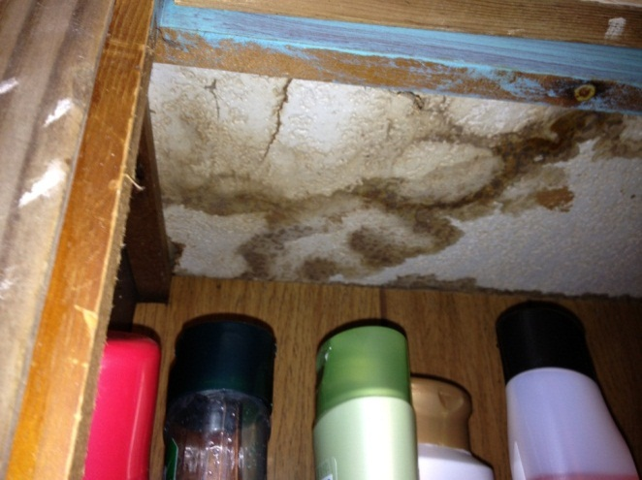

Slide 11
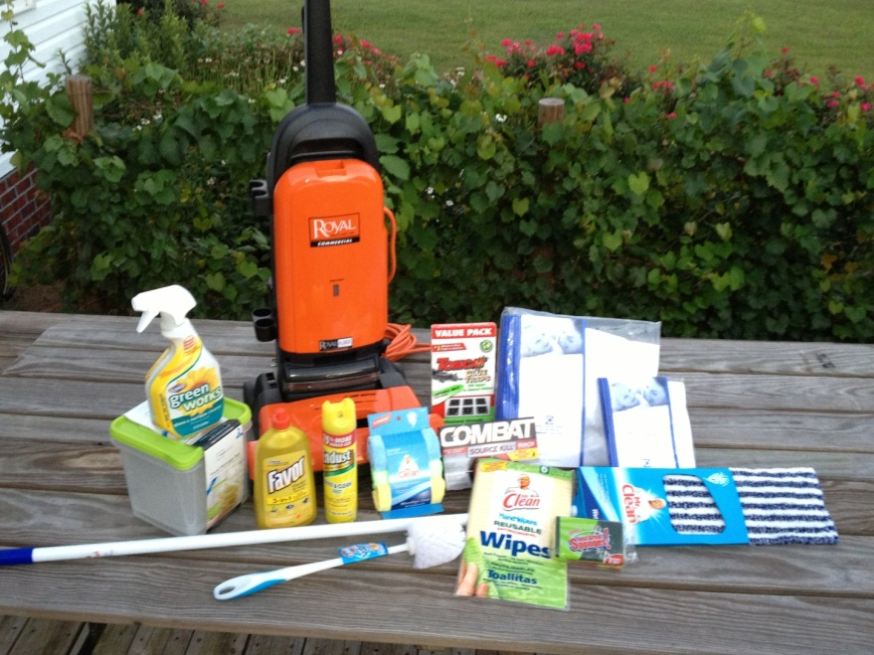
“Environmental” Products to reduce Indoor Allergens
Products:
Commercial grade Vacuum with HEPA filter
Non-allergen mattress /pillow encasings (fit to child’s bed)
Toxic “free” cleaning products
Non-odor, non-toxic, pesticides and rodent baits*
Food storage containers
*In some cases commercial pesticide/cleaning services were used
Notes:
Lisa

Slide 12
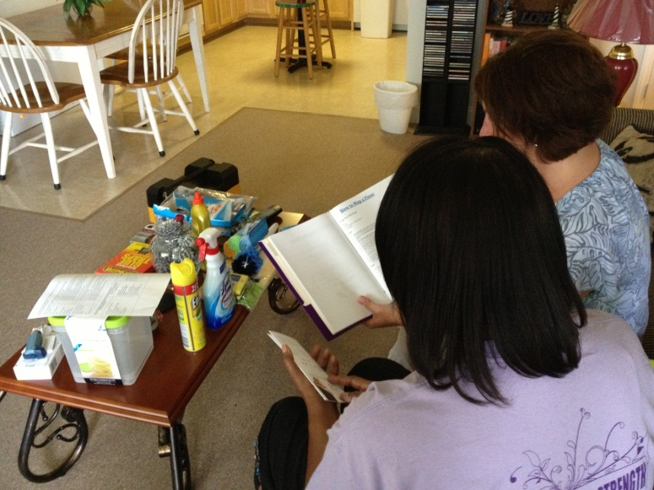
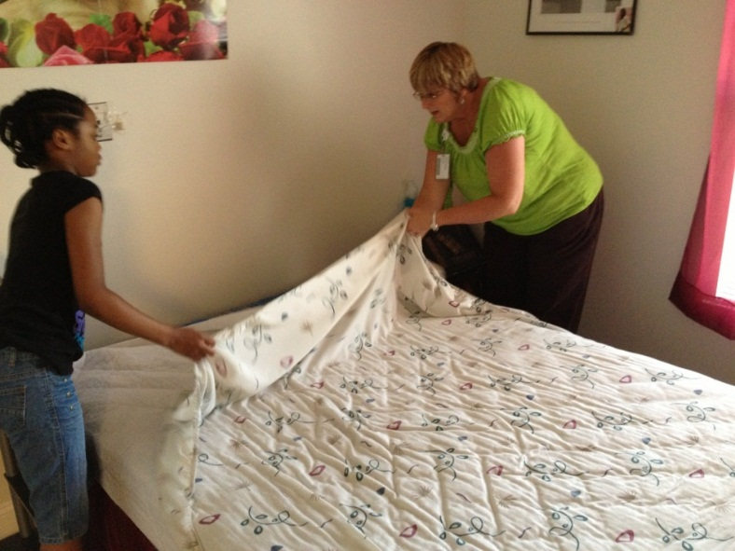
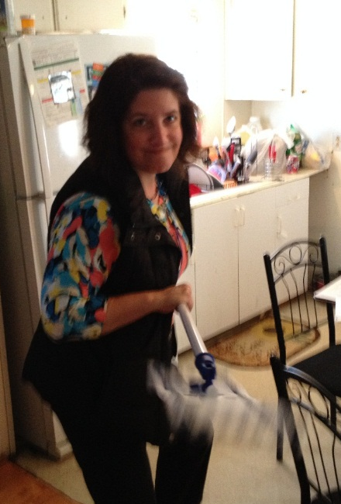
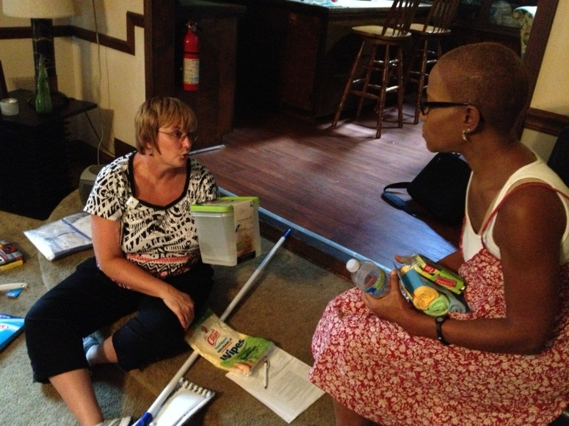
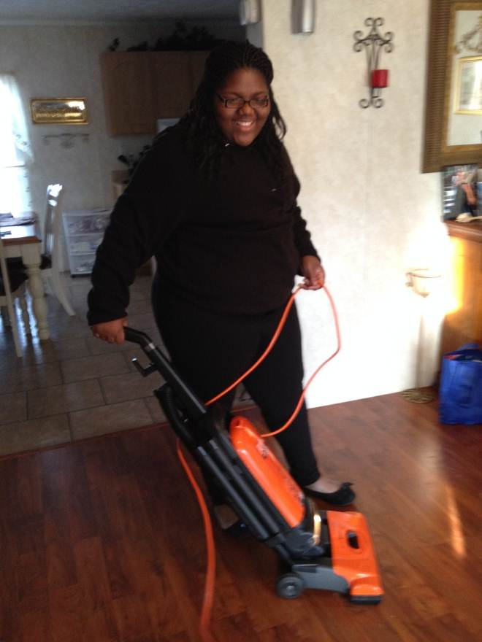
Intervention: Personalized Instructions ,Education and
Demonstrations on Using Products
Notes:
Lisa

Slide 13
Reduced cost savings –
Our cost $440-$500 per family for 2 scheduled home visits (included all products);*
Avg ED visit costs = $691 and In-patient stay = $7,987**
Other benefits: Fewer visits to ED, Physician office visits; fewer missed school and work days and less financial and emotional burden on child and family
* Does not include vacuum cleaner; For vacuum cleaner, add ~$170 (includes HEPA filter bags)
**Hoppin P, Jacobs M, Sillman L. Asthma Regional Council (ARC). Investing in Best Practices for Asthma: A Business Case. Available from: http://hria.org/resources/reports/asthma/best-practices-for-asthma-2010.html.

Slide 14
Eastern Carolina Asthma Prevention Program (ECAPP) Average Products and Service Costs (1 family/child enrolled for 6 months) for 2 home visits (12/2015)
Product/Service | Count | Cost
Travel (home visit) | 20 miles X 2 Trips X.59/mile | $23.60
Staff Time - 1 nurse & 1 Env. Health Specialist | 2 staff @ 3 hrs. (includes benefits) | $300.00
Dust Mite Mattress encasing (full size) | 1 | $31.97
Dust Mite Pillow encasing | 1 | $4.95
Toxic-Free Cleaning Products
Floor cleaner | 1 | $3.00
Mice baits | 8 (box) | $7.99
sponges | 8 (box) | $1.19
microfiber mop | 1 | $7.50
Roach baits | 5 (box) | $4.50
Lysol | 2 (cans) | $2.25
Dust cloths | 3 (pouch) | $3.00
Furniture polish | 1 (can) | $3.50
Counter-top Disinfectant | 1 (can) | $1.50
In-home Tests
Exhaled Nitric Oxide Test (eNO) for inflammation | 2 (times) | $19.00
Spirometry Test | 2 | N/C
Mouth Pieces for eNO | 2 | $1.60
Mouth Pieces for spirometry | 2 | $1.80
Nose clips | 2 | $0.60
Asthma Educational Material Printing Costs | 1 packet | $7.50
Gift Card (incentive) | 1 store card | $20.00
Total Costs |  | $ 443.65
Notes:
These are detailed costs.

Slide 15


Slide 16
Kennedy, K. Business NC, July 2016.

Slide 17
Strengths & Challenges
What worked
Reduced ED visits and unscheduled doc visits; increase in med compliance
Case workers - reflective of population (caring and supportive)
Continuous 2 week follow up calls
Challenges
Some behavioral changes, difficult or impractical (housekeeping; washing hot water; smoking in home)
Rental Housing and Landlords issues – Majority are renters
Sustainability
Access to resources - pest control, carpet cleaning and mold removal
Working with physicians that needed to be educated about FeNo testing and new technology

Slide 18
An Upstream Approach to a Downstream Problem
Strategies for improving indoor environmental quality must go beyond asking household members to take environmental actions (Kreiger et al., 2005)
Connect family with available community resources
Make Affordable Housing, Affordable.
Fund programs that go beyond looking under the “urban lamp post”
Physicians Medical Training -emphasis on social determinants of health (work, play, home)
Policies for Reimbursement on Products, Home-Based Visits; include Health Departments (EH and a community nurses)
Develop Policies to Giving EH in CHD authority to conduct IAQ investigations

Slide 19
References
Hall BR, Popular Government Spring/Summer, 2003. Retrieved August 31, 2016 from
http://sogpubs.unc.edu/electronicversions/pg/pgspsm03/article3.pdf
Kearney GD, Johnson LC, Xu X, Balanay JA, Lamm KM, Allen DL. Eastern Carolina asthma prevention program (ECAPP): An environmental intervention study among rural and underserved children with asthma in eastern North Carolina. Environ Health Insights. 2014;8:27-37.
Kennedy, K. Business NC, July 2016. Research Innovative Ideas: Private Funding Supports Research to Address Disease in Eastern N.C.
NC Department of Public Health and Human Service. 2016. Asthma in North Carolina.
TIME magazine. Wednesday, Jan 06, 2010. Retrieved August 31, 2016 from http://content.time.com/time/magazine/article/0,9171,1952313,00.html
Slade-Sawyer P. Is health determined by genetic code or zip code? measuring the health of groups and improving population health. N C Med J. 2014;75(6):394-397. doi: 75604 [pii].

