Slide 1
Reimbursement Landscape
Amanda Reddy, M.S.,
Director of Programs and Impact
National Center for Healthy Housing

Slide 2
Healthcare Financing of Home-Based Asthma Services
Amanda Reddy
Director of Strategy and Impact

Slide 3
But wait! I’m not a(n)… …healthcare provider …managed care plan …economist

Slide 4
Dwell in possibility.
Emily Dickinson

Slide 5
Healthy Homes and Healthcare Reform: Healthcare Financing of Healthy Homes Services
What is the current reimbursement landscape?
Through lens of asthma and lead
What opportunities exist for state/local agencies or organizations interested in exploring healthcare financing of healthy homes services?
The resource library, technical briefs and survey were made possible through a contract between the American Public Health Association and the National Center for Healthy Housing, funded through cooperative agreement 1U38OT000131 between the Centers for Disease Control and Prevention and the American Public Health Association. The contents of the resource library, technical briefs and survey are solely the responsibility of the authors and do not necessarily represent the official views of the American Public Health Association or the Centers for Disease Control and Prevention.

Slide 6
Medicaid 101
Medicaid is the nation’s main public health insurance program for low-income people of all ages.
Medicaid is financed through a federal-state partnership, and each state designs and operates its own program within broad federal guidelines.
States have traditionally provided benefits using a fee-for-service system, but Medicaid benefits have been increasingly offered through a managed care delivery system.

Slide 7
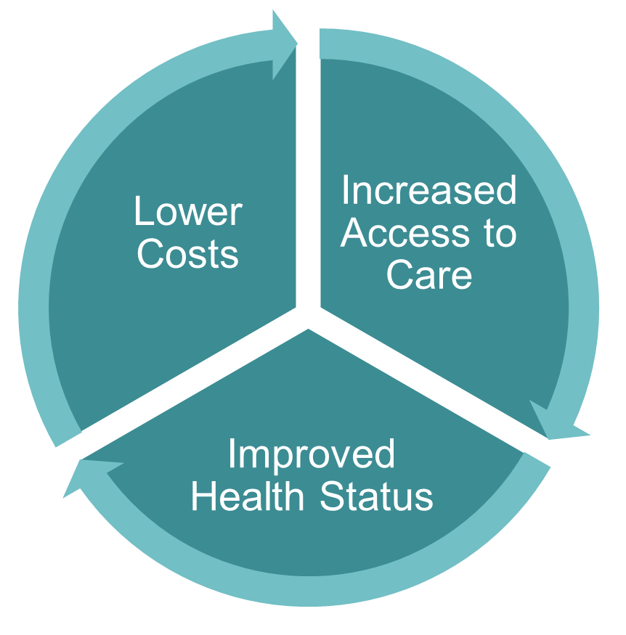
National Health Policy Context
The Triple Aim

Slide 8
Typical Avenues Healthcare Financing of Healthy Homes Services
Medicaid Managed Care contracts or incentives
Individual MCO use of administrative expenses
Reimbursement for direct services
Medicaid Administrative Claiming
Other programs and emerging opportunities
EPSDT
Health homes
Accountable Care Organizations (ACOs)
DSRIP funding pools
Essential Health Benefits Rule change
Hospital Community Benefits
Social Impact Bonds

Slide 9
Typical Avenues Healthcare Financing of Healthy Homes Services
Medicaid Managed Care contracts or incentives
Individual MCO use of administrative expenses
Reimbursement for direct services
Medicaid Administrative Claiming
Other programs and emerging opportunities
EPSDT
Health homes
Accountable Care Organizations (ACOs)
DSRIP funding pools
Essential Health Benefits Rule change
Hospital Community Benefits
Social Impact Bonds
Potential for local or regional action

Slide 10
Typical Avenues Healthcare Financing of Healthy Homes Services
Medicaid Managed Care contracts or incentives
Individual MCO use of administrative expenses
Reimbursement for direct services
Medicaid Administrative Claiming
Other programs and emerging opportunities
EPSDT
Health homes
Accountable Care Organizations (ACOs)
DSRIP funding pools
Essential Health Benefits Rule change
Hospital Community Benefits
Social Impact Bonds
Existing Medicaid authority

Slide 11
Managed Care
Many states contract with Managed Care Organizations (MCOs)
Opportunity to require community-based interventions in contractual agreements
Provide flexibility (and even encouragement!) for MCOs to design their own disease management strategies
In many cases, MCOs are using administrative expenses to pay for and cover services

Slide 12
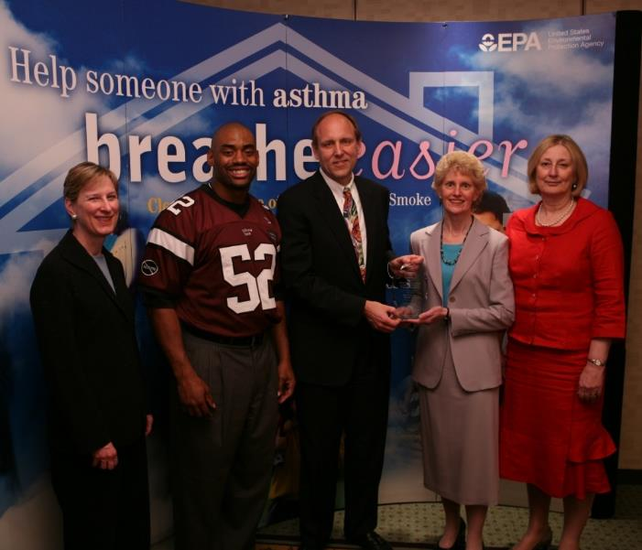
EXAMPLE: Managed Care Contract
The Monroe Plan for Medical Care
As part of a state-led quality improvement project for Medicaid MCOs, developed a disease management program for children with asthma that included home environmental assessments and supplies
Elizabeth Cotsworth, then Director, Office of Radiation and Indoor Air, U.S. EPA, and Beth Craig, then Deputy Assistant Administrator, Office of Air and Radiation, EPA, and Chris Draft, then NFL player, present the EPA National Leadership Award in Asthma Management to Dr. Joe Stankaitis and Deborah Peartree of the Monroe Plan for Medical Care

Slide 13
EXAMPLE: Administrative Expense
Three managed care plans in CA
Alameda Alliance for Health, Asthma Start Program
Inland Empire Health Plan, Health Navigator Program
L.A. Care Health Plan, L.A. Cares About Asthma
www.nchh.org/Program/DemystifyingHealthcareFinancing/CaseStudies.aspx

Slide 14
Mechanisms for Change
State Plan Amendments
Waivers

Slide 15
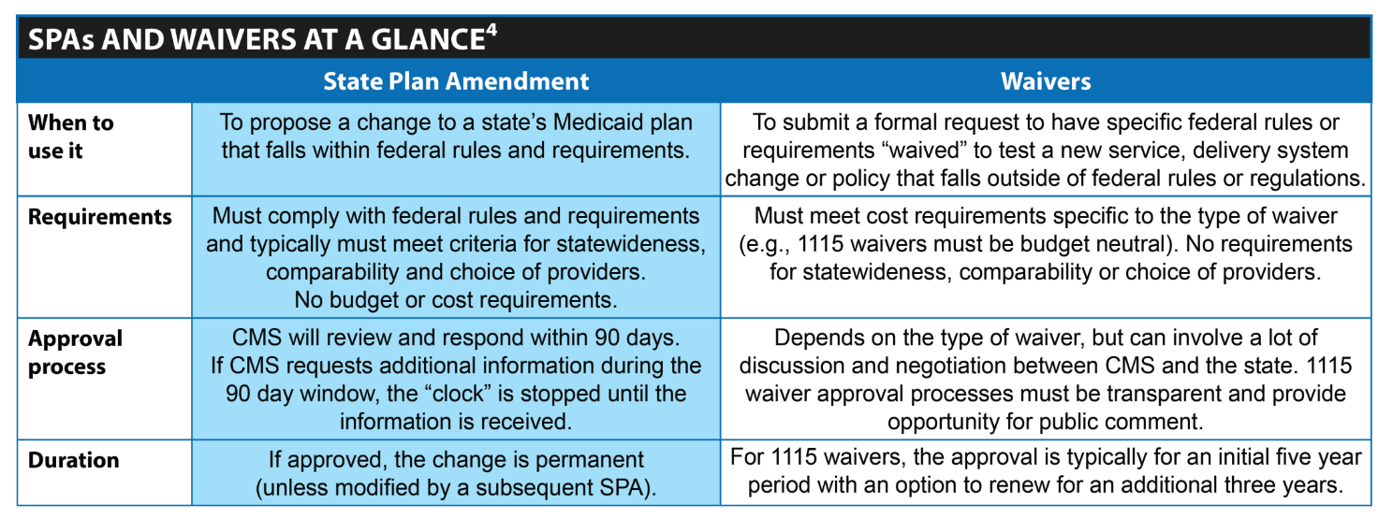
SPAs and Waivers

Slide 16
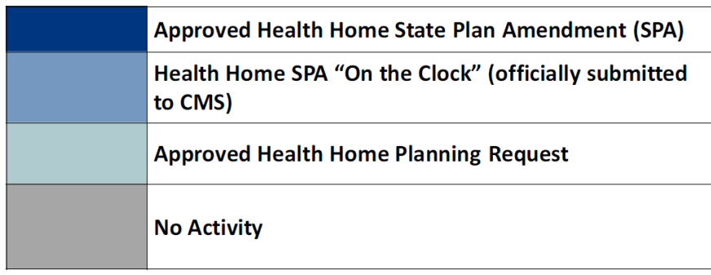
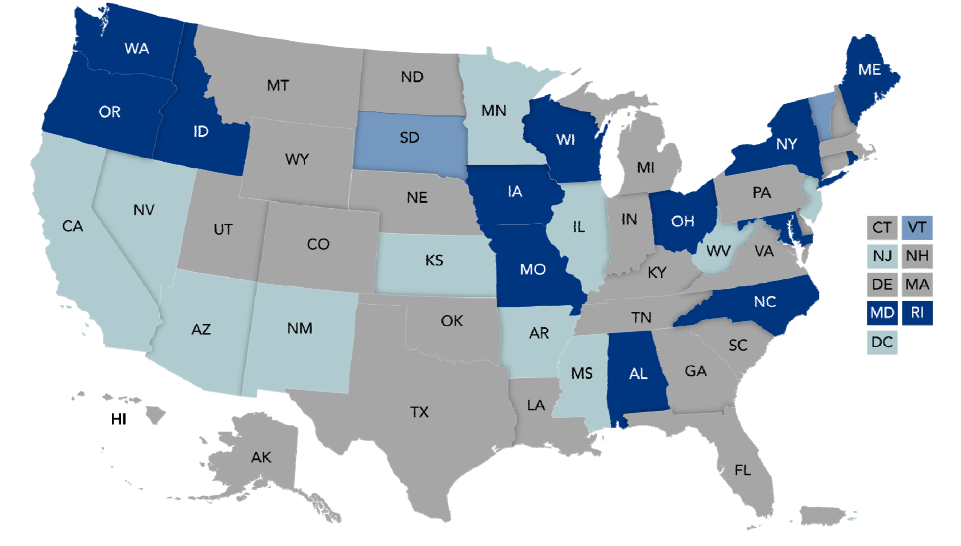
EXAMPLE: State Plan Amendment
Health Home target population includes asthma (2/13)

Slide 17
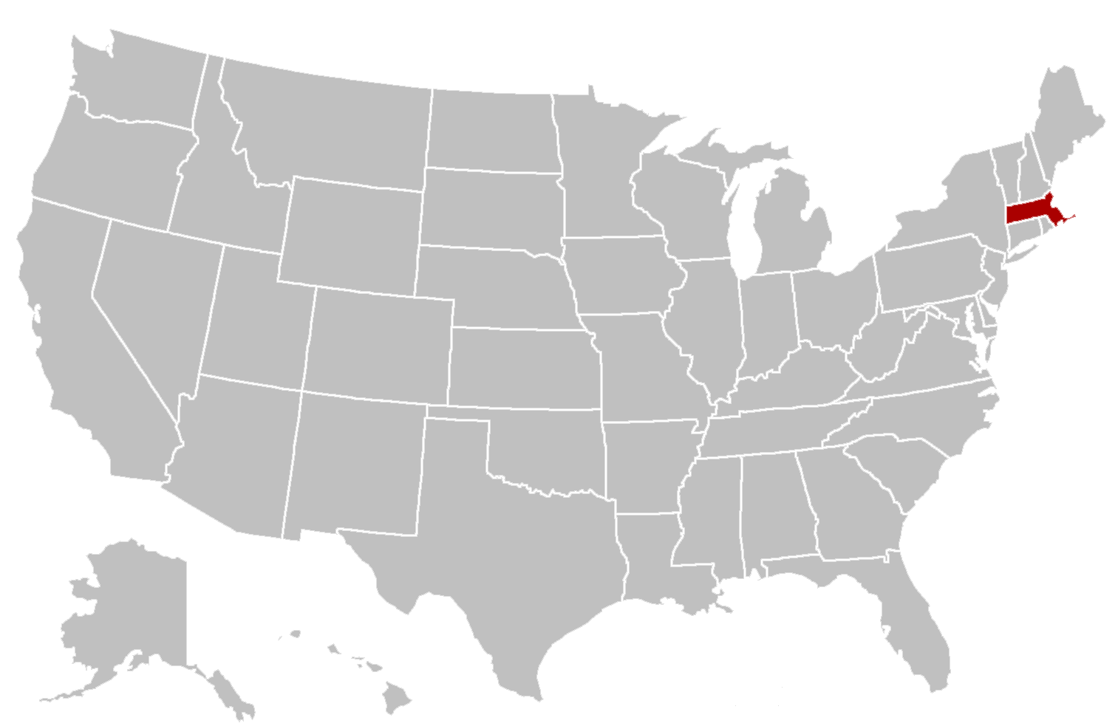
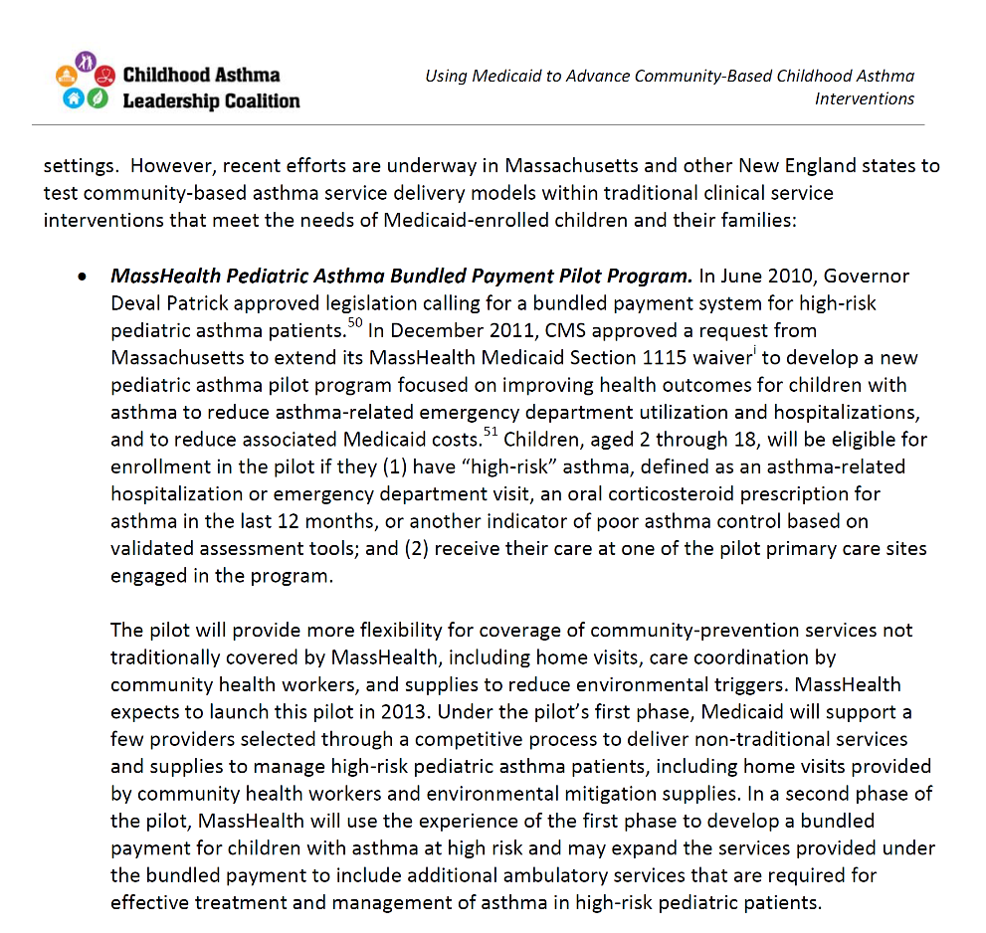
EXAMPLE: Waivers: Bundled Payment

Slide 18
EXAMPLE: Waivers: Delivery System Reform Incentive Payment
Put in place through an 1115 Waiver, DSRIP´s purpose in NYS is to fundamentally restructure the health care delivery system by reinvesting in the Medicaid program, with the primary goal of reducing avoidable hospital use by 25% over 5 years. Up to $6.42 billion dollars are allocated to this program with payouts based upon achieving predefined results in system transformation, clinical management and population health.

Slide 19
EMERGING OPPORTUNITIES The evolving healthcare landscape
Accountable Care Organizations
Network of providers and organizations, required to meet quality of care standards, but also incentivized to invest in preventive care services
Health Homes
State plan option, payment and healthcare delivery model similar to ACOs but designed to serve individuals with chronic conditions. Statewideness requirement waived. Increased federal match for two years. Requires state to submit a SPA.

Slide 20
EMERGING OPPORTUNITIES The evolving healthcare landscape
Hospital Community Benefits
Requirement for non-profit hospitals to retain their tax-exempt status. Required to conduct a Community Health Needs Assessment, and establish strategies for addressing identified needs.
Change in Rule on Essential Health Benefits (Preventive Services Rule Change)
Provides an opportunity for non-medical and non-licensed practitioners to offer preventive services ordered by a licensed practitioner. Requires the state to submit a SPA
Other State Plan Options

Slide 21
State Medicaid Policies: 2014 Survey
Online surveys
Home-based asthma services
Lead poisoning follow-up services
Sent to program contacts and Medicaid Directors in Spring 2014
Responses from 46 states for asthma and 49 states for lead

Slide 22
Reimbursement by the numbers: Home-based asthma services
13
states have some Medicaid reimbursement for home-based asthma services in place (may be on very limited scale)
3
additional states expect to have some Medicaid reimbursement for home-based asthma services in place within a year
19
states are exploring Medicaid reimbursement for home-based asthma services
(or an expansion of existing services)
37
states reported that no services are in place or the respondent was not sure whether services were in place or the state did not respond to the survey

Slide 23
Who is eligible for these services? Among 13 states with home-based asthma services in place (select all that apply)
100%
provide services to children
69%
provide services to adults
OTHER REQUIREMENTS
Recent hospitalization or ED visit (62%)
Other healthcare utilization (38%)
ACT score (15%)
Location of patient’s residence (15%)
Allergen testing, screening questions about home environment, referral from school/daycare (8%)

Slide 24
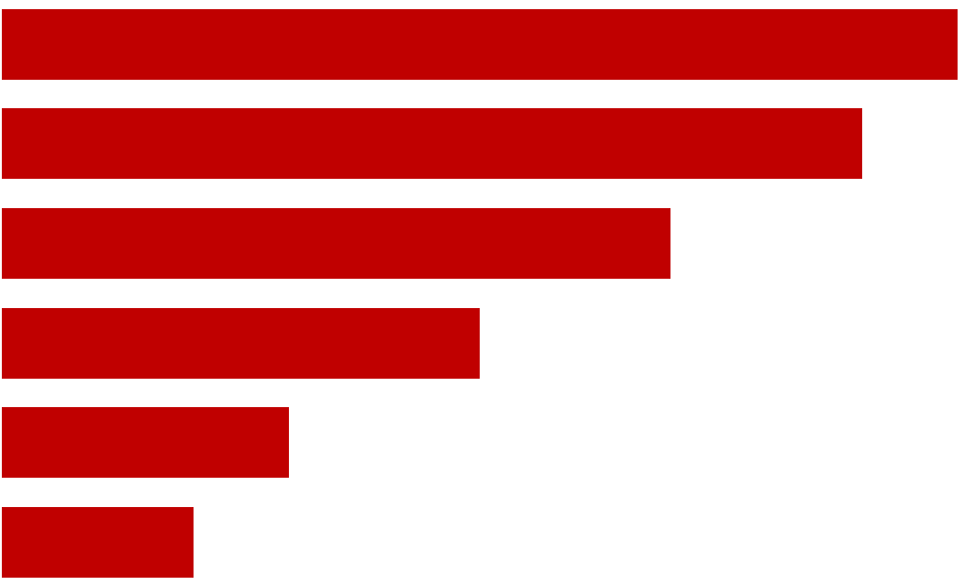
What services are reimbursable? Among 13 states with home-based asthma services in place (select all that apply)
Self-management education, 77%
Assessment of primary residence, 69%
In-home education about triggers, 54%
Low-cost supplies, 38%
Assessment of a second residence, daycare or school, 23%
Structural remediation, 15%

Slide 25
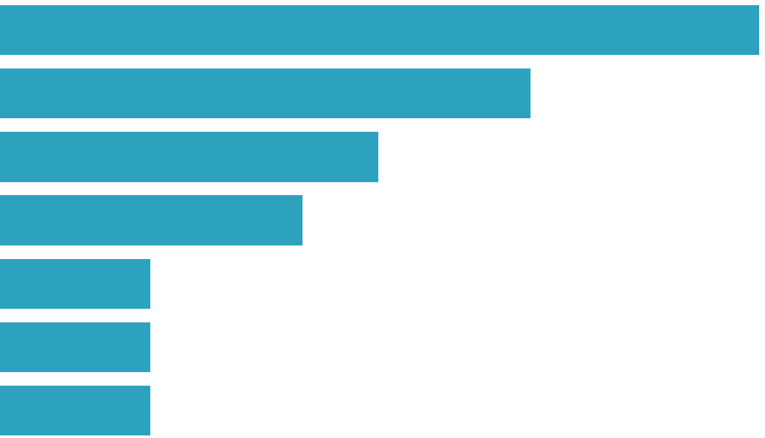
What type of staff provide services? Among 13 states with home-based asthma services in place (select all that apply)
Nurses, 77%
Certified Asthma Educators, 54%
Respiratory Therapists, 38%
CHWs, 31%
Housing Professional, 15%
Sanitarian/Environmental Health Professional, 15%
Social Workers, 15%

Slide 26
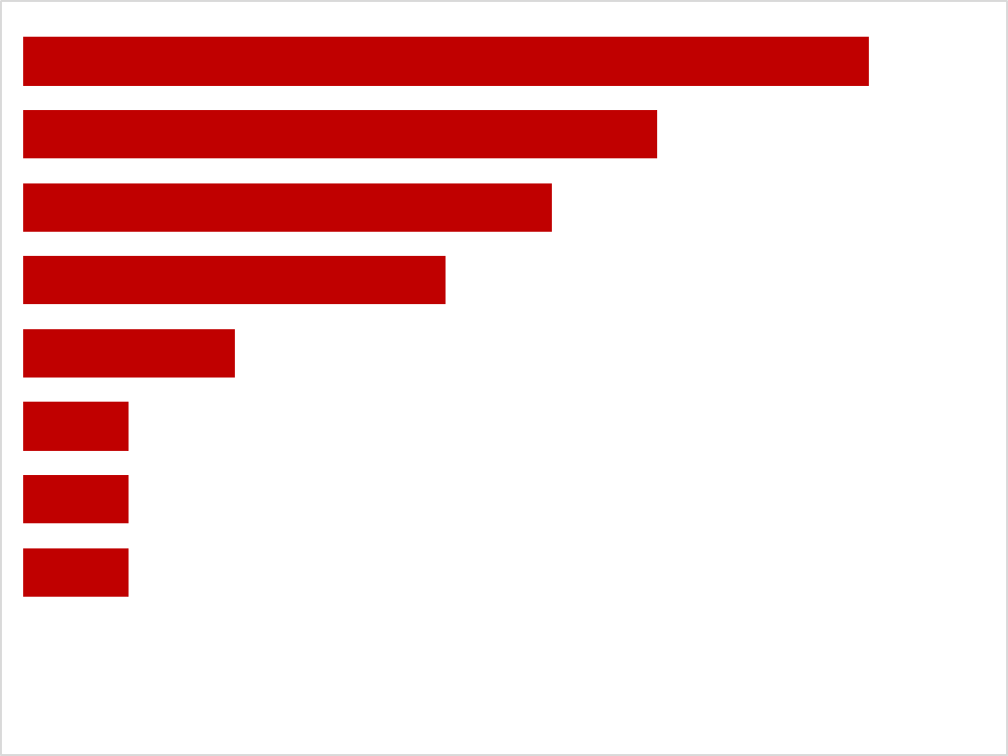
Who is billing for these services? Among 13 states with home-based asthma services in place (select all that apply)
Medicaid Managed Care Orgs, 54%
Visiting Nurse/Home Health Agencies, 46%
Hospitals/Clinics, 38%
Local Health Dept, 31%
Other Healthcare Providers, 15%
State Health Dept, 8%
Community-Based Orgs, 8%
Other, 8%

Slide 27
EXAMPLE: Aetna’s Delaware Physician’s Care, Inc
Deployed services through contracts with home health agencies
After struggling with low-uptake among residents in DE, deployed CHWs trained to use EPA’s asthma home checklist and engaged faith leaders in the community
www.nchh.org/Program/DemystifyingHealthcareFinancing/CaseStudies.aspx

Slide 28
How many visits? How much reimbursement?
Variable data quality. Interpret with caution!
NUMBER OF VISITS:
REIMBURSEMENT AMOUNT:
1-10
visits
Most states reported a range of possible number of visits. The minimum number of visits reported was 1 and the maximum number was 10 visits.
$80.98-$200 per visit
Most states reported a range of per visit reimbursement levels. Combined with the range of possible number of visits, this translates roughly into a total reimbursement range of $162-$1,000 per patient.

Slide 29
Other healthcare financing
7 states reported at least one private/commercial payer in their state; an additional 7 are aware of pending efforts
6 Hospital Community Benefits
2 ACOs
1 Social Impact Bond
12 State-funded programs

Slide 30
EXAMPLES Other Sustainable Financing
New York
State General Fund
Healthy Neighborhoods Program
Regional Asthma Coalitions
Montana
Tobacco Master Settlement Agreement
Awarded by state legislature
Massachusetts
Prevention and Wellness Trust
Part of state healthcare reform, funded by tax on hospitals

Slide 31
Doubts and Drivers
Survey report summarizes information from 117 respondents in 49 states
AHIP webinar, Health Plan Strategies for Managing Asthma and Reducing Exposure to Environmental Triggers – Key Findings from AHIP’s 2015 Asthma Assessment
https://ahip.org/asthma/ (look for March 17, 2106 webinar under On Demand Webinars)

Slide 32
CASE STUDIES Preliminary Findings
Relationships matter
Both long-term and opportunistic
Success often comes from knocking on multiple doors (partnerships)
Differences between asthma and lead
Emphasis on ROI
Connection to regulatory infrastructure and integration with clinical services
Interest from the private sector
There isn’t a single solution
Depending on the state Medicaid may be the only solution, a complementary solution or not part of the mix at all
Solutions often not portable between states
But it IS possible and there are many different ways to get this done

Slide 33
CASE STUDIES Preliminary Findings
State level changes need to allow for local innovation
Sustainability is tough and ongoing
Leadership changes or changes in health plan priorities can undermine existing coverage; don’t assume that coverage is permanent
Workforce capacity and infrastructure concerns
Payers often willing, but infrastructure is often not in place
Often, funding streams don’t pay for training of individuals, and workforce is a key barrier
Medicaid agencies are busy with healthcare reform
Don’t interpret slow response as lack of interest

Slide 34
AMANDA REDDY
Director of Strategy and Impact
areddy@nchh.org

