Slide 1





Asthma Healthy Homes Assessments
Models
Edwina K. Gibson, Program Manager
The Center for Working Families, Inc.

Slide 2

Lead Safe Atlanta- Healthy Homes

Slide 3
Overview of Program
 3 year Grant; December 2017
 29-Point Inspections to Identify Healthy Homes Issues
 120 Healthy Homes Interventions with the City of Atlanta
& 120 Healthy Homes Toolkits
 Provide 100 Education and Outreach Events

Slide 4
Current Status &
Encouraging Results
 77 Of 150 Completed to Date
 38 Of 120 Completed to Date
 Decreased school absences in 12 households an
average of 3 days per month
 13 Families have committed to smoking on the exterior of
their homes

Slide 5
Outreach & Education
 Neighborhood Canvassing
 Child Care Centers Vendor Tables
 Summer Camp Workshops
 Monthly NPU Meetings
 Senior Center Workshops
 Annual Bloodfest
 Post Construction Safe Practices

Slide 6
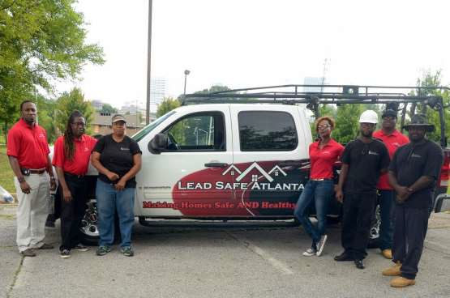
Our Staff

Slide 7
10 Tasks
 Moisture Barriers
 Sheetrock Repair
 Gutter Installation and/or Replacement
 Bathroom Ventilation
 Kitchen & Dryer Ventilation
 Window & Door Weatherization
 Minor Leakage Repair (Sinks, Faucets, Roof, etc.)
 HVAC Servicing or Installation/Duct Work Repair
 Water Heater Repair or Replacement
 Minor Mold Remediation

Slide 8
Healthy Homes Toolkits
 Combo Carbon Monoxide/Smoke Detector
 Cabinet Locks
 Liquid Bleach
 Rubber Gloves
 Swifter Mop
 Outlet Plug Covers
 Concrobium Mold Control Spray
 (2) 5 Gallon Buckets
 Sponges
 EcoSmart CFL Lightbulbs
 Hinatures Natural Laundry Detergent
 Bait Stations

Slide 9
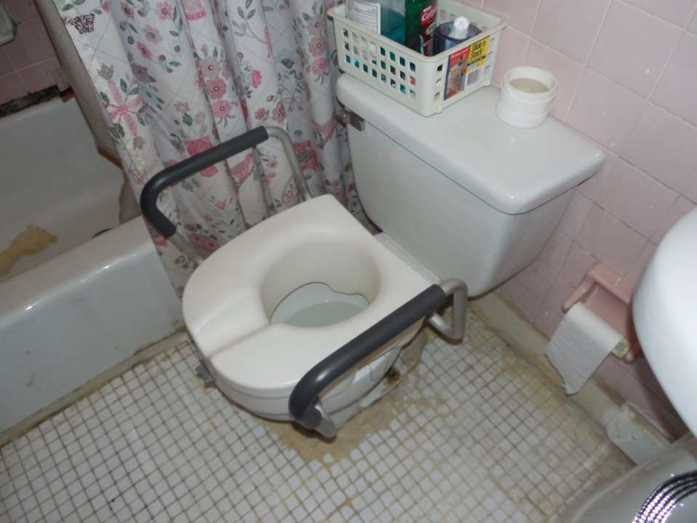

Slide 10
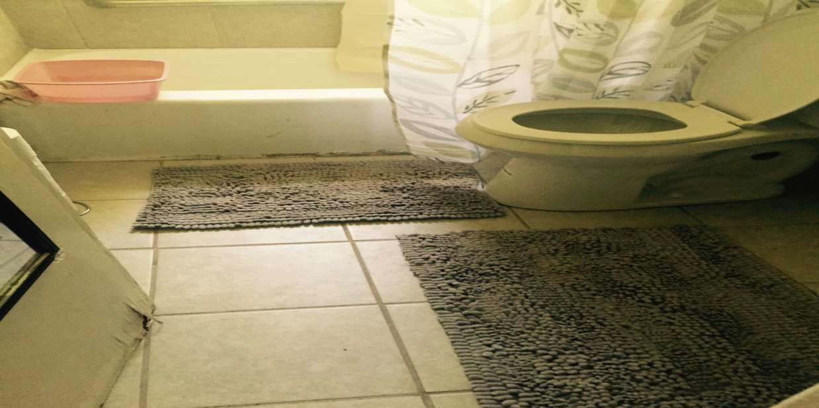

Slide 11
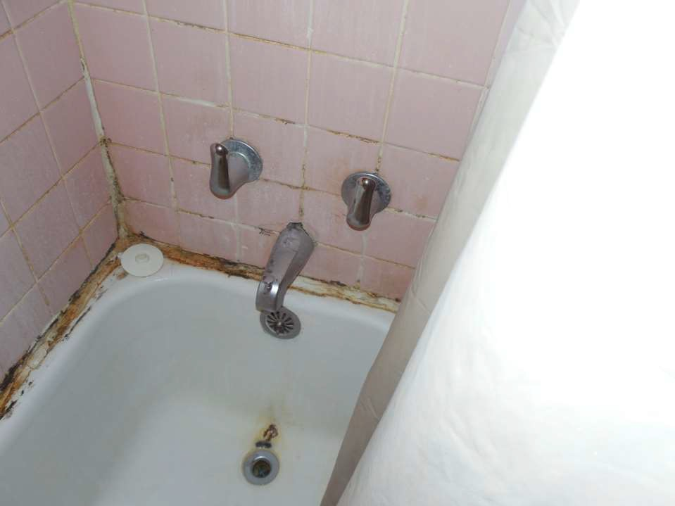
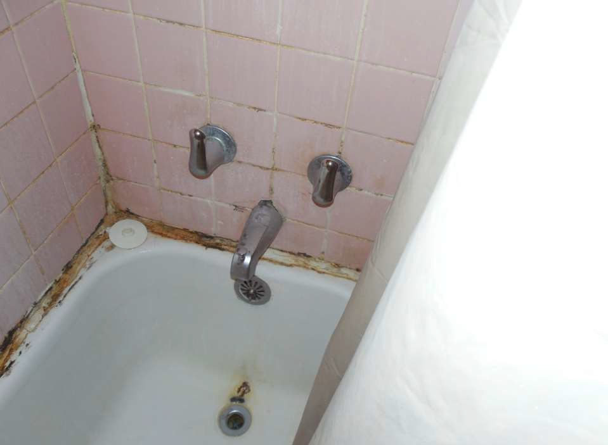
Replace damagewall tile with new similar tile
Replace damaged rusted tub

Slide 12
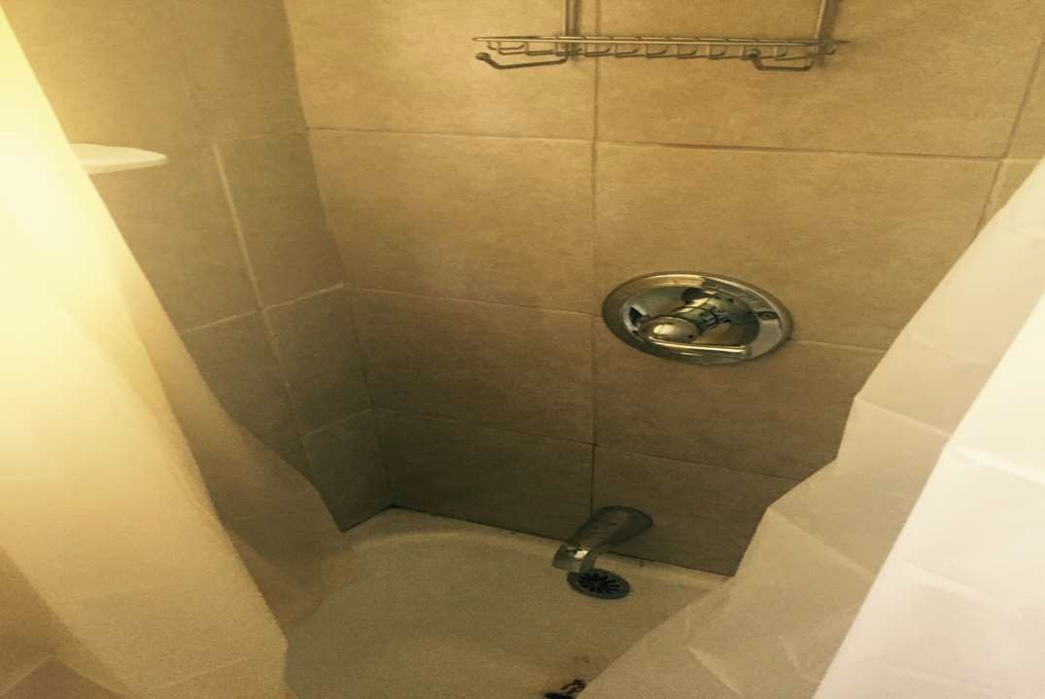

Slide 13
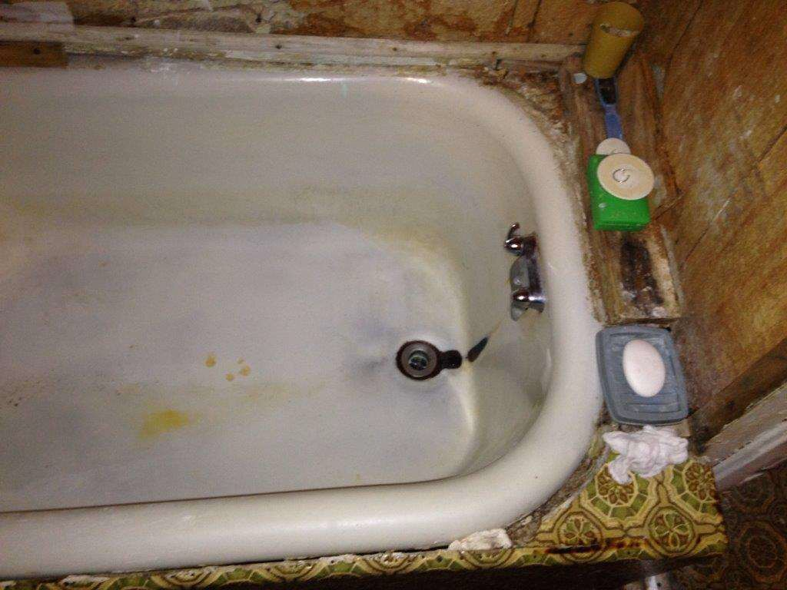

Slide 14
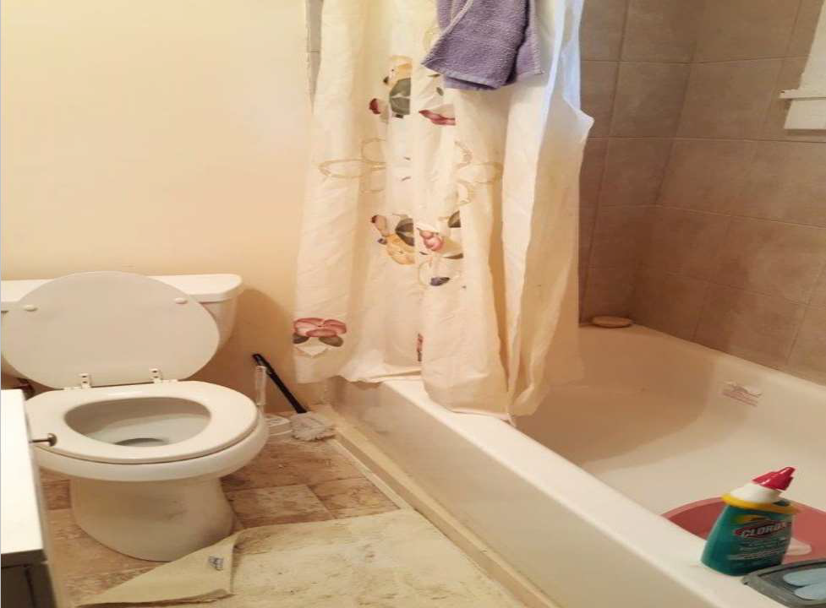

Slide 15
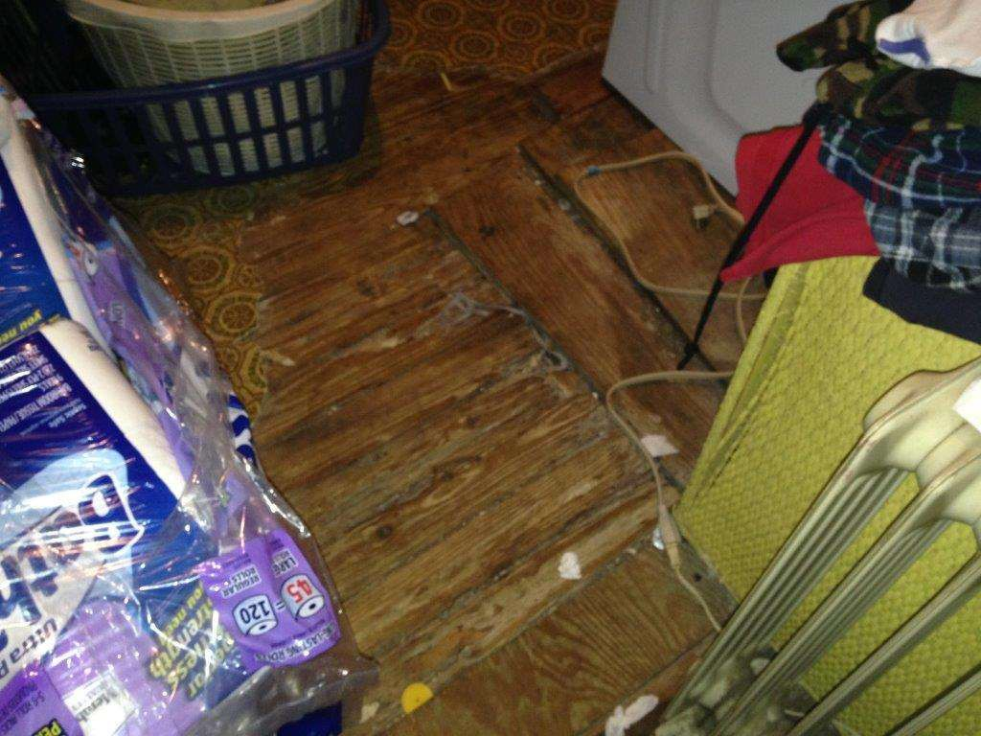

Slide 16
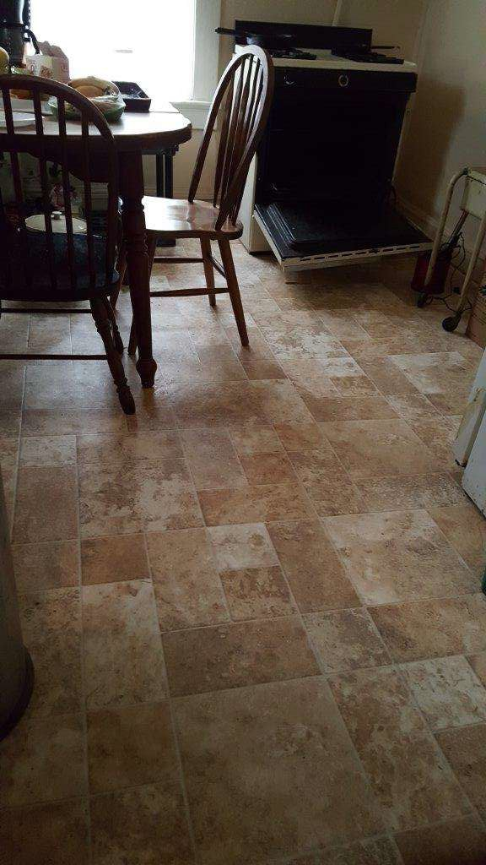

Slide 17
Asthma Healthy Homes Assessments
Models
Jessica Ramsay, MPH
Program Manager, Sinai Urban Health Institute

Slide 18



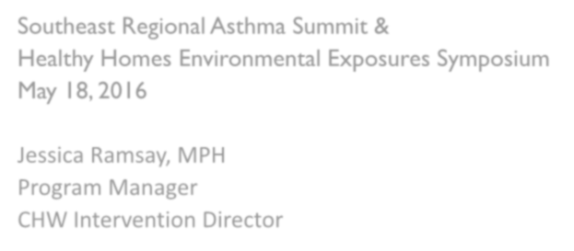


Sinai’s CHW Asthma and Healthy
Homes Model
Southeast Regional Asthma Summit &
Healthy Homes Environmental Exposures Symposium May 18, 2016
Jessica Ramsay, MPH Program Manager
CHW Intervention Director

Slide 19




Presentation Outline
Background
Sinai Asthma and Healthy Homes Model
  CHW Training
  Intervention Implementation/ Home Environmental Assessment
  Outcomes
Lessons Learned & Next Steps
44

Slide 20


Sinai Urban Health Institute
Part of the Sinai Health System
Founded in 2000
Vision: To serve as a leading urban health research institute for eliminating health disparities
Mission: To develop and implement effective approaches that improve the health of urban communities through data-driven research, interventions, evaluation, and community engagement
Areas of Work

Slide 21


Epidemiology of Asthma
23 million people with asthma nationwide
  6.1 million children (8.3%), 16.5 million adults (7.0%)*
  Most common chronic condition of childhood
Variation by race/ethnicity, with Puerto Rican and non-Hispanic Black people
having the highest rates
Race/Ethnicity | Age <18 years | Age > 18 years
Puerto Rican | 20.7% | 12.2%
Black, non-Hispanic | 13.4% | 8.6%
White, non-Hispanic | 7.5% | 7.3%
Mexican/Mexican American | 5.6% | 4.1%
*Source: National Health Interview Survey, 2013
46

Slide 22
Epidemiology of Asthma
Inner-city, minority adults and children experience a disproportionate asthma
burden
  In some instances, prevalence exceeds 1 in 4
    Sinai’s Community Health Survey
  More likely to have asthma that’s poorly controlled
    ↑ Hospitalization, ED, mortality and morbidity rates
  Asthma rates among federally-assisted housing residents are approx. twice the national rate
  Access to care can be a barrier
47

Slide 23



Controlling Asthma
A person’s home can heavily impact asthma symptoms
Many children and adults are in need of individualized education on how best to control asthma
Asthma is a serious lung disease, yet with proper long-term management it
can be controlled and people can have fulfilling and productive lives!
48

Slide 24

Sinai Asthma Initiatives: Overview
Since 2000, Sinai has implemented a series of 9
comprehensive interventions and 4 are currently underway
Expanded to home visit model in 2004
Goals:
  Decrease asthma-related morbidity and mortality
  Improve quality of life for people living with asthma
  Decrease costs
49

Slide 25

Sinai Asthma Initiatives: CHW Model
APHA defines a Community Health Worker (CHW) as:
”…a frontline public health worker who is a trusted member of and/or has an unusually close understanding of the community served.”
CHWs are the agent of change
CHWs are hired from the target community
Do not need to have any prior medical or asthma experience
Knowledge of the community and passion to help others
Host a pre-asthma training course prior to interviewing potential
CHWs
50

Slide 26

Overview: CHW Hiring and Training
CHWs were recruited from communities served
  No previous asthma knowledge required
  Passion for working with community members
Attend pre-hire training session
75 hour training conducted by the Sinai Asthma Education
Training Institute
  Asthma Overview, Home Environmental Assessment, CHW Core
Skills, HIPAA and Data collection
Shadowed teaching and role play evaluation
Random shadowing and evaluation throughout
intervention
51

Slide 27


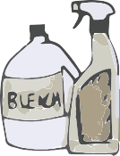




CHW Training: Home Environmental Assessment
CHWs trained by partner tenant’s rights organization and
senior CHWs to:
  Conduct thorough home environmental assessments utilizing the
Home Environmental Checklist tool
  Observe and assess for key asthma triggers throughout the home
Provide individualized triggers avoidance/reduction
Work with management companies, landlords, tenant’s rights
organization to refer housing issues
52

Slide 28
Sinai Asthma and Healthy Homes Intervention
6 home visits over 12 months by CHW
Provide home-based comprehensive, individualized asthma education
  Asthma basics, medical management, symptom recognition, etc.
  Trigger reduction in the home environment
3 Comprehensive Home Environmental Assessments:
2 week, 6 month and 12 month visits
Provide supplies: green cleaning kits, traps, baits, caulking, steel wool
53

Slide 29

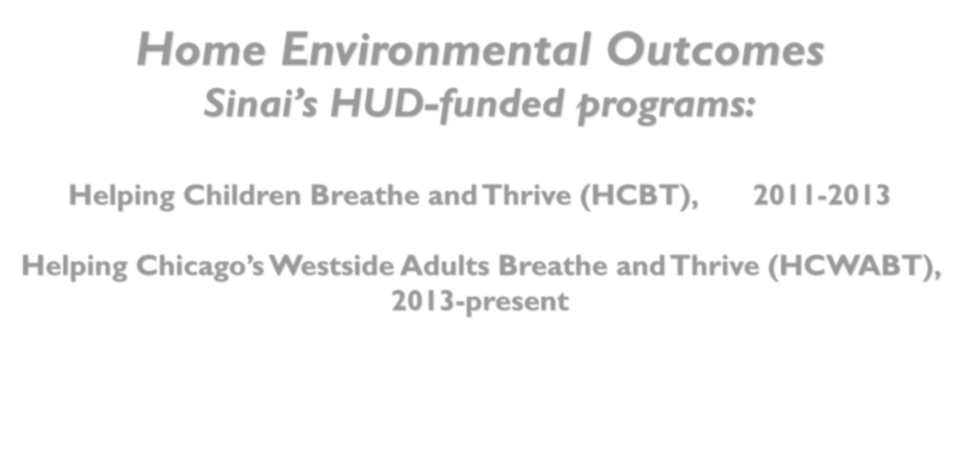











Home Environmental Outcomes
Sinai’s HUD-funded programs:
Helping Children Breathe and Thrive (HCBT), 2011-2013
Helping Chicago’s Westside Adults Breathe and Thrive (HCWABT), 2013-present

Slide 30

HCBT Final Outcomes:
Home Environmental Triggers
Total Number of Environmental Home Trigger Issues Reported Across all Households*
Type of Issue: Total |  | Resolved n % |  | Unresolved n %
Carpet | 17 | 10 | 59% | 7 | 41%
Crack | 5 | 5 | 100% | 0 | 0%
Hole | 12 | 12 | 100% | 0 | 0%
Mold | 15 | 14 | 93% | 1 | 7%
Pests | 4 | 4 | 100% | 0 | 0%
Water Damage | 6 | 6 | 100% | 0 | 0%
Bed Bugs | 3 | 2 | 67% | 1 | 33%
Other | 10 | 9 | 90% | 1 | 10%
Total | 72 | 62 | 86% | 10 | 14%
*Some households reported more than one housing issue
55

Slide 31
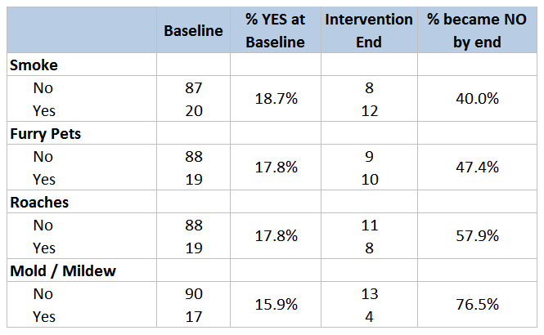
HCBT Outcomes:
Home Environmental Triggers
Presence of Home Triggers as Observed During the Home Evaluation Assessment at
Baseline and the end of the Intervention for Adult and Child Participants (n=107)

Slide 32


HCWABT Outcomes:
Home Environmental Triggers
Percent of participants who reported a home environmental issue at
baseline and after 6 months
Roaches 40.5%
Moisture 23.3%
24.1%
19.8%
Rodents 16.5%
Mold 14.7%
15.5%
12.2%
Baseline
6 Months

Slide 33

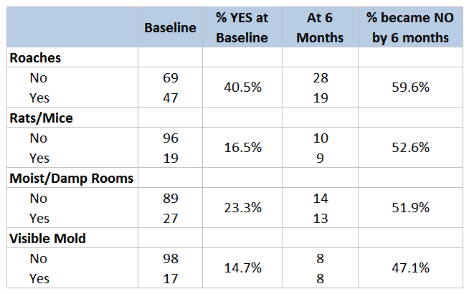
HCWABT Outcomes:
Home Environmental Triggers
Presence of Home Triggers as Reported by Participants at Baseline and 6
months into the intervention (n=116)

Slide 34

HCWABT Preliminary Outcomes:
Quality of Life
Asthma-Related Quality of Life Scores at Baseline and at Twelve Months Following
the Intervention (n=58)
Baseline 12M
5.1
4.6
4.7
4.7
4.4
4.0
4.0
3.8
3.5
3.7
Symptoms* Environmental* Activity Limitation* Emotional Function* Overall Score*
* Statistically significant difference (p<0.05) per Wilcoxon signed-rank non-parametric test. A
0.5 point change is also clinically significant

Slide 35

Sinai Asthma Initiatives: Key Lessons
CHWs are immensely effective at establishing relationships of
trust with the families they serve
Trust is a key reason why CHWs are able to conduct home environmental assessments
CHWs are effective at serving as a liaison between families and
management companies, landlords, tenant’s organizations
Consistent evidence of improved asthma control
  Asthma ED visits and hospitalizations decreased by 50-80%
  Reductions in symptom frequency
  Increased quality of life
  Reduction of home environmental triggers
CHW approach is associated with significant cost-savings
  $3-$8 saved per dollar spent
60

Slide 36


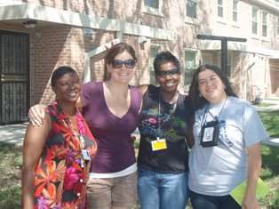



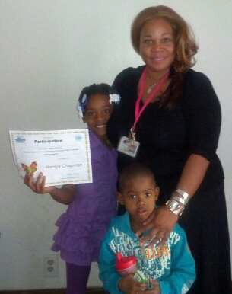

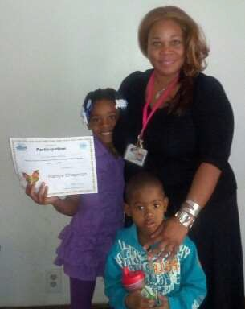
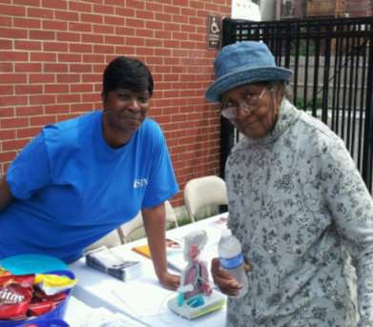

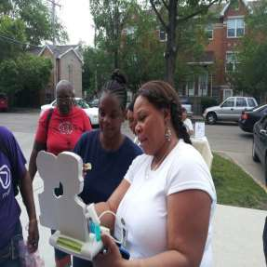
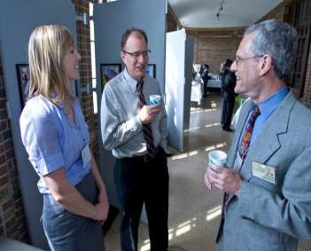
“Teamwork makes the dream work…”
61

Slide 37

Acknowledgements
Sinai Team: Kim Artis, Jeanette Avila, Jamie Campbell, Guadalupe Cruz, Sheena Freeman, Ana-Rosa Garcia, Melissa Gutierrez Kapheim, Julie Kuhn, Rhonda Lay, Helen Margellos-Anast, Pat Perkins, Jessica Ramsay, Tala Schwindt, Gloria Seals, Maureen Shields, Madeline Woodberry
Funders: Michael Reese Health Trust, Crown Foundation, Illinois Department of Public Health, Centers for Disease Control and Prevention, Department of Housing and Urban Development, Lloyd A. Fry Foundation, Family Health Network, Ann & Robert H. Lurie Children’s Hospital of Chicago, PCORI
Partners: Chicago Asthma Consortium, Chicago Housing Authority, Health & Disability Advocates, Metropolitan Tenants Organization, Sinai Children’s Hospital, Sinai Community Institute, Sinai Medical Group, American Lung Association, Respiratory Health Association, Marillac House, Catholic Charities, Lawndale Christian Health Center, CHICAGO Trial Sites
Participants and their families
62

Slide 38





Questions & Discussion
See: www.suhiChicago.org
Or contact: jessica.ramsay@sinai.org

Slide 39
Asthma Healthy Homes Assessments
Models
Kevin Kennedy, MPH, CIEC
Director, Environmental Health Children's Mercy Hospitals and Clinics Kansas City, MO

Slide 40




Principles of Home
Environmental Assessments
Kevin Kennedy, MPH, CIEC
Center for Environmental Health
2015 Winner-
HUD Secretary’s Award for Healthy Homes
©2013 Children's Mercy Hospitals and Clinics. All Rights Reserved. 03/13

Slide 41

Disclosures
Kevin Kennedy, MPH, CIEC
Software mentioned in this presentation
includes intellectual property of CMH and me.
CMH is a training partner for the National Healthy Home Training Center and earns revenue from teaching healthy home assessment courses including the processes described in this presentation.
66
©2013 Children's Mercy Hospitals and Clinics. All Rights Reserved. 03/13

Slide 42
Develop Mechanisms to Serve the Need
Stratify clients based on combination of health
status and reported home environmental risks
Divide assessment services into levels
  Basic Assessment Services
    Visual Assessment & In-home Education
    Assessment Reporting with Issues & Actions
    Follow-up & Case Management
  Advanced Assessment Services
    Basic Services, plus
    Advanced Environmental Investigation
    Environmental Measurement and Sampling
67
©2013 Children's Mercy Hospitals and Clinics. All Rights Reserved. 03/13

Slide 43
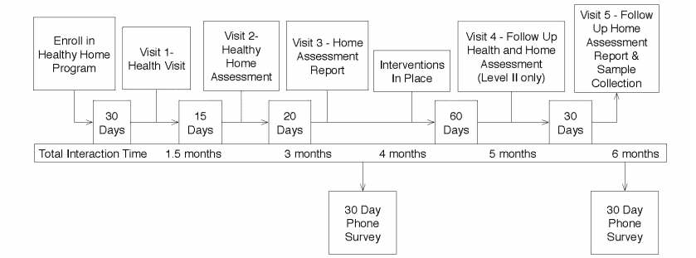
Level II - Family Interaction Timeline
Home assessment multi-visit model-
Health Visit-Environmental History
Home Assessment
Assessment Report Delivery
Follow up Assessment
Follow up Report Delivery
©2013 Children's Mercy Hospitals and Clinics. All Rights Reserved. 03/13

Slide 44
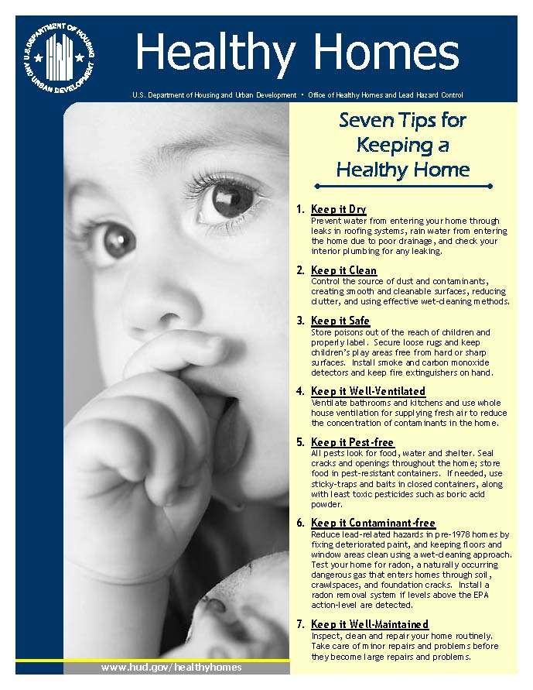
Home Assessments Should Promote:
Keep It:
Dry
Clean
Safe
Well-Ventilated
Pest-Free
Contaminant-Free
Well-Maintained
69
©2013 Children's Mercy Hospitals and Clinics. All Rights Reserved. 03/13

Slide 45
Home Assessments are
Risk Assessments
Risk Assessment Steps*
Hazard Identification
Hazard Evaluation
  Dose-response assessment
Exposure Assessment
Risk Characterization
70
*National Research Council, 1983 ©2013 Children's Mercy Hospitals and Clinics. All Rights Reserved. 03/13

Slide 46
Five Essential Factors to Consider During Healthy Home Environmental Assessments
Health & Medical History of the Patient “One Touch” Comprehensive Approach
Sources of Environmental Hazards
Pathways of Exposure
Recognize Building as “System”
71
©2013 Children's Mercy Hospitals and Clinics. All Rights Reserved. 03/13
71

Slide 47
Healthy Home Environmental Assessment
Principles
Initial contact and collection of information Establish a clear purpose for the assessment Formulate initial hypotheses
Site visit and walk-through
Qualitative and Quantitative Assessment Generate Assessment Report with Actions
Educate for Solutions
©2013 Children's Mercy Hospitals and Clinics. All Rights Reserved. 03/13
72
72

Slide 48
Common Housing-related Hazards
Asbestos & Vermiculite
Below ground
Contaminants
Building Products/Materials Emissions
CO & Other
Combustion Emissions
Environmental Tobacco Smoke (ETS)
Garage Pollution
Sources
Lead
Moisture (Mold & Other
Biologicals)
Ozone
Pests
Radon
Wood Smoke
Emissions
73
©2013 Children's Mercy Hospitals and Clinics. All Rights Reserved. 03/13

Slide 49
Critical Building Systems
HVAC Equipment
Combustion Safety (Vented & Unvented) Source Ventilation
Whole House Ventilation Multifamily Ventilation Home Safety
74
©2013 Children's Mercy Hospitals and Clinics. All Rights Reserved. 03/13
74

Slide 50


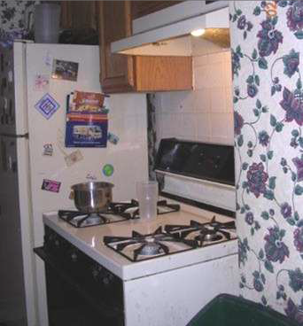
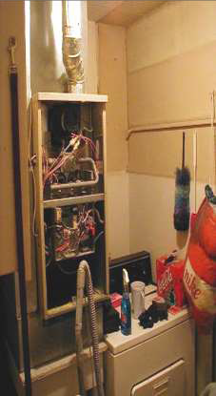

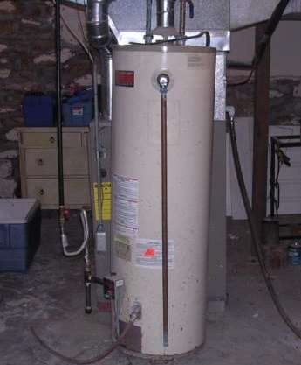


Assess Both Obvious and Not Obvious Indoor Combustion Sources (CH₄, CO, NO₂, H₂O?)
Gas Appliances and Water Heaters
Gas Furnaces
Gas/Fuel Space
Heaters
Candles and Incense
Photos courtesy of the Center for Environmental Health, Children’s Mercy Hospital, © 2010.
©2013 Children's Mercy Hospitals and Clinics. All Rights Reserved. 03/13

Slide 51


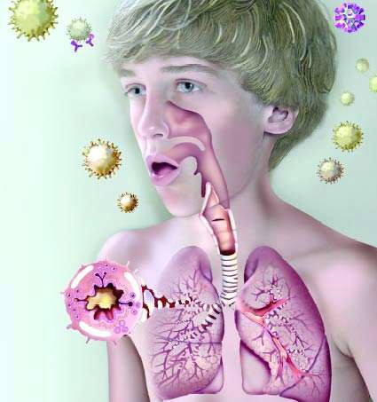
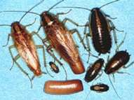
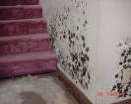

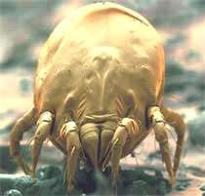
Top Asthma Triggers
Reducing Indoor Allergens Improves Asthma Control
©2013 Children's Mercy Hospitals and Clinics. All Rights Reserved. 03/13

Slide 52
Other Contaminants to Consider
High levels of Dust and Particulates Gases and off-gassing fumes
Household chemicals
Hobby chemicals and dusts
Fragrances Sewer Gas
Outdoor Pollutants and Fumes
77
©2013 Children's Mercy Hospitals and Clinics. All Rights Reserved. 03/13
77

Slide 53
Home Maintenance
How are maintenance activities performed?
What kinds of maintenance activities are performed by the occupants
What kinds of cleaning activities are performed?
  Vacuuming (carpets, floors, bedding,
upholstery, drapes?)
  Sweeping
How frequently does cleaning take place?
78
©2013 Children's Mercy Hospitals and Clinics. All Rights Reserved. 03/13

Slide 54
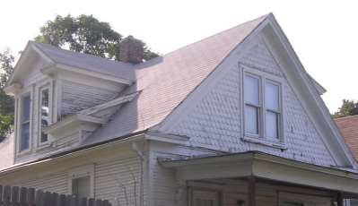
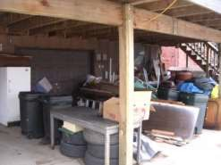
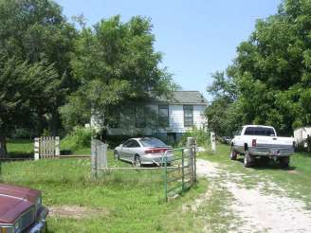
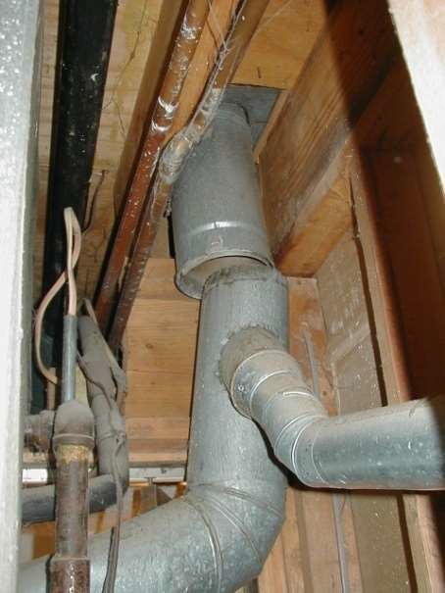
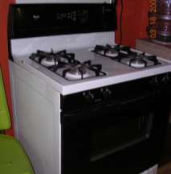
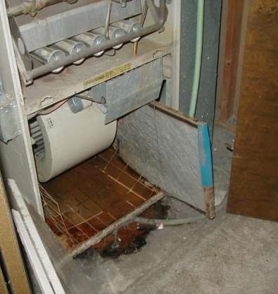
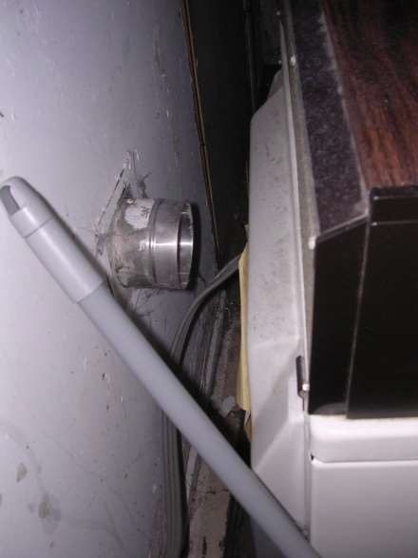
Assessing Family’s Home
Site & Building Assessment
Mechanical & Appliance Assessment
Rights Reserved. 03/13
©2013 Children's Mercy Hospitals and Clinics. All

Slide 55
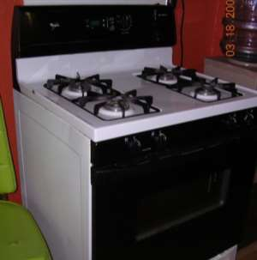
Identify the
Risk:
Justify why
it is a Risk:
Reserved. 03/13
Prioritize
the Risks:
©2013 Children's Mercy Hospitals and Clinics. All Rights

Slide 56
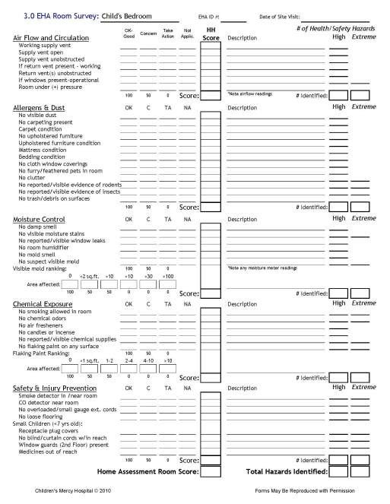
Room by Room Assessment
Domains of Qualitative
Assessment:
Air Flow & Circulation
Allergens & Dust
Moisture Control
Chemical Exposure
Safety and Injury Prevention
©2013 Children's Mercy Hospitals and Clinics. All Rights Reserved. 03/13

Slide 57

Healthy Home Keep it Principles
similar to CMH Home Assessment Domains
Healthy Home
Keep It:
CMH Home
Assessment Domains: Air Flow & Circulation Allergens & Dust Moisture Control Chemical Exposure Safety & Injury
Prevention
Dry Clean Safe Ventilated Pest-Free
Contaminant-Free
Well-Maintained
©2013 Children's Mercy Hospitals and Clinics. All Rights Reserved. 03/13

Slide 58
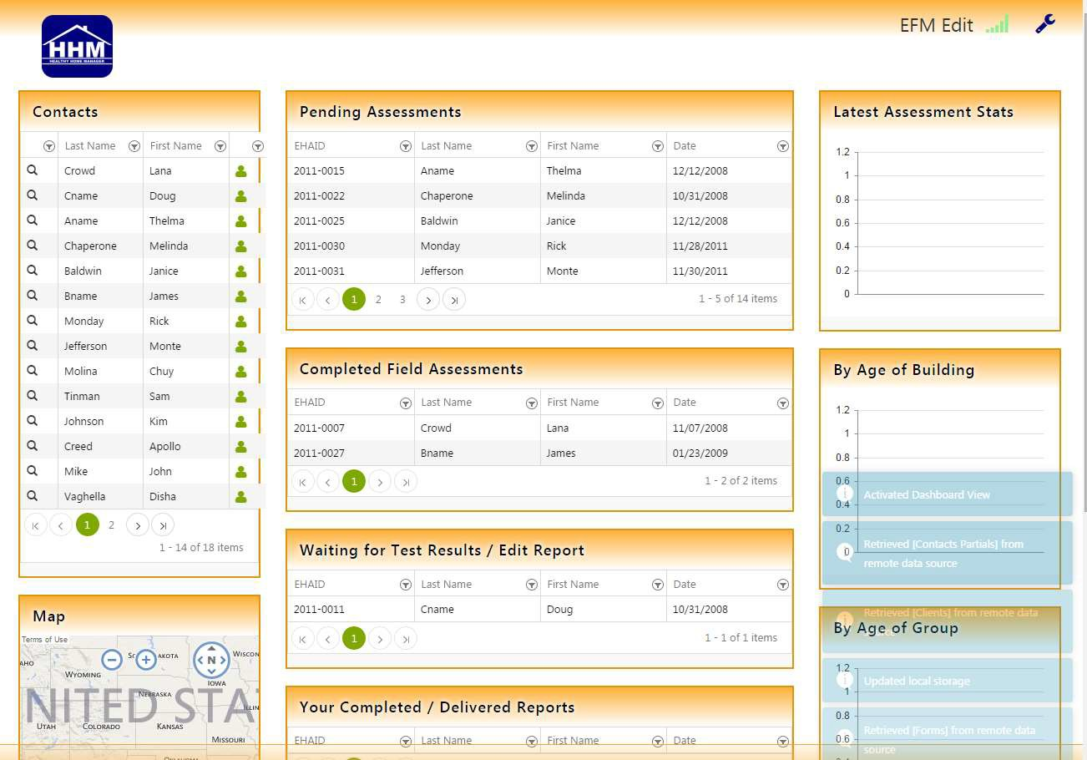
Home Environmental Assessment &
Intervention Management
©2013 Children's Mercy Hospitals and Clinics. All Rights Reserved. 03/13
83

Slide 59
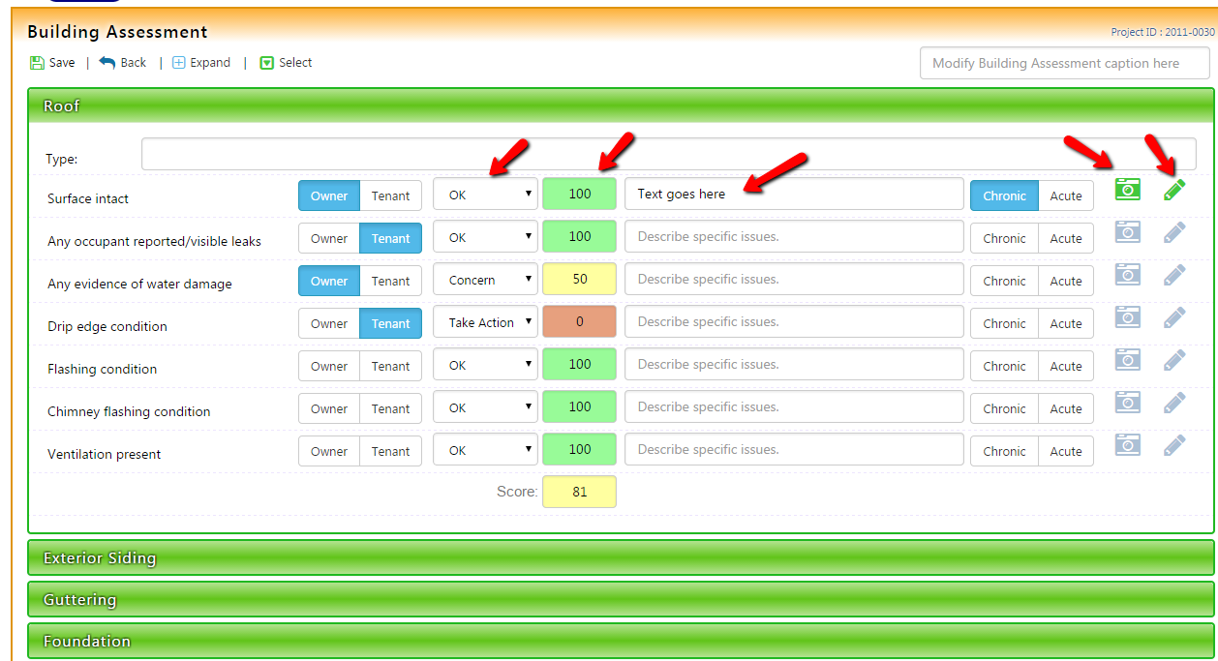
Home Environmental Assessment &
Intervention Management
84
©2013 Children's Mercy Hospitals and Clinics. All Rights Reserved. 03/13

Slide 60
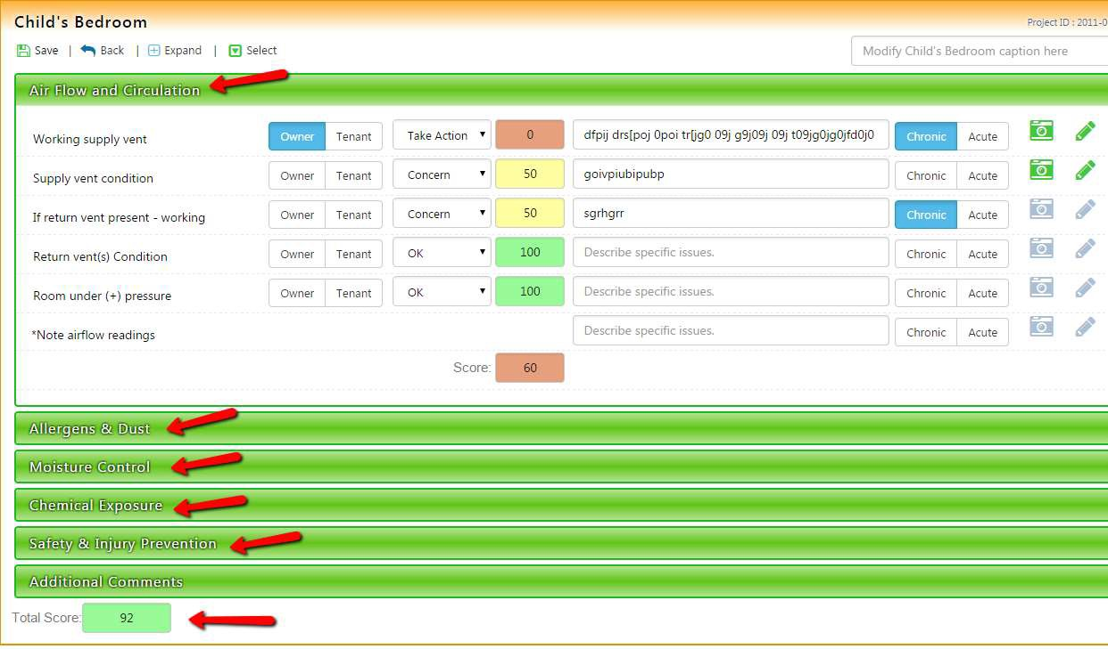
Home Environmental Assessment &
Intervention Management
85
© 2015 The Center for Environmental Health, Children’s Mercy Hospitals and Clinics
©2013 Children's Mercy Hospitals and Clinics. All Rights Reserved. 03/13
Presentation materials can not be used without permission

Slide 61
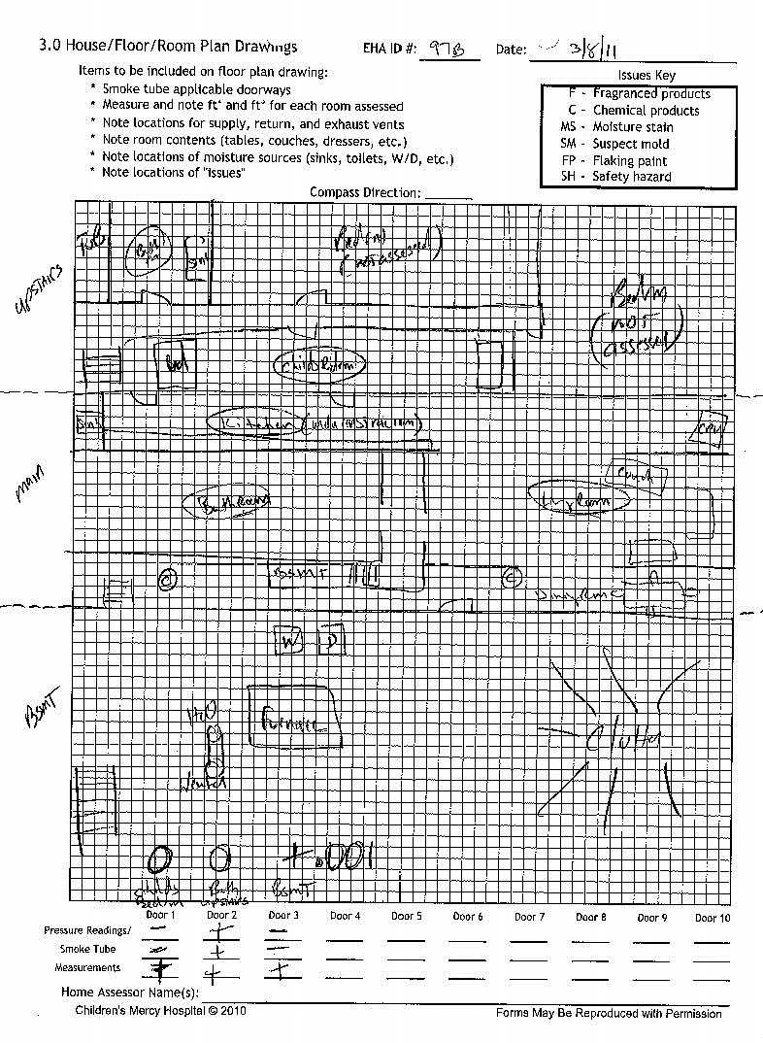
Floor Plan
Drawing
Hospitals and Clinics. All Rights Reserved. 03/13
Beneficial for:
Locating environmental contaminants in relation to rooms
Understanding exposure pathways
Remembering Home Layout
©2013 Children's Mercy

Slide 62
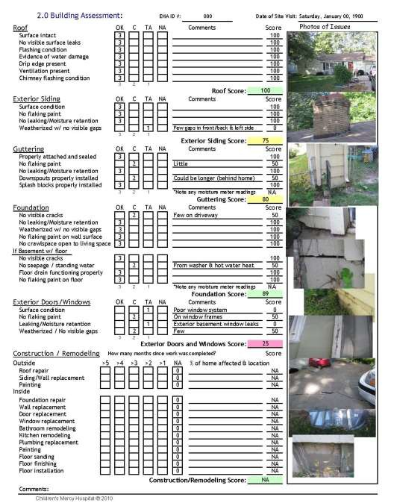
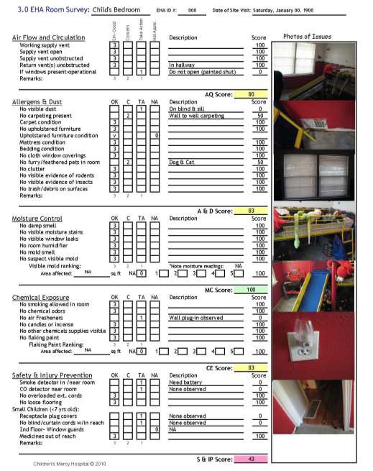
ospitals and Clinics. All Rights Reserved. 03/13
©2013 Children's Mercy H

Slide 63
Environmental Data is Used to Support:
Understanding of Building
Systems
Analysis of Exposure Pathways
Evaluation of Environmental Risks
©2013 Children's Mercy Hospitals and Clinics. All Rights Reserved. 03/13

Slide 64
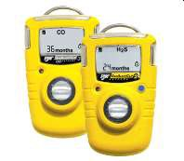

Basic Indoor Environmental
Measurement Tools
Strong flashlight
Camera
Moisture meter
Digital thermo-
hygrometer
Air Flow Indicator vapor
Combustion gas
detector
Carbon monoxide
detector
©2013 Children's Mercy Hospitals and Clinics. All Rights Reserved. 03/13

Slide 65
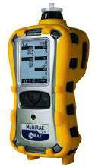
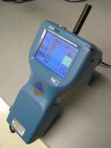
Advanced On-site Measurements
Additional gases
  Carbon Dioxide (CO₂)
  TVOCs
  Indoor Ozone (O₃)
  Formaldehyde (HCHO)
  Nitrogen Dioxide (NO₂)
  Hydrogen Sulfide (H₂S)
Air Velocity Meter
Flow
Air Changes
Air Pressure
Indicate (+/-) pressure
Laser Particle Counting:
Particle ranges between 0.5 um - 10 um
Ultrafine Particle Counting
Particle ranges 0.3 um - 0.01 um.
©2013 Children's Mercy Hospitals and Clinics. All Rights Reserved. 03/13

Slide 66
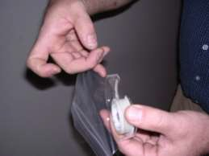
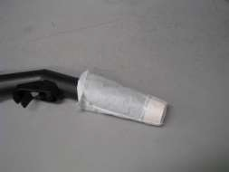




Air Sampling and
Analysis
Several methods
commonly used
The goal of all sampling is to provide the best representation of the environmental conditions on the day of sampling.
©2013 Children's Mercy Hospitals and Clinics. All Rights Reserved. 03/13

Slide 67


Summarize Quantitative Data
so it’s Meaningful
©2013 Children's Mercy Hospitals a
Clinics. All Rights Reserved. 03/13
92
nd

Slide 68
Develop a Healthy Home Action Plan
Plan needs be realistic and feasible
Plan should be do-able
Cost Effective
  Consider the type of home
  Might involve lifestyle changes
  Behavior changes take time, so do them slowly
  Start in child’s room and work your way out
  Should consider your ability to control the environment and sources (school, house, apartment)
When families know where contaminant sources
are, they can learn how to control them.
93
©2013 Children's Mercy Hospitals and Clinics. All Rights Reserved. 03/13

Slide 69

Assessment Report includes a Healthy Home Action Plan for Family-
Connects Home
Assessment to Interventions
Identifies what our HH program will do and what the family is asked to do
Prioritizes interventions
based on hazard risk
©2013 Children's Mercy Hospitals and Clinics. All Rights Reserved. 03/13

Slide 70




Assessment Results Case Review Process
ghts Reserved. 03/13
©2013 Children's Mercy Hospitals and Clinics. All Ri

Slide 71





Tailor Intervention Strategies
Resident education & behavior change: basic component of any housing intervention
Combined structural & behavioral interventions more effective than resident education alone
Healthy homes interventions reduce multiple sources of exposure, affect multiple health conditions
Choose evidence-based interventions
HUD Healthy Home Program Guidance Manual, Chapter 5, Intervention Strategies
©2013 Children's Mercy Hospitals and Clinics. All Rights Reserved. 03/13

Slide 72



Healthy Home Kits- Basic and Advanced
©2013 Children's Mercy Hospitals and Clinics. All Rights Reserved. 03/13

Slide 73
Grant-funded Intervention Costs
Average per home - $1887
Median Intervention Costs by Domain:
Airflow & Ventilation - $880
Allergens & Dust - $300
Moisture Control – $333
Chemical Exposure – $100
Safety & Injury Prevention - $270
98
©2013 Children's Mercy Hospitals and Clinics. All Rights Reserved. 03/13

Slide 74
Kevin Kennedy, kkennedy@cmh.edu
Center for Environmental Health Children’s Mercy Hospitals & Clinics 816-960-8918
©2013 Children's Mercy Hospitals and Clinics. All Rights Reserved. 03/13
99

Slide 75
Asthma Healthy Homes Assessments
Models
Michael McKnight
Vice President of Policy and Innovation
Green & Healthy Homes Initiative

Slide 76

Southeast Regional Asthma Summit
& Healthy Homes Environmental
Exposures Symposium
Michael McKnight 5/18/16
©2016 Green & Healthy Homes Initiative. All rights reserved.
www.ghhi.org

Slide 77



Environmental Assessment &
Education Together
Environmental Assessor-Energy Auditor (HHS/BPI)
Conduct pre-intervention environmental assessments / audits
Develop comprehensive scopes of work for properties
Conduct post intervention assessments and audits
Community Environmental Health Educator (CHES/AE-C)
Conduct resident education during assessment
Coordinate client health surveys and data collection
Distribute HEPA-Vacuum and indoor allergen reduction kit
Referrals and follow-up client services
Review asthma action plan
Medication adherence
Ongoing education, behavioral reinforcement, and band follow-up with PCP / care managers
©2016 Green & Healthy Homes Initiative. All rights reserved.
www.ghhi.org

Slide 78
Healthy Homes Interventions
Installation of mattress and pillow covers
Integrated pest management: gel baits, boric acid, glue traps,
reducing entry points, cleaning/behavioral change (clutter)
Mold remediation
Venting kitchen, bathroom and dryer; filter replacements
Removal or steam cleaning of carpets
Air filtering system installed in child’s bedroom
Air conditioners and dehumidifiers
Provision of a HEPA-vacuum and indoor allergen reduction
cleaning kit
Other Healthy Homes Interventions with leveraged funding (lead, radon, asbestos)
©2016 Green & Healthy Homes Initiative. All rights reserved.
www.ghhi.org

Slide 79

GHHI - A Model That Benefits Families
©2016 Green & Healthy Homes Initiative. All rights reserved.
www.ghhi.org

Slide 80
Healthy Homes Demonstration Project
Mean Change & Percent
Reduction of Key Outcomes
200 units completed with 139 respondents completing 6 month post intervention health surveys
In the past 6 months (N=139) | Intake Mean (StdDev) | 6 Month Mean (StdDev) | Pre Post Mean Change (StdDev) | One-sided t test | Percent Reduction
Hospitalizations | 0.364288 (0.923013) | 0.141791 (0.53667) | 0.238806 (0.824248) | 0.0008 | 65.5%
ER Visits | 0.942857 (1.22193) | 0.701493 (1.097022) | 0.261194 (1.250137) | 0.015 | 27.7%
Physician Visits | 1.76258 (1.462491) | 1.340909 (1.413293) | 0.389313 (1.460098) | 0.002 | 22%
Calls to Physicians | 2 (1.498792) | 1.481203 (1.490381) | 0.515152 (1.565296) | 0.0002 | 26%
Work days missed | 2.76259 (1.954492) | 1.736842 (1.85413) | 1.037879 (2.057959) | 0.0000 | 37%
School/ daycare missed | 2.372093 (2.008069) | 1.787402 (2.091669) | 0.647059 (1.998254) | 0.0002 | 27%
Environmental Justice, Vol 7. Number 6, 2014
©2016 Green & Healthy Homes Initiative. All rights reserved.
www.ghhi.org

Slide 81
Reduced Costs = Cashable Savings
1 asthma-related hospitalization on average
costs $7506 in Baltimore
1 asthma-related emergency room visit on average costs $820 in Baltimore
Asthma hospitalizations and ED visits
Cashable
Savings
[2009-10 data]
©2016 Green & Healthy Homes Initiative. All rights reserved.
www.ghhi.org

Slide 82
Challenges
Funding sources: HUD, DOE, CDBG, philanthropy, utilities, state and local housing funds. Healthcare investment for home remediation services has not been significant.
Currently no standard set of codes for Healthy Homes
measures and approved costs for services
Medicaid Rule Change adjusted “Who” is available to be reimbursed, not “What” services are reimbursable
Coordination of care between medical providers and
community based services is still improving
©2016 Green & Healthy Homes Initiative. All rights reserved.
www.ghhi.org

Slide 83

Opportunities
Medicaid Rule change for reimbursable professionals –
community health worker certifications
Waivers and State Plan Amendments
Hospital community benefit investments - can encompass “physical improvements and housing” and “environmental improvements”
Micro-credentials for home performance professionals
New Managed Care Regulations – “in lieu of” services
Education Funding Connections - Costs school districts $29
per child per school absence
©2016 Green & Healthy Homes Initiative. All rights reserved.
www.ghhi.org

Slide 84
What is Pay For Success?
Pay for Success (PFS) models are cross-sector partnerships in which private investors pay upfront for a social service and then government or healthcare payors repay the investment if and only if agreed-upon outcomes are met.
If outcomes are not met, investors lose money
©2016 Green & Healthy Homes Initiative. All rights reserved.
www.ghhi.org

Slide 85



Benefits of PFS
Progress towards systemic change
Bridges timing gap between service provision and cost savings
Pay for what works
Stable, flexible funding to service providers Shifts focus from remediation to prevention Rigorous program evaluation
©2016 Green & Healthy Homes Initiative. All rights reserved.
www.ghhi.org

Slide 86
The PFS Opportunity for Asthma
SOCIAL IMPACT
6.8M kids with asthma in U.S. (18.7M adults)
14M missed school days due to asthma
9M families living in unhealthy homes
CASHABLE SAVINGS
$56B spent on asthma annually
$5k - $15k per hospitalization
$500 - $5K per ED visit Other Rx & urgent care costs
PROVEN INTERVENTION
40% of asthma episodes caused by home-based triggers
GHHI Healthy Homes Demonstration Project:
66% asthma hospitalizations 28% asthma ED visits
62% participants with 0 absences
88% participants with 0 missed work days
Sources: Center for Disease Control and Prevention (http://www.cdc.gov/nchs/fastats/asthma.htm)
“GHHI: Improving Health, Economic, and Social Outcomes Through Integrated Housing Intervention,” Environmental Justice, Vol. 7, Number 6, 2014
©2016 Green & Healthy Homes Initiative. All rights reserved.
www.ghhi.org

Slide 87









GHHI Maryland PFS Model
Philanthropic Guarantee
& other investors
Investment pays for
cost of intervention
1
7
Repay principal and return
Draw down funds to pay for intervention
2
6
Make success payments from cost savings
Collective Goal: IMPROVE HEALTH AND
SOCIAL OUTCOMES
Home remediation and education
3
5
Validate savings and trigger success payments
Asthma High Utilizers
4
Evaluate outcomes
Flow of funds Services & Evaluation
Graphic altered from: “Pay for Success (PFS) Financing,” by Social Finance, in “Pay for Success: A Primer for Social Innovators,” Social Innovation Fund
©2016 Green & Healthy Homes Initiative. All rights reserved.
www.ghhi.org

Slide 88




GHHI’s PFS work across the country
Leading 10 asthma-focused PFS feasibility studies with healthcare and service
provider partners across the country.
Feasibility studies
Bronx, NY
Buffalo, NY
Chicago, IL
Grand Rapids, MI
Houston, TX
Memphis, TN
Philadelphia, PA
Rhode Island State
Salt Lake City, UT
Springfield, MA
Transaction structuring
Baltimore, MD
Funders of asthma PFS feasibility studies:
GHHI feasibility studies GHHI transaction structuring
©2016 Green & Healthy Homes Initiative. All rights reserved.
www.ghhi.org

Slide 89
Michael McKnight
Vice President of Policy & Innovation
mmcknight@ghhi.org
202-769-5763
@McKnight_GHHI
@HealthyHousing
GHHINational
©2016 Green & Healthy Homes Initiative. All rights reserved.
www.ghhi.org

