Slide 1





Pests Related to Asthma and Integrated Pest Management to Control Them
Brian Forschler, Professor
University of Georgia

Slide 2

Pests related to asthma and IPM
to control them
Brian T. Forschler University of Georgia

Slide 3

US EPA Home Page, 2016 Definition of IPM
Pesticides are powerful tools for controlling pests. However, there are also other tools available for use in pest control, many of which pose greatly reduced risk to human health and the environment than do pesticides. Integrated Pest Management (IPM) is an effective and environmentally sensitive approach that makes use of a variety of these tools. The concept—know what the problem is before you apply pesticides—is fundamental to planning a successful IPM program. IPM relies on a combination of common-sense practices and science-based strategies, rather than solely on pesticide spraying.
Integrated Pest Management (IPM) is an effective and environmentally
sensitive approach to pest management that relies on a combination of
common-sense practices. IPM programs use current, comprehensive information on the life cycles of pests and their interaction with the environment. This information, in combination with available pest control methods, is used to manage pest damage by the most economical means, and with the least possible hazard to people, property,
and the environment.

Slide 4
Supervised Control of Insects
utilizes parasites and predators and makes chemical
control more efficient
Ray F. Smith and Gordon L. Smith
CALIFORNIA AGRICULTURE, MAY, 1949
“A successful supervised control program in a district requires the following:
an intimate knowledge of the insects; a sufficient acreage to finance the district; an informal grower cooperative to administer the district and a properly trained entomologist to supervise the insect control.”

Slide 5
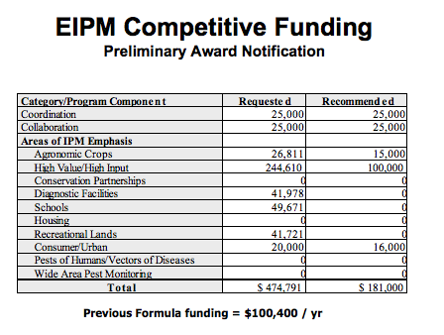
The concept of IPM was birthed as an
agricultural discipline
And it is all
about reducing use of
Pesticides
in a monoculture habitat
that has not translated well to the
heterogeneous urban landscape
20
Insecticide Applications (mean)
Insecticide Applications per Acre
Georgia Cotton
15.8
15
1986-2014
11.9
12.6
10.5
10
7.8
7.4
5
5.0
_{4.2} 4.7 _{4.5}
3.4
3.1 _{2.9} 3.1
3.0
3.3 _{2.8}
2.0
2.6
2.2 _{1.9}
2.6 _{2.4 1.9} 2.6 _{2.4 1.8} 2.6
1.3
0
1986
1988
1990
1992
1994
1996
1998
2000
2002
2004
2006
2008
2010
2012
2014

Slide 6
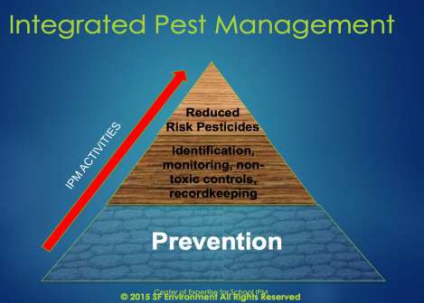
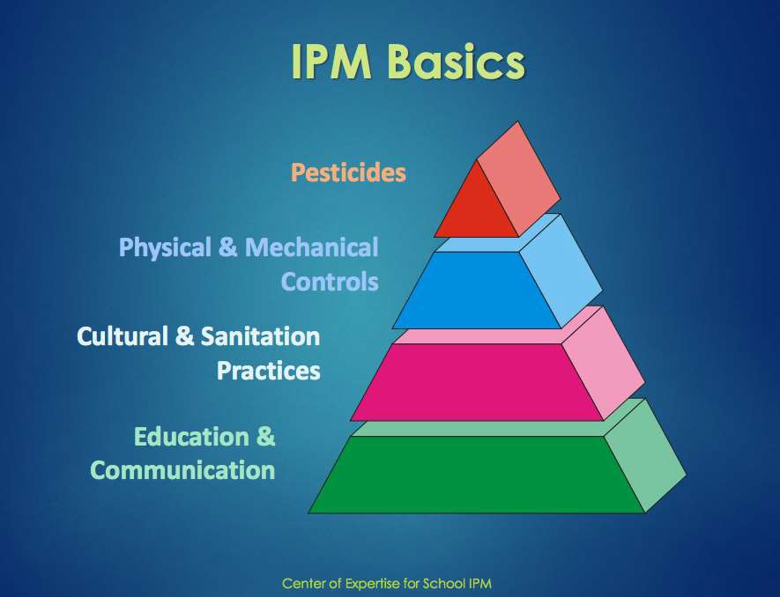
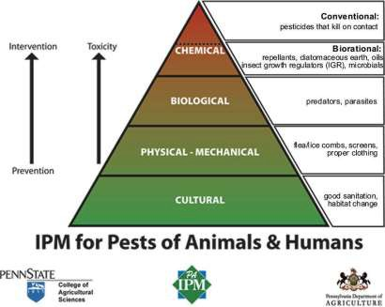
The message continues to evolve but the mechanics of the pest control themes remain the same…

Slide 7

Two views of IPM
Highlighting one cause
for the gulf between theory and practice.
Methodological
The academic and scientist
version
Ideological
The pragmatic and industry version
Greene and Breisch 2002 “Measuring Integrated Pest Management Programs for Public Buildings”
J. Econ. Entomol. 95: 1-13

Slide 8

accountability in
IPM involves
the form of a record-keeping system to acknowledge and
COMMUNICATE:
Site Specific
Conditions – at time of inspection
Suggested Solutions – that should
involve all stakeholders
Actions Taken

Slide 9
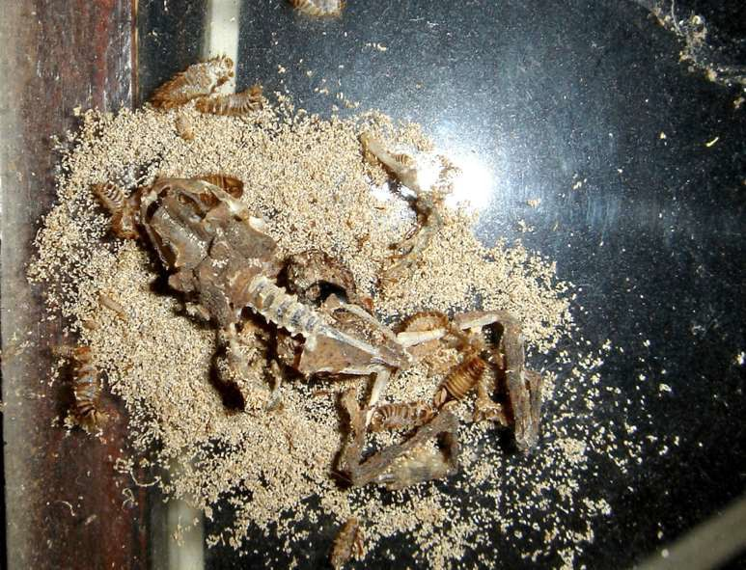













Admit PMP’s
aren’t
magicians
Regulators
Encourage through
incentives
Academia
Provide pragmatic educational opportunities & demonstrations
Sustainability?
Cost?

Slide 10

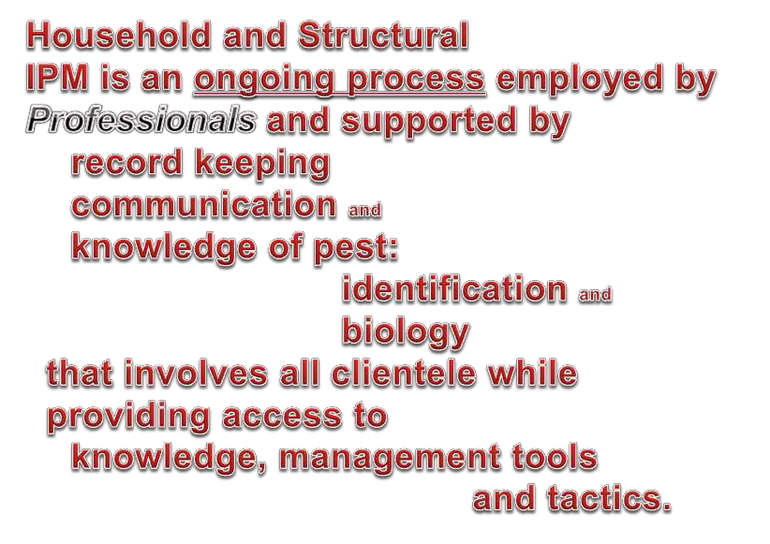

Slide 11
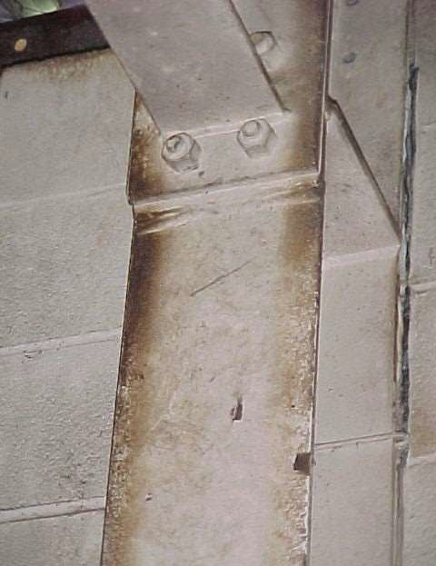
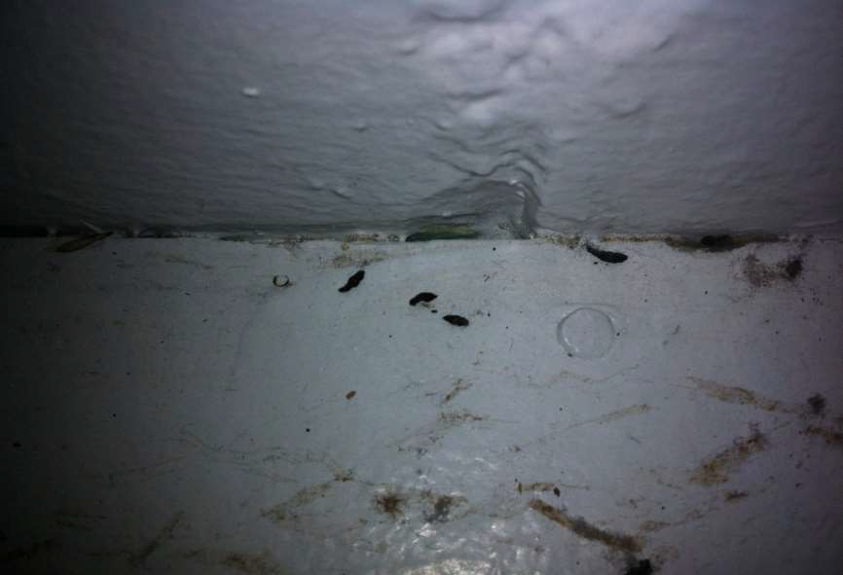
Many pests leave telltale signs.

Slide 12
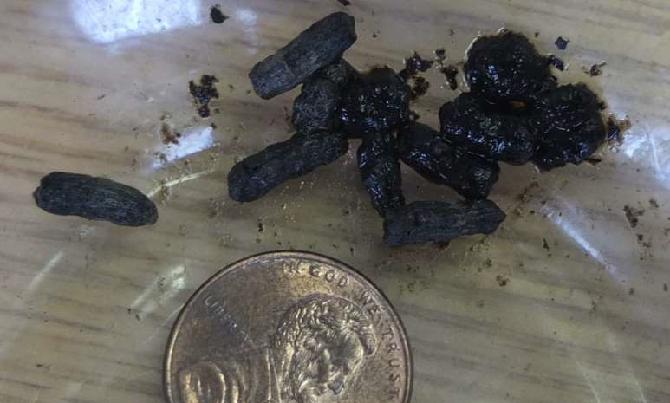
What pest left this ‘mark’?

Slide 13
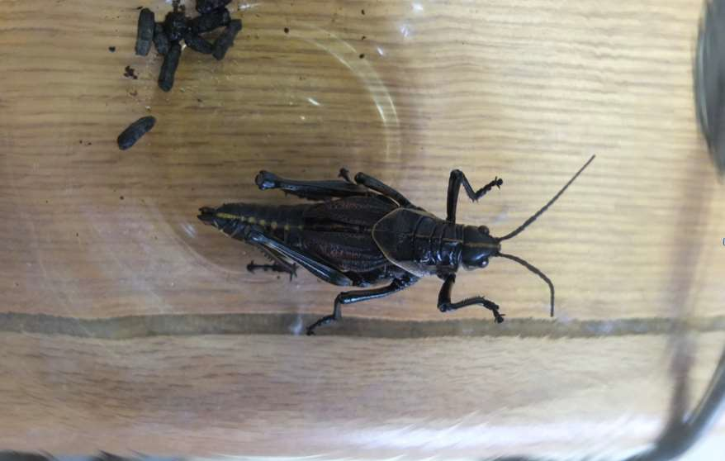
Lubber Grasshopper

Slide 14
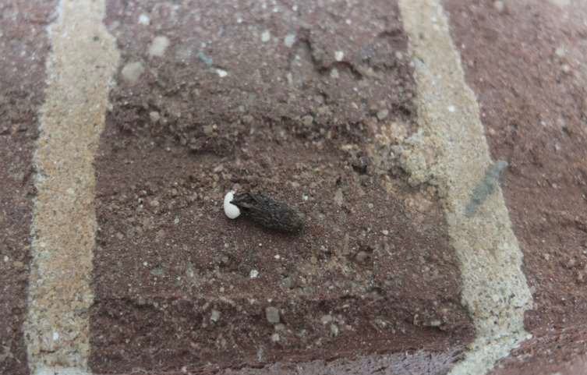
what is this?

Slide 15
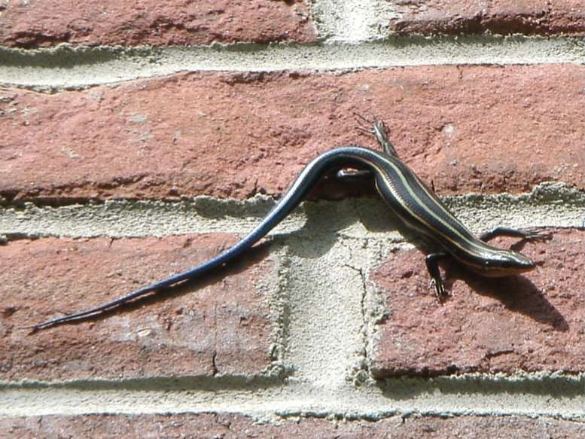

Slide 16
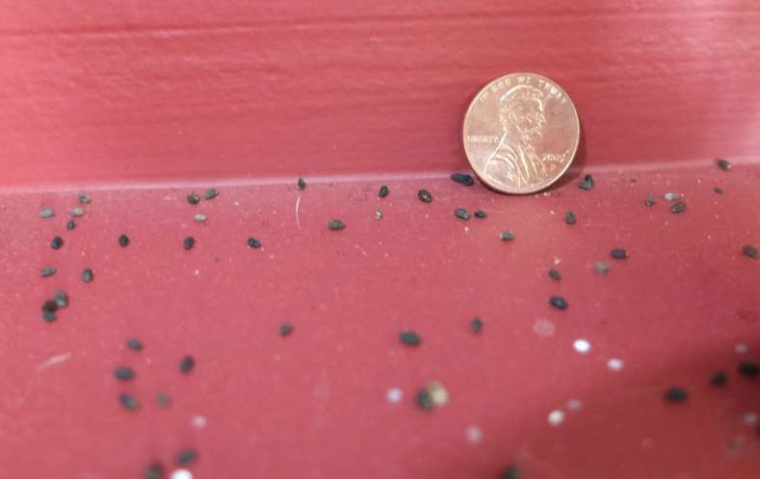
What produced these on an indoor shelf

Slide 17
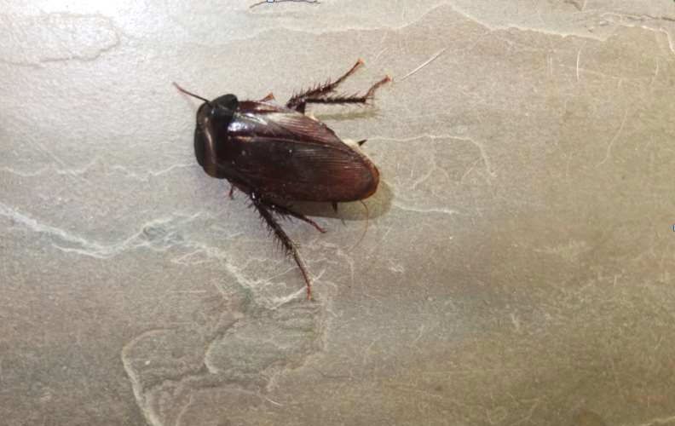
The actual culprit

Slide 18
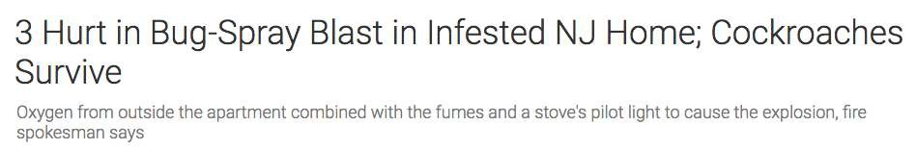
The point...
http://www.nbcnewyork.com/news/local/Bug-Spray-Explodes-in-Infested-NJ-Home-Injuring-3-Cockroaches-Survive-375741381.html
As mentioned in the Smith and Smith (1949) a trained pest professional should be involved at some point to – at the very least - properly identify the pest.
That professional could be;
Academic, Extension specialist, Museum curator
PMP, consultant

Slide 19
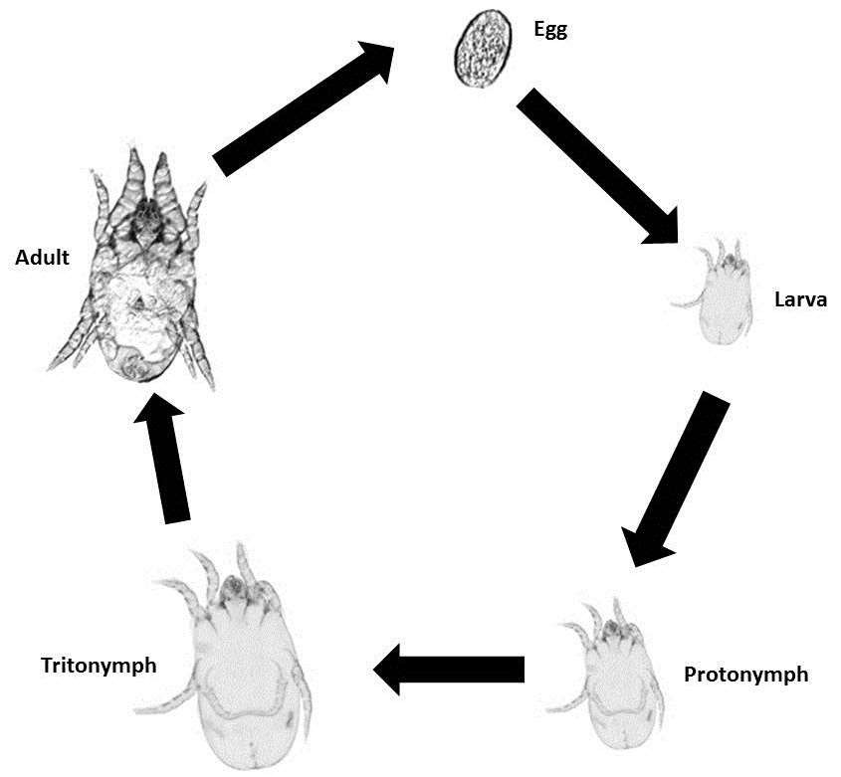
House Dusts Mites
Small – 0.2-mm Eggs/female - 30- 100 Feed upon – shed skin cells
One to three weeks from egg to adult which live 1-3 months
Asthma Issues involve
proteins in
feces, shed cuticle
Big particles (10-30 microns)
Don’t remain airborne
for long

Slide 20
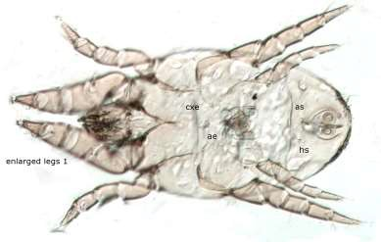
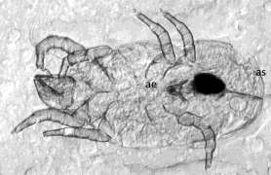
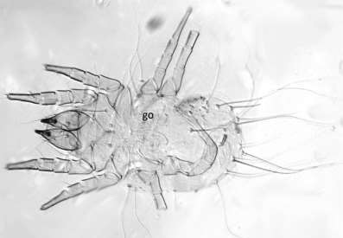
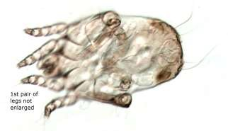
House Dust Mites
Dermatophagoides farinae American dust mite
Suidasia spp., storage mites
Tyrophagus spp., storage mites
Dermatophagoides pteronyssinus
European dust mite

Slide 21
Dermatophagoides farinae Weight (mg) v. Number of Mites Counted
2500
2000
1500
1000
Number of mites counted
y = 204.38x - 159.32
R² = 0.9464
500
Flotation Method Percent
0
Recovered
0.0
2.0
4.0
6.0
Weight (mg)
8.0
10.0
12.0
100.00%
80.00%
60.00%
40.00%
20.00%
0.00%
-20.00%
Percentage Recovered
D. pteronyssinus heat escape extraction efficiency
20.00%
Percent Recovery
15.00%
, 0.45%
10.00%
Trials
5.00%
Sample initally only in EtOH - 1.0 mg weight class Sample initally only in EtOH - 5.0 mg weight class Sample containing dust - 1.0 mg weight class Sample containing dust - 5.0 mg weight class Sample containing kapok - 1.0 mg weight class Sample containing kapok - 5.0 mg weight class
0.00%
1 2 3 4 5 6 1 2
% Recovery of First Heat Escape Extraction
% Recovery of Second Heat Escape Extraction
3
4
5
-5.00%

Slide 22
Managing house dust mites
must be a multi-faceted program
Humidity is critical, below 60% RH will stop most
mite populations
Encase mattress and pillow
Vacuuming w/ HEPA filters, 20-m re-entry period Washing and high-heat drying
Replace/remove carpet
Weekly cleaning surfaces with wet cloth rather
than dry dusters

Slide 23
Roaches
Insects from the order Blattodea
Antigens are proteins – the major ones are found in feces, other secretions and saliva – termed Bla g 1, Bla g 2 and Per a 1.
Large particles (10 microns) with properties like HDM antigens that settle within minutes of vigorous activity.

Slide 24
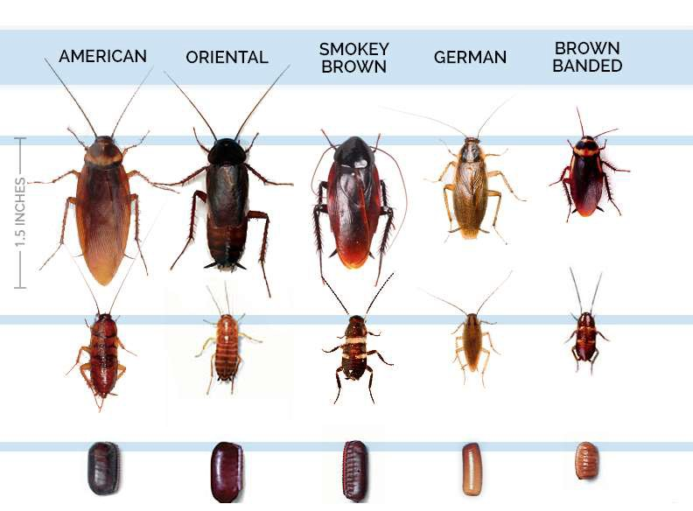
Roaches; Identification is critical

Slide 25
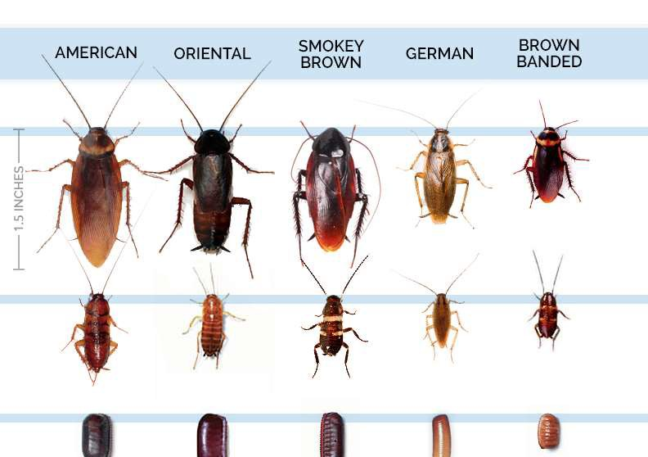
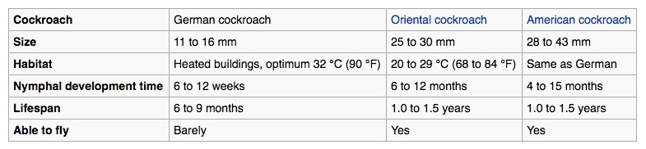
Roaches; Identification is critical

Slide 26
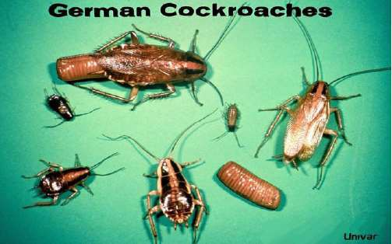
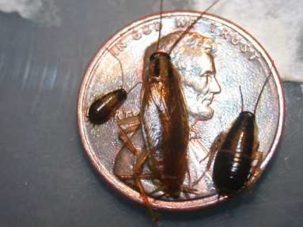
German Roaches (Blattella germanica)
African/SE Asian origin, small… omnivorous, aggregate in harborage, nocturnal, follow structure.
Activity outside harborage varies by
species, age and food/water source

Slide 27
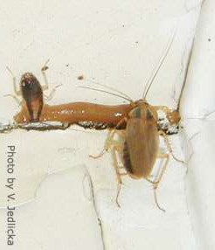
Management of roaches and antigens
Site specific – find source of infestation
Find and reduce sources of food and water
fix leaks, tightly sealed food containers

wash dishes, empty garbage
Find and reduce access to harborage
Clean, clean, clean, (organize, reduce clutter)
don’t dry-dust
HEPA vacuum large populations from harborages, can
use compressed air to force them out
Pesticidal baits should be the toxin-based intervention

Slide 28
Cockroach counts and house dust allergen concentrations after professional cockroach control and cleaning
Rob McConnell, MD*; Craig Jones, MDt; Joel Milam, PhD*; Patty Gonzalez, RNt;
Kiros Berhane, PhD*; Loran Clement, MDt; Jean Richardson, PhD*; Jean Hanley-Lopez, MDt; Kenneth Kwong, MDt; Najib Maalouf, MDt; Judith Galvan, MS*; and Tom Platts-Mills, MD!
Ann Allergy Asthma lmn1unol. 2003;91:546 552.
Table 3.Cockroach Counts and Allefgen ConcootrationIn Different Groups during FolJo·w up
Group N• |  |  |  | Median QOR)
 |  |  | Cockroach | Kitchen 8Ja | Bedroom
 |  |  | count | g 2,U/g | Bia g 2,U/g
Controls
1 wl< |  | 18 | 19 (7-298) | 104 (9.3- 7) | 15 (5.3-79)
5 \111< |  | 16 | 8.5 (2-301) | 31 (12-150) | 16 (9.5-57)
8 w1< |  | 14 | 10 (2-136) | 52 (7.1-129) | 13 (7.9-26)
11 wk |  | 13 | 22 (Q.-249) | 61 (18-247) | 10 (6.3-32)
Sham bait
Baselne |  | 12 | 55 (32-215) | 214 (13-1,403) | 21 (4.5-41)
Preclean/p | ost treatment | 10 | 85 (54-157) | 173 (16-672) | 12 (5.0.-25)
Postel.can |  | 10 | 124 (6&-27 1) | 44 (32-132) | 15 (4.8-27)
Postcfean/post-ro-treatment Insecticide bait |  | 8 | 68 (31-244) | 25(4.8-197) | 7.3 (3.8-24)
Baseline |  | 19 | 136 (14--1,600) | 136 (73-4-02) | 32 (11-113)
Preclean/posttreatment |  | 19 | 26 (4-173) | 171 (28-279) | 28 (7.5-80)
Postclean |  | 19 | 21(2-95) | 179 (63-377) | 17 (13-106)
Postcl.canlpost-rc--treatment |  | 17 | 14 (Q.-26) | 66 (26-197) | 19 (7.8-57)
Abbreviation:IOR.interquanile range.
No.of partic pants (varies by visit).

Slide 29
MICE
Rodents that are omnivorous (mostly plant material) and avoid bright light. They nest in secluded locations, live a year or two as adults are mature in 6 weeks and a single female can produce 5-10 litters a year of 3-14 mice each.
Commensal mice have small territories and live in groups of several females that assist in rearing the young.

Slide 30
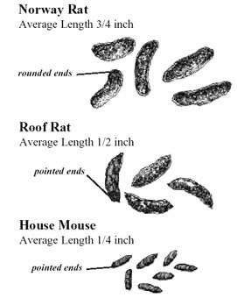
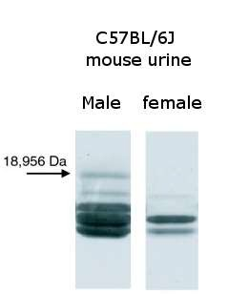
Contamination
from Mice
Mice
40-100 droppings per day
Thousands of microdroplets of urine per day in travels
Contain MUP (Major Urinary Proteins)
Mus m1 & Mus m2
Pheromones Promote
  aggression in male mice
Sex pheromone, attracts females (MUP darcin)
Mice also demonstrate fear to MUPs of predators (cats, dogs, rats)
Carried on small airborne particles
Protein gel showing mouse urinary proteins,
http://en.wikipedia.org/wiki/File:Protein_gel_showing_
mouse_urinary_proteins.jpg

Slide 31
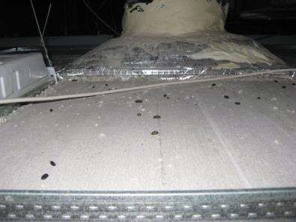
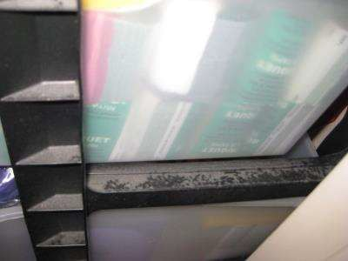
MUP=Major Urinary Proteins
Potent human allergen
Sensitization to rodent MUP is considered a risk factor in childhood asthma
Mus m 1 detected in
  Schools: 96.8%
– Homes: 92.3%
Bla g 2 detected in
  Schools: 1.2%
  Homes: 2.9%
(Permaul et al. 2013. Predictors of indoor exposure to mouse allergen in inner-city elementary schools. Ann Allergy Asthma Immunol. 111(4): 299-301.

Slide 32
Controlling mice
Habitat Modification, Rodent proofing – sealing entryways and access to harborage/nesting sites
Sanitation – store food in rodent resistant packaging, clean up spills
Frightening/repellents – ultrasonic don’t work
Trapping – bait traps unset the first time, placement along travel ways
in out of the way locations, glue boards, live traps
Baiting - use bait stations
First & Second generation anticoagulants most mice need to take several feedings on a bait, use fresh baits

Slide 33
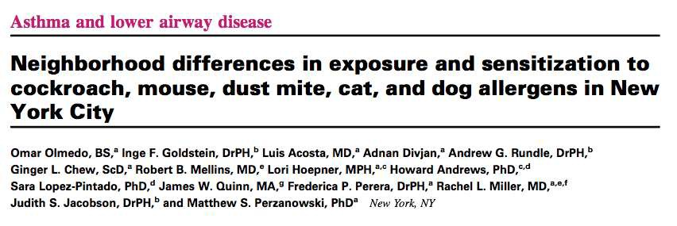

2011
Allergens sampled from bed dust.
Increasing allergen exposure was associated with increased probability of sensitization (IgE) to cockroach (P <.001), dust mite (P < .009), and cat (P < .001), but not mouse (P < .58) or dog (P < .85).

Slide 34
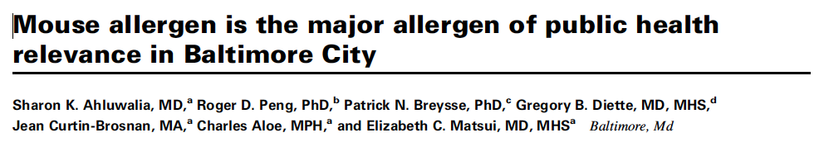

2013
In a community with high levels of both mouse and cockroach allergens, mouse allergen appears to be more strongly and consistently associated with poor asthma outcomes than cockroach allergen.

Slide 35
NIH Public Access
7-
o,..f/EJ>.
0 Au1hor Manuscri1>t
Published in finaledited fonn as:
JAllergy Cli11 lmmunol. 2010 March ; 125(3): 57.5-581. doi:10.1016/j.jaci.2010.01.023.
Pest and allergen exposure and abatement in inner-city asthma: A Work Group Report of the American Academy of Allergy, Asthma & Immunology Indoor Allergy/Ai r Pollution Committee
William J.Sheehan,Moa,b,Pitud A.Rangsithienchai,MO, MAa,c.Robert A.Wood,Mod.Don Rivard BA,RIPMPe,Sasawan Chinratanapisit,Moa.f.Matthew S. Perzanowski,PhD,
MPH!J.h,Ginger L. Chew,sco9.h,James M.Seltzer, MDI,Elizabeth c.Matsui,MD,MHsd.and
Wanda Phipatanakul, MO,Msa.b
•Division ofImmunology,Children's Hospital Boston
Harvard Medical School, Boston
⁰Department of Medicine,McGaw MedicalCenter. Northwestern University, Evanston Program.
Evanston
"Johns Hopkins University School of Medicine, Baltimore
•Rivard's Resources IPM, Waltham
'Department of Pediatrics, BhumibolAdulyadej Hospital, Bangkok 9Mailman Schoolof Public Health.Columbia University, New York "the Columbia Center for Children's EnvironmentalHealth,New York 1he Fallon Clinic at Worcester Medical Center, Worcester
Abstract
Our work group repon details the imponancc of pest allergen exposure i11 inner-city astluna. We will
focus specificaJJy on mouse and cockroach exposure. We willdiscuss how exposure to these pests is co1111nonin lhc inner city and'''lli.ll condi1ions cx st in urbantu-cas that 1nigh1 Ie.:td 10 increased exposure. We will discuss how exposure is associated with allergensensiLizarion and asthma mmbidity. Fi nally. we will discussdifferent met hodsof imervemion and tile effectivenessof these tactics.

Slide 36
Curr Allergy Asthma Rep (2014) 14:419 DOI 10.1007/s11882-014-0419-7
ALLERGIES AND THE ENVIRONMENT (RL MILLER, SECTION EDITOR)
Environmental Remediation in the Treatment of Allergy and Asthma: Latest Updates
Lakiea S.\\'right·\.Va nda Phipatanakul
Published online: I February 2014
© Springer Science+Bu siness Media New Yock 2014
Abstract lo the modem era, the prevalence of asthma and allergies are increasing. It has been speculated that environ­ mental exposures are contributing to thisrise.Several studies demonstrate that common indoor aJJergen exposures exacer­ bate asthma. M inim izing expos ure to allergens and remediating the environment play a critica l role in the treat­ ment of asthma and aJJergies. The most effective environmen ­ tal control measures are tailored muJtifaceted interventions which include education, thorough cleaning, using higb­ efficiency particulate air (HEPA) filters, integrated pest man­ agement, and maintenance of these practices.

Slide 37
http://extension.psu.edu/pests/ipm/community/healthyhomes
http://entomology.ifas.ufl.edu/creatures/main/search_crop.htm#household
http://www.impcenters.org/
********************************************************************* http://ischoolpestmanager.org/
*********************************************************************

Slide 38
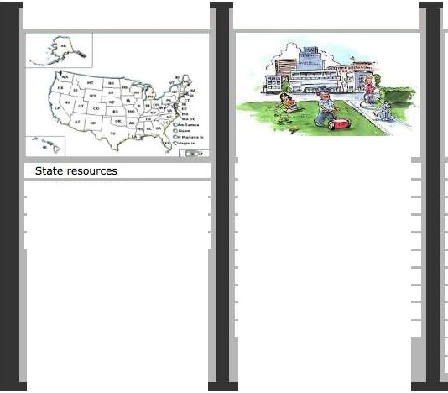

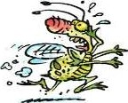
iSchootPEST MANAGER1s
About What's New? File Types Regulations Training Modules Document Toolbox Pests
Help
Contact Us
Show Me Everything
AAA
Go Local
lust For You
What•., Bugging You?
Document Toolbox
!PM Coordinators
Ants
Templates
State!PM Programs
Facilty Managers
Bees & Wasps
Fact Sheets
Laws in each state
CustodialStaff
Cockroaches
Action Plans
State regulators
Grounds/Landscape
Pantry Pests/Stored Products
Presentations
University Extension
SchoolNurses
Public Health
Training
Kitchen Staff
Wood-Destroying Organisms
Guidelines
Teachers
Flies
Checklists
Administrators
Occasional nvaders
Regulations
Pest Mgmt. Professionals
Spiders
Posters/Signs
All Hands
Rodents
Log/Forms
Weeds
Award/Certificate
Wildlife
Switch to Mobile site
This project is a cooperative agreement (#X8-8355900 l)between the US Environmental Protection Agency (EPA) and Texas A&M Agrillfe Extension, withcooperators at Auburn University, Oregon State University, Colorado State University and others. A national School IPM workgroup \•1as assembled to ensure that the best possibJe information would be made available in a format that works for school employees.

Slide 39
Pests Related to Asthma and Integrated Pest Management to Control Them
Rosmarie Kelly, PhD, MPH
Public Health Entomologist
Georgia Department of Public Health Environmental Health Section

Slide 40
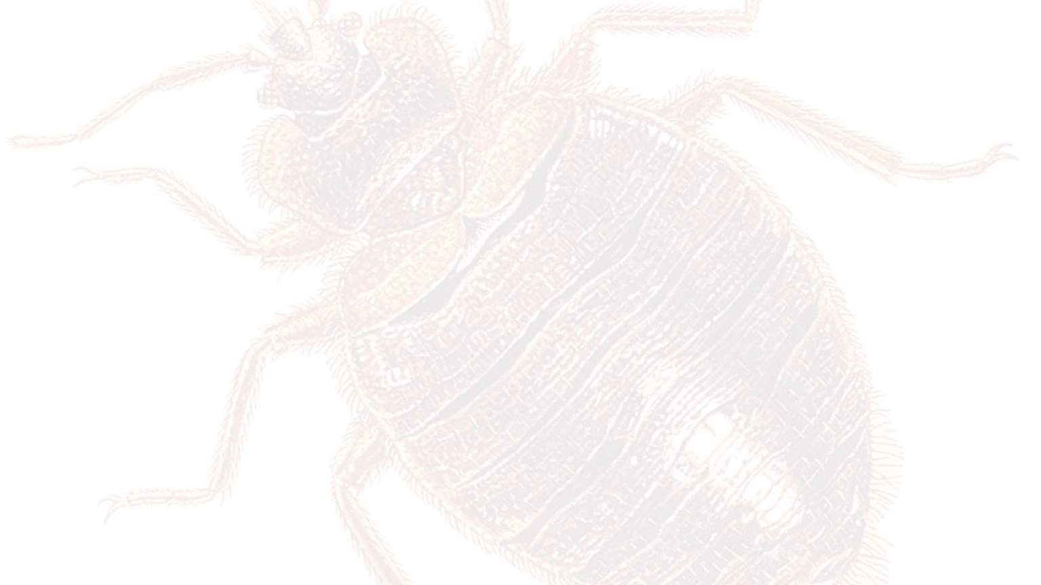
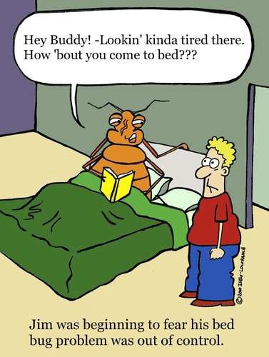


Good Night. Sleep Tight.
Don’t let the bed bugs bite.
Bed Bugs
Rosmarie Kelly
Public Health Entomologist
GDPH

Slide 41
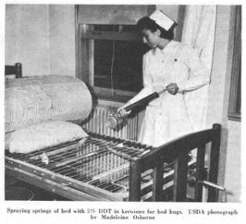
Bed bugs were once a common public health pest
worldwide.
Bedbugs were originally brought to the United States by early colonists from Europe.
Bedbugs thrive in places with high occupancy, such as hotels.
Bedbugs were believed to be altogether eradicated 50 years ago in the United States and elsewhere with the widespread use of DDT.

Slide 42
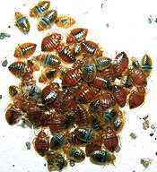
They’re Back!
The cause of this resurgence is still uncertain, but most believe it is related to increased international travel and the use of new pest-control methods that do not affect bedbugs.
The use of baits rather than insecticide sprays is believed to have contributed to the increase.
Bed bugs are once again becoming a problem within residences of all kinds, including homes, apartments, hotels, cruise ships, dormitories and shelters.

Slide 43




Movement
Some of the most common ways new bed bug infestations may be introduced include:
Spending a night (or longer) in an environment which is already infested by bed bugs (hotels, homes, international flights, etc).
Having someone visit from such an infested environment
(bed bugs can be transported in luggage).
Renting furniture or buying used furniture or bedding.
Picking up discarded bedding or furniture from a
curbside, trash collection point or dumpster.

Slide 44
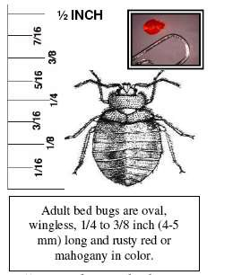
Of the 90 or so species in the family Cimicidae approximately 7 will feed on human blood, but only 2 are commonly found: Cimex lectularius (bed bug) and Cimex hemipterus (tropical bed bug).

Slide 45
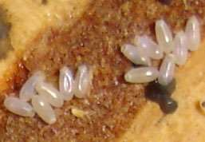
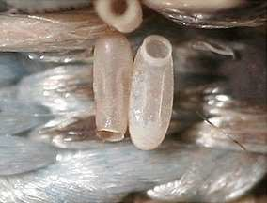
Bed Bug Life Cycle
Incomplete metamorphosis - bugs hatching from egg look just like very small adults. There are three stages of development:
Eggs
Females lay one to five eggs a day over a period of two to 10 months, producing about 200 total.
They deposit the 1mm white eggs intermittently each day in protected places near their hosts' sleeping quarters, cemented to bedding or in cracks.
The eggs hatch in one or two weeks, depending on
temperature.

Slide 46
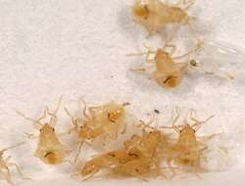
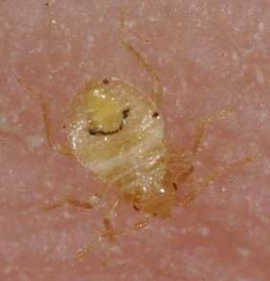
Bed Bug Life Cycle
Nymphs
Tiny and colorless at first, nymphs resemble small
adults.
They require a blood meal between each of five
molts.
Blood meals take about three to 10 minutes, at which time the nymphs inject saliva containing an anticoagulant.
The nymphal stage can last for several weeks under favorable conditions or as long as a year when temperatures or host availability are low.

Slide 47
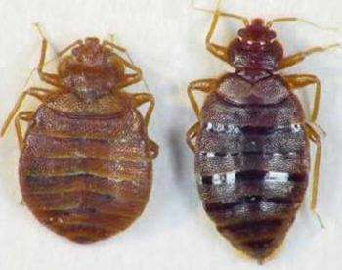
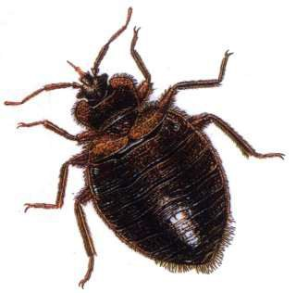
Bed Bug Life Cycle
Adults
About 1/4 inch long, 3/16 inch wide and reddish-brown in color.
The flattened oval bodies are adapted for hiding in narrow spaces.
The head has a pair of four-segmented antennae and
piercing-sucking mouthparts that fold to lie between the first
pair of legs.
The tiny wings are represented only by pads.
The body may become greatly enlarged and blood-red in color
during a blood meal but turns a dirty brown subsequently.
Males and females both feed on blood.
female
male

Slide 48
Bed Bug Facts
Individual bed bugs usually do not feed every night but at
intervals of a few days to a week.
Bed bugs do not usually remain on the host between
feedings.
Once a bed bug is finished feeding, it quickly retreats back to its hiding place.
Bed bugs tend to cluster in cracks, preferring old harborages
and places that smell of other bedbugs.
Bed bugs may also feed on small animals, such as pets.

Slide 49
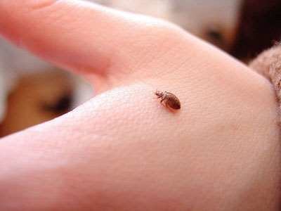
Bed bug bites are painless.
Bed Bug Bites
Reactions to the bites may be delayed up to 14 days before lesions appear.
Reactions may be accompanied by severe itching that lasts for several hours to days.
Scratching may cause the welts
to become infected.
Bed bugs have never been proven to biologically transmit any human pathogen.

Slide 50
Asthma, Infections, and Allergies
Serious infestations and chronic attacks can cause anxiety, stress, and insomnia.
  Development of delusional parasitosis is possible as a person develops an overwhelming obsession with bed bugs.
  Sufferers of delusional parasitosis may feel the sensation of "bugs" crawling on or under their skin, even when in reality no parasites are present.
A number of other symptoms may occur from either the bite of the bed bugs or from their exposure.
  Anaphylaxis, a life threatening allergic reaction from the injection of serum and
other nonspecific proteins, has been rarely documented.
  Bacterial skin infections may occur due to skin break down from scratching.
  Systemic poisoning may occur if the bites are numerous.

Slide 51
Want another reason to fear bed bugs?
They can sometimes set off allergic reactions, asthma attacks, and anaphylaxis according to allergists at the annual scientific meeting of the American College of Allergy, Asthma and Immunology (ACAAI) in Phoenix, Nov 11-16.
The insects can trigger an allergic asthma attack when their dried outer skins and feces become airborne and inhaled by susceptible people.

Slide 52
Controlling Bed Bugs
A comprehensive IPM program to control bed bugs may include a number of non-chemical and chemical methods. Most of these are best done by a licensed pest control professional.
Non-Chemical Means
Put bedding and clothing in the dryer at high temperatures for 30 minutes to kill bed bugs (just washing will generally not kill bed bugs).
Heat infested articles and/or areas to at least 120 ºF (approx.
49 ºC) for 90 minutes to ensure that eggs are killed.
Vacuum
Use mattress and box spring enclosures

Slide 53
Controlling Bed Bugs
Using Pesticides
Use a comprehensive strategy for controlling bed bugs -
pesticides should be only one part of a multi-part IPM plan.
Use the EPA Bed Bug Product Search tool to help you find a pesticide product that meets your needs. Currently, there are over 300 products registered by EPA for use against bed bugs -
- the vast majority of which can be used by consumers.
Before reapplying or trying a different product read the EPA
document, ”When Treatments Don’t Work”.
https://www.epa.gov/bedbugs/controlling-bed-bugs-using-integrated-pest-management-ipm

Slide 54
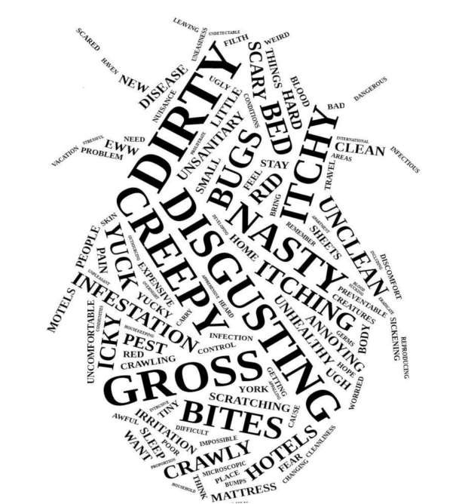
Any Questions?
http://dph.georgia.gov/infestations

Slide 55
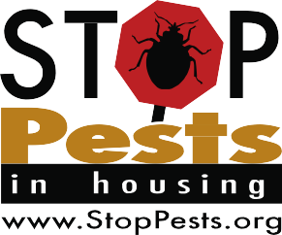


StopPests in Housing
Your IPM Resource
StopPests is Funded by HUD via USDA to provide consultation and training to affordable housing providers to manage pests using integrated pest management (IPM). Contact StopPests for:
In-house staff training “IPM in Multifamily Housing”
Individual consultation and recommendations for challenging situations
Training opportunities including recorded and live webinars and videos
Up-to-date pest control information on StopPests.org and a blog and social media sites

