Slide 1





Environmental Tobacco Smoke as
an Asthma Trigger
Peter Ashley, DrPH, Director
Policy and Standards Division
Office of Lead Hazard Control and Healthy Homes
U.S. Department of Housing and Urban Development

Slide 2



Overview of HUD Activities
on Smoke-free Housing
Peter J. Ashley, DrPH
Office of Lead Hazard Control and Healthy Homes
U.S. Department of Housing and Urban Development

Slide 3
Health Effects from Secondhand Smoke (SHS) Exposure
Children
  More severe asthma
  Increased risk of Sudden Infant Death Syndrome (SIDS)
  Acute respiratory and middle ear infections
Adults
  Heart disease
  Lung cancer
  Stroke
Other
  SHS is classified as a “known human carcinogen” by the
U.S. EPA and other organizations

Slide 4
Thirdhand Tobacco Smoke
Thirdhand Smoke (THS) is the residue from tobacco smoke that settles out on surfaces within the homes of smokers, on clothing, etc.
It contains toxic substances, including nicotine,
carcinogens, and metals such as lead
Chemicals and particles from THS can be resuspended in the air (e.g., from carpets, upholstered furniture)
Health effects?.....asthma trigger?
175

Slide 5
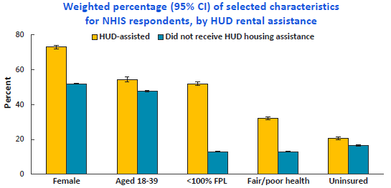
*Preliminary Results: Sample of Residents Receiving HUD Assistance who Participated in NHIS (1999-2012)
Lloyd PC, Brittain J, Golden C, et al. Health characteristics of 1999-2012 NHIS adults receiving housing assistance from HUD. Society of Epidemiologic Research.. Denver, CO. June 16-19, 2015. (Poster presentation)

Slide 6
Snapshot of Public Housing Residents
Characteristic | Public Housing Residents (2014/15) | Comparison
Total Population | ~ 2 Million | N/A
African American | 45% (head of household) | 13.2% of U.S. Population
Hispanic | 25% (head of household) | 17.4% of U.S. population
< 18 yrs old | 37% | 23.1%
Income | 95% of households are low to extremely low income | N/A (relative to local area median income) 177

Slide 7
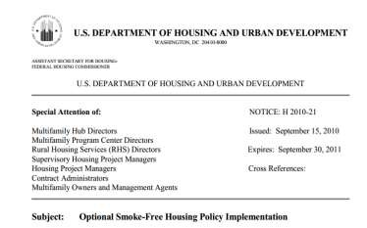
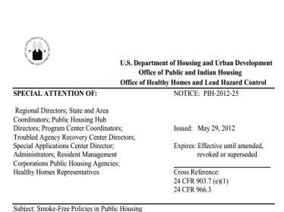
HUD Smoke-Free Initiative
2009: Office of Public and Indian Housing issued Notice PIH 2009-21
2010: Office of Housing issued Notice 2010-21
2012: Office of Public and Indian Housing issued Notice 2012-25 and HUD released “Smoke-free Housing” toolkits
2012 Federal Register Notice published soliciting feedback on HUD initiative (e.g. barriers, effective implementation practices)
2014: Office of Lead Hazard Control and
Healthy Homes releases “Action Guide”
2015: Proposed rule prohibiting smoking in federally financed public housing published
178

Slide 8
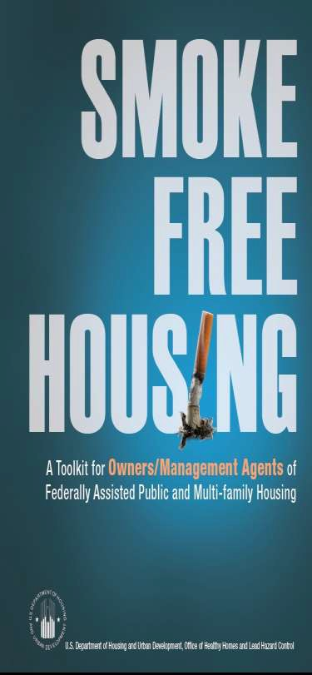
HUD’s Smoke-Free Housing Toolkits
- Released in June, 2012
Endorsed by American Academy of Pediatrics, the American Lung Association, and CDC Office of Smoking and Health
Sent to directors of
~ 2,200 PHAs in 2013
Separate toolkit created
for residents
179

Slide 9
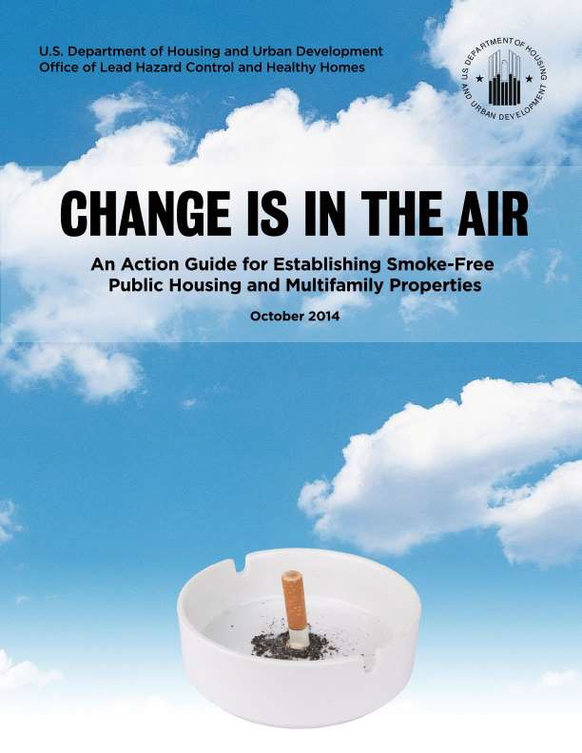
180
oIncorporates information from HUD’s October 2012 FR Notice soliciting feedback on the Department’s SF housing initiative
o116 comments received
(summarized in Appendix)
oIncludes recommendations from 9 housing managers with experience implementing SF policies

Slide 10
Major Contents of Action Guide
Reasons to adopt a SF housing policy
Summarizes interviews with 9 “Smoke-free housing pioneers” (representing: public housing agencies; federally subsidized multifamily housing, and market-rate housing)
Recommended steps to adopting and implementing a SF policy
FAQs
Appendices (HUD Notices; Resources; summary of Fed Reg comments)
181

Slide 11

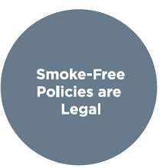

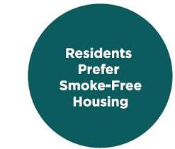
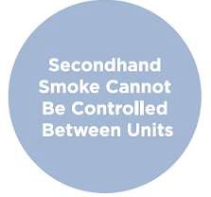
Why a Smoke-Free Housing Policy?
182

Slide 12
183
Smoke-Free Pioneer
I was adamant that the policy was going to take too much effort, and we were going to be spending our whole lives to get people to stop smoking. It was not actually like that at all.
Diane Martin, Property Manager, Housing and
Redevelopment Authority of Duluth, Minnesota

Slide 13
Smoke-Free Pioneer
184
In September of 2009, HUD issued a letter to owners and agents saying that they were in support of smoke-free housing. It could not have come out at a better time, because in January of 2010, we had two very large smoking-related apartment fires within a 10-day period that cost us well over $1 million.
Scott Alderman, Landura Management

Slide 14
HUD’s Proposed Rule to Prohibit
Smoking in Public Housing
185

Slide 15
Basic Requirements of Proposed Rule
Prohibits smoking of lit tobacco products in all indoor areas of public housing properties, including administrative buildings.
Applies to all housing types, including single family.
Benefits identified in rule include improved IAQ, health benefits to residents and staff, reduced fire risk, and lower maintenance costs.
Prohibition would extend to outdoor areas up to 25 ft. from
buildings.
Public housing authorities (PHAs) could add further restrictions (e.g., buffer around playgrounds, property-wide ban).

Slide 16
Basic Requirements (2)
PHAs required to document policies in their annual plans (includes plans for resident engagement, public meetings).
The prohibition would be written into tenants’ leases either
through an amendment or at the annual lease renewal.
Requirement would become effective 18 months after publication of the final rule.
PR does NOT cover:
  Housing units in mixed finance developments
  Privately owned, federally subsidized multifamily housing
(i.e., referred to as Project-based Section 8 housing)

Slide 17
Questions Soliciting Comment in the PR
For PHAs: possible implementation barriers?....estimates on costs of
enforcement?
Does the PR adequately address the adverse effects of smoking and SHS exposure on residents?
What are burdens, costs, or benefits to specific families, children,
persons with disabilities, owners, or the elderly? Impact of eviction?
For PHAs that have implemented SF policies:
  What exceptions to the policy have been granted based on tenants’ requests?
  What experiences, lessons, or advice can you provide on implementation or enforcement?
  What cessation services did you offer residents?...did you partner with outside organizations for this?

Slide 18
Questions Soliciting Comment in the PR (2)
Are there particular areas of support that HUD could provide that would be particularly helpful for implementation?
Should the policy cover electronic nicotine delivery systems (ENDS)?
Should the policy cover water pipes? Do these increase
the risk of fire or property damage?
HUD received 1058 public comments on the proposed rule

Slide 19
invasive
*NUMBER of COMMENT S per ISSUE (estimate)*
Too
Large areas of concern (>100)
Prohibit ENDS
& hookah pipes
Expand to all programs
Problems w/25’|Elderly/disabled impact
Medium areas of concern (25-100)
Allow ENDS (e-cigs) | Difficult to enforce
Punishes poor/working | Enforcement guidance
Make SF optional| Provide cessation help | Doubt science
Smoking on porches and balconies should be allowed | All grounds should be SF
Smaller areas
of concern
PHAs should determine +/- 25’ policy | Courts won’t uphold evictions b/c smoking legal
(<25)
Unf u n d ed man d ate issu e | Better d ef in e “smo kin g ” | Req u ire D SAs (d esign ated smo kin g area s)
Specify graduated enforcement steps| Remove eviction option | Designate buildings as non-smoking
Will increase evictions/homelessness | Allow/forbid grandfathering | Provide more funding | More than 18 mo.
Require resident engagement activities | Require plan amendment | Inconsistent with slowing evictions for criminal past
Need clarification on how PHAs could offer reasonable accommodation | Expand to other unhealthy activities (e.g. fatty foods)
*Note: this summary does not reflect a complete review of all comments submitted.

Slide 20

Areas of support from public
Health aspects of Rule
Scientific basis for Rule
Covering indoor areas
Not allowing exemptions/grandfathering
Using lease as enforcement mechanism
25-foot perimeter
The PR and comments are publically available at:
http://www.regulations.gov/#!docketDetail;D=HUD-2015- 0101

Slide 21
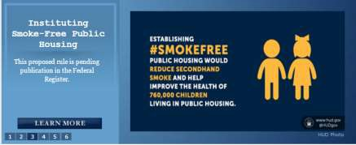
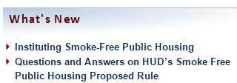
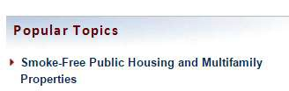
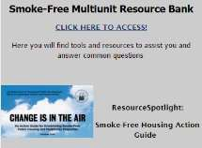
Resources for More Information
Hud.gov and PIH’s website
Office of Lead Hazard Control and Healthy Homes www.hud.gov/healthyhomes

Slide 22
What’s Next
Review comments (initial review conducted)
Issue guidance on enforcement and reasonable accommodations
Technical assistance for PHAs
  Consider designating regional SMEs
  Community Compass TA NOFA
  Support state and local convening's
Update list of PHAs that have smoke free policies (to be completed in May, 2016)

Slide 23
194
Thank You!
peter.j.ashley@hud.gov

Slide 24
Environmental Tobacco Smoke as
an Asthma Trigger
Michelle C. Kegler, DrPH, MPH
Professor, Department of Behavioral Sciences
and Health Education Director
Emory University

Slide 25



Secondhand Smoke and
Asthma:
Promoting Smoke-Free Homes
among
Low Income Households
Michelle C. Kegler, DrPH, MPH Director, Emory Prevention Research Center
Rollins School of Public Health
Emory University

Slide 26


Secondhand Smoke Exposure and Asthma
Major asthma trigger
Causes more severe and frequent asthma attacks in children with asthma
Systematic review by Wang et al. (2015) found:
  Children with asthma and SHS exposure were twice as likely to be hospitalized as children with asthma and no SHS exposure
  SHS significantly associated with ED and urgent care visits, and wheeze symptoms
Contributes to over 200,000 asthma attacks in children per year; some older estimates up to 1 million
Source: Wang et al., 2015; CDC, International Agency for Research on Cancer & CA EPA, Air Resources Board, 2005

Slide 27
Exposure to Secondhand Smoke
in the U.S.
Overall Good News:
Secondhand smoke (SHS) exposure in the U.S. declined from 52.5% of nonsmokers in 1999-2000 to 25.3% 2011-2012 Problems Remain:
Home is now a major source of exposure
Children aged 3-11 had the highest exposure to SHS (40.6%) with detectable serum cotinine in 2011-2012
African Americans (46.8%) more likely to have detectable serum cotinine in 2011-2012 relative to 21.8% in non- Hispanic whites and 23.9% in Mexican Americans
*Cotinine is an objective biomarker of exposure to secondhand smoke
Source: Homa DM, Neff, L.J., King, B.A., Carballo, R.S., Bunnell, R.E., Babb, S.D., Garrett, B.E., Sosnoff, C.S., Wang, L. Vital Signs: Disparities in Nonsmokers' Exposure to Secondhand Smoke- United States, 1999-2012. MMWR. 2015; 64:6.

Slide 28
Prevalence of Smoke-Free
Home Rules
• In 2010-2011, 83.0% of U.S. households had a 100%
smoke-free home rule
91.4% of households with no smokers
46.1% of households ≥ one smoker
Disparities by SES and race/ethnicity (2012-2013 NATS)
  No HS diploma with smoke-free home (75.1%) vs graduate degree (93.1%)
• Asian (91.5%), Hispanic (87.7%), White (84.4%),
African American (76.4%)
Source: King et al., 2016; Kruger et al., 2015

Slide 29

Overview of Resear
ch
Developed and pilot tested a simple smoke-free homes intervention
Efficacy trial of smoke-free homes intervention in
partnership with United Way of Greater Atlanta 2-1-1
Effectiveness trial with North Carolina 2-1-1
Replication trial with 2-1-1 Texas/United Way Helpline
Gulf Coast (Houston area)
National Dissemination through grants program
Pilot test with Georgia Department of Public Health’s
Lead/Healthy Homes program
Adaptation for American Indian/Alaska Native families
Adaptation for delivery through other channels
Grant Number U01CA154282 from the National Cancer Institute.

Slide 30



What is 2-1-1?
An information and referral system (call centers and websites)
Typically operated by United Way agencies; consists of over 200 state and local call centers operating in all 50 states
Over 16 million callers a year
A large majority are seeking assistance with basic needs such as paying for shelter, heat, electricity and food
Callers are disproportionately low-income, unemployed, uninsured and have less education than the general public

Slide 31
Why a “Brief” Intervention?
Easier to deliver in a range of settings
Higher potential for scalability and greater reach
Component | Timing | Description
1 | Week 0 | First mailing of print materials
2 | Week 2 | Coaching call
3 | Week 4 | Second mailing of print materials
4 | Week 6 | Third mailing of print materials

Slide 32


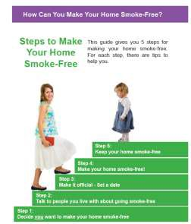
Component #1: SFH toolkit

Slide 33

Component #2: Coaching
Call
I can help you make your home smoke- free!

Slide 34

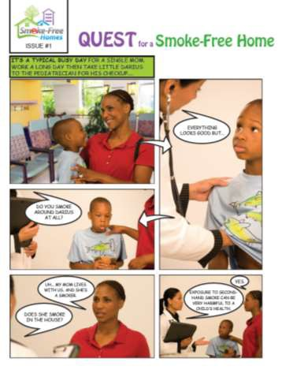
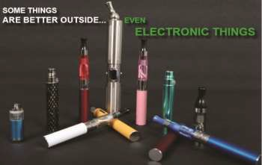
COMPONENT #3:
Challenges/Solutions booklet, Photo
Story, and Electronic Cigs

Slide 35
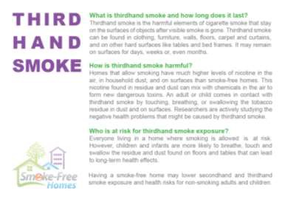
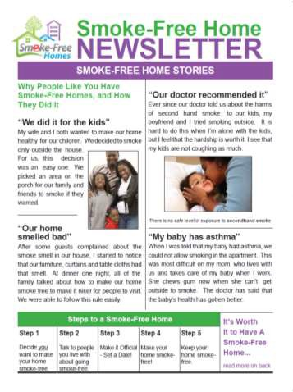


COMPONENT #4: Newsletter, Factsheet, Stickers, Window
Cling

Slide 36
Efficacy Trial in Atlanta: Demographics of
Participants (n=498)
Gender | N | %
Male | 86 | 17.3
Female | 412 | 82.7
Age
Mean | SD | Range
40.2 | 10.9 | 19-70
Race/Ethnicity | N | %
African American/Black | 41 | 83.3
White | 57 | 11.5
Other | 25 | 5.0
Hispanic | 9 | 0.2
Relationship status | N | %
Not married, living w/ partner | 137 | 27.5
Married | 83 | 16.7
Single | 278 | 55.8
Education | N | %
Less than high school | 16 | 3.2
Some high school | 108 | 21.7
High school graduate or GED | 197 | 39.6
Vocational/technical school | 10 | 2.0
Some college | 130 | 26.1
College graduate or higher | 37 | 7.4
Household income | N | %
$10,000 or less | 277 | 55.6
$10,001 - $15,000 | 81 | 16.3
$15,001 - $20,000 | 57 | 11.5
$20,001 - $25,000 | 30 | 6.0
$25,001 - $35,000 | 33 | 6.6
$35,001 - $50,000 | 13 | 2.6
$50,001 - $75,000 | 1 | 0.2
Don't know | 5 | 1.0
Household size (income) | Mean | SD
 | 3.5 | 1.7
Smoking Status | N | %
Nonsmoker | 101 | 20.3
Smoker | 397 | 79.7

Slide 37
Efficacy Trial in Collaboration with United
Way of Greater Atlanta 2-1-1
Primary Outcome: Household Smoking
Bans
Baseline
HH smoking ban | Intervention |  |  |  |  |  |  | Control |  |  | p-value
 | N |  | % |  |  |  |  | N |  | %
full ban | Not eligible |  |  |  |  |  |  |  |  |  | .60
partial ban | 154 |  |  | 62.6 |  | 152 |  |  |  | 60.3
no ban | 92 |  |  | 37.4 |  | 100 |  |  |  | 39.7
total | 246 |  |  |  |  | 252
3 months
HH smoking ban | Intervention |  |  |  |  | Control |  |  |  |  | p-value
 | N |  |  | % |  | N |  |  | %
full ban | 58 |  |  | 30.4 |  | 33 |  |  | 14.9 |  | <.0001
partial ban | 98 |  |  | 51.3 |  | 101 |  |  | 45.5
no ban | 35 |  |  | 18.3 |  | 88 |  |  | 39.6
total | 191 |  |  |  |  | 222
6 months
HH smoking ban |  | Intervention |  |  |  |  | Control |  |  |  | p-value
 |  | N |  |  | % |  | N |  |  | %
full ban |  | 74 |  |  | 40.0 |  | 53 |  |  | 25.4 | .0003
partial ban |  | 83 |  |  | 44.9 |  | 93 |  |  | 44.5
no ban |  | 28 |  |  | 15.1 |  | 63 |  |  | 30.1
total |  | 185 |  |  |  |  | 210
Intervention participants were significantly more likely to have a smoke-free home than control participants (p = .001) - binary logistic growth modeling (intent-to-treat). Self-report validated with air nicotine monitors.
Kegler M, Bundy L, Haardoerfer R, et al. A minimal intervention to promote smoke-free homes among 2-1-1 callers: A randomized controlled trial. American Journal of Public Health, 105(3):530-7, 2015.

Slide 38
Comparison of Primary Results across Trials
Result | Atlanta | North Carolina | Texas
Three month | I: 30.4% | I: 38.1% | I: 46.6%
full ban | C: 14.9% | C: 19.3 | C: 25.4%
 | Diff: 15.5% | Diff: 18.8% | Diff: 21.2%
Six month | I: 40.0% | I: 43.2% | I: 62.9%
full ban | C: 25.4% | C: 33.2% | C: 38.4%
 | Diff: 14.6% | Diff: 10.0% | Diff: 24.5%
Six month OR from ITT | 1.56 | 1.72 | 2.19

Slide 39
National Grants Program for 2-1-1 RFA process
Application Review
Two-stage (31 initial; 13 final)
Two independent reviewers per app
Four criteria: impact, need, support, plan
NIH scoring (1-9)

Slide 40

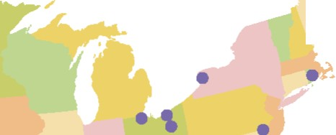

•
•
•
•
•
• •
•
•
•
••
•
•
Applicants

Slide 41
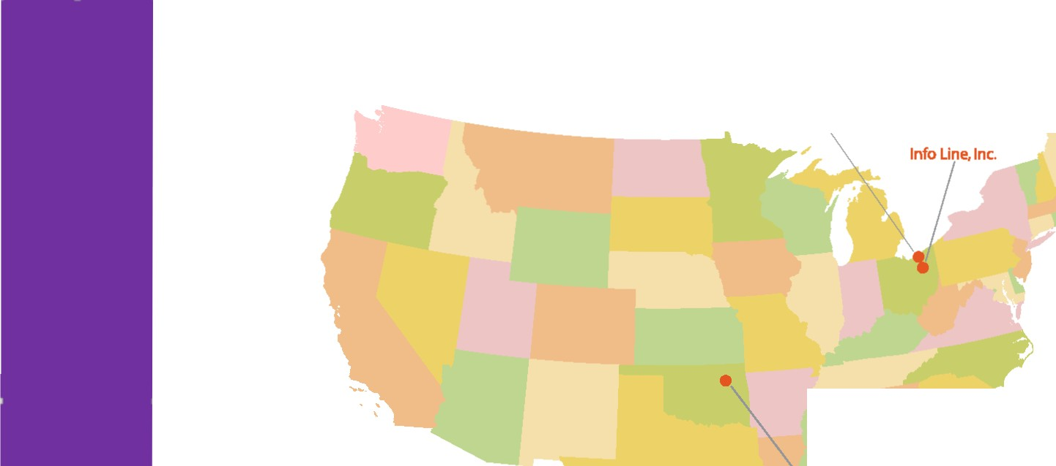

UnitedWay of Greater
Cleveland (United Way 2-1-1)
•----1--_United Way of Alabama
(2-1-1Connects Alabama}
Heart of Florida
•-united Way 2-1-1
Awardees
Community Service Council/
2-1-1 Helpline Program

Slide 42
National Grants Program Demographics
 | Total
 | N | (%)
Total enrolled as of 4-26-2016 | 2130 | 100.0
Gender
Male | 358 | 16.8
Female | 1769 | 83.1
Race/Ethnicity
African American/Black | 1149 | 53.9
White | 753 | 35.4
Other | 212 | 10.0
Smoking Status
Nonsmoker | 340 | 16.0
Former Smoker | 186 | 8.8
Current Smoker | 1599 | 75.3

Slide 43

Pilot Study to Integrate Smoke-Free Homes Intervention into Georgia Healthy Homes Program
Difficult time finding families that reported smoking in the home
But, of those enrolling in the program and completing follow-up, (n=22) 27.3% established a household smoking ban and this was validated by air nicotine monitors

Slide 44
Smoke-Free Multi-Unit Housing in
Georgia (PI: R. Haardörfer)
Investigate presence and type of smoke-free
policies in MUH two cities in Georgia
  Atlanta – smoking still allowed in bars and no MUH regulations
  Savannah – progressive SF policies include electronic cigarettes, restrict smoking in outdoor areas of restaurants, and prohibit smoking in common indoor areas in MUH
Investigate knowledge, beliefs, and attitudes of property managers and owners (PM/Os) regarding smoke-free MUH policies including e-cigarettes

Slide 45


Property characteristics
 | Mean/N | SD/%
Type of Property
Market-rate general | 63 | 72.4
Market-rate senior | 1 | 1.2
Low-income public general | 3 | 3.5
Low-income public seniors | 3 | 3.5
Mix of market-rate &subsidized | 15 | 17.2
Other | 2 | 2.3
Number of buildings | 14.7 | 15.8
Number of units | 193.9 | 107.9

Slide 46
Smoke-free policies
No differences between Atlanta and Savannah
45.1% (N = 41) had some SF policy
Of those
19.5% allowed no smoking on the entire property
29.3% allowed no smoking in individual units
75.6% included some common outdoor areas in the SF policy
82.9% included some common indoor areas in the SF policy

Slide 47
Reasons to adopt
 | Any SF policy |  |  | SF Units |  | No SF Units |  | p
 | N | % |  | N | % | N | %
Reduce fire hazards | 33 | 80.5 |  | 16 | 80.0 | 17 | 81.0 | 0.26
Reduce complaints from residents | 30 | 73.2 |  | 15 | 75.0 | 15 | 71.4 | 0.23
Improve health of residents | 28 | 68.3 |  | 14 | 70.0 | 14 | 66.7 | 0.10
Reduce maintenance costs | 27 | 65.9 |  | 16 | 80.0 | 11 | 52.4 | 0.02

Slide 48
Compliance
How many residents comply with the SF policy? | Any SF policy |  |  | SF Units |  | No SF Units |  | p
 | N | % |  | N | % | N | %
All | 12 | 29.3 |  | 3 | 15.0 | 9 | 42.9 | 0.048
Most | 27 | 68.9 |  | 16 | 80.0 | 11 | 52.4
Half or less | 2 | 4.8 |  | 1 | 5.0 | 1 | 4.8
Answer choices were: All, Most, About half, Less than half, A few, & None

Slide 49
Enforcement
Enforcement techniques used (Yes reported) | Any SF policy |  |  | SF Units |  | No SF Units |  | p
 | N | % |  | N | % | N | %
Written notices due to complaints | 29 | 70.7 |  | 17 | 85.0 | 12 | 57.1 | 0.05
Informal discussion | 26 | 63.4 |  | 16 | 80.0 | 10 | 47.6 | 0.03
Written notices based on staff inspections | 22 | 53.7 |  | 15 | 75.0 | 7 | 33.3 | 0.01
Fines | 10 | 24.4 |  | 6 | 30.0 | 4 | 19.1 | 0.38
Terminating leases | 7 | 17.1 |  | 4 | 20.0 | 3 | 14.3 | 0.63

Slide 50
Knowledge about SF policies
 | All
Residents who think they are harmed by tobacco smoke … | N | %
can sue owners | 31 | 34.1
may initiate claims under the Americans with Disabilities Act | 30 | 33.0
Smoking units have higher maintenance costs | 86 | 94.5
Smoking prohibitions in apartment complexes may reduce insurance costs | 77 | 84.6
Cities and counties in the US have adopted local laws that prohibit smoking in multi- unit housing | 50 | 55.0
Do you believe that PM/Os can legally adopt policies that prohibit smoking on their properties, including all individual residential units, common areas, and exterior grounds? (Yes) | 75 | 82.4
Note: No significant differences between those with and without any smoke-free policy

Slide 51
Promoting Smoke-Free Policies in Public versus Affordable Housing: Understanding
Similarities and Differences
Conduct key informant interviews with affordable and public housing authority decision-makers to identify similarities and differences in processes, facilitators and barriers to adoption, implementation and enforcement of smoke-free policies (N=36/40).
Conduct interviews with resident opinion leaders within affordable and public housing to identify resident perspectives on barriers and facilitators to adoption, implementation and enforcement of smoke-free policies (n=23).
Disseminate findings and tools for tobacco control practitioners interested in promoting smoke-free policies within the affordable housing community.

Slide 52
Smoke-Free Homes Team and
Advisory Committee members
University Partners
Emory University: Michelle C Kegler, Carla J Berg, Lucja T Bundy, Cam Escoffery, Regine Haardörfer, Shadé Owolabi, Erin Lebow-Skelley, Jaimie Lee, Liz Hook, Sajani Patel
University of Texas, Houston: Pat Mullen, Lara Savas, Jo Ann Arely Monroy, Maria Ferrnandez
University of North Carolina, Chapel Hill: Rebecca Williams, Jana Stollings, Kurt Ribisl
Washington University in St. Louis:
Matt Kreuter, Nikki Caito
San Diego State University: Mel Hovell
United Way 2-1-1’s
St. Louis, MO: Regina Greer
North Carolina: Marti Morris Atlanta, GA: Donna Burnham Houston, TX: David Jobe
State Tobacco Prevention & Control Programs
Georgia: Yomi Fabayo, Kenny Ray
Missouri: Michael Carter
Texas: Barry Sharp
North Carolina: Sally Herndon
Tobacco Technical Assistance Consortium (TTAC)
Madeleine Solomon

Slide 53
Environmental Tobacco Smoke as
an Asthma Trigger
Oluwayomi Fabayo, MPH
Program Consultant
Georgia Tobacco Use Prevention Program

Slide 54


Environmental Tobacco Smoke on Increasing Asthma
Triggers
Presentation to: Presented by: Date:
Healthy Homes Symposium Participants
Oluwayomi Fabayo, MPH May 18th 2016

Slide 55

Overview of Georgia Tobacco Use Prevention Program
The Georgia Tobacco Use Prevention Program (GTUPP) plans, implements and evaluates evidence based interventions designed to reduce the burden of tobacco- related morbidity and mortality in Georgia.
Tobacco Control Goal Areas
Preventing the initiation of tobacco use among young people.
Promoting quitting among young people and adults.
Eliminating exposure to secondhand tobacco smoke.
Identifying and eliminating the disparities related to tobacco use among various population groups.

Slide 56
Burden of Tobacco Use in Georgia
Tobacco use is the leading cause of preventable illnesses and deaths in the users and non-users with over $2 billion healthcare cost annually and over 11,000 deaths annually in Georgia.
Currently, adult smoking rate is 17.4% (1.4 million) and the youth smoking rate among middle school is 4% (14,000) and high school is 13% (53,000).
Four percent (4%; 5,500) of pregnant women in Georgia smoked during the last three months of their pregnancy.
Data Source: 2014 Behavioral Risk Factor Surveillance System (BRFSS) and 2013 Youth Risk Behavior Survey (YRBS)

Slide 57
Burden of Tobacco Use in Georgia
Approximately 27,000 (8%) middle school students and 79,000 (19%) high school
students in Georgia used some form of tobacco.
14,000 (4%) middle school students and 53,000 (13%) high school students smoked cigarettes.
13,000 (4%) middle school students and 42,000 (9%) high school students used smokeless tobacco.
Data Source: 2013 Youth Risk Behavior Survey (YRBS)

Slide 58
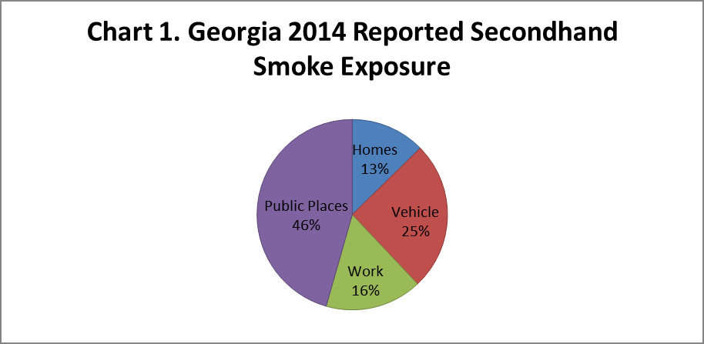
Burden of Environmental Tobacco Smoke in Georgia
Data Source: 2014 Georgia Adult Tobacco Survey

Slide 59
Environmental Tobacco Smoke & Asthma
38,000 (13%) middle school students, 50,400 (14%) high school students, and
630,000 (8%) adults in Georgia have asthma.
Among those with asthma, approximately 2,100 (5%) middle school students, 6,100 (13%) high school students, and 140,000 (23%) adults are current smokers.
Among youth with asthma, approximately 13% of middle school students and 21% of high school students are exposed to secondhand smoke at home or in the car.

Slide 60

Thirdhand Smoke
Thirdhand smoke triggers asthma attacks and it also worsens asthma
attack.

Slide 61
ENDS
Electronic nicotine delivery systems (ENDS) are handheld devices that produce an aerosolized mixture from a solution typically containing concentrated nicotine, flavoring chemicals, and propylene glycol to be inhaled by the user.
ENDS contains nicotine, heavy metals, ultrafine particulate and cancer causing agents like acrolein.
ENDS emits lower levels of dangerous toxins.
ENDS are not safe and contributes to indoor asthma triggers.
Studies have shown that the use of e-cigarette increases the prevalence and severity
of asthma attacks (Cho & Paik, 2016)

Slide 62

Eliminating Tobacco Use Related Asthma Triggers in Georgia

Slide 63
Eliminating Tobacco Use Related Asthma Triggers in Georgia
Smokefree Homes and multiunit housing environment
Smokefree/ tobaccofree
Parks and Recreation
Smokefree Vehicles
Smokefree bars, restaurants and workplaces
Smokefree Cities

Slide 64
Eliminating Tobacco Use Related Asthma Triggers in Georgia
Tobacco-free Schools
Asthma-friendly Environment for kids
Tobacco-free Colleges and Universities

Slide 65
Eliminating Tobacco Use Related Asthma Triggers in Georgia
Georgia Smokefree Air Act of 2005
The Georgia Smokefree Air Act was enacted in 2005 prohibiting smoking inside most public places including private residence used as a licensed child care, adult day care and healthcare facility.

Slide 66
Eliminating Tobacco Use Related Asthma Triggers in Georgia
Multiunit Housing
Currently, 13 Public Housing Authorities are smoke-free
3 low income housing/senior housing are smoke-free
Over 50 private housing (apartment communities) are smokefree
Breatheasy Georgia Workgroup was developed in partnership with the Emory Prevention Research Center, Georgia Apartment Association, American for Non-Smokers’ Rights; Tobacco Control Legal Consortium, public health districts; public housing authorities, community organizations and health systems.
Breatheasy Georgia has developed strategies to educate, provide technical assistance and support multiunit housing environments to promote the adoption, implementation and enforcement of smoke- free policy.

Slide 67
Eliminating Tobacco Use Related Asthma Triggers in Georgia
Smokefree Cities/Counties
Efforts are in place to promote the adoption of a comprehensive smoke-free policy in cities and counties.
Currently, we are working with the City of Columbus and Augusta to promote the
adoption of comprehensive smoke-free policy.
The City of Savannah, City of Pooler, City of Morrow, City of Buena Vista and Chatham County have adopted a comprehensive smoke-free policy
There are several municipalities that have a stronger smokefree ordinance than the Georgia Smokefree Air Act of 2005.

Slide 68
Eliminating Tobacco Use Related Asthma Triggers in Georgia
Hospitals
The Georgia Tobacco Use Prevention Program partnered with the Georgia Hospital Association to promote the adoption of tobacco-free policies in hospitals making the environment asthma friendly.
This partnership has led to 131 tobacco-free hospitals and 16 smokefree hospitals.

Slide 69
Eliminating Tobacco Use Related Asthma Triggers in Georgia
Tobacco-free workplaces
The Georgia Tobacco Use Prevention Program (GTUPP) provides technical assistance to worksites to promote the adoption of tobacco-free policy in worksites.

Slide 70
Eliminating Tobacco Use Related Asthma Triggers in Georgia
Tobacco-free Schools, Colleges and Universities
Currently, 109 school districts are tobacco-free making the school environment asthma friendly.
46 colleges and universities are tobacco-free.
GTUPP partnered with the Truth Initiative to promote the adoption of tobacco-free policy in all HBCU campuses (Historical Black Colleges and Universities)
Parks & Recreation
Currently, 20 parks and recreation are tobacco-free; 9 parks and recreation are smokefree.
GTUPP partnered with the Georgia Park and Recreation Association to promote the adoption of tobacco-free policy making all the parks and recreation asthma friendly.

Slide 71
Eliminating Tobacco Use Related Asthma Triggers in Georgia
Education campaign on the dangers of secondhand smoke exposure
The Georgia Tobacco Use Prevention Program partners with public health districts, community organizations, colleges, universities and hospitals to educate on the dangers of secondhand smoke exposure.
The education campaign has led to business voluntary adopting smoke-free policy promoting asthma friendly environment.

Slide 72
Georgia Strategies to Address Tobacco Use Related Asthma
Triggers
Tobacco-free policy that include ENDS.
Smokefree homes (including ENDS).
Smokefree multiunit housing (including ENDS).
Smokefree vehicles (including ENDS): In the last couple of years a bill is introduced to ban smoking in vehicles with children in Georgia during legislative session. The bill is yet to pass.

Slide 73
Resources to Support Policy Adoption
Technical assistance towards policy adoption.
Trainings to increase capacity.
Technical assistance on policy implementation and enforcement.
Cessation support.

Slide 74

Georgia Tobacco Quit Line

Slide 75

What is the Georgia Tobacco Quit Line?
The quit line is an evidence based, best practice tool to provide cost-free help in tobacco
cessation
Offers effective, evidence-based interventions to help Georgians quit smoking and using tobacco products
Individuals 13 years of age and older can call the quit line
  Tobacco users, relatives/friends of tobacco users
  Healthcare providers, general public
Vendor is nationally ranked, serving multiple states
different
Qualified interpreters available to accommodate Georgians who speak
languages

Slide 76
Benefits of Quit Lines*
Accessible, Effective, Efficient and FREE
Eliminates barriers of traditional cessation classes (e.g. waiting for classes to form, busy schedules)
Helpful for those residing in rural or remote areas
Appeals to tobacco users reluctant to seek help provided in a group setting
Provides direct referrals to local programs
Accommodates busy schedules
* Centers for Disease Control and Prevention. Telephone Quitlines: A Resources for Development, Implementation and Evaluation

Slide 77
Program Current Offerings
Available to Georgia tobacco users aged 13 years and older
Phone Counseling
  5 call Program available to all
  10 call program available in Pregnant and Postpartum Women
Youth Support Program
Integrated Web Coach
4 weeks of Nicotine patches or gum, while supplies last
Referral to Community Resources
Coordination with Heath Plan and Employer benefits
Materials Only

Slide 78

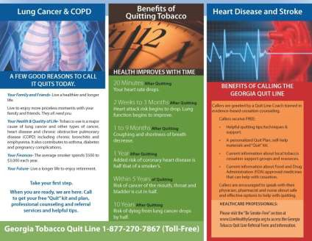
Contact the Georgia Tobacco Quit Line
24 hours a day, 7 days a week (including holidays)
English: 1.877.270.STOP (1.877.270.7867)
Spanish: 1.877.2NO-FUME
(1.877.266.3863)
Hearing Impaired, TTY Services:
1.877.777.6534

Slide 79
References
Butz, A. M., Matsui, E. C., Breysse, P., Curtin-Brosnan, J., Eggleston, P., Diette, G., ... & Rand, C. (2011). A randomized trial of air cleaners and a health coach to improve indoor air quality for inner-city children with asthma and secondhand smoke exposure. Archives of pediatrics & adolescent medicine, 165(8), 741-748.
Crocker, D. D., Kinyota, S., Dumitru, G. G., Ligon, C. B., Herman, E. J., Ferdinands, J. M., ... & Task Force on Community Preventive Services. (2011). Effectiveness of home-based, multi-trigger, multicomponent interventions with an environmental focus for reducing asthma morbidity: a community guide systematic review. American journal of preventive medicine, 41(2), S5-S32.
Ferrante, G., Simoni, M., Cibella, F., Ferrara, F., Liotta, G., Malizia, V., ... & La Grutta, S. (2015). Third-hand smoke exposure and health hazards in children. Monaldi archives for chest disease, 79(1).
Goniewicz, ML, Knysak J, Gawron M, Kosmider L, Sobczak A, Kurek J, Prokopowicz A, Jablonska -Czapla M, Rosik-
Dulewska C, Havel C, Jacob P, Benowitz N. Levels of selected carcinogens and toxicants in vapour from electronic cigarettes. Tobacco Control 2014,23(2): 133–9.

Slide 80
References
Polosa, R., Campagna, D., & Sands, M. F. (2015). Counseling patients with asthma and allergy about electronic cigarettes: an evidence-based approach. Annals of Allergy, Asthma & Immunology.
Stapleton, M., Howard-Thompson, A., George, C., Hoover, R. M., & Self, T. H. (2011). Smoking and asthma. The Journal of the American Board of Family Medicine, 24(3), 313-322.
Thomas, J. L., Hecht, S. S., Luo, X., Ming, X., Ahluwalia, J. S., & Carmella, S.
G. (2014). Thirdhand tobacco smoke: a tobacco-specific lung carcinogen on surfaces in smokers’ homes. nicotine & tobacco research, 16(1), 26-32.
Kanchongkittiphon, W., Gaffin, J. M., & Phipatanakul, W. (2014). The indoor environment and inner-city childhood asthma. Asian Pacific journal of allergy and immunology/launched by the Allergy and Immunology Society of Thailand, 32(2), 103.
Wilson, K. M., Klein, J. D., Blumkin, A. K., Gottlieb, M., & Winickoff, J. P. (2011). Tobacco-smoke exposure in children who live in multiunit housing. Pediatrics, 127(1), 85-92.

Slide 81

Oluwayomi Fabayo, MPH Program Planning Policy Advisor Smoke-Free / Tobacco-Free Places
Office of Tobacco, Policy, System and Environmental Change Chronic Disease Prevention Section
Georgia Department of Public Health
Email: Oluwayomi.Fabayo@dph.ga.gov
Kenny Ray, MPH
Deputy Director Office of Tobacco, Policy, System and Environmental Change Kenneth.Ray@dph.ga.gov
404-657-6523
404-697-2804

