Slide 1

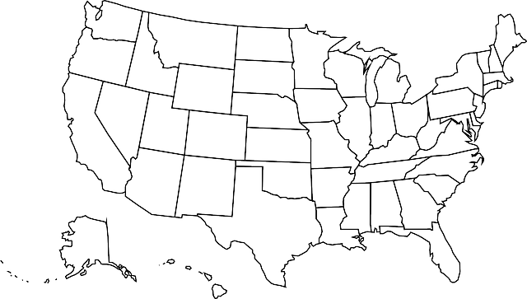
Winning Strategies From Coast to Coast:
How EPA’s 2017 Asthma Award Winners Are Addressing Asthma Disparities

Slide 2
Welcome to the Webinar
Winning Strategies From Coast to Coast:
How EPA’s 2017 Asthma Award Winners Are Addressing Asthma Disparities
Moderator
Tracey Mitchell, U.S. Environmental Protection Agency
Presenters
Bridget Burke, Health Care Service Corporation
Kathleen Bowden, Children’s Hospital of Richmond at VCU
Amelia Fay-Berquist, Esperanza Community Housing Corporation
Wednesday, May 16, 2017
Webinar 2:00 p.m. – 3:00 p.m. EDT
Live Online Q&A 3:00 p.m. – 3:30 p.m. EDT on AsthmaCommunityNetwork.org
Operator Assisted Toll-Free Dial-In Number: 800-374-0278
Conference ID: 12398563
Notes:
Tracey’s Talking Points:
Good morning or good afternoon, depending on where you are located.
Welcome to “Winning Strategies from Coast to Coast: How EPA’s 2017 Asthma Award Winners are Addressing Asthma Disparities,” a Web-based presentation sponsored by the Environmental Protection Agency.
We’re glad you can join us today! I’m Tracey Mitchell from EPA. I’m going to give a quick overview of this webinar and walk through some housekeeping items.
Since we have a lot of material to cover, we’ll go ahead and get started.

Slide 3
Question & Answer Session on
AsthmaCommunityNetwork.org Discussion Forum
Immediately after the webinar, join us in the AsthmaCommunityNetwork.org Discussion Forum for a live online Q&A Session:
3:00 p.m.–3:30 p.m. EDT.
To post a question in the Discussion Forum, follow these directions:
If you are a Network member, log in to your AsthmaCommunityNetwork.org account.
Click on the “Discussion Forum” button on the home page.
Click on the “Live Online Q&A for 5/16/17 Webinar” link.
Click on the “Post to the Forum” link to post your question.
Enter your question and click the “Save” button at the bottom of the page.
Not a member? Create an account at AsthmaCommunityNetwork.org by clicking the “Join Now” link at the top of the page. Your account will be approved momentarily and you can begin posting questions.
Notes:
Tracey’s Talking Points:
Our Q&A will take place on the Discussion Forum on AsthmaCommunityNetwork.org.
To see the discussion forum directly, please click the link that we just sent you via the chat function.
To ask questions, you must first be a member of AsthmaCommunityNetwork.org, so please take a minute to join so that you can post questions throughout the webinar—it is a simple and quick process. The Site Administrator will be approving memberships as they are submitted.
After the Q&A period is closed, please visit the Discussion Forum often to see other contributions as well as to make your own!

Slide 4
Agenda
EPA’s National Environmental Leadership Award in Asthma Management
Hear From Speakers
  Kathleen Bowden, Children’s Hospital of Richmond at VCU
  Bridget Burke, Health Care Service Corporation
  Amelia Fay-Berquist, Esperanza Community Housing Corporation
Q&A Session in AsthmaCommunityNetwork.org Discussion Forum
Notes:
Tracey’s Talking Points:
Our plan for today is to talk about the National Environmental Leadership Award in Asthma Management. I will begin by presenting information about the Awards Program and a framework that many of our award winners have used, EPA’s System for Delivering High Quality Asthma Care.
Then our 2017 award winners will tell us about their programs and the outstanding results they have achieved.
After the webinar, each of our presenters will be available on AsthmaCommunityNetwork.org for 30 minutes to respond to your questions.

Slide 5
Learning Objectives
Hear strategies from the 2017 National Environmental Leadership Award in Asthma Management winners on how to build a successful integrated asthma care system tailored to a specific population.
Learn new approaches to addressing asthma triggers, improving health outcomes in disparate populations and helping increase patient access to health services.
Learn best practices for establishing scalable, high-performing community partnerships that address gaps in care.
Understand how to effectively track and utilize program data as a tool for strategic planning, program evaluation and funding
Notes:
Tracey’s Talking Points:
The desired outcomes for todays’ webinar include:
Hearing strategies from the 2017 National Environmental Leadership Award in Asthma Management winners on building an integrated asthma care system;
Learning new approaches for addressing asthma triggers, improving health outcomes and increasing access to health services;
Hearing best practices for partnerships that address gaps in care; and
Understanding how to effectively track and use program data

Slide 6
Polling Question 1
What type of organization do you represent?
Government agency
Health care provider
Health plan
Community-based program
Other
Notes:
Tracey’s Talking Points:
Before we dive into today’s presentations, let’s get a sense of who’s with us today. To do that, please take a moment to answer the polling question on your screen: “What type of organization do you represent?”
Polling Question #1

Slide 7
Polling Question 2
What strategies does your program currently use to address asthma disparities?
Home visit programs to address indoor triggers
Building partnerships with other community programs to expand care services
Tracking data to identify opportunities for closing gaps in care
Other
Notes:
Tracey’s Talking Points:
Looks like we have a great audience today. We have one more question for you…
Polling Question #2: “What strategies does your program currently use to address asthma disparities?”
Great – [provide overview of responses] Thanks to you all for sharing strategies your program is employing to improve the lives of those with asthma. You will hear more strategies and best practices from our speakers that will help to enhance what you are already doing or inspire you to try something new.

Slide 8

About the Award
It is the Nation’s highest honor for exceptional asthma management programs.
The goal of the Awards program is to showcase best practices in asthma care and management.
To be eligible, applicants must use the National Institutes of Health (NIH) Expert Panel Report 3 (EPR-3): Guidelines for the Diagnosis and Management of Asthma.
Join the Hall of Fame: Apply in 2018! www.asthmacommunitynetwork.org/awards
Notes:
Tracey’s Talking Points:
This award is the highest recognition in the country that a program and its leaders can receive for delivering excellent environmental asthma management.
Winners receive a place in the National Environmental Leadership Award in Asthma Management Hall of Fame; national recognition through a press release and blogs; a crystal award; and the opportunity to serve as mentors to help other programs achieve impactful results.

Slide 9
























Award Winners Hall of Fame
Notes:
Tracey’s Talking Points:
Since 2005, EPA has recognized health plans, health care providers and communities in action for their best practice approaches to delivery of comprehensive asthma care.

Slide 10
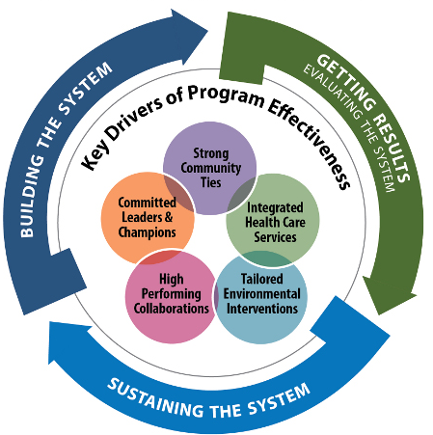
The System for Delivering
High-Quality Asthma Care
-
Notes:
Tracey’s Talking Points:
As I mentioned earlier, many of our award winners have used EPA’s System for Delivering High-Quality Asthma Care, which features essential components to developing an effective and sustainable asthma program.
The System is a conceptual framework, based on results of the Asthma Health Outcomes Project, conducted by University of Michigan, which identifies the core elements of successful asthma programs and the processes that drive their implementation, continuous improvement and endurance. The five key drivers of the System are committed leaders and champions; strong community ties; integrated health care services; tailored environmental interventions; and high-performing collaborations.
The System is flexible, and any asthma program—regardless of its size, institutional home (e.g., health plan, health care provider, community program), budget, target community, or level of development—can use the System to guide its work.

Slide 11
Sustaining the System
Tailored environmental interventions
-
Notes:
Tracey’s Talking Points:
A core feature of an effective asthma program is tailored environmental services. This key driver includes educating care teams on environmental triggers, employing techniques for minimizing trigger exposure, providing patient education, and referring patients for environmental services.

Slide 12
Sustaining the System
Tailored environmental interventions
Provide tailored education and counseling during clinical visits
Promote in-home environmental trigger management
-
Notes:
Tracey’s Talking Points:
Two essential strategies on this driver, which our speakers will touch on are—
Provide Tailored Education and Counseling During Clinical Visits
Ensuring care teams educate patients on how to identify, control, and avoid their environmental triggers; and tailoring recommended interventions to individual sensitivities.
Promote Environmental Trigger Management
Partnering with local service providers to provide home assessments and interventions, and to teach patients to manage home environments.

Slide 13
Sustaining the System
High-performing collaborations
-
Notes:
Tracey’s Talking Points:
It’s hard to do it alone. Partner organizations are key to providing a high level of asthma care. Many of our speakers have connected with other organizations to connect patients with much-needed additional services.

Slide 14
Sustaining the System
High-performing collaborations
-
Building on what works
Collaborating to build credibility
Notes:
Tracey’s Talking Points:
Two key aspects of the high-performing collaborations driver are—
Building on What Works:
Build partnerships with organizations that are active in your target community and seek out organizations providing complementary services to foster strong collaborations.
Collaborating to Build Credibility:
Collaborate with established organizations to build the social capital and local infrastructure of your program.
Each of our programs today will describe how they reached out to other organizations in their community to collaborate on targeting underserved populations. You’ll hear some innovative and creative solutions that demonstrate the value of thinking outside the box and how to build community support and buy-in.

Slide 15

Notes:
Tracey’s Talking Points
I’d like to introduce our first presenter, Kathleen Bowden, and Asthma Social Worker, from the UCAN Program at the Children’s Hospital of Richmond at VCU located in Richmond, Virginia.
The UCAN Program is a part of the hospital’s Division of Pediatric Pulmonology.
The UCAN Program is the winner of the 2017 National Environmental Leadership Award in Asthma Management in the Health Care Provider Category.

Slide 16

UCAN
(You Can Control Asthma Now)
Program
Division of Pediatric Pulmonology at Children’s Hospital of Richmond at VCU
Kathleen Bowden
Asthma Social Worker

Slide 17
UCAN
Richmond has been named the #1 most challenging place to live with asthma for 3 of the last 5 years.
In 2015 the Children’s Hospital of Richmond (CHOR) Foundation provided funding to implement a program to address outcome disparities of low-income children with asthma who live in the Richmond, VA, area.
Notes:
Richmond has been named the #1 “most Challenging Place to Live with Asthma” for 3 out of the last 5 years in the Asthma Capitols Report published by the Asthma and Allergy Foundation of America. Richmond has a worse than average asthma death rate and number of emergency room visits for asthma. The average pediatric asthma hospitalization rate in the Richmond metropolitan area is more than twice the overall Virginia average.
The prevalence of asthma is twice as high in minority children and rates of emergency room visits, hospitalizations and deaths due to asthma are 3 times higher. Although the reasons for these disparities are complex, economic social and cultural factors (the so-called “social Determinants of Health”) add to the greater asthma burden among these groups
In 2015 Dr. Michael Schechter approached the Children’s Hospital of Richmond Foundation to create a program to address the asthma outcome disparities evident in the low-income population of pediatric asthma patients in the Richmond metropolitan area. 393 patients have been enrolled in UCAN since 2015.

Slide 18
Goal and Population
To improve health outcomes for low-income Richmond-area children with asthma
  Children hospitalized at CHOR of Virginia Commonwealth University (VCU) for asthma exacerbations
  Children with 2 or more emergency department (ED) visits to VCU for asthma in the previous 12 months
  Children with asthma referred from the community or their primary care doctor who have limited income and resources

Slide 19
Goal and Population
Medicaid
Commercial
Uninsured
Other

Slide 20
Medical treatment
Education and disease self-management
Family psycho-social - environmental support
What We Do

Slide 21
Specific Services
Patient-centered, culturally sensitive, relationship-based medical care
  Consistent providers
  Frequent, regular follow-up
  24-hour phone access
  Educational support to promote disease self-management
Case management to ensure coordination of needed care
  Scheduling
  Transportation
  Asthma assessment of other family members
Screening and follow-up of social needs
  Mental health
  Food and housing needs
  Advocacy and legal assistance
Home visits
  Environmental assessment and interventions

Slide 22
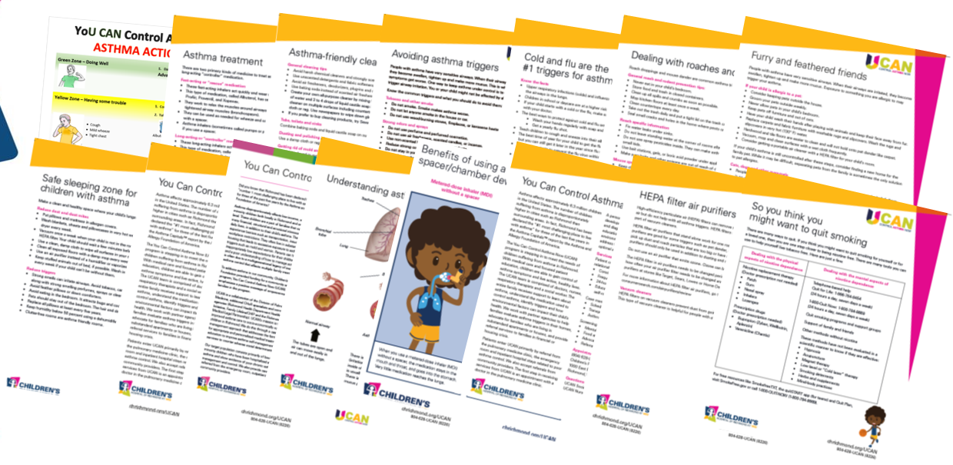
Educational Handouts
Notes:
These are some of the educational handouts we use for patients and their parents. All are written for lower literacy individuals and we are currently having all of these handouts translated into Spanish. We try to neve just hand a family an educational sheet as that is an almost certain guarantee that it will end up in the trash. Any educational material we share we review verbally with the family.

Slide 23

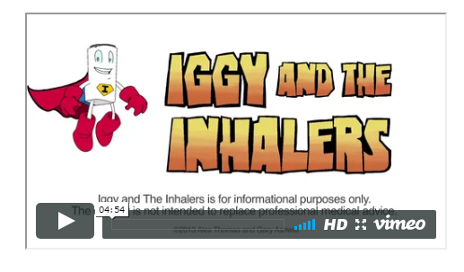


Educational Support
and Community Outreach
Notes:
Reaching patients and families with a variety of education enables us to share information in a way that is most effective. We use video, comics, and provide inhaler labels to decrease mediation confusion.
We reach out to the broader community through advertorials in the local urban newspaper, bus back advertising, and Facebook posts, in addition to presence at community health fairs, school nurse conferences and schools.

Slide 24
Outreach and Engagement
Questions we attempt to answer for our patients
Why should they follow up with us?
What value do we offer our patients in addition to excellent asthma care?
Notes:
UCAN staff visit to patients and families while they are hospitalized to begin assessment, education and introduce service providers.
Phone Calls after hospital discharge to answer questions, and continue creating a relationship.
Weekly text messages with asthma “tips” to reinforce learning and relationship with the team as a source of value to the family.
Utilize reports created by the hospital to identify patients who have utilized the Emergency Department 2 or more times for an asthma related diagnosis for outreach phone call and invitation for services
Telephone calls after missed appointments
Periodic outreach phone calls to those with no appointments to assess status and answer questions.
Help with the nitty gritty. Allergen covers for mattresses and pillows. Hepa Filter vacuum cleaner. We are a source of information and support. Help with asthma, help with social barriers through family care interventions, help with physical remediation in a small way.

Slide 25
UCAN Team
Pulmonologist
Asthma nurse/NP
Asthma social worker
Respiratory therapist
Clinic RN/LPN
Notes:
Experts in asthma care and management Assure appropriate diagnosis and treatment.
Certified asthma educator, provide asthma education during each visit. Coordinate services between pharmacies, schools and primary care. Conduct initial assessments and outreach in the hospital for hospitalized patients. Outreach and follow up between visits or after missed appointments.
Provides psycho-social- environmental assessment for barriers to treatment. Provide appropriate referrals to ameliorate or correct issues . Conduct initial assessments and outreach in the hospital for hospitalized patients. Outreach and follow up between visits or after a missed appointments. Outreach to those who have visited the ED more than 2 times during the past 12 months.
Conducts Pulmonary Function Tests. Reinforces asthma education and proper inhaler and spacer usage.
Front door contact. Initial physical intake and history. Administers Asthma Control Test or Pediatric Asthma Control Test which is provided at each visit.

Slide 26
Community Partners
Medical-legal partnership
Richmond City Health District Lead Safe and Healthy Homes Initiative
Family Lifeline: asthma home-visiting program
School nurses
Primary care office case managers
Notes:
Our work cannot be completed in our office alone. We rely on partners and collaborators in asthma treatment.
Work with patients primarily around issues related to substandard housing due to landlord negligence. We have aging housing stock in Richmond and some landlords do not properly maintain units leading to mold issues due to water leaks and damage. Safety hazards due to falling tiles or vents left unmaintained for years. We have just recently obtained permission to begin referring other types of legal issues to the partnership such as SSI appeals or even IEP advocacy.
The Healthy Homes program is able to go into the homes of pediatric asthmatic patients and conduct an environmental assessment of possible triggers in the home of those patients who live in the city of Richmond. They provide guidance on fixing any environmental issues and at times provide environmentally friendly cleaning supplies or other supplies such as humidity monitors.
Asthma home visitors from family lifeline can see patients within 7 miles of their office to provide in-home asthma education and support. Family Lifeline is also a referral partner to help support parents of young children in their Parent education home visiting program.
We coordinate with school nurses around having current asthma action plans, educating teachers and for some patients we have arrangements that they receive their control inhaler at school during the week. We also coordinate with care managers in primary care offices for outreach and asthma education.

Slide 27
Range of Estimated Financial Impact
Utilization Cost
Hospitalization ↓ 50–75% ↓ 39–74%
Observation visits ↓ 81–88% ↓ 71–75%
ED visits ↓ 0–40% ↓ 34–43%
Asthma clinic visits ↓ 17%–↑92% ↓ 46%–↑31%
Total ↓ 48–66%
$152,598 – $1,475,955
Notes:
We need to be able to share what impacts we are seeing for patients and families through connection with UCAN. We are able to pull hospital and clinic data through our hospital analytics. We also evaluate changes in number of sick visits and number of prescriptions of prednisone as well as track which educational topics are provided to patients through a separate database. This slide speaks specifically to utilization and cost changes for the hospital and clinic.
Calculation of change in utilization and costs
We evaluated utilization and costs
With or without the “index” enrollment visit
For all patients seen and for those who came to clinic (“engaged”)
For just asthma-related diagnosis codes and for all hospital encounters
We could not evaluate non-CHOR encounters or medication costs
That’s it from here. I look forward to answering your questions at the conclusion of the webinar.

Slide 28


Notes:
Tracey’s Talking Points
Our next speaker is Bridget Burke from Health Care Service Corporation.
Bridget is joining us from Chicago, IL although the program itself serves 5 states – Illinois, Montana, New Mexico, Oklahoma, and Texas.
HCSC is the winner of the 2017 National Environmental Leadership Award in Asthma Management in the Health Plan Category.

Slide 29

Health Care Service Corporation
Bridget Burke
Director, Public Affairs
Investments and Reporting

Slide 30

Health Care Service Corporation
Largest customer-owned health insurer in the United States, operating through five Blue Cross and Blue Shield® Plans
Nearly 15 million members, 21,000 employees and 60 offices
Social responsibility portfolio
  Local-level and company-wide community efforts
  Volunteerism and civic participation
  Diversity and inclusion efforts
  Sustainable practices
  Employee wellness program

Slide 31
Healthy Kids, Healthy Families®
Key areas of focus
  Food security
  Physical activity
  Preventing and managing disease
  Supporting safe environments
Since 2011
  More than $47 million donated to approximately 300 partners
  More than 21 million health and wellness services provided
  In 2016 alone, more than 2.5 million children impacted

Slide 32
Enhancing Care for Children With Asthma Partnership With the American Lung Association of the Upper Midwest
Partner with primary care clinics on a 12-month asthma quality improvement initiative
Execute home-based education and trigger modification component
Build capacity through community health initiatives

Slide 33
Clinic-Based
Quality Improvement (Q1) Initiative
Ensure guidelines-based care and comprehensive asthma self-management
American Lung Association of the Upper Midwest-led nationwide program implemented in more than 120 primary care clinics in IL, MT, NM, OK, and TX
Proven to work in a variety of clinic settings, including school-based clinics

Slide 34
QI Initiative = Sustained Changes in Care

Slide 35
Improved Quality Reduces Hospitalizations and
Emergency Department Visits
 | All age categories | < 18 | > 18
Hospitalizations | ↓ 56% | ↓ 59% | ↓ 52%
ED Visits | ↓ 55% | ↓ 54% | ↓ 56%

Slide 36
Improved Quality = Cost Savings
Plan paid amount and out-of-pocket savings for hospitalizations/emergency department visits
minus
intervention cost
equals
return on investment
$1 : $2.40

Slide 37
Environmental Improvements for Children’s Asthma
The program interacts with the child with asthma and their parents or guardians a minimum of three times.
A phone call to schedule a home visit.
The initial visit includes basic asthma education and a home environmental assessment.
A follow-up visit to deliver the allergen-reducing and remediation products.

Slide 38
Partnership & Program Highlights
120 health clinics engaged
2,000 community education and outreach activities occurred
190,000 health care and school professionals and parents of children with asthma involved
140 children and their parents received home assessments, remediation, and in-home asthma education
505,000 people impacted overall

Slide 39

Notes:
Tracey’s Talking Points
Our next speaker is Amelia Fay-Berquist. She is the Healthy Breathing Program Manager from Esperanza Community Housing in Los Angeles, California.
Esperanza Community Housing is the winner of the 2017 National Environmental Leadership Award in Asthma Management in the Community in Action Category.

Slide 40

Esperanza Community Housing Corporation
Amelia Fay-Berquist
Healthy Breathing Program Manager
Notes:
Comprehensive approach to community here at Esperanza Community Housing Corporation!
Esperanza Community Housing Corporation
Founded in 1989
Community Health Promotion through direct services
Annual Community Health Promoter training
Healthy Homes Program
Healthy Breathing Program
People Not Pozos
Lantermann
Community Health Promotion through policy
UNIDAD: United Neighbors in Defense Against Displacement
STAND-LA: Stand Together Against Neighborhood Drilling
ACT-LA: Local ordinances
HIA and Reef Development
Affordable Housing Owner
9 buildings in South Los Angeles

Slide 41
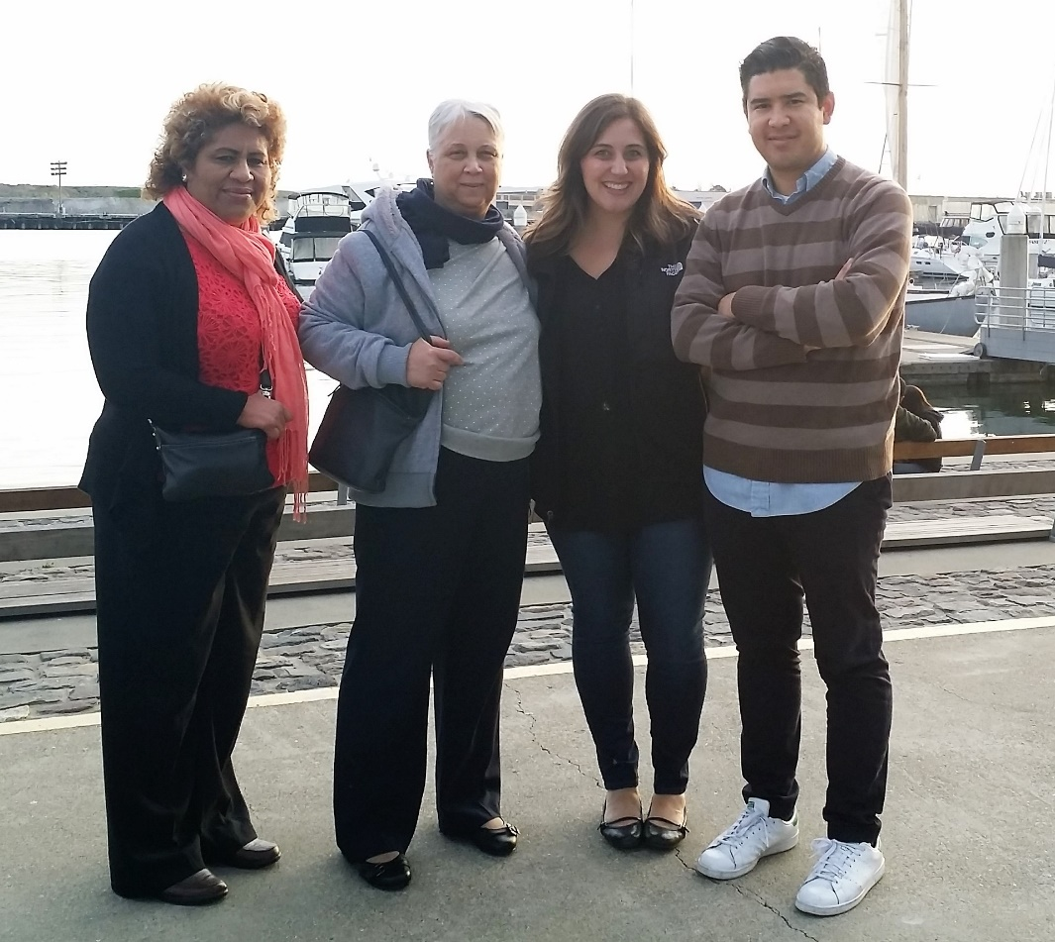
Healthy Breathing Program Overview
Healthy Homes Program and the birth of the Healthy Breathing Program
Healthy Breathing Team, 2013-2016 (left to right): Maria Bejarano, Consuelo Pernia, Ashley Kissinger, Toby Rodriguez
Notes:
Healthy Breathing history
1998 Healthy Homes Program begins w/ HUD outreach grants
Work with a specific census tract that was a “lead hot zone”
But promotoras always address more than just lead in the home and with asthma as a condition that is caused and exacerbated by the indoor environment, asthma was being tackled by our promotoras 20 years ago even if data wasn’t being collected on that particular issue;
2011: ECHC recipient of American Recovery & Reinvestment Act (ARRA) HUD grant for our Healthy Homes Program;
First time ECHC targets asthmatics and the in-home triggers as a healthy homes issue;
HHs team noticed big ED reduction in the data
HH team f/u’d with the families to ask what they believed were the driving forces behind their reduction in ED use
Answer: In-home promotoras visits

Slide 42
Healthy Breathing Pilot Project, 2013–2016
Goals
Community Health Promoters, trained as both generalists and as asthma-specific care providers
Support delivery through a popular education framework and community health promoter model
  Asthma management education
  Environmental assessment
  Materials and equipment to both assist in greater control of asthma and interrupt indoor triggers
  Resource referrals
Results: DRAMATIC!
Notes:
Healthy Breathing Pilot Project
Three-year Unihealth-funded grant to partner with California Hospital Medical Center, Eisner Pediatric & Family Medical Center, St. John’s Well Child & Family Clinic (FQHC)
ECHC received referrals from ED for every pediatric asthmatic that came in for care;
Community Health Promoters dispatched to the family
12-month enrollment in the Healthy Breathing Program
4 visits over enrollment
1st visit the most critical
Since I wasn’t here during this pilot, I want to recognize Ashley Kissinger, who was the PM of this pilot and Consuelo Pernia and Maria Bejarano, two of our CHPs still on the HB team, who were promotoras during the pilot.
GOALS:
Reduce ED Emergency Department (ED) use by pediatric asthmatics in South Los Angeles;
Increase control of asthma by pediatric asthmatics in South Los Angeles;
Ensure asthmatics have a medical home for consistent, on-going asthma care;
Grow the evidence base of the impact of in-home asthma programming
HOW DID WE DO THIS?
Asthma education
Physiology of asthma
Proper medication administration
Environmental assessment
Visual inspection of the home
Cockroaches
Mold
Heavy dust
Materials
Chamber/spacer
Air filter
Hepa-filter vacuum
Mattress and pillow covers
Microfiber mops
Lung-friendly cleaning bucket
Hydrogen peroxide
White vinegar
Boric acid
Baking soda
Scrub brush, dust mask, microfiber towels
Resource referrals:
FQHCs for those without a medical home
Health insurance support for un- and underinsured patients
Other CBOs ex. Housing rights, tenants’ rights, legal aid
Government agencies ex. HCIDLA, LACDPH
Grow the evidence base through data collection!
Robust survey that collected both the baseline data and the program impacts over the course of the 12-months and captured the broader narrative of the asthmatics’ history that enabled the promotoras to identify priority areas to focus upon and ensure the program was tailored specifically to them so that we had the greatest likelihood getting the asthma under control and successfully serving the child and their family.

Slide 43






Results!
76% of enrollees did not return to the ED after receiving a home visit from the HB team
160% improvement in Asthma Control Test (ACT) scores
65% improvement in missed school days per 6 months
At baseline: 93% of families administering Rx incorrectly
At 6-month follow-up: 84% administering Rx correctly
97% of families switched to lung-friendly cleaning products and integrated pest management methods
99% of families made lung-friendly changes to their home

Slide 44
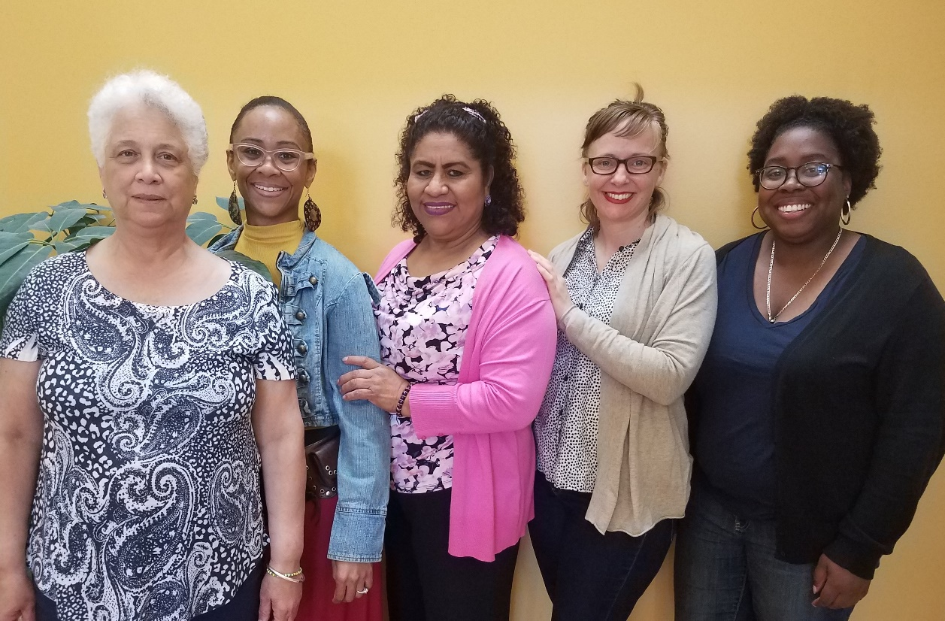
Healthy Breathing Program, 2017–2019
Program evolution
Strategic outreach and building partnerships across South Los Angeles
Growing our data capacities and building a culture of data around Healthy Breathing
Healthy Breathing Team, 2017–present (left to right): Consuelo Pernia, Destinee DeWalt, Maria Bejarano, Amelia Fay-Berquist, Ashley Lewis
Notes:
SO WHERE ARE WE NOW?
We are now in our 2nd 3-year cycle of Healthy Breathing and we are now a permanent program!
Program Evolution:
Three-year, $1.2 million Unihealth grant to continue the work of the pilot;
Healthy Breathing is now a stand-alone program accepting referrals from any source;
Now serving asthmatics of all ages.
Strategic outreach and building partnerships across South Los Angeles
Medical: hospitals, clinics, sole practitioners
Other: senior centers, churches, other CBOs, parent groups
Huge piece of my work as manager is growing the program
Shout-out to Southside Coalition of Community Health Center and Andrea Williams, ED and Felix Dominguez, Case Manager and Asthma Coordinator at Eisner Pediatric & Family Medical Center!
How have we done this?
Team networks
Signing up for every event where community members are coming through
Creating target area maps and dropping in
Data:
Improve our survey instruments
What do we want to know?
Incorporating psychosocial triggers so that we are able to understand how poverty-related issues are driving asthma outcomes and disparities.
Intern, Brandi Loper, MPH student and Biostatistician, got us there.
Growing the data – we are collecting so much information now. We want that information to reflect the multilayered complexities of the local asthma epidemic in South L.A. looks like and have the capacity to share that data with our friends and partners doing work that indirectly impacts asthma outcomes (urban planning, housing, climate change, etc.).
Additionally, since we are no longer tethered to one referral source, one of the fundamental goals of Healthy Breathing is that we are connecting with and in service to those in our catchment area where the data shows those greatest disparities:
For example: We know that Black children experience the greatest asthma morbidity while Black adults experience the greatest mortality of asthma
Blacks have the most striking disparity in the burden of asthma. Compared to Whites, Blacks have 40% higher asthma prevalence, four times higher asthma ED visit and hospitalization rates, and two times higher asthma death rates. (Source: Asthma in California: A Surveillance Report, 2013)
In 2015, 51% of Black/African American asthmatic children (0-17) visited the ER or Urgent Care in LA County due to asthma (Source: LA County Health Survey, 2015)
More than one in four African American school children in urban Los Angeles have probable asthma, and hospitalization rates for asthma are three times higher for African American children than for children of other racial and ethnic groups. (Source: Controlling Asthma in Los Angeles County: A Call to Action, 2006)
In LA County, Black folks experience dramatically higher rates of hospitalization and ED use due to their asthma than any other group of people (Source: Office of Statewide Health Planning and Development, 2014)
However, with displacement and scattering of Black folks in both the city and county of LA, how do we conduct outreach to ensure we’re serving those most in need when community is no longer necessarily confined to a particular geographic space?

Slide 45
Polling Question 3
After participating in this webinar, what would you like to hear more about in future webinars?
  Gaining buy-in from stakeholders
  Building my program workforce
  Establishing collaborative partnerships
  Tracking data to identify key program results
  Making the business case for my program
Notes:
Tracey’s Talking Points:
Thank you, Amelia, for a terrific presentation.
I would like to congratulate each of our EPA Award winners and thank them for their informative presentations today.
Before we head into the Q&A on the discussion forum, I would like to take this opportunity to learn from you, our asthma community, on what you would like to hear more about in our webinar series. Your feedback helps us develop webinars that are meaningful to you.
Polling Question #3
Great, thank you for your participation. Also, as another opportunity for sharing your ideas with us, please be on the lookout for a brief feedback form in your email following today’s webinar.
It will only take 5 minutes to complete and it will greatly help us in planning our future webinar activities.

Slide 46
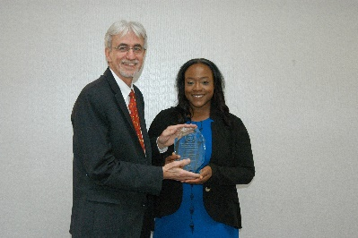
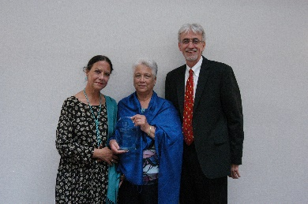

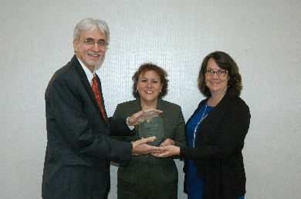
Thank You to Our Winners
Post your questions now on
www.AsthmaCommunityNetwork.org
Notes:
Tracey’s Talking Points/Closing Remarks:
That concludes our webinar. My thanks again to our speakers for their time and willingness to share their information and experiences. Also, thanks to all of you who participated. We’re glad you could join us and hope the session was helpful for you.
Be on the lookout for an audiovisual file of this webinar posted on AsthmaCommunityNetwork.org in the coming weeks.
Also, the award winners are available now for a live online Q&A discussion at AsthmaCommunityNetwork.org to answer your questions. They will do their best to respond to your questions in the next 30 minutes. The Q&A discussion will be archived on AsthmaCommunityNetwork.org for future viewing. The next slide provides instructions for posting questions to the online forum.

Slide 47
Question & Answer Session on
AsthmaCommunityNetwork.org Discussion Forum
Immediately after the webinar, join us in the AsthmaCommunityNetwork.org Discussion Forum for a live online Q&A Session.
3:00 p.m. – 3:30 p.m. EDT
To post a question in the Discussion Forum, follow these directions:
If you are a Network member, log in to your AsthmaCommunityNetwork.org account.
Click on the “Discussion Forum” button on the home page.
Click on the “Live Online Q&A for 5/16/17 Webinar” link.
Click on the “Post to the Forum” link to post your question.
Enter your question and click the “Save” button at the bottom of the page.
Not a member? Create an account at AsthmaCommunityNetwork.org by clicking the “Join Now” link at the top of the page. Your account will be approved momentarily and you can begin posting questions.
Notes:
Tracey’s Talking Points:
Here are some directions for how to post a question in the Discussion Forum on AsthmaCommunityNetwork.org.
You will need to log in to your Network account to post questions.
If you are not a member yet, you can join the Network today by clicking the “Join Now” link at the top of the AsthmaCommunityNetwork.org homepage.
Your account will be approved momentarily and you can begin posting questions.
Thanks again for joining us, and we look forward to chatting with you in the Discussion Forum.

