Slide 1

Using Data to Drive Buy-In and
Funding to Reduce Asthma Triggers:
The Value Proposition of
School IAQ Management
Thursday, May 4, 2017
Webinar: 1:00 p.m. – 2:00 p.m. EDT
Question and Answer Session: 2:00 p.m. – 2:30 p.m. EDT
Call-In: 855-231-0808
Conference ID: 95277126
Notes:
Welcome to the webinar Using Data to Drive Buy-and Funding to Reduce Asthma Triggers: The Value Proposition of School IAQ Management. My name is Tracy Washington Enger, I am with the Indoor Environments Division of the US EPA and I have the pleasure of serving as your facilitator.

Slide 2
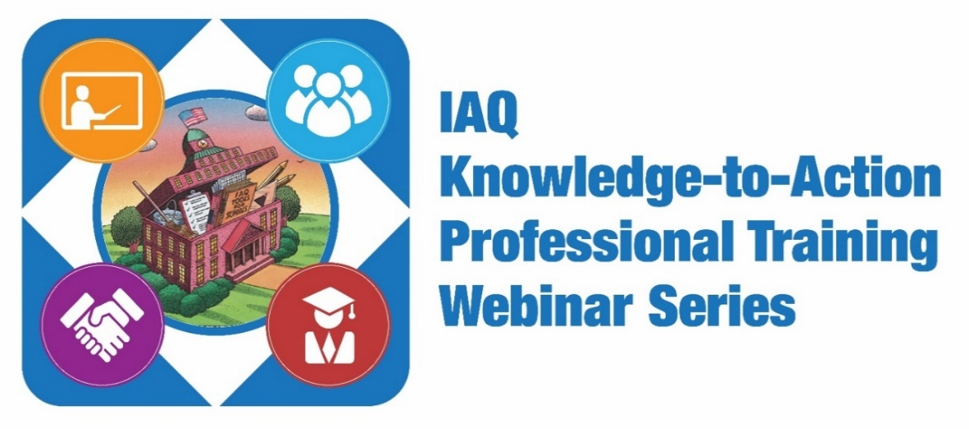
These technical Web-based trainings are designed to deepen the IAQ knowledge base of school stakeholders and prepare them to take immediate action to create healthy and productive indoor environments in schools.
    Healthy Schools, Healthy Students: Taking Action to Improve IAQ in Your School District
    Training Staff to Create Healthy Indoor Environments and Reduce Asthma
    How to Secure Funding to Address and Prevent Mold and Moisture Issues
    Gaining Buy-In to Provide Optimal Ventilation to Improve Academic Performance
    Using Data to Drive Buy-In and Funding to Reduce Asthma Triggers:
    The Value Proposition of School IAQ Management
    Green Cleaning for Improved Health: The Return on Investment of Green Cleaning in Schools (scheduled for June 22, 2017)
  Stay tuned for more IAQ Knowledge-to-Action offerings!
  www.epa.gov/iaq-schools/iaq-knowledge-action-professional-training-webinar-series
Notes:
Tracy: This webinar is one of an on-going series that was developed to address the specific areas school stakeholders in our network have committed to actively addressing in order to achieve dramatic results in health, academic and building performance.
You will have the opportunity to gain recognition for your knowledge acquisition and commitment to action through certificates of completion after completing the evaluation for each training.

Slide 3

These 10 technical Web-based trainings are designed to build the capacity of school district staff across the country to start, improve or sustain an IAQ management program.
  Creating Healthy Indoor Environments in Schools
  Making the Case
  HVAC Systems
  Moisture and Mold
  Energy Efficiency and IAQ
  Integrated Pest Management
  Asthma Management
  Cleaning and Maintenance
  Materials Selection
  Source Control
  www.epa.gov/iaq-schools/indoor-air-quality-schools-master-class-webinar-series
Notes:
Tracy: The Knowledge to Action Professional Webinar series builds on the foundational content in the IAQ Master Class Professional Webinar Series. The next action you can to take on the way to addressing asthma by improving IAQ in your schools is to join the 2017 IAQ Master Class by viewing 10 webinars in the IAQ Master Class Professional Training Webinar Series. Your ability to move into action more quickly will be enhanced by viewing these webinars on demand. We will be recommending specific webinars for you to view on demand in order to deepen your understanding of the content delivered in the webinars that are a part of the Knowledge to Action series. Because reducing asthma triggers is so intertwined with IAQ , we recommend that in addition to the Master Class Asthma Management webinar, you also view Integrated Pest Management, Cleaning and Maintenance, Material Selection and Source Control as well as the previous asthma webinar in this series, Training Staff to Create Healthy Indoor Environments and Reduce Asthma.
Complete all 10 hours and you will be acknowledged with a certificate that recognizes your efforts toward IAQ Mastery as a member of the 2017 SHIELD Network IAQ Master Class (CEUs pending).

Slide 4
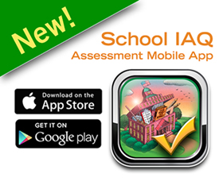
Download the App Today
Android: Google Play
Apple: iTunes
developer.epa.gov/school-iaq-assessment-tool
Notes:
Tracy: Another terrific tool we have to help you move into action to improve IAQ in schools is the IAQ Tools for Schools Mobile App. If you haven’t already done so, grab your smart device and download this app and make your mobile device a one-stop shop for managing IAQ. During the this webinar you will hear specific ways the Mobile app can help you integrate IAQ data to garner broader support for you IAQ and asthma management programs.

Slide 5
Learning Objectives
Webinar participants will learn how to—
Harness the power of evaluation to develop a business case, a value proposition, and a communication strategy that generates broader acceptance of, compliance with and funding for IAQ management, with a specific focus on reducing asthma triggers.
Design and successfully implement a strategy to identify, collect and use data with low-cost, easy-to-use tools (e.g., the School IAQ Assessment Mobile App) to start, improve or sustain a comprehensive IAQ and asthma management program.
Employ evidence-based strategies and proven practices that are being used in school-based health centers across the country to reduce exposure to environmental asthma triggers.
Replicate the strategies used by a school district that successfully reduced asthma attacks, increased attendance and improved academic performance through effective implementation of the “Communicate” and “Evaluate” Key Drivers of the IAQ Tools for Schools Framework.
Notes:
This webinar will explore how good IAQ management programs can reduce or eliminate asthma triggers in the indoor school environment, and the positive impacts on student and staff health, academic achievement and building performance, that can be realized by coordinating IAQ and asthma management in schools. During the webinar, you will hear how 2 asthma and IAQ champions are using the IAQ Tools for Schools resources to design and implement successful programs, then collecting and harvesting data and results and translating that data into a powerful value proposition that makes a strong business care for supporting and funding their efforts.

Slide 6
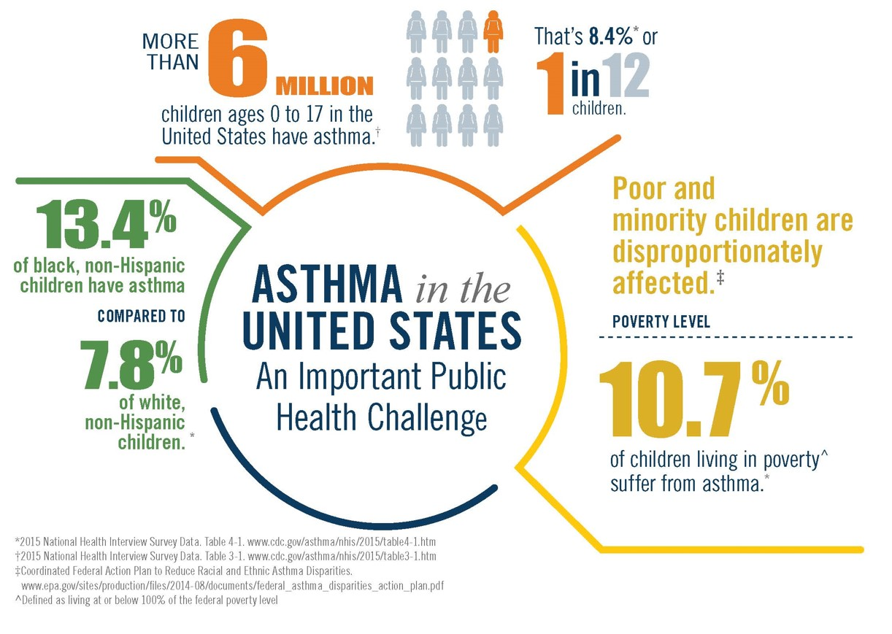
Asthma Facts
Notes:
So, let’s start with taking a look at the problem. As these statistics demonstrate, asthma is a serious health issues impacting millions of people, but people are not impacted equally. We know that there are lots of disparities in asthma health outcomes. Depending on the demographics of your school district asthma prevalence, morbidity and morality can look very different for your students that the students in a neighboring school district. Another way of saying it is, if the students in your district look and live differently than the students in a neighboring district, asthma is likely to impact them far differently.
An estimated 24 million people, including more than 6 million children, have asthma.
Asthma prevalence is higher among persons whose family income is below the poverty level.
The rate of asthma among Puerto Ricans is approximately 2 times higher than among non-Hispanic Whites.
The economic cost of asthma, including lost school and work days, amounts to more than $56 billion dollars annually.
Black persons had higher rates of emergency department, hospitalizations and deaths than whites persons.

Slide 7

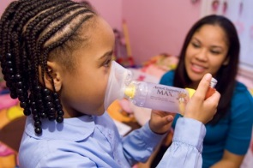
Asthma and IAQ in Schools
More than 10 million school days are missed each year due to asthma.
IAQ affects the health, productivity, performance and comfort of students, teachers and staff.
Poor IAQ in a school building can cause students and staff to suffer adverse health effects, including respiratory infections, asthma and allergies.
Indoor and outdoor environmental factors—including dust mites, molds, cockroaches, pet dander, secondhand smoke, and poor air quality—can trigger asthma attacks.
Notes:
When it comes to asthma in schools, the impact is clear
1 in 10 children in the United States has asthma.
Asthma accounts for 10.6 million missed school days a year, which clearly affects student performance.
The estimated annual cost for treating asthma in children in this country is $8 billion.
In some states, school funding is tied to student attendance; the absenteeism caused by asthma can cost districts in those states significant amounts of money.
Because parents of younger children need to stay home when their child is sick, as many as 14 million work days are lost each year because of pediatric asthma.
There is a strong evidence base that supports the connection between Asthma and IAQ in schools.
The most recent data show that about 51% of school districts in the United States have an IAQ management plan—that’s 60,000 schools—and the vast majority of those schools base their plan on the IAQ Tools for Schools guidance.
This is good news, but EPA wants to reach the half that don’t have a plan and help them develop one, AND we want to make it easier for those that do have a plan to implement and improve it.

Slide 8
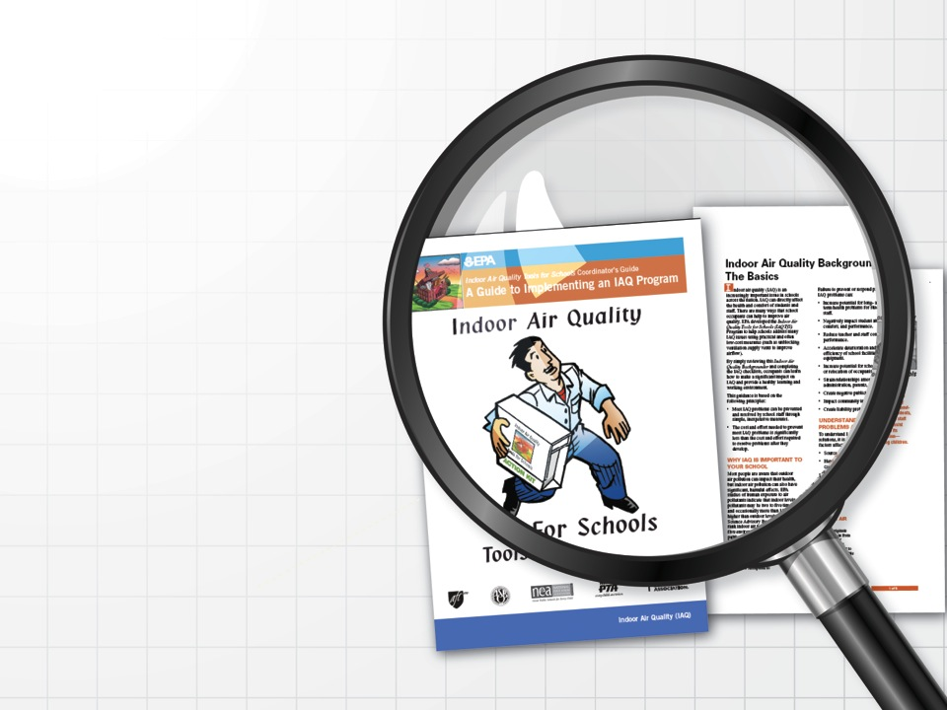
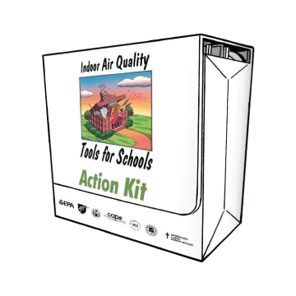
The IAQ Tools for Schools Guidance
Notes:
The EPA IAQ Tools for Schools Kit was developed to address the IAQ issues found in many of the nation’s schools and it serves as the knowledge base of what schools and school districts need to do to put an IAQ management plan in place.
The action kit was first published back in the 1990s, and has been updated continuously since then. We’ve added to it. We’ve refined it and included more and more of the best practices that we are seeing many of you implementing around the country. In addition to the best practices, it provides walk-through checklists, industry guidelines, sample policies and sample IAQ management plans to help schools and school districts take immediate action to implement effective Indoor Air Quality management programs.

Slide 9
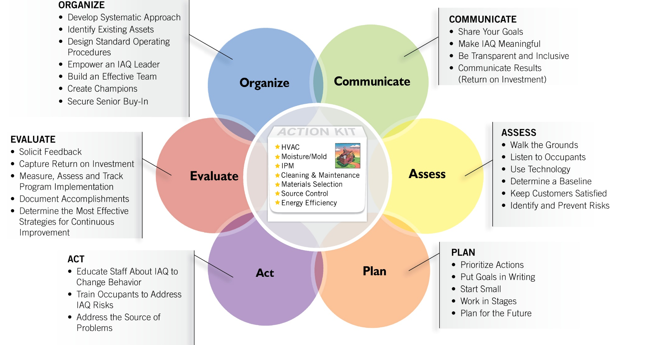
The Framework for Effective School IAQ Management:
Six Key Drivers
Notes:
The Framework for Effective School IAQ Management helps schools districts implement the Kit using 6 key drivers and successful strategies. This webinar will highlight how you can employ the strategies under the Assess, Plan and Act Key Drivers to design and implement IAQ management plans that effectively reduce asthma triggers. You can then employ the strategies under the Evaluate driver to collect data on your results and then share those results to influence stakeholders and funders using the Organize and Communicate Key Drivers.

Slide 10
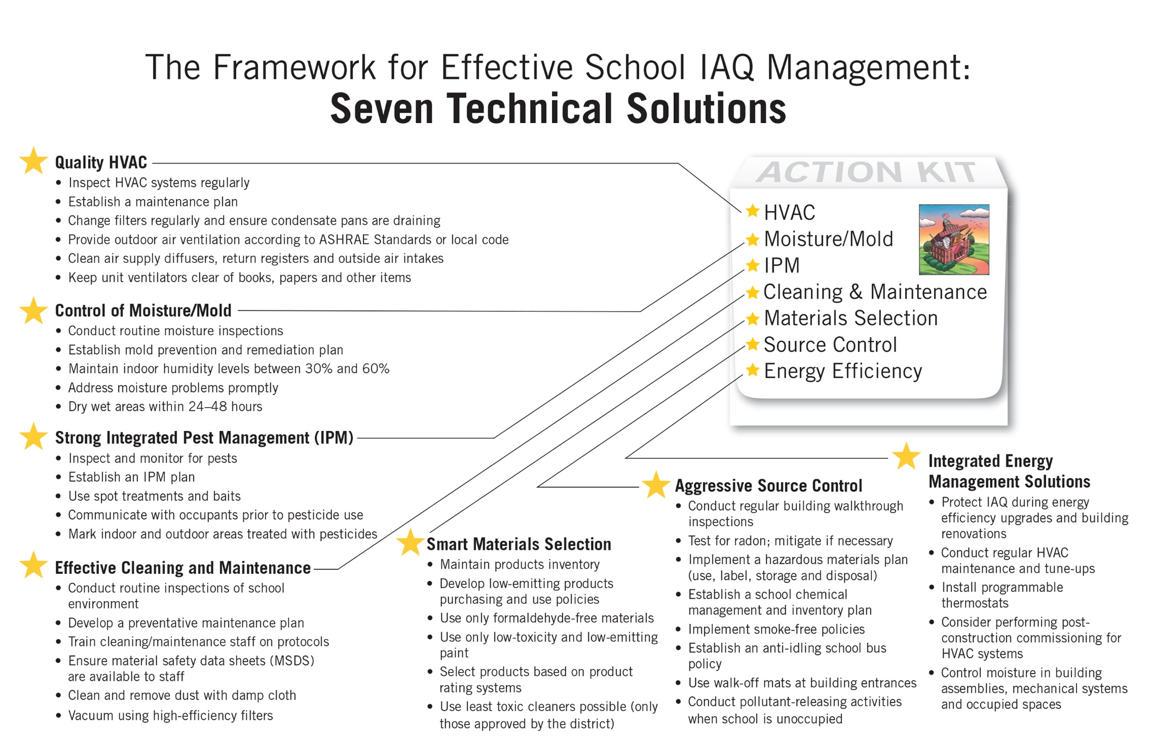
The Framework for Effective School IAQ Management:
Seven Technical Solutions
Notes:
In addition to the Framework, the Action Kit offers seven technical solutions. Successfully controlling asthma in the indoor environment requires incorporating all of these areas into your plan. When you are looking for return on investment, this is the ideal place to identify activities that will give you the most bang for the buck.

Slide 11
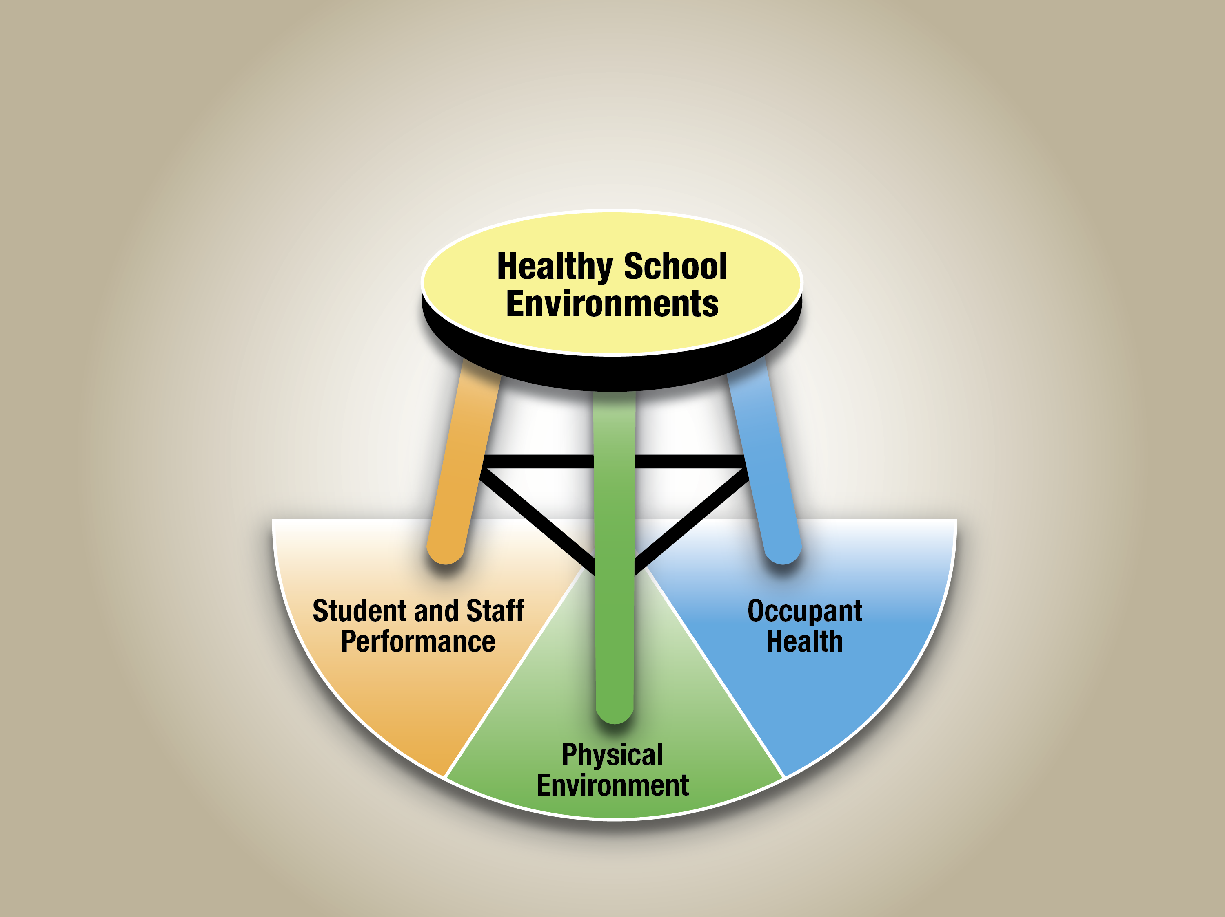
Importance of
Indoor Environmental Management in Schools
Notes:
When Making the case for investing in managing the indoor environment, it is critical to convey the role IAQ plays in creating a healthy schools environment and the subsequent impact that healthy indoor environments have on the health of occupants, the ability of students to learn and teachers to instruct, and practical and financial considerations for maintaining the physical environment. The key to using this strong business case to gain buy in and secure funding for your IAQ program lies in the ability to communicate the benefits using a language that generates support.

Slide 12
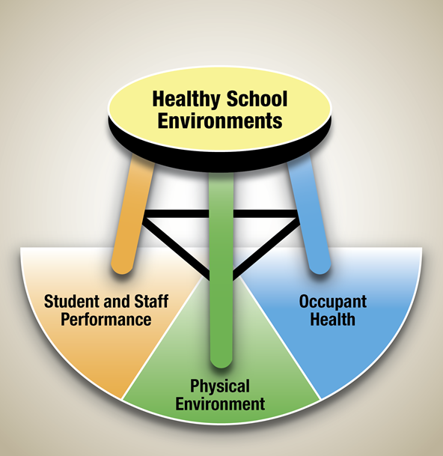
What Is a Value Proposition?
An analysis and quantified review of the benefits, costs and value that an organization can deliver to customers/funders and other stakeholders
A value proposition is a succinct statement (e.g., 2–4 sentences) that clearly describes the tangible results a customer gets from your program.
A value proposition is an offer to someone in which they get more than they give up.
A value proposition is the basic reasoning for why people should support your program.
A value proposition uses tangible results to draw interest and share a success story within a few words.
Notes:
The condition of the indoor environment in schools has a direct impact on health and performance outcomes for both students and staff. Although most schools are working hard to provide a safe and healthy learning environment for students and staff, there are times when a focused pitch is needed to help make the case for a specific action or program to a target audience that might include the superintendent, school board, teachers, or, facility director, Your value proposition statement is your elevator pitch for describing the benefits of your program. The purpose of your statement is to quickly demonstrate to your target audience that your proposed activities are critical and worth funding/supporting.

Slide 13
Value Proposition for an IAQ and Asthma Management Program
Your Value Proposition:
The bold goals my program is focused on include [impacts/long-term outcomes] ___________, _____________, and ________________.
For/By [inputs/investment] _________, my program will [achieve outcome/short-term and intermediate goal] __________ for [target population] _______________ and will generate [benefits/cost savings] _____________ over/within [time period] ____________.
Example:
The bold goal my program is focused on is creating healthy learning environments for our students, including reducing asthma triggers, through comprehensive indoor air quality and asthma management activities.
For $80,000, my program will reduce the average number of school days missed by those with asthma by 50 percent for the North East Independent School District, and it will generate $1,070,208 in cost savings within 1 year of program completion.
Notes:
The Value Proposition for IAQ and Asthma management is a simple declaration of the investments you program requires, the results your program will produce and the bountiful benefits your program will deliver.
Think of your Value Proposition as making a sensible and reasonable request in exchange for an amazing offer that no one in their right mind would refuse. During this webinar you will hear some of these irresistible offers from our speakers.

Slide 14
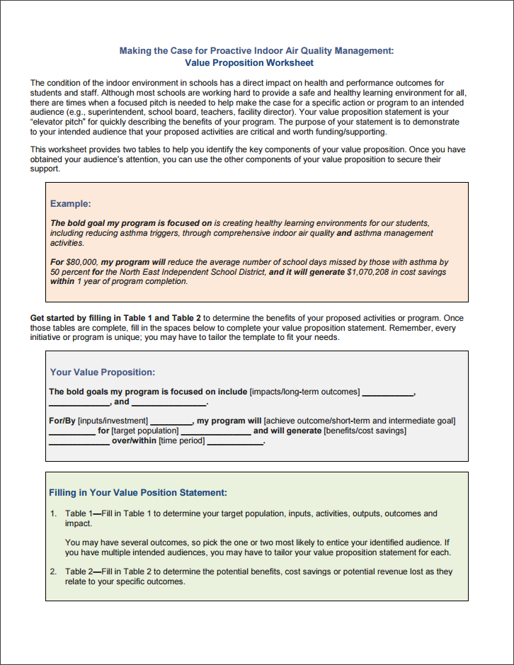
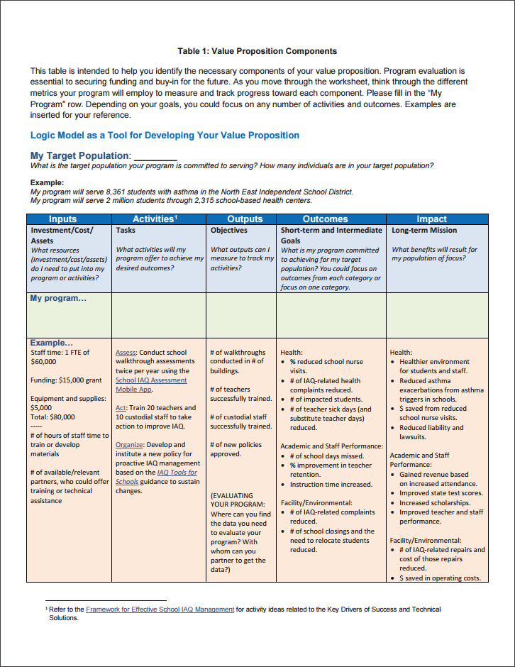
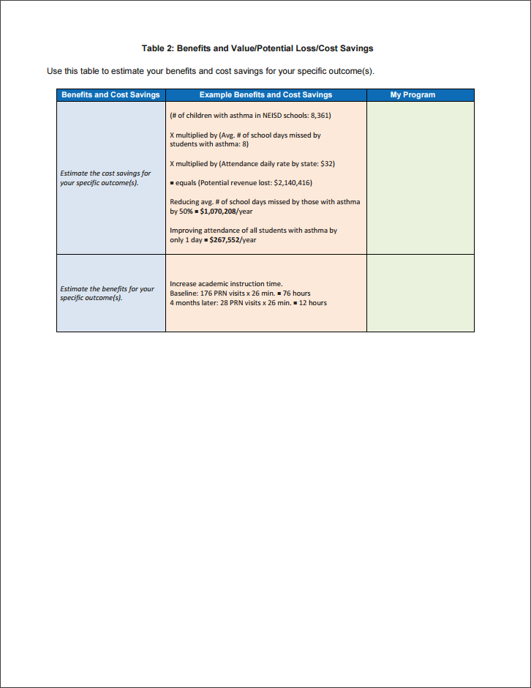
Value Proposition Worksheet
Notes:
While on the surface the Value Proposition may appear daunting, There is a process behind developing a successfully compelling Value Proposition. The IAQ Tools for Schools Program has developed a Value Proposition Worksheet that takes you through the process step by step. This worksheet can be used at any stage of you program. Whether you are looking for support to launch a new program and get it off to a great start, or to expand, enhance or replicate an existing program, The Value Proposition worksheet is the tool you need to design, refine and align your program to the needs of your audience.

Slide 15
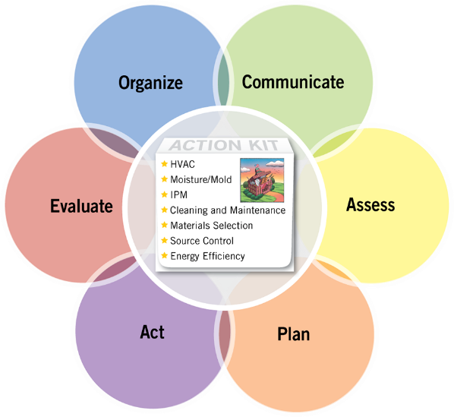
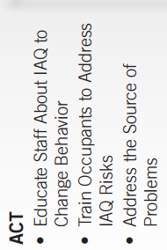
Design, Implement and Evaluate an IAQ Program to Reduce Asthma Triggers
Target Population: Which individuals are you committed to serving? How many? All students and staff, in particular, students with asthma
Inputs: What are your investments, costs and assets? Supplies, materials, staff time
Activities and Tasks: What activities are you conducting to meet your desired outcomes? Use the Framework and Technical Solutions to identify activities.
Notes:
The Value Proposition Worksheet will allow you to think systematically and comprehensively about your IAQ and Asthma projects, plans and programs and about the value they provide for different stakeholders. Think about who you are serving, who are beneficiaries of your work. Remember that improving IAQ impacts more than just the students and staff with asthma. What are your investments, remembering to go beyond budget and consider things like staff time spent, as well. This is where we have to develop an enterprise mindset. I am shocked by how often people who are running successful, mature IAQ and asthma programs undersell themselves because they have no idea of their costs. You can not make a valid case for your benefits, savings and value if you don’t know your costs. When it comes to designing and describing activities, use the IAQ Framework and Technical Solutions to identity the activities that are proven to be effective in meeting your desired outcomes.

Slide 16
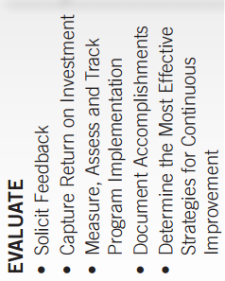
Design, Implement and Evaluate an IAQ Program to Reduce Asthma Triggers
Outputs: What products of your activities are you tracking? Staff trained, assessments completed, teams formed
Outcomes: What goals is your program committed to achieving? Where and how are you acquiring the data you need to evaluate? Student attendance, staff retention, reduced complaints
Impact: What is your overall mission? What long-term benefits do you anticipate for your target population? Cost savings, health improvements, student and staff performance
Notes:
The Evaluation Key Driver combined with the Outputs, Outcomes and Impact sections of the Value Proposition worksheet will help you measure, track, document and describe what your program accomplishes, what difference it makes, and why it matters to your stakeholders.
Our featured speakers will further illustrate how to translate your program successes into the language of the Value Proposition.

Slide 17

Director
Regional Asthma Management and Prevention Program, CA
Anne Kelsey Lamb
Notes:
Join me in welcoming Anne Kelsey Lamb is the Director of RAMP the Regional Asthma Management and Prevention Program. Serving as the Director since 2002, Anne provides overall strategic guidance in working toward the organization’s vision and mission, ensuring a highly effective organization and innovative, successful programs. With a strong interest in both chronic illness and social inequities, she leads all components of the organization’s efforts to reduce the burden of asthma including: technical assistance to community-based asthma coalitions; the provision of a clearinghouse of information on asthma;, convening groups to facilitate networks and capacity-building; and creating change through policy advocacy. Anne is a graduate of Bowdoin College and received a Master’s degree in Public Health from the University of Michigan.

Slide 18
Regional Asthma
Management & Prevention (RAMP)
A project of the Public Health Institute
Founded in 1996
With support from the EPA, we have been working with school-based health centers (SBHCs) for the past 3 years.
Notes:
RAMP works to reduce the burden of asthma through a broad and comprehensive approach that ranges from clinical management to environmental protection. We are particularly concerned about asthma disparities and focus much of our work on the social and environmental inequities that contribute to those disparities.

Slide 19
The Important Role of SBHCs
SBHC users are—
Less likely to go to the emergency department (ED) or be hospitalized for asthma
Less likely to have asthma-related restricted activity days
Less likely to miss school as a result of their asthma
Notes:
There are 2,315 SBHCs throughout the country serving an ethnically-diverse population of more than 2 million children, primarily in low-income areas. Nearly 90% of these SBHCs offer chronic disease management, including asthma. Research shows that SBHCs are already leaders in the clinical management of asthma.

Slide 20
Underlying Premise of Our Project
SBHCs provide an ideal setting in which to incorporate environmental components into chronic disease management programs, leveraging their role as a strong link between the student, school and home.
Notes:
There is also an opportunity for SBHCs to also be leaders in managing the environmental factors that make asthma worse. Even children with the best medically managed asthma will continue to suffer from asthma attacks if their home, school, and outdoor environments contain environmental asthma triggers.
So, RAMP and our partners at the CSBHA and National SBHA have been working to increase engagement of SBHCs in the environmental management of asthma.

Slide 21
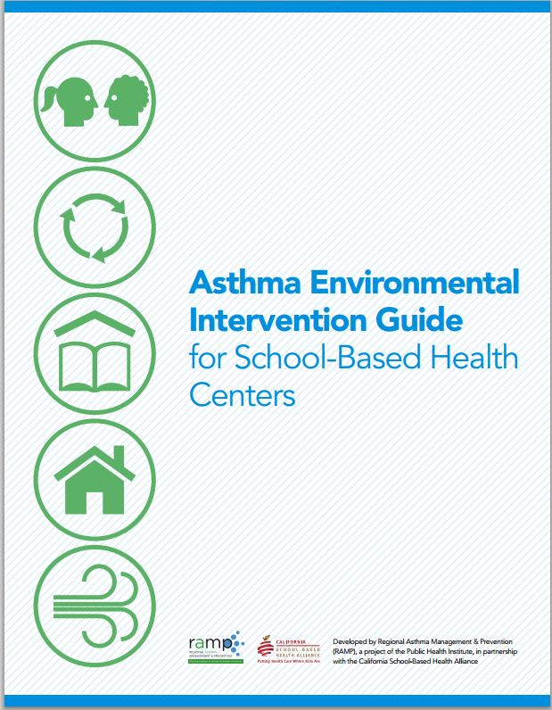
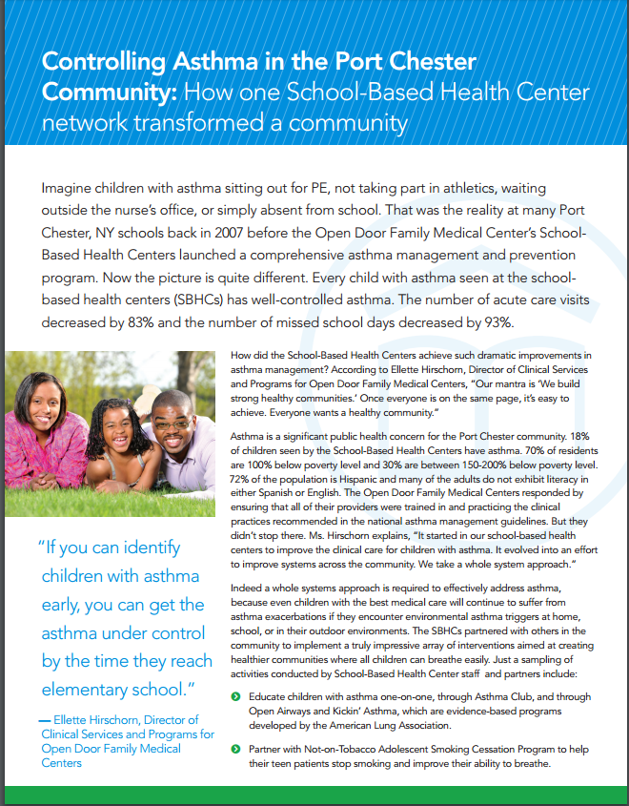
Notes:
The work has included:
The development of a guide on environmental asthma interventions, which is pictured on the left. This guide includes numerous evidence-based interventions aimed at reducing exposure to environmental asthma triggers and describes how SBHCs can lead, initiate or otherwise support them.
Trainings in several states, in partnership with state SBHC alliances
Two year-long learning collaboratives of SBHCs who each received a stipend to participate and implement a small-scale environmental asthma intervention
Case studies to highlight success stories and hopefully serve as models for other SBHCs
On the right is a picture of one of the case studies. For today’s presentation, I’m going to talk about 3 of the SBHCs that participated in our learning collaboratives and how their work aligns with the Value Proposition framework.

Slide 22

Reducing Diesel Bus Idling
Carson, CA
Target population: Students and staff
Inputs: Staff time to conduct training and develop materials
Activities: Conduct survey; identify champion; develop and conduct training about the health impacts of idling and the anti-idling policy
Outputs: Bus drivers changed behavior; 100% compliant with policy; increased knowledge about how respond to asthma emergency
Outcomes: Reduction in outdoor and indoor air pollution Reduction in asthma exacerbations (clinic visits, missed school days, etc.)
Notes:
Staff in the clinic reported smell of exhaust fumes, mostly in the mornings and afternoons on really hot or really cold days. Realized the smell was coming from the school buses parked outside our clinic – right next to the “fresh air vent.” So they selected reducing bus idling as their project.
They began by conducting a survey of bus drivers to get a better understanding of their knowledge and behaviors. What they learned is that the bus drivers were idling in order to keep their air conditioners or heaters on. They knew that there was a policy against idling, but they didn’t know about the health effects of idling.
So, the SBHC staff invited the drivers in for an educational session. They identified a champion – the woman pictured here – and she made sure that all of her colleagues attended the session. By the end of the session, they had a better understanding of the health impacts of idling and agreed to change their behavior. The SBHC staff offered for the bus drivers to come into their clinic – which has AC and heat – on those hot or cold days.
The bus drivers were so interested in the issue that they asked for a training on how to respond to an asthma emergency.

Slide 23

Managing Classroom Triggers
Milwaukee, WI
Target population: students and staff at multiple schools
Inputs: Staff time to conduct classroom assessments, analyze data and educate teachers
Activities: Conduct classroom assessments using EPA checklist; analyze data; educate teachers
Outputs: Teachers making changes to reduce triggers in their classrooms; partners pursuing policy goals
Outcomes: Reduction in classroom triggers
Reduction in asthma exacerbations (clinic visits, missed school days, etc.)
Notes:
The Children’s Hospital in Milwaukee runs a number of SBHCs at various schools in the community
The SBHC staff person used the Teacher’s Classroom Checklist from the EPA’s IAQ Tools for Schools Toolkit. They first talked with the teachers about the purpose of this activity – being very careful to make it clear that they weren’t looking to blame or “ding” the teachers for any triggers that they found. Basically, all members of the school community have behaviors that either improve or worsen IAQ, often without even realizing it. Things like making a cozy reading nook or having so many books that the vents are blocked.
They partnered with the WI Asthma Coalition to leverage resources and together, they conducted walk-throughs, identified triggers, and educated the teachers. The teachers all agreed to make changes to their classrooms.
Partners in the state asthma coalition will also pursue policy changes at the district level. The SBHC staff focused on the frontline teachers and immediate actions they could take.

Slide 24
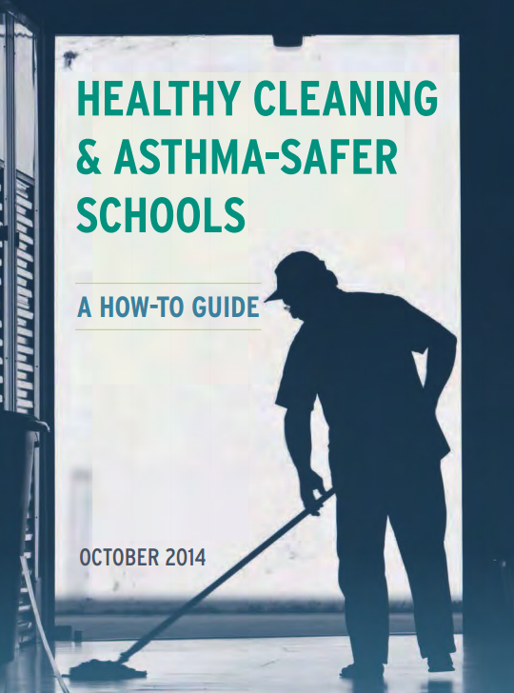
Making the Switch to Asthma-Friendlier Cleaning Products — Oakland, CA
Target population: Students and staff
Inputs: Relationship building with custodial staff and administration; staff time to research and provide information
Activities: Worked with vendor to provide samples; worked with custodial staff to understand and overcome barriers
Outputs: Agreement by custodial staff to switch to asthma-friendlier products once they finish them
Outcomes: Reduction in triggers
Reduction in asthma exacerbations
Notes:
The Madison SBHC in East Oakland participated in our learning collaborative and their selected intervention was to work with the school to make the switch to asthma-safer cleaning products.
The first critical step was to build relationships with and gain buy-in from both the principal and the custodial staff.
Through those relationships, she identified and worked with them to address barriers
One barrier was the perception that asthma-safer cleaning products don’t work – she brought in evidence demonstrating effectiveness
Another barrier was the perception that the asthma safer cleaning products would be more expensive – she was able to show them that, while there would be an increased cost upfront, over the course of the year, there would be cost savings.
They then worked with the vendor to send samples of the asthma-safer cleaning products so the custodial staff could try them out.
In the end, they agreed that they would work through their current supply of regular cleaning products and then make the switch!

Slide 25
Components of the Value Proposition
The bold goal for SBHCs is to—
Improve asthma outcomes and support a healthy student population.
The bold goal for RAMP is to—
Promote a comprehensive approach to reducing the burden of asthma among vulnerable populations.

Slide 26
Components of the Value Proposition
Outcomes (short-term and intermediate)
Reduced number of SBHC visits for asthma exacerbations
Reduced number of school days missed
Reduced number of IAQ-related complaints
What data can you collect?
What data will be most compelling to your target audience?
Notes:
For all three SBHC stories that I shared, I listed as the outcome reduction in triggers, which leads to reduction in exacerbations. For the value proposition, you need to think about what data you can collect (like those listed above) and what data will be most compelling to the target audience. If you’re trying to get the school board to support a policy change, use an outcome like the cost savings from the reduction of missed school days.

Slide 27
Components of the Value Proposition
Costs
For the investment needed,
Estimate just like you would for a grant proposal (staff time, supplies, etc.).
For cost savings,
Conduct a small pilot project.
Extrapolate from existing data.
Notes:
-Pilot: One SBHC we worked with in Tulare started classroom walkthroughs with just the 3 5th grade classrooms. This gave them a sense of the amount of staff time it takes for each walkthrough, the education, etc. It also gave them a sense of what kind of reduction they’d see in the number of visits to the SBHC among students with asthma. They could then take those numbers, multiply them by the number of classrooms and come up with a decent estimate.
-Extrapolate: For a different project that RAMP is working on, we’re trying to convince health plans to pay for asthma home visits. The Community Preventive Services Task force did an economic analysis based on published literature and found that the ROI ranged from about $5-14. Using that, we were able to estimate the cost savings that the health plans could expect to realize.

Slide 28
Example of a Completed
Value Proposition
The bold goal of my program focuses on improving asthma outcomes and supporting a healthy student and staff population. For $5,000 to support staff time, my program will result in a switch from regular cleaning products to asthma-friendlier cleaning products, which will lead to a 10% reduction in spending on cleaning products over the course of one year and a reduction in urgent care visits to the SBHC.
Notes:
Even without concrete numerics, programs can make a powerful Value Proposition Statement, In the case of the green cleaning products, the SBHC staff know how much staff time was required to work with the custodial staff, school administrators, and vendor to make this change and can place a monetary value on that. She could work with the vendor to identify an estimated reduction in spending and, even without numeric measures, explicitly state that there will be an impact on health care utilization.

Slide 29
Next Steps
For the SBHCs
Many are currently developing plans to expand or continue their work.
For RAMP
We will be developing case studies to share as models and are seeking financial support to expand this work.

Slide 30

Assistant Director,
Health Services
North East Independent School District, TX
Diane Rhodes
Notes:
Diane Rhodes is a Certified Asthma Educator (AE-C) and Registered Respiratory Therapist (RRT) with a thirty eight year career in the healthcare profession. She also holds a Bachelor of Business Administration from Texas Tech University.
After joining North East Independent School District in 2006, Rhodes developed and implemented an innovative, comprehensive Asthma Awareness Education Program. In 2013 the Asthma Awareness Education Program received the EPA National Environmental Leadership Award in Asthma Management. Additionally, eighteen NEISD campuses have been nationally recognized by the American Lung Association’s Asthma Friendly School Initiative by receiving the Gold recognition level; the only schools in the nation to receive this level of recognition.
The Asthma Awareness Education Program was also the catalyst for the district's award winning Indoor Air Quality Program. The district’s IAQ program received the Environmental Protection Agency Excellence Award (2008) and the Model for Sustained Excellence Award (2010) for the dedication to providing a healthy school environment. Rhodes was individually recognized by the EPA by receiving the Special Achievement Award (2008).

Slide 31

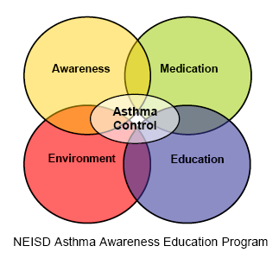
NEISD Asthma Awareness Education Program
North East Independent School District
A large urban school district in San Antonio, Texas
67,770 students (pre K–12); 9,300 employees
67 traditional campuses, 14 magnet programs
Registered Nurse (RN) for every campus.
8,320 students with asthma (12% of student population)
1 Registered Respiratory Therapist (RRT), Certified as Asthma Educator (AE-C)
Program created in 2006 utilizing a four-component approach to Asthma Disease Management (National Heart, Lung, and Blood Institute’s
Expert Panel Report 3)
Notes:
Thank you Tracy, it is an honor to be with you today and to share this webinar with Anne and her amazing program.
NEISD is a large urban school district in San Antonio, Texas with close to 68 thousand students and 9300 employees. The district has 67 campuses. We are blessed the district realizes the importance and insight to have RNs on every campus.
NEISD has over 8000 students with asthma. In 2006, the superintendent hired a respiratory therapist who is also a certified asthma educator to develop and implement an asthma program to address the needs of 12% of the student population as part of the district’s wellness program. The superintendent also realized the magnitude of capturing every dollar the states allotment formulas allowed a district.

Slide 32
MISSION STATEMENT
Asthma Awareness Education Program
The Asthma Awareness Education Program will address the needs of students and staff by creating asthma friendly environments and by providing technical and educational resources for the students and staff on air quality and asthma disease management.
Our commitment to classroom indoor air quality and asthma management education results in higher student/staff productivity and attendance, which benefits the district with increased student performance, lower health care costs and increased state funding.
Healthier children learn better.
Notes:
Asthma is a chronic inflammatory disease that is genetically predisposed and environmentally induced. Without a well-defined IAQ program, these inducers will be found in school facilities/classrooms and exposures to these inducers may lead to the development of asthma and allergy of those genetically predisposed occupants. This can occur at any age. Once asthma develops, symptoms are variable and can persist frequently when exposed to the long list of common asthma triggers. Simply providing medication once symptoms develop is only a reaction and is a temporary improvement; it is not addressing the underlying cause – inflammation.

Slide 33
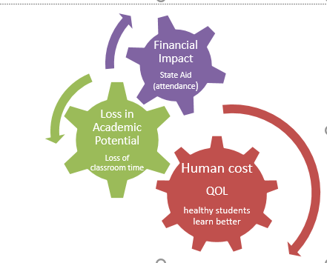
Value Propo$ition: Asthma Program
BOLD GOAL: My program focuses on creating healthy learning environments for all students, including reducing asthma triggers, through comprehensive indoor air quality and asthma management.
Healthy Children Learn Better.
In the first year and for an input cost of $63,000, the program will
reduce the annual average number of school days missed by
students with asthma from 8 to 7. This cumulative effect of
a one-day reduction in absenteeism by over 8,000 students
with asthma will generate $267,552 in state revenue for
North East Independent School District. Within 5 years we will
change the culture; reduce absenteeism due to asthma by
50 percent, generating $1 million in revenue gains each year; and will decrease
the amount of lost academic instruction time due to asthma symptoms;
ensuring students with asthma may achieve their full academic potential.
Costs of doing nothing
Notes:
All school district personnel should realize the role the school environment may play in the development of disease as well as the prevalence of current symptoms. Asthma is a completely controllable disease that may affect 10-20% of your student population.
When asthma symptoms occur, they impact your school district with academic, financial and health costs.
Providing an asthma-friendly school environment will reduce the occurrence of symptoms and play a key role in disease management of students/staff. It improves the quality of life of the child , which directly impacts the child's ability to achieve academic success; this will impact the district in its state’s accountability system and in its funding.

Slide 34
NEISD Asthma Awareness Education Program
DASHBOARD
Bring an understanding of prevalence and assess needs to improve processes district wide:
Provide tools/resources to reduce health care barriers:
Awareness
Quality of Life Surveys
Medication & Tools
Emergency Nebulizer Policy
Environment
Raise parent expectations
Indoor environment quality best practices
TfS Six Technical Solutions
Asthma Action Plans ALL medications
Inspiratory flow assessment
Data, data, data
Health Check √ data
NHLBI EPR 3 guidelines/
6 priority messages Logic Model
PRN usage tracking
School District impact: Funding/Performance
Recruit champions (custodial, nurses, PE staff, administrators )
Standardized Environmental Assessment
Facility scores feedback
Staff development Symptom threshold
Parent activities: PTA, ABO
Walkthroughs: Remove triggers from school environments
Education
Return on investment
Staff disease awareness
Student/Staff Activities: Asthma Obstacle Course
Curriculum: Asthma and Environmental Quality
Webinars/Podcasts to admin
AIMS Asthma: Incentivizing Management Skills
Referral mechanism
Symptom threshold
Asthma Control Test
Tips for Healthy Learning Environment
O r g a n i z e
plan
act
evaluate
assess
Awareness
Medication & Tools
Asthma Control
Assess culture; reduce environmental risks:
Environment
Education
Identify gaps; provide
disease management
strategies to stakeholders
to improve quality of life:
C o m m u n i c a t e
Stakeholders:
students, parents,
staff, community
Notes:
NEISD Asthma program’s DASHBOARD. In the beginning I organized the program to align with the four components of Asthma Control as published by the National Asthma Education and Prevention Program. Objectives were crafted for each component that suited the school setting. The EPA’s six key drivers framework allowed the program to evolve over time. The program is a living program; we implement new strategies to meet the fluctuating needs of the different stakeholders in our district (students, families, administrators, staff, and community) based on the evaluation/assess drivers. I firmly believe the program expanded over the years due to the communication of our value-add to the district.
This is our program as it looks today as I complete my 11th school year. The dashboard is a snapshot of the action and planning for each component. Each component is important to the success of the program as they all tie in/support each other to achieve a proactive disease management program involving all stakeholders. I will highlight the bolded actions from the different components and present it in a value proposition format.

Slide 35
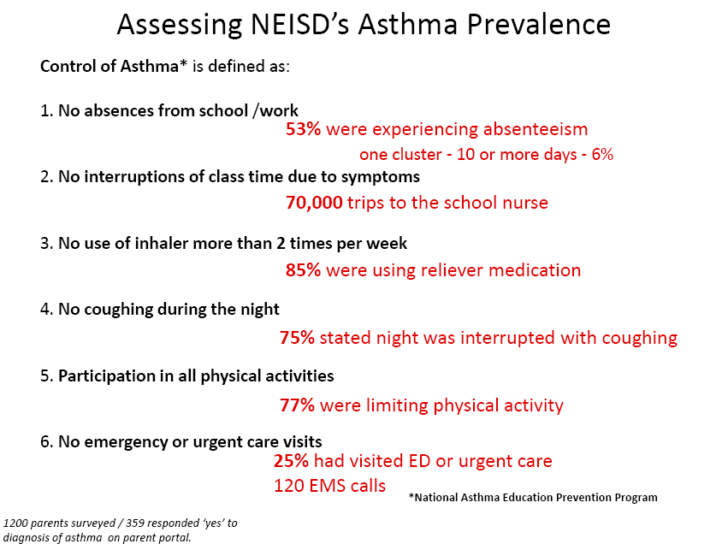
Awareness Component: Bring an understanding of prevalence and assess needs to improve processes district wide
Target Population: students with asthma (6000)
Input: 1 FTE (Asthma Educator), NEISD research department staff member (3 hours)
Activities: plan QOL asthma survey, assess students’ QOL and family burden/barriers
(handout or online), evaluate results
Outputs: identified campus outliers and at­­-risk populations—absenteeism, percent of uncontrolled asthma, ER visits, limited activity, visits to clinic (classroom interruption)
Outcomes: communicate results, campus/admin buy-in, policy changes, new policies, staff education on asthma triggers, asthma letter (welcome packet)
Impact: targeted outreach asthma education to community and bringing health care providers to NEISD families, increase asthma awareness, improve attendance, control symptoms, and increase student performance
Quality of Life Survey
Notes:
Assessment of the Quality of Life of our students with asthma
As a new program, I needed to establish a baseline and to identify the unmet needs of my customer – the student with asthma and their families. A 25 question survey was created and was placed on the parent portal communication software program the district already utilized. To capture information from our lower socioeconomic areas, paper surveys were distributed. Keep in mind – this was before smart phones.
The data collected identified the areas of concern and established buy-in from district leadership and administrators, campus administrators, PE teachers, and teachers. It allowed strategic planning in our implementation of other activities. I would say most of our initial activities were supported because of output of this assessment. This also was well received by asthma families as they felt ‘heard’.
Some Outcomes and Impact included development of policies to close health care gaps (nebulizer protocol), gained support for district wide asthma education events, address environmental issues, and identified new champions going forward.

Slide 36
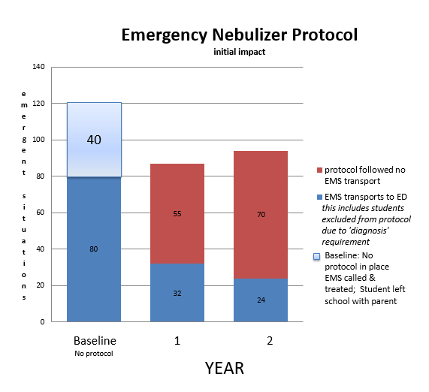
EMS Calls—Nebulizer Protocol
Medication Component—Provide tools/resources to reduce health care barriers
Target Population: students with asthma with no medication or not
responding to personal medication in clinic (8,000)
Inputs: compressor/campus—capital outlay ($2,000),
supplies and albuterol ($1.49/treatment) as needed
Activities: assess EMS calls/transports data, organize
policy to close health care gaps (HS, MAC)
Outputs: provide an albuterol treatment for students
who meet criteria, provide earlier intervention to
reverse/minimize symptoms
Outcomes: decreased EMS calls, decreased EMS transports, decrease risk of death due to asthma, improve continuity of care with primary asthma physician
Impact: parents see NEISD as a partner; establishes a coordinated approach to asthma management, reduces cost of ER visit for parents, increases academic instruction time, attendance and student performance.
Notes:
Reducing heath care barriers through the emergency nebulizer protocol.
When someone with asthma begins to have symptoms, quick intervention with life-saving bronchodilator medication directly impacts outcomes. During the first year, health services data indicated 120 asthma-related EMS calls, 80 of which required transport to the Emergency Department. EMS calls to a campus is a crisis that disrupts learning.
Further assessment revealed the calls were predominately due to lack of medication on campus.
Once NEISD leadership was aware of this data, they were emphatic the district would create a policy to help these at-risk students.
With a capital outlay of $2000, compressor nebulizers were purchased for each campus. Medication and supplies were stocked. It costs the district $1.49 to give a treatment. A nominal amount to avoid a devastating outcome.
As the graphic shows, within the first 2 years of the protocol, we decreased EMS transports from 80 to 24. Of those 24 transported, 19 didn’t meet the protocol due to lack of documented asthma diagnosis, for the remaining 5 the protocol was followed and the student was in such a severe episode they still needed to be seen in the ED despite our early intervention.
The outcomes and impact from the nebulizer protocol go way beyond financial and academic – you can not put a price on the life of a child.

Slide 37
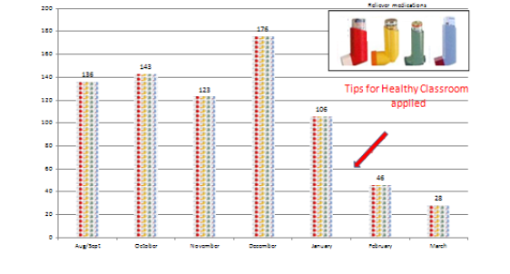
Tracking PRN Data
Medication Component - Provide tools/resources to reduce health care barriers
Target Population: asthma students with quick-relief medication on campus
Input: 1 FTE AE-C
Activities: assess nurses’ data for clinic visits for quick relief
inhaler use
Outputs: nurses to isolate symptom driven (PRN) inhaler use
from scheduled symptom inhaler use. Track # PRN use to
determine loss of classroom time due to symptoms occurring
during the school day/classroom
Outcomes: identify campus with outliers in PRN usage.
Increase IAQ investigations driven by health of students.
Removal of stuffed animals, fragrances, wall-wall carpet,
residential animals from classrooms. Communicate IAQ improves health of students and decrease clinic visits, identifying uncontrolled asthma (> PRN use 2 times/week) earlier
Impact: development of electronic medical record (Healthcheck). Tracking asthma and IAQ symptoms to classroom where symptoms developed. Understanding “Reaching” Symptom Threshold of administrators and staff, proactive asthma management versus reactive, strategic use of facilities maintenance resources
Notes:
Tracking Symptom-Driven Medication use
Campus nurses collected data of inhaler use and forwarded that information to the Health Services department. We had information on total inhalers given district wide – which was well over 70,000 – but had no idea the reason for the use of the inhaler. Many physicians order a scheduled administration of asthma inhaler before exertion. This is done to prevent potential symptoms during exercise. Under the current data collection process, there was no way to determine why an inhaler was given. PRN use is one criteria to measure uncontrolled asthma under the national guidelines for asthma management. PRN means it was given for symptoms. You take a pain reliever for a headache is an example of PRN use.
The nurses begin to isolate PRN usage from scheduled usage before exercise. This allowed us to identify students who were experiencing symptoms at school and allowed us to identify campuses with higher PRN rates. Because asthma is environmentally induced, it gave us valuable insight into the conditions in the school and strategically direct limited facilities maintenance resources. It permitted the nurses to be proactive and provide the family or physician insight into a child's changing level of asthma control.

Slide 38
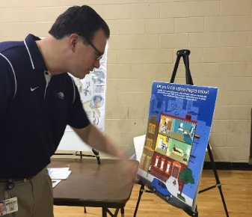
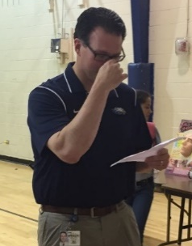
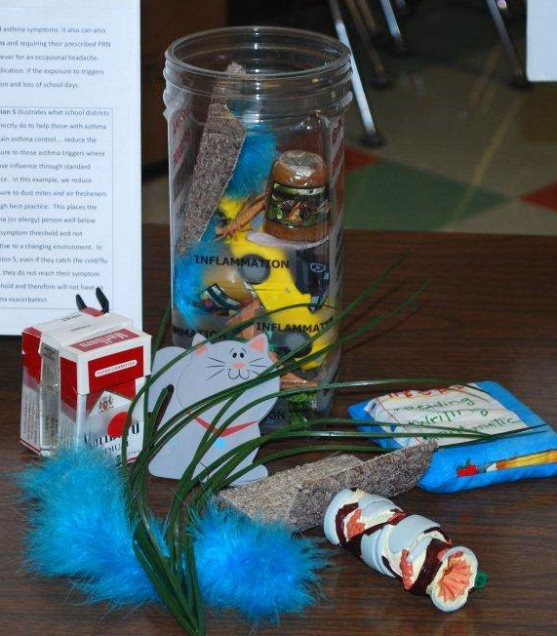
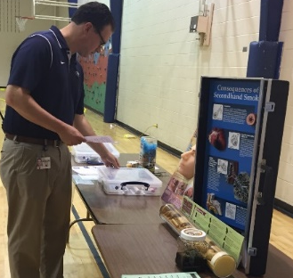

Asthma Obstacle Course
Education Component: Identify gaps; provide disease management strategies to all stakeholders to improve quality of life of those with asthma
Target Population: all campus staff, students, families
Input: 1 FTE AE-C, grant of $1500 (props)
Activities: plan hands-on asthma awareness education
with a strong environmental component.
Outputs: increase number of teachers informed about asthma triggers, “experience”
symptoms that follow trigger exposure (set up during school day), and airway changes,
increase number of families understanding the pathophysiology of asthma, triggers, medication actions (wellness/health fairs)
Outcomes: increase in staff trigger awareness/IAQ best practices,
trigger cause and effect, classroom self-assessment, increase
general population's awareness of asthma triggers and symptoms
Impact: change in culture: asthma-friendly classrooms/disease management. Reducing clinic visits and increase classroom instruction time. Teachers conceptualize healthy environments.
Principals experiencing the Asthma Obstacle Course
Notes:
Education – make it fun, make it relevant
The Asthma Obstacle Course is a hands-on activity that provides asthma awareness in a larger-than-life format. It engages the participant to experience life as a person with asthma.
1. The participant first travels through a normal, healthy airway – with no barriers, they can travel through with ease.
The participant now encounters triggers – this includes common allergens (mold, dustmites, animal dander, cockroaches, etc.). Next comes the irritants (fragrances, exhaust, strong odors, cigarette smoke, etc.). Before moving forward the participant must find 14 asthma triggers in a house graphic.
After exposure to the triggers, the participate now experiences symptoms – shortness of breath and chest tightness.
The challenge of living with asthma is experienced as they travel through an inflamed, mucus filled, broncho-constricted airway. Which is much more difficult than the normal airway they went through earlier.
Participants leave the asthma obstacle course with asthma friendly strategies. For instance, teachers will receive the American Lung Association's Healthy Air Classroom Checklist to assess their rooms for triggers and best practice technical solutions.
Teachers, students, and parents have all taken the challenge and the feedback is very positive – the AOC is now sought after (vs me begging people to do it) as word gets out how participants learn about asthma and its triggers, and the challenges those with asthma must tackle.

Slide 39
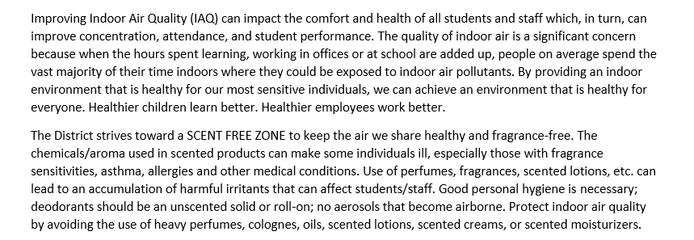
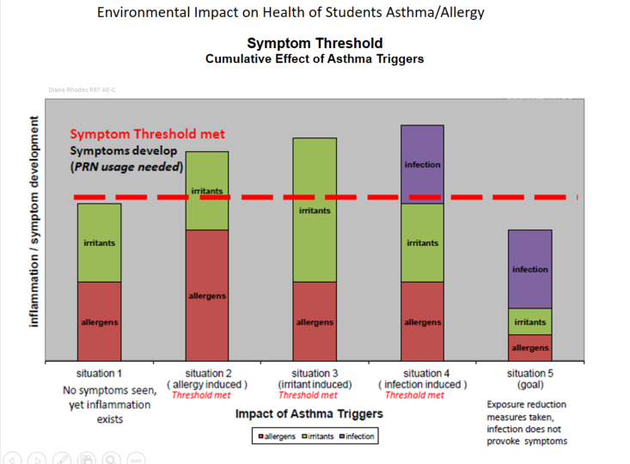
Environmental Assessments
Environment Component: Assess culture and reduce environmental risks
Target Population: all environmentally sensitive students and staff (asthma, allergy, migraines, chemical sensitivity, etc.)
Input: 1 FTE Indoor Air Quality, 1 FTE AE-C
Activities: campus assessment “Environmental Health”
issue (submitted by campus via electronic work order
system), Healthcheck data-driven classroom assessments,
routine assessment of campus (walkthrough)
Outputs: track the number of PRN uses to determine origin and
possible trigger location (classroom, building), remove triggers,
IAQ assessment standards, train teachers/administrators/custodians,
communicate Symptom Threshold philosophy, track pollen count
Outcomes: identify campus and classrooms with outliers in PRN usage,
increase in IAQ investigation requests, communicate IAQ benefits
(improve health of students and decrease clinic visits), reduce
maintenance costs (ex water intrusion events), end of year clean-out
Impact: Development of electronic Environmental Assessment software application,
CHANGED CULTURE, IAQ/asthma in parent/student manual, facilities staff buy-in,
administrator buy-in, additional IAQ staff member, Symptom Threshold understanding
Excerpt From NEISD Student/ Parent Handbook
Health Services/ Asthma / IAQ
Notes:
Assess Environmental Triggers
Asthma and IAQ go hand in hand. The person with asthma relies on a healthy indoor environment to feel normal and symptom free; a successful IAQ program needs the person with asthma to make the program relevant and ‘human’.
Science journals and peer-reviewed research seldom motivate change in the human behavior of a person not personally affected by asthma; it is assessed data that make things relevant for that individual that can drive change.
The environmental walkthrough is crucial to assess where you are, in order to know where you need to go. When I started the program I walked every campus classroom my first year to assess the driving force behind the data of high inhaler use and EMS calls. Despite a symptom-free life for the last 25 of my 45 year young life, I had two asthma exacerbations my first year at NEISD; simply because of the indoor environment where I was spending my day.
The campus walkthroughs provide insight of areas to target first, where to focus attention to remove triggers and then collect the data using the PRN inhaler use to evaluate the intervention actions. We communicated our results at every encounter – we demonstrated how improved IAQ can decrease inhaler use and loss of instruction time – administrators/teachers comprehend the relevance of healthy classroom environments.
This lead to additional staff. District environmental assessment standards were created to provide objective feedback to campus administration and strategies to create healthier learning environments.
The asthma and IAQ programs use the symptom threshold graphic to drive home the relationship between environment and health of those with allergy and asthma. We make relevant the cumulative effect of even the smallest particles and how they impact health.
After 11 years of the Asthma Program the NEISD culture has changed. In fact, there are times that people use the symptom threshold term with me… not realizing its originator. - very cool indeed!

Slide 40
Bold Goals Value Proposition Overview
Asthma-Friendly Environments and Disease Management Policies
Capture State Revenue: Potential Revenue Gains
Reduce Loss of Academic Instruction Time
Notes:
I want to briefly highlight the Bold Goal Value Propositions. The following slides quantify NEISD outcomes which may
help you create/improve/sustain your program.
One is financial, one is academic - one may resonate (or be more relevant) to the different positions in your school district.

Slide 41
Attendance Funding
Return on Investment
Number of students with asthma in NEISD
11.935%
8,361
Average number of school days missed by those with asthma
(CDC)
8
Attendance daily rate by state
$32.00
Potential revenue
LOST
$2,140,416
Benefits possible when asthma/allergy control environmental measures applied:
Reducing average number of schools days missed of those with asthma by 50% ...
$ 1,070,208.00/year
Improving attendance of all students with asthma by only 1 day …
$ 267,552.00/year
Notes:
Funding – this will be more relevant with the superintendents, central office budget staff, or accountant/business type board members, etc. We call them the ‘bean’ counters as they pay attention to line item budget items and want to capture as much revenue from the district’s piece of the funding pie from the state.
Your asthma students offer you a unique opportunity to embrace the importance of healthy learning environments through state funding. In Texas, as well as other states, the funding formula for state aid includes average daily attendance and a daily rate is calculated based on total enrollment. In our case our daily rate is $32.00 dollars per student.
We have over 8000 students with asthma, the CDC states that students with asthma miss on average 8 days. I want to restate that is an average from CDC. Privacy laws protect health information, so collection of actual days missed due to asthma is unknown; however, we know we have students who have missed 30 or more days of school and some that miss none. I think 8 is a realistic number based on my experience here at the district.
I missed well over 25 days each year when I was a kid; and they were consecutive spurts of 3-5 days throughout the year. My son, however missed maybe 2-3 days every 3-4 years. Why? As a respiratory therapist, I advocated for his environment at school to ensure it was asthma friendly. Today, parents of those with asthma should NOT have to do that.
For NEISD, simply doing nothing to address asthma, results in potentially losing over 2 million dollars per year.
The activities we have provided and the data we have collected, I have no doubt I achieved my bold goal. When you apply the technical solutions as best-practice in a proactive asthma management & IAQ program you will see a return on investment….. In our district, improving the attendance of those with asthma by just ONE day proves that point.

Slide 42
PRN Inhaler Use = Loss of Academic Instruction Time
** In many instances, a second dose is required if the student’s symptoms have not completely subsided at time of reassessment. In this case, an additional 20 minutes of wait-time is required before administration of second dose.
Total Academic Time Lost 26 min
Student symptomatic during class, notifies teacher, walks to clinic*
Gives inhaler, (2 puffs 1 min apart)
Wait-time for med to work
Reassesses student
In clinic, nurse assesses (symptoms, history, etc.)
Variable
Sends back to class if symptoms clear
7 minutes
5 minutes
5 minutes
**
5 minutes
4 minutes
Asthma is an individual disease and responses to medication vary. This example is a best-case scenario in which a student responds appropriately to the first administration of a quick-relief inhaler and can return promptly to class.
* Buddy system used to escort to clinic
Notes:
This is a value proposition that is most relevant to those involved in monitoring student performance. This would be your campus administrators, academic deans, teachers, at-risk student advocates, etc.
If a child exhibits symptoms in the classroom, they need their medication to reverse those symptoms. The breakdown of each step was provided by campus nurses who follow their clinical nurse practice act/guidelines of proper care for a respiratory student.
26 minutes of academic instruction time is lost. This is a best case scenario where the child responded appropriately to the first dose of medication. Many times, a second dose is required to completely reverse the symptoms. In this instance you would add another 20 minutes if the child does not respond and needs a second dosing.

Slide 43
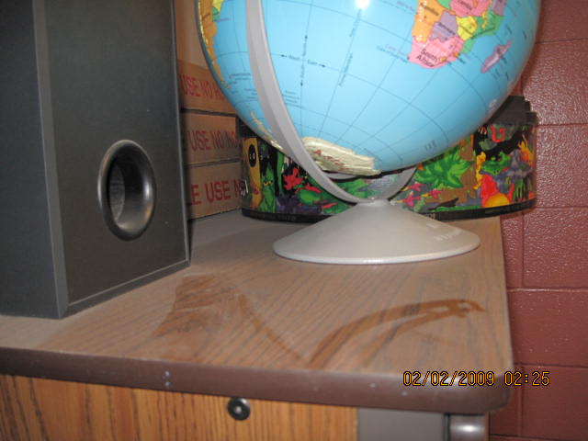
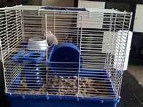
IAQ Influences PRN Inhaler Use
Campus A Campus B Campus C Campus D Campus E
Notes:
As I mentioned earlier, using PRN inhaler usage data, identified campuses that needed targeted environmental assessments.
In this instance Campus E had a substantially higher PRN use than similar campuses (in age, population) in the same general area of our district.
Upon assessment, we detected a couple of technical solutions best practices were not followed through out the campus: Source Control (Guinea Pig), Cleaning and Maintenance.

Slide 44
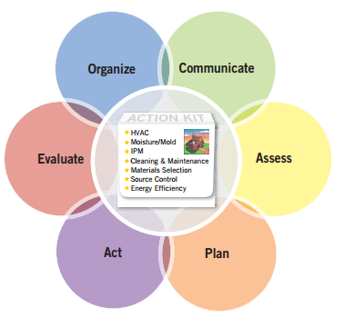
IAQ BEST PRACTICE Reduces PRN Inhaler Use
Notes:
The IAQ issues were resolved and we evaluated our intervention. Airway Inflammation doesn’t resolve itself over night – it is a gradual return to normal once exposures are removed. You can see the drop in the PRN inhaler use over the next few months, this realigned campus E with the other campuses.

Slide 45
Academic Instruction Time Gains When IAQ Best Practices Applied
176 PRN visits
26 minutes
4,576 minutes
January
76 hours
50 hours
20 hours
12 hours
106 PRN visits
26 minutes
2,756 minutes
February
46 PRN visits
26 minutes
1,196 minutes
March
28 PRN visits
26 minutes
728 minutes
April
Notes:
Remember the 26 minutes of lost of instruction time for a PRN visit?
Using the data from the previous example we can estimate how much valuable academic instruction time was lost at Campus E due to PRN inhaler data in one month. We can also show the reduction of time lost in academic instruction time when we applied IAQ best practices for the following months.
This data set only includes identified asthmatics with inhalers in the clinic; rhinitis/sinusitis students probably responded well with the reduction of dust and animal dander as well.
The month of March in San Antonio is the height of Oak Pollen season in San Antonio when all cars change colors due to the yellow dust that blankets everything. Oak is a known asthma allergen. Even with that outdoor pollen added, we still had substantial drops in PRN inhaler use.

Slide 46
Bold Goals Value Proposition Summary
NEISD Asthma Awareness Education Program
Initial input cost of $63,000
Financial Impact
REDUCTION in annual average number of
school days missed by 8,000 students with asthma — 1 day = $267,552; 50% = $1 Million
Academic Impact
DECREASE in asthma-related clinic visits
Reduction in Loss of Academic Instruction Time
Asthma students achieve full academic potential
Human Impact
IMPROVED Quality of Life, Change in Culture
Notes:
I want to circle back to our Value Proposition from the beginning of this presentation, this slide summarizes the Asthma Program’s Bold Goal.
Monetary Return on Investment: Reduction in annual average school days missed can yield a substantial amount of state funding that far outweighs input costs.
Academic benefit to asthma students - they get back those 26 minutes of valuable instruction time that are lost each time a student becomes symptomatic due to campus environmental conditions; this will positively affect student performance.
Change in Culture improves the life of every student with asthma and reduces risks of asthma exacerbations.

Slide 47


Create an environment conducive to learning for all students.
Healthier children learn better…
and come to $chool
Diane Rhodes BBA, RRT, AE-C, RCP
drhode@neisd.net
www.neisd.net/env_health
Notes:
In closing, the short and long term health of a child and their capacity to learn is directly related to the indoor environment where that learning takes place; using the value propositions we discussed can help in your messaging. Using asthma as your marker, it humanizes IAQ and allows you to evaluate your progress.
Healthy children learn better. It is our responsibility to create an environment where every child can reach their full academic potential.

Slide 48
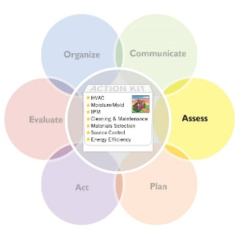
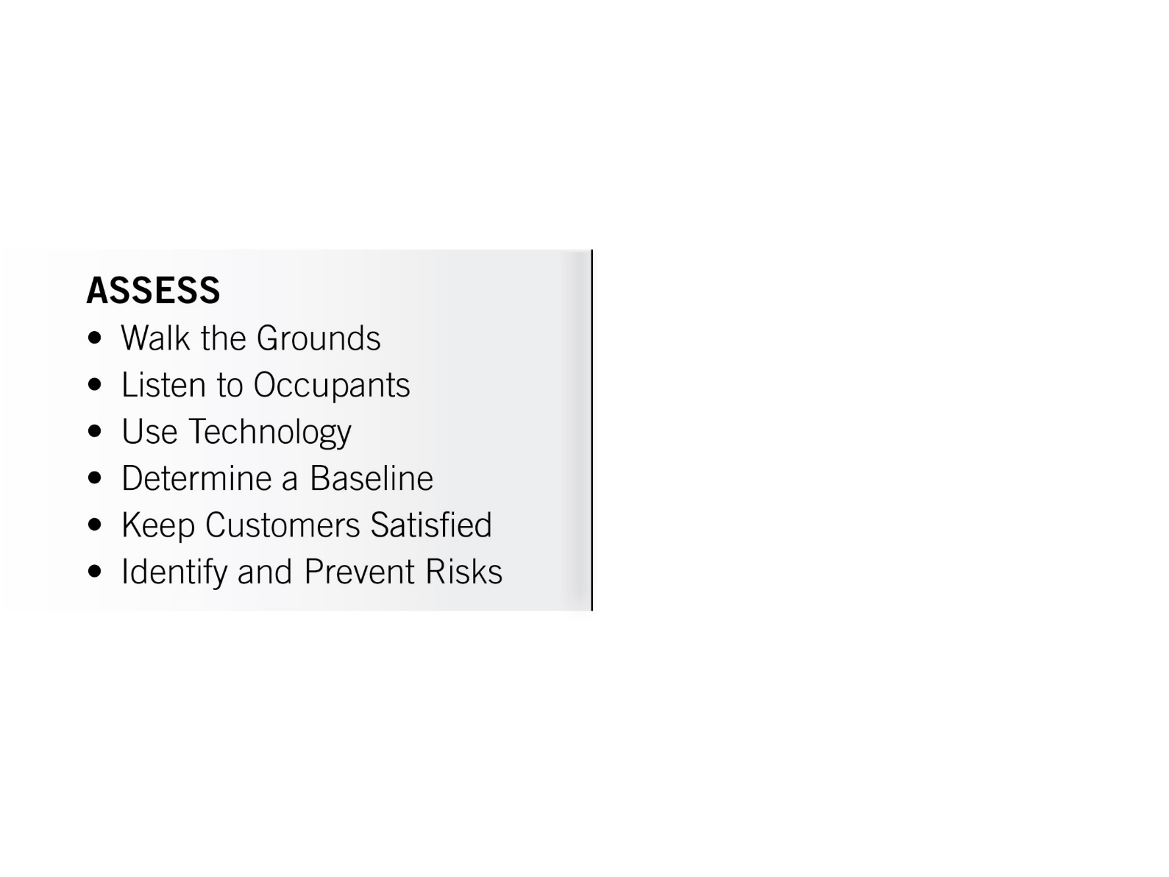
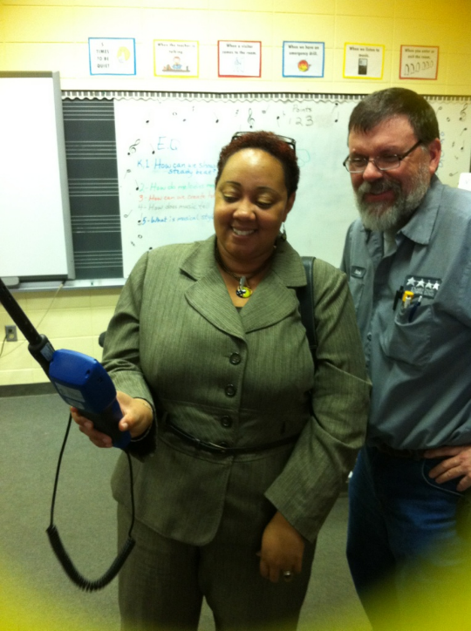
KEY DRIVER:
Assess Your Environments Continuously
Notes:
So, let’s unpack one of the stories you heard here to see how the IAQ TfS resources can help you design your program, develop your value proposition and communicate your results. Let’s consider the success that Anne’s program had with addressing bus idling. When establishing any IAQ and asthma program, we know from the Framework that one of the first things to do is assess your environment.
The Assess Driver is how you validate you program efforts. This is where you conduct one of the most important action in your IAQ management plan, the schools assessment walk-through. During the walk-through you collect the data you need to identify, address, prevent asthma triggers.

Slide 49
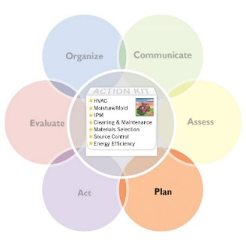
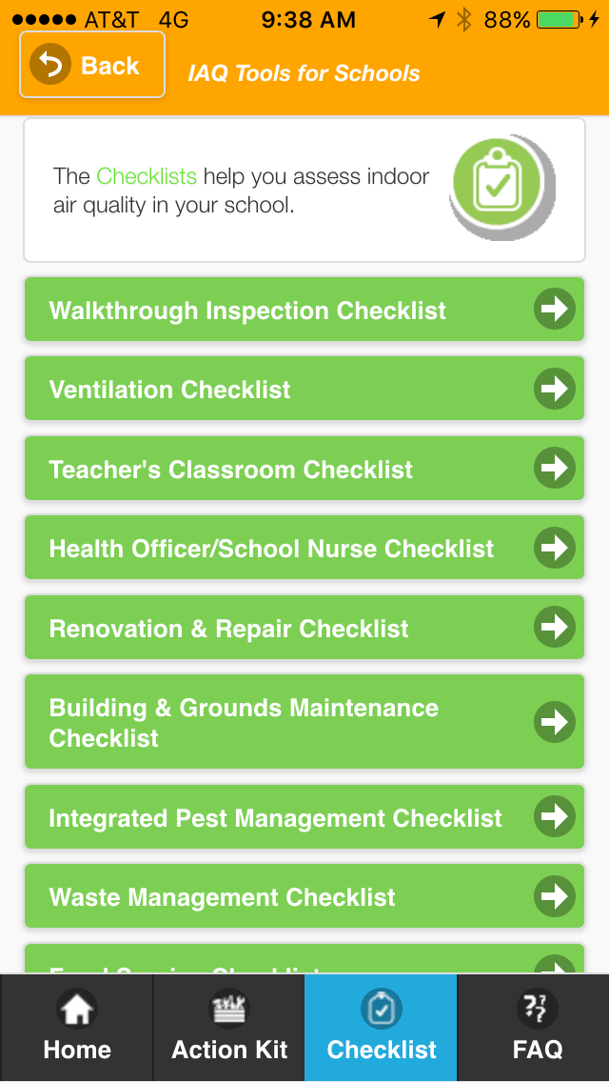
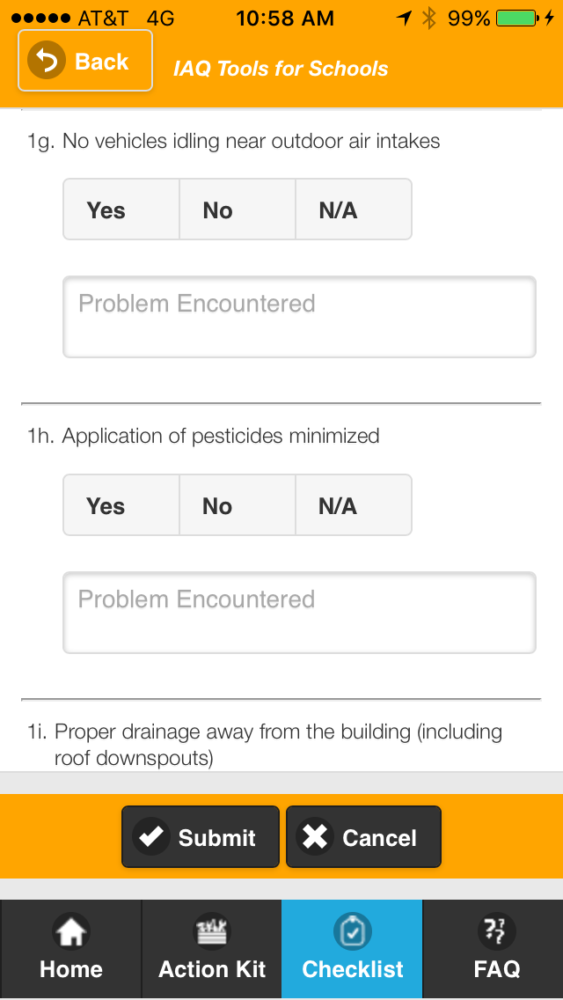
Assess Your Environments Continuously
Walkthrough Inspection Checklist
Notes:
The walkthrough checklist in the mobile app allows you to conduct a thorough walk through and collect your data. Using the checklist you can identify potential asthma triggers that call for action like vehicles idling near intakes.

Slide 50
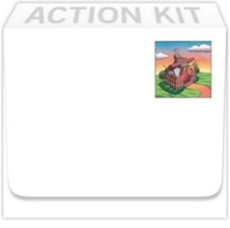

Aggressive Source Control
• Conduct regular building walkthrough inspections.
• Test for radon; mitigate if necessary.
• Implement a hazardous materials plan (use, label, storage and disposal).
Establish a school chemical management and inventory plan.
Implement smoke-free policies.
• Establish an anti-idling school bus policy.
• Use walk-off mats at building entrances.
• Conduct pollutant-releasing activities when the school is unoccupied.
Source
Control
Photo credit: EPA Walkthrough of a school in Philadelphia, PA
Notes:
By using the Source Control Technical Solution strategies you can identify establishing an anti-idling school bus policy as a high return value activity that is worth investment.

Slide 51
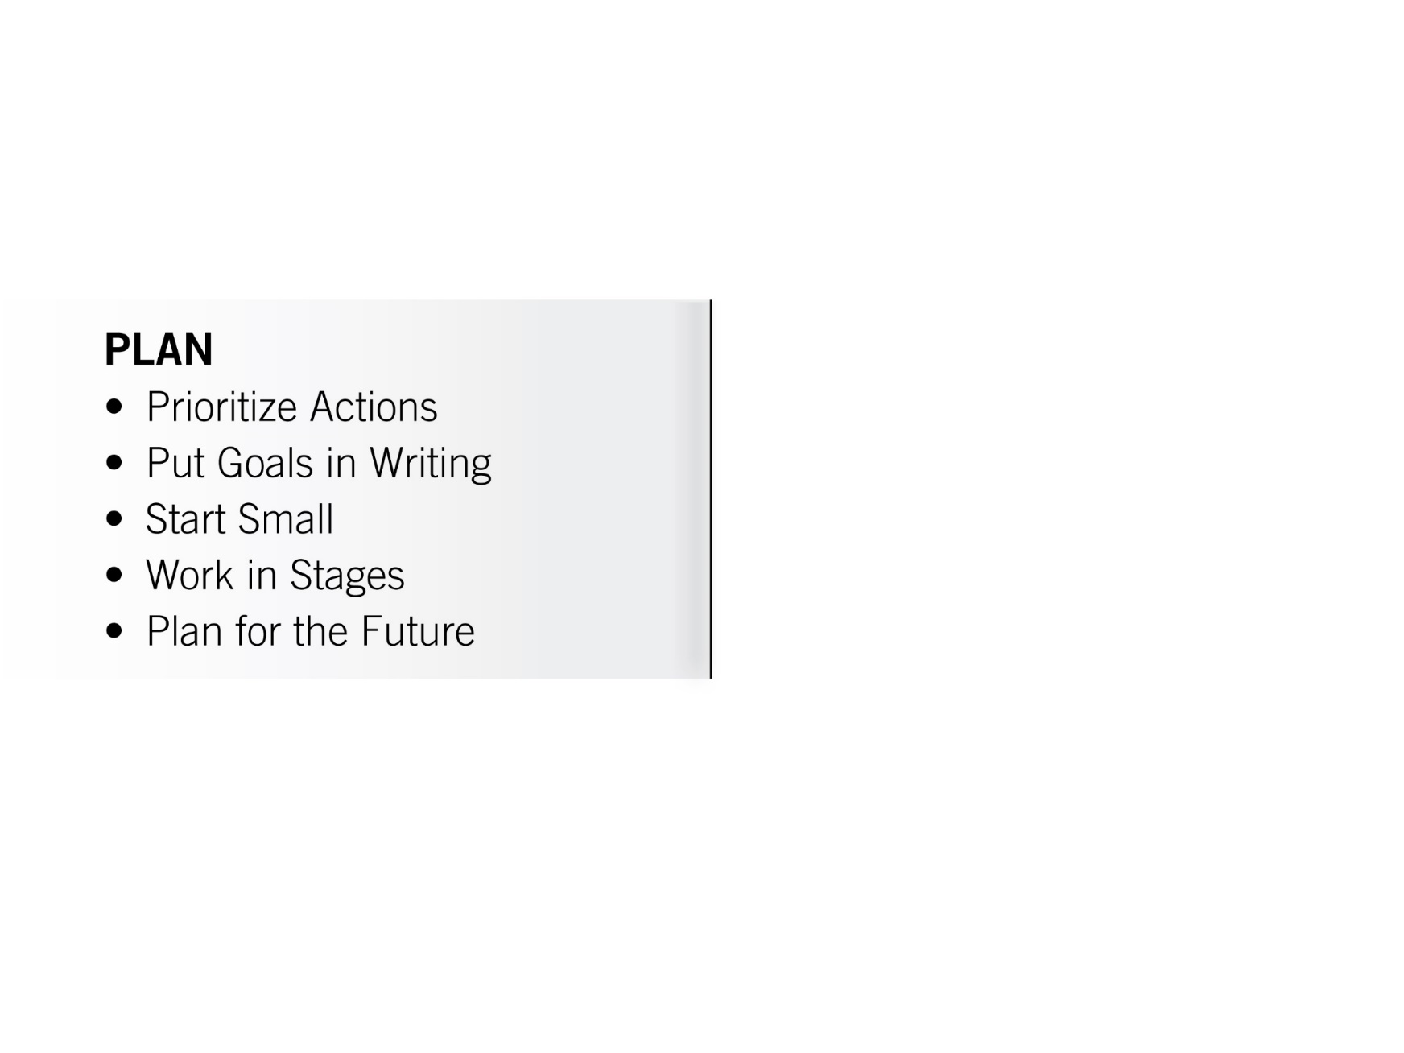
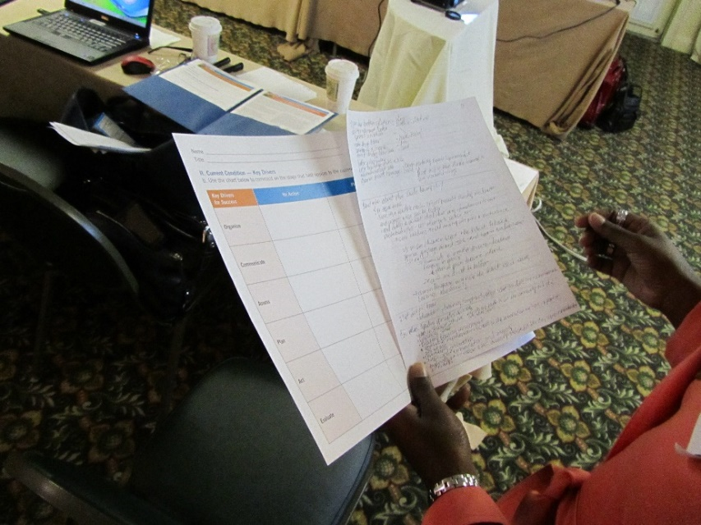
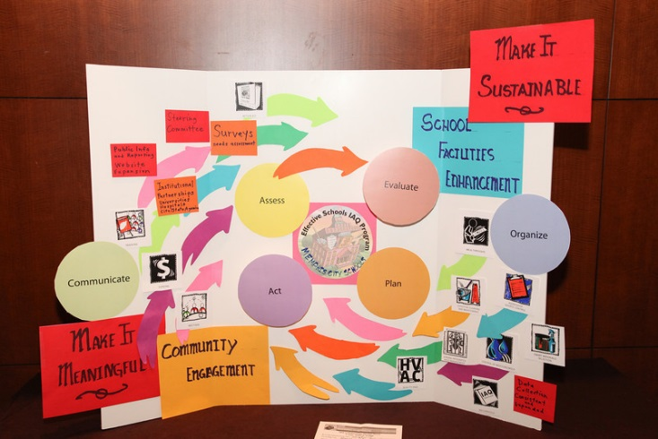
KEY DRIVER:
Plan Your Short- and Long-Term Activities
Notes:
When initiating any new policy, The Plan Key Driver strategies reinforce the importance of putting plans and goals in writing. The Value proposition worksheet is a really useful tool for capturing your goals on paper and making sure activities are geared toward achieving them. The IAQ Tools for schools checklists and mobile app ensure the written plan and goals include the leaders, and stakeholders whose support you are seeking for the program.

Slide 52

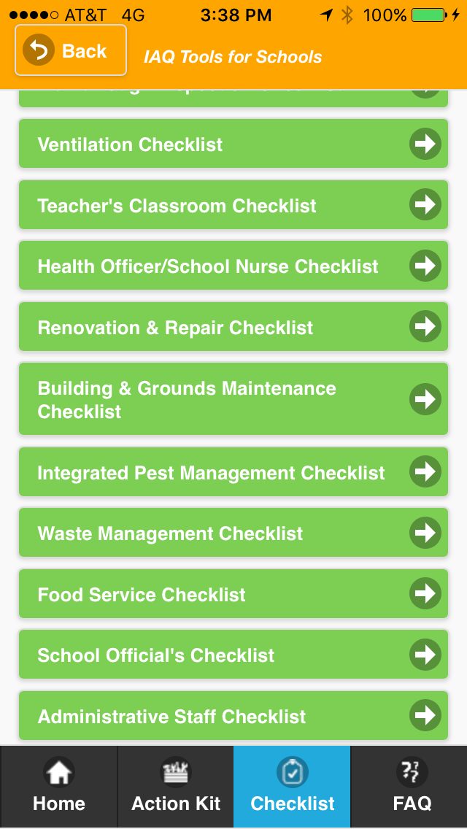
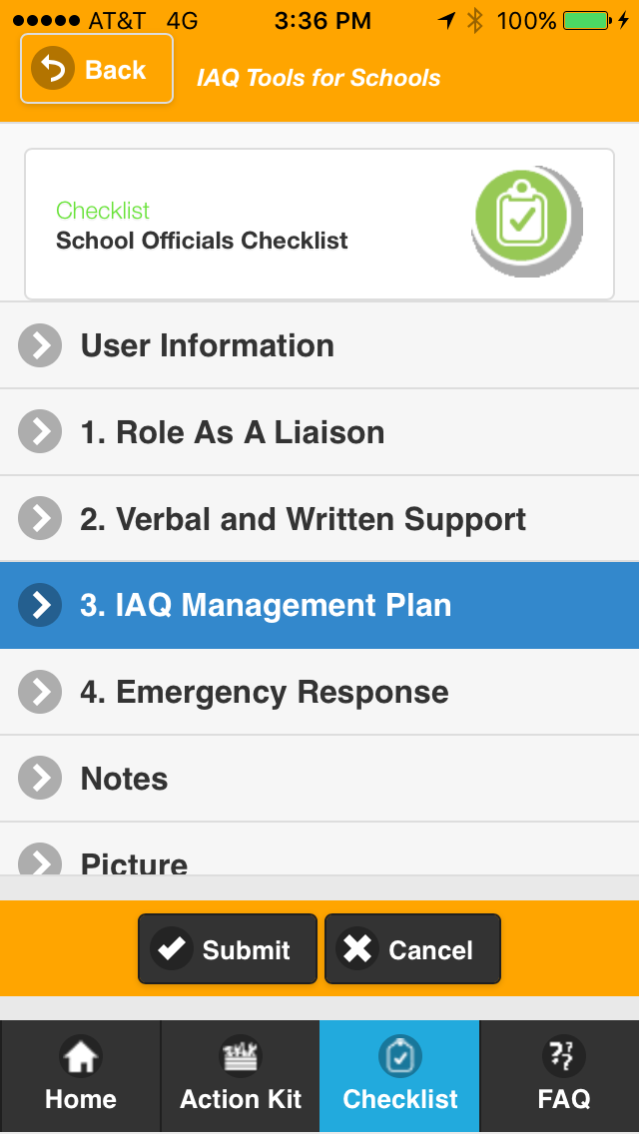
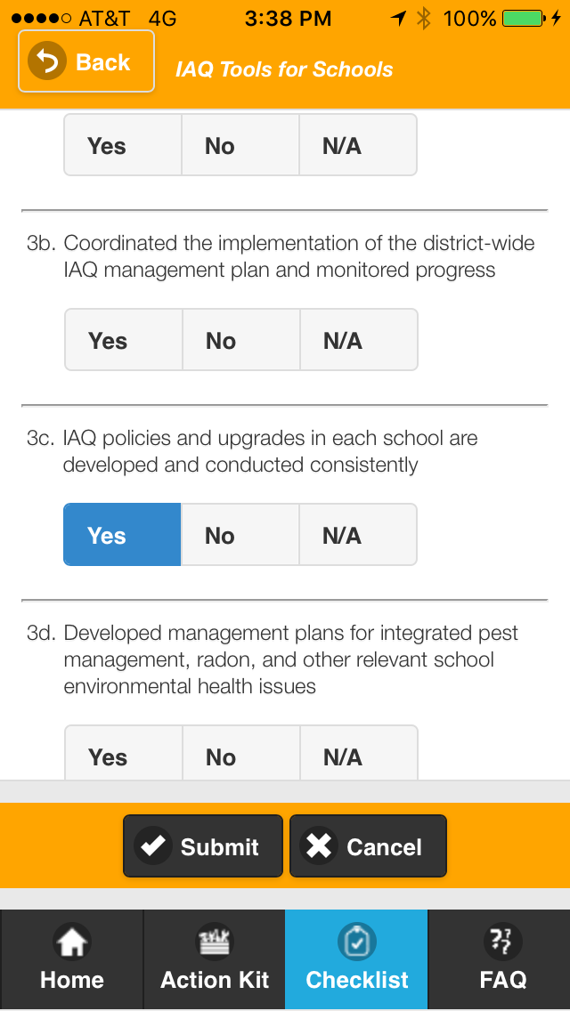
Plan Your Short- and Long-Term Activities
School Officials Checklist
Notes:
When the time comes to reach out to those stakeholders, The School Officials checklist is a powerful resource and communication strategy for working with school administrators to implement an IAQ and Asthma management plan. This checklist is a mechanism for creating Co-ownership and shared accountability for your program and sets an expectation that policies like bus idling will be supported and monitored. Using this checklist to get schools officials on board with their role in IAQ and asthma management immediately builds in value for achieving compliance with a bus idling policy, since the school official is responsible for ensuring that IAQ policies and upgrades in each school are developed and conducted routinely.

Slide 53
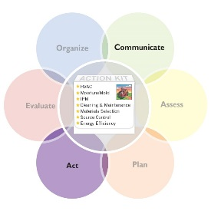
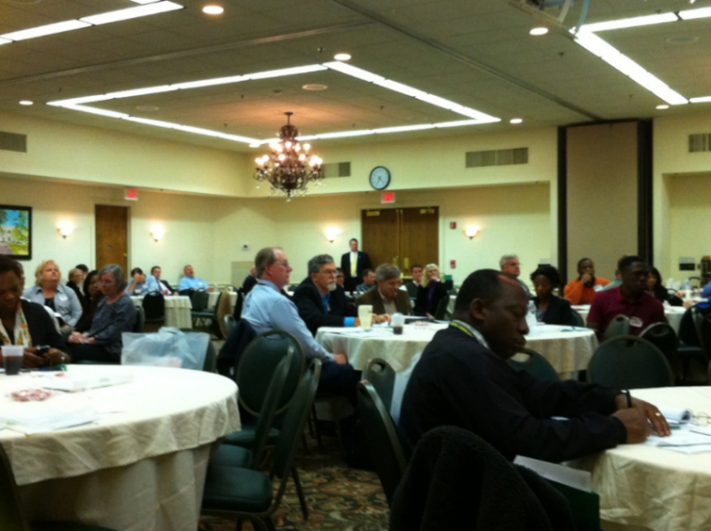
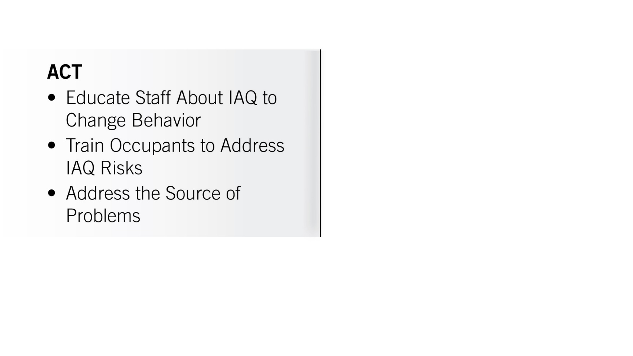
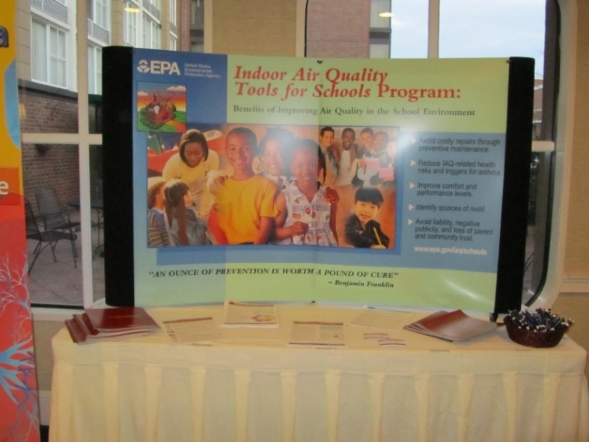
KEY DRIVER:
Act to Address Structural, Institutional
and Behavioral Issues
Notes:
Once the bus idling policy is in place, The Act Driver helps you establish the training and education for bus drivers and other transportation staff to accomplish the behavior changes and attitude changes that lead to full compliance.

Slide 54




KEY DRIVER:
Evaluate Your Results
for Continuous Improvement
Photo credits: Dave Blake and Rich Prill’s images from the
2013 Virtual School Walkthrough Webinar
Notes:
The strategies in the Evaluation driver allow you to manage and track the data that lead to recognition of your accomplishments and demonstrates return on investment.

Slide 55




KEY DRIVER:
Communicate With Everyone, All the Time
Notes:
The Communication driver provides a vehicle for you to broadcast your results, build confidence in your program and recruit champions to institutionalize policies.

Slide 56




KEY DRIVER:
Organize for Success
Notes:
Through successfully communicating you results, you can secure senior buy-in and support.

Slide 57

The School IAQ Assessment Mobile App
Kids learn best in a healthy school environment. Now there’s an app for that! This app puts a powerful tool to protect children’s health in the hands of people at the state, district and school levels.
— Janet McCabe, Acting Assistant Administrator for EPA’s Office of Air and Radiation
Notes:
I encourage you to use the IAQ Tools for Schools Kit, Framework and Mobile App along with the new Value Proposition worksheet to build the business case that secures the resource you need to support you IAQ and asthma management program.

Slide 58
Healthy Indoor Environments in Schools Resources
School IAQ Assessment Mobile App | www.epa.gov/iaq-schools/school-iaq-assessment-mobile-app
IAQ Tools for Schools Guidance | www.epa.gov/iaq/schools
IAQ Tools for Schools Action Kit | www.epa.gov/iaq-schools/indoor-air-quality-tools-schools-action-kit
IAQ Tools for Schools Framework and Technical Solutions | www.epa.gov/iaq-schools/framework-effective-school-indoor-air-quality-management-key-drivers
IAQ Master Class Professional Training Webinar Series | www.epa.gov/iaq-schools/indoor-air-quality-schools-master-class-webinar-series
IAQ Knowledge-to-Action Professional Training Webinar Series | www.epa.gov/iaq-schools/iaq-knowledge-action-professional-training-webinar-series
IAQ Tools for Schools Connector E-Newsletters and Emails | public.govdelivery.com/accounts/USEPAIAQ/subscriber/new?category_id=USEPAIAQ_C1
Schools IAQ Connector Listserv | Send a blank email message to schools_iaq_connector-subscribe@lists.epa.gov.
Notes:
Your heard a lot of great information today, and there is even more to be found using a rich trove of resources!

Slide 59




Other Essential Resources
Envisioning Excellence: IAQ Strategies in Action — The Framework for Effective School IAQ Management. This resource details the step-by-step strategies and actions that successful school districts can take to create healthier and safer learning environments.
Envisioning Excellence: Lessons From Effective School Indoor Air Quality Programs — A Snapshot of Profiles in IAQ Excellence.
This collection of IAQ profiles provides a comprehensive look into several very different school districts that have applied the Framework for Effective School IAQ Management to create effective and enduring IAQ programs.
Discover the Power of Effective Evaluation of IAQ Management — Key Drivers in Action. Schools that leverage the Evaluate Driver of the IAQ Tools for Schools Framework for Effective IAQ Management are better positioned to create healthier learning environments. Read examples of districts that have used evaluation to refine their programs and showcase their successes and learn how you can do the same.
Energy Savings Plus Health: Indoor Air Quality Guidelines for School Building Upgrades. Schools can protect and improve IAQ during building upgrades by controlling exposure to potential contaminants, controlling moisture, and ensuring adequate ventilation. This Guide includes a Master Verification Checklist to help track project processes, accomplishments and upcoming tasks.
Notes:
Many of our resources allow you to take a deep dive into many of the area we touched on in this webinar.

Slide 60
Credit(s) earned on completion of this course will be reported to AIA CES for AIA members. Certificates of Completion for both AIA members and non-AIA members are available upon request.
This course is registered with AIA CES for continuing professional education. As such, it does not include content that may be deemed or construed to be an approval or endorsement by the AIA of any material of construction or any method or manner of
handling, using, distributing, or dealing in any material or product.
_______________________________________
Questions related to specific materials, methods, and services will be addressed at the conclusion of this presentation.
Notes:
Additionally our SHIELD Network partner, The Council for Education Facility Planners International, is making it possible for you to receive 1.5 Learning Units toward the American Institute of Architects’ (AIA) Health, Safety, and Welfare and Sustainable Design (HSW/SD) standards. Please send your full name, AIA#, name of webinar and email address to IAQschools@epa.gov.

Slide 61
Course
Description
Creating Green Clean and Healthy Schools requires mastering the indoor environment using a comprehensive approach. The U.S. Environmental Protection Agency’s (EPA) Indoor Environments Division (IED) IAQ Knowledge-to-Action Professional Training Webinar Series will demonstrate how to translate the knowledge gained in the IAQ Master Class Professional Training Webinar Series into actions that improve IAQ in schools.
The webinar Using Data to Drive Buy-In and Funding to Reduce Asthma Triggers: The Value Proposition of School IAQ Management will provide participants with the knowledge to learn how to harness the power of evaluation to develop a business case, a value proposition, and a communications strategy that generates broader acceptance of, compliance with and funding for IAQ management programs.
Notes:
You will receive information after

Slide 62
This concludes The American Institute of Architects Continuing Education Systems Course.
Association for Learning Environments
(480) 391-0840

Slide 63
Thank you for attending!
Your next action steps—
Fill out the webinar evaluation form.
Access your personalized certificate of completion.
Notes:
My request is that for your next action steps, you fill out the webinar evaluation form to help us better serve and support your needs. At the end of the evaluation, please access your personalized certificate of completion and display it as a demonstration of your commitment to take action for clear, safe and healthy school indoor environments.
Thank you for attending this webinar.
This concludes the presentation portion of webinar today, but please continue to stay on the line for Q and A with our speakers.

Slide 64
Question & Answer Session
Notes:
Please stay on for our question and answer session which in addition to our webinar speakers will feature an panel of asthma expert including
Francine Locke, MS
Environmental Director
School District of Philadelphia
Barbara M. Kaplan, M.P.H., C.H.E.S
Director, Asthma Education
American Lung Association
Diane Rhodes, BBA, RRT, AE-C, RCP
Assistant Director of Health Services and Asthma Awareness Education
North East Independent School District

