Slide 1
Welcome to the Webinar
Exploring Pathways to Reimbursement for
In-Home Asthma Interventions
Welcome
Sheila Brown, U.S. Environmental Protection Agency, Washington D.C.
Moderator
Kate Hastings, The Scientific Consulting Group, Inc.
Presenters
Julian Rodriguez-Drix, Rhode Island Department of Health
Eric Armbrecht, Missouri Asthma Prevention and Control Program
Cliff Mitchell, Maryland Department of Health and Mental Hygiene
Thursday, May 3, 2018
Webinar: 1:00 p.m. – 2:00 p.m. EDT
Live Online Q&A: 2:00 p.m. – 2:30 p.m. EDT on AsthmaCommunityNetwork.org
Operator-Assisted Toll-Free Dial-In Number: 866-527-8921
Conference ID: 7588408
Notes:
At 1:00 pm ET on May 3, Sheila says:
Welcome to the U.S. EPA's webinar on Pathways to Reimbursement for In-Home Asthma Care. We are going to give everyone a chance to log in and connect and I will get us started in just a couple of minutes.
At 1:05 (or earlier, but no later!), Sheila officially begins:
Good afternoon to you all and welcome to the first week of National Asthma Awareness Month!
The U.S. Environmental Protection Agency is pleased to host you today for an important and exciting webinar presentation followed by a discussion forum on reimbursement for in-home environmental asthma interventions.
As one of the developers of the science that proves the link between asthma and environmental exposures, U.S. EPA has for years been a committed champion for expanding delivery and sustainability of in-home asthma care. We are so pleased to be able to offer today's webinar to hear from innovators in communities nationwide who have found solutions to ensure that the children who most need in-home environmental asthma care can receive it.
We are eager to learn from, to support, and to shine a spotlight on our local partners' stories that can teach us all so much about how to convince critical partners that improved asthma care is possible, and how to move whole systems to bring the best care we can to the people, particularly children, who most need it.
Thank you for joining this important discussion.
I'm going to turn the microphone over now to our facilitator, Kate Hastings. Some of you may know Kate. She has been a contractor and partner to U.S. EPA (and other government agencies) for more than 20 years and has been one of my partners working for EPA's Indoor Environments Division for almost that long. Kate works with communities across the country to help to facilitate system changes to improve population health and she is very experienced in facilitating conversations about improving asthma care. Kate will run our webinar today. Kate…

Slide 2
Question & Answer Session on
AsthmaCommunityNetwork.org Discussion Forum
Immediately after the webinar, join us in the AsthmaCommunityNetwork.org Discussion Forum for a live online Q&A Session:
2:00 p.m. – 2:30 p.m. EDT
To post a question in the Discussion Forum, follow these directions:
If you are a Network member, log in to your AsthmaCommunityNetwork.org account.
Click on the “Discussion Forum” button on the home page.
Click on the “Live Online Q&A for 5/3/18 Webinar” link.
Click on the “Post to the Forum” link to post your question.
Enter your question and click the “Save” button at the bottom of the page.
Not a member? Create an account at AsthmaCommunityNetwork.org by clicking the “Join Now” link at the top of the page. Your account will be approved momentarily and you can begin posting questions.
Notes:
Our Q&A will take place on the Discussion Forum on AsthmaCommunityNetwork.org.
To see the discussion forum directly, please click the link that we just sent you via the chat function.
To ask questions, you must first be a member of AsthmaCommunityNetwork.org, so please take a minute to join so that you can post questions throughout the webinar—it is a simple and quick process. The Site Administrator will be approving memberships as they are submitted.
After the Q&A period is closed, please visit the Discussion Forum often to see other contributions as well as to make your own!

Slide 3
Learning Objectives
Attendees will learn about—
The current state of reimbursement nationally.
The diverse pathways to reimbursement through Medicaid.
How local programs can begin or continue their journeys toward sustainable financing, and resources to help along the way.

Slide 4
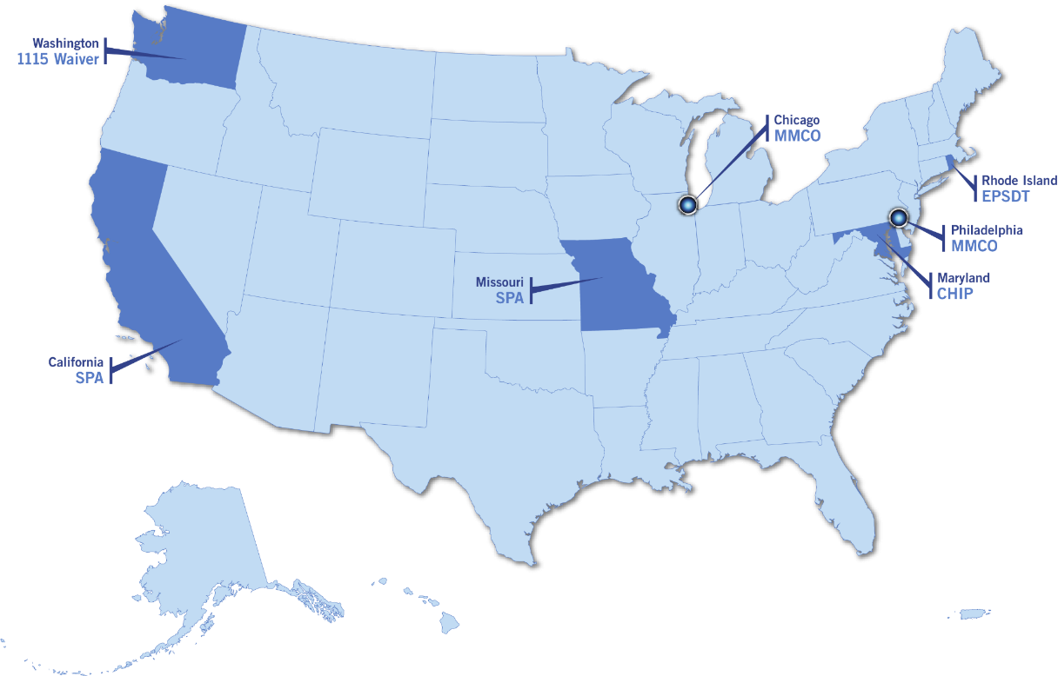
How We Will Guide Today’s Conversation
Background on Asthma Reimbursement
Hear from Leaders About Pathways They Have Pursued
  Rhode Island – EPSDT
  Missouri – SPA
  Maryland – CHIP
Notes:
Background on Reimbursement
- Navigating a shifting health care landscape.
- Across the country, we are seeing sustainable reimbursement policies for in-home asthma visits conducted by licensed, certified, and non-licensed and non-certified professionals.
What approaches and policy levers are working well? Where and under what circumstances?
What lessons can we identify in one location that we can adapt and apply in others, while realizing that local realities sometimes drive different communities toward different solutions?
Here are some examples of pathways to asthma reimbursement for in-home services that we have seen in states around the country. Today we will focus on 3: RI, MO, MD.

Slide 5


Rhode Island’s Story—
HARP: Home Asthma Response Program
Julian Rodríguez-Drix, Asthma Program Manager
May 3, 2018
Exploring Pathways to Reimbursement for In-Home Asthma Interventions

Slide 6
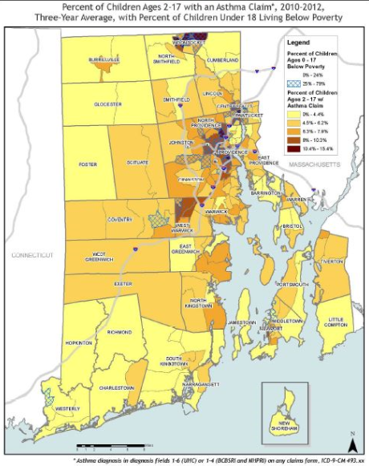
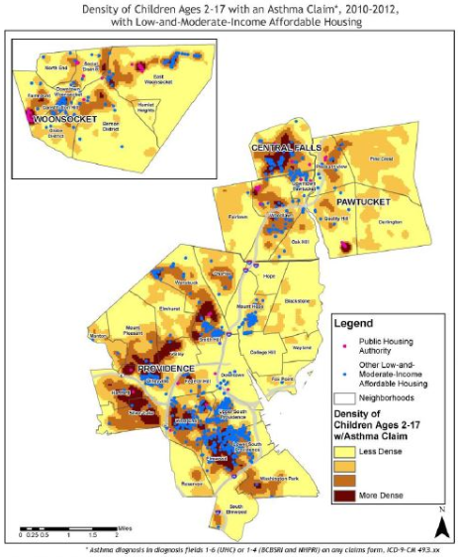
Asthma, Poverty and Housing in RI
www.health.ri.gov/publications/databooks/2014AsthmaClaims.pdf

Slide 7
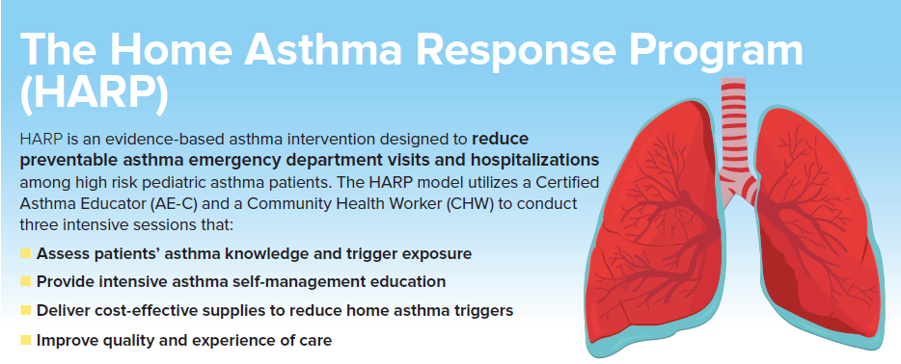
Rhode Island’s Asthma Intervention
Launched in 2011 in partnership with RI’s Hasbro Children’s Hospital and Saint Joseph’s Health Center, HARP is a well-established intervention with strong partnerships and well-defined roles and responsibilities, curriculum, service delivery infrastructure, eligibility criteria, and evaluation framework.

Slide 8



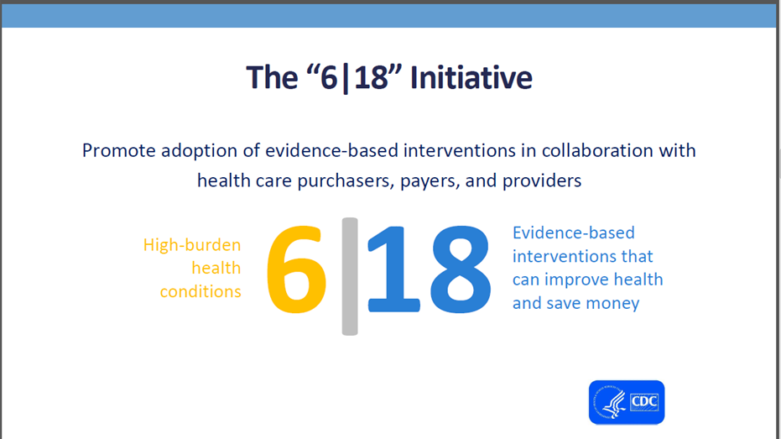


Partnerships and Support

Slide 9
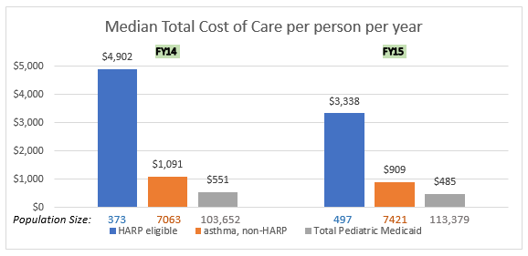
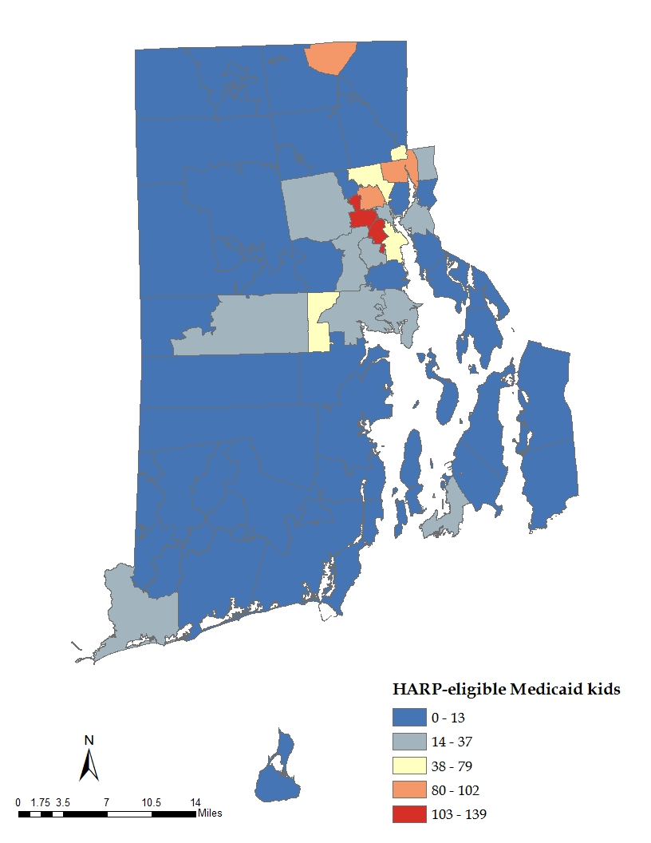
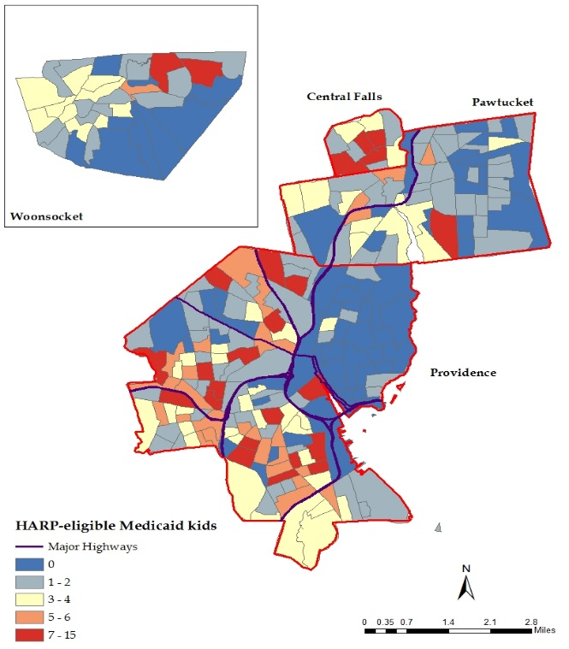
Utilizing Medicaid Data

Slide 10
Results
We have demonstrated—
Consistent reductions in emergency department visits and hospitalizations, with larger (% and total) reductions for high utilizers
Improved asthma control and quality measures
Return on investment (ROI)
We have—
Support from RI Medicaid
Strong partnerships and ongoing data sharing/analysis
Policy options for coverage
health.ri.gov/publications/programreports/HomeAsthmaResponseProgram.pdf

Slide 11

Julian Drix
Asthma Program Manager
Division of Community Health & Equity
Rhode Island Department of Health
julian.drix@health.ri.gov

Slide 12

Show-me Reimbursement
Missouri’s Pathways to Reimbursement for In-Home Asthma Interventions
Eric Armbrecht, Ph.D.
Lead Evaluator
Peggy Gaddy, RRT, M.B.A.
Program Manager
EPA Asthma Program
May 3 Webinar
Exploring Pathways to Reimbursement
for In-Home Asthma Interventions

Slide 13
What we learned on our bumpy, curvy road to reimbursement for asthma care support services
1
A State Plan Amendment (SPA) is a starting line, not a finish line.
State-specific data helped MO HealthNet pursue an SPA.
Be patient. SPAs take time. Chart an 18-month course of action to advance this option.
Take what you can get. Do not be greedy or overly prescriptive. Some wiggle room later may be very helpful.
Managed Care Companies (aka managed Medicaid health plans) can make changes happen, with alignment around key performance indicators (KPIs).
Change is made possible through managed care companies. Gain an understanding of their business and KPIs.
Approach managed care companies with a mindset of helping, not demanding a set of covered benefits.
An asthma clause in a Request for Proposals can be used to require coverage or promote asthma-specific KPIs.
2

Slide 14
What we learned on our bumpy, curvy road to reimbursement for asthma care support services (cont.)
3
The Health Home Program (aka PMPM-funded care coordination by primary care sites) can increase provider demand for asthma interventions.
Get program eligibility for children with asthma.
Enrollment enhances clinic and outreach service capacity.
Increases provider interest in risk identification and referral for asthma care support interventions (e.g., self-management education, inhalation instruction, home environment assessment).
Return on investment (ROI) and risk stratification are your friends.
Risk stratification is critical for allocating services and controlling fear of
cost explosion (related to adding new services).
Local data and experience are essential for estimating a believable ROI.
4

Slide 15
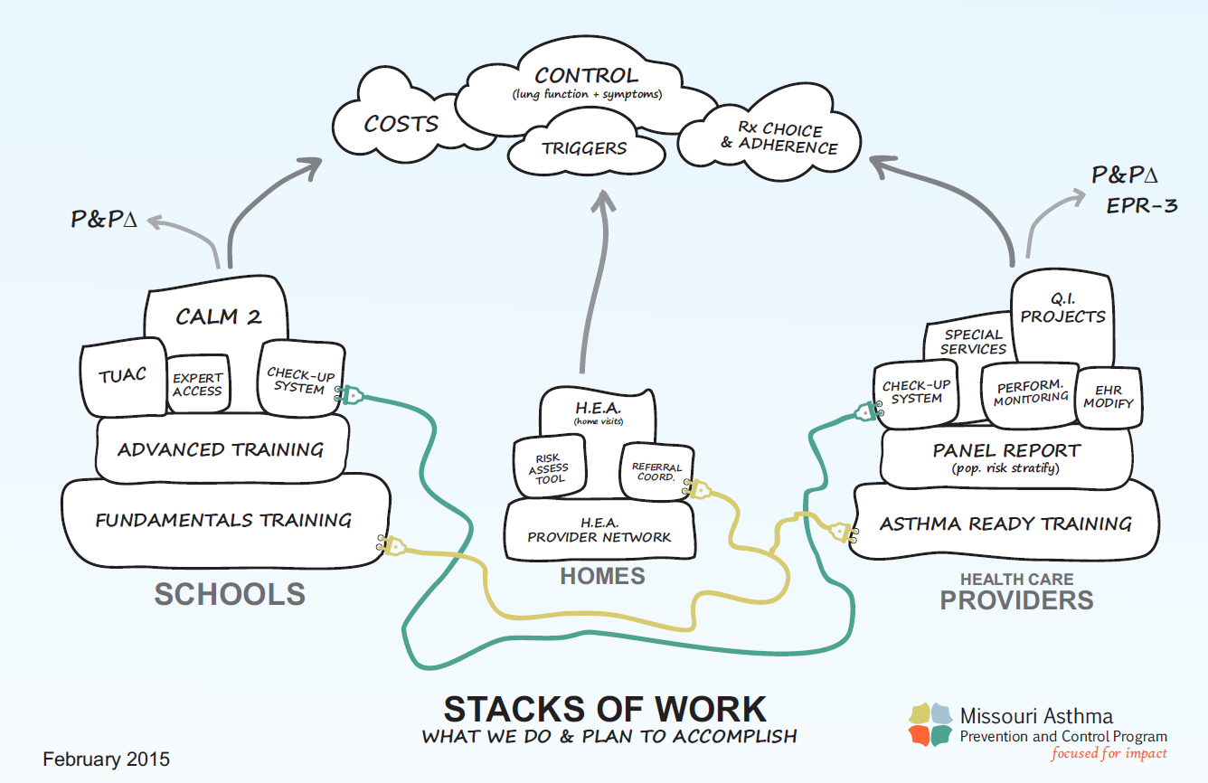

Slide 16

www.SchoolNurseLink.com
Why connect with managed Medicaid health plans?
Get extra services and benefits for children.
Save time for school nurses.
Health plans can help school nurses—
  Communicate with physicians and other health care providers.
  Obtain same-day or next-day transportation.
  Make appointments with specialists and primary care physicians.
  Make referrals for self-management education or home visit programs.
New FERPA
template available
www.SchoolNurseLink.com
info@SchoolNurseLink.com

Slide 17
Maryland’s Approach to Reimbursement for Asthma In-Home Interventions
Clifford Mitchell, M.D., M.P.H.
Director, Environmental Health Bureau
Maryland Department of Health and Mental Hygiene
May 3, 2018

Slide 18



Online eLearning
10 short, self-paced courses
Selected key resources
Helpful tools/exercises
Links to all resources
Share your stories
Ask the Experts!
*Now until June 28th*
Open office hours
Quickly access expert TA
Customized, flexible, informal
Responsive to your needs
Bonus in-person opportunity
Learn more:
Online at http://bit.ly/BlogExpertise or email lfudala@nchh.org
Notes:
You are not alone! Additional resources are available to support your efforts:
Online eLearning
10 short, self-paced courses with links to all resources used to develop the course so you can dive deeper where you need it most
2. Informal technical assistance
For the next 10 weeks, NCHH and several of our expert colleagues will offer “open office hours” to share feedback, advice, mentorship, successful (or not!) peer examples, or even just be a friendly ear to those wanting to discuss challenges and next steps related to the many facets of building systems to sustain home-based asthma services.
Easy access to experts who know a great deal about this field and what’s going on in other states or communities
Might help you develop or refine your “elevator pitch” OR Provide advice on how to build your best workforce team or reach the right clients OR Help you better understand what “sustainably financing” your efforts even means
Initiative welcomes any and all related discussions, and we encourage you to ask your questions and bring your challenges on specific issues related to your current work.

Slide 19
Question & Answer Session on
AsthmaCommunityNetwork.org Discussion Forum
Immediately after the webinar, join us in the AsthmaCommunityNetwork.org Discussion Forum for a live online Q&A Session:
2:00 p.m. – 2:30 p.m. EDT
To post a question in the Discussion Forum, follow these directions:
If you are a Network member, log in to your AsthmaCommunityNetwork.org account.
Click on the “Discussion Forum” button on the home page.
Click on the “Live Online Q&A for 5/3/18 Webinar” link.
Click on the “Post to the Forum” link to post your question.
Enter your question and click the “Save” button at the bottom of the page.
Not a member? Create an account at AsthmaCommunityNetwork.org by clicking the “Join Now” link at the top of the page. Your account will be approved momentarily and you can begin posting questions.
Notes:
That concludes our webinar. My thanks again to our speakers for their time and willingness to share their insights. Also, thanks to all of you who participated. We’re glad you could join us and hope the session was helpful for you.
Be on the lookout for an audiovisual file of this webinar posted on AsthmaCommunityNetwork.org in the coming weeks.
I would now like to invite you to join the Q&A session. Here are some directions for how to post a question in the Discussion Forum on AsthmaCommunityNetwork.org.
You will need to log in to your Network account to post questions.
If you are not a member yet, you can join the Network today by clicking the “Join Now” link at the top of the AsthmaCommunityNetwork.org homepage.
Your account will be approved momentarily and you can begin posting questions.
Thanks again for joining us, and we look forward to chatting with you in the Discussion Forum.

