Slide 1

Opportunities for In-Home Asthma Care in Native Communities:
A Northwest Initiative and Tribal Pilot Project
Phone Number: 866-527-8921
Conference ID: 5738629

Slide 2
Welcome to the Webinar
Opportunities for In-Home Asthma Care in Native Communities:
A Northwest Initiative and Tribal Pilot Project
Moderator
Erin McTigue, U.S. Environmental Protection Agency (EPA) Region 10
Presenters
Matthew Hayashi, Principal Organizational Development and Leadership Consultant, Headwater People Consulting
Shawn Blackshear, Acting Director, Portland Area Division of Environmental Health Services, Indian Health Service’s Yakama Field Office
Tuesday, July 23, 2019
Webinar: 3:00 p.m. – 4:00 p.m. EDT
Live Online Q&A: 4:00 p.m. – 4:30 p.m. EDT
Phone Number: 866-527-8921
Conference ID: 5738629
Notes:
Erin:
Welcome to the U.S. EPA's webinar on Opportunities for In-Home Asthma Care in Native Communities: A Northwest Initiative and Tribal Pilot Project
We are going to give everyone a chance to log in and connect and I will get us started in just a couple of minutes.
At 3:05 (or earlier, but no later!),
Good afternoon to you all. My name is Erin McTigue
The U.S. Environmental Protection Agency is pleased to host you today for an important and exciting webinar presentation followed by a discussion forum on Opportunities for In-Home Asthma Care in Native Communities: A Northwest Initiative and Tribal Pilot Project.
As one of the developers of the science that proves the link between asthma and environmental exposures, U.S. EPA has for years been a committed champion for expanding delivery and sustainability of in-home asthma care. We are so pleased to be able to offer today's webinar to share the collaborative work that has been happening in the NW on ensuring that native children who need in-home environmental asthma care can receive it.
.
Thank you for joining this important discussion.

Slide 3
Question & Answer Session on
AsthmaCommunityNetwork.org Discussion Forum
Immediately after the webinar, join us in the AsthmaCommunityNetwork.org Discussion Forum for a live online Q&A Session:
4:00 p.m. – 4:30 p.m. EDT
To post a question in the Discussion Forum, follow these directions:
If you are a Network member, log in to your AsthmaCommunityNetwork.org account.
Click on the “Discussion Forum” button on the home page.
Click on the “Live Online Q&A for 7/23/19 Webinar” link.
Click on the “Add New Forum Topic” link to post your question.
Enter your question and click the “Save” button at the bottom of the page.
Not a member? Create an account at AsthmaCommunityNetwork.org by clicking the “Join Now” link at the left side of the page. Your account will be approved momentarily, and you can begin posting questions.
Indoor Air Quality (IAQ)
Notes:
Erin:
Our Q&A will take place on the Discussion Forum on AsthmaCommunityNetwork.org.
To see the discussion forum directly, please click the link that we just sent you via the chat function.
To ask questions, you must first be a member of AsthmaCommunityNetwork.org, so please take a minute to join so that you can post questions throughout the webinar—it is a simple and quick process. The Site Administrator will be approving memberships as they are submitted.
After the Q&A period is closed, please visit the Discussion Forum often to see other contributions as well as to make your own!

Slide 4
Polling Question 1
Which type of organization do you represent?
Tribal government
Federal, state or local agency
Health care provider
Health plan
Community asthma program
Indoor Air Quality (IAQ)
Notes:
Erin:
Before we dive into today’s presentations, let’s get a sense for who’s with us today. To do that, please take a moment to answer the polling question on your screen: “What type of government or organization do you represent?”
Polling Question #1

Slide 5
Learning Objectives
Participants will learn about—
Lessons from a 5-year effort to build capacity and explore sustainable funding for asthma in-home environmental interventions in Native communities.
Guidance about how a multidisciplinary team was formed with tribes, federal partners, and state and local organizations, including the importance of involving tribal voices in program design.
Firsthand experiences from a leader of a home-visiting program in a tribal community in Washington state.
Opportunities and barriers to expanding in-home asthma care in Native communities.
Indoor Air Quality (IAQ)
Notes:
Erin:
On today’s webinar, “Opportunities for In-Home Asthma Care in Native Communities: A Northwest Initiative and Tribal Pilot Project” we feature Matthew Echohawk Hayashi, Principal Organizational Development and Leadership Consultant, Headwater People Consulting, and Shawn Blackshear, Acting Director, Portland Area Division of Environmental Health Services, Indian Health Service’s Yakama Field Office. I will also be speaking on EPA Region 10’s role in this work.
In the webinar, you will learn about:
Lessons from a 5-year effort to build capacity and explore sustainable funding for asthma in-home environmental interventions in Native communities.
Guidance about how a multidisciplinary team was formed with tribes, federal partners, and state and local organizations, including the importance of involving tribal voices in program design.
Firsthand experiences from a leader of a home-visiting program in a tribal community in Washington state.
Opportunities and barriers to expanding in-home asthma care in Native communities.

Slide 6
Polling Question 2
Based on the learning objectives I’ve outlined, what are you most interested in learning about today?
    On-the-ground experiences from the Tribal Asthma Program on the Yakama Reservation
    How momentum and partnerships are being built around tribal in-home asthma work in the Northwest
    Opportunities and barriers to in-home asthma care in Native communities
    Other
Indoor Air Quality (IAQ)
Notes:
Erin:
Based on the learning objectives I’ve just outlined -
What are you most interested in learning about today?

Slide 7
Northwest Tribal Asthma Initiative
July 23, 2019
Notes:
Children playing at the beach.
Credit Elisabeth Kawe.
Erin:
Now, we’ll jump right into the content.
.

Slide 8

Paying for Holistic Asthma Programs
Historically and Now in R10:
Piecemeal funding from the Centers for Disease Control and Prevention, Indian Health Service (IHS), EPA and direct tribal funds
The Vision and Opportunity:
Culturally appropriate tribal programs sustainably financed through public and private health insurance
Notes:
Erin:
To ground us, we’ll start with our vision: that culturally appropriate, holistic tribal asthma programs are active and sustainably financed across the nation, for example, through health insurance funding streams.
We believe we are at a moment of opportunity for helping to advance this work and, at EPA, that we have a responsibility to do so. We hear from tribal leaders and staff across our region (ID, AK, OR, WA) that respiratory diseases like asthma and substandard housing and indoor air conditions are high priorities and challenging to address. Historically and now, tribes have been working to address the issue through piecemeal grant opportunities and direct tribal funds.
We feel it is part of our tribal trust responsibility and mission to support tribes in addressing these public and environmental health opportunities sustainably.

Slide 9
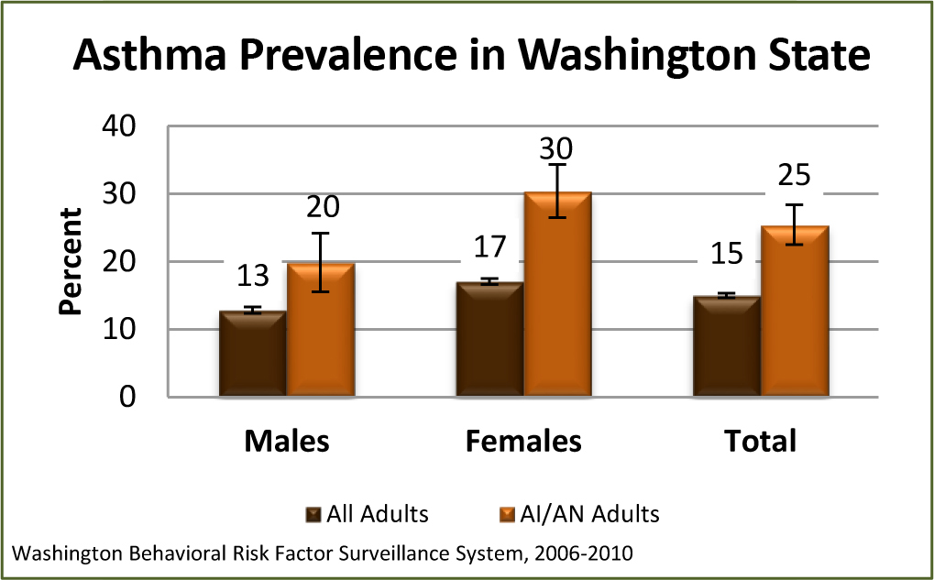
Notes:
Erin:
The disparities in asthma prevalence in native communities are significant and striking.
In WA State, 15% of the general adult population has asthma, compared to 25% of native people in the State.
Further concerning is that we understand from partners that most surveillance systems are under-reporting native health data, so the disparity is likely even worse.

Slide 10
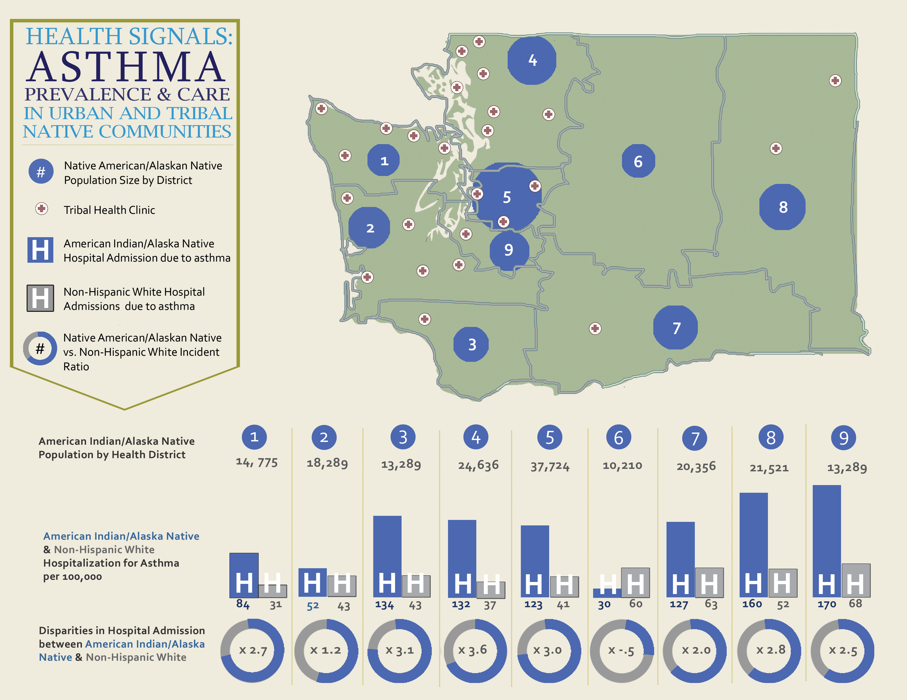

In Washington state,
hospitalization due to asthma is
more likely for Native patients than white patients.
Washington Comprehensive Hospital Abstract Reporting System, 2012–13, corrected for American Indian/Alaska Native misclassification by the IDEA-NW Project
DRAFT. PLEASE DO NOT DISTRIBUTE.
Notes:
Erin:
And not only is the prevalence of asthma higher, but the disease itself has a greater burden on native people.
There is a lot going on in this slide, but the take away is that native patients in WA State are almost 3x more likely to be hospitalized for asthma than white patients.
This is, of course the tip of the iceberg when it comes to burden – as this is only hospitalization, not clinic visits or exacerbations.

Slide 11
Notes:
Erin:
The positive part of this picture is that there is a solution, with a strong evidence base:
We know that coordinated holistic asthma care that addresses both the clinical and environmental needs of an asthma patient through home visit can immediately and measurably improve asthma management.
Common asthma triggers we here about such as wood smoke from wood stoves, mold and moisture, and ventilation can often be better managed with basic tools and education and can drastically help improve quality of life for asthma patients.

Slide 12

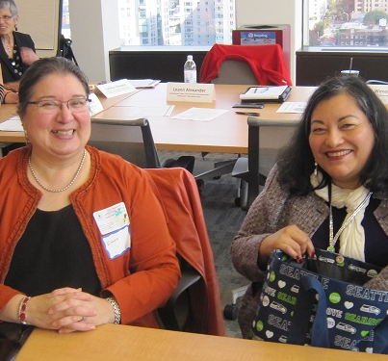

Tribal Asthma Summit:
‘Bold Goal’
By 2020, we will reduce asthma urgent care visits for children by 30 percent in tribal populations in the Northwest by funding and delivering high-quality in-home asthma care.
Notes:
Erin:
In 2014, we convened a group of partners to explore how we could collaboratively work to address asthma disparities among native communities in the NW, particularly exploring the new opportunities through public health insurance – Medicaid – that allowed paying for home visits by non-licensed professionals, such as community health workers, for prevention work. We also were funding, supporting, and tracking work that NW and Alaska Tribes were doing on indoor air and asthma and recognized the capacity, interest, and need.
This new policy opportunity combined with the strong evidence base for asthma home visiting and the tribal indoor air work in the region prompted us to kick off a Tribal Asthma Initiative which was launched with an asthma summit bringing together 40+ key stakeholders in 2014. You’ll see some images from the meeting here. Together, the attendees created and committed to the goal here – to drastically reduce asthma urgent care visits for native children in the NW through delivery and funding of this type of high quality care.

Slide 13
Progress at a Glance
Conducted Research; Convened Stakeholders
Established Tribal Buy-In
Narrowed Focus to Washington; Engaged State
Identified Tribal Pilot Programs
Formalized Partnership Team
Summer 2014 2014–2015 2015 2015–2017 2016–2017
Next Steps
Support
Pilot Design,
Kick-Off and Implementation
Evaluate and Share Pilot Process and Outcomes
Policy Shaped by Pilot Results and Tribal Input
In-Home Environmental Interventions Are Active and Sustainably Financed in Tribal Communities
2017–2021 2017–2021 Ongoing–2022
Notes:
Erin:
Since the summit, we have been very busy. This slide attempts to illustrate what has been an un-linear process in a very linear way.
As mentioned, we collected information and convened stakeholders in 2014. After, we worked to appropriate engage with tribes to understand needs and gather buy-in. Matt will talk about this more.
We established a partnership team, which soon narrowed its focus to WA State, given the momentum at the state level and the impressive work of Tribes. Since then, the EPA-led team has been working to identify and support pilot programs, help with design, evaluation and sharing of learnings, with the ultimate goal of achieving sustainably financed, effective in-home environmental interventions for native people with asthma.

Slide 14









Northwest Tribal Asthma Project Team
CMS & TRIBAL AFFAIRS
Notes:
Erin:
The interdisciplinary team that was established as an outcome of the summit is the NW Tribal Asthma Project Team.
We are so fortunate to have this wise, engaged group of partners that includes Tribal representatives like the NW Portland Area Indian Health Board, the Tribal Healthy Homes Network, the Urban Indian Health Institute, and the Seattle Indian Health Board, as well as federal agencies like EPA, HUD, IHS, and Centers for Medicare and Medicaid Services.
I’m going to turn it over to Matt now to describe this team’s work to engage with tribal leaders and organizations.

Slide 15
Tribal Leader Engagement
Tribal Leader Engagement
Northwest Portland Area Indian Health Board
Seattle Indian Health Board
Northwest Tribal Health Directors
Affiliated Tribes of Northwest Indians
American Indian Health Commission for Washington State
Northwest Indian Housing Association
Notes:
Matt (add as needed):
Critical to moving this work forward has been developing relationships with a new set of tribal leaders and organizations that we have not been closely engaged with before, many of them on the health side.
In addition to those already mentioned, we have connected with Tribal Health Directors of NW Tribal Health Systems and clinics, a powerful tribal leadership group called the Affiliated Tribes of NW Indians, or ATNI, the American Indian Health Commission of WA State, and the NW Indian Housing Association.

Slide 16
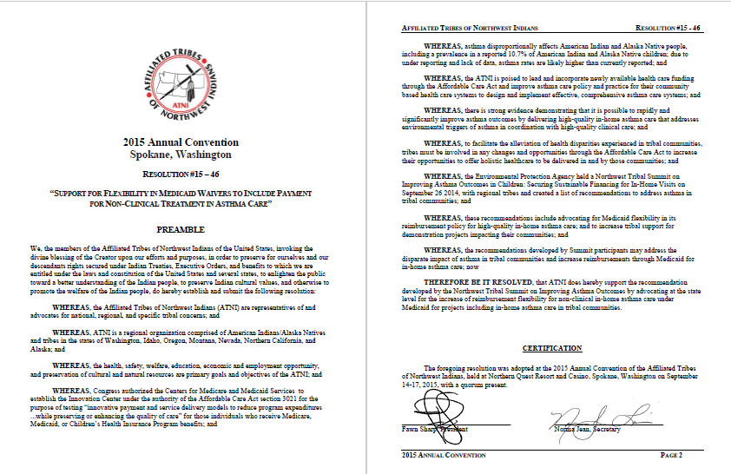
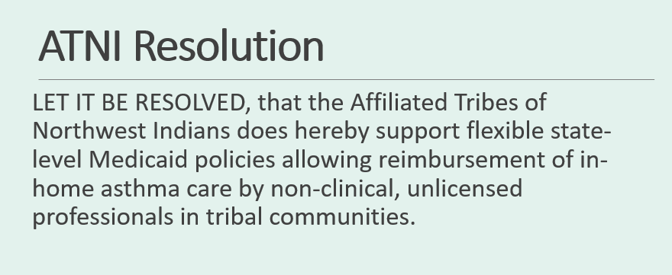
Notes:
Matt:
Insert talking points about ATNI, health committee connections, and overall ATNI resolution and its meaning – demonstrates support of 57 tribal governments in the NW

Slide 17
Supporting Asthma Work in Tribal Communities
EPA funding a pilot at the Tulalip Tribes
Partnership/support to the Yakama pilot project
Technical assistance to Seattle Indian Health Board
Tracking how tribes can access and weigh in on Washington’s Medicaid Transformation Project funds
Notes:
Matt:
Our team has deemed it equally critical to simultaneously explore policy opportunities and support on the ground work – as tribes are doing this work whether or not there is sustainable financing because they know it’s important and impactful.
A recent success was securing EPA funding, through the Indian General Assistance or IGAP program in Region 10, for Tulalip Tribes (WA State) to design and conduct a pilot project
Additionally, the team closely engaged with Indian Health Service on their asthma home visiting work on the Yakama Reservation in WA, as they had recently begun a program in coordination with their pharmacy and clinic. Our colleague Shawn will be talking in more detail about this work in a minute.
Headwater People, under our contract with EPA, also connected with the Seattle Indian Health Board, the largest urban Indian organization in the country, to provide technical assistance to look at what an asthma program that involves home visiting could look like for their urban Indian patient population
Finally, we have been tracking and sharing how tribes can participate in the WA state transformation process and access funding – which I’ll talk a bit more about later on.
We’d like to share a bit more about each of these activities, starting with Shawn Blackshear of the Indian Health Service in Washington State. We think you’ll be as impressed as we are with the work his program has done over the past 4-5 years and early results.
Shawn, please take it away.

Slide 18

Yakama Nation and IHS Asthma Pilot
Clinic and pharmacy referrals to IHS Environmental Health Officer made through electronic health record (EHR), 25 home visits.
72% of patients made environmental or habit modifications.
47% of patients decreased use of asthma rescue medication.
Urgent care visits reduced from 53% to 12%.
Emergency room visits decreased from 47% to 18%.
90% of patients went from reporting asthma as being not well controlled to being well controlled.
Notes:
Shawn:
Hello I’m Shawn Blackshear, introduce role of position environmental health officer and IHS Environmental Health Program
Place based in Yakama Indian Reservation, Toppenish, WA.
Been doing home visits to identify asthma triggers in coordination with the clinic and pharmacy for five years –share why IHS started this work
Going to start by sharing some early data from the first year (2014) of our program
Saw impressive improvements in environmental and health outcomes
Clinic & pharmacy referrals to IHS Environmental Health Officer through electronic health record, 25 home visits
72% of patients made environmental or habit modifications; e.g. installed covers for bedding, dusted more often, IPM
47% patients decreased use of asthma rescue medication: chart review by PHN
Urgent Care visits reduced from 53% to 12%
Emergency Room visits decreased from 47% to 18%
90% of patients went from reporting asthma as being not-well controlled, to well controlled

Slide 19

Methods
Patients with moderate to severe asthma who are not obtaining adequate control with prescription therapy.
Referred through EHR by provider or pharmacist.
Home assessment by environmental health officer; can include public health nursing where applicable.
Findings and health education provided to patient at each visit; report of findings placed in EHR for provider signature.
Notes:
Shawn (please expand/change as needed):
Now I’ll describe the program’s nuts and bolts
Who’s eligible; Native Amer. members of Fed. Recognized tribe.
How they are referred
Who does home assessment and what it involves; we are attempting to train health technicians and other tribal programs within the YN.
Results go to patient and are placed in EHR for the provider to review

Slide 20

5. Assessment addresses home, work, hobbies, lifestyle and medication usage.
6. Opportunity to participate in expanded program with two additional visits consisting of continued counseling in medication, lifestyle change and environmental modifications.
7. Incentive materials of proven interventions—e.g., mattress and pillow encapsulation supplies, green cleaning supplies—for control of common triggers.
8. Surveillance of implementation of environmental recommendations and asthma control diagnosis after home assessments.
Notes:
Shawn:
Discuss what the assessment involves
Discuss additional visits, timing, and what they involve
Describe tools provided, costs if you are able
Describe evaluation methods
Share any key insights and lessons learned from your work – challenges, common issues you see, what works well; note other areas for deficiencies and assist.
Getting a visit, not to come across as judging the circumstance, common ground personal experiences, vacuum cleaner incentives that are deemed worth the time.
Close relationship with Tribal HUD; YN Environmental Management Program; YN Facilities Management, IHS Engineering; IHS Clinical providers.

Slide 21
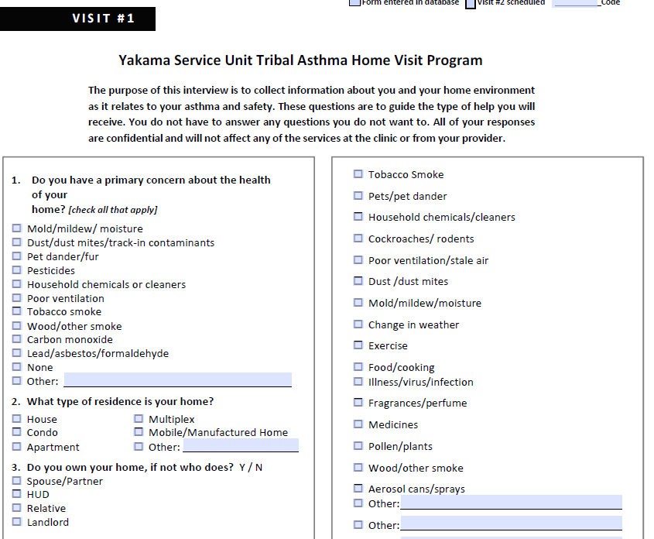
Notes:
Shawn:
This slide and the next just give a brief snapshot of our 16 page asthma home visit assessment tool/intake form that we do with the residents
Asks basic questions about resident concerns and the household/building

Slide 22
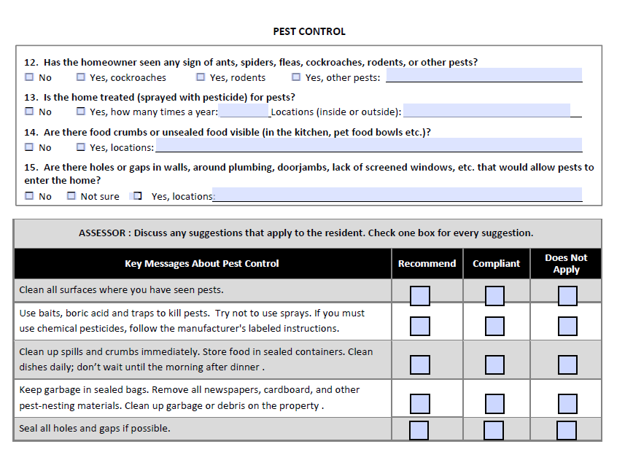
Notes:
Shawn:
Also has sections on specific issue areas like pest control, mold and moisture, etc. includes assessment questions, key messages, and a table for suggested changes or modifications.

Slide 23



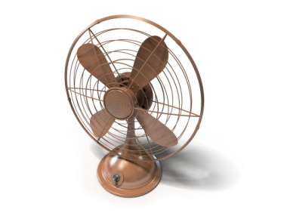



Health–Environment–Housing
Referral Network
Review or Monitor Medical Records
Healthcare Provider Assesses Patient
Provider Refers Patient to Specialist
Environmental Specialist Conducts Home Assessment
Specialist Makes Recommendations and Conducts Health Education; Findings Entered Into Patient’s EHR
Occupant Changes Behavior and/or Housing Is Improved
Goal:
Reduce Patient
Asthma Exacerbations and Asthma Rates in Tribal Communities
Notes:
Shawn:
Here is a visual that shows our overall referral network and process
Walk through again if you think useful

Slide 24
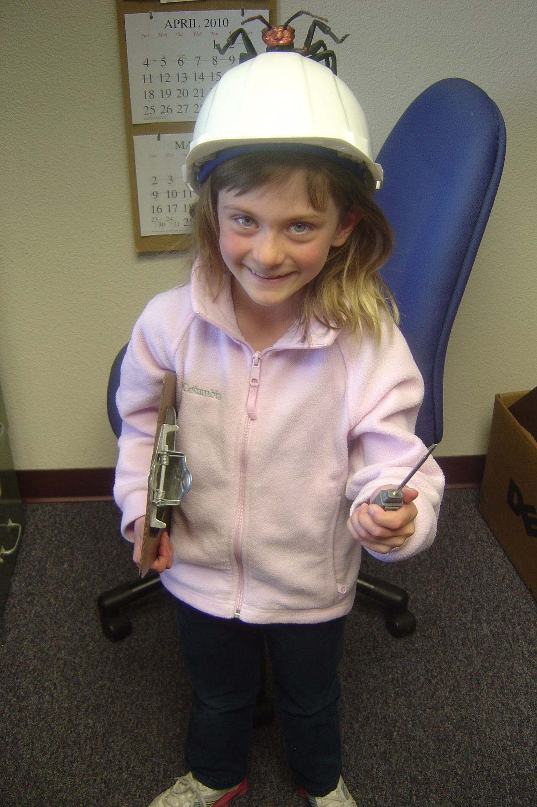
Notes:
Photo credit: Shawn Blackshear
Mention that next step is to expand program to other tribes, train more evaluators, have more robust evaluation given involvement in an NIH funded study, which will be described a bit more later in the presentation
happy to share tools/insights as needed
Turning back over to Matt to talk about some additional tribal programs

Slide 25
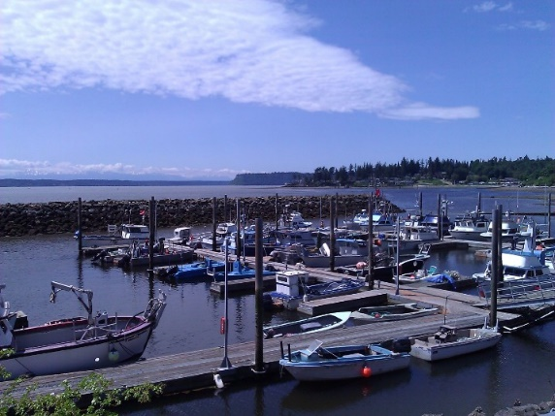
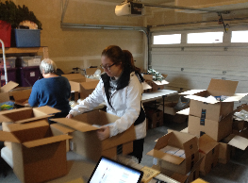
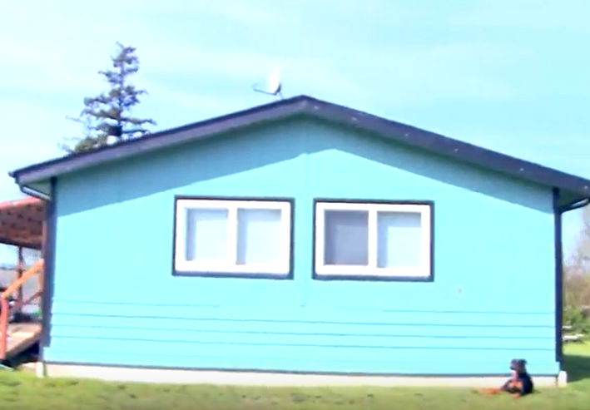
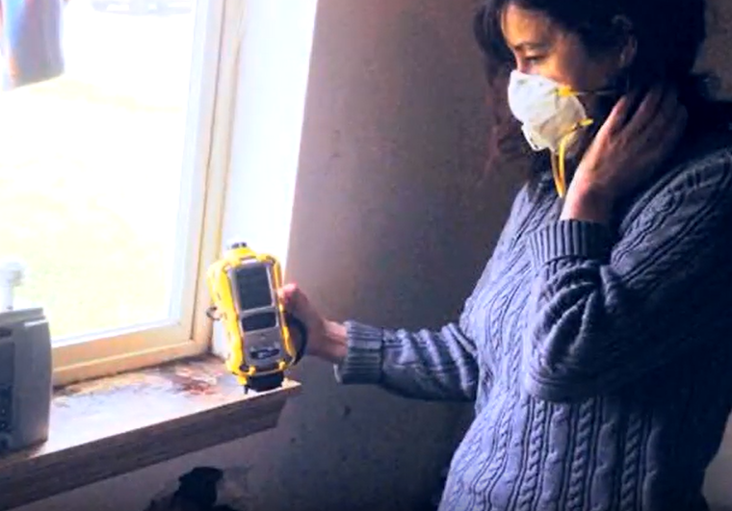
Tulalip Tribes Asthma Home-Visiting Program
Home assessments
Mobile spirometry
Self-reported health outcomes
Patient education
Basic remediation
Cross-department collaboration
Notes:
Matt:
A little bit about the Tulalip project, which is funded both by EPA and direct tribal dollars through their community public health program
The Tribe is in the process of building a formal asthma home visiting program, with the aim of doing 10-12 home assessments of pediatric asthma patients over the next year – though they have been doing innovative indoor air work for years in their tribal air program
[insert key details from Tulalip’s snapshot that we recently created]
Home environmental assessment will be conducted by a healthy homes specialist, followed by two visits by pharmacist (confirm this)
Program will involve mobile spirometry, patient education, and basic remediation
Key to successful kick-off at Tulalip has been cross department collaboration and the public health program’s leadership of the program

Slide 26
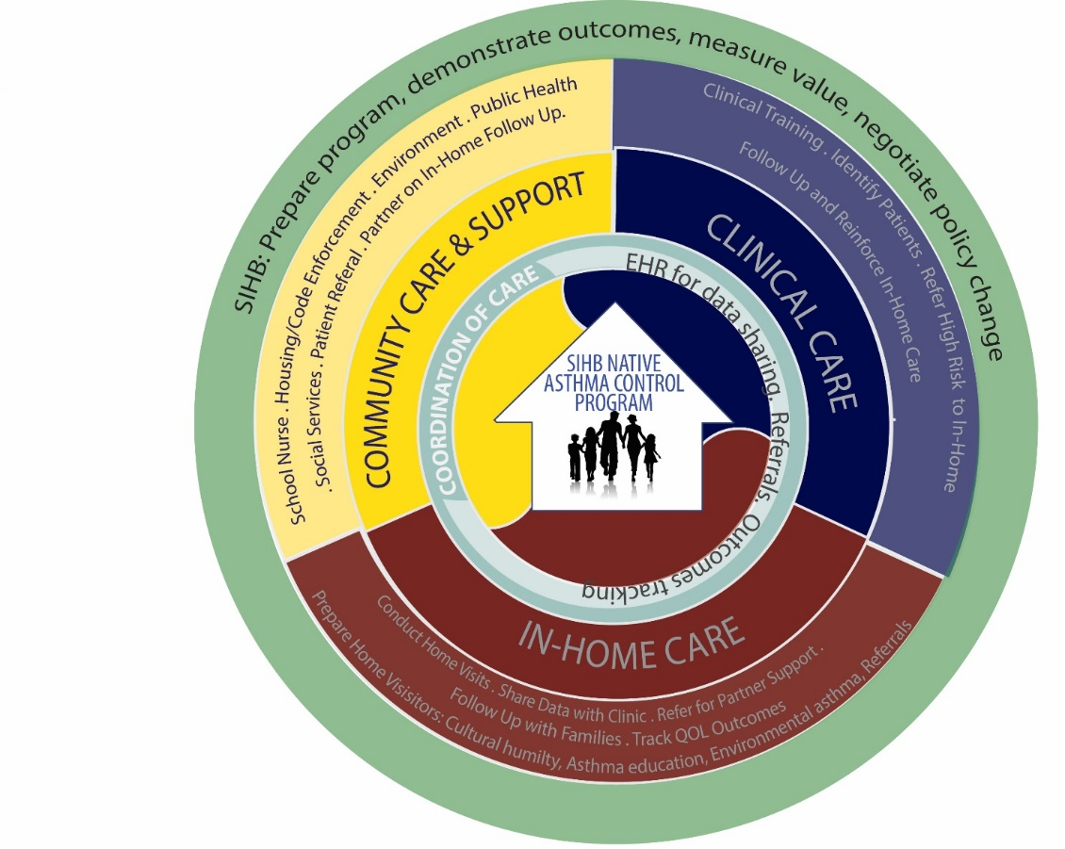
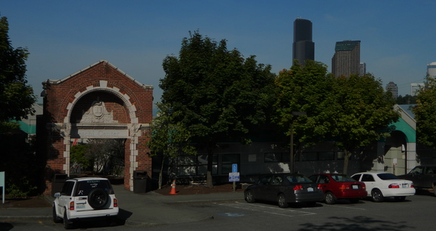
Seattle Indian Health Board
EPA support to design urban Indian approach to comprehensive asthma management and explore funding
Notes:
Matt: [update with talking points on work with SIHB]
In the earlier stages of planning is the SIHB - as mentioned, we’ve been working with SIHB and they are actively interested in expanding their asthma work
Have done small pilot before with positive results
Serves King County’s native urban population, unique needs
ADD/edit please

Slide 27
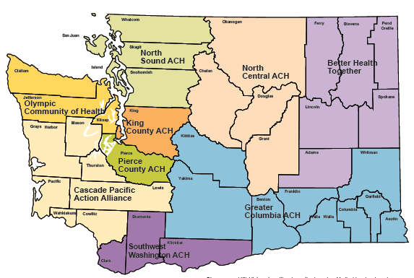
Washington Medicaid Transformation
5-year demonstration project
Section 1115 contract with Centers for Medicare & Medicaid Services
Triple aim
  Reduce avoidable use of intensive settings/services
  Improve population health
  Accelerate the transition to value-based payment
Accountable Communities of Health
Notes:
Matt:
Another key aspect of this work is learning about state level work and in our case, the WA State Health Care Authority’s Medicaid transformation efforts.
Going through 1115 mega waiver
Developing contract with cMS
Triple aim aligns with our goals
Building a relationship with tribal liaison there has been very helpful.
Before the summit, we also connected with the HCAs in ID and OR to understand political landscape
Through waiver process have created ACHs
Share more on ACHs role
Discuss funds at a high level

Slide 28

WA State Healthcare Transformation Process
Chronic Disease Project:
Integrate and test health system and community approaches to improve asthma, cardiovascular disease, and diabetes.
HealthierHere: Accountable Community of Health
Notes:
Matt:
Discuss EPA/Headwater role with King Co ACH
Though there are many ACHs across state, King Co’s includes the most directly connected project on chronic dz/asthma
Our early work/guidance/education supported incorporation/special consideration of tribal asthma disparity needs and cultural engagement into the ACH’s planning
the Accountable Communities of Health in King Co. Chronic Disease project was formally adopted into the ACH portfolio in January of 2018.
Played key role in ensuring tribes/tribal orgs in county knew about opps to participate, have a voice, access funding
Supported tribes by elevating their concerns and needs to the planning teams

Slide 29
Northwest Portland Area Indian Health Board—
New Grant
National Institutes of Health (NIH)
Native American Research Centers for Health
Project Aims
Measure impacts of combined clinic and home-visit program.
Document protocols and practices.
Develop training materials for other tribal clinics.
Implement at three other tribal communities in Washington and Oregon.
Notes:
Matt:
Looking forward, additional exciting momentum expected from work being funded by the NIH NARCH program – NPAIHB was awarded a grant to support pilots at 4 Tribes in the NW
As Shawn mentioned, starting with Yakama
Don’t mention NP unless we get permission
Project aims are to measured the impacts of a combined clinical and asthma home visit program,
To document protocols, practices, learnings, and develop training materials for other tribes
And select 3 additional sites

Slide 30
Components of a Successful In-Home Model
Data infrastructure
  Improved mechanisms for tracking patients and outcomes.
  Improved communication across departments to increase referrals.
Policy challenges
  Demonstration of value requires robust evaluation.
  Reimbursement of costs (via Medicaid) versus public health prevention (tribal costs).
Notes:
Matt or Meghan:
Share that we’ve gathered insights from existing tribal program leaders and other tribal representatives In the NW and wanted to share a few key points that we’ve learned about the nuts and bolts need for a successful in-home program for a tribe, and potentially others
Data infrastructure is key
Policy challenges
[update with talking points]

Slide 31
Components of a Successful In-Home Model
Key partners
  Tribal housing authority—plays a critical role in improving housing conditions to reduce asthma triggers.
  Deliver education in non-clinical settings.
Cultural components
  Identify American Indian/Alaska Native community members to deliver services whenever possible.
  Community health workers with a range of cultural competencies carry out the in-home visits.
Notes:
Matt or Meghan:
[add talking points about what we’ve heard from tribal reps]
Now will hand back to Erin to close where we are going next and a few overall learnings from our process

Slide 32
Northwest Tribal Asthma Project Team:
Plans for Moving Forward
SUPPORT WORK ON THE GROUND
LEVERAGE SYSTEMS CHANGE
Notes:
Erin:
Thanks Matt.
So, where are we going next?
Broadly speaking, we hope to continue what we’ve been doing with supporting work on the ground, ongoing and new tribal projects, while simultaneously leveraging bigger systems change in support of that good work

Slide 33
Leverage Systems Change
Continued leadership and technical support by the Northwest Tribal Asthma Project Team.
Engage in educational and policy discussions with Washington state and others; provide technical assistance where appropriate.
Maintain critical connections with tribal leadership groups; solicit input.
Gather and share lessons learned.
Notes:
Erin:
At EPA, we hope to continue to lead and support our team of partners in moving this work forward
For example, by finding the right times and venues to engage with the State of WA or others on Medicaid transformation work, for example by making sure they are aware of existing tribal programs, needs, and successes. As an agency, our role is to educate and elevate tribal needs and the evidence based solutions to those needs.
Our team will work to continue to report back to and get input from tribal leadership groups we’ve engaged with before, as well as engage with new entities as needed
A key part of this is tracking and packaging and sharing the lessons we’ve learned and the keys to success that tribes have shared with us so that any policy or programs created take these considerations into account

Slide 34
Team Support of Tribal Programs/Pilots
Provide technical assistance.
Support pilot design, share evidence-based practices, and set up for evaluation.
Track process and learnings; create replicable products/tools.
Facilitate connections and sharing of results with decision makers and funders.
Notes:
Erin:
EPA and our project team aims to continue to provide TA to Tulalip, Yakama, and other programs, such as the TBD sites under the NIH grant
We’ve been able to provide guidance on pilot project design, share models and considerations from other parts of the country that have shown success, and provide guidance on evaluation to position programs for funding in the future
We will work with the NPAIHB and Tribes to track learnings and create and share tools that could be used by other tribes and communities
And facilitate connections between decision makers and key information and tribal leadership

Slide 35
Northwest Tribal Asthma Project Team:
Key Learnings
Notes:
Erin:
To close, I’ll share a few overall learnings that may be useful for others embarking on this work

Slide 36
Key Learnings
Understand the Medicaid structure and opportunities in each state.
Understand the landscape of existing in-home asthma care services.
Critical to convene key stakeholders and identify a focus.
A demonstration project is needed for—
  Developing and piloting necessary infrastructure and building capacity.
  Evaluating health and economic outcomes of the work to provide data needed by state Medicaid programs.
Notes:
Erin:
Looking back at our somewhat nebulous process, we’ve learned that it’s critical to
understand what Medicaid looks like in each state, and where the opportunities lie – every state has a different Medicaid program, different types of opportunities for funding asthma work – WA is different than ID and OR
Understanding what can be paid for right now and what tribes (or other communities) are doing and having success with is a critical foundation
Pulling together the right people and identifying a focus area will ensure momentum from the start
A demonstration project will be needed both for the development of infrastructure on the ground and to gather the data on health and economic outcomes that the state Medicaid program will need to show value and ROI

Slide 37
Keys to Successful Collaboration
A committed group of stakeholders representing health, housing and environment.
  Rich mix of expertise and roles
  Existing partnerships and momentum
Active tribal and urban Native participation and input.
A clear vision aimed at improving health and housing conditions for a specific population.
Being grounded in a Bold Goal and focused on action.
A culture of moving forward without all the answers.
Notes:
Erin:
We think what made this interdisciplinary work successful so far was the committed group of partners from the key sectors
We also had a rich mix of expertise and some good foundational partnerships to build on
Active tribal participation and input throughout the process were critical
And we had a clear vision for improving health and housing conditions for a specific population, a goal we could all agree on, and the culture of moving forward even though we didn’t have all the information or answers.

Slide 38
t̕igʷicid.
Thank You.
t̕igʷicid.
Thank You.
Erin McTigue, EPA Region 10 Tribal Indoor Air Program mctigue.erin@epa.gov
Shawn Blackshear, Indian Health Service
shawn.blackshear@ihs.gov
Matt Hayashi, Headwater People
matt@headwaterpeople.com
Meghan Jernigan, Headwater People
meghan@headwaterpeople.com
Notes:
Canoe landing and Suquamish during 2019 Canoe journey.
Credit Dana Arviso
Erin: with that, we’d like to close with our contact information and a big thank you for listening to our story today. We welcome you to reach out to us with questions , input, ideas, experiences. You can do so using the contact info provided, or hopefully you can join us in our online discussion on ACN.org now.
If time: take questions from chat box.

Slide 39
Question & Answer Session on
AsthmaCommunityNetwork.org Discussion Forum
Immediately after the webinar, join us in the AsthmaCommunityNetwork.org Discussion Forum for a live online Q&A Session:
4:00 p.m. – 4:30 p.m. EDT
To post a question in the Discussion Forum, follow these directions:
If you are a Network member, log in to your AsthmaCommunityNetwork.org account.
Click on the “Discussion Forum” button on the home page.
Click on the “Live Online Q&A for 7/23/19 Webinar” link.
Click on the “Add New Forum Topic” link to post your question.
Enter your question and click the “Save” button at the bottom of the page.
Not a member? Create an account at AsthmaCommunityNetwork.org by clicking the “Join Now” link at the left side of the page. Your account will be approved momentarily, and you can begin posting questions.
Indoor Air Quality (IAQ)
Notes:
Our Q&A will take place on the Discussion Forum on AsthmaCommunityNetwork.org.
To see the discussion forum directly, please click the link that we just sent you via the chat function.
To ask questions, you must first be a member of AsthmaCommunityNetwork.org, so please take a minute to join so that you can post questions throughout the webinar—it is a simple and quick process. The Site Administrator will be approving memberships as they are submitted.
After the Q&A period is closed, please visit the Discussion Forum often to see other contributions as well as to make your own!
Thank you for joining us today!

