Slide 1
Building a Star Asthma Care Team: Best Practices From the 2016 Asthma Award Winners

Slide 2
Building a Star Asthma Care Team: Best Practices From the 2016 Asthma Award Winners
Welcome to the Webinar
Moderator:
Tracey Mitchell, U.S. Environmental Protection Agency
Presenters:
Stacey Chacker, Asthma Regional Council of New England
Samuel DeLeon, M.D., Urban Health Plan
Bradley Kramer, Public Health—Seattle & King County
Andrea D. Gelzer, M.D., AmeriHealth Caritas
Wednesday, May 25, 2016 Webinar 2:00 p.m. – 3:00 p.m. EDT Live Online Q&A 3:00 p.m. – 3:30 p.m. EDT on AsthmaCommunityNetwork.org
Operator Assisted Toll-Free Dial-In Number: (800) 374-0278
Conference ID: 97484833
Notes:
Tracey’s Talking Points:
Good morning or good afternoon, depending on where you are located.
Welcome to “Building a Star Asthma Care Team: Best Practices From the 2016 Asthma Award Winners,” a Web-based presentation sponsored by the Environmental Protection Agency.
We’re glad you can join us today!
Since we have a lot of material to cover, we’ll go ahead and get started.

Slide 3
Introduction
Tracey Mitchell, RRT, AE-C
U.S. Environmental Protection Agency
Operator Assisted Toll-Free Dial-In Number: (800) 374-0278
Conference ID: 97484833
Notes:
Tracey’s Talking Points:
I’m Tracey Mitchell from EPA. I’m going to give a quick overview of this webinar and walk through some housekeeping items.
Then I’ll turn it over to our featured presenters, who will introduce themselves and start the presentation.

Slide 4
Polling Question 1
What type of organization do you represent?
Government agency
Health care provider
Health plan
Community-based program
Other
Notes:
Tracey’s Talking Points:
Before we dive into today’s presentations, let’s get a sense of who’s with us today. To do that, please take a moment to answer the polling question on your screen: “What type of organization do you represent?”
Polling Question #1

Slide 5
Polling Question 2
What are your main challenges in facilitating communication across your care team(s)?
Communication channels unclear
Delays in sharing important information
Difficulty connecting with various care providers to discuss patient cases
Other
Notes:
Tracey’s Talking Points:
Looks like we have a great audience today. We have one more question for you…
Polling Question #2: “What are your main challenges in facilitating communication across your care team(s)?”
Great – [provide overview of responses] Thanks to you all for sharing your challenges with facilitating cross-communication. Our speakers have some great insights on how you can tackle these challenges.

Slide 6
Agenda
EPA’s National Environmental Leadership Award in Asthma Management
Hear From Speakers
Stacey Chacker, Asthma Regional Council of New England
Dr. Samuel DeLeon, Urban Health Plan
Bradley Kramer, Public Health—Seattle & King County
Dr. Andrea D. Gelzer, AmeriHealth Caritas
Q&A Session in AsthmaCommunityNetwork.org Discussion Forum
Notes:
Tracey’s Talking Points:
Our plan for today is to talk about the National Environmental Leadership Award in Asthma Management. I will begin by presenting information about the Awards Program and a framework that many of our award winners have used, EPA’s System for Delivering High Quality Asthma Care. Then our 2016 award winners will tell us about their programs and the outstanding results they have achieved.
After the webinar, each of our presenters will be available on AsthmaCommunityNetwork.org for 30 minutes to respond to your questions.

Slide 7
Question & Answer Session on
AsthmaCommunityNetwork.org Discussion Forum
Immediately after the webinar, join us in the AsthmaCommunityNetwork.org Discussion Forum for a live online Q&A Session from
3:00 p.m. to 3:30 p.m. EDT.
To post a question in the Discussion Forum, follow these directions:
If you are a Network member, log in to your AsthmaCommunityNetwork.org account.
Click on the “Discussion Forum” button on the home page.
Click on the “Live Online Q&A for 5/25/16 Webinar” link.
Click on the “Post to the Forum” link to post your question.
Enter your question and click the “Save” button at the bottom of the page.
Not a member? Create an account at AsthmaCommunityNetwork.org by clicking the “Join Now” link at the top of the page. Your account will be approved momentarily and you can begin posting questions.
Notes:
Tracey’s Talking Points:
Our Q&A will take place on the Discussion Forum on AsthmaCommunityNetwork.org.
To see the discussion forum directly, please click the link that we just sent you via the chat function.
To ask questions, you must first be a member of AsthmaCommunityNetwork.org, so please take a minute to join so that you can post questions throughout the webinar—it is a simple and quick process. The Site Administrator will be approving memberships as they are submitted.
After the Q&A period is closed, please visit the Discussion Forum often to see other contributions as well as to make your own!

Slide 8
About the Awards
It is the Nation’s highest honor for exceptional asthma management programs.
The goal of the Awards program is to showcase best practices in asthma care and management.
To be eligible, applicants must use the National Institutes of Health (NIH) Expert Panel Report 3 (EPR-3): Guidelines for the Diagnosis and Management of Asthma.
Join the Hall of Fame: Apply in 2017! www.asthmacommunitynetwork.org/awards
Notes:
Tracey’s Talking Points:
This award is the highest recognition in the country that a program and its leaders can receive for delivering excellent environmental asthma management.
Winners receive a place in the National Environmental Leadership Award in Asthma Management Hall of Fame; national recognition through a press release and blogs; a crystal award; and the opportunity to serve as mentors to help other programs achieve impactful results.

Slide 9
Award Winners Hall of Fame
Notes:
Tracey’s Talking Points:
Since 2005, EPA has recognized health plans, health care providers and communities in action for their best practice approaches to delivery of comprehensive asthma care.

Slide 10
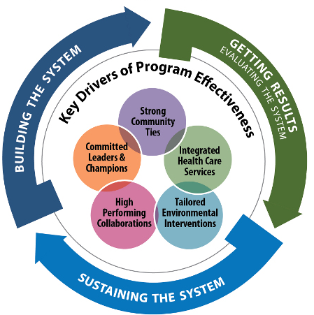
The System for Delivering High-Quality Asthma Care
-
Notes:
Tracey’s Talking Points:
As I mentioned earlier, many of our award winners have used EPA’s System for Delivering High-Quality Asthma Care, which features essential components to developing an effective and sustainable asthma program.
The System is a conceptual framework, based on results of the Asthma Health Outcomes Project, conducted by University of Michigan, which identifies the core elements of successful asthma programs and the processes that drive their implementation, continuous improvement and endurance. The five key drivers of the System are committed leaders and champions; strong community ties; integrated health care services; tailored environmental interventions; and high-performing collaborations.
The System is flexible, and any asthma program—regardless of its size, institutional home (e.g., health plan, health care provider, community program), budget, target community, or level of development—can use the System to guide its work.

Slide 11
Connecting to the System
Integrated
Health Care
Services
-
Notes:
Tracey’s Talking Points:
Two key drivers of program effectiveness include—
Building a Strong Foundation:
Community health workers, health educators and other staff are core members of asthma programs. They deliver crucial asthma care services, such as in-home visits that identify asthma triggers in the home and provide education on managing asthma to patients and their families.
Integrating Health Care Services:
Along with well-trained staff, integrating health care services can help asthma programs provide more effective care. Examples of integrated services include providing patient referrals and using electronic health records or registries to facilitate the sharing of patient information across care providers.
Today you’ll hear from our speakers about strategies they implemented for training their staff to provide optimal asthma care and how they integrate asthma care services throughout their program’s team.

Slide 12
Connecting to the System
High-Performing Collaborations
-
Notes:
Tracey’s Talking Points:
It’s hard to do it alone. Partner organizations are key to providing a high level of asthma care. Many of our speakers have connected with other organizations to access additional services in order to deliverable comprehensive care.
Two key aspects of the high-performing collaborations driver are—
Building on What Works:
Build partnerships with organizations that are active in your target community and seek out organizations providing complementary services to foster strong collaborations.
Collaborating to Build Credibility:
Collaborate with established organizations to build the social capital and local infrastructure of your program.
Each of our programs today will describe how they reached out to other organizations in their community to collaborate on targeting underserved populations. You’ll hear some innovative and creative solutions that demonstrate the value of thinking outside the box and how to build community support and buy-in.

Slide 13
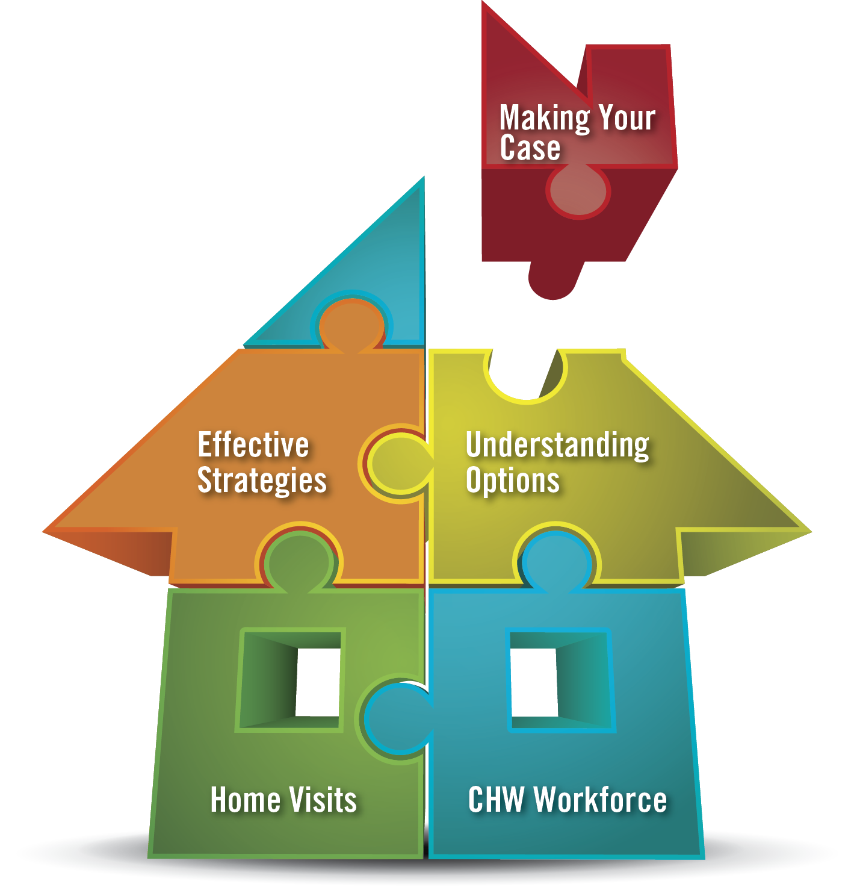
Sustaining the System
Notes:
Tracey’s Talking Points:
Sustainability is also a key component of delivering high quality asthma care. As organizations seek to increase their program’s impact, pursuing sustainable financing options is imperative.
Strategies for sustainability include—
Using data to demonstrate your program’s value:
Present data that matters to potential funders and payers and that demonstrates the need for your program and your impact.
Making it easy to support your program:
Identify discrete program elements and their costs so that funders and payers can support individual elements if they are not ready to support the program in its entirety.
Programs that establish a strong workforce, incorporate in-home asthma visits, and demonstrate their value through positive results have a solid foundation for exploring a variety of sustainable financing options. Each of our speakers today will share how they were able to build a star asthma care team that made a difference.

Slide 14
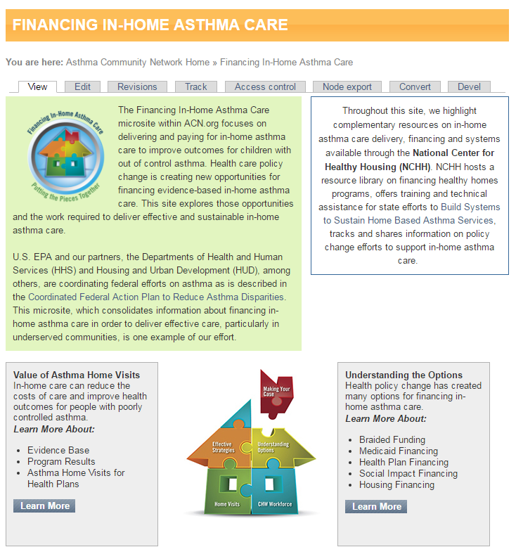
Financing In-Home Asthma Care
Learn more about—
The Value of Asthma Home Visits
Building Your Workforce
Effective Reimbursement Strategies
Understanding the Options
How to Make Your Case to Funders
Visit www.AsthmaCommunityNetwork.org/Financing
Notes:
Tracey’s Talking Points:
Finally, to help you make sense of the latest health care policy changes and the new opportunities for financing evidence-based in-home asthma care, I want to introduce you to the “Financing In-Home Asthma Care” microsite on AsthmaCommunityNetwork.org.
This site focuses on delivering and paying for in-home asthma care to improve outcomes for children with asthma.
You will find a wealth of information and resources on topics such as—
The Value of Asthma Home Visits
Building Your Workforce
Effective Reimbursement Strategies
Understanding the Options
How to Make Your Case to Funders
And now, I would like to turn to our first speaker, Stacey Chacker from the Asthma Regional Council of New England.

Slide 15
Health Resources in Action’s Asthma Regional Council of New England — New England Asthma Innovation Collaborative
Stacey Chacker
Project Director and Co‑Principal Investigator of NEAIC

Slide 16
New England Asthma Innovation Collaborative
NEAIC is a project of the Asthma Regional Council of New England, a program of Health Resources in Action.
Established in July 2012 with a $4.2 million award from Centers for Medicare and Medicaid Innovation
“The project (NEAIC) described is supported by Grant Number 1C1CMS331039 from the Department of Health and Human Services, Centers for Medicare & Medicaid Services. The contents of this publication are solely the responsibility of the authors and do not necessarily represent the official views of the U.S. Department of Health and Human Services or any of its agencies.”

Slide 17
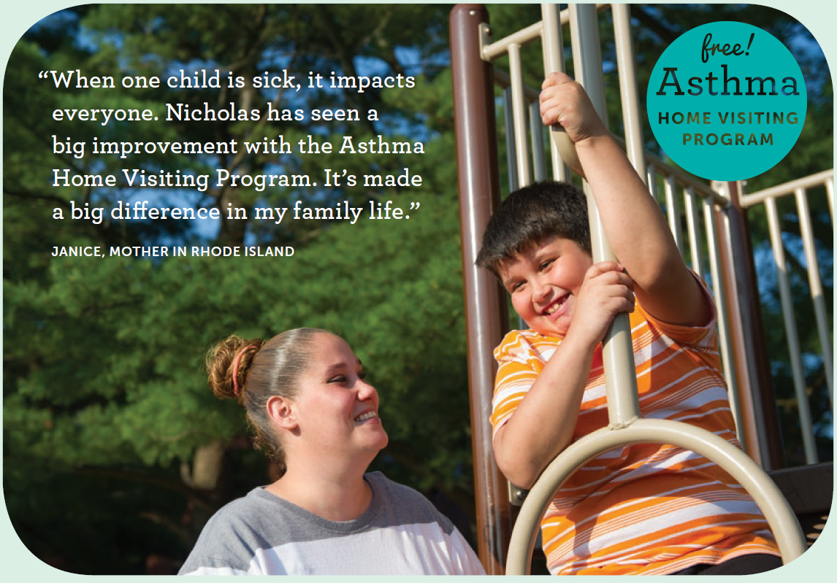
NEAIC Goals and Partners
For children with poorly controlled asthma—
Improve quality of care
Improve health and quality of life outcomes
Decrease health care utilization costs
Advance sustainable payment systems
NEAIC is in VT, RI, MA and CT.

Slide 18
NEAIC Is a Collaborative Partnership
Convening Organization/Evaluator:
Health Resources in Action/Asthma Regional Council of New England
Clinical Providers
Boston Children’s Hospital (Boston, MA)
Baystate Children’s Hospital (Springfield, MA)
Boston Medical Center (Boston, MA)
Children’s Medical Group (Hamden, CT)
Middlesex Hospital (Middletown, CT)
Rhode Island Hospital / Hasbro Children’s Hospital (Providence, RI)
Rutland Regional Medical Center (Rutland, VT)
St. Joseph’s Health Clinic (Providence, RI)
Thundermist (Woonsocket, RI)
Medicaid Payers
BMC Healthnet Plan (Boston, MA)
MassHealth (MA Medicaid))
Department of Vermont Health Access (VT)
Community Health Network/Department of Social Services (CT Medicaid)
Health New England (Springfield, MA)
Neighborhood Health Plan of Rhode Island (Providence, RI)
Neighborhood Health Plan of Massachusetts (Boston, MA)
Workforce Development Partners
Central Massachusetts Area Health Education Center of Central MA, Outreach Worker Training Institute (Worcester, MA)
American Lung Association of the Northeast (Waltham, MA)
Boston Public Health Commission, Community Health Education Center (Boston, MA)
Massachusetts Association of Community Health Workers (Worcester, MA)

Slide 19
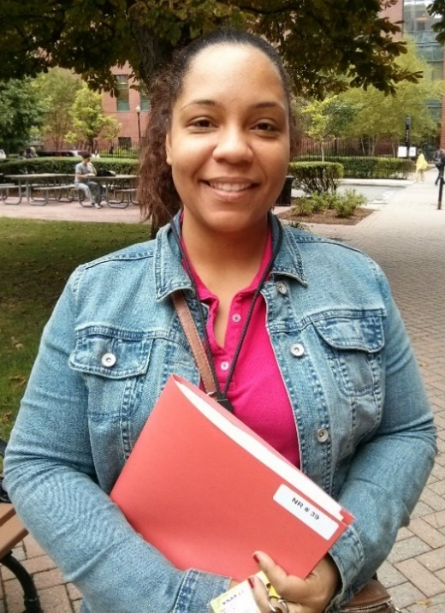
NEAIC Intervention:
Community Health Worker-Led Asthma Home Visits
Assess patients’ needs and home environment
Provide asthma self-management education
Deliver cost-effective environmental supplies
Improve quality and experience of care:
Client-centered, use of motivational interviewing
Promote asthma action plans
Promote connections to primary care & prevention
Referrals for social services
Target Population
Ages 2–17 years old
Medicaid or CHIP beneficiary
Diagnosis of asthma from an authorized clinician
Poorly controlled asthma

Slide 20
Preliminary Results are Promising!
1,145 children served from 2012 to 2015
Data from home intervention show—
Improvements to
Home environment
Quality of life
Asthma control
Decrease in ER visits and number/length
of hospital stays = cost savings!
Preliminary economic evaluation — Decreases:
90% in asthma-related ER visits (26% greater than comparison)
60% in overall ER visits (14% greater than comparison)
80% in use of oral corticosteroid (23% greater than comparison)
$1,104 in total health care costs

Slide 21
Pursuing Sustainable Financing
Current sustainability
Community benefits
DPH and donor funding
Continuing efforts
Final economic analysis
State meetings with payers and ACOs
Providers seeking funding—NIH, HUD
CPT Code changes
Negotiations with MMCO and State Medicaid
CDC’s 6|18 Initiative in Rhode Island
Feasibility study for asthma home visiting

Slide 22
Takeaways
Engaging payers—critical and takes persistence
Engaging providers key—value-based payments
Financing uptake takes time
Home visiting models need flexibility
Learning communities support replication

Slide 23
Thank You!
Stacey Chacker, Project Director and Co-PI schacker@hria.org
Heather Nelson, Ph.D., M.P.H., Senior Research Scientist and Co-PI hnelson@hria.org
Annie Rushman, M.S.P.H., Program Associate arushman@hria.org
“The project described is supported by Grant Number 1C1CMS331039 from the Department of Health and Human Services, Centers for Medicare & Medicaid Services. The contents of this publication are solely the responsibility of the authors and do not necessarily represent the official views of the U.S. Department of Health and Human Services or any of its agencies.”
Notes:
Tracey’s Talking Points:
Thank you for sharing such great insights, Stacey! Our next speaker is Dr. Samuel DeLeon from Urban Health Plan.

Slide 24
Urban Health Plan, Inc.
Samuel DeLeon, M.D.
Chief Medical Officer

Slide 25
Organization Overview
New York City: South Bronx and Corona, Queens
Population(s) served in 2015: 73,000 patients; more than 366,000 visits
Staffing: More than 800 associates and providers
Notes:
Founded by Dr. Richard Izquierdo in 1974
Network of Federally Community Health Centers
9 sites: 8 in Bronx; 1 in Corona, Queens
9 School-based Health Centers
3 administrative sites
2015: 73,000 patients; more than 366,000 visits
Over 800 associates and providers
Joint Commission accredited
2006: National Exemplary Award recipient from the United States Environmental Protection Agency for asthma management program.

Slide 26
Asthma Program Overview
Focuses on empowering patients to manage disease and prevent future episodes
Multifaceted implementation strategy
Asthma management at every visit
Medical Assistant gathers signs and symptoms
Provider reviews MA’s findings; Provider interviews on medication adherence
Education by Health Educator at point of care
Notes:
Background and description:
BPHC Health Disparity Collaborative 2001
Model for Improvement & Chronic care Model
Located in epicenter for asthma in the U.S.
Overview
Focuses on empowering patients to manage disease and prevent future episodes
Multifaceted implementation strategy
Asthma management at every visit
Medical Assistant gathers signs and symptoms
Provider reviews MA’s findings, provider interviews on medication adherence
Education by health educator at point of care
eNo q 3 months
Spirometry q 6 months
Follow up visits:
Acute cases q 2 weeks
Well-controlled cases q 3 months
Asthma screening for non asthmatics q 4 mos
Education:
Robust asthma education program
11 health educators
Education at point of care.
Definition of asthma
Triggers
Difference between controller and quick relief medicine
Importance of using daily medication
AAP provided

Slide 27
Our Star Asthma Team
Providers
Health educators
Medical assistants
Social intervention for patients and parents
Integrated pest management
Notes:
Team consists of—
Providers
Health educators
Medical assistants
Social intervention for patients and parents
Integrated Pest Management
Training:
All new providers are trained on our asthma program during the first month of hire by an asthma physician champion
Providers are in-serviced on asthma at least 3 times a year by a specialist.
Health educators participate in asthma in-services and webinars
Coordination:
Monthly asthma meeting with all team members
Measures of asthma program shared monthly with providers and team members

Slide 28
Collaborative Partnerships
EPA: EPA-HHS-HUD Regional Summit on Pediatric In-Home Interventions and Reimbursement Opportunities
Coalition of Asthma-Free Homes
South Bronx Rising Together
Delivery System Reform Incentive Payments (DSRIP)
Asthma home-based self-management program
RESPIRAR: New York State Regional Asthma Network
Notes:
Partnerships:
Coalition of Asthma Free Homes
medical referrals, targeted to those with persistent moderate to severe asthma
The proposal would include inspections for hidden mold and also covers tenants in non-multiple dwellings (i.e., 1 or 2 apartment unit buildings)
South Bronx Rising Together: a collaborative network of program providers and community stakeholders that works together to create a community that is college and career ready by leveraging the expertise of a network of families, schools, business leaders, community advocates and service providers to support the lifelong success of families and youth in Bronx Community District 3.
DSRIP:
Project Objective: Implement an asthma self-management program including home environmental
Trigger reduction, self-monitoring, medication use, and medical follow-up to reduce avoidable ED and hospital care.
RESPIRAR: a coalition under the leadership of Lincoln Hospital
Create a five year strategic plan to meet the coalition’s asthma fighting-goals.
Also coordinate care for high risk asthma patients through the intervention of a high risk asthma care team comprised of care managers, peer educators and pharmacists.
The coalition will also create an asthma patient registry from Lincoln Hospital’s advanced electronic medical records system to enhance communication and coordination of care across the health delivery system, monitor a patient’s response to treatment, and evaluate clinical outcomes.
Coalition will enlist the support of elected officials and health departments to introduce policies and promote environmental changes that will reduce the asthma burden in the community. UHP is a key player in training providers.

Slide 29
Program Results
March 2016
12,784 patients
11 symptom-free days
99% prescribed anti-inflammatory
86% severity assessment
3% with ED/Urgent care visit in last 6 months
0.14 lost work/school days in past 6 months
Business Case: 2008 quality study
◦ Adults: 22% less cost than rest of providers
◦ Children: 39% less cost than rest of providers

Slide 30
Pursuing Sustainable Financing
What steps is your program taking to ensure sustainable financing?
◦ Increase in case load
◦ Gradual transition to a value-based payment system
Notes:
Tracey’s Talking Points:
Thank you, Dr. DeLeon. I’d like to turn to our next speaker, Bradley Kramer from Public Health—Seattle & King County.

Slide 31
Public Health – Seattle & King County
Bradley Kramer, MPA
Community Health Worker Program Manager

Slide 32
Organization Overview
Seattle & King County:
2.04 Million people
Geographic area: about the size of Delaware
Population(s) served:
Low-income, underserved, poorly controlled asthma
Website:
http://www.kingcounty.gov/depts/health/chronic-diseases/asthma.aspx

Slide 33
Core Asthma Service – Community Health Worker model
CHWs provides 3-5 visits over a four month period.
Guided by cultural competence, motivational interviewing, and self-management goal setting
Provide tools and resources. Either supplies or community referrals

Slide 34
Asthma Program Team
Program Manager
Evaluation Core
Nurse / Clinical Lead
Community Health Worker
Program Coordinator
Training Core: Motivational Interviewing Expert
Health Dept Admin / Peer Staff
Community Advisory Board

Slide 35
Asthma Program Overview
Home Environment
Weatherization
Primary Care Clinic
Community Health Worker & Client
Medical Legal/ Tenant Rights Orgs
Health Plan (Medicaid MCO)
Pharmacy
Child Care/ School Nurses
Current Programming
Expanded Programming

Slide 36
Partnerships
2009 HUD grant – partner with Weatherization (Wx) service provider
Wx + plus health growing nationally
2015 State legislative bill directing funding through Department of Commerce
2016/2017: 6 asthma teams across the state piloting this partnership between Wx service providers and asthma programs

Slide 37
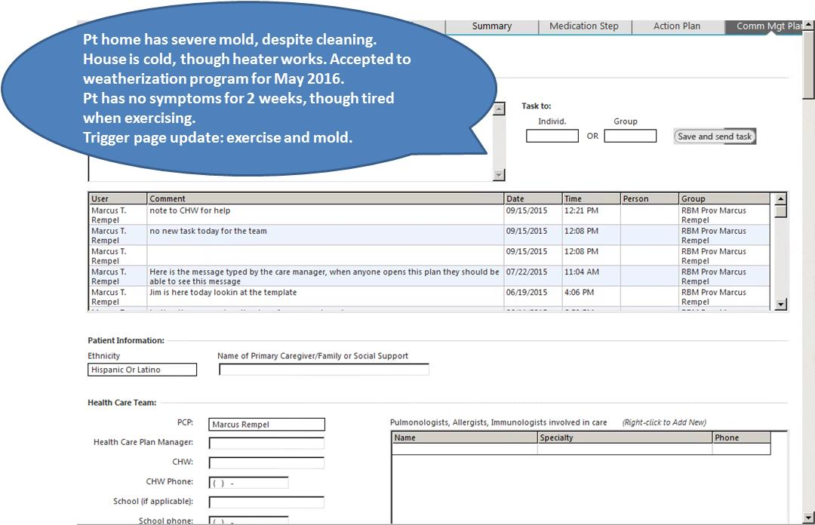
Best Practice Example: Cross Care Team Communication

Slide 38
Pursuing Sustainable Financing
Weatherization plus health
Medicaid 1115 Waiver
Healthy housing partnerships
Medicaid Managed Care Organizations

Slide 39
bradley.kramer@kingcounty.gov
Thank You!

Slide 40
AmeriHealth Caritas’ Comprehensive Asthma Management Program
Andrea D. Gelzer, M.D., M.S., F.A.C.P.
Senior Vice President, Corporate Chief Medical Officer
AmeriHealth Caritas Family of Companies
AGelzer@amerihealthcaritas.com

Slide 41
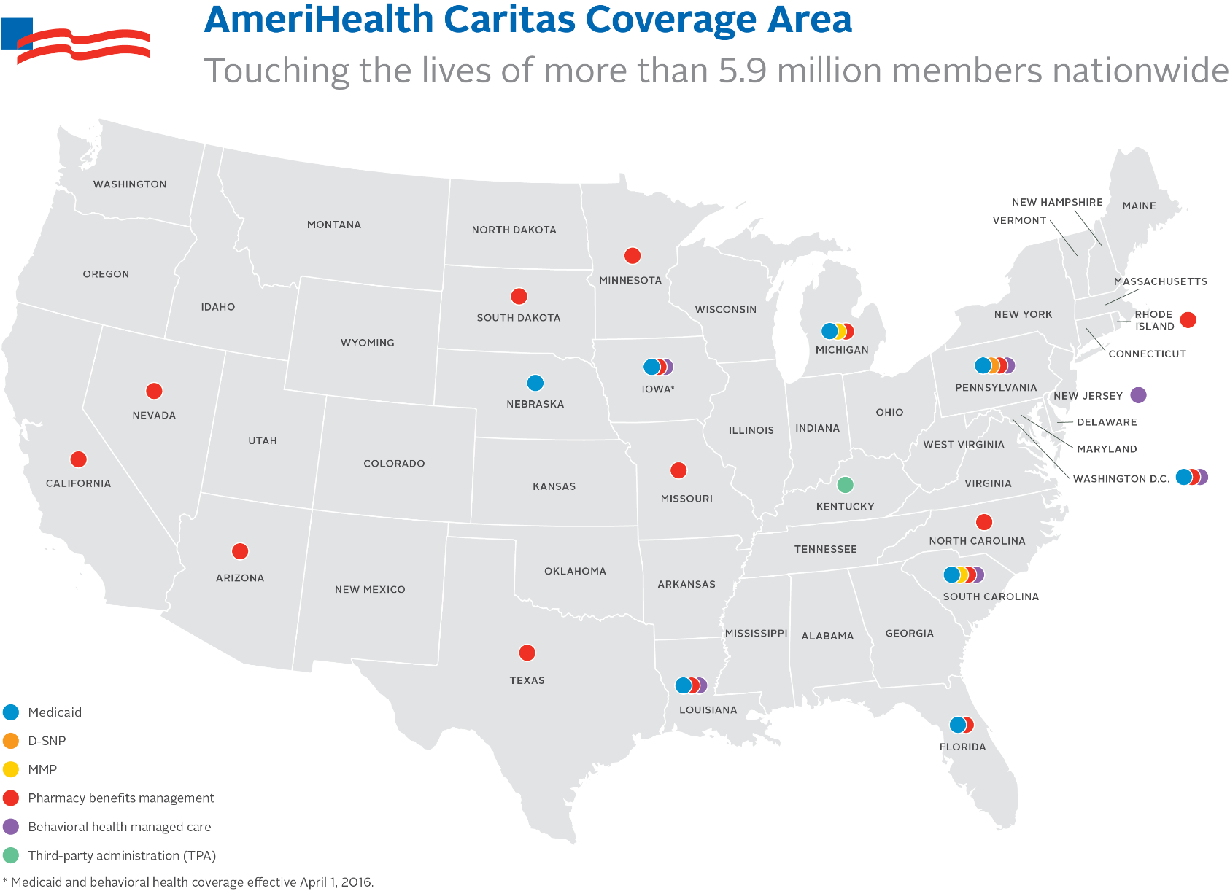
Who We Are

Slide 42
The Problem Before Us
Our members live in some of the worst cities for asthma in the United States¹:
Philadelphia, PA (#3)
Detroit, MI (#4)
New Orleans, LA (#9)
In inner city Philadelphia, one out of four children has diagnosed asthma and/or was admitted to the hospital for wheezing.²
Inner city homes nationwide have unsafe levels of cockroach or dust mite allergens, increasing the risk of developing a positive allergic response by 40 to 50 percent.³
For our members, asthma is among the top conditions treated by providers and for non-urgent emergency department visits.⁴
1. Asthma and Allergy Foundation of America, 2015; 2. Bauer. The Philadelphia Inquirer, April 18, 2015; 3. Rosenstrich. N Eng J Med, 1997; AmeriHealth Caritas claim data, 2014-2015.

Slide 43
Healthy Hoops®
Program established in 2003
Member and family-based asthma program
Wellness and asthma screenings:
Blood pressure
Height, weight, BMI
Spirometry
Asthma action plan consultation
Asthma medication demonstration and education

Slide 44
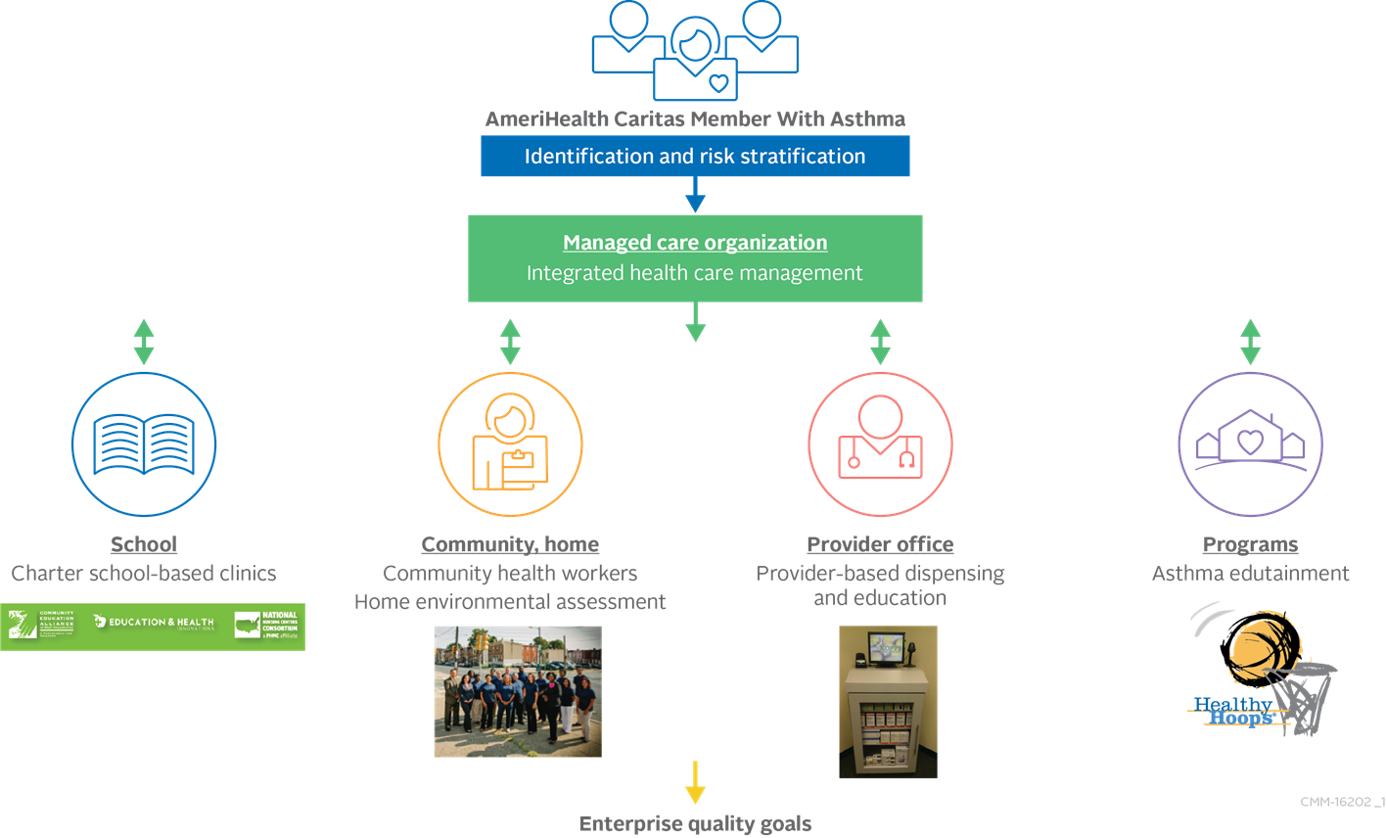
AmeriHealth Caritas’ Comprehensive Asthma Management Program
Notes:
Creative Services is updating this graphic to look sharper

Slide 45
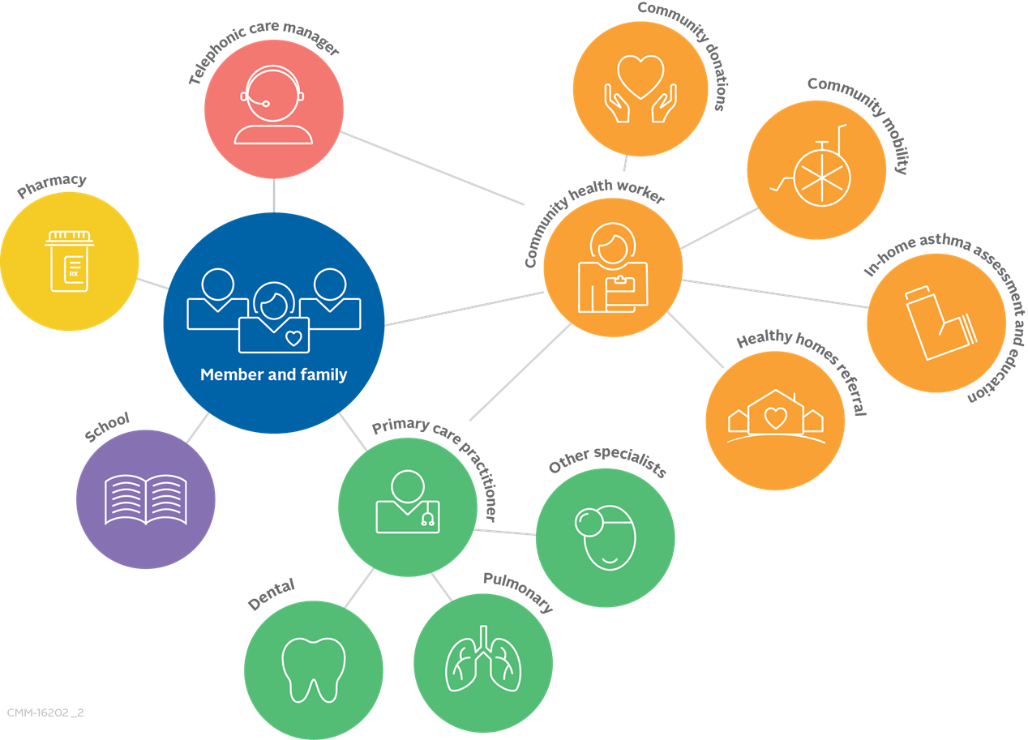
Coordinating a Patient-Centered Medical and Social Neighborhood
Barrier Assessment
Navigational Support
Common Plan of Care
Notes:
Creative Services is updating this graphic to look sharper

Slide 46
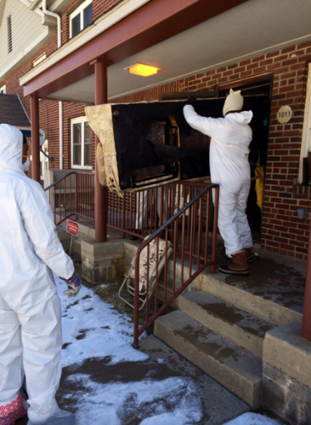
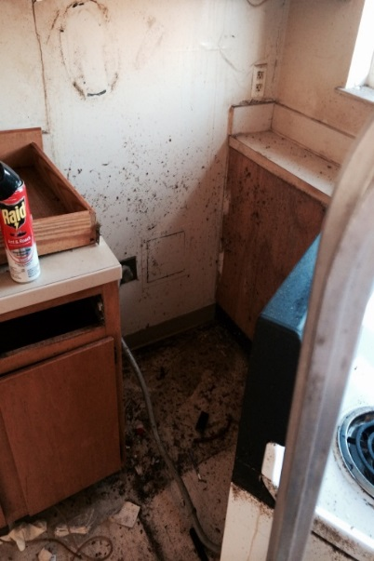
Community Health Worker Approach
Build trusting relationship with our members.
Engage within the community and high-volume provider practices.
Provide connections back to health plan and provider office.
Perform in-home environmental assessment.
Educate the member and family about asthma triggers and avoidance techniques.
Connect the family to resources to make their environment more asthma-friendly, including an asthma home kit.

Slide 47
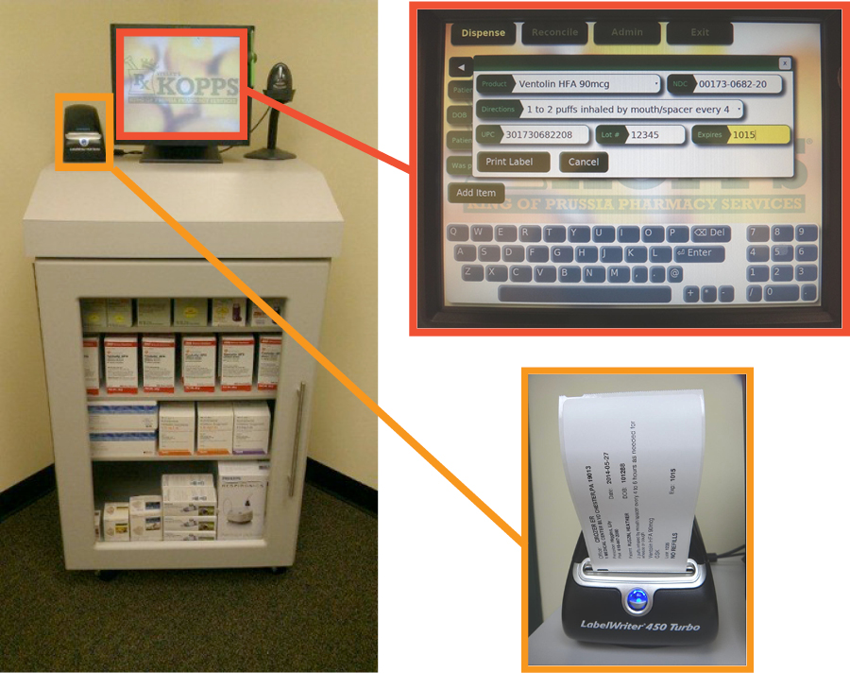
B.E.S.T. asthma program— Breathe Easy. Start Today®
Automated unit with medication stock cabinet, with computer system and prescription label-maker highlighted.

Slide 48
Partnering with School-Based Clinics

Slide 49
Lessons Learned
Move toward a population-based program.
No single program meets the needs of all members with asthma. A multi-pronged approach is the most successful.
Adapt to the “local health ecosystem” to address member needs.
Engagement within the community is key.

Slide 50
Questions?

Slide 51
Polling Question 3
After participating in this webinar, what would you like to hear more about in future webinars?
Building my program’s workforce
Establishing collaborative partnerships
Creating a program infrastructure to prepare for funding
Making the business case for my program
Notes:
Tracey’s Talking Points:
Thank you, Dr. Gelzer, for a terrific presentation.
I would like to congratulate each of our EPA Award winners and thank them for their informative presentations today.
Before we head into the Q&A on the discussion forum, I would like to take this opportunity to learn from you, our asthma community, on what you would like to hear more about in our webinar series. Your feedback helps us develop webinars that are meaningful to you.
Polling Question #3
Great, thank you for your participation. Also, as another opportunity for sharing your ideas with us, please be on the lookout for a brief feedback form in your email following today’s webinar.
It will only take 5 minutes to complete and it will greatly help us in planning our future webinar activities.

Slide 52
Thank You to Our Winners
Post your questions now on
www.AsthmaCommunityNetwork.org
Notes:
Tracey’s Talking Points/Closing Remarks:
That concludes our webinar. My thanks again to our speakers for their time and willingness to share their information and experiences. Also, thanks to all of you who participated. We’re glad you could join us and hope the session was helpful for you.
Be on the lookout for an audiovisual file of this webinar posted on AsthmaCommunityNetwork.org in the coming weeks.
Also, the award winners are available now for a live online Q&A discussion at AsthmaCommunityNetwork.org to answer your questions. They will do their best to respond to your questions in the next 30 minutes. The Q&A discussion will be archived on AsthmaCommunityNetwork.org for future viewing. The next slide provides instructions for posting questions to the online forum.

Slide 53
Question & Answer Session on
AsthmaCommunityNetwork.org Discussion Forum
Immediately after the webinar, join us in the AsthmaCommunityNetwork.org Discussion Forum for a live online Q&A Session.
3:00 p.m. – 3:30 p.m. EDT
To post a question in the Discussion Forum, follow these directions:
If you are a Network member, log in to your AsthmaCommunityNetwork.org account.
Click on the “Discussion Forum” button on the home page.
Click on the “Live Online Q&A for 5/25/16 Webinar” link.
Click on the “Post to the Forum” link to post your question.
Enter your question and click the “Save” button at the bottom of the page.
Not a member? Create an account at AsthmaCommunityNetwork.org by clicking the “Join Now” link at the top of the page. Your account will be approved momentarily and you can begin posting questions.
Notes:
Tracey’s Talking Points:
Here are some directions for how to post a question in the Discussion Forum on AsthmaCommunityNetwork.org.
You will need to log in to your Network account to post questions.
If you are not a member yet, you can join the Network today by clicking the “Join Now” link at the top of the AsthmaCommunityNetwork.org homepage.
Your account will be approved momentarily and you can begin posting questions.
Thanks again for joining us, and we look forward to chatting with you in the Discussion Forum.

