Slide 1
California Asthma Financing
Informational Webinar
Social Impact Bonds and Pay for Success Models

Slide 2
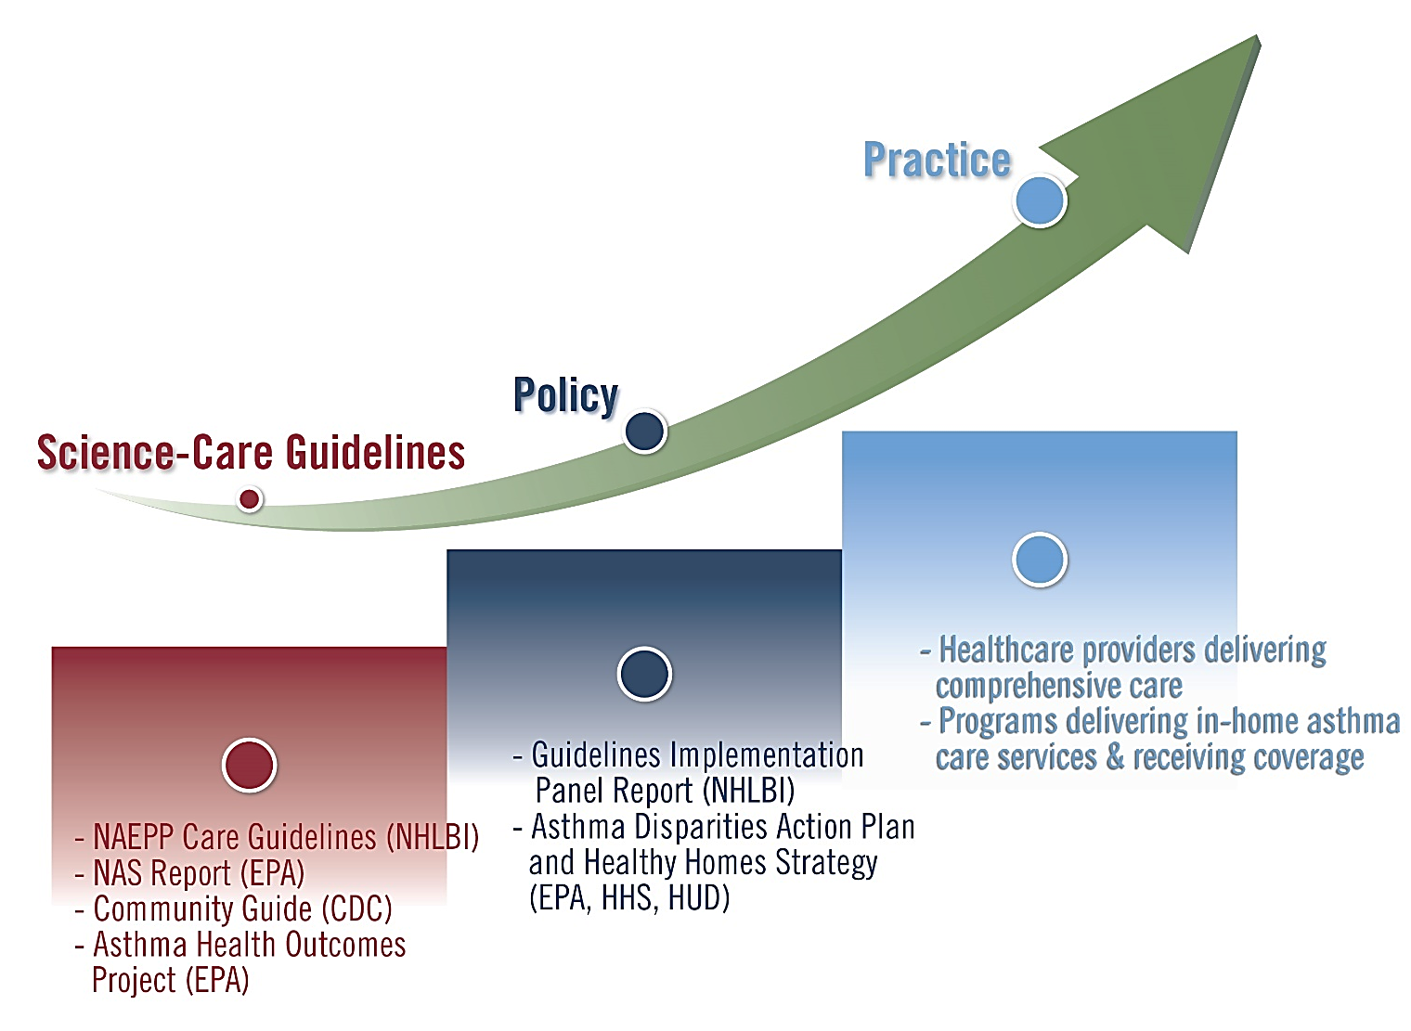
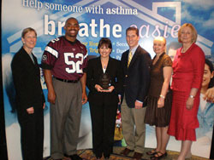
Our Path to Sustainable Financing
Sustainable Financing
Science, Policy & Practice in Place
Notes:
Pleasure to be with you. I’m excited about the content we have to share with you. It’s remarkable that we are at a place where we are able to discuss options for sustainably financing in-home asthma care services.
It’s been a long road to get here and I would briefly like to share EPA’s story with you as well as underscore the importance of the work happening in California on this front.
Since 1998, EPA has invested in increasing awareness and action around the importance of managing indoor environmental triggers to help control and manage asthma.
As awareness and acceptance has spread and healthcare and housing programs have begun translating environmental evidence base and care guidelines into practice, we are now shifting our focus to systems-based changes that will support the spread and sustainability of comprehensive asthma care both inside and outside the clinic setting.
We’ve known how to manage asthma effectively for over 20 years with quality healthcare, medicine and environmental controls. Yet, still today, kids with asthma are frequently ending up in the ER or hospital because they and their caregivers aren’t able to properly manage the disease.
As I’m sure you all appreciate, uncontrolled asthma severely limits quality of life for children and families, is the leading cause of school absenteeism from a chronic disease, and poses a huge economic burden to society. Poor asthma control is associated with high healthcare spending, including emergency room and hospital utilization.
The traditional healthcare system is not equipped to address environmental causes and exacerbators of diseases, such as asthma, because the healthcare required to bring asthma under control very often needs to be delivered at home and in the community as much as it does in the clinic.
Addressing the environmental causes of disease requires reaching people where the live, work and play, and in the case of asthma, it requires addressing specific factors in an individual’s environments -- work that we know we can do more effectively and at better cost outside the clinical setting.
Home visits provide that one-on-one time that families need to figure out an approach they can follow to help a child keep their asthma under control. We believe this is particularly important when addressing asthma disparities.
For almost 10 years now, EPA has been helping communities nationwide to develop and deliver in-home asthma care that includes environmental controls, typically delivered by non-clinical staff.
We are now trained on systems-based changes that will support expansion and sustainability of care outside of the clinic setting.

Slide 3
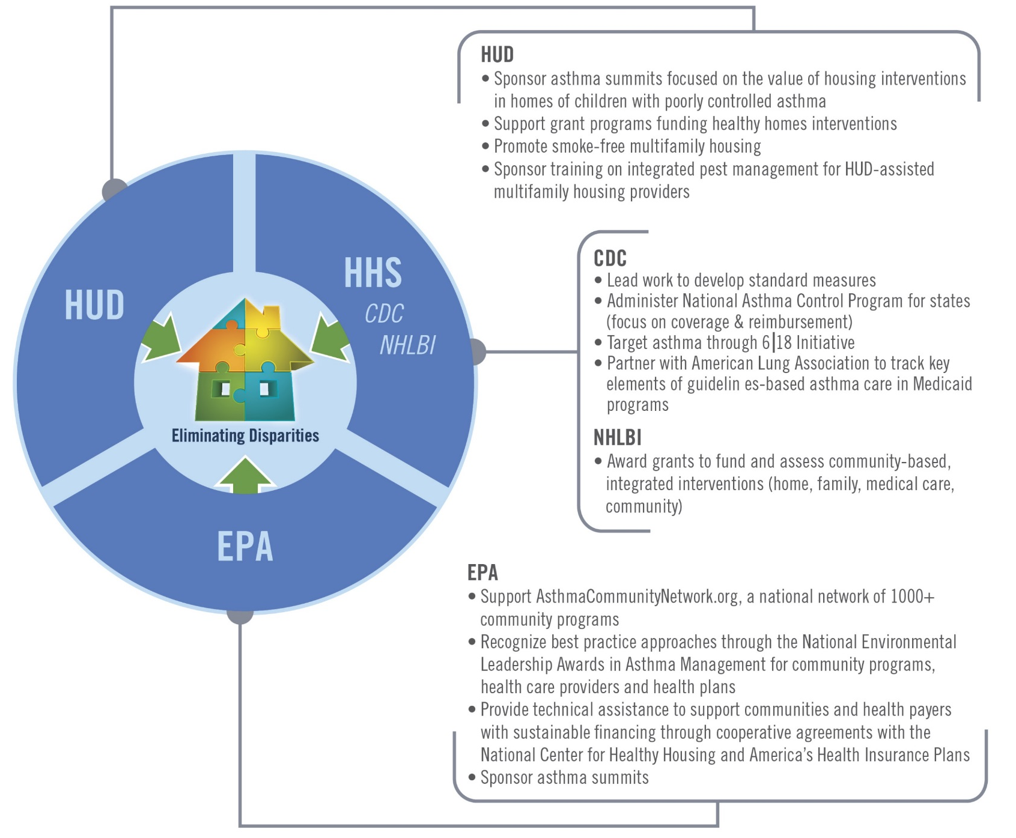
Federal Agencies Working to Expand Access to In-Home Asthma Care Services
Notes:
We are not in this alone.
The federal family recognizes the importance of leveraging systems at all levels (national, regional, local) and across sectors to effectively address asthma disparities and ensure that all children have access to comprehensive asthma care both in and outside the clinic setting.
The Coordinated Federal Action Plan to Reduce Racial and Ethnic Asthma Disparities (released May 31, 2012), serves as a platform for cross-agency collaboration aimed at eliminating disparities and expanding access to comprehensive care, including in-home interventions.
The Disparities Plan also acknowledges the role of the community in supporting delivery of in-home asthma care services and the need to create sustainable financing sources. Plan provides a nice framework for action and draws on agencies areas of expertise to leverage environmental, healthcare and housing systems.
This graphic highlights key assets that each of our federal partners bring to the effort to expand access and secure sustainable financing for in-home asthma care services.
Not going to run through specifics but I would like to highlight the role of the asthma summits…

Slide 4
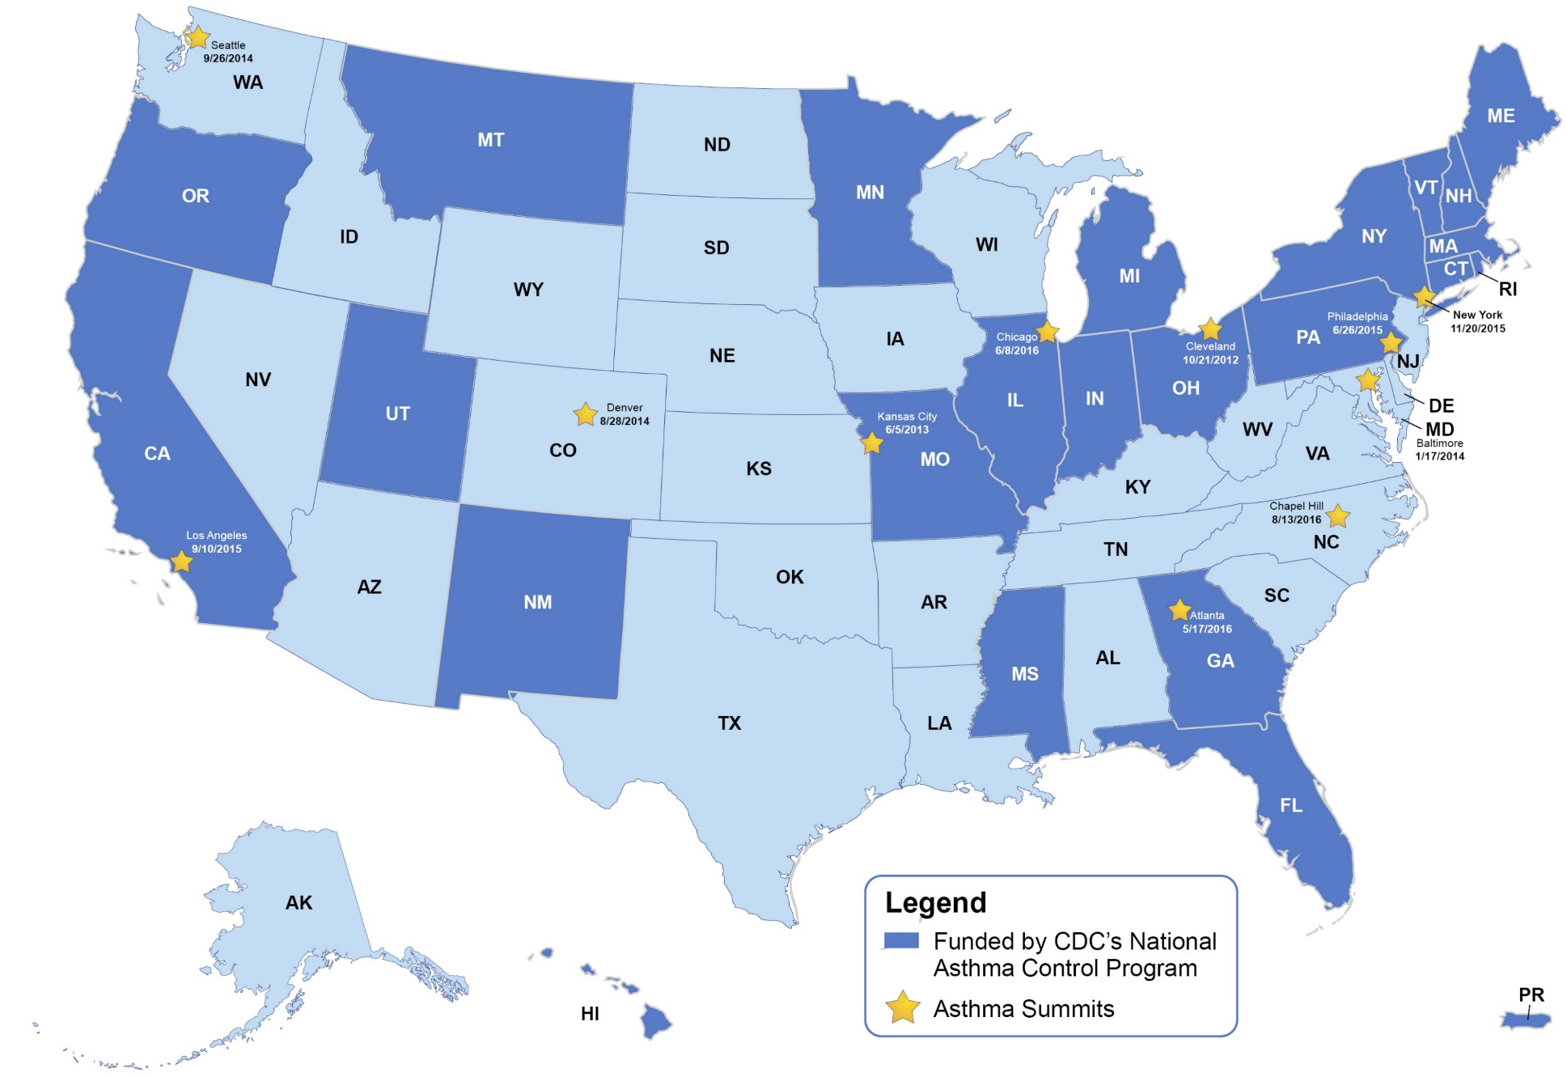
Asthma Summits: Promoting Access and Sustainable Financing
Notes:
The summits, similar to the one held in LA in Sept 2015, are key to advancing local conversations and growing a network of multi-disciplinary stakeholders committed to scaling up and securing sustainable financing for in-home services at the state level. Since 2012, more than 15 states have been represented at 11 regional summits held in partnership with HUD and CDC.
We recently brought past summit hosts together to take stock of the work and surface key insights…. A lot to learn from the approach in California…impressive how you mobilize and engage stakeholders and move forward with intent….look forward to following your progress

Slide 5
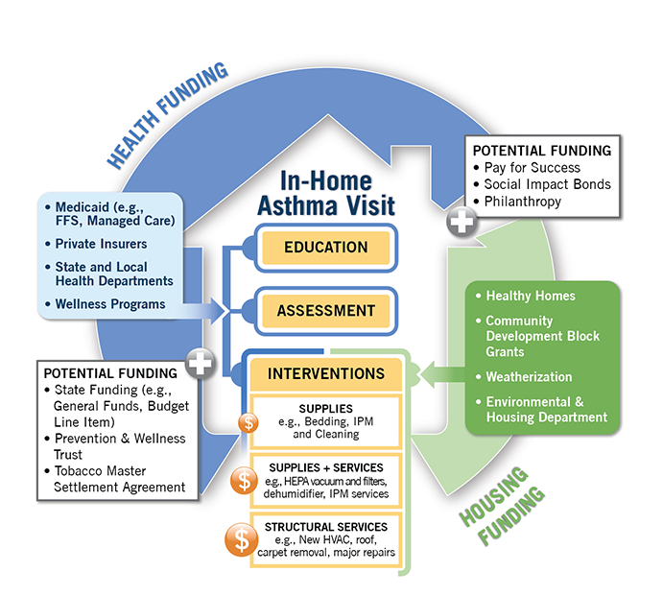
Sustainable Financing Options for In-Home Asthma Care
Notes:
One of the key topics discussed by communities invested in identifying sustainable financing for in-home asthma care services is the concept of braided funding.
This concept underscores the importance of bringing multiply streams of funding together to cover the full spectrum of in-home asthma care services – from education to environmental assessment and interventions.
In many cases this type of approach requires institutional changes and leveraging of systems and partnerships to integrate work into portfolios.
This illustration depicts two primary funding streams and what they typically will and won’t pay for.
HEALTH
Covers traditional healthcare funders like public and private insurers as well as state and local health departments.
When you look at populations disproportionately impacted by asthma this often includes poor and minority children –state Medicaid is often a primary payer for these populations.
But what specific program components and types of providers will Medicaid “reimburse” or “cover?” There are examples of Medicaid paying for education, assessment and light remediation provided by licensed and non-licensed practitioners (CHWs).
When comes to structural changes, this typically falls outside of Medicaid’s purview. Provider delivering in-home services is also a critical component
HOUSING
May need to look to housing funding streams to cover structural interventions.
EMERGING/POTENTIAL FUNDING SOURCES are also key to developing a robust financing portfolio and can help fill in some of the gaps or incentivize participation. Social impact bonds and pay for success programs are key opportunities in this area.

Slide 6
Definitions
PAY FOR SUCCESS
Pay for Success (PFS) is an approach to contracting that ties payment for service delivery to the achievement of measurable outcomes. The movement towards PFS contracting is a means of ensuring that high-quality, effective social services are working for individuals and communities
In a PFS contract, the payor for outcomes – typically, but not exclusively, government – agrees to provide funding if and when the services delivered achieve a pre-agreed-upon result. Typically, an independent evaluator determines whether the agreed-upon outcomes have been met.
SOCIAL IMPACT BONDS
A Social impact bond, also known as a Social Benefit Bond, is a contract with the public sector in which a commitment is made to pay for improved social outcomes that result in public sector savings. The term was originally coined by Geoff Mulgan, Chief Executive of the Young Foundation

Slide 7
Brenda Yamashita
Alameda County Public Health Department

Slide 8
Asthma Start
Alameda County Public Health Department Asthma Start
Brenda Rueda-Yamashita
March 28, 2017

Slide 9
Our Start
Asthma Start Began in 2001
Alameda County had the third highest rate of asthma in CA
Health Officer committed to a program because of rate
First 5 or Every Child Counts was offering funding
The program began an in-home case management program using Social Workers
Served 0-5 year olds living in Oakland, CA

Slide 10
Original Design
In home visiting program
Asthma education
Address psycho/social issues
Connect families to services
Identify triggers in the home
Work with property owners to make changes
Insured there is a medical home and insurance
Collected data

Slide 11
We Grew
2005 began to serve 0-18 year olds
Expanded to all 14 cities
Updated our database
Improved educational materials
250 -300 visits per year
3 social workers

Slide 12
Pay For Success Design
5 social workers
Expanded partnerships
Set program eligibility criteria
Targeted 250 cases
Updated all educational materials and intake forms
Added forms (Asthma Control Test, Spare the Air)
All PFS clients receive the same services
Speck Meter placed in homes

Slide 13
Our Partners
Expanded Partnerships
Healthy Homes
Home inspections and asthma treatments
Alameda Alliance for Health
Referrals, funding and data (PFS partner)
Impact for Health
Guidance and coordination
UC Berkeley
Improve data collection and analysis
Actuarial
Review and analyze insurance billing and cost information
Third Sector Capital
Advice on design and attracting investors

Slide 14
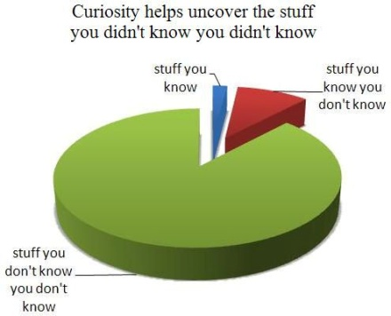
Things to Know
PFS studies cost money
Funds for all of the partners
Funds to see clients
Partnerships are vital to complete the picture
A PFS partner that agrees to pay for your successes
Maintaining your partnerships takes work
Staff need time to transition
Not every family wants to participate
It takes time for the outcomes to be measured

Slide 15
Outcomes
“Spare the Air Days” is not a concept well know by families where English is not their first language
Pre and Post tests need to be looked at from a change in knowledge and not the score
Self report shows a reduction in emergency visit and hospitalizations
Asthma in Home Treatments are appreciated and gives families a start in maintaining their home
Success with property owners making changes

Slide 16
Kevin Hamilton
Fresno AIM

Slide 17
AIM4FRESNO FINAL REPORT

Slide 18
AIM4FRESNO PROJECT OVERVIEW:THE LONG AND WINDING ROAD

Slide 19
ASTHMA:A CRISIS FOR CHILDREN AND COMMUNITIES
Current efforts not sufficient to address asthma emergencies in Fresno County
Office of Statewide Health Planning and Development (OSHPD), 2010.
Hospitalization calculation based on OSHPD 2010 utilization and cost data; emergency services calculation based on OSHPD
2010 utilization data and cost data from Florida Agency for Health Care Administration, February 2009 (2006 data).
Social Finance, Inc. © 2016 Confidential
4

Slide 20
STRONG EVIDENCE FOR IN-HOME ASTHMA MANAGEMENT
But is there a business case to support scale-up?

Slide 21
PROGRAMMATIC RESULTS

Slide 22
BASELINE CHARACTERISTICS FOR TREATMENT & CONTROL GROUPS
BASELINE | Sex | Mean Age | Total HC Costs* PMPM | Inpatient Costs* PMPM | Drug Costs* PMPM | Asthma Inpatient Admits* / 1,000/year | Asthma ED Visits** / 1,000/year | Mean Risk Score
Total Treatment Group | Males:50 Females: 36 | 9.23 | $1,967.29 | $1,699.13 | $35.32 | 145.2 | 34.4 | 2.93
Treatment Group Participating | Males: 18 Females:19 | 9.44 | $3,165.38 | $2,771.74 | $62.22 | 204.8 | 108.1 | 3.73
Treatment Group Non- participating | Males: 32 Females: 17 | 9.07 | $1,080.70 | $905.39 | $15.41 | 101.1 | 0 | 2.34
Control Group | Males: 52 Females: 35 | 8.89 | $567.39 | $456.13 | $7.26 | 116.2 | 8.6 | 1.84
*Baseline total health care and inpatient costs per member per month (PMPM) exclude non-asthma inpatient claims; drug costs include all conditions.
**Inpatient admits and emergency department (ED) visits shown here are asthma-only.

Slide 23
TREATMENT GROUP IMPACTS:
ASTHMA MANAGEMENT AND CONTROL
Survey data collected by CCAC indicates the program significantly improved the rate at which participants felt asthma conditions were controlled.
Background
5 question self-administered test to determine if asthma is controlled
Test measures symptoms and daily functioning
Score below 19 indicates poorly controlled asthma
Recognized by the National Institute of Health
Baseline 3 mo
Three Month Impact
AIM4Fresno Results
At baseline, mean ACT scores for participants was ~19, which is the cut-off between poor and well-controlled asthma
Mean improvement in ACT score from baseline and 3 month follow-up is statistically significant (shaded box in chart)
Upward trend in mean ACT score improvement from 3 months to 12 month follow-up
6 mo
9 mo
12 mo
Error bars = 95% Confidence Interval

Slide 24
TREATMENT GROUP IMPACTS: QUALITY OF LIFE
CCAC patients reported positive impact on asthma symptoms, activity limitation and emotional function
Background
Mini Pediatric Asthma Quality of Life Survey
13 question survey developed to measure the physical, emotional, and social problems for children with asthma
Validated by National Institute of Health
AIM4Fresno Results
Mean improvement in MPAQLS score from baseline to the 3rd visit is statistically significant
Upward trend MPAQLS score improvement from baseline visit to last visit
Error bars = 95% Confidence Interval

Slide 25
TREATMENT GROUP IMPACTS:
REDUCED HEALTH CARE UTILIZATION (SELF-REPORT)
CCAC patients reported lower rates of emergency department, inpatient and urgent care visits in the 12 months after the program relative to 12 months prior to the program
Parent-reported Utilization
(12 months pre vs 12 months post)
Background
2.50
During the first meeting, CCAC collects self-reported asthma-related health care utilization for the previous 12 months
CCAC surveys participants every month regarding their asthma-related health care utilization
Average Number of Visits per Subject
2.25
2.00
1.75
1.50
1.25
1.00
AIM4Fresno Results (SELF-REPORTED)
0.75
Asthma-related hospitalizations decreased by 70%
Asthma-related ED usage decreased by 81%
Asthma-related outpatient visits
decreased by 53%
0.50
0.25
0.00
ED Pre
ED Post
Hosp. Pre
Hosp. Post
Urgent Case Pre
Urgent Case Post

Slide 26
PROGRAMMATIC COST ANALYSIS

Slide 27
THE COST OF DELIVERING IN-HOME ASTHMA MANAGEMENT PROGRAM
 | Original Budget | Actual Budget | CCAC Time Study
Personnel Costs | $288,618 | $288,618 | $19,499
Home Remediation Costs | $113,627 | $39,248 | $11,655
Total Service Delivery Costs | $402,245 | $327,867 | $31,154
Number of Cases | 200 | 37 | 37
Personnel Cost per Case | $1,443 | $7,800 | $527
Home Remediation Cost per Case | $568 | $1,061 | $315
Total Service Delivery Cost per Case | $2,011 | $8,861 | $842
Budget Notes:
The discrepancy between the Original Budget and the Actual Budget is largely twofold: 1) the fixed costs of maintaining asthma management staff in the midst of lower-than-expected enrollment, and 2) the prolonged delay in obtaining eligibility data impacted staff and service delivery costs.
CCAC Time Study Methodology
Time study measured the actual staff time and home remediation supplies associated with each of the 37 participants; representing steady-state projection of service delivery costs.
On average, 12.4 hours of staff time were associated with each case (includes initial visits, follow-up visits and calls, and drive times.

Slide 28
EVALUATION RESULTS AND COST-BENEFIT ANALYSIS

Slide 29
COST-BENEFIT ANALYSIS
ROI of $3.63:1 (based on program costs from CCAC time study)
 | Per Person | 37 Participants
Health Care Savings (24 months) | $3,056 | $113,075
Intervention Costs | $842 | $31,175
Net Savings | $2,214 | $81,900
Return on Investment (ROI)
Health Care Savings / Program Cost
$113,056 / $31,175
ROI = $3.63 : $1
Considerations:
As noted, this includes health care savings only; a more robust benefit estimate may be expanded to include ancillary value generated by the program—such as averted school absenteeism and increased parent productivity.

Slide 30
OTHER OUTCOMES
While program shows positive overall savings impact and cost-benefit, there were mixed results on specific utilization and cost measures.
Outcome | Treatment-Participating |  |  |  | Control
 | Pre | Post | Change | Pre | Post | Change
Asthma ED Visits/Thousand/Year | 108.1 | 81.1 | (25%) | 8.6 | 14.2 | 64.6%
Asthma Inpatient Admits/Thousand/Year | 204.8 | 221.9 | 8% | 116.2 | 87.1 | (25%)
Asthma Inpatient Costs PMPM | $2,771.74 | $1,081.05 | (61%) | $456.13 | $192.44 | (58%)
Drug Costs PMPM— all conditions | $62.22 | $124.98 | 101% | $7.26 | $30.5 | 314%
Treatment-participating had 25% reduction in asthma ED visits vs. 64.6% increase in Control group.
Treatment-participating had 8% increase in number of asthma inpatient admits vs. 25% decrease in Control group.
However, asthma inpatient costs PMPM declined 61% in the Treatment-participating group, which was slightly
better than in the Control group.
Increased total drug costs may indicate greater compliance.
As noted, results impacted by the small sample size of program participants and the volatility of these utilization areas.

Slide 31
LEARNINGS

Slide 32
WHAT WE’VE LEARNED: FINANCING SYSTEM
Fragmented health care financing and risk sharing complicate scale-up strategy
Insights and Challenges
Federal (56%)
State (44%)
Medi-Cal has complex payment flows among multiple financial stakeholders; creates dispersion of risk/value
SIB strategy requires payer with significant risk/value or multi-payer approach
Medi-Cal Cost Sharing
Health Net / CalViva Health
Anthem Blue Cross
Fresno County Health Plans
LaSalle
EHR
Independent Practice Associations
Health Care Providers
Negotiated Rate
Risk Adjusted / Capitated Rate

Slide 33
WHAT WE’VE LEARNED: HEALTH PLANS
Insights and Challenges
Lesson Learned
Sustaining Health Plan engagement proved very challenging for a number of reasons
Resource constraint: Despite offering to compensate both health plans for their time, both health plans indicated they did not have the bandwidth to dedicate FTE resources to the project
Low prioritization: Given the size and magnitude of the project, the health plans could not justify shifting resources and prioritizing the data pulls associated with the project
External forces: The following factors derailed and, ultimately, resulted in the health plans withdrawing support
ACA implementation
Merger and acquisition
Data breach
Generating greater buy-in from health plans
Integrate health plans as core team members
Establish a Memorandum of Understanding clearly outlining each party’s commitments
Agree to resource/financial support
Initiate a proof of concept SIB project with a foundation payor
Highlight the impact of the intervention over a short time period
Establish a SIB contract that the health payors could easily adopt

Slide 34
WHAT WE’VE LEARNED:TARGET POPULATION
Insights and Challenges
Lesson Learned
Prevalence of uncontrolled asthma lower than anticipated among CHC patients:
Only 20% of 908 CSV Medi-Cal patients with asthma matched our selection criteria
It will be critical to access clients via multiple providers and health plans to help identify sufficient individuals to scale the project in a cost efficient manner.
Valley Children’s Hospital would be a great partner in Fresno, as they have the highest volume of asthma patients and could be direct referral source into the program
Identifying, reaching, and enrolling hard- to-reach population
Reaching clients from a pre-generated list vs. direct marketing or direct provider referrals compounded the team’s ability to reach and enroll members of the treatment group
CCAC implemented two strategies to improve outreach and enrollment
Revamp the program’s intake process to minimize client touch points prior to the first home assessment
Initiated mobile outreach team to knock on doors of prospective clients

Slide 35
SCALE RECOMMENDATIONS

Slide 36
THREE PATHS TO SCALE IN-HOME ASTHMA MANAGEMENT
These options are not mutually exclusive
1
A government or other entity could directly fund in-home asthma management programs given the business case.
Entities with most benefit to gain from direct investment:
Department of Health Care Services (DHCS)
Medi-Cal health plans
Direct Investment
2
Pay for Success or Performance-Based Contract
Pay for Success (PFS) of Performance-Based Contracts (PBC) allow back-end payors (e.g., DHCS, health plans) to test the efficacy of in- home asthma management while shifting the financial risk to private investors.
The PFS sector has evolved significantly since the start of the AIM4Fresno project. There are several active asthma-focused PFS projects being explored.
3
Hybrid (Braided Funding)
State or the health plans would directly fund in-home asthma education and a PFS/PBC would be established to fund the home remediation cost.
This option could dovetail nicely with existing efforts to sustainably fund in-home asthma education.

Slide 37
DIRECT INVESTMENT INTO IN-HOME ASTHMA MANAGEMENT
Leverage AIM4Fresno experience in conversations with state and health plans
1
State Plan Amendment (SPA)
DHCS is reviewing SPA language that would reimburse non-licensed providers for in-home education and environmental assessment.
DHCS has requested RAMP to pursue legislation granting DHCS authority to submit SPA to CMS for approval.
Earliest effective date of new policy: Jan 2018.
CDC 6|18 Initiative
California Public Health Association – North (CPHA-N) convened stakeholders in July to consider moving forward with in-home asthma management as part of this CDC initiative.
CA declined to participate in CDC 6|18; no federal or state funding is available.
CPHA-N sees opportunity to catalyze health plan investment in asthma, tobacco, and diabetes. Funding both asthma education and/or remediation is on the table.
Health Homes Program (HHP)
CA will soon implement HHP per Section 2703 of the ACA. HHP will serve eligible Medi-Cal beneficiaries with multiple chronic conditions who are frequent utilizers.
Given the quick realization of cost-savings from asthma home-visiting programs, counties will be incentivized to include them in their HHPs.
Phased rollout starting in January 2017.
Medi-Cal Health Plans
CCAC is in active discussion with Health Net and Anthem Blue Cross on how in-home asthma management can help the Medi-Cal plans achieve HEDIS quality measures.
Both of these plans are operating well under the benchmark HEDIS measures; therefore, risk financial penalties.
This financial penalty may increase health plans appetite for investing in asthma management.

Slide 38
SCALING WITH PAY FOR SUCCESS
The evolution of Pay for Success
2
More Deals in More
Geographies
In March 2013 when the AIM4Fresno project was launched, only the
New York City Rikers Island PFS project was launched
Today, there are 11 active PFS projects in the market with many more in development
There is one active PFS project in California (Santa Clara) and a number of projects in development at the County level
2011
2016
Diverse Application
of PFS
The application of PFS varies widely across completed and projects in
development, including:
issue areas
level of evidence-base
types of investors
evaluation methodology
payment terms

Slide 39
SCALING WITH PAY FOR SUCCESS
2
There is Interest in an asthma-focused PFS Project
Green and Healthy Homes Initiative (GHHI) received a federal $1.01M Social Innovation Fund grant to explore PFS feasibility in five sites across the country
Social Finance is working with GHHI to develop a PFS project in Baltimore, potentially partnering with a health plan as the payer
Alameda is exploring PFS for an in-home asthma management project
How can this translate into opportunities in California?
 | Opportunities | Challenges
Payors | DHCS is actively reviewing SPA language to fund in-home asthma education. PFS could complement or be a back-up option PFS offers is a risk-free way for health plans to test if investments in in-home asthma management will yield better HEDIS measures | Perceived complexity of PFS may be a barriers Setting aside budget funding for PFS may be difficult in this budget environment Complicated healthcare financing will likely require Payors to pay for non-fiscal benefits
PFS Investors | There is investor appetite to invest in health; specifically focused on social determinants of health | Given small sample size, AIM4Fresno findings unlikely to provide PFS investors with more confidence in the impact of in-home asthma management
Scale | Significant need in Fresno and greater CA | Identifying an appropriate payor that allows for sufficient scale to make PFS cost-effective Establishing referral and outreach over large geography

Slide 40
SCALING WITH PERFORMANCE-BASED CONTRACTING
Opportunity to engage health plans in simplified performance-based contract?
2
FFS Payment
PFS
Fee-for-service
Partially performance-based
Fully performance-based
Payor pays for the cost of service
Payor pays for portion of service upfront; remaining portion dependent on performance
Payor only pays to the extent that outcomes are achieved
Pros: No payment risk
Cons: Government may pay for less than full cost; price unrelated to value; challenging to scale; year-to- year contracting
Pros: Limits risk while ensuring government acknowledges value creation
Cons: Challenging to scale; provider has performance risk; may require working capital financing
Pros: Allows provider demonstrate (and recapture) value; enticing to government
Cons: Complex; may require working capital financing; risky
Contingent renewal
Future contract size based on performance criteria
Pros: Ensures longer-term relationship tied to performance; improves sustainability; potentially a viable option for health plans engagement
Cons: Typically challenging to obligate for government (but not necessarily health plans)
37

Slide 41
HYBRID:
Braiding direct investment with PFS or PBC
3
How would a Hybrid Approach Work?
State or health plan directly invests in in-home education and home assessment with their budget
State or health plan executes a PFS / PBC contract that
Leverages private capital to fund upfront cost of home remediation
Requires State or health plan to repay private investors if positive outcomes are achieved. State or health plan payments would account for their investment
How can this translate into opportunities in California?
 | Opportunities | Challenges
Payors | DHCS is actively reviewing SPA language to fund in-home asthma education Health plans direct investments in in-home education would likely count towards medical expenses for medical loss ratio requirements PFS/PBC provides an opportunity to fund home remediation while transferring financial risk | Perceived complexity of PFS may still be a barrier Setting aside budget funding for PFS may be difficult in this budget environment Health plans repayments on PFS or PBC may count as administrative expenses for medical loss ratio
PFS Investors | There is investor appetite to invest in health; specifically focused on social determinants of health | Given small sample size, AIM4Fresno findings unlikely to provide PFS investors with more confidence in the impact of in-home asthma management
Scale | Allows for greater scale as investment dollars can be focused on home remediation Lower nominal cost of capital for government / health plan payments | Identifying an appropriate payor that allows for sufficient scale to make PFS cost-effective Establishing referral and outreach over large geography
 |  |  | 38

Slide 42
SOUTH CAROLINA NURSE-FAMILY PARTNERSHIP PROJECT
An example of the hybrid approach in practice
3
Medicaid
PFS Funders
Via a 1915(b) wavier,
Medicaid is funding
~45% of the service delivery cost on a per- visit basis
Funding flow
Information flow
Success payments (based on outcomes)
Outcome Payor
Service Provider
Independent Evaluator
Target Population
3,200 first-time low income mothers
39

Slide 43
Questions & ANSWERS

Slide 44
Thank you!!!
Please join us for our next CAF Working Call:
April 26, 2017 @ 11 AM

