Slide 1
Data to Dollars: 2015 Asthma Award Winners Share Their Stories

Slide 2
2015 National Award Winners Data to Dollars: 2015 Asthma Award Winners Share Their Stories
Welcome to the Webinar
Moderator:
Tracey Mitchell, U.S. Environmental Protection Agency
Presenters:
Susan Steppe, Le Bonheur Children’s Hospital’s CHAMP (Changing High-Risk Asthma in Memphis through Partnership) Program
Ruth Ann Norton, Green & Healthy Homes Initiative (GHHI)
Notes:
Tracey’s Talking Points:
Good morning or good afternoon, depending on where in the country you’re joining us from.
Welcome to “Data to Dollars: 2015 Asthma Award Winners Share Their Stories,” a Web-based presentation sponsored by the Environmental Protection Agency.
We’re glad you can join us today!
People will probably continue to connect in on the Web and on the phone over the next few minutes, but since we have a lot of material to cover and so that we can let you folks get back to the good work you’re doing, we’ll go ahead and get started.

Slide 3
Introduction
Tracey Mitchell
U.S. Environmental Protection Agency
Notes:
Tracey’s Talking Point(s):
I’m Tracey Mitchell from EPA. I’m going to give a quick overview of this webinar and also walk through some housekeeping items.
Then I’ll turn it over to our featured presenters, who will introduce themselves and start the presentation.

Slide 4
Purpose of Webinar
To develop a baseline understanding of program evaluation metrics, data tracking systems, and data analysis strategies.
Discover the ways in which data can be used to successfully attract new and different funding sources.
To learn how to package program data into a compelling story that demonstrates return on investment, sustainability and concrete evaluation measures for targeted funding audiences.
Notes:
Tracey’s Talking Points:
The purpose of today’s webinar is to hear about and learn how to…[read slide]

Slide 5
Polling Question 1
What type of organization do you represent?
Notes:
Tracey’s Talking Points:
Before we dive into today’s presentations, I would like to take a minute to get a sense for who’s with us today. To help me do that I would like to encourage you all to answer the polling question on your screen: “What type of organization do you represent?”
Polling Question #1

Slide 6
Polling Question 2
What is your program’s experience with seeking funding?
Notes:
Tracey’s Talking Points:
Looks like we have a great audience today. We have one more question for you…
Polling Question #2: “What are your program’s experiences with seeking funding?”
Great – [provide overview of responses] Thanks to you all for sharing your experiences with funding.

Slide 7
Agenda
EPA’s National Environmental Leadership Award in Asthma Management
Hear From Speakers—
Susan Steppe, Le Bonheur Children’s Hospital’s CHAMP Program
Ruth Ann Norton, GHHI
Q&A Session in AsthmaCommunityNetwork.org Discussion Forum
Notes:
Tracey’s Talking Points:
Our plan for today is to share a little with you on the National Environmental Leadership Award in Asthma Management. Then, our 2015 award winners will then tell us about their programs’ and the outstanding results they have achieved.
After the webinar, each of our presenters will be available on AsthmaCommunityNetwork.org for half an hour for your questions.

Slide 8
Question & Answer Session on
AsthmaCommunityNetwork.org Discussion Forum
Immediately after the webinar, join us in the AsthmaCommunityNetwork.org Discussion Forum for a live online Q&A Session from
3:00 p.m. to 3:30 p.m. EDT.
To post a question in the Discussion Forum, follow these directions:
If you are a Network member, log in to your AsthmaCommunityNetwork.org account.
Click on the “Discussion Forum” button on the home page.
Click on the “Live Online Q&A for 5/27/15 Webinar” link.
Click on the “Post to the Forum” link to post your question.
Enter your question and click the “Save” button at the bottom of the page.
Not a member? Create an account at AsthmaCommunityNetwork.org by clicking the “Join Now” link at the top of the page. Your account will be approved momentarily and you can begin posting questions.
Notes:
Tracey’s talking points:
•Our Q&A will take place on the Discussion Forum on AsthmaCommunityNetwork.org.
•To see the discussion forum directly, please click the link that we just sent you via the chat function.
•To ask questions, you must first be a member of AsthmaCommunityNetwork.org so please take a minute to join so that you can post questions throughout the Webinar – it is a simple and quick process. The Site Administrator will be approving memberships as they are submitted.
•After the Q&A period is closed, please visit the Discussion Forum often to see other contributions as well as to make your own!

Slide 9
About the Awards
It is the nation’s highest honor for exceptional asthma management programs.
The goal of the Awards program is to showcase best practices in asthma care and management.
To be eligible, applicants must use: the National Institutes of Health (NIH) Expert Panel Report 3 (EPR-3): Guidelines for the Diagnosis and Management of Asthma.
Join the Hall of Fame: Apply in 2016! www.asthmacommunitynetwork.org/awards
Notes:
Tracey’s Talking Points:
Since 2005, EPA has honored exceptional health plans, health care providers and communities in action.
This award is the highest recognition in the country that a program and its leaders can receive for delivering excellent environmental asthma management.
Winners receive a place in the National Environmental Leadership Award in Asthma Management Hall of Fame, national recognition through a press release, blogs, etc., a crystal award, and the opportunity to serve as mentors to help other programs achieve impactful results

Slide 10
Award Winners Hall of Fame
Notes:
Since 2005, EPA has recognized health plans, health care providers and communities in action for their best practice approaches to delivery of comprehensive asthma care.

Slide 11
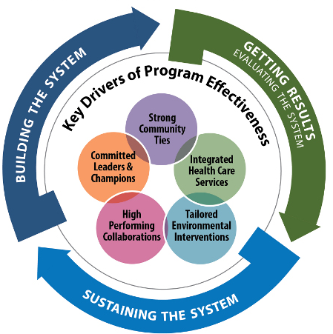
The System for Delivering High-Quality Asthma Care
Notes:
Tracey’s Talking Points:
•Many of our award winners have used EPA’s model for Delivering High Quality Asthma Care, which features essential components to developing an effective and sustainable asthma program.
•The System is a conceptual framework, based on results of the Asthma Health Outcomes Project, conducted by University of Michigan, that identifies the core elements of successful asthma programs and the processes that drive their implementation, continuous improvement, and endurance. The five key drivers of the System include: committed leaders and champions, strong community ties, integrated health care services, tailored environmental interventions, and high performing collaborations.
•The System is flexible and any asthma program, regardless of its size, institutional home (e.g., health plan, health care provider, community program), budget, target community, or level of development, can use the System to guide its work.
•How you apply the System will depend on where your program is in its evolution. As programs mature, the System evolves with them. The applicability to your program and your understanding of different elements of the System is likely to change over time. Early on, you may focus on using the System as a guide for getting started. After several years, you may focus more on using it to make your program last.

Slide 12
Sustaining the System
Use data to demonstrate value.
Be visible to funders.
Promote institutional change.
Identify discrete program elements.
Notes:
Tracey’s Talking Points:
Since today’s topic is on turning data to dollars, we are going to focus on “Sustaining the System.”
Each of our programs today will describe how they used data to promote their program and appeal to funders. You’ll hear some innovative and creative solutions to data mining, demonstrating the value of thinking outside the box and how to build support from various funding streams.
The main components of “Sustaining the System” include:
1. Put data that matters to potential funders and payers in front of them to demonstrate the need for your program and your impact, or your value proposition.
2. Be visible to funders and support what they know. Publicize and market your program’s activities.
3. Make it easy to support your program by identifying discrete program elements and their costs so that funders and payers can support individual elements if they are not ready to support the program in its entirety.
4. Keep asthma management and the need for institutional change for sustainability in mind at all times!

Slide 13
What is a Value Proposition?
“For $400,000, we will improve asthma outcomes for 400 at-risk children with poorly controlled asthma by achieving reductions in emergency room (ER) visits and hospital admissions, through our in-home asthma case management program.
We estimate that our work will deliver $640,000* per year in cost savings to the health care system through 40% fewer hospital admissions and 25% fewer ER visits.”
-Asthma Network of West Michigan
* $1,600 savings per patient/year x 400 patients/year
Notes:
A value proposition is a tool to help you communicate the unique value and benefits of your program to funders.
It demonstrates that the health outcomes a program creates and the economic savings a program generates outweigh the program operating costs.
Whether you are starting a new pilot project or you are a part of a well-established program, value propositions are effective tools for securing future funding.
The benefit of developing your value proposition is that it crystalizes the value of your program to potential funders.
It is also an opportunity for a program to see the impact it has on health outcomes by capturing costs, calculating health cost savings, and conducting a program evaluation.
For more information on developing your program's Value Proposition --visit AsthmaCommunityNetwork.org and check out the Value Proposition content on the site.
13

Slide 14
Susan Steppe, Project Director
Le Bonheur Children’s Hospital
Changing
High-risk
Asthma in
Memphis through
Partnership
The project described is supported by Grant Number 1C1CMS331046 from the U.S. Department of Health and Human Services, Centers for Medicare & Medicaid Services. The contents of this publication are solely the responsibility of the authors and do not necessarily represent the official views of the U.S. Department of Health and Human Services or any of its agencies. The research presented here was conducted by the awardee. Findings might or might not be consistent with or confirmed by the independent evaluation contractor.
Notes:
Tracey’s Talking Points:
•Now, I would like to introduce Susan Steppe, Project Director at Le Bonheur Children’s Hospital’s CHAMP Program. The Le Bonheur Children’s Hospital’s CHAMP Program (Changing High-Risk Asthma in Memphis through Partnership) is a collaborative that serves children ages 2–18 in Memphis, Shelby County, Tennessee, who are identified as having high-risk asthma. The program is funded by the U.S. Department of Health and Human Services, Centers for Medicare and Medicaid Services, as a round 1 innovations project.
•Of CHAMP’s patients, 95 percent are African American children who suffer from poorly controlled asthma that results in preventable hospital and emergency room encounters, missed school days, and diminished quality of life. They primarily live in rental properties characterized by environmental hazards—such as mold, mildew and cockroaches—that exacerbate asthma episodes, and many of them move frequently or spend significant periods of time in more than one residence over the course of a week or month.
•To talk more about Le Bonheur’s award winning program, I will turn it over to project director, Susan Steppe.

Slide 15
CHAMP High-Risk Criteria
Shelby County resident and TennCare recipient
Ages 2–18
Two or more of the following asthma-related events in a 1-year period—
Hospitalizations
Emergency department (ED) visits
Urgent care visits
Steroid bursts in event separate from above
OR
One or more intensive care unit admissions in the past 2 years
Notes:
This slide is solely to orient the audience to the CHAMP target population.

Slide 16
Components of the Program “WHAT WE DO”
Identify, engage, and enroll patients
High-risk clinic: Medical evaluation and Plan of Care (POC)
Home Visits by Community Health Workers (CHWs): Environmental assessment, support asthma education, meds reconciliation, social service needs
Asthma Education by Certified Asthma Educator in the clinic and in the field
Notes:
This is a quick overview of the elements of the intervention. Emphasis on Engagement because it doesn’t matter how skilled we are, how well

Slide 17
Components of the Program “WHAT WE DO” (continued)
Educating School Staff: Deliver POC and medication to schools
Delivering to primary care
Operating 24/7 call line answered by EMT and nursing staff, linked to on-call physician
Ongoing case management
Followup for sick calls, 24/7 call-in lines, and unplanned encounters
Document activities in the CHAMP asthma registry

Slide 18
Sounds good, but . . .
Does it work?
Do children achieve better control over their asthma?
How do we know if better control is achieved?
How does “better control” translate into desired outcomes?
Notes:
The program design looks fine but at the end of the day you have to be able to show what your program accomplishes beyond delivering a good service. You must be able to answer these questions if you want to assure that your program hits the mark and make your program attractive to potential funders who would interested in helping you continue your good work.

Slide 19
Outcome vs. Process
Outcome: The desired state or condition we wish to achieve
What does success look like?
Process: The steps and activities you complete in order to achieve the outcome

Slide 20
Outcome vs. Process (continued)
Specific and measurable goals or aims
What is the story you want to tell? The story of a group of children experiencing significant improvement in the control of their asthma.
Metrics—What does achievement look like?
Examples of measures: Children wheeze less, go to school more, and visit the ED and hospital less, with corresponding reduction in health care costs.
Create a system to gather data on those measurements. Weave this process into daily life.

Slide 21
Outcome vs. Process (continued)
Analyze that data at regular intervals to see how you are doing. Get help if you don’t have the expertise.
Embrace the results and use the information.
If negative, identify the problems and change your approach. This is an opportunity,
If positive, throw a party for the staff, then ask, “How could this be even better?”
Don’t live in fear of your results.

Slide 22
CHAMP Registry
Means to document all program activity
Web-based and accessible in the field (i.e., iPads)
Medical data imported from electronic medical records (EMR)—Not all of it
Not an “add-on”—Integrated into the daily work flow
Monthly download of TennCare data—Powerful case management tool with ability to analyze cost data
Ability to generate reports on any elements within the system
Evaluator on staff

Slide 23
CHAMP Goals
Improve the health of children with high-risk asthma who are served by the program:
Reduce deaths from pediatric asthma to 0 by June 15, 2015.
Reduce ED and urgent care visits by 15% by June 30, 2015.
Reduce avoidable hospitalizations by 15% by June 30, 2015 .
Reduce asthma exacerbations or episodes by 15% by June 30, 2015.
Lower overall health care costs for children served by more than $4 million by June 30, 2015.
Achieve an overall positive patient/family rating of the CHAMP program from at least 95% of the patients/families surveyed by June 30, 2015.
Improve the quality of life for 80% of the patients by June 30, 2015.

Slide 24
ED Utilization – 6 months
42% reduction in 6 month utilization over 9 quarters*
*The positive results cited are based on data from the awardee. Findings may or may not be consistent with or confirmed by the independent evaluation contractor.

Slide 25
Hospitalizations/Observations
43% reduction in the percentage of children hospitalized per quarter, over 9 quarters*
*The positive results cited are based on data from the awardee. Findings may or may not be consistent with or confirmed by the independent evaluation contractor.

Slide 26
Cost Comparison
Comparison of pre-CHAMP costs with “during CHAMP” costs indicates less money was spent on asthma care.
In the last 3 quarters, there has been a 38.5% reduction in the average cost of care per child, per year—an imperfect method of calculation.
National Opinion Research Center (NORC) at the University of Chicago, the external evaluator, is exploring the cost issue with a control group.

Slide 27
Essence of the CHAMP Story
CHAMP appears to be successful in helping children in Memphis who are TennCare recipients control their asthma as evidenced by reduced ED and hospital visits.
CHAMP shows promise (notice wording here) in helping these children stay healthier at a lower cost.

Slide 28
Things You Can Do When You Don’t Have a Registry
Set goals in specific and measureable terms. (What story do you want to tell? What does success look like?)
Define how the goals will be measured. (What types of information will tell that story?)
Establish the way that you can obtain information on those measures. Watch out for burdensome processes placed on front-line staff.
Track the data collection process.
Obtain technical assistance from a local expert (e.g., a university or local business volunteer) both to develop your metrics and to analyze the data.

Slide 29
More Things You Can Do When You Don’t Have a Registry:
Pull reports on at least a quarterly basis so you can see progress in achieving goals. Avoid the delusion of “Everything is going great!”
Share data with the whole team and discuss what the data mean in terms of practice.
Celebrate the good reports.
Embrace the “not so good” data. Program strength comes from responding proactively to disappointing data. “What more can I do?”
Admit problems and work them out. This shows great strength of character.

Slide 30
Data Arms You With Tools for Sustainability
Reimbursement by private and Medicaid insurance payers.
Reimbursement may be available for services performed in the field (such as CHW visits and certified asthma education).
Meet with the Medicaid/insurance leaders early on. Share your goals and ask for collaboration. Update them at reasonable intervals.
Notes:
Once you have the data

Slide 31
Funding Strategies
Social Impact Bonds (SIBs)
SIBs are a cutting-edge concept.
Private payers invest in health care programs that promise to improve population health at a lower cost.
This is not a simple process—but IF YOU HAVE THE DATA on your program outcomes, you can make a compelling case to participate in this type of venture.

Slide 32
Use Your Data
To tell your story and show your progress in achieving goals
To show your strategies for working through the obstacles to achieve goals
To make a compelling case to a potential funder that you can help children control their asthma, stay healthier, and do so at a reduced cost

Slide 33
Questions?
Susan Steppe
Project Director, CHAMP Program Susan.Steppe@lebonheur.org
901-287-5650
Follow us on Twitter: @LeBonheurChild.
Like us on Facebook: lebonheurchildrens.
Learn more on YouTube.

Slide 34
Green & Healthy Homes Initiative Ruth Ann Norton, President and CEO
Notes:
Tracey’s Talking Points:
•Thank you Susan. It is clear that your program uses very unique and innovative methods of data collection and analysis which has been instrumental in the success of your program! Now, I would like to introduce Ruth Ann Norton, President and CEO of the Green & Healthy Homes Initiative.
•The Green & Healthy Homes Initiative (GHHI) serves low-income families living in Baltimore City, Maryland, who face a higher than average rate of asthma prevalence, hospitalizations, emergency visits and deaths compared with other Maryland regions and the nation as a whole. Working through a coalition of 35 federal, state, local, nonprofit, university and philanthropic partners, GHHI uses a transformative asthma management model that combines in-home family asthma education; a comprehensive health, safety and home energy audit; and root cause remediation. Since 2000, GHHI Baltimore has completed housing interventions in 1,118 homes of patients diagnosed with asthma in Baltimore City.
•Without further delay, I’ll turn it over to Ruth Ann Norton to discuss her award winning program’s use of data, proposal development and braided funding approach.

Slide 35
Green & Healthy Homes Initiative
GHHI is dedicated to breaking the link between unhealthy housing and unhealthy families.
The GHHI model replaces stand-alone housing intervention programs with an integrated, whole-house approach that aligns resources, braids funding and coordinates partnerships to produce healthy, safe and energy-efficient homes.
GHHI improves health, economic and social outcomes for low-income children, families and seniors.
Notes:
Nearly 9 million families live in unhealthy homes
Billions of taxpayer dollars lost annually due to inefficient & unhealthy housing – 3% of US healthcare costs
$43.4 billion due to lead poisoning
$20 billion due to asthma-related illness
$19 billion for trip and fall injuries for seniors (projected at $30B by 2020)
14 million missed school days (#1 reason for absenteeism = asthma)
Low-income households spend 14% of income on energy vs. 3.5% for other households

Slide 36
Our Goals
Optimally efficient and effective service delivery
Evidenced-based practices and rigorous data collection to demonstrate improved outcomes
Community-based workforce development
Development of new funding sources to scale and sustain green, healthy and affordable housing
Best-practice adoption for standards, policies and practices
Medicaid payment for root-cause remediation
Notes:
Nearly 9M families live in unhealthy homes
Billions of taxpayer dollars lost annually
$43.4B = lead poisoning
$50.1B = asthma
$19B = trip and fall injuries for seniors
14.4 million missed school days from asthma
14.2 million missed work days from asthma
40% of asthma attacks from home triggers-RWJF

Slide 37
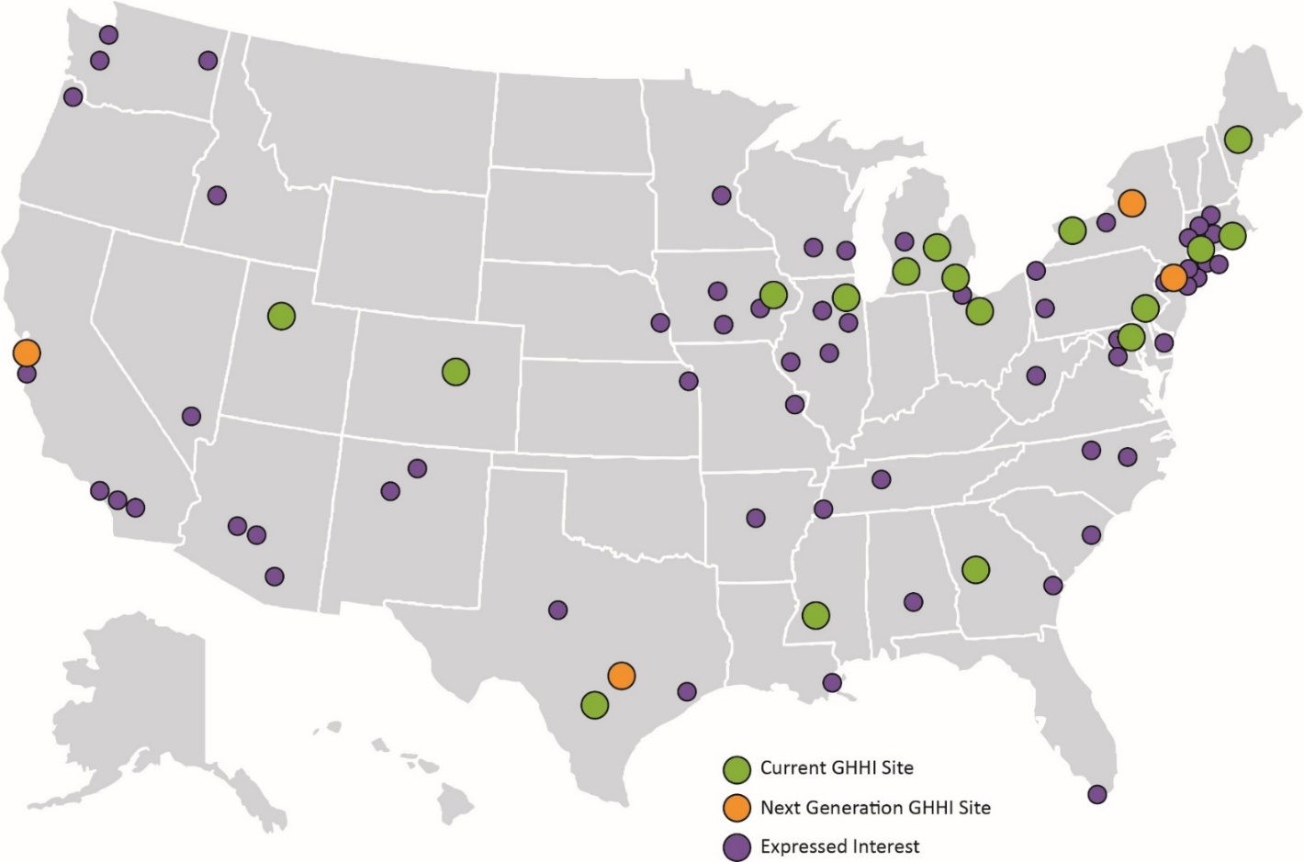
GHHI National Scaling
Using evidence-based practices and data to open new pathways for funding, bringing program to scale and changing policy
Notes:
Animation on this slide:
1st click: brings up onboarding sites
2nd click: brings up yellow dots “expressed interest”

Slide 38
Collective Burden
Nearly 9M families live in unhealthy homes
$51.1B in taxpayer dollars lost annually due to asthma-related illness
14.4 million missed school days due to asthma
14.2 million missed work days due to asthma
12.4 % of adults in Baltimore have asthma, vs. 8.6 % nationally
20% of children in Baltimore have asthma, vs. 9.4% nationally
Notes:
Nearly 9 million families live in unhealthy homes
Billions of taxpayer dollars lost annually due to inefficient & unhealthy housing – 3% of US healthcare costs
$43.4 billion due to lead poisoning
$20 billion due to asthma-related illness
$19 billion for trip and fall injuries for seniors (projected at $30B by 2020)
14 million missed school days (#1 reason for absenteeism = asthma)
Low-income households spend 14% of income on energy vs. 3.5% for other households

Slide 39
Breaking the Link Between Unhealthy Housing and Children With Asthma
Unhealthy Home
Asthmatic Child
Hospital Visit
Treatment/ Inhaler
Notes:
Nearly 9M families live in unhealthy homes
Billions of taxpayer dollars lost annually
$43.4B = lead poisoning
$50.1B = asthma
$19B = trip and fall injuries for seniors
14.4 million missed school days from asthma
14.2 million missed work days from asthma
40% of asthma attacks from home triggers-RWJF

Slide 40
Problem/Root Cause
The Commission on Building a Healthier America* found that 40% of all incidents of asthma are attributable to home-based environmental health hazards.
Department of Health and Human Services (HHS) Guidelines call for (1) Assessment of disease severity; (2) Medication; (3) Patient education; and (4) Environmental control.
HHS’s Community Preventive Services Task Force found “strong evidence of effectiveness of in-home environmental interventions” in improving asthma management.
Return on investment: HHS’s economic review of published studies showed a return of $5.3 to $14 for each $1 invested.
*Robert Wood Johnson Foundation Commission on Building a Healthier America
Notes:
Nearly 9M families live in unhealthy homes
Billions of taxpayer dollars lost annually
$43.4B = lead poisoning
$50.1B = asthma
$19B = trip and fall injuries for seniors
14.4 million missed school days from asthma
14.2 million missed work days from asthma
40% of asthma attacks from home triggers-RWJF

Slide 41
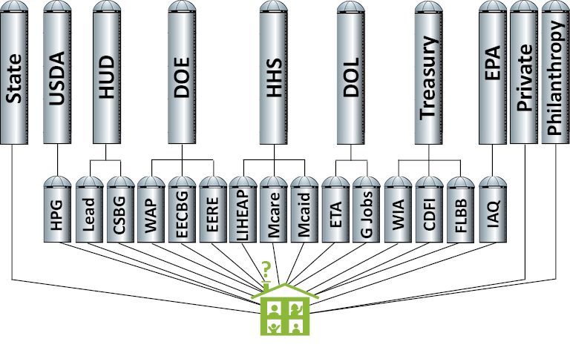
Healing a Fractured Delivery System
Notes:
How Most Residents Experience Housing Intervention Programs

Slide 42
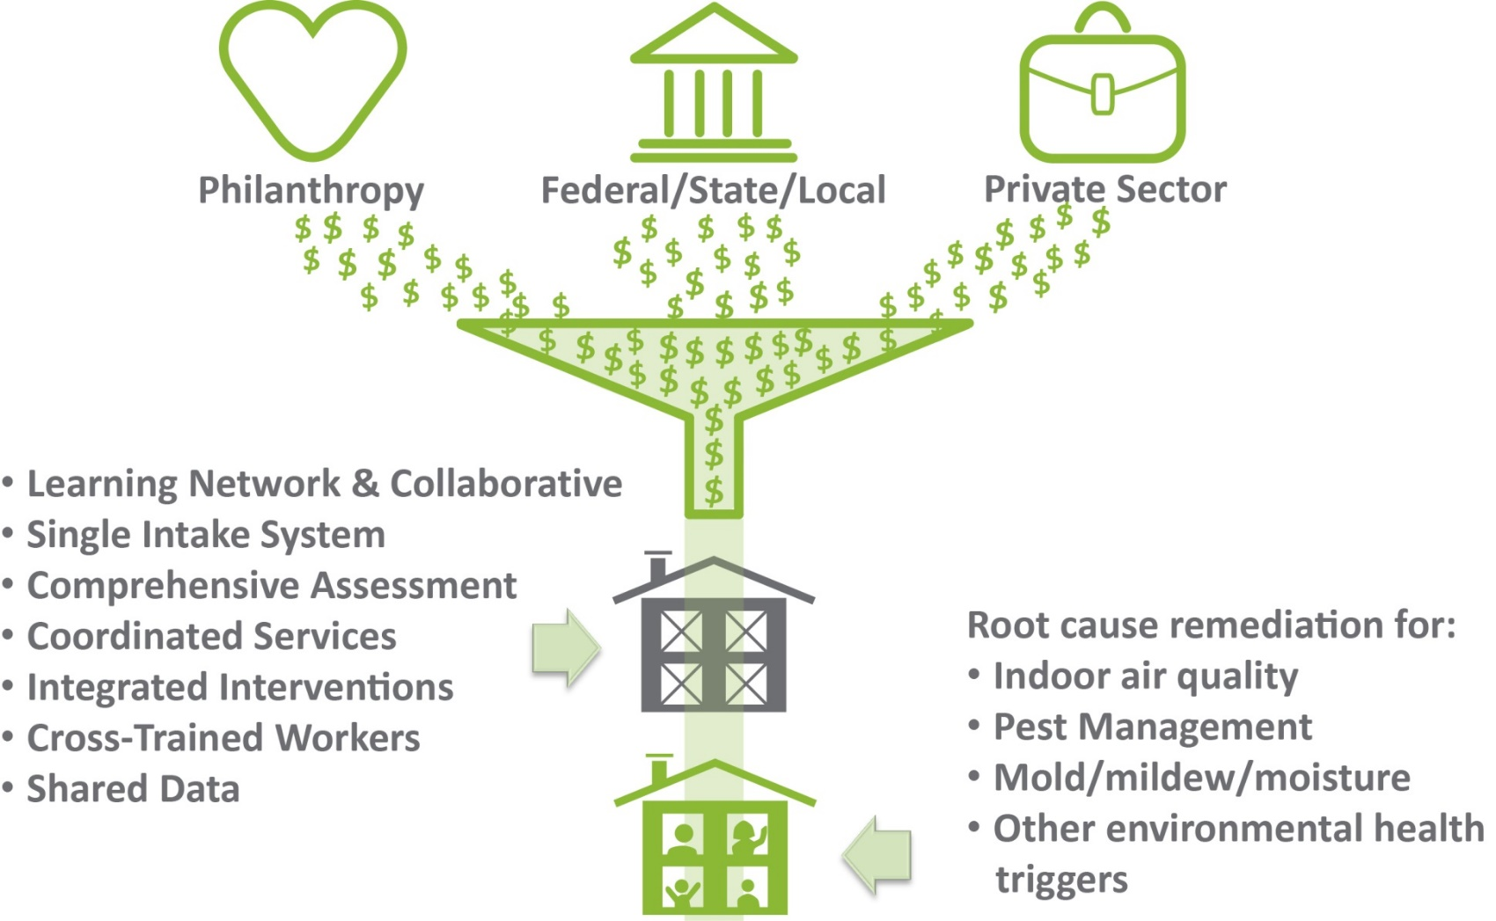
GHHI: A Model That Benefits Families

Slide 43
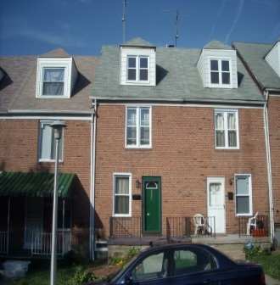
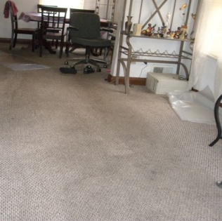
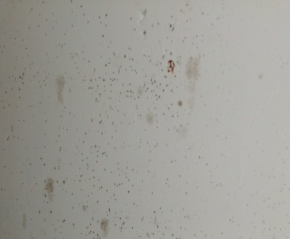
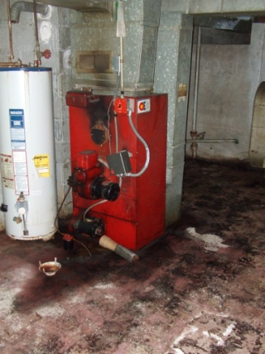
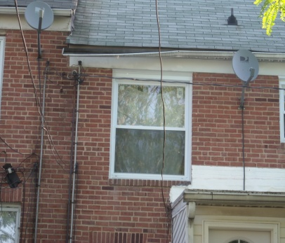
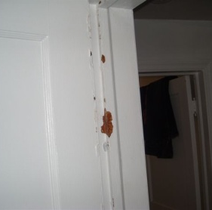
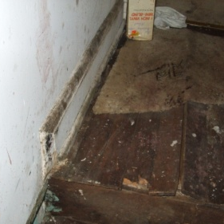
One Family’s Story
DeWayne Davis, age 8, suffered from asthma caused by his unhealthy, energy-inefficient home, which was full of asthma triggers.
Old carpets = allergens
Water leaks = mold hazards
Deteriorated windows = air leaks
Broken hot water heater and furnace
Defective gutters = water leaks
Chipping paint = lead hazard
Broken tile = safety hazard
Broken ducts = higher heating bills
Notes:
How Most Residents Experience Housing Intervention Programs

Slide 44
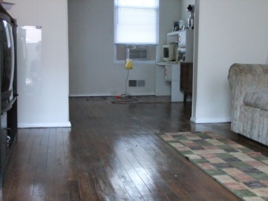
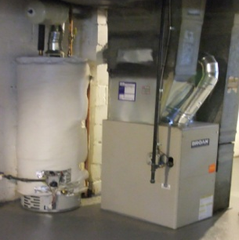
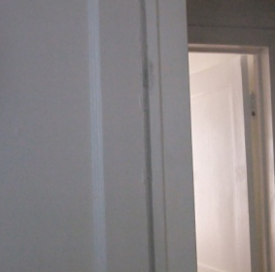
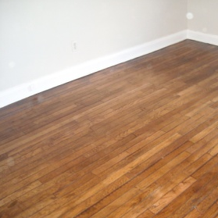
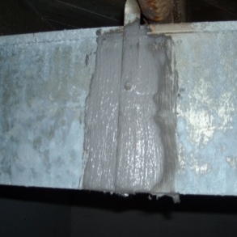
A Solution Through Braiding
An integrated approach cost 25% less to implement ($12,057 vs. $16,096), has kept DeWayne out of the hospital for asthma-related visits, improved his school attendance and reduced the family’s monthly heating bills—and helped his mother achieve, as well.
Remove old carpets
Remediate mold, install dehumidifier
Install ENERGY STAR® windows
Install furnace and hot water heater
HUD
(HHDP)
HUD
(HHDP)
HUD
(HHDP)
Philanthropy
Replace broken gutters
Stabilize chipping paint
Resurface uneven floors
Seal ducts, blow insulation
HUD
(HHDP)
HUD
(HHDP)
HUD
(HHDP)
DOE
(WAP)
Notes:
How Most Residents Experience Housing Intervention Programs

Slide 45
Healthy Homes Demonstration Project Findings
Mean Change and Percent Reduction of Key Outcomes
200 units completed with 139 respondents completing 6-month post-intervention health surveys
In the past 6 months (N=139) | Intake Mean (StdDev) | 6-Month Mean (StdDev) | Pre-Post Mean Change (StdDev) | One-sided t test | Percent Reduction
Hospitalizations | 0.364288 (0.923013) | 0.141791 (0.53667) | 0.238806 (0.824248) | 0.0008 | 65.5%
ER Visits | 0.942857 (1.22193) | 0.701493 (1.097022) | 0.261194 (1.250137) | 0.015 | 27.7%
Physician Visits | 1.76258 (1.462491) | 1.340909 (1.413293) | 0.389313 (1.460098) | 0.002 | 22%
Calls to Physicians | 2 (1.498792) | 1.481203 (1.490381) | 0.515152 (1.565296) | 0.0002 | 26%
Work Missed | 2.76259 (1.954492) | 1.736842 (1.85413) | 1.037879 (2.057959) | 0.0000 | 37%
School/Daycare Missed | 2.372093 (2.008069) | 1.787402 (2.091669) | 0.647059 (1.998254) | 0.0002 | 27%

Slide 46
Quality Improvements Pay Off
Current GHHI Baltimore Data—
68% reduction in asthma-related client hospitalizations
34% reduction in asthma ER visits
28% reduction in visits to the physician’s office due to asthma episodes
25% reduction in calls to the physician’s office due to asthma episodes
Notes:
Costs of ER visit can be $500-$1100. Cost of hospitalization can be $5000-$12,000

Slide 47
What These Data Mean: Reduced Costs
Reduction in asthma-related client hospitalizations— 1 hospital stay on average costs $7,506 in Baltimore City. By reducing hospitalizations we are helping to reduce costs.
Reduction in asthma-related emergency room visits— 1 emergency room visit on average costs $820 in Baltimore City. By reducing ER visits, we are helping to reduce costs.
Notes:
Costs of ER visit can be $500-$1100. Cost of hospitalization can be $5000-$12,000

Slide 48
What These Data Mean: Improved Opportunities
62% improvement in school attendance
88% reduction in missed work days for parents
Notes:
Costs of ER visit can be $500-$1100. Cost of hospitalization can be $5000-$12,000

Slide 49
Pay for Success (PFS): Using Data to Scale Program Services
Notes:
Costs of ER visit can be $500-$1100. Cost of hospitalization can be $5000-$12,000

Slide 50
Current PFS Projects in the United States
Location | Issue | Budget | Time Frame
Massachusetts | Juvenile Justice | $21.3 M | 6 years
Massachusetts | Homelessness | $3.5 M | 6 years
Salt Lake County | Early Education | ~$7 M | 1 year, additional years based on pending funding
State of New York | Adult Recidivism | $13.5 M | 5 ½ years
New York City | Juvenile Justice | $16.8 M | 4 years
Chicago | Early Education | $16.9 M | 4 years
Cuyahoga County | Homelessness / Foster Care | $5 M | 5 years
Also, asthma PFS demonstrations in Fresno and Alameda County, CA

Slide 51
GHHI Baltimore PFS
Target setting
Loan for services
Monetized savings
Loan re-payment
Risk mitigation
Evaluation
Guarantee

Slide 52
Players involved
Year 1
Year 2
Year 3
Year 4
Year 5
Year 6
Year 7
Draws
Model
flow
$
$
$
Timeline overview
Intervention
Per-home economics
Evaluation
Needs
Savings & Payment
Progress to date
Guarantee
Policy implications
Payments
Guarantee

Slide 53
Challenges to Address
Complexity of health care system, especially during broad health care reform
Evaluation structure (e.g., randomized control trial? comparison group?)
Accounting—making payment if the program is successful
Sensitivity of actuarial projections on savings
Identifying and having sufficient target population
Notes:
Sensitivity of actuarial projections on savings –

Slide 54
Organizational Prerequisites
Proven intervention/defined service model
Compelling base of evidence and ability to track outcomes
Infrastructure to scale interventions
Organizational bandwidth (i.e., project manager, etc.)
Know why you’re doing this (e.g., To scale? To change policy?)
Board support: These things take time, no guarantees
Notes:
Sensitivity of actuarial projections on savings –

Slide 55
Benefits
SIBs/PFS can lead to sustainable funding for Healthy Homes
Solving the “wrong pocket” problem
Investment directed Savings produced
to improve housing for health care
Building the case for Medicaid reimbursement
Rigorous evaluation
Proving model at scale
Eliminates risk to government/health care/education system

Slide 56
Questions?
Ruth Ann Norton
President & CEO
ranorton@ghhi.org
410-534-6447
@RuthAnnNorton
Follow us on Twitter: @HealthyHousing.
Like us on Facebook: GHHINational.
Learn more on: YouTube.

Slide 57
Polling Question 3
After participating in this webinar, what would you like to hear more about in future webinars?
Notes:
Tracey’s Talking Points:
Thank you Ruth for a terrific presentation.
•I would like to thank both of our presenters today for their very informative presentations on enhancing asthma program sustainability by attracting funders using compelling data storytelling.
•Before we head into the Q&A on the discussion forum, I would like to take this opportunity to learn from you, our asthma community, on what you would like to hear more about in our webinar series. Your feedback helps inform our strategy on developing webinars that are meaningful to you.
Polling Question #3
• Great, thank you for your participation. Also, as another opportunity for sharing your ideas with us, please be on the lookout for a brief feedback form in your email following today’s webinar.
• It will only take five minutes to complete and it will greatly help us in planning our future webinar activities.

Slide 58
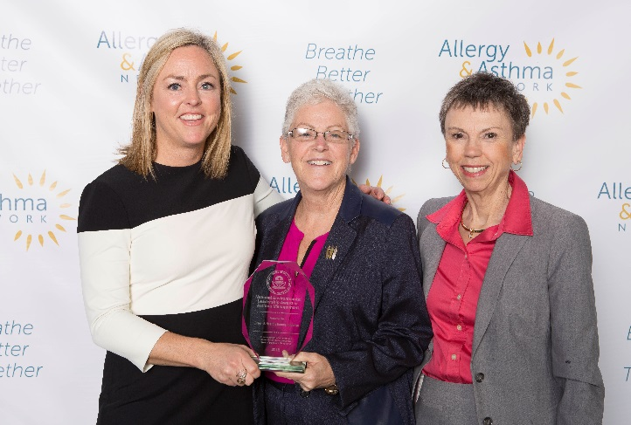
Thank You to Our Winners
Le Bonheur Children’s Hospital’s CHAMP Program
Green & Healthy Homes Initiative
Notes:
Tracey’s Talking Point(s)/Closing Remarks:
• That concludes our webinar. Thank you to our speakers for their time and willingness to share their information and experiences. Also, thanks to all of you who participated. We’re glad you could join us, and hope the session was helpful for you.
• Be on the look out for an audiovisual file of this webinar posted on AsthmaCommunityNetwork.org in the coming weeks.
• Also, the award winners are available now for a live online Q&A discussion at AsthmaCommunityNetwork.org to answer your questions. They will do their best to respond to your questions in the next thirty minutes. The Q&A discussion will be archived on AsthmaCommunityNetwork.org for future viewing. The next slide provides instructions for posting questions to the online forum.

