Slide 1

Home Characteristics and Asthma Triggers Checklist and Training for Home Visitors: Making Homes Healthier
Previously recorded on July 28, 2020

Slide 2



Featured Speakers
Home Characteristics and Asthma Triggers Checklist and Training for Home Visitors: Making Homes Healthier
Ginger L. Chew, Sc.D., Deputy Associate Director of Science,
Division of Environmental Health Science and Practice, Centers for Disease Control and Prevention (CDC)
Eugene Pinzer, CIH, Senior Environmental Scientist, Office of Lead Hazard Control and Healthy Homes, U.S. Department of Housing and Urban Development (HUD)
Tracey Mitchell, RRT, AE-C, Environmental Protection Specialist, Indoor Environments Division, U.S. Environmental Protection Agency (EPA)
Tuesday, July 28, 2020
Webinar: 1:00 p.m. – 2:00 p.m. EDT
Live Online Q&A: 2:00 p.m. – 2:30 p.m. EDT
Phone Number: +1 (415) 655-0052
Audio Access Code: 519-597-915

Slide 3
Learning Objectives
Participants will learn about—
The history, development and evidence base of the Home Characteristics and Asthma Triggers Checklist.
How a trained home visitor can use the checklist to help find common asthma triggers in homes and discuss ways to reduce and remove triggers to improve health.
The development of the NEW Home Characteristics and Asthma Triggers Checklist training module.
Considerations for using the checklist in a virtual setting.
Notes:
Tracey’s Talking Points:
Before we dive into today’s presentations, let’s get a sense for who’s with us today. To do that, please take a moment to answer the polling question on your screen: “What type of organization do you represent?”
Polling Question #1

Slide 4
Polling Question 1
What type of organization do you represent?
Government agency
Health care/plan provider
Community-based program
Housing provider
Other
Notes:
Tracey’s Talking Points:
Before we dive into today’s presentations, let’s get a sense for who’s with us today. To do that, please take a moment to answer the polling question on your screen: “What type of organization do you represent?”
Polling Question #1

Slide 5
Polling Question 2
What in-home environmental asthma services does your program perform? (click all that apply)
Education about common asthma triggers
Walkthrough/assessment of triggers
Provide supplies for trigger mitigation
Trigger remediation
Other
Notes:
Tracey’s Talking Points:
Before we dive into today’s presentations, let’s get a sense for who’s with us today. To do that, please take a moment to answer the polling question on your screen: “What type of organization do you represent?”
Polling Question #1

Slide 6
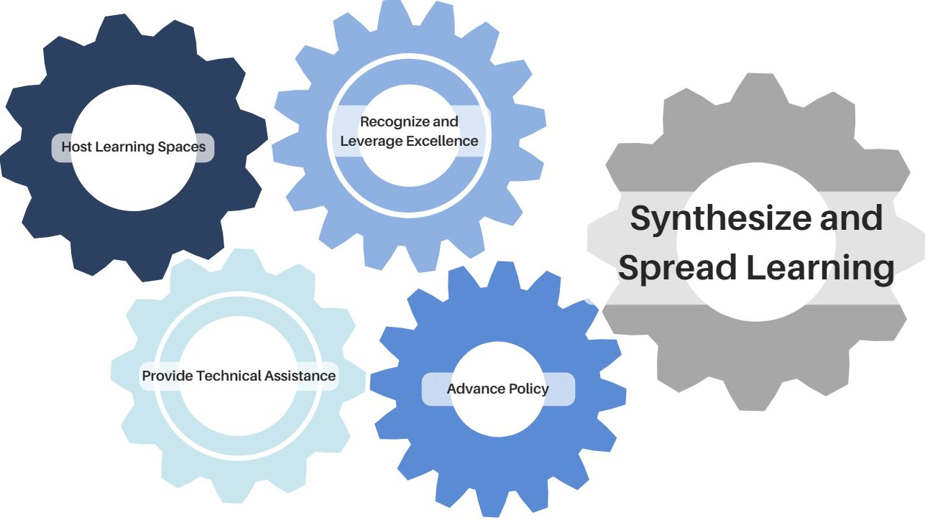
Supporting In-Home Interventions to Bring Asthma Under Control
Notes:
How does EPA support program who are working at the state and local level? These cogs represent EPA’s 5 basic program areas that work together.
First, EPA hosts learning spaces to share, learn and to connect over 1,00 asthma programs through AsthmaCommunityNetwork.org and continues to conduct national media campaigns
We provide technical assistance through cooperative agreements and partnerships
EPA recognizes and leverages excellence through our competitive National Environmental Leadership Award in Asthma Management
We work to advance policy nationally through collaboration with Asthma Disparities Working Group federal partners and advance policy locally through regional asthma summits
And finally, we synthesize and spread learning in a variety of ways, one example is through webinars like our webinar today.

Slide 7




Collaboration for In-Home Interventions

Slide 8
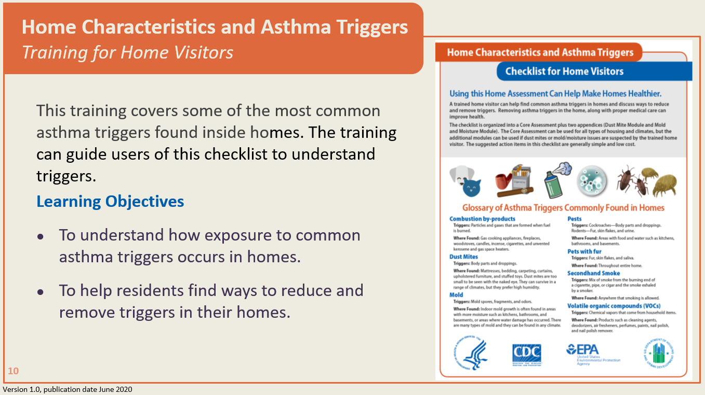
Supporting In-Home Interventions to Bring Asthma Under Control
Notes:
How does EPA support program who are working at the state and local level? These cogs represent EPA’s 5 basic program areas that work together.
First, EPA hosts learning spaces to share, learn and to connect over 1,00 asthma programs through AsthmaCommunityNetwork.org and continues to conduct national media campaigns
We provide technical assistance through cooperative agreements and partnerships
EPA recognizes and leverages excellence through our competitive National Environmental Leadership Award in Asthma Management
We work to advance policy nationally through collaboration with Asthma Disparities Working Group federal partners and advance policy locally through regional asthma summits
And finally, we synthesize and spread learning in a variety of ways, one example is through webinars like our webinar today.

Slide 9
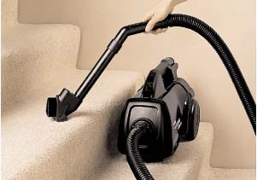
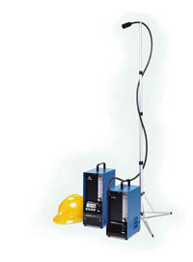
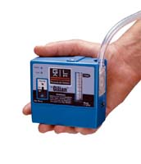
Methods for Assessing
Asthma Triggers in the Home
1. Questionnaire
2. Inspection
3. Dust sampling
4. Air sampling
Area
Personal

Slide 10
The History of Home Characteristics Questionnaires for asthma triggers
Clinicians to directly help patients
(for centuries)
Researchers
(since 1960s)
Home visit staff to directly help patients
(this is more recent 1990s – present)
Is a mite (Dermatophagoides sp.)the producer of the house dust allergen?
Voorhorst R., Spieksma- Boezeman MI, and Spieksma FT
Allerg. Asthma,10:329 -34. (1964)

Slide 11

Which Is Better?
“We identified a number of housing conditions
that are consistently associated with
increased allergen concentrations.”

Slide 12
Considerations for a Good
Home Assessment Tool
Based on evidence
  Associations with exposure and/or health outcomes
Brief
  Home assessor’s time
  Residents’ time
Culturally appropriate
  Languages
  How do some words translate? (for example, rats vs. mice)
Actionable or “referral-able”
Standardized
  Core should be appropriate for
    Housing across the country (e.g., different climate zones)
    Different types of housing stock (e.g., single-family, multifamily, brownstones, ranch)
Flexible
  Some additional modules might be useful for some asthma programs

Slide 13
The Core Questionnaire
Based on:
The American Housing Survey
  A standardized population-based survey administered by the U.S. Census Bureau and sponsored by HUD
Peer-reviewed literature

Slide 14
Recent Publications: The Joint Task Force on Allergy, Asthma, and Immunology
Annals of Allergy, Asthma & Immunology, 2012
Journal of Allergy and Clinical Immunology, 2013
Annals of Allergy, Asthma & Immunology, 2013

Slide 15
The Dust Mite Practice Parameter
Portnoy et al., Annals of Allergy, Asthma & Immunology 111:465–507, 2013

Slide 16
Core Questions

Slide 17
Core Questions
(cont’d)

Slide 18
Dust Mite Module

Slide 19
Mold and Moisture Module

Slide 20
Home Characteristics and Asthma Triggers
Training for Home Visitors
This training covers some of the most common
asthma triggers found inside homes. The training can guide users of this checklist to understand triggers.
Learning Objectives
To understand how exposure to common asthma triggers occurs in homes.
To help residents find ways to reduce and remove triggers in their homes.
Version 1.0, publication date June 2020
Notes:
This training covers some of the most common asthma triggers found inside homes. This training supplements information in the Home Characteristics and Asthma Triggers: Assessment Checklist for Home Visitors. The Centers for Disease Control and Prevention (CDC), the Environmental Protection Agency (EPA), and the U.S. Department of Housing and Urban Development (HUD) developed the checklist, which is available on their websites:
www.epa.gov/sites/production/files/2018-05/documents/asthma_home_environment_checklist.pdf
www.cdc.gov/asthma/pdfs/home_assess_checklist_P.pdf
www.hud.gov/sites/dfiles/HH/documents/17_287251A_CHEW_HomeAssessCHECKLISTFINALnot508.pdf
By completing this training, you will be able to:
Understand how exposure to common asthma triggers occurs in homes, and
Help residents find ways to identify, reduce, and remove triggers in their homes

Slide 21
What Are Allergens and Irritants?
Allergens
  Affect people with specific sensitivity to a certain substance.
  Can be found on particles.
  Include dust mite droppings, mold spores, pet skin flakes (dander), cockroach droppings and dried rodent urine.
Irritants
  Affect people with asthma even without a specific allergy.
  Can be found in particles, vapors and gases.
  Include smoke, mold spores and odors, secondhand smoke, and cat urine odor.
Notes:
Some people are sensitive to allergens (such as dust mites, mold, pests, and pets with fur). For these people, exposure to allergens on particles in the air can lead to symptoms such as stuffy nose, wheezing, and red or itchy eyes. With repeated exposure to the allergens, such as cat allergen for some people, the symptoms occur faster and can be more intense.
People with allergies can develop asthma. For many people who have asthma, allergens can trigger an asthma attack.
Some particles in the air can act as irritants:
Volatile organic compounds (VOCs) are vapors that act as irritants.
Combustion by-products such as smoke and secondhand smoke also can be irritants.
Irritation from inhaling particles, gases, or vapors into the airways can trigger asthma attacks, whether the person is allergic or not.

Slide 22
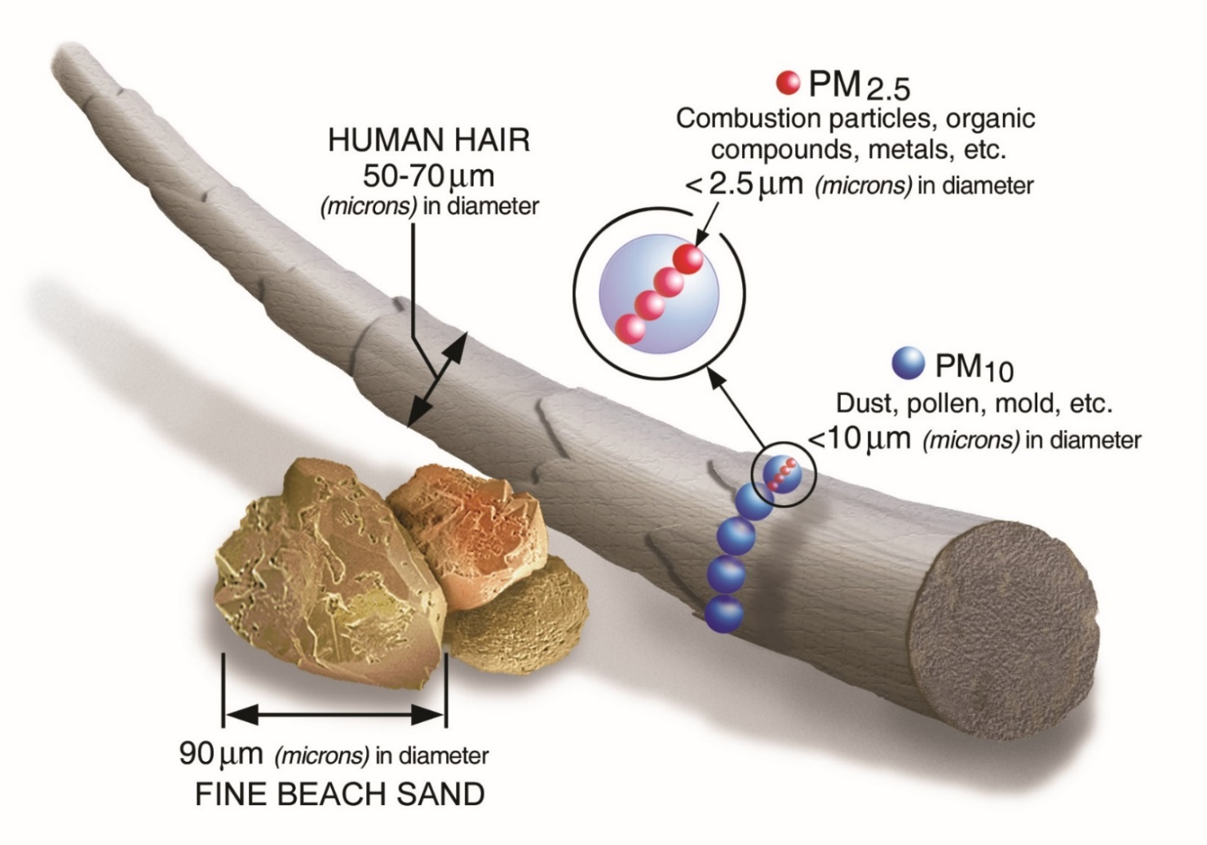

Particle Sizes
(such as secondhand smoke particles)
Notes:
This graphic compares sizes of common particles found indoors. These particles are measured in microns. A micron is a very small unit of length. One micron is equal to 1 millionth of a meter. The width of a human hair is about 50-70 microns. Beach sand can be about 90 microns.
Particulate matter, or PM, makes up what we commonly think of as part of air pollution. It is a mixture of solid and liquid particles. PM 2.5 and PM 10 are commonly measured particle sizes in indoor and outdoor air. PM 2.5 means the particle is 2.5 microns or less. PM 10 particles are 10 microns or less. Common asthma triggers are the particles from secondhand smoke; these are smaller than PM 2.5.

Slide 23
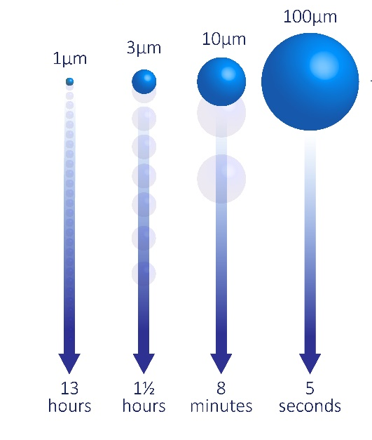
Why Does Particle Size Matter?
Small
Medium
Large
Secondhand smoke
Cat/dog allergen
Mouse allergen
Dust mite allergen
Cockroach allergen
Mold spores
Pollen grains
5
10
15
20
25
30
40
Particle size (microns)
Size range of asthma trigger particles in air
Notes:
Many of the large particles associated with dust mites, cockroaches, mold, and pollen can settle out of the air quickly. However, they can also be re-suspended in the air by various activities. That can happen when vacuuming, sweeping, cleaning, playing on carpeted floors, using fans, and tossing and turning in bed.
Portable air cleaners will not “clean” the air of the large particles that are briefly re-suspended, but they can remove small and medium particles that tend to stay in the air. For example, a person with dust mite allergy would not be helped by trying to remove dust mite allergens with an air cleaner. That person might benefit more by using dust mite mattress covers to keep the large particles from being inhaled while sleeping. On the other hand, an air cleaner could help with removing small particles such as those containing allergens from mice.
Vacuum cleaners with high-efficiency (HEPA) filters can remove a wide range of particle sizes and should be considered for persons with asthma or allergies. Cleaning out filters and vacuum bags can lead to exposure, so appropriate precautions should be taken. Bags are best emptied in an area away from the main living space, such as a garage.

Slide 24
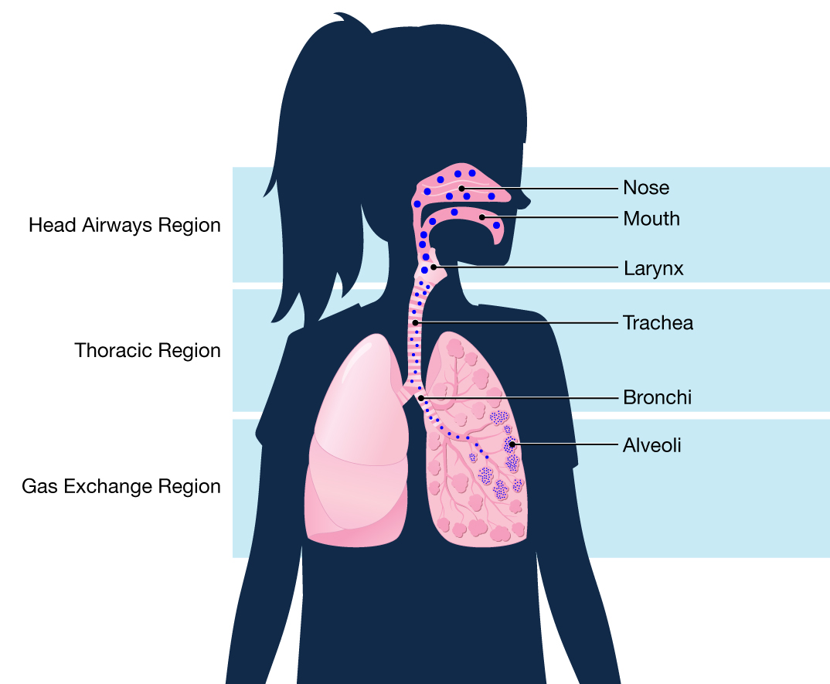
Where Do Particles Go in the Airways?
Large
Medium
Small
Notes:
Particle size can also affect where the particles go in the airways, and thus, how long a person is exposed to the particle.
Inhaled large particles are mainly caught in the nasal passages and are sneezed or coughed out.
Medium particles go deeper in the airways but can still be coughed out.
Smaller particles, such as secondhand smoke, go deep into the lungs and can stay there for a while, meaning they have a longer residence time in the body. Because gas exchange also occurs in the small airways, some of the chemicals, such as those from secondhand smoke, enter the bloodstream, resulting in longer exposure compared with large particles.

Slide 25
Pets
Notes:
The next section is about pet allergens.

Slide 26

Pets With Fur: Allergen Characteristics
Cat and dog allergens
  Mainly skin flakes and saliva
  Found in a range of particle sizes
    Small (<2.5 microns)
    Medium (2.5–10 microns)
    Large (>10 microns)
  Small particles can remain airborne for hours
  Easily carried on clothes to other places
*Allergen avoidance should focus on removing allergens from surfaces and air
Notes:
Cat and dog allergens are found mainly on skin flakes and saliva. The allergens can be found on small, medium, and large particles. As a reminder, small particles are less than 2.5 microns in size. Medium particles range from 2.5 microns to 10 microns . Large particles are bigger than 10 microns.
Small particles can remain airborne for hours.
Cat and dog allergen particles can easily be carried on clothes into other locations.
Allergen avoidance for cats and dogs should focus on removing particles from surfaces and air.

Slide 27
Pets With Fur
Action steps to decrease exposures and symptoms
Find a new home for the pet and thoroughly clean all surfaces
  OR
For pets still in home
Keep pet out of bedroom
Wash furry pets
Use air cleaner with HEPA filter
Use allergen-proof mattress and pillow covers
Notes:
The most effective way to decrease asthma symptoms from dog or cat allergens is to remove the pet from the home. If the pet is still in the home, several action steps can be used to help decrease pet allergen exposure and symptoms. Taking only one action rather than a combination of actions might not decrease asthma symptoms.
For several years, clinicians have advised keeping pets out of bedrooms to decrease exposure to allergens. From the previous slides on particle sizes, it is clear that pet allergens on small particles can flow through the home. Plus, pet allergen can be on clothes and inadvertently carried into the bedroom.
In terms of health promotion, people with asthma living in homes with pets can try to incrementally increase the number of action steps to ultimately accomplish all action steps. However, the resident should keep in mind that the best way to avoid the asthma trigger is to remove the pet and thoroughly clean all surfaces. Even with pet removal, it can take several months to a year to achieve low pet allergen levels similar to those of homes that never had a pet.

Slide 28
Mold
Notes:
The next section is about mold exposure in the home.

Slide 29

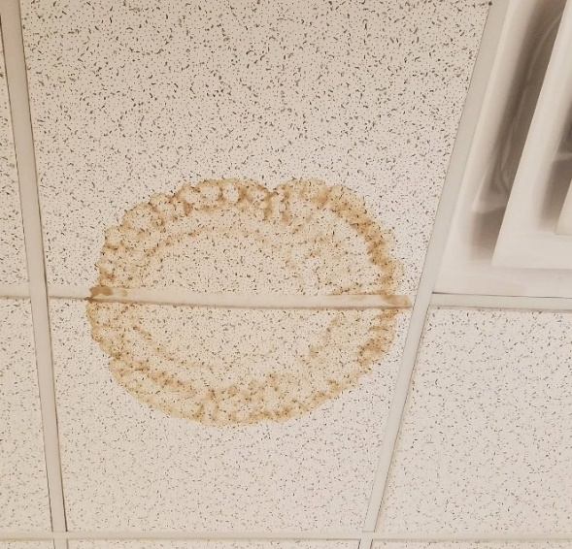

Other Signs of Moisture
Rust
Water stains (but could be mold on the other side)
Algae
Notes:
Here are some examples of things that are not mold.
Rust can result from water damage, but it is not mold. Nonetheless, it could be a marker for where mold might grow.
Likewise, water-damaged ceiling tile is not mold, but it could be a marker for potential mold growth on the other side of the tile.
Like mold, you can find algae where there is a lot of water. However, it is different from mold.

Slide 30
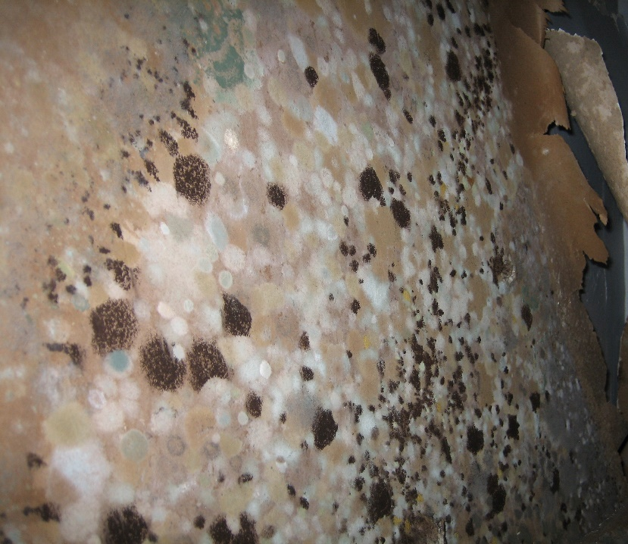
Where Does Mold Grow?
Anywhere it has
Water—from leaks, condensation on surfaces, etc.
and
Sufficient nutrient—food, dust in carpet, paper in gypsum board or drywall, wood, etc.
Notes:
Mold is found in virtually every environment. It can be detected indoors and outdoors, year-round. Mold growth is encouraged by warm and humid conditions. Outdoors, molds can be found in damp areas or places where leaves or other vegetation are decomposing. Indoors, mold can be found where humidity levels are high, such as showers.
It is impossible to eliminate all mold and mold spores in the indoor environment. However, mold growth can be restricted by controlling moisture indoors.
Common sources or causes of water or moisture problems include:
Roof leaks
Leaks from plumbing, window air conditioners, and other appliances
Condensation associated with high humidity or cold spots in the building
Localized flooding
Uncontrolled humidity

Slide 31
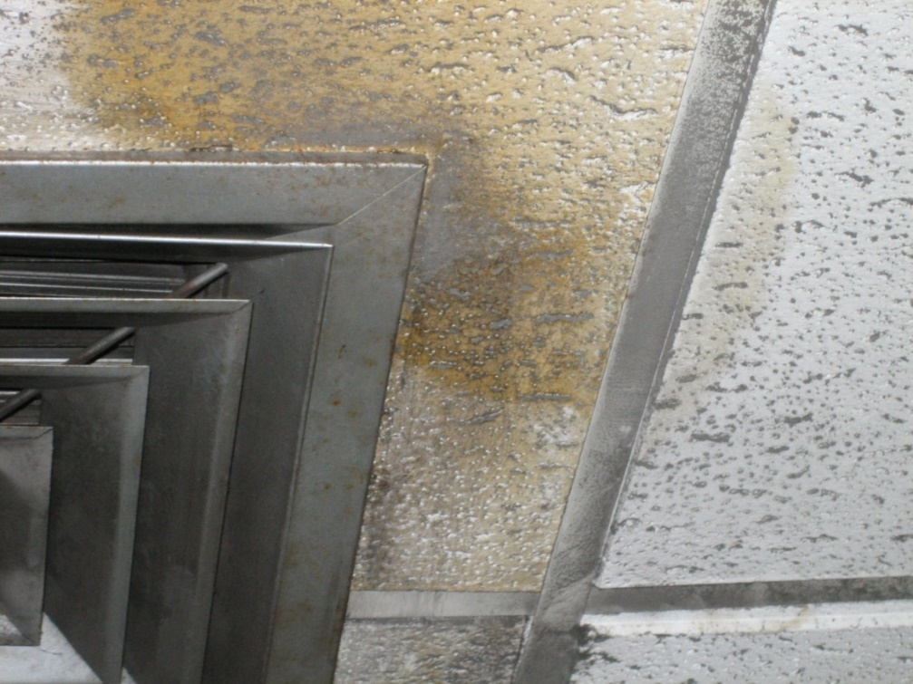
Mold Growing on Ceiling Tile
Notes:
This is a photo of mold growing on a ceiling tile.

Slide 32
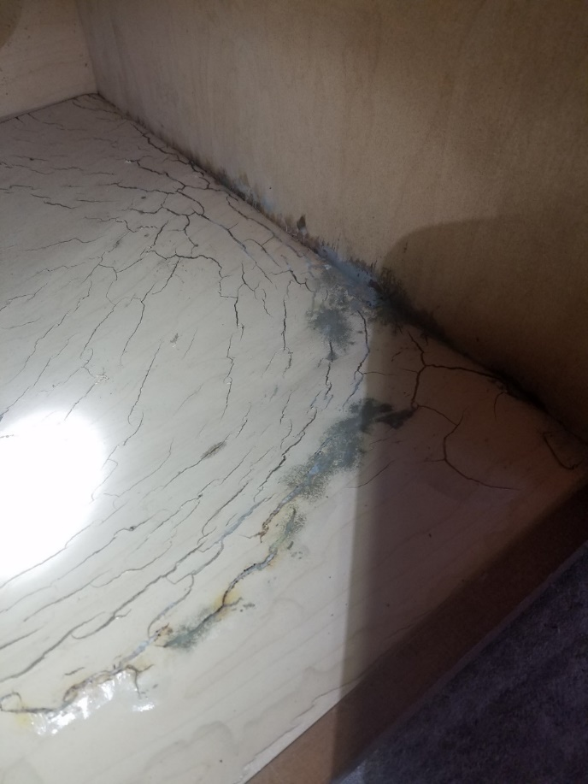
Water Leak Under Kitchen Sink
Mold
Notes:
.
This mold growth occurred after a plumbing leak.

Slide 33
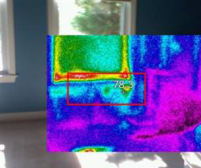
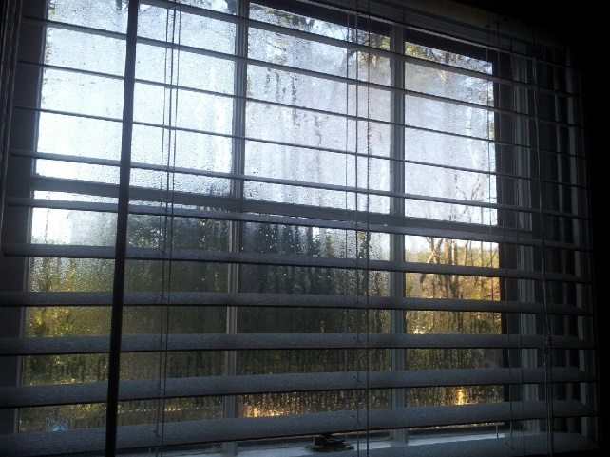
Condensation
Surfaces can have different temperatures
Colder surfaces coming in contact with warm air leads to condensation
Notes:
This slide shows an infrared photo of the temperatures of different surfaces in the home. The box shows temperature differences around a window. The red and yellow are hotter areas next to the cooler blue area below the windowsill.
Large differences in temperature on surfaces can lead to condensation.

Slide 34
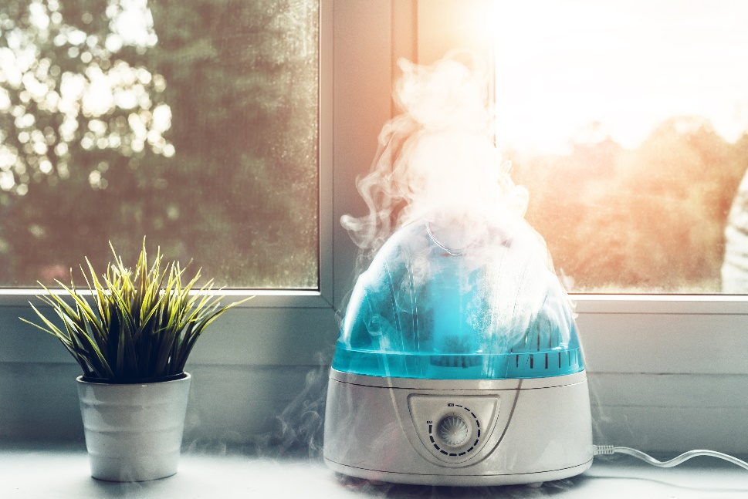
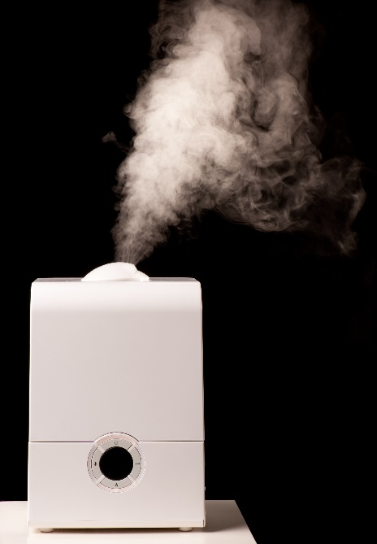
Types of Humidifiers
Warm mist (vaporizer)
Cool mist
Notes:
There are different types of humidifiers. All of them add humidity to the air.
Sometimes, a humidifier is called by other names such as vaporizer.

Slide 35
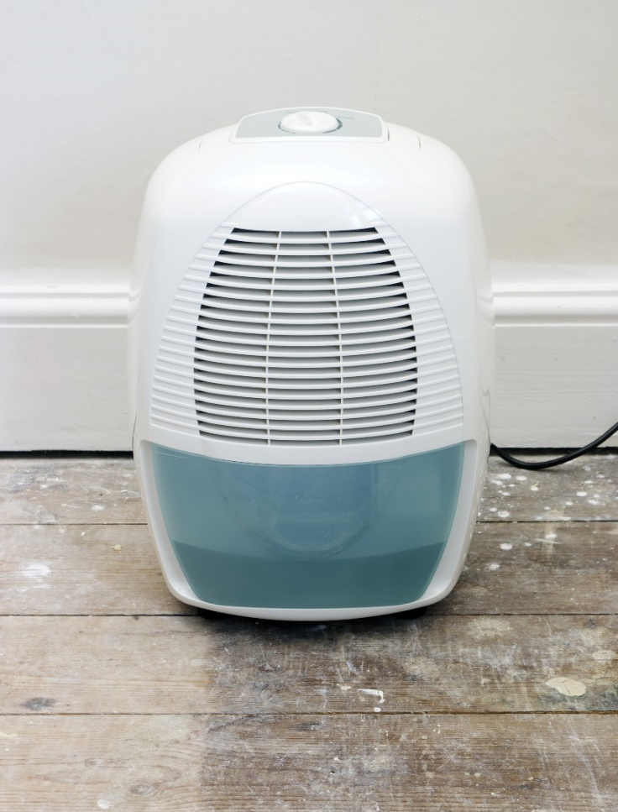
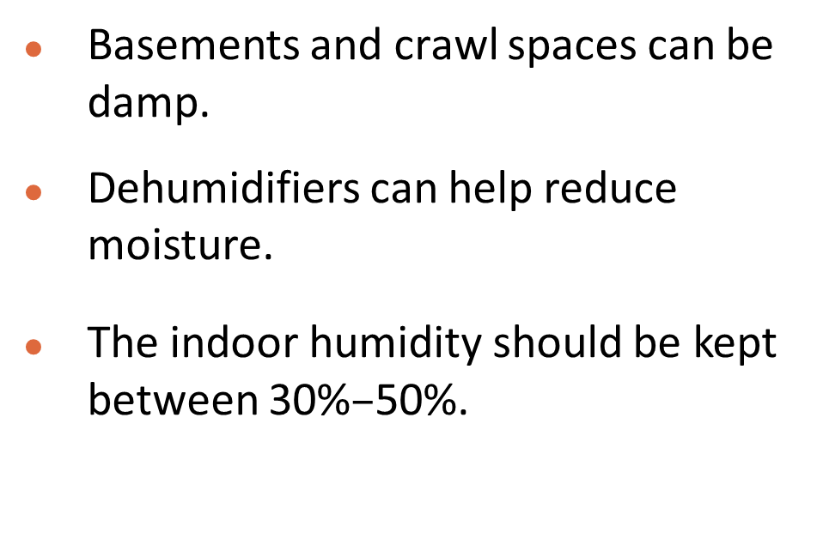
Dehumidifiers
Basements and crawl spaces can be damp.
Dehumidifiers can help reduce moisture.
The indoor humidity should be kept between 30%$–$50%.
Notes:
Residents might consider using a dehumidifier in homes with high humidity. Dehumidifiers should be placed in the room or rooms with the highest humidity. The target range for indoor humidity is 30%–50%.
If a home has a crawl space, extra steps might be required to reduce humidity. After being cleaned, exposed ground within the crawlspace should be covered with plastic sheeting to limit potential mold growth and moisture migration into the house. Then, using a dehumidifier inside the home (not the crawl space) might decrease residual moisture that gets into the home.

Slide 36
Dust mites
Notes:
The next section is about dust mites and their allergens.

Slide 37
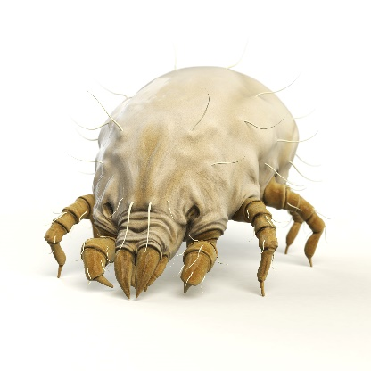



What Are Dust Mite Allergens?
Dust mite allergens are proteins found in fragments of body parts and droppings.
Allergens are too small to be measured by microscope.
Allergens
Der f 1, Der p 1, Blo t 5
(much less than 1 micron)
Dust mite
(200–300 microns)
Dust mite droppings
(about 10–40 microns)
Notes:
Although the exposure source is the dust mite, the allergens are found on much smaller particles people inhale. Allergens are found in fragments of dust mite body parts and dust mite droppings. The allergens can trigger an allergic reaction in some people.
This slide shows examples of some types of allergens. Der f 1 comes from one type of dust mite, Der p 1 comes from another type of dust mite, and so on.

Slide 38
Dust Mite Allergen Characteristics
Dust mite allergen
  Mainly droppings (fecal pellets)
  Airborne particles > 10 microns
  Settle out of air quickly
  Mainly exposed by breathing near surfaces with dust mites
  Not easily transferred passively (e.g. from clothes to sofa)
  Mainly found in soft fabric furnishings
Therefore
  Allergen avoidance often focuses on the surfaces rather than the air
    Wash bedding regularly
    Remove carpet if possible or vacuum regularly
    Use allergen-proof mattress and pillow covers
Notes:
To decrease exposure to dust mites, residents should
Wash bedding regularly
Remove carpeting, if possible, or vacuum regularly
Use allergen-proof mattress and pillow covers.
These strategies work better than others, such as opening a window or using an air filter. Particles associated with dust mites can settle out of the air quickly and attempts to “clean” the air might not remove the greatest sources of exposure, disturbance of dust. Most studies have shown that dust mite allergens don’t stay in the air for a long time.

Slide 39
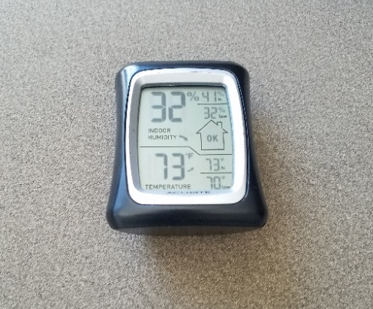
Dust Mite Intervention
Removing the allergens is not the same as decreasing the dust mite population.
Use a device (hygrometer) to measure relative humidity.
Keep relative humidity 30%–50%* to help keep dust mite population low.
Measure humidity in several locations in home throughout the year.
* Less than 30% can dry out mucus membranes and promote respiratory infections.
Notes:
It is difficult to get rid of dust mites in homes because they burrow into upholstered furniture, mattresses, and bedding. However, by washing bedding frequently, residents can decrease their exposure to dust mite allergens. Residents don’t need to use hot water for washing bedding. Warm water is fine to get rid of the dust mites and remove their allergens.
As mentioned previously, all dust mites need humidity. Residents can use try using a device (hygrometer) to measure relative humidity in the home. Dehumidifiers can decrease the humidity and make it difficult for dust mites to survive. Residents should be careful not to dry out the air too much because it also can dry out a person’s mucus membranes.

Slide 40
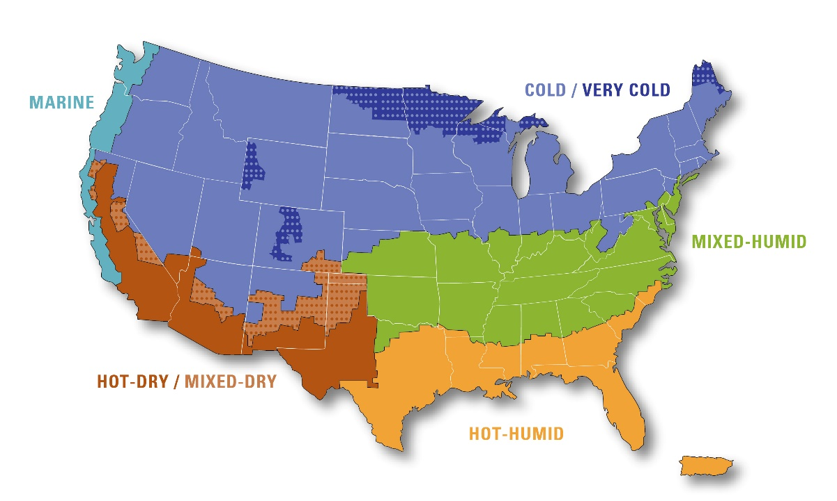
Where You Live Could Affect Dust Mite Avoidance Strategies
COOL/ HUMID
Hot and dry areas tend to have the lowest dust mite levels.
Hot and humid areas tend to have the highest dust mite levels.
Alaska = Cold/very cold
Hawaii = Hot-humid
Notes:
The Dust Mite Module might not be useful for very dry parts of the country. As mentioned earlier, dust mites need high humidity (above 50% relative humidity), so not all places have dust mites. Studies show that areas with very dry climates, such as deserts, don’t have dust mites or their allergens. In these very dry places, the home visit would likely focus on other asthma triggers.
However, some places with higher humidity, such as the southern coast, might be so humid that dust mites thrive. In such areas, it will be difficult to control the dust mites themselves. Instead, the home visit should focus on trying to decrease the allergens. For example, residents should try washing bedding, avoiding carpet, and decreasing red check box factors indicated in the Dust Mite Module.

Slide 41
BUILDING INFORMATION and
HOME INTERIOR
Notes:
Now that we understand allergens and irritants, and how the particle size affects exposure, we can begin reviewing items in the Core Assessment

Slide 42

Building Information
Type of home
  Single (detached)
  Attached to other homes
  Manufactured/mobile home
Rental vs. owned
Number of stories in building
Notes:
Type of home
Where people live influences which allergens they might encounter. The type of home they live in is associated with different risk factors for asthma triggers, and with the resident’s ability to control them in their own home.
Single (detached)
Single-family homes are one-unit buildings, detached from any other building. People who live in single- family homes might have more control over some asthma triggers than do people in multi-family buildings.
However, single-family homes can have different points of entry for pests and places for these pests to hide. Also, the house might have an attached garage from which car exhaust could enter the home. The house also might have a crawl space. Poorly designed or maintained crawl spaces can be damp and hide mold damage that affects the occupied space.
Attached to other homes
Apartments, Row homes, duplexes, condominiums, and other types of multi-family homes can be prone to infiltration of asthma triggers from neighbors directly or from common spaces such as hallways and laundry rooms.
Manufactured and mobile homes
Manufactured and mobile homes are usually small; therefore, indoor air is easily affected by outdoor air. Condensation can easily occur if these homes are located in warm areas of the country, with humid air entering the home and condensing on surfaces. Like any new home, off-gassing of building materials in manufactured homes releases VOCs and can trigger asthma symptoms, but over time, the off-gassing will subside.
Rental vs. owned
People who rent their homes might have less control over some asthma triggers. Common areas, for example, might be used by many people. Tenants also might need landlord approval or commitment for major building repairs to remove moldy drywall or carpet with allergens.
Consider providing a list of local resources available from public health departments or reach out to local tenant’s rights groups for assistance.
Number of stories
The number of stories in a building also can affect asthma triggers. Multi-story buildings often have pipes, trash chutes, and ductwork that carry asthma triggers throughout the building and give pests easy access. Basements are often damp, which can lead to mold growth.

Slide 43
HeatING and cooling
Notes:
To help reduce particles in the air, there are three areas to focus on:
source control (limiting the amount of pollutants brought in or created inside),
ventilation, and
filtration (or air cleaning).
In this section of the training, we’ll focus on ventilation and filtration. Filters are available for heating, ventilation, and air conditioning (HVAC) systems that help reduce some common asthma triggers.

Slide 44
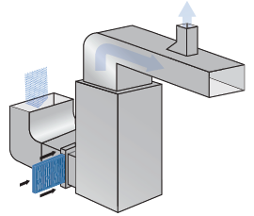
Heating, Ventilation and Air Conditioning (HVAC)
HVAC systems and some appliances can circulate pollutants.
Indoor air pollutants can enter living areas from crawl spaces, basements, attics and wall cavities.
Notes:
Indoor air quality can be affected by pollutants brought in or circulated by HVAC systems, as well as a number of appliances and fixtures used indoors.
Sometimes, air with indoor air pollutants pass from “unoccupied spaces” in a home, such as crawl spaces, basements, attics, and wall cavities, into areas where people live.

Slide 45
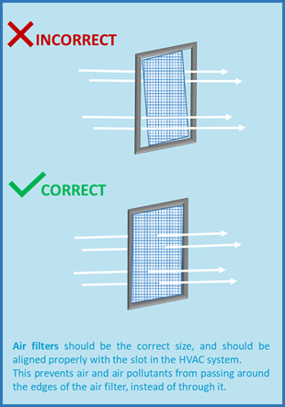
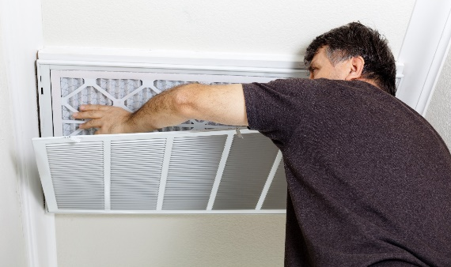
HVAC Maintenance and Filters
To help maintain indoor air quality, follow manufacturers’ instructions for routine HVAC maintenance.
Air filters that reduce indoor pollutants can be installed correctly by a professional.
Use the correct size air filter.
Align filter properly in HVAC system slot.
Notes:
Generally, for all sources of heat in a home, residents should review the manufacturer’s instructions to make sure all devices and appliances are properly installed, inspected, adjusted, and maintained so that they operate properly and do not cause indoor air problems. This might not be possible if the resident doesn’t have access to the HVAC system or is not responsible for maintenance because they live in a multi-family building. Regular cleaning or inspections may be required, and this can help control asthma and allergies.
High-efficiency pleated filters should be installed within the HVAC system, initially by a professional, if possible.
Residents can usually replace filters if they carefully follow the manufacturer’s instructions. High-efficiency pleated filters can be found at local hardware stores for future replacements.
Keep in mind that if the filter(s) are not fitted correctly, indoor pollutants can still enter the living space. If filters are installed incorrectly, as shown in the top image in the graphic, air can pass around the sides of the filters, allowing particles to be carried into the living spaces. The bottom image in the graphic shows air passing through a properly fitted filter.

Slide 46


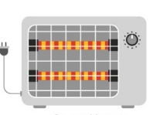

Heating
Checklist questions
During the winter, what is the primary way your home is heated?
In addition to the main source of heat, do you use any other source(s)?
Potential action steps
Properly ventilate the room where a fuel- or wood-burning appliance is used.
Never use a gas cooking appliance as a heating source.
Use proper fuel and follow instructions when using an unvented kerosene or gas space heater.
Radiator
Fireplace
Space Heater
Baseboard Heater
Notes:
Asthma management may include addressing indoor pollutants from the primary source of heating, ventilation, and cooling. Secondary heating sources also might be a concern.
Unvented combustion appliances, such as unvented and kerosene space heaters, are not recommended. Such fuel-burning appliances can create particulate matter and gaseous pollutants. If used, all fuel-burning appliances should be vented to the outside. If they cannot be vented to the outside, as in the case of portable units, it is important to have good ventilation and to bring in fresh air.
Radiators and Baseboard Heaters: These don’t have air filters, so the benefit of air filtration is not possible unless portable air cleaners are used to provide supplemental air filtration. For older radiators, steam leaks can lead to possible mold on surfaces near those leaks.
Forced hot air vents: Consider using filters that can be inserted into the vents or work with a professional to make sure that filters in the HVAC system are appropriate for the needs of the residents.
Space heaters: If using an unvented kerosene or gas space heater, follow the manufacturer’s instructions for proper fuel to use and keep the heater properly adjusted, cleaned, and maintained.
Fireplace/Wood-Burning Stove: If using a fireplace, make sure it is properly vented to help ensure smoke escapes through the chimney. If a wood-burning stove is used, make sure that doors are tight-fitting. Use aged or cured wood only and follow the manufacturer’s instructions for starting, stoking, and putting out the fire.
Combustion gases and particles can come from improperly installed or maintained chimneys and flues and cracked furnace heat exchangers. Pollutants from fireplaces and woodstoves with no dedicated outdoor air supply can be "back-drafted" from the chimney into the living space, particularly in weatherized homes.
The use of wood stoves or fireplaces increases the risk for mold growth for several reasons, including excess storage of wood indoors. Like wood stoves and fireplaces, space heater use can overheat one room, which can result in other rooms being colder and thus increasing the risk for condensation and mold growth.
Gas cooking: Never use a gas-cooking appliance as a heating source.

Slide 47
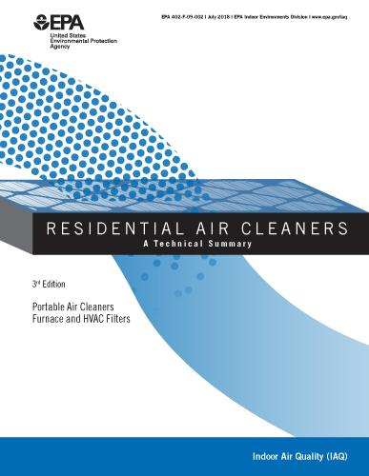
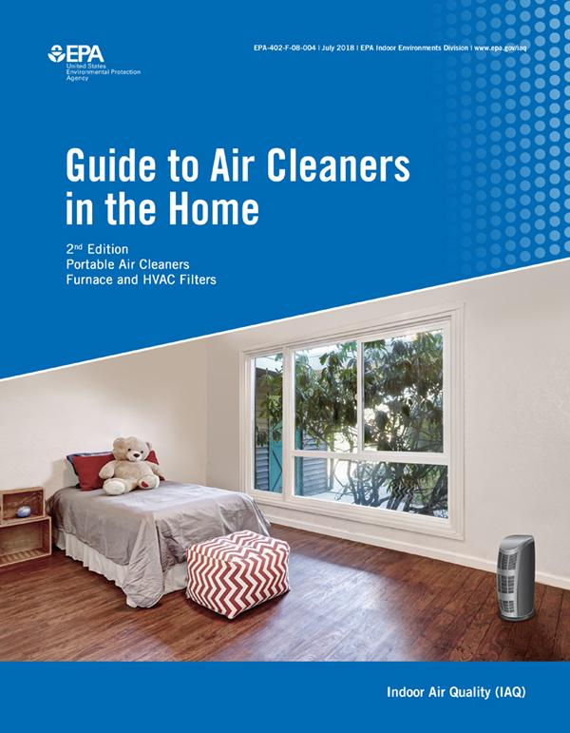
Air Cleaners
Eliminating sources of asthma triggers, such as candles, cigarettes, perfumes, air fresheners, etc., is the best method for controlling indoor air quality.
Ventilation and air cleaning help remove particles and gases.
EPA has a consumer guide and a more technical summary about using air cleaners at home (www.epa.gov/indoor-air-quality-iaq/air-cleaners-and-air-filters-home).
Notes:
Sometime, residents choose to use air cleaners to remove asthma triggers in their homes.
Eliminating sources of asthma triggers such as candles, cigarettes, perfumes, and air fresheners is the best method for controlling indoor air quality.
Ventilation and air cleaning are used to help remove particles and gases
EPA has a consumer guide, and a more technical summary about using air cleaners at home.

Slide 48
smoking
Notes:
The next section is about smoke exposure in the home.

Slide 49
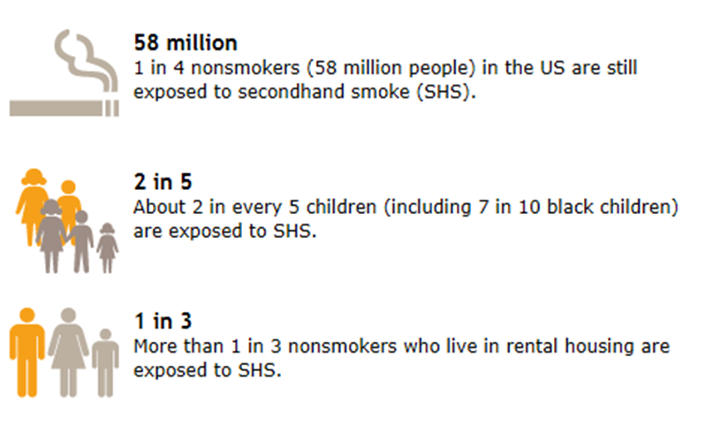

Secondhand-Smoke Exposure in the United States
Notes:
Secondhand smoke is the smoke in air from a cigarette, cigar, or pipe, and the smoke exhaled by a smoker.
Secondhand smoke contains more than 4,000 substances, including several compounds that cause cancer.
Secondhand smoke can trigger asthma episodes and increase the severity of attacks. Secondhand smoke is also a risk factor for new cases of asthma in preschool-aged children. Children's developing bodies make them more susceptible to the effects of secondhand smoke and, due to their small size, they breathe more rapidly than adults, thereby taking in more secondhand smoke.
Children receiving high doses of secondhand smoke, such as those with smoking parents, run the greatest relative risk of experiencing damaging health effects.
Home is the main place where many children and adults breathe secondhand smoke.

Slide 50
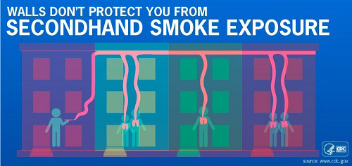
“Separating smokers from non-smokers, cleaning the air, and ventilating buildings cannot eliminate exposure of nonsmokers to SHS…”
— Surgeon General, 2006
SHS is a universal asthma trigger.
There is no safe amount of SHS.
Smoke-free policies benefit tenants and property owners.*
* To learn how to start a smoke-free policy, go to
www.hud.gov/program_offices/healthy_homes/smokefree2
Notes:
Each year, an estimated 28 million multi-unit housing residents are exposed to secondhand smoke in their home or apartment that came from somewhere else in their building, such as a nearby apartment.
100% smoke-free policies are the only effective way to fully eliminate secondhand smoke exposure.
In the meantime
Encourage and support families with asthma to take action and not allow smoking in their home or car.
Connect people who smoke to a smoking cessation program, such as their state quitline (1-800-QUIT-NOW).

Slide 51

E-Cigarettes
E-cigarettes create an aerosol that can contain toxic chemicals.
Risks that secondhand aerosol might trigger asthma symptoms are unknown.
Other concerns
  Dramatic increase in use of e-cigarettes by young people.
  Possible path to traditional smoking among youth.
Notes:
E-cigarettes create an aerosol that can contain toxic chemicals. Both tobacco smoke and marijuana smoke contain particles and combustion by-products.
We do not yet have enough research to tell us if secondhand aerosol from e-cigarettes triggers asthma symptoms. However, we know that nicotine is harmful to the developing brain.
Also, the Surgeon General, CDC, and many public health advocates recommend including all tobacco products, including e-cigarettes, in smoke-free rules.

Slide 52
PesTs
Notes:
The next section is about pests and their allergens.

Slide 53


Slide 54


Slide 55

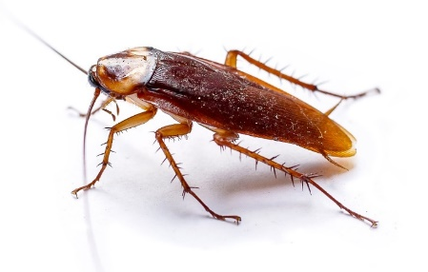

Types of Pests
Notes:
Different types of cockroaches are found in different climates. American cockroaches are common in the southern United States and in basements throughout the United States. German cockroaches are common in single-family and multi-family homes that have pest infestations. In some places, cockroaches might be called water bugs or palmetto bugs. These are still cockroaches.
Mice also differ. Field mice, for example, might only enter a home when it’s cold outside. Other mice might live year-round in the house or multi-family building.
Rats are rarely found in homes; therefore, rat allergen in homes is rare. However, many people really can’t tell the difference between rats and mice, so that is why we ask about both.

Slide 56
Pests: Allergen Characteristics
Mouse and rat allergens
Mainly urine (but also in dander).
Airborne allergens on a range of microscopic particles (<10 and ≥10 microns).
Can remain airborne
for hours.
Cockroach allergens
Mainly fecal pellets (but also in dried body parts).
Airborne allergens on larger but still microscopic particles (mainly >10 microns).
Settle out of air quickly.
Notes:
Mouse and rat allergens are found mainly in urine (but also in dander, which is another term for skin flakes). The airborne allergens can be found on small, medium, and large particles, but the small particles (those less than 2.5 microns in size) can remain airborne for hours.
On the other hand, cockroach allergens are found mainly on fecal pellets or droppings (but also in dried body parts). The cockroach allergens are found on larger particles (mainly those larger than 10 microns), which settle out of the air quicker than mouse or rat allergen particles.

Slide 57
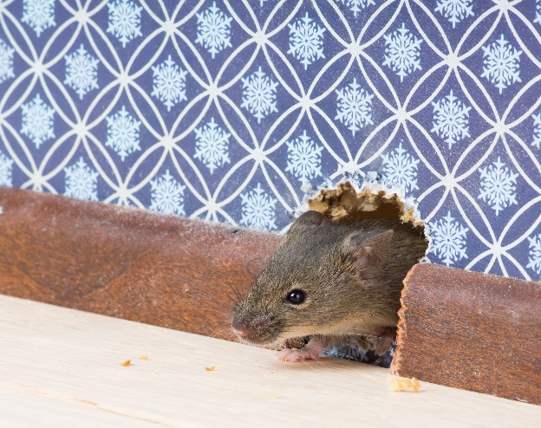
Things That Affect Pest Allergen Levels
Changes within the home—new roommates, parties with a lot of food, new pet.
Changes in the building—new holes, recent pesticide application in neighboring buildings.
Changes in weather—cold temperatures can drive pests indoors.
Notes:
Several things can affect pests and their allergens.
Changes by residents in the home (new roommates, parties with a lot of food, new pet)
Changes in the building (new holes, recent pesticide application in neighboring buildings)
Seasonal changes (cold weather can drive pests indoors)
The next slide shows examples of changes inside and outside the home that can affect pests and their allergens.

Slide 58

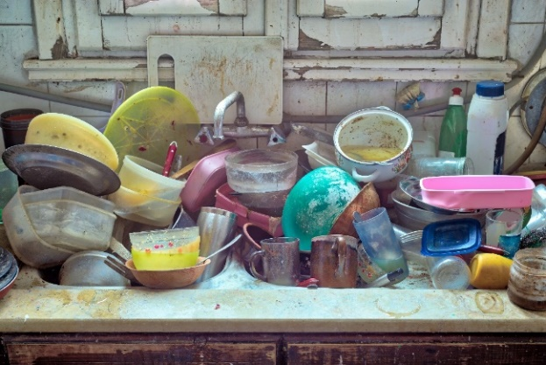

Specific Examples of Things That Attract Pests
Notes:
Leaving trash next to buildings can attract pests such as cockroaches and rodents. Subsequently, the pests can enter the buildings to find other sources of food and shelter. Leaving dirty dishes in the sink or on the table can also attract pests and if left overnight, mold can begin to grow too.

Slide 59
What Is Integrated Pest Management (IPM)?
Integrated: Using multiple approaches that work together.
Pest: Unwanted rodents and bugs in the home.
Management: Effective methods with the least possible hazard to people, property and the environment.
Notes:
Integrated Pest Management (IPM) is best described by its component words:
Integrated means it uses multiple approaches that work together.
Pest Unwanted rodents and bugs in the home
Management means it uses effective methods for pest control, with the least possible hazard to people, property, and the environment.

Slide 60
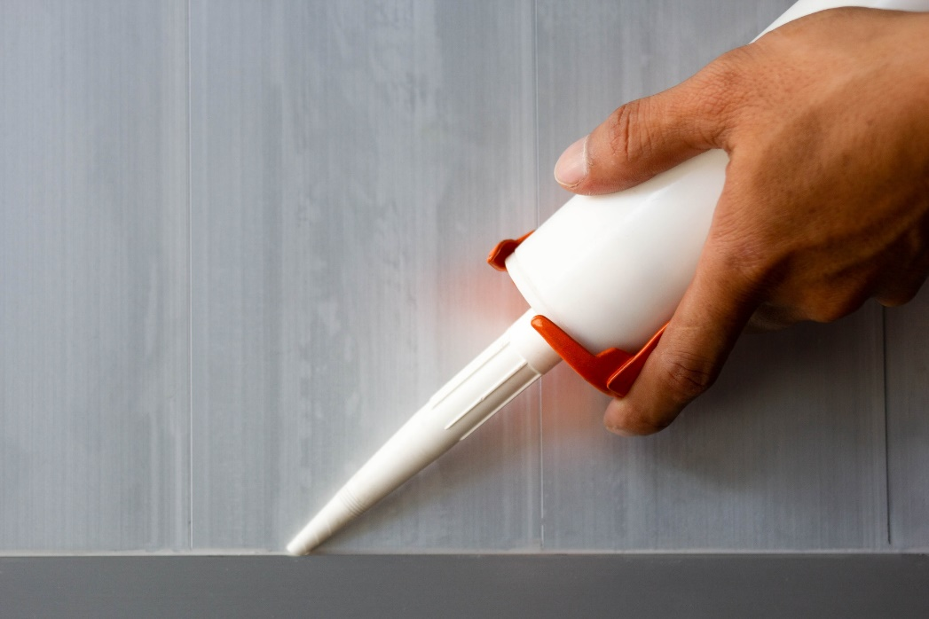
Integrated Pest Management
Physical changes in home
Cleaning
Sealing cracks and holes
Education
Clean up spills.
Eat only in dining area.
Use sealed food containers.
Dispose of trash frequently.
Notes:
Two main concepts of IPM are:
1. Make physical changes in home, such as cleaning and sealing cracks and holes
2. Educate residents to clean up spills, eat only in the kitchen or dining room, use sealed food containers to keep pests out, and dispose of trash often

Slide 61
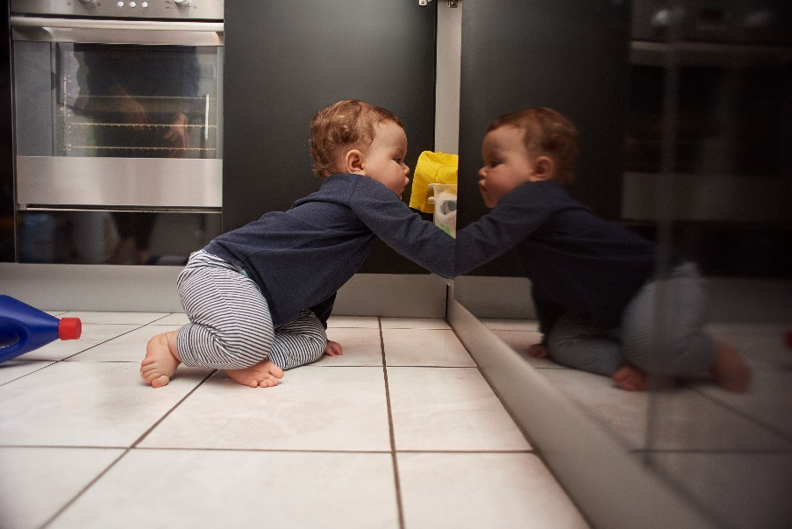
Keep Pesticides and Traps Away From Children and Pets
Use gel bait application for insects (such as cockroaches).
Use snap traps for mice and rats.
Avoid spray pesticides, bombs and foggers (these are asthma triggers).
Notes:
Various methods are available to control pests:
Gel bait application for insects (such as cockroaches)
Snap traps are used for mice and rats
However, spray pesticides, bombs, and foggers are asthma triggers. Avoid using them.
Also be sure to keep pesticides and traps away from children and pets.

Slide 62
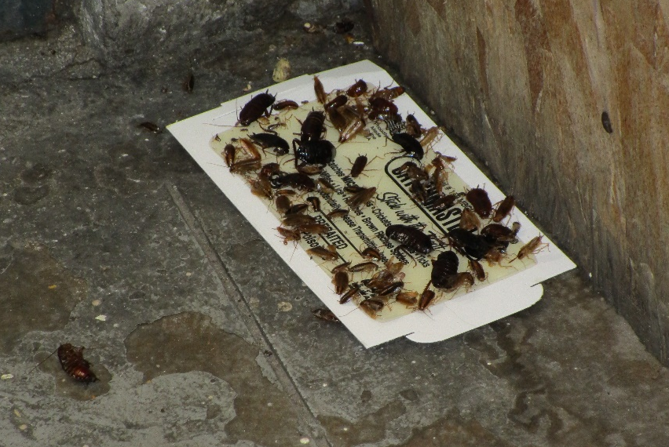
Cockroach Monitoring Trap
Notes:
Cockroaches don’t just crawl on floors, they crawl on walls and ceilings, too. First placing sticky traps or monitors throughout the home will help show where cockroaches live and pathways they follow throughout the home. Those are the ideal spots to place bait.
Common places for traps are under kitchen and bathroom sinks, and on kitchen counters where food is stored. The traps have a sticky substance with natural chemical attractant (pheromone) inside the trap. We use these to monitor the cockroach population; the traps are not used as a pest control method.
Home visitors, residents, or professionals can place these easy-to-use monitors around the home in areas where cockroaches travel to find food, water, and shelter. Monitoring can help guide where residents should focus their IPM efforts, such as where to place gel baits for cockroaches.

Slide 63
Pests: Action Steps
To decrease exposure and symptoms
  Clean or remove pest reservoirs to prevent exposure.
  Use IPM.
Other considerations
In multifamily buildings, infestation can spread from other units and common areas.
Building-wide approaches might be needed, with help from the landlord and other tenants.
IPM is an ongoing process for homes that have pest problems. It is not a one-time fix.
Notes:
The most recent evidence by expert panels supports using IPM to decrease exposure, asthma symptoms, and emergency department visits.
In multifamily buildings, infestation from other apartments can occur inside the unit and in common areas, so building-wide approaches might be necessary. That might require engaging the landlord and other tenants in the process.
IPM is an ongoing process for homes that have pest problems. It is not a one-time fix.
IPM can prevent infestations.

Slide 64
Volatile organic compounds
(VOCs)
Notes:
The next section is about VOCs in the home.

Slide 65
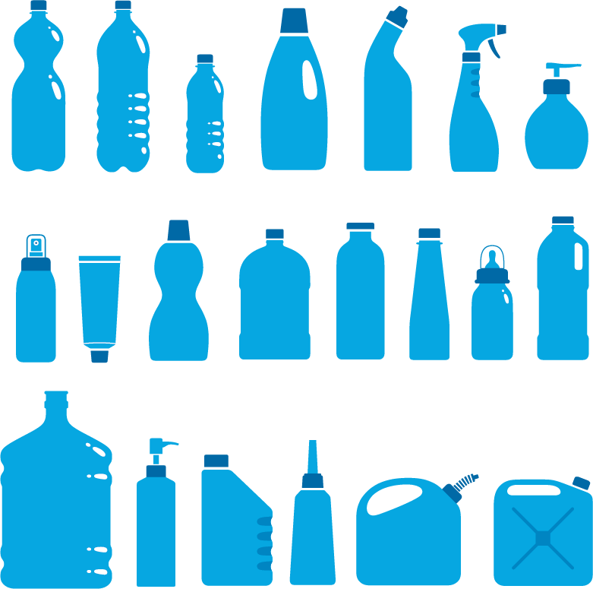

Volatile Organic Compounds (VOCs)
Chemicals commonly found in many household products
Wood preservatives
Aerosol sprays
Cleansers and disinfectants
Moth repellents and air fresheners
Fuels and automotive products
Hobby and craft materials supplies
Paints, paint strippers and solvents
Dry-cleaned clothing
Pesticides
Building materials and furnishings
Glues, adhesives, permanent markers and photo chemicals
Notes:
Volatile organic compounds (VOCs) are emitted as gases from certain solids or liquids. VOCs include a variety of chemicals, some of which have short-term or long-term adverse health effects and can irritate airways of persons with asthma.
Concentrations of many VOCs can be higher indoors than outdoors.

Slide 66
VOCs Can Be Irritating and Harmful to All People With Asthma
Limit exposure by minimizing product use (e.g., use low VOC paints).
Use products only when person with asthma is not present or use alternative products.
Follow manufacturer’s instructions for use and storage.
If using products, carefully follow manufacturer’s instructions and make sure that the area is well-ventilated.
Never mix household-care products unless directed on the label.
Do not store opened containers of unused paints and similar materials.*
Keep products out of reach of children and pets.
When buying supplies and cleaners, favor those certified by such programs as Green Seal or EPA’s Safer Choice.
* www.epa.gov/indoor-air-quality-iaq/volatile-organic-compounds-impact-indoor-air-quality
Notes:
VOCs can be irritating and harmful to all people with asthma.
Limit exposure to VOCs as much as possible by
minimizing product use,
using products only when persons with asthma are not present, or
trying less-irritating products.
EPA provides information online about proper storage of products that release VOCs: https://www.epa.gov/indoor-air-quality-iaq/volatile-organic-compounds-impact-indoor-air-quality
Follow manufacturer’s instructions for use and storage of products with VOCs.
If products that release VOCs are used, carefully follow manufacturer’s instructions on the label and make sure the area is well-ventilated.
Never mix household care products unless directed on the label.
Do not store opened containers of unused paints and similar materials
Keep products out of reach of children and pets.
When purchasing supplies and cleaners, give preference to those that are third-party certified by programs such as Green Seal or EPA’s Safer Choice.

Slide 67
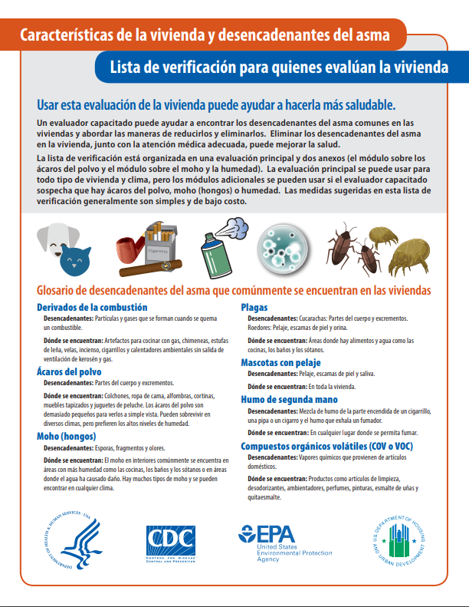
Considerations for Using the Checklist in a Virtual Setting
We would love to hear how your program has pivoted to conducting virtual home assessments and suggestions you have for incorporating the Checklist. Please join the discussion forum to share your experiences: AsthmaCommunityNetwork.org Discussion Forum
Access the Checklist and the Training slides on EPA’s asthma website: www.epa.gov/asthma/publications-about-asthma#healthcare
Access the Spanish Checklist on EPA’s asthma website:
espanol.epa.gov/cai/lista-de-control-para-el-asma-en-el-entorno-del-hogar
Access the Checklist and the Training slides on CDC’s website:
www.cdc.gov/asthma/public_health.html
Access the Checklist on HUD's website:
https://www.hud.gov/sites/dfiles/HH/documents/Home%20Assessment%20Checklist%20English.pdf
Access the Spanish Checklist on HUD's website:
https://www.hud.gov/sites/dfiles/HH/documents/Home%20Assessment%20Checklist%20Spanish.pdf
Notes:
Tracey’s Talking Points:
Before we dive into today’s presentations, let’s get a sense for who’s with us today. To do that, please take a moment to answer the polling question on your screen: “What type of organization do you represent?”
Polling Question #1

Slide 68
Polling Question 3
Before this webinar, were you aware of this Checklist as a resource?
Yes
No
Notes:
Tracey’s Talking Points:
Before we dive into today’s presentations, let’s get a sense for who’s with us today. To do that, please take a moment to answer the polling question on your screen: “What type of organization do you represent?”
Polling Question #1

Slide 69
Polling Question 4
Based on what you learned today, what action do you plan to take?
Download the Checklist and Training slides.
Use the Training slides to train my program’s CHWs.
Incorporate the Checklist into my program’s home visits.
All of the above.
Keep my program’s current home assessment tool.
Notes:
Tracey’s Talking Points:
Before we dive into today’s presentations, let’s get a sense for who’s with us today. To do that, please take a moment to answer the polling question on your screen: “What type of organization do you represent?”
Polling Question #1

Slide 70
Question & Answer Session on
AsthmaCommunityNetwork.org Discussion Forum
Please join us in the AsthmaCommunityNetwork.org Discussion Forum
for a live online Q&A Session.
2:00 p.m. – 2:30 p.m. EDT
To post a question in the Discussion Forum, follow these directions:
If you are a Network member, log in to your AsthmaCommunityNetwork.org account.
Click on the “Discussion Forum” button on the home page.
Click on the “Live Online Q&A for 7/28/2020 Webinar” link.
Click on the “Add new Forum topic” link to post your question.
Enter your question and click the “Save” button at the bottom of the page.
Not a member? Create an account at AsthmaCommunityNetwork.org by clicking the “Join Now” link at the top of the page. Your account will be approved momentarily, and you can begin posting questions.
Notes:
Today’s webinar is scheduled for one hour. Immediately following our presentation, you will have the opportunity to ask questions and interact with our speakers in the discussion forum on asthmacommunitynetwork.org. You do need to be a member to participate so please follow the directions here to join and access the discussion forum. Asthmacommunitynetowrk.org is also where you will be able to access the archive of this webinar and all previous webinars EPA has offered regarding asthma.

