Slide 1

Demonstrating Positive Asthma Outcomes: Collecting and Analyzing Data to Make Your Case
Phone Number: 866-527-8921
Conference ID: 9228608

Slide 2
Welcome to the Webinar
Demonstrating Positive Asthma Outcomes: Collecting and Analyzing Data to Make Your Case
Moderator
Tracey Mitchell, RRT, AE-C, U.S. Environmental Protection Agency, Washington D.C.
Presenters
Kevin Kennedy, M.P.H., CIEC, Program Director for the Environmental Health Program Children's Mercy Kansas City, Missouri
Ben Francisco, Ph.D., PNP, AE-C, Associate Teaching Professor, Pediatric Pulmonary Medicine and Allergy, University of Missouri Health Care, Columbia, Missouri
Tuesday, July 30, 2019
Webinar: 3:00 p.m. – 4:00 p.m. EDT
Live Online Q&A: 4:00 p.m. – 4:30 p.m. EDT
Phone Number: 866-527-8921
Conference ID: 9228608
Notes:
Good afternoon everyone. My name is Tracey Mitchell, I am a RRT and a AE-C at the U.S. Environmental Protection Agency in Washington DC.
EPA is pleased to host you today for an important and exciting webinar presentation - Demonstrating Positive Asthma Outcomes: Collecting and Analyzing Data to Make Your Case.
Our presenters today are Kevin Kennedy, Program Director of the Environmental Health Program at Children’s Mercy Kansas City. Mr. Kennedy has been involved in environmental health science, safe and healthy housing advocacy, and industrial hygiene chemistry consulting for over 30 years. He teaches courses in environmental health assessment and investigations, environmental measurement and sampling, building science, and safe and healthy housing. He received his Master’s Degree in Public Health from the University of Kansas Medical School. He is a Certified Indoor Environmental Consultant and previously worked as an environmental analytical chemist and research scientist.
And Ben Francisco, Associate Professor, Pulmonary Medicine & Allergy University of Missouri, School of Medicine, Child Health and Director, Asthma Ready® Communities
NEED MORE BIO FOR BEN
EPA is eager to support, and to shine a spotlight on partners, information and stories that can teach us all so much about how data is used to improve asthma care, and how to move whole systems to bring the best care we can to the people, particularly children, who most need it.
Thank you for joining this important discussion.

Slide 3
Question & Answer Session on
AsthmaCommunityNetwork.org Discussion Forum
Immediately after the webinar, join us in the AsthmaCommunityNetwork.org Discussion Forum for a live online Q&A Session:
4:00 p.m. – 4:30 p.m. EDT
To post a question in the Discussion Forum, follow these directions:
If you are a Network member, log in to your AsthmaCommunityNetwork.org account.
Click on the “Discussion Forum” button on the home page.
Click on the “Live Online Q&A for 7/30/19 Webinar” link.
Click on the “Add New Forum Topic” link to post your question.
Enter your question and click the “Save” button at the bottom of the page.
Not a member? Create an account at AsthmaCommunityNetwork.org by clicking the “Join Now” link at the left side of the page. Your account will be approved momentarily, and you can begin posting questions.
Indoor Air Quality (IAQ)
Notes:
After today’s presentations, our Q&A will take place on the Discussion Forum on AsthmaCommunityNetwork.org.
To see the discussion forum directly, please click the link that we just sent you via the chat function.
To ask questions, you must first be a member of AsthmaCommunityNetwork.org, so please take a minute to join so that you can post questions throughout the webinar—it is a simple and quick process.
After the Q&A period is closed, please visit the Discussion Forum often to see other contributions as well as to make your own!

Slide 4
Polling Question 1
Which type of organization do you represent?
Federal, state or local agency
Health care provider
Health plan
Community asthma program
Other
Indoor Air Quality (IAQ)
Notes:
Tracey’s Talking Points:
You’ve been introduced to our presenters and now please introduce yourselves by telling us: “What type of organization do you represent?”
Polling Question #1

Slide 5
Polling Question 2
How do you currently use data in your program?
    We collect only the most basic data in our program but do not use data to demonstrate results.
    We are able to use data to show positive outcomes and ROI.
    We are able to use data to target high-risk individuals to receive in-home services.
    We are able to translate complex data to improve asthma care for patients with poorly controlled asthma.
    Other
Indoor Air Quality (IAQ)
Notes:
Next we’d like to get a sense for how your program is currently collecting and using data.

Slide 6
Learning Objectives
Participants will learn about—
The basic data framework to show positive program outcomes.
Using data to help provide in-home asthma environmental assessments and education.
Translating complex data to improve care for asthma patients.
Best practices for identifying high-risk individuals through data.
Indoor Air Quality (IAQ)
Notes:
In the webinar, you will learn about:
The basic framework for the data you need to show positive outcomes for your program.
How to use data to help your program provide home environmental assessments for asthma and deliver asthma education in the home.
How complex data can be translated and presented to clinicians to help them improve care for their asthma patients.
The best practices for reviewing data to identify high-risk individuals who would benefit from environmental care and education in settings outside the clinical arena.

Slide 7
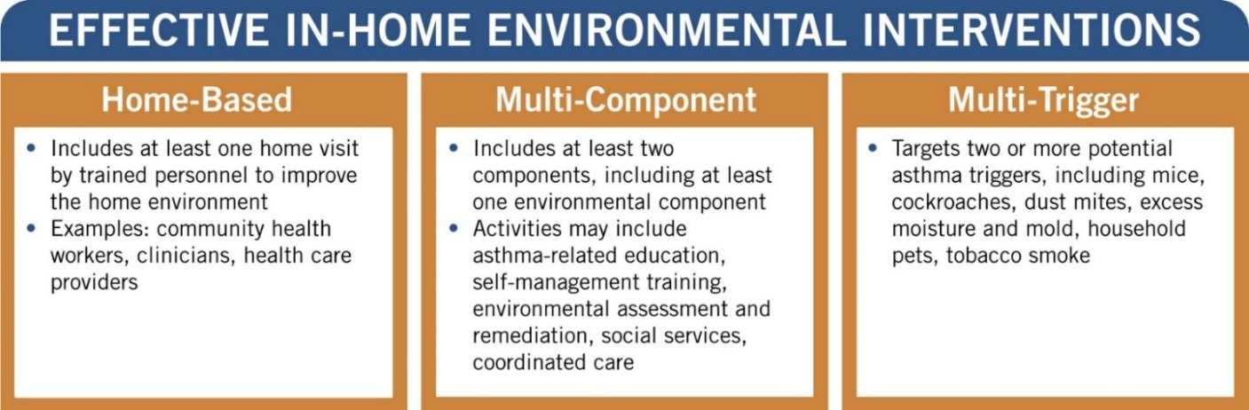
Environment Plays a Critical Role in Asthma Control
Federal asthma guidelines recognize environmental trigger reduction as a critical component of comprehensive asthma care.*
The evidence base demonstrates that in-home environmental interventions are effective at improving asthma control in children and adolescents.†
EPA is a federal lead for integration of
environmental risk reduction into standards of care.
NHLBI. 2007. Guidelines for the Diagnosis and Management of Asthma (EPR-3). www.nhlbi.nih.gov/health-pro/guidelines/current/asthma-guidelines
CDC. 2005. The Guide to Community Preventive Services. www.thecommunityguide.org
Indoor Air Quality (IAQ)
Notes:
We know the environment plays a crucial role in asthma.
At EPA, science informs policy and forms the foundation for our program approaches
Science tells us that along with medical management -- there is a strong evidence-base and supporting national guidelines that recognize the role of environmental triggers and their remediation as an important part of comprehensive asthma management. We know that eliminating common indoor triggers like tobacco smoke, pet dander, molds, cockroaches and dusts mites results in decreased symptoms and asthma episodes and improved outcomes for people with asthma.
We also know that home visits are a critical care component of asthma care, particularly for at-risk populations. These families are often in crisis-mode and facing so many issues that effectively managing a child’s asthma becomes a real challenge. Home visits provide that one-on-one time to educate families, assess their environment and remediate triggers.
As the technical experts on the built environment and health, EPA has led the federal effort through non-regulatory strategies that enable communities to deliver and sustain in-home environmental asthma care, aimed at ensuring access.

Slide 8
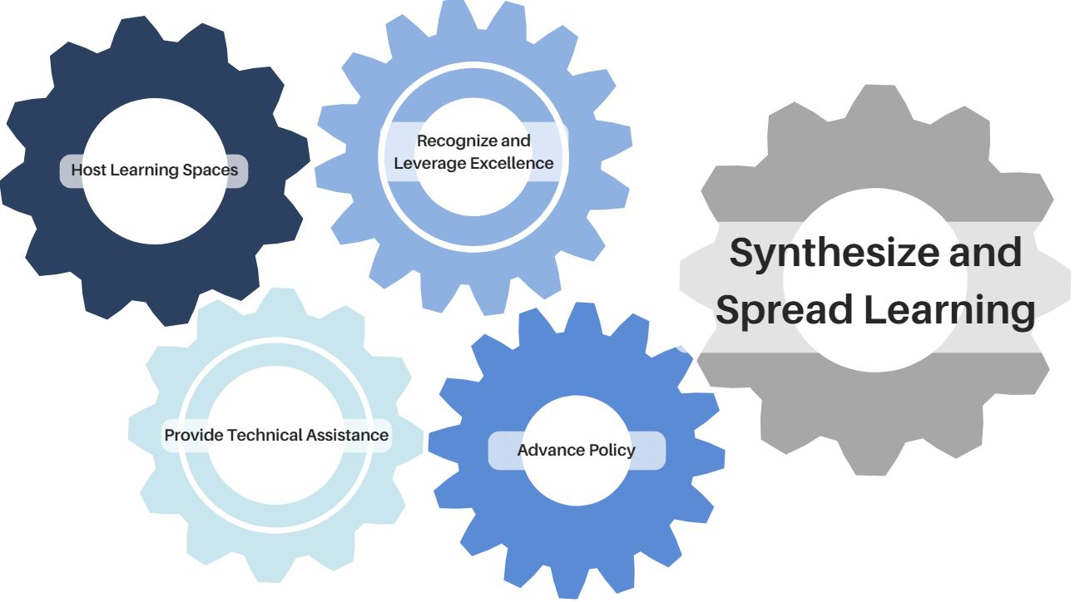
Supporting In-Home Interventions to Bring Asthma Under Control
Notes:
How does EPA support program who are working at the state and local level? These cogs represent EPA’s 5 basic program areas that work together.
First, EPA hosts learning spaces to share, learn and to connect over 1,00 asthma programs through AsthmaCommunityNetwork.org and continues to conduct national media campaigns
We provide technical assistance through cooperative agreements and partnerships
EPA recognizes and leverages excellence through our competitive National Environmental Leadership Award in Asthma Management
We work to advance policy nationally through collaboration with Asthma Disparities Working Group federal partners and advance policy locally through regional asthma summits
And finally, we synthesize and spread learning in a variety of ways, one example is through webinars like our webinar today.

Slide 9
Data Plays a Critical Role in Demonstrating Your Program’s Impact
What data can support our shared goal of securing sustainable financing for in-home asthma care services?
Build your evidence base
DATA
Collect the right information for your audiences
Develop your value proposition
Demonstrate your impact
Indoor Air Quality (IAQ)
Notes:
We’re here today to talk about one of the central pieces to your program, data collection and analysis.
We hear from many of our community based programs that this is an issue of importance to them. Some of our programs are much further along in developing sophisticated data practices, and others are just starting out.
For example, some stakeholders may need to gather data from published literature in order to gain traction to establish a program. Others may need data from their own program to justify continuation and/or expansion.
Importance of how data is deployed:
1) What information is important to collect? How will the information be used? Who are the decision-makers we need to target and what data will be most compelling to them?
(Health Plans will want to hear about cost savings; Hospital Community Benefit Programs may want to hear about ED reductions; Medicaid may want to hear about “high utilizers” and the services provided)
2) Using data to build evidence base and make your case. We have a lot of resources available on ACN about this.
3) Using data to develop your value prop. What is a value proposition?
An analysis and quantified review of the benefits, costs and value that an organization can deliver to customers/funders and other stakeholders. It is…
A succinct statement (e.g., 2–4 sentences) that clearly describes the tangible results a customer gets from your program.
An offer to someone in which they get more than they give up.
A reason for why people should support your program.
A way to draw interest and share a success story within a few words.
4) Moving from collecting data to showing your impact. Given our shared goal of advocating for sustainable financing for our programs, what data can support that goal? That is what our speakers are going to talk about today using examples from their work in Missouri and with groups around the country.

Slide 10

Using Data in Asthma Home Environmental Assessment Programs
Kevin Kennedy, M.P.H., CIEC
Program Director, Environmental Health
2015 Winner—
HUD Secretary’s Award
for Healthy Homes

Slide 11

The business case and data analysis is about helping people get better.
It’s about Jeremy.

Slide 12

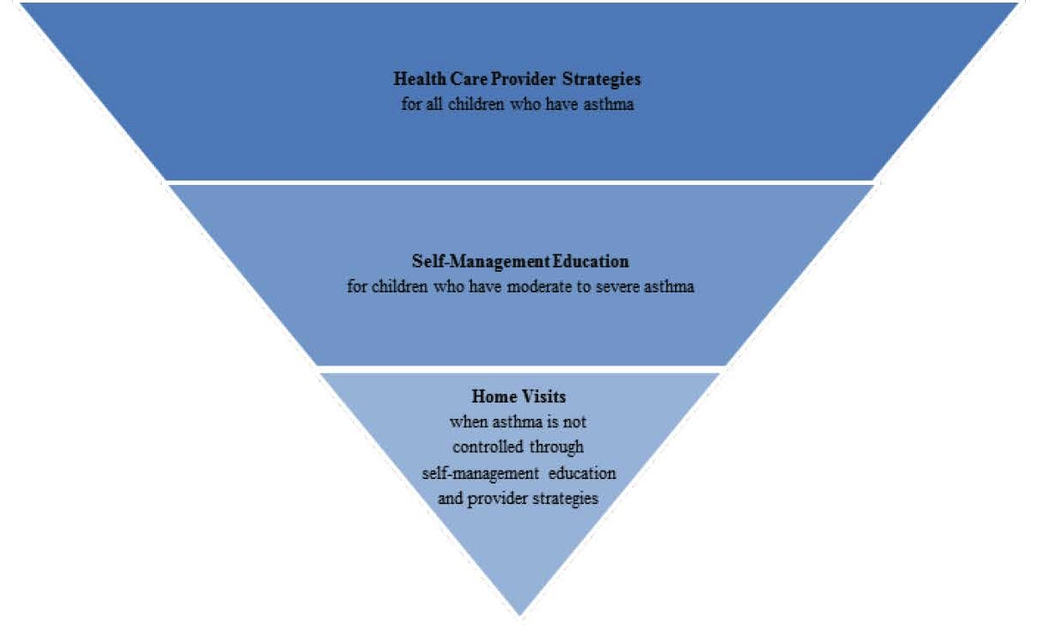
Health Investments That Pay Off:
Strategies for Addressing Asthma in Children
Health Care Provider Strategies
Self-management Education
National Governor’s Association white paper recommends investing in home visits for asthma patients.
“Asthma self-management strategies should be targeted to the intensity of patient’s needs.”
Home visits when not controlled by other strategies

Slide 13
How do we evaluate whether our asthma care efforts are helping patients?
  What matters?
  1. Keys to program development—what do you want to show?
  Program impact—patient outcomes, financial outcomes.
  2. What has the greatest impact on asthma care costs?
  Hospitalizations, emergency department (ED) visits, urgent care, medications for some.
  3. To measure impact, calculate return on investment (ROI).
  ROI = input or investment vs. savings and health improvement
  Can we utilize pilot projects to build a home visit model?

Slide 14
To evaluate impact, use ROI.
“Return on investment” (ROI) is a process of using data about health care service costs for implementing a program compared to the savings from the impact the program has on the patients served.

Slide 15
Why ROI?
It helps with identifying the population served, cost drivers and opportunities to improve quality while decreasing expenses.
It is useful for program design, resource allocation and funding, and monitoring and evaluation.
It uses data and its analysis to move from what you believe a program is doing to computing its real impact.

Slide 16
What data do we need for evaluate ROI?
Size of target population
Risk stratification
Enrollment rate
Duration of program pilot
Baseline costs
  Existing services
  New program services
Data types:
  Health utilization
    Hospital, ED, medications, procedures
  Staff labor
  Cost of education materials
  Cost of home interventions

Slide 17
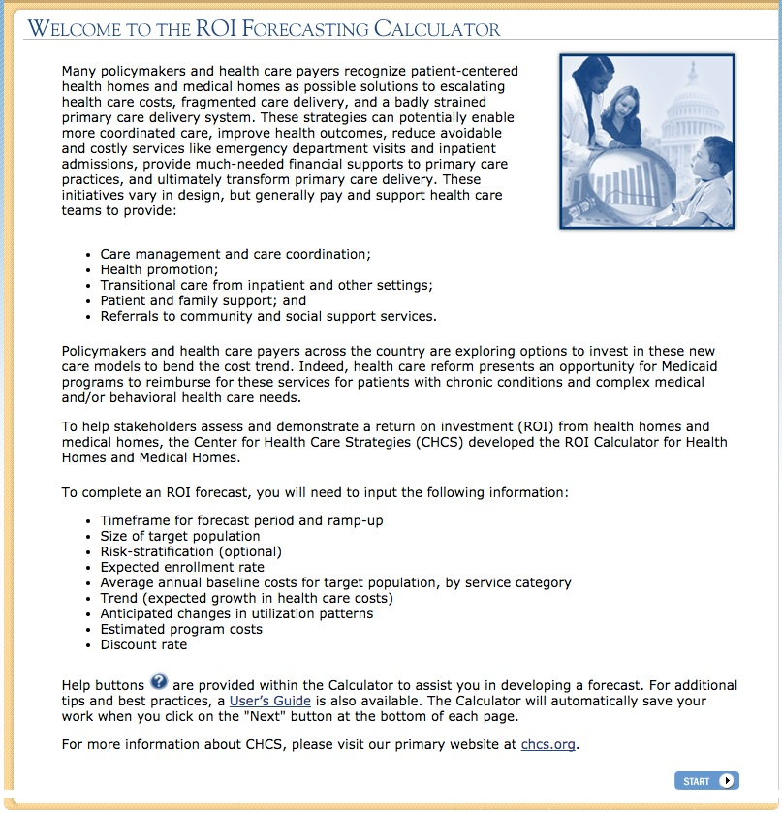
Center for Health Care Strategies provides a web-based interactive ROI calculator.
www.chcsroihealthhomes.org/welcome.aspx

Slide 18
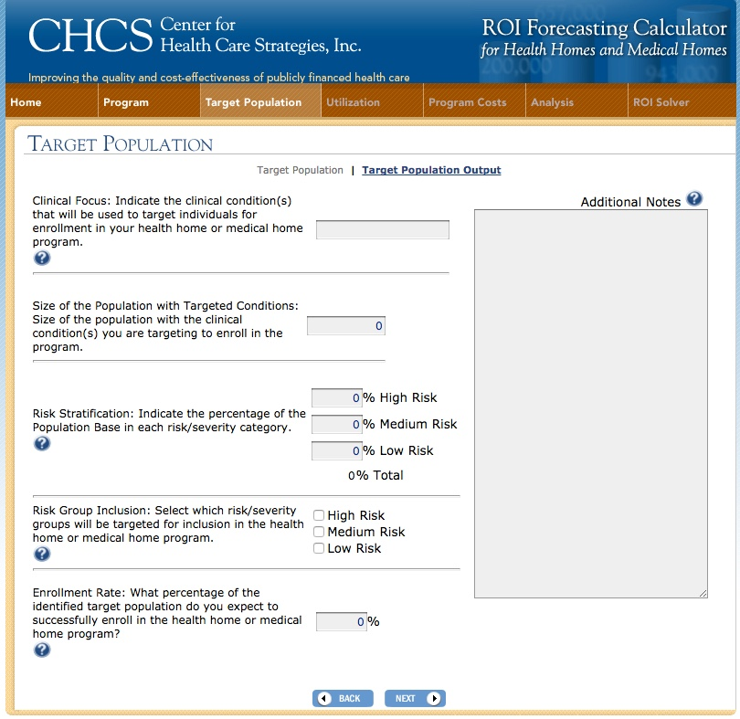
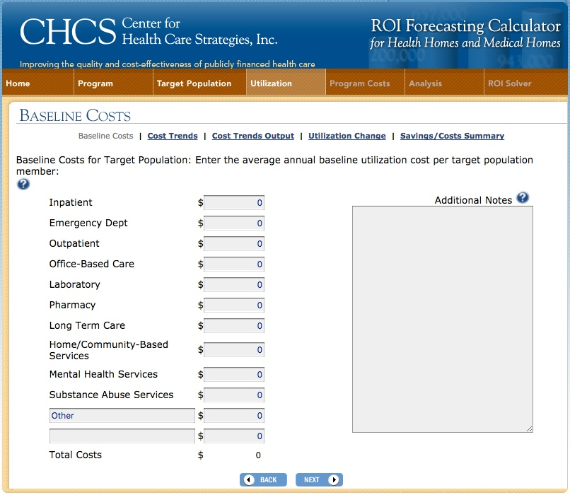
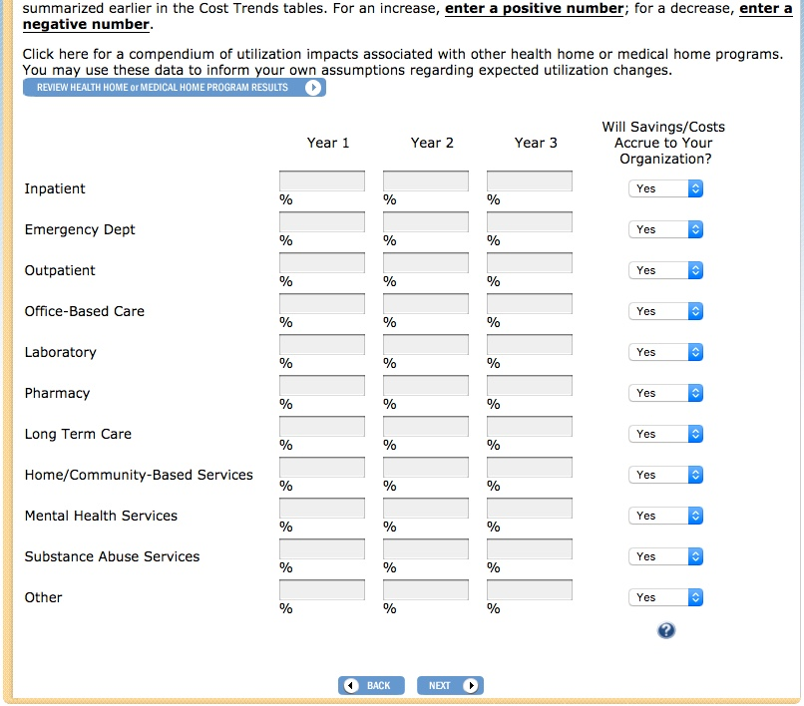
www.chcsroihealthhomes.org/welcome.aspx

Slide 19
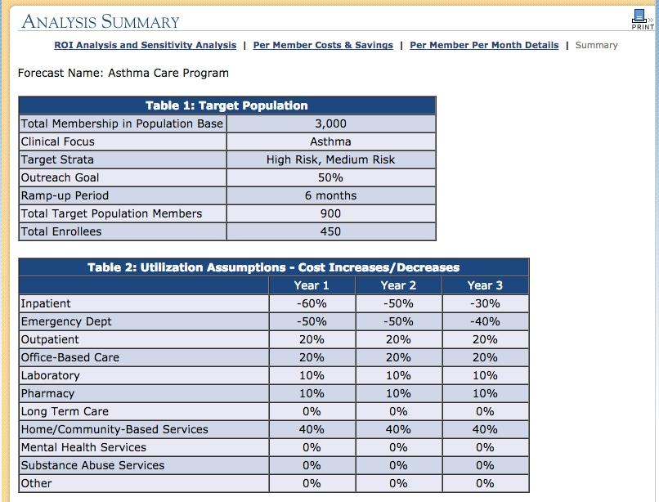
www.chcsroihealthhomes.org/welcome.aspx

Slide 20
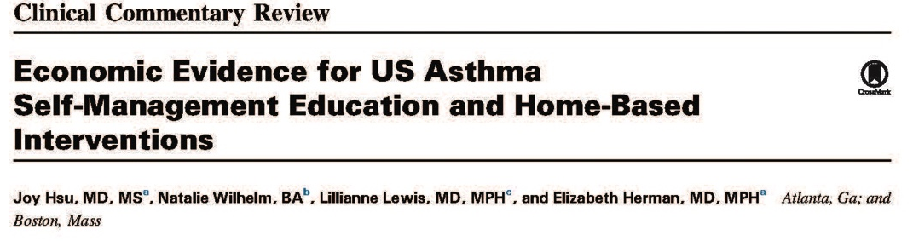
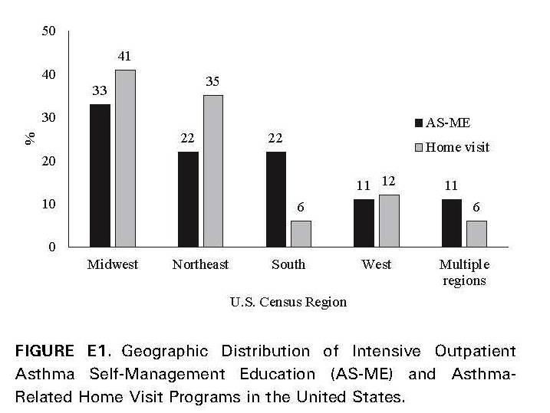
Detailed summaries of programs and reported ROIs are available.
Hsu, et. al., Economic Evidence for US Asthma Self-Management Education and Home-Based
Interventions, 2016, J Allergy and Clinical Immunology in Practice 4 (6), 1123-1134.

Slide 21
Many asthma care programs included home visits and showed significant ROI.
42 programs identified: Nine outpatient ASME programs and 17 home-based intervention programs reported ROI data.
Most programs were associated with a positive ROI.
A few programs observed positive ROIs only among selected populations (e.g., higher health care utilization).
Interpretation limited by heterogeneous ROI calculations.
Hsu, et. al., Economic Evidence for US Asthma Self-Management Education and Home-Based Interventions, 2016, J Allergy and Clinical Immunology in Practice 4 (6), 1123-1134.

Slide 22
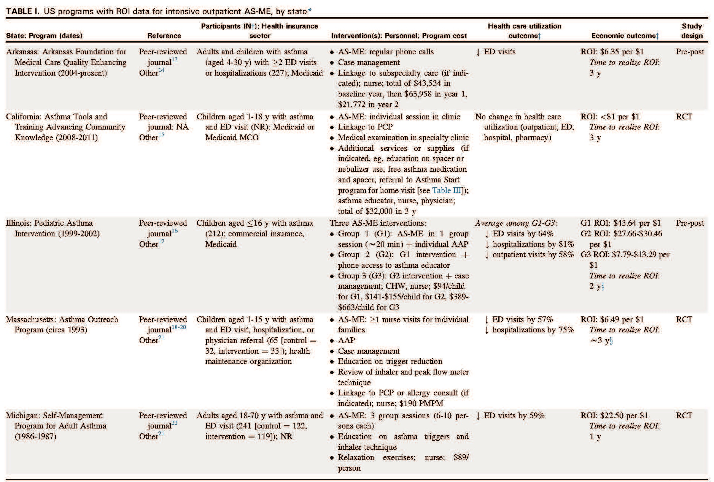
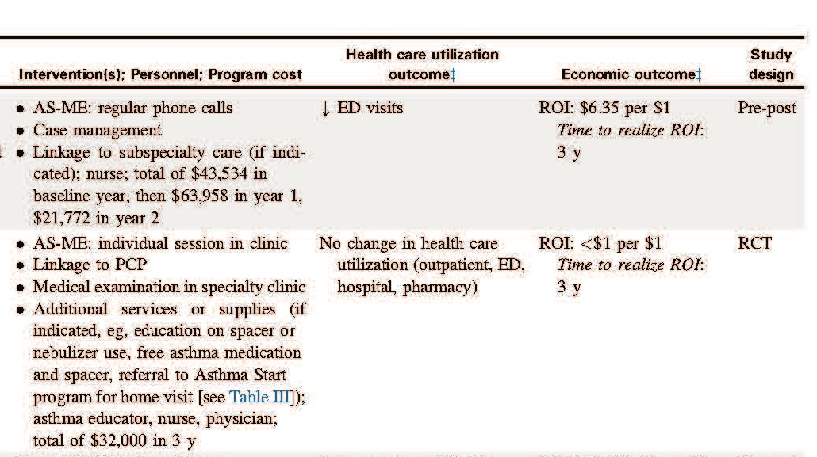
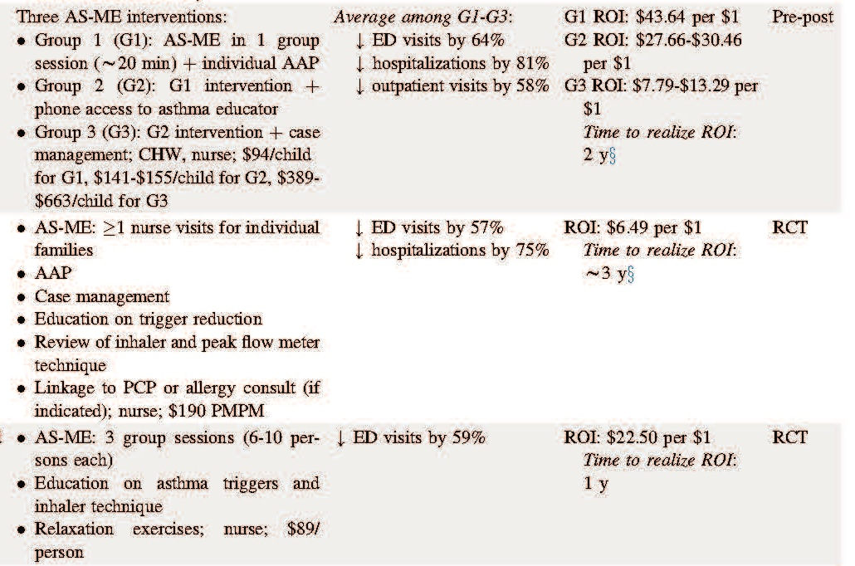
Hsu, et. al., Economic Evidence for US Asthma Self-Management Education and Home-Based Interventions, 2016, J Allergy and Clinical Immunology in Practice 4 (6), 1123-1134.

Slide 23
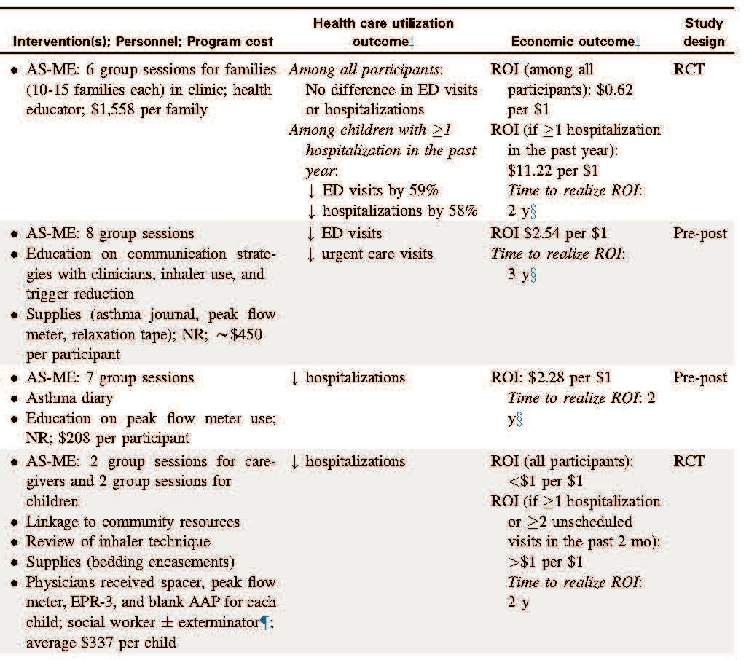
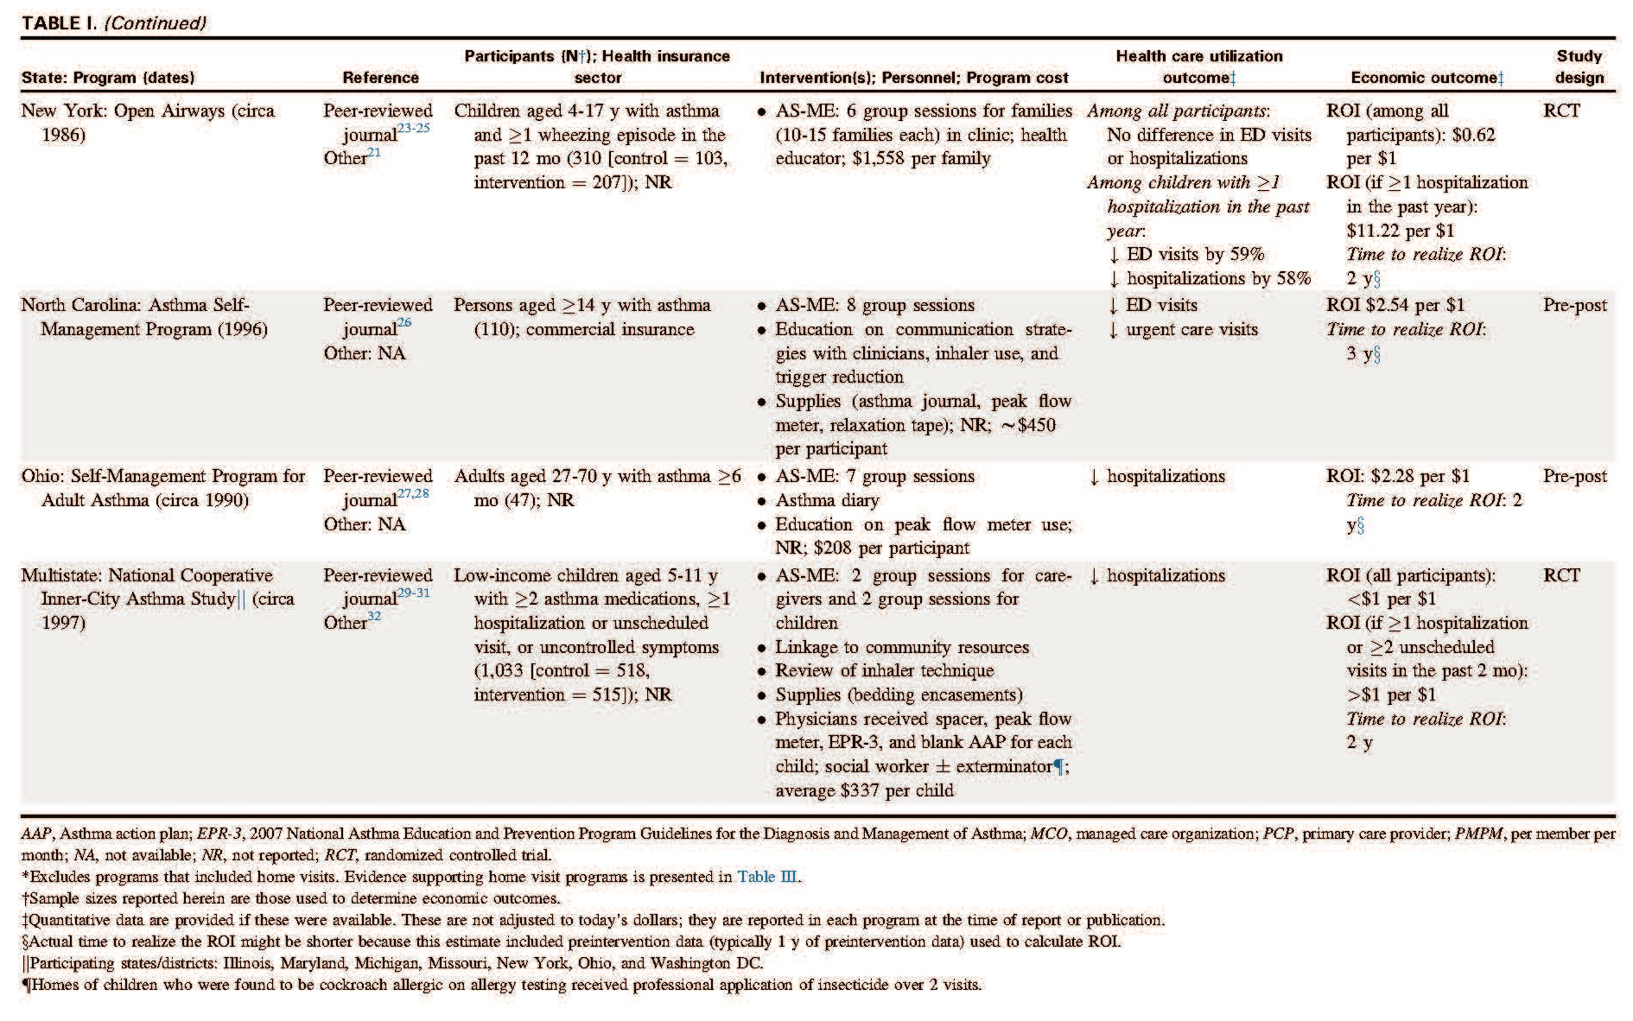
Hsu, et. al., Economic Evidence for US Asthma Self-Management Education and Home-Based Interventions, 2016, J Allergy and Clinical Immunology in Practice 4 (6), 1123-1134.

Slide 24
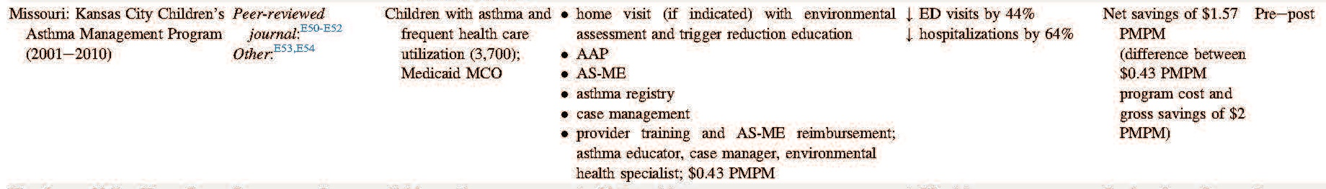
Children’s Mercy Hospital (CMH) Program 2001–2010
Hsu, et. al., Economic Evidence for US Asthma Self-Management Education and Home-Based Interventions, 2016, J Allergy and Clinical Immunology in Practice 4 (6), 1123-1134.

Slide 25
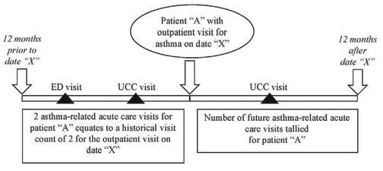
Predicting Health Care Use in Children With Asthma
Data from 2009–2013
28,047 outpatient visits identified
Representing 10,785 patients
55% ED visits, 25% urgent care, 20% inpatient
Hanson, et. al., Developing a risk stratification model for predicting future health care use in asthmatic children, 2016, Annals of Allergy, Asthma & Immunology, 116(1), 26–30.

Slide 26
Probability of Future Health Care Need for Asthma Patients
Hanson, et. al., Developing a risk stratification model for predicting future health care use in asthmatic children, 2016, Annals of Allergy, Asthma & Immunology, 116(1), 26–30.

Slide 27
In 2016, Established the High-Risk Asthma Protocol (HRAP):
Provide consistency of care in the screening and evaluation of patients with asthma who are classified as high risk and ensuring they receive coordinated care involving comprehensive resources associated with improved outcomes.
Elements
Outpatient Elements
Education
Inpatient consults offered
  Guidelines-based asthma action plan
  Environmental health referral
  Social work
  Screen for complications of steroid use
  Contact PCP
Education
Spirometry
Exhaled nitric oxide
Asthma Control Test (ACT)
Allergy testing
Environmental assessment
Social work
  Depression and adherence screening
  Case management

Slide 28
CMH Asthma Risk Stratification
3 components to determine risk:
  Past: Health care utilization
    ED visits, hospital PICU, urgent care visits
  Current: Asthma status
    Asthma Control Test (ACT score)
  Recent: Environmental exposure
    Tell us about your home.
  Determine Total Asthma Risk.

Slide 29
Stratify Service for Efficiency
Divide home-assessment services into levels based on Total Asthma Risk.
  ~75% are lower risk patients needing basic assessment services.
    Visual assessment and in-home education
    Assessment reporting with issues and actions
    Follow-up and case management
  ~25% are higher risk patients needing advanced assessment services.
    Basic services, plus…
    Deeper environmental investigation
    Environmental measurement and sampling
Kennedy et al. 2019. “The Role of Home Environments in Allergic Disease.” Clinical Reviews in Allergy and Immunology.
Notes:
We try to help investigate indoor environments for families when:
Patients have symptoms that don’t respond to “regular” treatment.
For example, a child’s doctor has prescribed appropriate medication to relieve symptoms, but because of what they are being exposed to, the medications are not sufficient to help overcome the symptoms.
Patient’s symptoms respond to treatment, but require it to be continued.
Here the child’s symptoms may have been relieved by the medication, but because of the continued exposure in the environment, they must continue to take the medicine or the symptoms will return. It’s important to make sure the family is following the directions for the medication’s use and is adhering to the therapy prescribed. Otherwise, the cause of the recurring symptoms may be from poor compliance and not actual chronic exposure.
(Remain aware of patient compliance with treatment / therapy issues)
When there is a reported pattern of symptoms within a group at a facility housing children.
This is usually a situation where a school or daycare may be having unknown air quality problems.

Slide 30
CMH Asthma-Friendly Home Program
>1,200 families received home visits, including—
Healthy home education
Visual environmental assessment
Indoor environmental assessment (advanced)
  Air flow and ventilation assessment
  IAQ gas measurement
  Dust particle and allergen assessment
  Moisture and mold assessment
Home maintenance and product surveys
Home safety check-up
  Healthy Home Resource Manual
(Williams D 2010, KCCAMP, RWJ 2007, CHCS 2006, Miller et al. 2003)

Slide 31
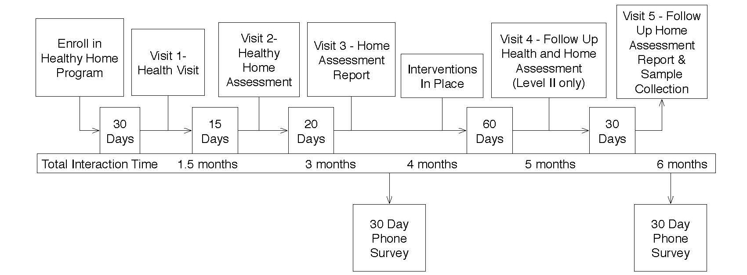
Multivisit case management models that include home assessments and in-home education are very useful.
*CDC Task Force. 2010. Findings and Rationale Statement Interventions for Children and Adolescents with Asthma. www.thecommunityguide.org/asthma/rrchildren.html
Kennedy et al. 2019. “The Role of Home Environments in Allergic Disease.” Clinical Reviews in Allergy and Immunology.

Slide 32
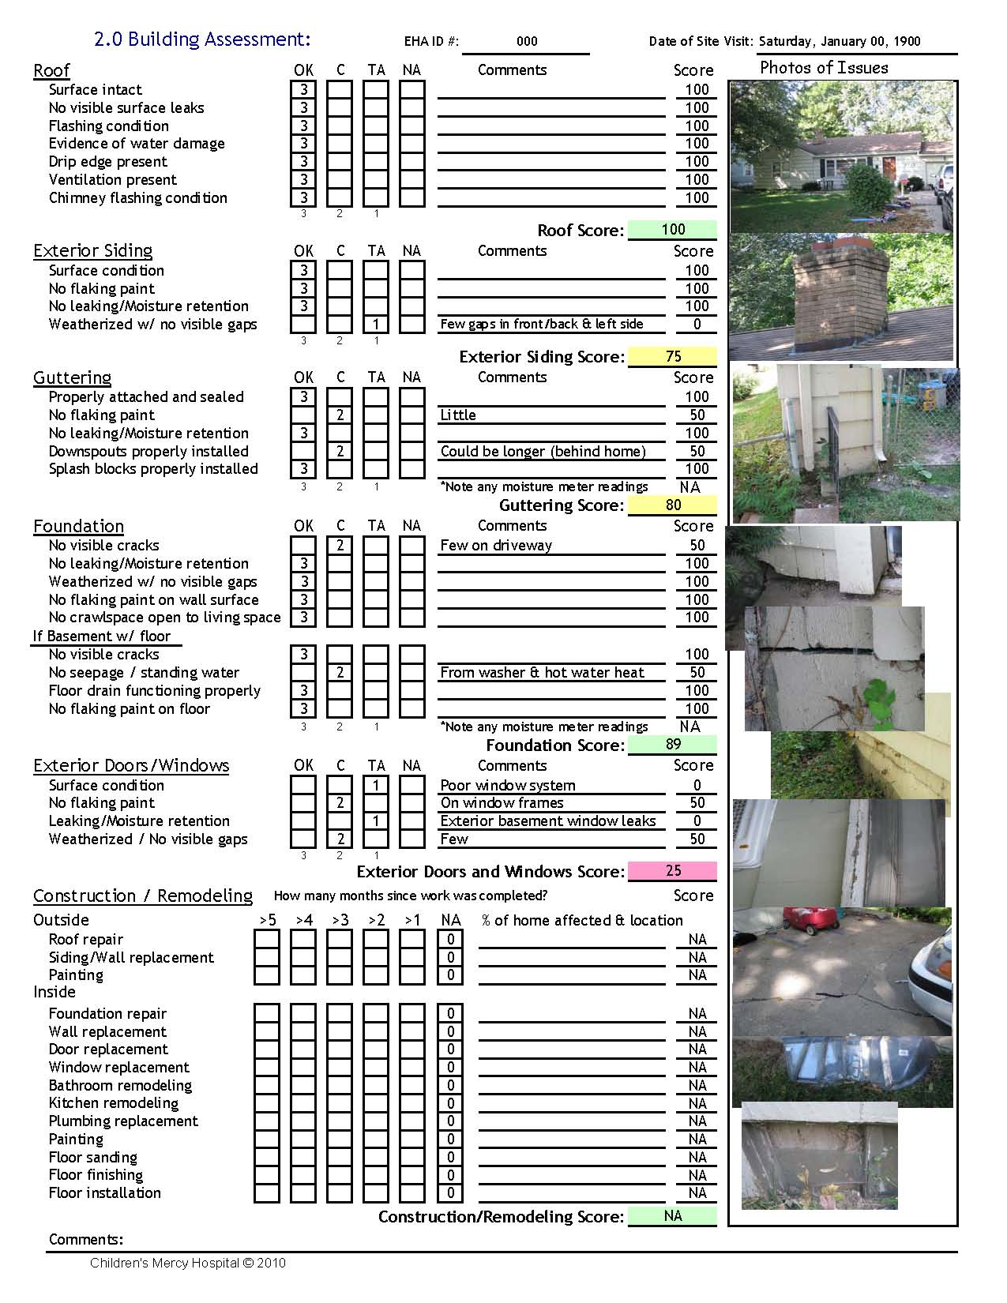
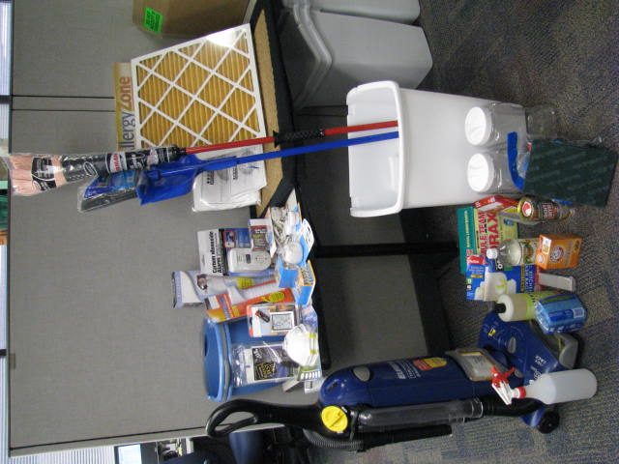
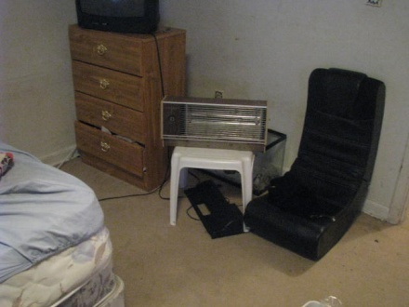
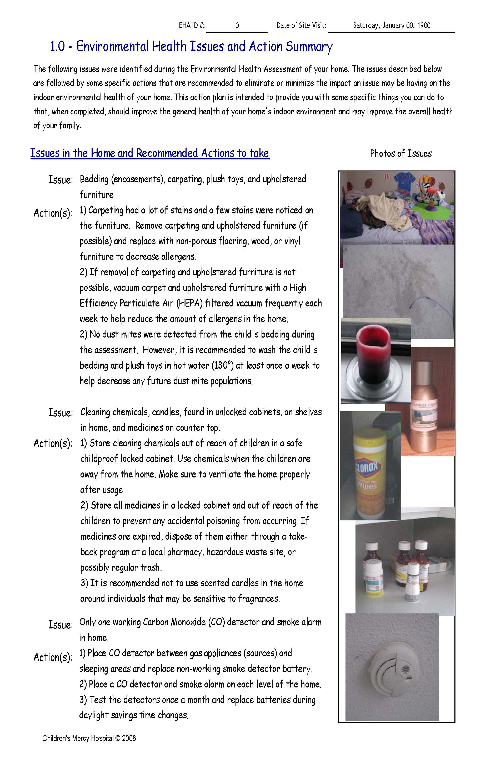
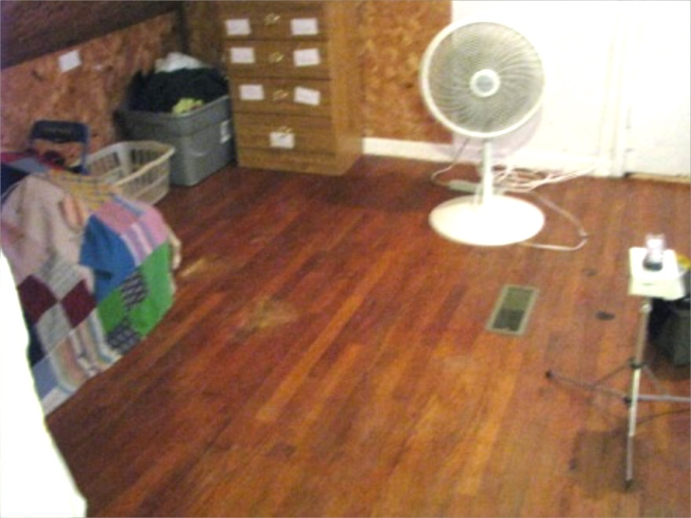
We use a multifaceted, multitargeted process.
Healthy Home Assessments
Healthy Home Supplies
Healthy Home Interventions
Before
After
Healthy Home Actions

Slide 33


Lots of resources on programs and data are here:
www.nchh.org/Resources/HealthcareFinancing/CaseStudiesandResources.aspx

Slide 34
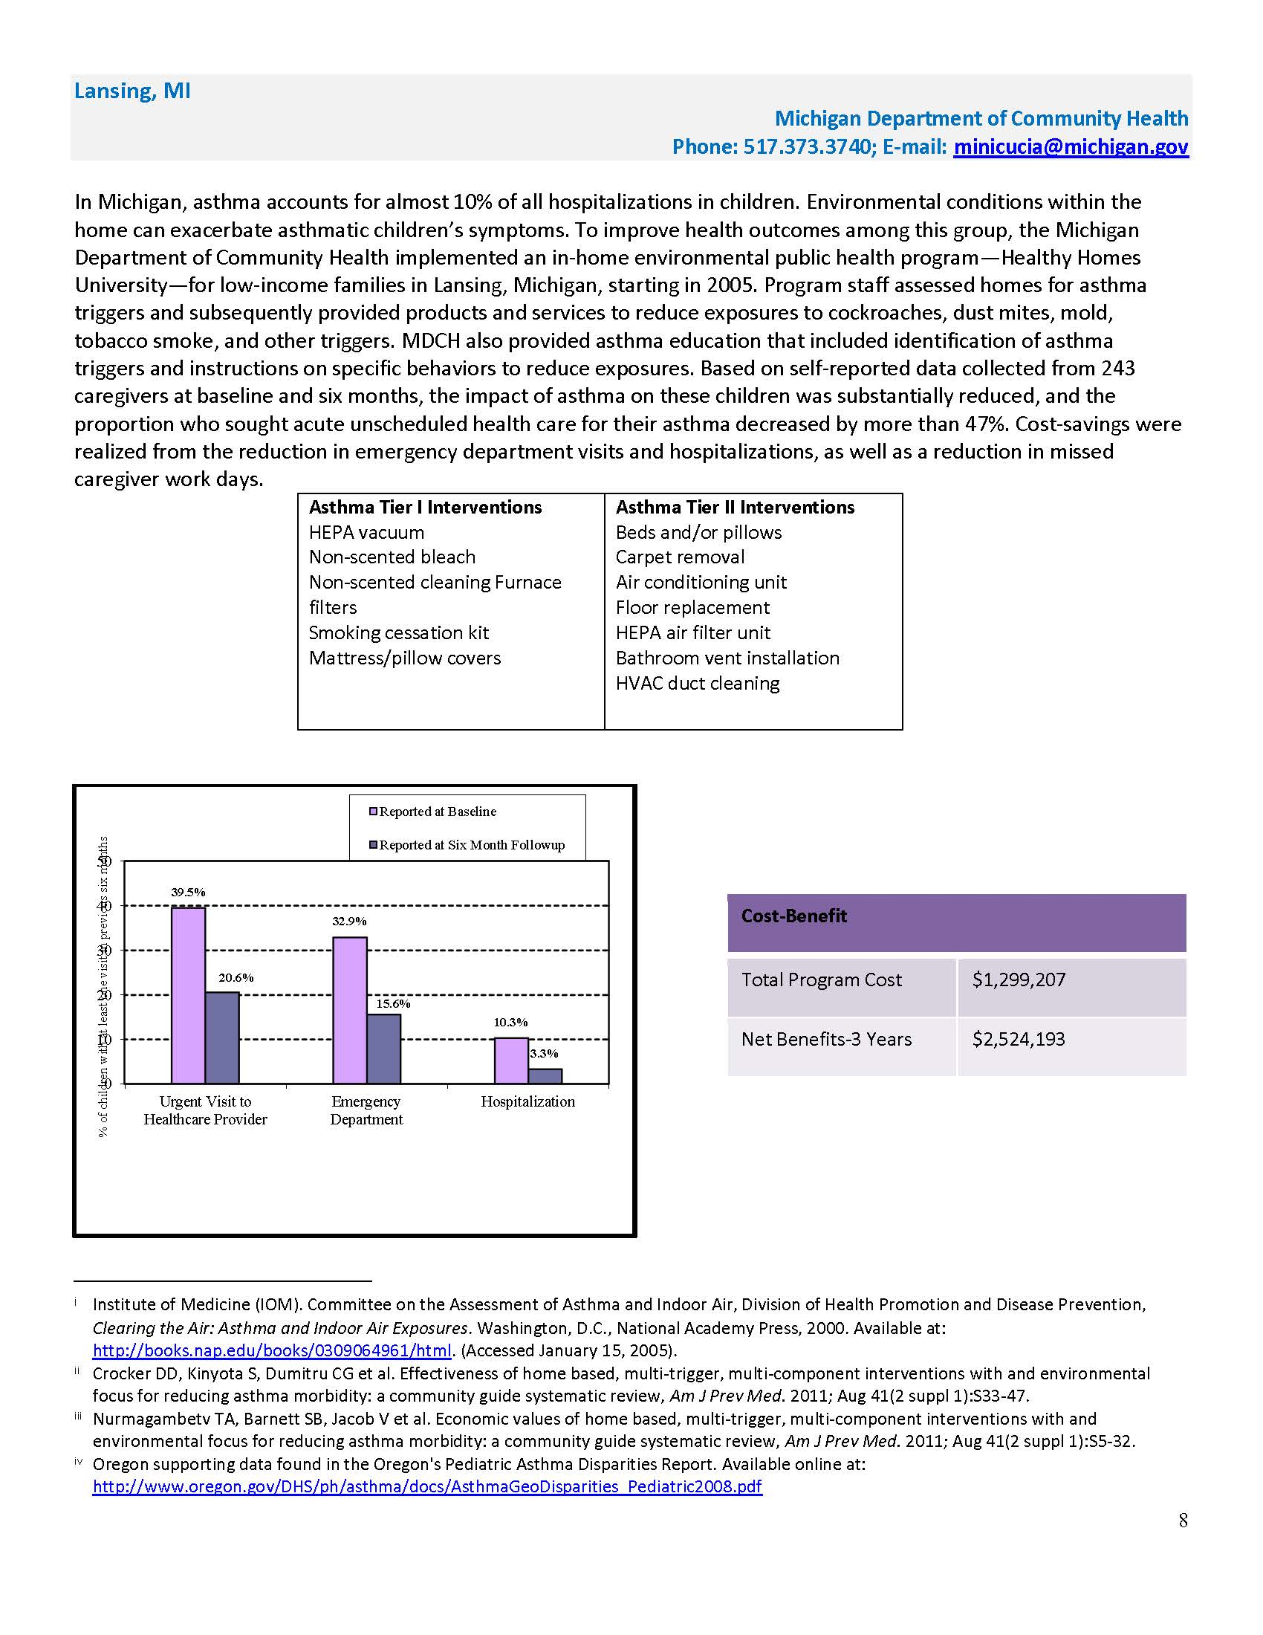
Michigan Department of Community Health
Cost Benefit (3 years)
Total Program Cost:
$1,299,207
Net Benefits:
$2,524,193
Case Studies: The Benefits of Home Visits for Children with Asthma, National Center for Healthy Housing, Report, 2014

Slide 35

Asthma Management Isn’t Just ROI
It’s about—
Managing complex co-morbidities.
Asthma disparities in communities.
The mission to improve community health.
It’s about Jeremy.

Slide 36
Kevin Kennedy, kkennedy@cmh.edu
Environmental Health Program
816-302-8556
36
Notes:
36
Launching a Healthy Homes Program
www.healthyhomestraining.org/launching/
36

Slide 37
Data-Driven Approaches for Improving Asthma Control
While Lowering Cost
Asthma Ready® Communities

Slide 38
Focus
“Using data to support and demonstrate real results in children with uncontrolled asthma and the difference data makes in sustaining your program for long term success.”

Slide 39
Better Care, Better Health, Lower Costs
What is our goal? We are trying to change…
Which authoritative sources will guide us?
What are the evidence-based drivers?
Our intervention is based on [framework(s)].
Which outcomes would show success?
Which data will show progress and outcomes?
If this works, can it be scaled and sustained?
Who are our strategic partners?
How will we show ROI?

Slide 40
Objective 1
Use two Missouri asthma improvement initiatives to illustrate application of these ideas with an emphasis on administrative claims data.

Slide 41
Objective 2
Describe an integrated model for assessing asthma status of individuals that utilizes self-report, community assessment, clinical and claims data.

Slide 42
Objective 3
Propose a population-based approach
to match asthma workforce development and service delivery to address local asthma burden for “better care, better health and lower costs.”

Slide 43

Promoting Evidence-Based Asthma Management
A School Nurse Workforce Initiative
Benjamin Francisco, PhD, PNP-BC, AE-C
Tammy Rood, MSN, CPNP-PC, AE-C
Sherri Homan RN, FNP, PhD
Rebekah Nevel, MD
Bin Ge, MD
University of Missouri
Missouri Department of Health and Senior Services (MO DHSS)
The evaluation of “Teaming Up for Asthma Control” was funded by the Centers for Disease Control and Prevention (CDC), Cooperative Agreement #5U59EH000510-05.
Notes:
Good afternoon,
Promoting Evidence-Based Asthma Management: A School Nurse Workforce Initiative, is an overview of a program entitled “Teaming Up for Asthma Control.” Principle Investigator is Dr. Benjamin Francisco. Of note, Sherri Homan is a nurse practitioner and PhD epidemiologist for the Missouri Department of Health and Senior Services who made significant contributions after initial submission of the abstract, so her name has been added to the list of authors.

Slide 44

Need Assessments
2003 survey by MO DHSS to determine the training/resource needs of Missouri school nurses
2005 web survey of the needs of practicing Missouri school nurses
2005 survey of school nurses assessing asthma disability among Missouri students
Bachman, J. A., Brennan, P. F., Patrick, T. B., & Cole, M. 2005. “A World Wide Web-Based Health Resource. Survey of Missouri School Nurses to Determine Priority Health Information Resources for Schoolhealthlink.” Journal of School Nursing 16(1), 28–33.
Notes:
Results of the study are as follows:

Slide 45
Close Gaps in Asthma Care at School
No uniform asthma training for school nurses
Lack of peak flow meters and spacers
Lack of quick-relief medications for students
No asthma educational materials
Lack of educational materials for families
Lack of uniform school asthma-care policies
Goal: Support school nurses
What we are trying to change?

Slide 46

EPR3 (2007): Rigorous, systematic review of the scientific literature
10 committees, dozens of national experts
3 years screening 15,444 abstracts
Reviewed full text of 2,122 articles.
Found that 1,654 contributed new evidence.
Constructed 20 evidence tables to analyze data from 316 articles on critical topics.
EPR3 recommendations are weighted by evidence level (Categories A, B, C & D).
Authoritative Source

Slide 47
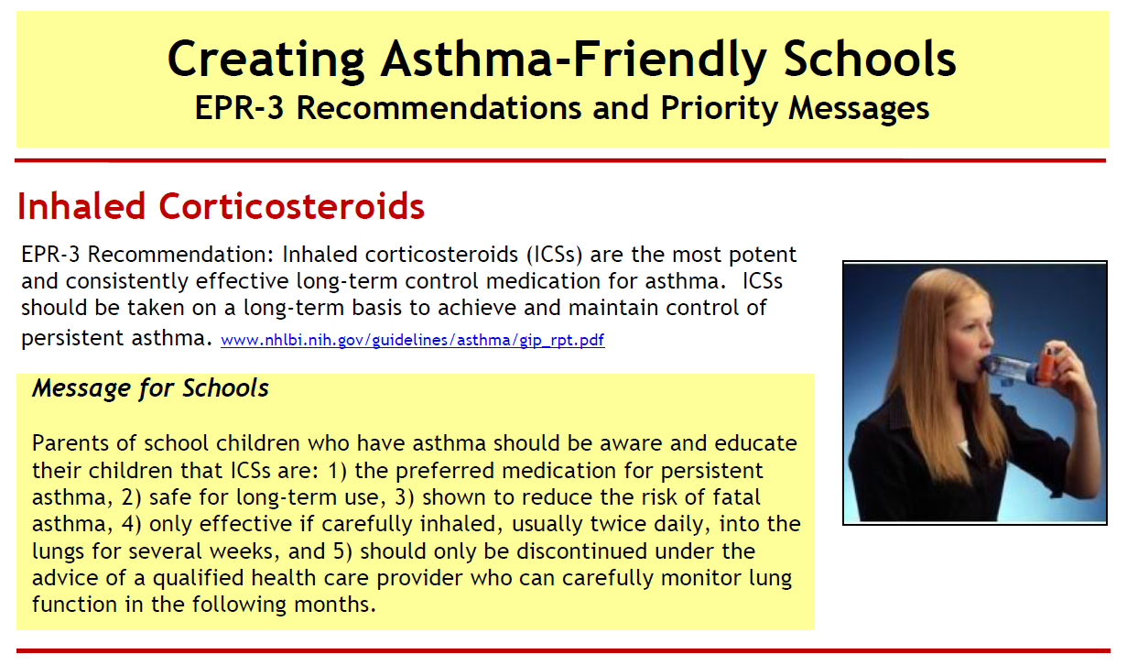

Slide 48
Teaming Up for Asthma Control
Aim: Improve asthma control in school-age children in Missouri
Intervention:
  Promote school nurse competency
    Clinically relevant assessment of impairment
    Monitoring and reporting asthma control status
    Improving student self-care
    Promote family education, healthy homes
Notes:
The aim of this study was to improve asthma control in school age children in Missouri through the develop and implementation of a highly scalable intervention to promote school nurse competency in assessing and educating students with uncontrolled asthma. The intervention was to increase monitoring, self-care behaviors and family support among students with persistent asthma in elementary schools by an asthma-trained school nurse.

Slide 49
Seven Clinical Steps to Control
(Adapted from “Partners Putting Guidelines Into Action,” 2008)
Prescribe inhaled corticosteroids.
Provide a written asthma action plan.
Assess severity, then monitor control.
Schedule periodic visits and education.
Use objective measures of airflow.
Assess/improve inhalation technique.
Bill for necessary services.
Evidence-Based Drivers

Slide 50
Potential Impact
Well Controlled
Not Well Controlled
Very Poorly Controlled
“Children’s school absences and their parents’ absences from work represented the greatest economic burden of impairment in children with severe asthma” (observational study, 600 children).
Chest Physician, vol. 5:12, p. 21, December 2010

Slide 51
Insurer Medication Costs at 24 Months
  Very poorly controlled ($2,298)
  Not well controlled ($1,995)
  Well controlled ($1,606)
Chest Physician, vol. 5:12, p. 21, December 2010

Slide 52
Increase Asthma Assessments
EPR3 1st component “Assessment & Monitoring”
Reality check—0.5 to 1.6 outpatient visits per year for Missouri Medicaid children with asthma
Challenge—obtain “Assessment & Monitoring” data at an affordable cost
Objective—support clinical decision-making, deploy special care and education for high-risk or impaired children
Collective Impact - Stanford Social Innovation Review
https://ssir.org/articles/entry/collective_impact
“Understanding the Value of Backbone Organizations in Collective Impact” ... Unlike most collaborations, collective impact initiatives involve a centralized infrastructure, ...... The five types of collaborations are a great conceptual framework.‎
Our intervention is based
on “Collective Impact.”

Slide 53


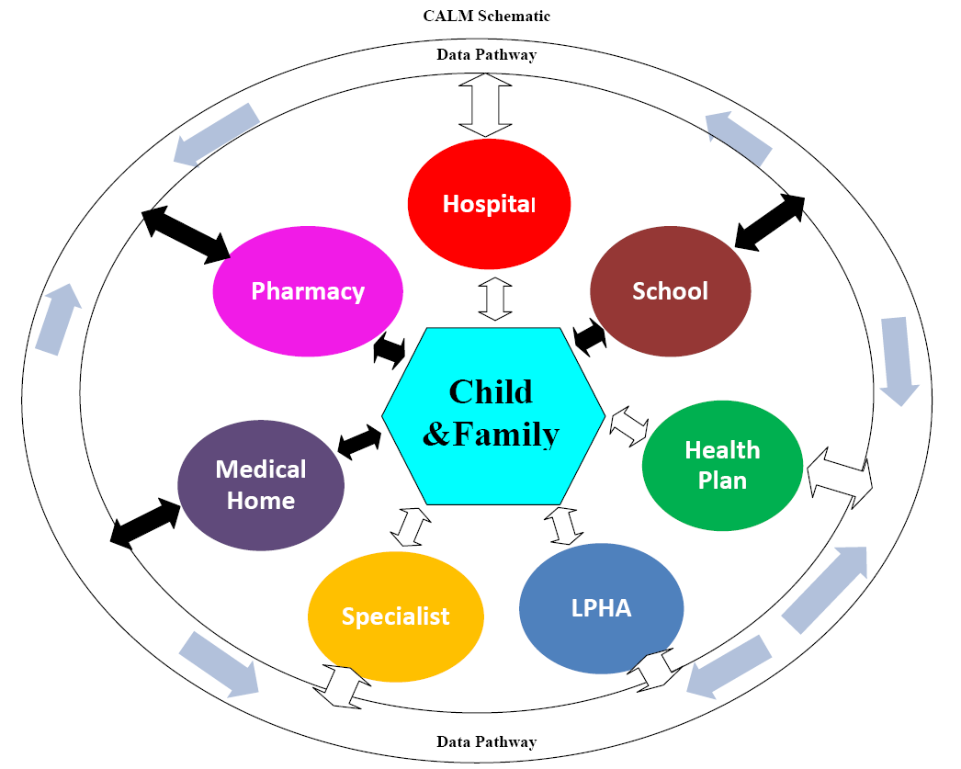

just do it.
®

Slide 54
Align Sustainable Interventions With EPR3
Educational messages and self-care coaching
  Four components
    Assessment/monitoring
    Education for self-management
    Control environmental triggers/co-morbidities
    Appropriate pharmacologic therapy
Expanded reimbursement for providers
  Opportunity to involve school nurses
Expert Panel Report 3 (EPR3) | Key messages
Assessment/monitoring | Measure airflow (FEV1)
Education for self-management | Inhaler identification/training
Control environment/co-morbidities | Avoid triggers, manage co-morbidities
Appropriate pharmacologic therapy | Inhaled corticosteroid improves control
Notes:
The National Heart, Lung, and Blood Institute, National Asthma Education and Prevention Program releases reports of evidence-based asthma care recommendations/guidelines called the Expert Panel Report, with EPR3 being the most recent version, released in 2007. This outlined key components of essential asthma control and management which included 1) assessment and monitoring, 2) education for self-management, 3) control of environmental factors and co-morbid conditions, 4) appropriate pharmacologic therapy. These can be converted into key messages for providers, patients, and families.
A second important background concept is that there has been recent appropriation in the state of Missouri which the types of providers eligible to deliver reimbursable preventive services to Medicaid participants, allowing opportunity to involve school nurses in asthma care.

Slide 55
Design/Methods
  Students enrolled by school nurses (n = 176)
    Checklist to identify children with persistent asthma
    Three encounters at school
      Forced expiratory volume in 1 second (FEV1)
      Impairment—Children's Health Survey for Asthma – Child Version, American Academy of Pediatrics (CHSA-C)
      Psychosocial well-being (CHSA-C)
      Adequacy of ICS inhaler technique (IFR and IFT)
      Identification of medication/inhaler (access and use)
      ETS and other environmental factors (CARAT)
    Self-care education by IMPACT Asthma Kids©
Notes:
Students were identified and enrolled by school nurses utilizing a checklist to identify inadequately controlled persistent asthma. There were a total of 179 students in the study arm, with an additional 1600 assessments not part of the research arm. During three encounters with each student at school, nurses assessed forced expiratory volume in one second (FEV1), impairment (Children's Health Survey for Asthma – Child Version, American Academy of Pediatrics) and adequacy of ICS inhaler technique using In-Check Dial. Students watched an animated video based on the evidenced-based program IMPACT Asthma Kids © and were sent home with materials for their family as well.

Slide 56
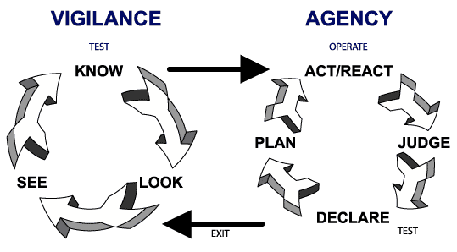
Self-Regulation Theory
Our intervention is based
on “self-regulation theory.”

Slide 57

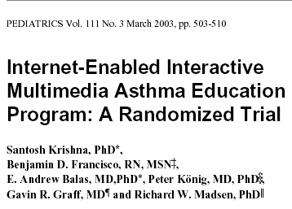
RCCT Design
228 children, 6 to 18 years
A parent present
Specialty care for all
Caring for Kids info
Three visits, 1 year
Knowledge gain
Self-report, Sx, Rx, days missed, ER, impairment
www.pediatrics.org/cgi/content/abstract/111/3/503

Slide 58



Community Healthcare for Asthma Management and Prevention of Symptoms (CHAMPS):
Highly Tailored NIH Asthma Interventions
NCICAS: The National Cooperative Inner-City Asthma Study
Asthma counselor intervention
ICAS: Inner-City Asthma Study
Environmental intervention
HEAL: Head-off Environmental Asthma in New Orleans
Combined asthma counselor (NCICAS) and environmental (ICAS) intervention in post-disaster New Orleans

Slide 59
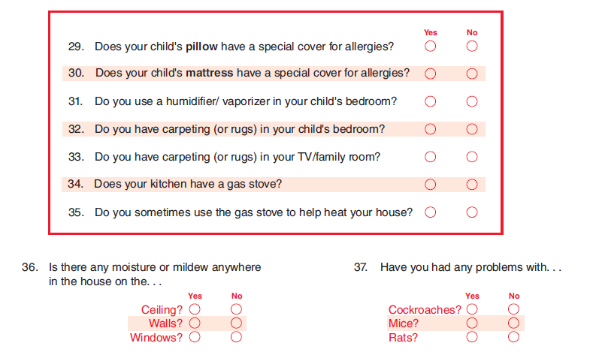

Educator Assessment (ACE©)
Using CARAT Environment Questions
®
March 26, 2012

Slide 60
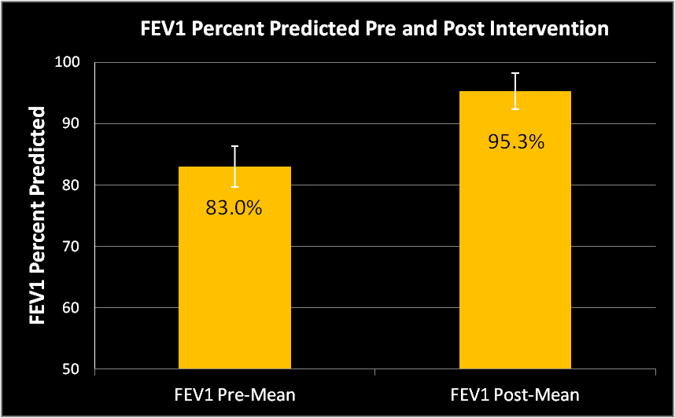
(P < 0.0001)
Notes:
FEV1 was used as the marker for airflow obstruction, measured by the handheld device the ASMA-1. Pre and post mean FEV1 for students rose 12.3 percentage points (p<0.0001).
N-173

Slide 61
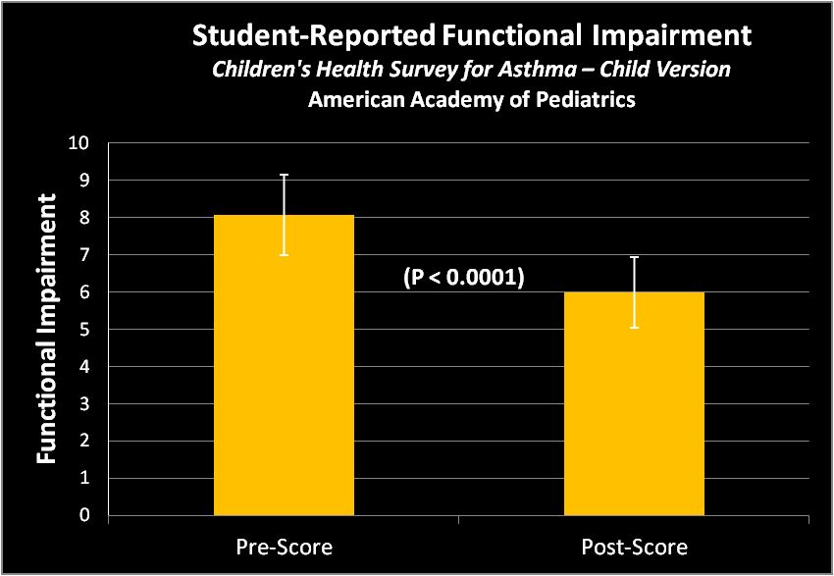
8.07
6.00
Notes:
The Children’s Healthy Survey for Asthma – Child Version from the American Academy of Pediatrics is a measurement of pediatric health-related quality of life. On this survey, the student reported functional impairment was statistically significantly improved (p<0.0001). Additionally, the Child attitude / belief score (which asks about feelings of Frustration, Isolation, Sadness, Anger, Embarrassment) – was statistically significantly improved (p<0.0001).

Slide 62
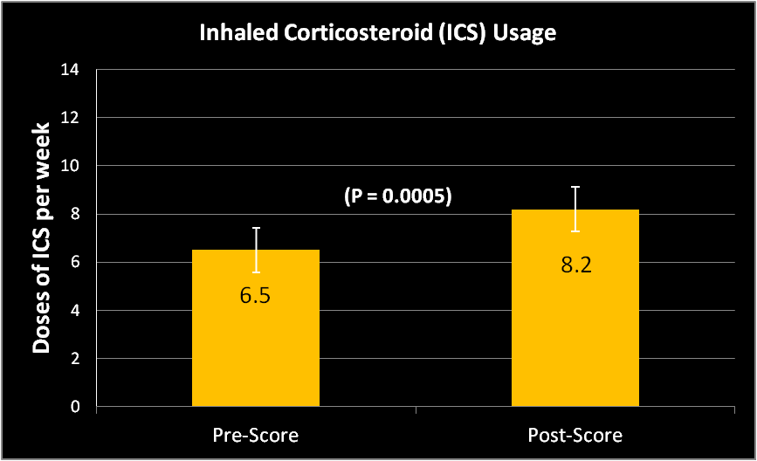
Adherence rate:
pre = 46% post = 56%
Notes:
Inhaled corticosteroids are integral to evidence based asthma care. Weekly usage of inhaled corticosteroids as per student report, was statistically significantly increased, from 6.5 doses to 8.2 doses per week.
ICS usage, n138

Slide 63
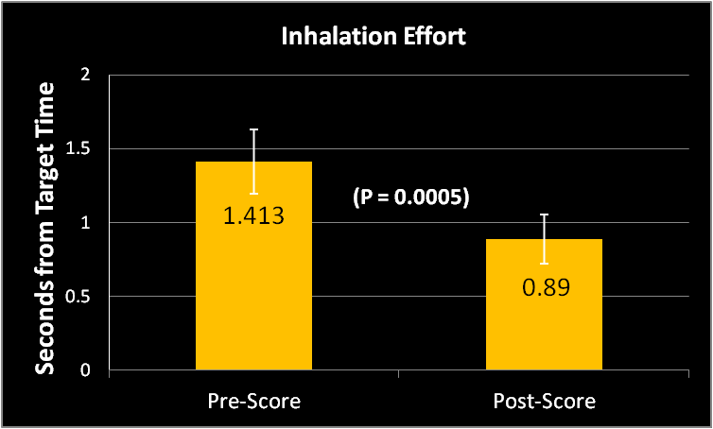
Notes:
It is known that inhalation technique (or inspiratory flow) significantly affects adequate delivery of drug deposition for inhaled medications – if too slow deposits in the mouth, if too fast deposits in the throat. Inhalation technique was assessed by target flow via the handheld In Check Dial®. Coaching by school nurses on correct technique with target flow for each inhaler (30L/min for MDI, 60L/min for DPI) and calculated target time by FEV1 to attain goal flow rate was completed by the nurse. Metered dose inhaler (MDI) technique statistically significantly improved, p<0.0001. There was no statistically significant improvement for dry powder inhaler (DPI) technique.
Of note, an additional coaching session by the evaluation team members following the nurse’s last assessment/coaching led to an additional improvement of 0.4sec (p<0.0001).

Slide 64
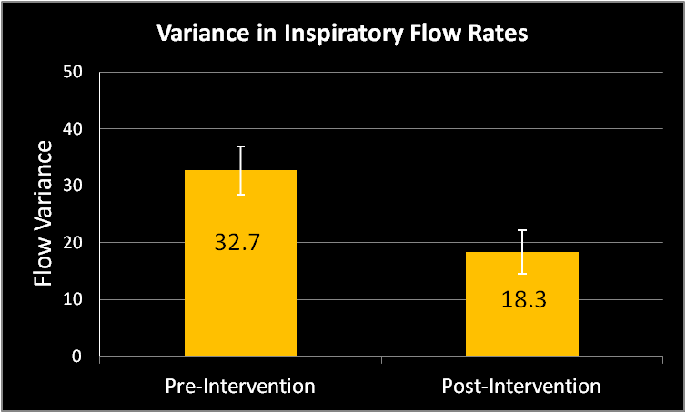
(P < 0.0001)

Slide 65
Student Psychosocial Well-Being
CHSA-C:
Child’s feelings and beliefs:
  Frustration
  Isolation
  Sadness
  Anger
  Embarrassment
Attitude/Belief Score significantly improved (p < .0001).

Slide 66
Results
Additional findings:
  Student-reported smoke exposure scores decreased (p < 0.0001).
  Participants liked the program:
    93% of parents would recommend to other families who have children with asthma.
    87% of participating nurses would recommend to other school nurses.
Notes:
Additional findings from this study include reduction in student-reported smoke exposure. A second important finding is that on post-participation surveys, the participants liked the program. 87% of participating nurses would recommend the program to other school nurses, and 93% of parents would recommend the program to other families who have children with asthma.

Slide 67
Results—ROI
Cost analysis
  Mean medical care costs rose by 11% annually between 2009 and 2014.
  Average rate increase of $350.20/year.
  TUAC costs $150 per student.
    Delivery by school nurse (or RRT, AE-C, other)
    TUAC student total mean medical care cost fell by >$1,300
  ROI 7:1 in Year 1, likely savings Years 2, 3…
Notes:
Cost analysis of this intervention was completed on children in the study who were on continuous Medicaid during the study period (so that total health care costs could be assessed), with an N of 74. These children were matched with 1,066 controls, with match criteria of age, gender, race, and pre-intervention cost strata within a $2000 cost bracket). After accounting for the mean increase cost of Medicaid expenditures per year and the $150 the program costs per child each year, this results in a mean savings of $11,000 per year for each child enrolled in this study.

Slide 68
Asthma-Trained School Nurses Serving Students With Uncontrolled Asthma
Identified at-risk students (guided judgement).
Delivered 3 standardized “check-ups.”
ICS adherence improved.
Inhalation technique improved.
FEV1% predicted increased (83 to 95).
Impairment decreased (AAP-CHSA-C).
MC cost fell by 30% (>$1300), ROI–7:1 .

Slide 69
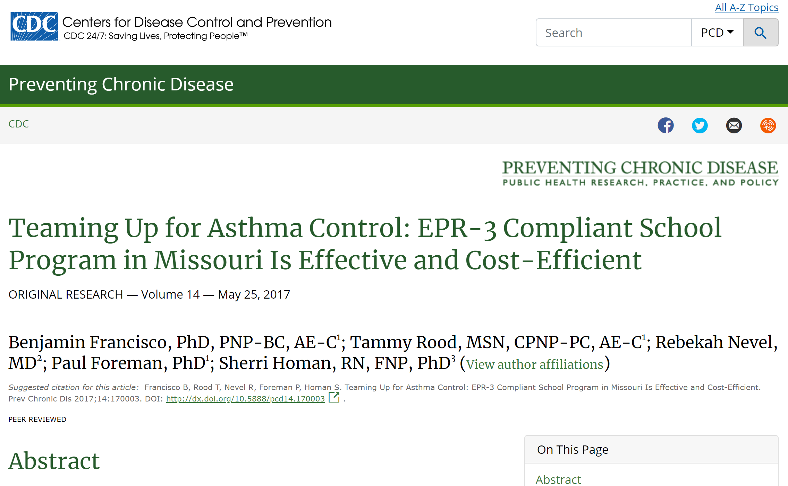
Google: “Teaming Up for Asthma Control”
www.cdc.gov/pcd/issues/2017/17_0003.htm

Slide 70
Objective 2
Describe an integrated model for assessing asthma status of individuals that utilizes clinical, claims, community services and self-report data.

Slide 71
Medical Home
Person With Asthma
Community Partners

Slide 72
Could “community” interventions and assessments coupled with claims data improve asthma care and education?
®
March 26, 2012

Slide 73
Four Critical Data Sources
1) Patients
2) Clinicians
2) Administrative claims
3) Community interventions
a) Pharmacists
b) School nurses
c) Educators
d) In-home services
®
March 26, 2012

Slide 74

EPR3 Guide to Stepping Therapy Up or Down
Step up IF needed.
FIRST, check adherence.
THEN, check inhaler technique.
AND, check environmental control.
Step down IF asthma is well controlled for 3 months or longer.
Must base therapy step changes on assessment of adherence, inhalation technique and triggers.

Slide 75
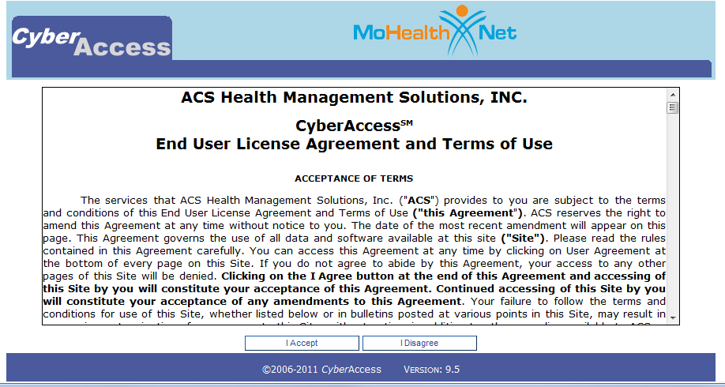
just do it.
®

Slide 76
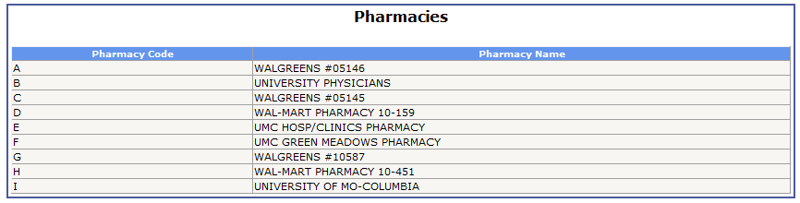
just do it.
®

Slide 77
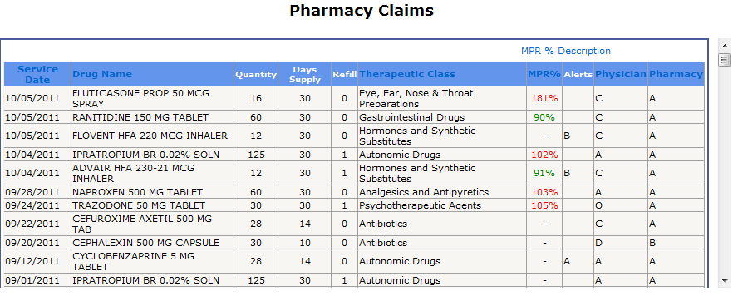
just do it.
®

Slide 78
Medication-Related Problems (MRPs)
Examples of MRPs include—
1) Low rate of ICS refills
2) >3 albuterol dispensed in 6 months
3) No spirometry in 3 years
4) Recent ER visit for asthma
5) >1 oral steroid burst in 12 months
mediasuite.multicastmedia.com/player.php?v=al80y67g
®
March 26, 2012

Slide 79
Objective 3
Summarize a population-based approach for enhancing asthma outcomes and lowering costs.

Slide 80


Traditional fee-for-service payment arrangements incent high volume care while payment reform can incent high value care and achieve cost savings.
States may work with external contractors for data management and analytics related to payment reform.
Claims data can be used to identify
high-need, high-cost patients for care coordination; and measuring, supporting, and rewarding provider performance.
“Transforming the way states pay Medicaid providers through value-based incentives holds tremendous opportunity to both slow the growth of spending and improve patient care.”
This project was supported by the Health Resources and Services Administration (HRSA) of the U.S. Department of Health and
Human Services (HHS) under grant number UD3OA22891, National Organizations of State and Local Officials, for $611,127

Slide 81
Reducing the Burden of Childhood Asthma Through Physician Engagement for Maintenance of Certification (MOC)
55,000 children with asthma are enrolled in Missouri Medicaid; 20% have uncontrolled asthma.
There is low provider adoption of best practices.
Preliminary findings in 2018 showed seven providers who adopted best practices after participating in a video-teleconferencing (ECHO®) program for MOC reduced asthma burden for their panel of patients.
A second provider cohort will participate in 2019. An implementation science, learning health system approach will be used to refine this strategy.

Slide 82

Favorable Policy Changes in Missouri
Impacting Asthma Care and Education
MC Reimbursement 99605 Medication Therapy Management (2009)
House Bill 1188 Life-Threatening Asthma (2012)
Missouri Revised Statute Funds ECHO® (2015)
Medicaid SPA*–Childhood Asthma HH* (2016)
MC SPA–Preventive Asthma Services (2016)
Senate Bill 579–Telemedicine in Schools (2016)
*HH = sole qualifying condition for patient center health home
*SPA = state plan amendment approved by Centers for Medicare
and Medicaid Services

Slide 83
Array of Clinical and Preventive Services*
Service Type | Eligible Group | Service Cost
1) Asthma literacy* | Everyone with asthma | Low, S9441*
2) Key messages | Everyone with asthma | Bundled w/OP visit
3) Inhalation instruction | Everyone with asthma | Low, 94664
4) PMC, risk reduction | Not well controlled | Moderate, 99401,2
5) Medication Therapy Management* | Claims alerts at point of dispensing Rx | Moderate, 99605,6,7
6) Self-management* | Very poorly controlled | Moderate, 98960,1,2*
7) Home trigger reduction* | VPC, high ACD, good ICS adherence and IHT | Moderate, S9441-SC*
8) Coach/counselor* | VPC, VH$, refractory | High, Health Home

Slide 84
Promoting Asthma Best Practices—
The Asthma Care Accelerator©
Learning Health System framework
ECHO® platform to connect >1,200 health care providers and health agency staff
Provides CE, CME, Advanced Pharmacology credit and MOC, Part 2 and Part 4
Uses local run charts over 6 months to document implementation of best practices
Compares claims data for the year before and the year of participation

Slide 85
How Do We Implement Best Asthma Practices?
Learning together (ECHO®)
Academic detailing (supplies, routines)
Performance feedback (claims data)
Practice facilitation (seeing patients)
Implementing Asthma Guidelines Using Practice Facilitation and Local Learning Collaboratives: A Randomized Controlled Trial
www.ncbi.nlm.nih.gov/pmc/articles/PMC4018371/

Slide 86
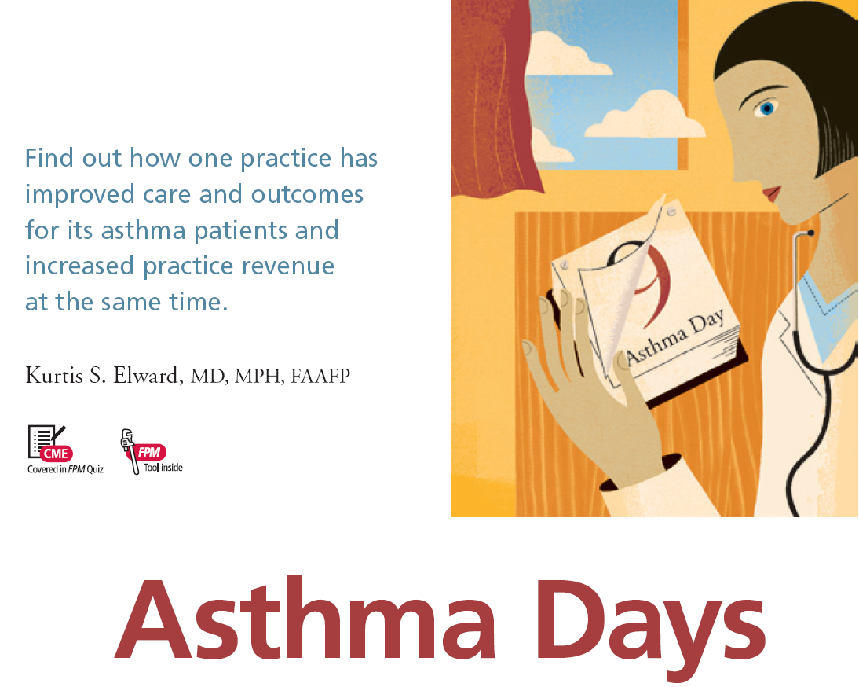
Model for Asthma Practice Facilitation

Slide 87
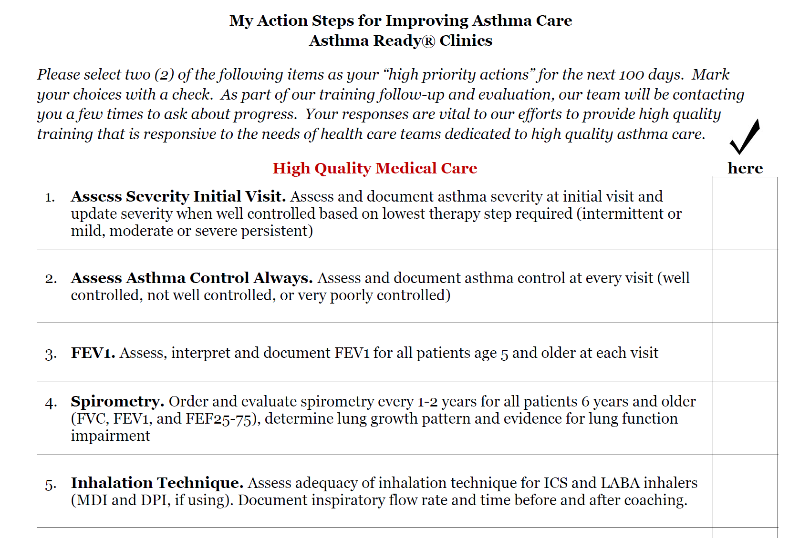
Implementing Asthma Best Practices fs2.formsite.com/openform/form30/index.html

Slide 88
Use of Specified Asthma Diagnoses—2014 to 2017 (Missouri Medicaid)

Slide 89

www.ahrq.gov/learning-health-systems/index.html

Slide 90




THE TRANSFORMATIVE MODEL IN MEDICAL EDUCATION AND CARE DELIVERY
www.youtube.com/watch?v=VAMaHP-tEwk
Project ECHO® (Extension for Community Healthcare Outcomes) helps democratize medical knowledge and develops specialty care capacity in underserved communities.
Using a revolutionary model of telementoring, collaborative medical education and care management, Project ECHO empowers front-line primary care professionals to provide the right care, in the right place, at the right time.
Image Credit: NEJM : 364: 23, June 9-2011, Arora S, Thornton K, Murata G

Slide 91

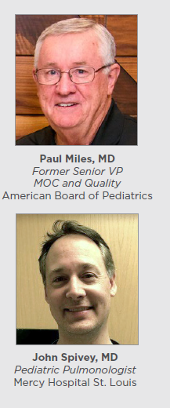
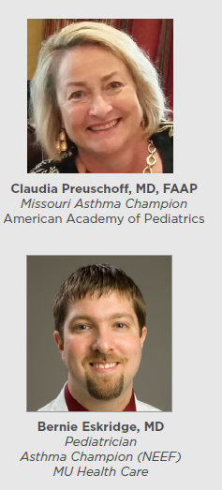
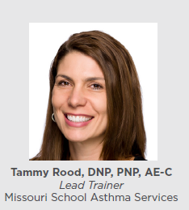


Part of the Team

Slide 92
Asthma ECHO® Participants
2015–2019

Slide 93
Population-Based Approach
ZIP-code level asthma surveillance
Workforce development—current health professionals not prepared or equipped
Robust claims analysis to promote best practices and stratify asthma interventions
  Drug utilization reviews, provider messaging
  Messaging families of at-risk children
Standardized assessments and interventions
Asthma Control Data Monitor©

Slide 94
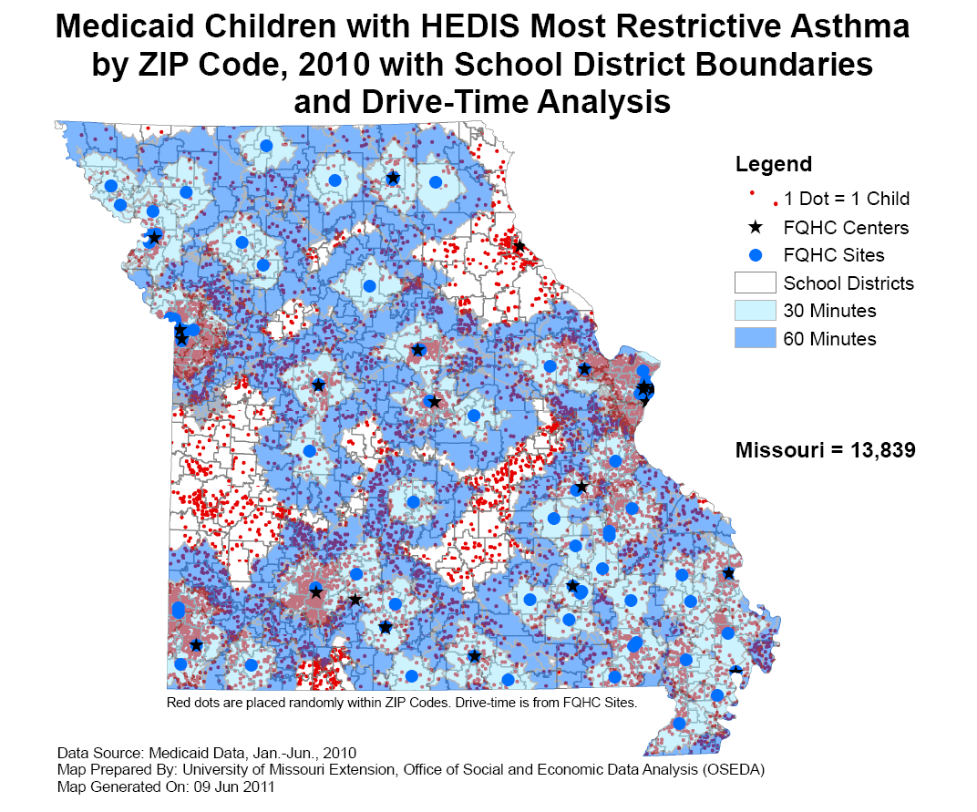
Geo-Mapping by FQHC

Slide 95
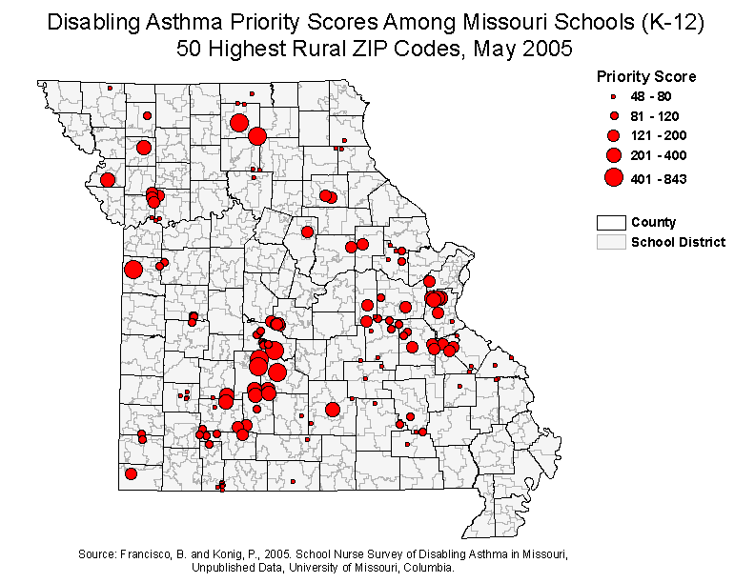
Top 50 Rural School Districts

Slide 96
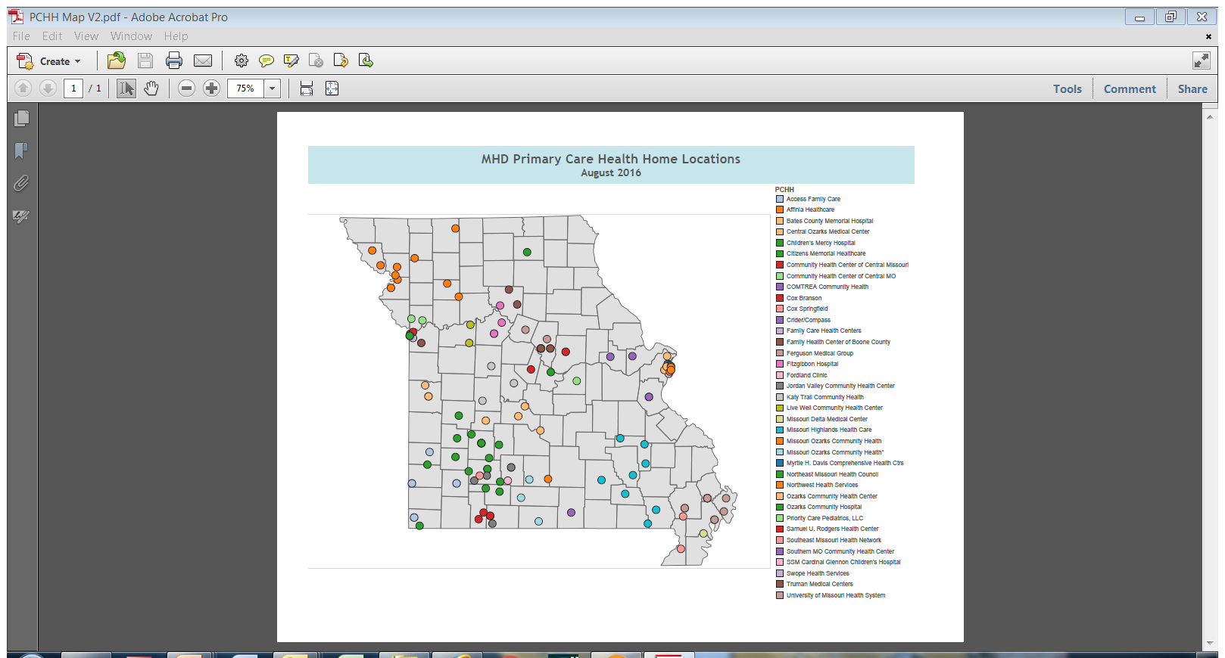
Community Asthma Care & Education Hubs

Slide 97

High Impact – Low Cost
Plan and Implement Best Practices

Slide 98
Low-Cost, High-Impact Actions
Clinical
  94664 inhalation instructions, standardized assessments, each knows “target time”
  Interventions to promote ICS adherence, gift card incentive, 2-month “Star Chart”
  Use of hypertonic saline for self-care, nasal rinse or mist
  Trigger identification, avoidance, indoor air quality (NEEF clinical history, EPA Home Survey, CARAT)

Slide 99
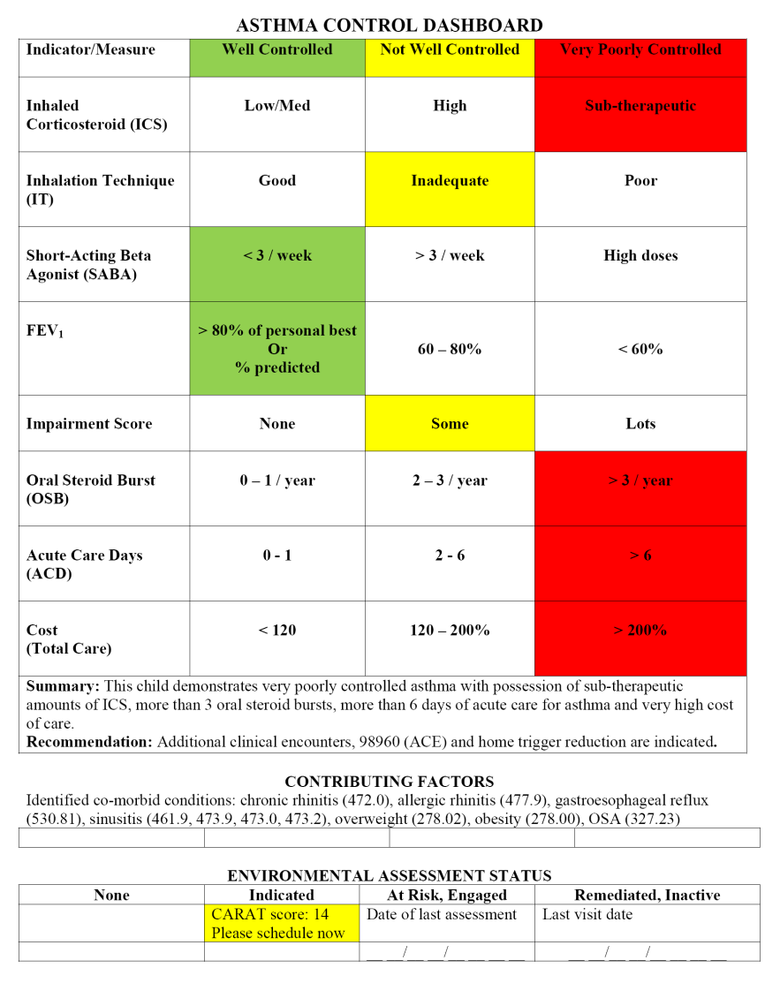
Asthma Control Data Monitor©

Slide 100
Asthma Control Dashboard appdev.cares.missouri.edu/cgi-bin/ARC/ACM.py
(Patient 1)
Past 90 days | Indicator / Measure | Well Controlled | Not Well Controlled | Very Poorly Controlled
 | Inhaled Corticosteroid | Low / Med | High | Sub-therapeutic
 | Inhalation Technique | Good | Inadequate | Poor
 | SABA | < 3 / week | > 3 / week | High doses
 | FEV₁ | > 80% of personal best Or % Predicted | 60% - 80% | < 60%
 | Impairment Score | None | Some | Lots
Past 3 years | Oral Steroid Burst | 0 - 1 / year | 2 - 3 / year | > 3 year
 | Acute Care Days | 0 - 1 day | 2 - 6 days | > 6 days
 | Cost | < 120% | 120% - 200% | > 200%
 | Summary: This child demonstrates very poorly controlled asthma with possession of sub-therapeutic amounts of ICS, more than 3 oral steroid bursts, more than 6 days of acute care for asthma and very high cost of care. Recommendation: Additional clinical encounters, 98960 (ACE) and home trigger reduction.

Slide 101
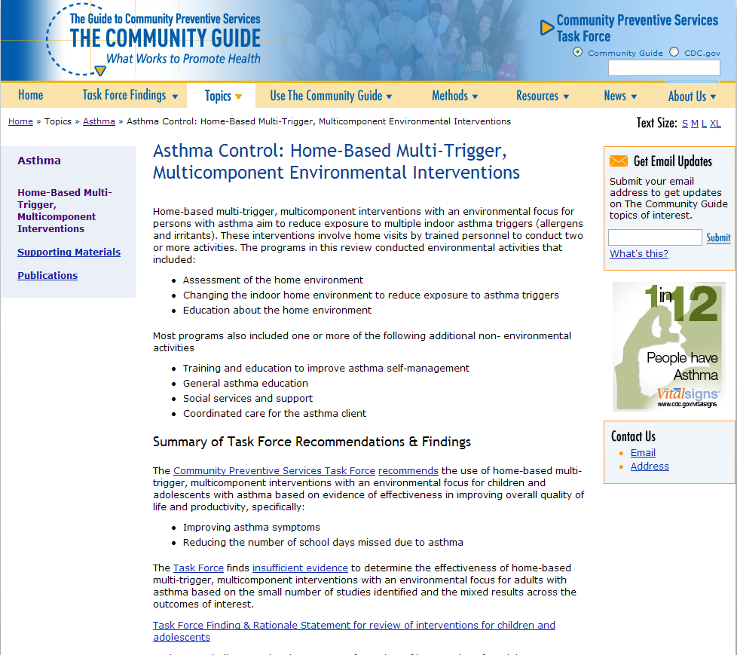
Environmental Interventions

Slide 102
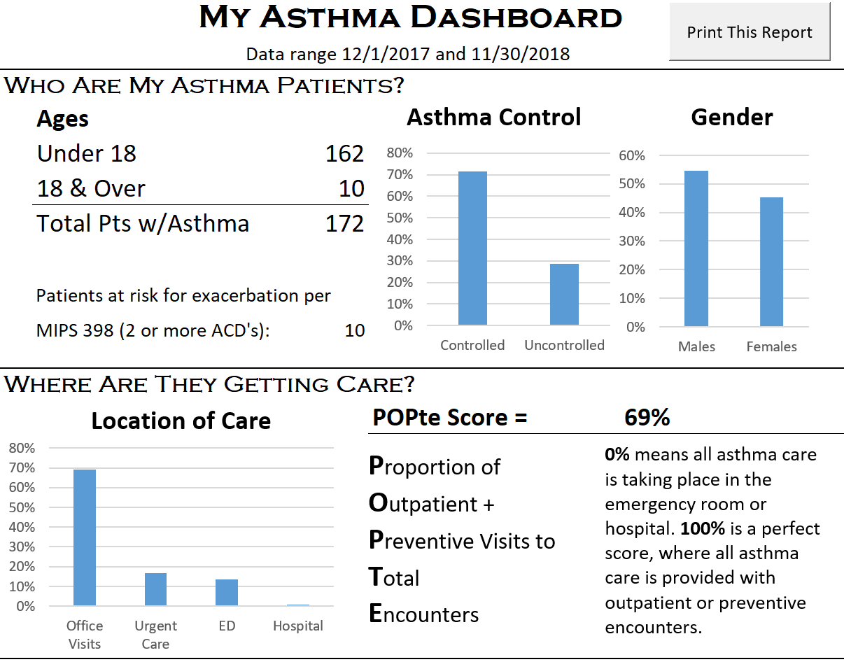
Clinical Provider Asthma Panel Report

Slide 103
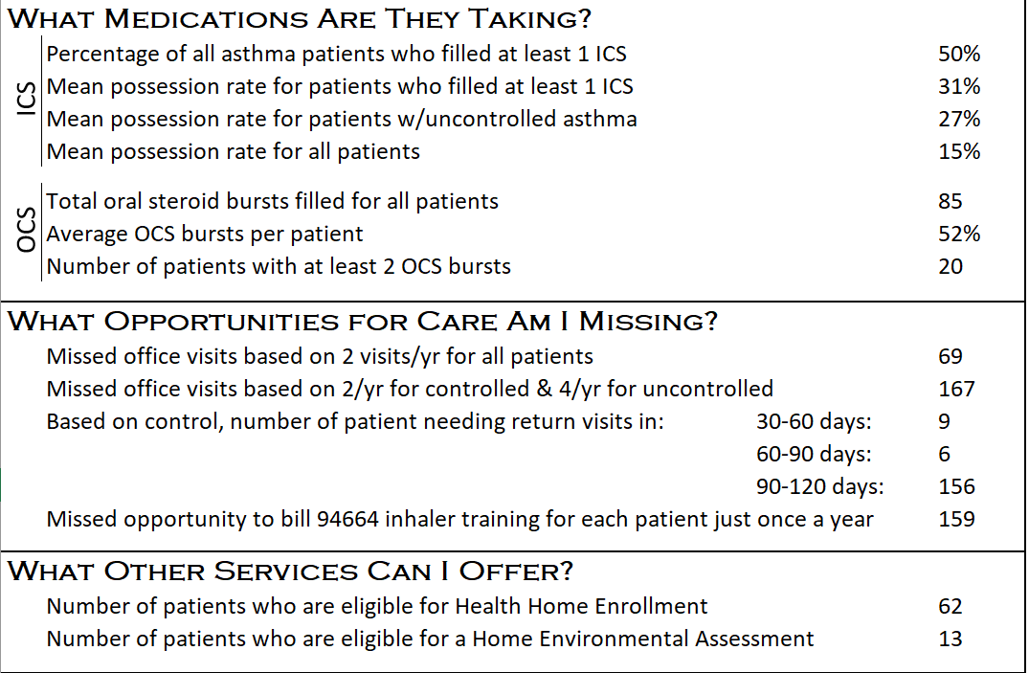
Clinical Provider Asthma Panel Report

Slide 104

$umming Up
Better care (EPR3-compliant)
Better outcomes for our patients
Greater professional satisfaction
Increased clinical revenue
Lower insurer costs
Lower total health care costs

Slide 105

www.asthmaready.org

Slide 106


Slide 107







Slide 108
Polling Question 3
Based on what you heard from our speakers, what will you do next to use data to improve asthma control?
    Work within my program to better collect and analyze data.
    Work with partners in my community to gain access to other asthma data (e.g. hospitals, payers, schools, etc.).
    Learn more about data by accessing resources on AsthmaCommunityNetwork.org.
    Other
Indoor Air Quality (IAQ)

Slide 109
Question & Answer Session on
AsthmaCommunityNetwork.org Discussion Forum
Immediately after the webinar, join us in the AsthmaCommunityNetwork.org Discussion Forum for a live online Q&A Session:
4:00 p.m. – 4:30 p.m. EDT
To post a question in the Discussion Forum, follow these directions:
If you are a Network member, log in to your AsthmaCommunityNetwork.org account.
Click on the “Discussion Forum” button on the home page.
Click on the “Live Online Q&A for 7/30/19 Webinar” link.
Click on the “Add New Forum Topic” link to post your question.
Enter your question and click the “Save” button at the bottom of the page.
Not a member? Create an account at AsthmaCommunityNetwork.org by clicking the “Join Now” link at the left side of the page. Your account will be approved momentarily, and you can begin posting questions.
Indoor Air Quality (IAQ)
Notes:
Our Q&A will take place on the Discussion Forum on AsthmaCommunityNetwork.org.
To see the discussion forum directly, please click the link that we just sent you via the chat function.
To ask questions, you must first be a member of AsthmaCommunityNetwork.org, so please take a minute to join so that you can post questions throughout the webinar—it is a simple and quick process. The Site Administrator will be approving memberships as they are submitted.
After the Q&A period is closed, please visit the Discussion Forum often to see other contributions as well as to make your own!

