Slide 1




Welcome
Coordinated Care: Making
In-Home Asthma Visit Referrals Work
Participant Dial-In: (800) 374-0278
Conference ID: 65863332
Thursday, November 19, 2015, Webinar: 2:00 p.m.–3:00 p.m. EST
Live Online Q&A: 3:00 p.m.–3:30 p.m. EST on AsthmaCommunityNetwork.org
Notes:
[Sheila Brown, Moderator]
Greetings and welcome. I’m Sheila Brown from EPA’s Office of Air and Radiation. I have the honor of serving as the moderator for today’s webinar titled, “Coordinated Care: Making In-Home Asthma Visit Referrals Work.”
I also want to extend a warm welcome to our expert speakers for the webinar—Dr. Elizabeth Gates, Taney [“TAH- knee”] Simon, and Anjali [“Ann-JAH-lee”] Nath.
Thank you all for participating in this important discussion and for the helpful questions that many of you submitted in advance.
In addition to introducing our topic and speakers, I will let you know how to keep this conversation going through our online discussion forum at AsthmaCommunityNetwork.org.

Slide 2
Purpose
Gain insights into—
What makes a successful referral process
Strategies for facilitating referrals and communication
Collaboration to support and sustain programs
Notes:
[Sheila Brown, Moderator]
As you may know, in-home asthma visits that include a focus on reducing environmental asthma triggers have been shown to improve asthma control, particularly for children and adolescents.
By extending care beyond physicians' offices and into patients’ homes and communities, these visits also hold promise for reducing asthma disparities.
Yet this effective intervention is often underutilized and thus, represents a missed opportunity to improve patients’ lives.
Connecting patients with in-home asthma visit programs—and coordinating their care—requires effective referral and communication.
Today’s webinar will offer you strategies—ranging from simple steps to high-tech approaches— for promoting a success referral process as part of a comprehensive asthma management program. We also hope that it will contribute to the wider use and reimbursement of in-home asthma visits, and ultimately, to better outcomes.

Slide 3
Agenda
Introduction
Roundtable Discussion With Experts in the Field
Q&A in AsthmaCommunityNetwork.org Discussion Forum
Member? You can post questions now. Use the link in the Chat box.
Not yet a member? Joining online is quick and easy.
Go to AsthmaCommunityNetwork.org.
Click “Join Now” at the top of the screen and complete the application process.
Post questions as soon as your account is approved.
Notes:
[Sheila Brown, Moderator]
Following this introduction, Lisa Gilmore of The Cadmus Group will offer a few insights then kickoff the roundtable discussion with our three expert speakers. They will provide a quick overview of their programs and share their stories and strategies for success.
Right after this webinar, you can interact with our expert speakers through a 30-minute live question-and-answer session. If you are a member of AsthmaCommunityNetwork.org, give yourself a round of applause. You can begin posting your questions now, using the link sent to you in the webinar chat box.
If you are not a member, let’s change that right now. Simply go to AsthmaCommunityNetwork.org, click “Join Now” at the top, and then take a few minutes to complete the application process. Our Site Administrator is eagerly waiting to approve your membership as soon as it is submitted.

Slide 4
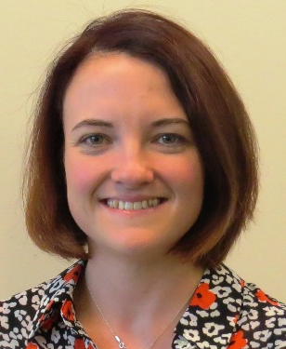


Speakers
 | Elizabeth Gates, M.D. Director of Pediatrics Unity Health Care, Inc. Washington, D.C.
 | Taney Simon Public Health Analyst, Lead and Healthy Housing Division Department of Energy and Environment Government of the District of Columbia
 | Anjali Nath, M.P.H. Director, Asthma Prevention and Control Program Division of Healthy Homes and Community Supports Boston Public Health Commission, Boston, MA
Notes:
[Sheila Brown, Moderator]
I am now pleased to introduce our experts from the field, including a pediatrician who refers patients for in-home asthma visits and two program leaders from public agencies who coordinate collaborative asthma home visit and environmental inspection programs.
Dr. Elizabeth Gates is the Director of Pediatrics at Unity Health Care in Washington, D.C.
Taney [“TAH-knee”] Simon is a Public Health Analyst with the Lead and Healthy Housing Division at the District of Columbia’s Department of Energy and Environment.
Anjali [“Ann-JAH-lee”] Nath is the Director of the Asthma Prevention and Control Program at the Boston Public Health Commission in Massachusetts.

Slide 5
Poll 1
What type of organization do you represent?
Health care provider
Health plan
Community-based asthma program
Government agency
Other
Notes:
[Sheila Brown, Moderator]
Before I turn it over to Lisa, we’d like to ask the audience two quick questions. First what type of organization do you represent?
[Wait for webinar participants to answer the poll and make a few comments about the answers]

Slide 6
Poll 2
What do you see as the largest barrier to successful referrals?
Time required to make the referral
Lack of knowledge about where to refer
Need to protect patient privacy (HIPAA)
Patient acceptance of the referral
Negotiating data-sharing agreements
Notes:
[Sheila Brown, Moderator]
Our next poll asks what you see as the largest barrier to a successful referral.
[Wait for webinar participants to answer the poll and make a few comments about the answers.]
Our experts for today’s webinar will discuss with you their thoughts about how to address these barriers.
Lisa, you may begin.

Slide 7
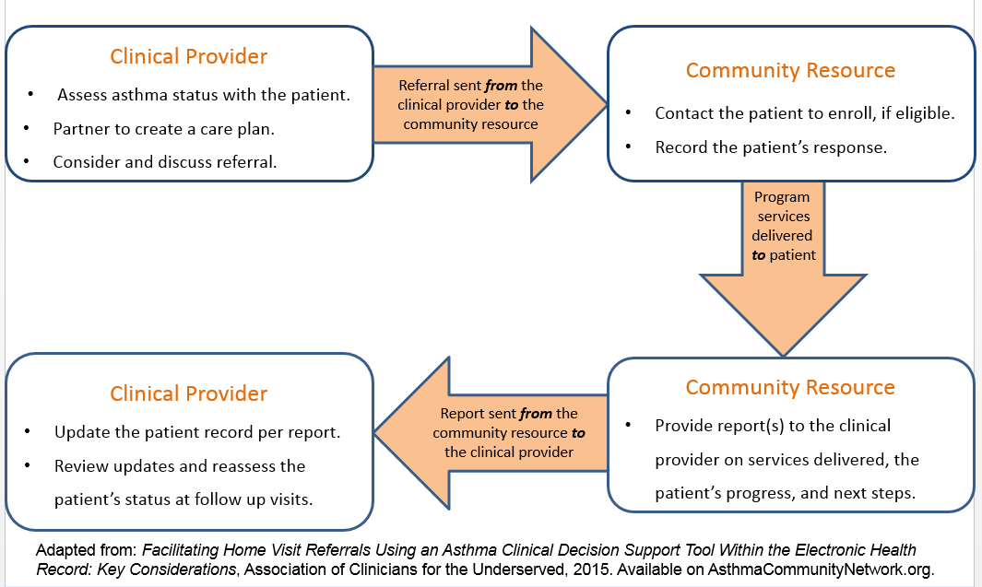
What Makes a Successful Referral?
Notes:
[Lisa Gilmore, Facilitator]
Thank you, Sheila.
What makes a successful referral?
Successful referrals connect patients with asthma to effective community resources—and report back to referring clinicians on the progress and results to inform future care.
However, making a successful referral is not as easy as it sounds. It works best when there are strong relationships among the referring provider, patient, and program, and when all parties have the information and support they need at each stage of the referral process.
There are several steps that you can take to help ensure a positive outcome.

Slide 8
What is Needed to
Facilitate Referrals?
Collaborative relationships and agreements
Patient support
Pathways for communication
Accountability for coordinating and tracking
Notes:
[Lisa Gilmore, Facilitator]
First, build collaborative relationships. Crafting agreements that clearly outline shared expectations for referral, information sharing, and care coordination between the referring provider and the program providing in-home services are particularly helpful. Health plans and government agencies also are key players to include in your program planning.
Second, engage patients, families and caregivers as active partners throughout the referral process and assist them with any barriers or concerns that they might have. For example, they may wonder why the referral has been made, or they may feel uncomfortable letting someone into their home.
Third, develop pathways for communication among referring partners. Communication can range from the simple—such as a physician sending a referral form to the home visit program by secure fax or email—to the more advanced—such as enabling real-time data sharing between providers and programs through a Web-based database, portal or electronic health record.
Finally, assume accountability for coordinating and tracking referrals to completion. A hiccup at any stage could lead to less-than-desirable results for all concerned.
Our speakers will now share with you their perspectives on what it takes to facilitate successful referrals.

Slide 9
Would you tell us about your program and what referral and communication strategies you use?
Notes:
[Lisa Gilmore, Facilitator]
Our first question is for all of our speakers —
Would you tell us about your program and what referral and communication strategies you use?
Dr. Gates—we will start with you, seeking your perspective as a referring physician.

Slide 10
Collaborating on In-Home Asthma Visit Referrals and Communication for Underserved Patients in the
District of Columbia
Elizabeth Gates, M.D.
Director of Pediatrics
Unity Health Care, Inc.
November 19, 2015
Notes:
[Dr. Elizabeth Gates, Speaker]
Hello, everyone. I’ll be speaking today about Unity Health Care, what we do, whom we serve, and our experiences in collaborating with the Department of Energy and Environment in D.C. to refer patients for in-home services.

Slide 11
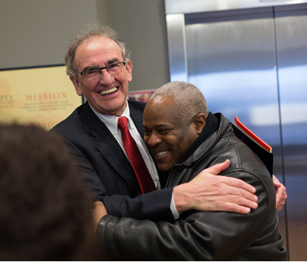
Our Mission Comes First
Promoting healthier communities through compassion and comprehensive health and human services, regardless of the ability to pay.
Notes:
[Dr. Elizabeth Gates, Speaker]
Our mission at Unity Health Care is promoting healthier communities through compassion and comprehensive health and human services, regardless of the ability to pay.

Slide 12
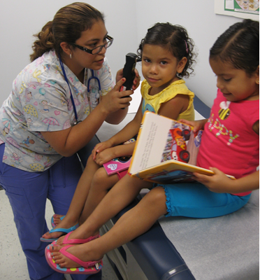
Unity Health Care, Inc.
Founded in 1985 as the Health Care for the Homeless Project.
Became a Federally Qualified Health Center in 1996.
Recognized as a NCQA Level 3 Patient-Centered Medical Home.
Served 108,595 patients (532,202 visits) in 2014:
  61% Medicaid/CHIP
  74% African American
  18% Hispanic
  21% Children
Notes:
[Dr. Elizabeth Gates, Speaker]
Unity was founded in 1985 as the Health Care for the Homeless Project and became a Federally Qualified Health Center in 1996. True to our founding mission, we provide care to a predominantly minority, low-income, medically underserved population, including those experiencing homelessness or incarceration.

Slide 13
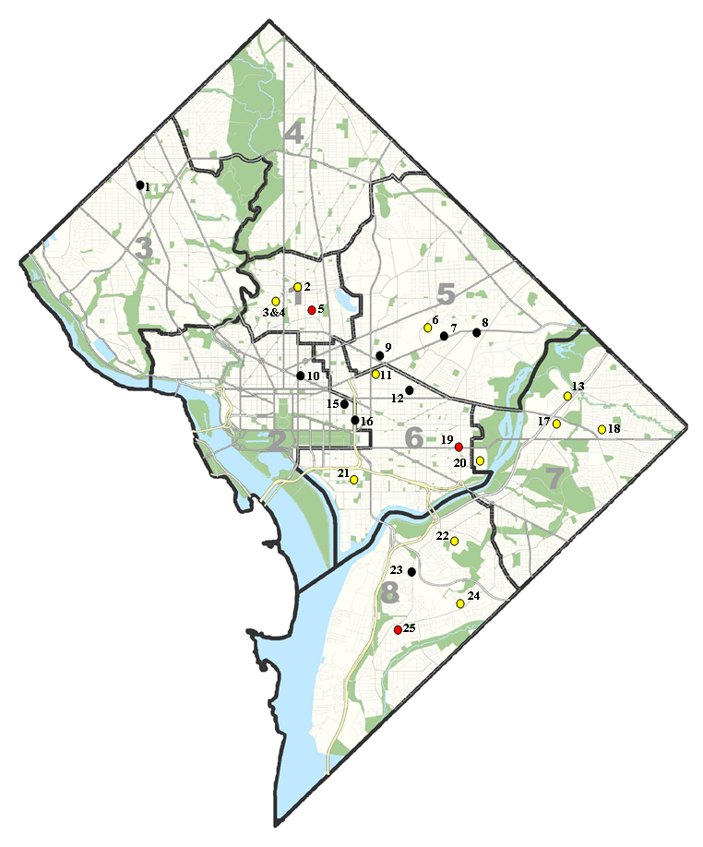
Unity Sites
District of Columbia
11 community health centers
10 medical sites in homeless shelters
4 school-based health centers
Health services in the D.C. jail
1 mobile van
Health Centers
Homeless Sites
School-Based Health Centers
Notes:
[Dr. Elizabeth Gates, Speaker]
In addition to our 11 community health centers, Unity provides medical services at homeless shelters, within school-based health centers, and at the DC Department of Corrections. We also operate a mobile medical outreach vehicle.

Slide 14

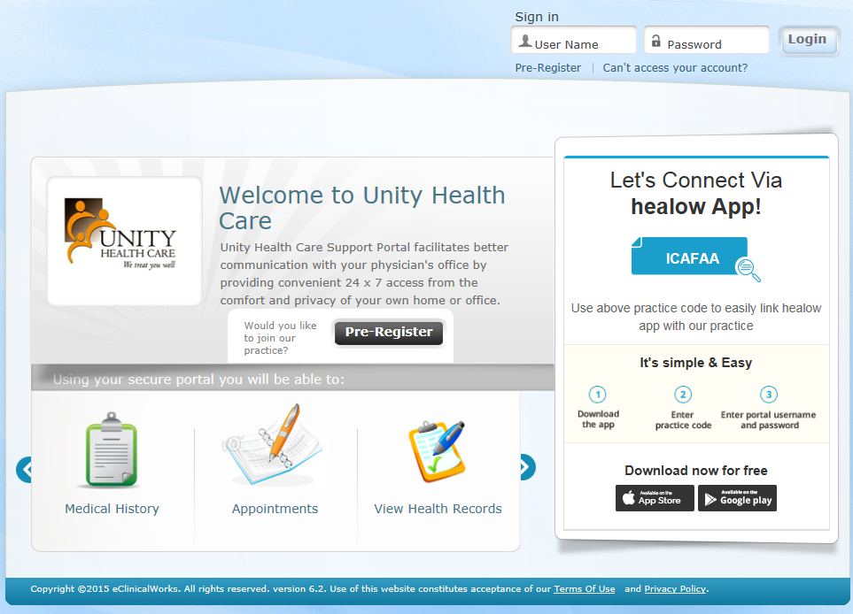
Patient-Centered Communication, Collaboration and Care Coordination
Recognized as a NCQA Level 3 Patient-Centered Medical Home
  ↑ Team-based care
Patient Portal
  ↑ Patient support
Electronic Health Record and Practice Management System
  ↑ Care coordination
  ↑ Provider productivity
Notes:
[Dr. Elizabeth Gates, Speaker]
As a Patient-Centered Medical Home, we’ve worked hard to improve our communication systems so that we can better coordinate patient care, both internally and through referrals to outside programs.
Our secure patient portal and app make it easier for patients to communicate with their provider, schedule appointments, and track their own care.
And implementation of our electronic health records and practice management system across 29 health care sites has improved the effectiveness, efficiency, safety and quality of care and has significantly enhanced our capacity to collect, monitor and use data for quality assurance and quality improvement activities.
[Lisa Gilmore, Facilitator]
Thank you, Dr. Gates. As you indicated, Unity Health Care is collaborating with the Department of Energy and Environment in D.C. to refer patients for in-home services. We will now turn to Taney Simon who coordinates these services.

Slide 15

DC’s Healthy Homes Program
Promoting Safer Homes and
Supporting Better Care Coordination
Lead and Healthy Housing Division
Department of Energy and Environment (DOEE)
Government of the District of Columbia
Taney Simon
Public Health Analyst
November 19, 2015
Notes:
[Taney Simon, Speaker]
Greetings ☺ This is Taney Simon, Public Health Analyst with D.C.’s Department of Energy and Environment (DOEE). Our work within the Lead and Healthy Housing Division supports our desire to promote safer homes and support better care coordination.
DOEE’s Healthy Homes Program visits homes identified as potentially containing a variety of different environmental hazards, many of which may be asthma triggers. Coordination then occurs between DOEE and other District agencies to reduce or eliminate those environmental health threats.

Slide 16
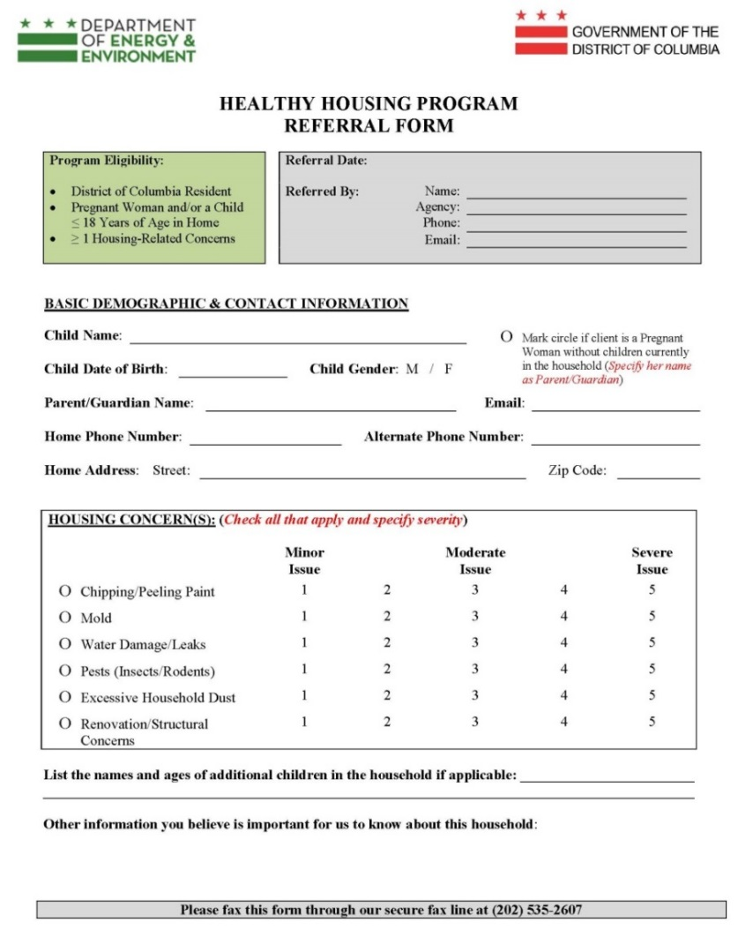
Referral Process
    Program eligibility
District of Columbia resident
Pregnant woman and/or child ≤ 18 years
At least 1 housing-related health concern
    Referrals to DOEE via secure fax
  Use a fax number known to the partners
  Tailor the referral form for each partner
  Provide housing concerns data
Notes:
[Taney Simon, Speaker]
Our environmental health specialists and case managers are happy to serve any District resident who is a pregnant woman and/or caregiver living in a home with a child 18 years old or younger. The family must report at least one housing-related health concern in order for a referral to be initiated.
Referrals are made through our various partners who send referral forms through our secure fax line. We make a point to tailor our referral form to accommodate each of our partner’s special populations, as well as data collection needs and collaborative data sharing agreements. For instance, you may want our report back to you to capture a statistical break down of how many patients you referred to us with a particular insurance provider. Since we know that information is important to you, we would add a correlating field to just your referral form and be sure to report the data back to you quarterly.
Physicians and health care professionals in our community have grown accustomed to making childhood lead exposure referrals through this system and continue to be comfortable making Healthy Homes referrals this way.
The housing concerns section of our referral form contains fields that we are particularly interested in, as they allow the person referring to conduct a prescreening of the in-home hazards their patients are most worried about. As you can see, a patient might be prompted to reflect their health-related housing hazard concerns, along with an indication of how great a concern there is.
Our partners are able to ask the right questions to complete the housing concerns assessment due their involvement in DC’s Partnership for Lead-Safe and Healthy Homes,….

Slide 17

DC Partnership for Lead-Safe and Healthy Housing
    A DOEE-led partnership of medical providers, managed care organizations, health and social service agencies, nonprofits and environmental health groups that works to—
    Establish step-by-step collaborative protocols and procedures for referral and communication.
    Enhance patient support through Healthy Homes education for key partner staff.
    Ensure accountability through partner meetings, quarterly result reports and partnership evaluations.
Partners
Catholic Charities
Community of Hope
Children’s National Medical Center
DC Department of Health
Health Services for Children with Special Needs
Howard University Hospital
Impact DC Asthma Clinic
Lead Safe DC
Mary’s Center
Strong Families Program
Unity Health Care
AmeriHealth, District of Columbia
MedStar Family Choice
Trusted Health Plan
Bread for the City (legal aid)
Children’s Law Center (legal aid)
Housing Choice Voucher Program, DC Housing Authority
Notes:
[Taney Simon, Speaker]
…which is a DOEE-led partnership of medical providers, managed care organizations, health and social service agencies, nonprofits, and environmental health groups that works to—
Establish step-by-step collaborative protocols and procedures for referral and communication. We work diligently to make sure that our program understands the procedures and operations of those of the other side of the referral. This helps us work better with the community toward collaborative care.
We also provide Healthy Homes education to our partner staff, making them aware of the inner workings of our program, our case management targets and standards, and how our policies guide our team, which pushes us toward the overall goals of enhancing patient support.
Last, we ensure accountability through partner meetings, quarterly result reports, and partnership evaluations. The Partnership meets as a whole unit a few times a year, and we also meet with individual partners as much as necessary. Our quarterly results report the story of how your referred patients progressed through our program and share our interactions with property owners and landlords throughout the city, as well as our remediation and intervention victories.

Slide 18
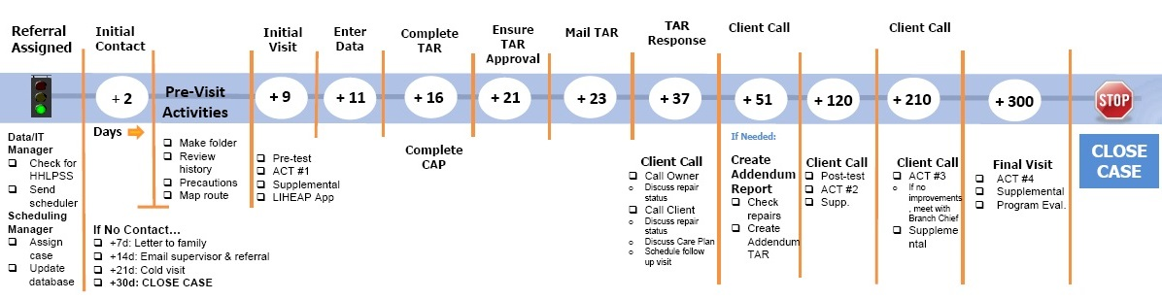
DC Healthy Homes Timeline
Home Inspection
Conduct a thorough environmental assessment and energy audit.
Produce a Technical Assistance Report (TAR) and work with owners and agencies to address health and safety threats.
Provide a custom Client Care Plan and educate the family on reducing risks.
Asthma Management
Administer Asthma Control Test™ at quarterly intervals per timeline.
Use DOEE’s Asthma Management Diagnostic Tool to identify gaps vs. six key asthma guidelines measures.
Coordinate with the family and health care provider to close gaps in care.
Notes:
[Taney Simon, Speaker]
Typically, we build our reports and updates around specific program checkpoints found on our program timeline, which is our internal quality assurance tool. We use it to make sure each patient you refer to us receives the same standard of care. Our environmental health specialists conduct thorough environmental assessments and energy audits. All identified hazards are entered into a product we refer to as a Technical Assistance report. We use these reports to have conversations with landlords and property owners about safety threats, acceptable housing conditions and how existing hazards should be changed. We also track client behaviors through the creation of a Client Care Plan. We use this tool to highlight existing behaviors and suggest new ones through education.
A second home visit focuses on asthma management. We administer Asthma Control tests quarterly and begin this particular visit with our Asthma Diagnostic Tool, which is an in-depth assessment tool adapted from NIH’s 2007 Expert Panel report titled Guidelines for Diagnosis and Management of Asthma. This assessment helps us to identify gaps in asthma care. We record those gaps and provide the patient’s medical provider with relevant feedback. Here’s a snapshot of our Diagnostic tool, which is available in the Resource Bank on AsthmaCommunityNetwork.org.

Slide 19
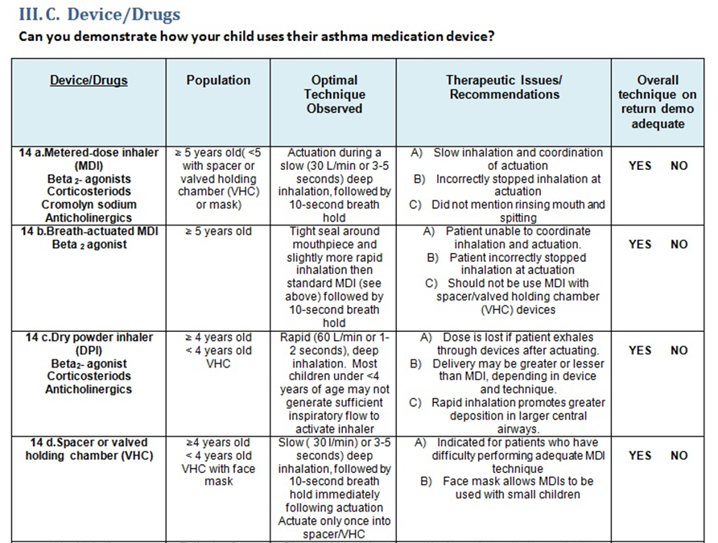
DC Healthy Homes
Asthma Management Diagnostic
Notes:
[Taney Simon, Speaker]
Here is Section 3C. It prompts our environmental health specialist to have the patients demonstrate their use of their asthma medication. If, for example, our staff notices that a patient is improperly administering the medication, they’d record that information and provide it to the patient’s physician.

Slide 20
DC Healthy Homes
Technical Assistance Report
Room ID # | Hazard ID # | Hazard Description | Potential Health Risk | Suggested Corrective Measure
1 | A | Gap at the base of the front door. | Holes and gaps allow pests to migrate in the home. The presence of pests in the home may trigger an allergic reaction and/or worsen any existing asthma conditions and symptoms. | Review the “The Lead-Safe Certified Guide to Renovate Right.” (enclosed) Then safely repair the gap in the door.
1 | C, D | Water damage on living room ceiling. | Unrepaired surfaces that have experienced water damage may continue to host mold and other harmful bacteria, even when moisture is not present. | Repair ceiling as described in “Renovate Right” pamphlet. Review “Mold, Mildew, Moisture & Your Home” pamphlet (enclosed).
3 | A | Mold in kitchen cabinet. | Mold can cause respiratory problems and exacerbate asthma. | Repair as described in “Renovate Right” pamphlet. Review “Mold, Mildew, Moisture & Your Home” pamphlet (enclosed).
4 | A | Vent is missing air duct. | Absence of air duct eliminates proper ventilation in the home. | Replace the air duct.
5 | E | Electrical cover missing from bedroom wall. | Absence of electrical outlet cover is a fire hazard and increases the risk of home injury. | Replace outlet cover.
Notes:
[Taney Simon, Speaker]
We also make our Technical Assistance Reports available to partners. You’ll see here that we code hazards by assigning each room a number and each hazard a letter. We then describe the hazard, explain the potential health risk and suggest recommended repairs. Our program has seen more than 75% of landlords voluntarily comply with our recommendations before any fines are issued.
[Lisa Gilmore, Facilitator]
Thanks, Taney. It was great to hear about the collaborative protocols, procedures and tools that your program is using.
Anjali, we now look forward to learning more about your programs and strategies for referral and communication.

Slide 21
Creating Systemic Support for Improving Asthma Home Visiting Standards
Anjali Nath, M.P.H.
Director, Asthma Prevention & Control
Division of Healthy Homes & Community Supports
Boston Public Health Commission (BPHC)
Asthma Community Network
November 19, 2015
Notes:
[Anjali Nath, Speaker]
[Read from slide]

Slide 22
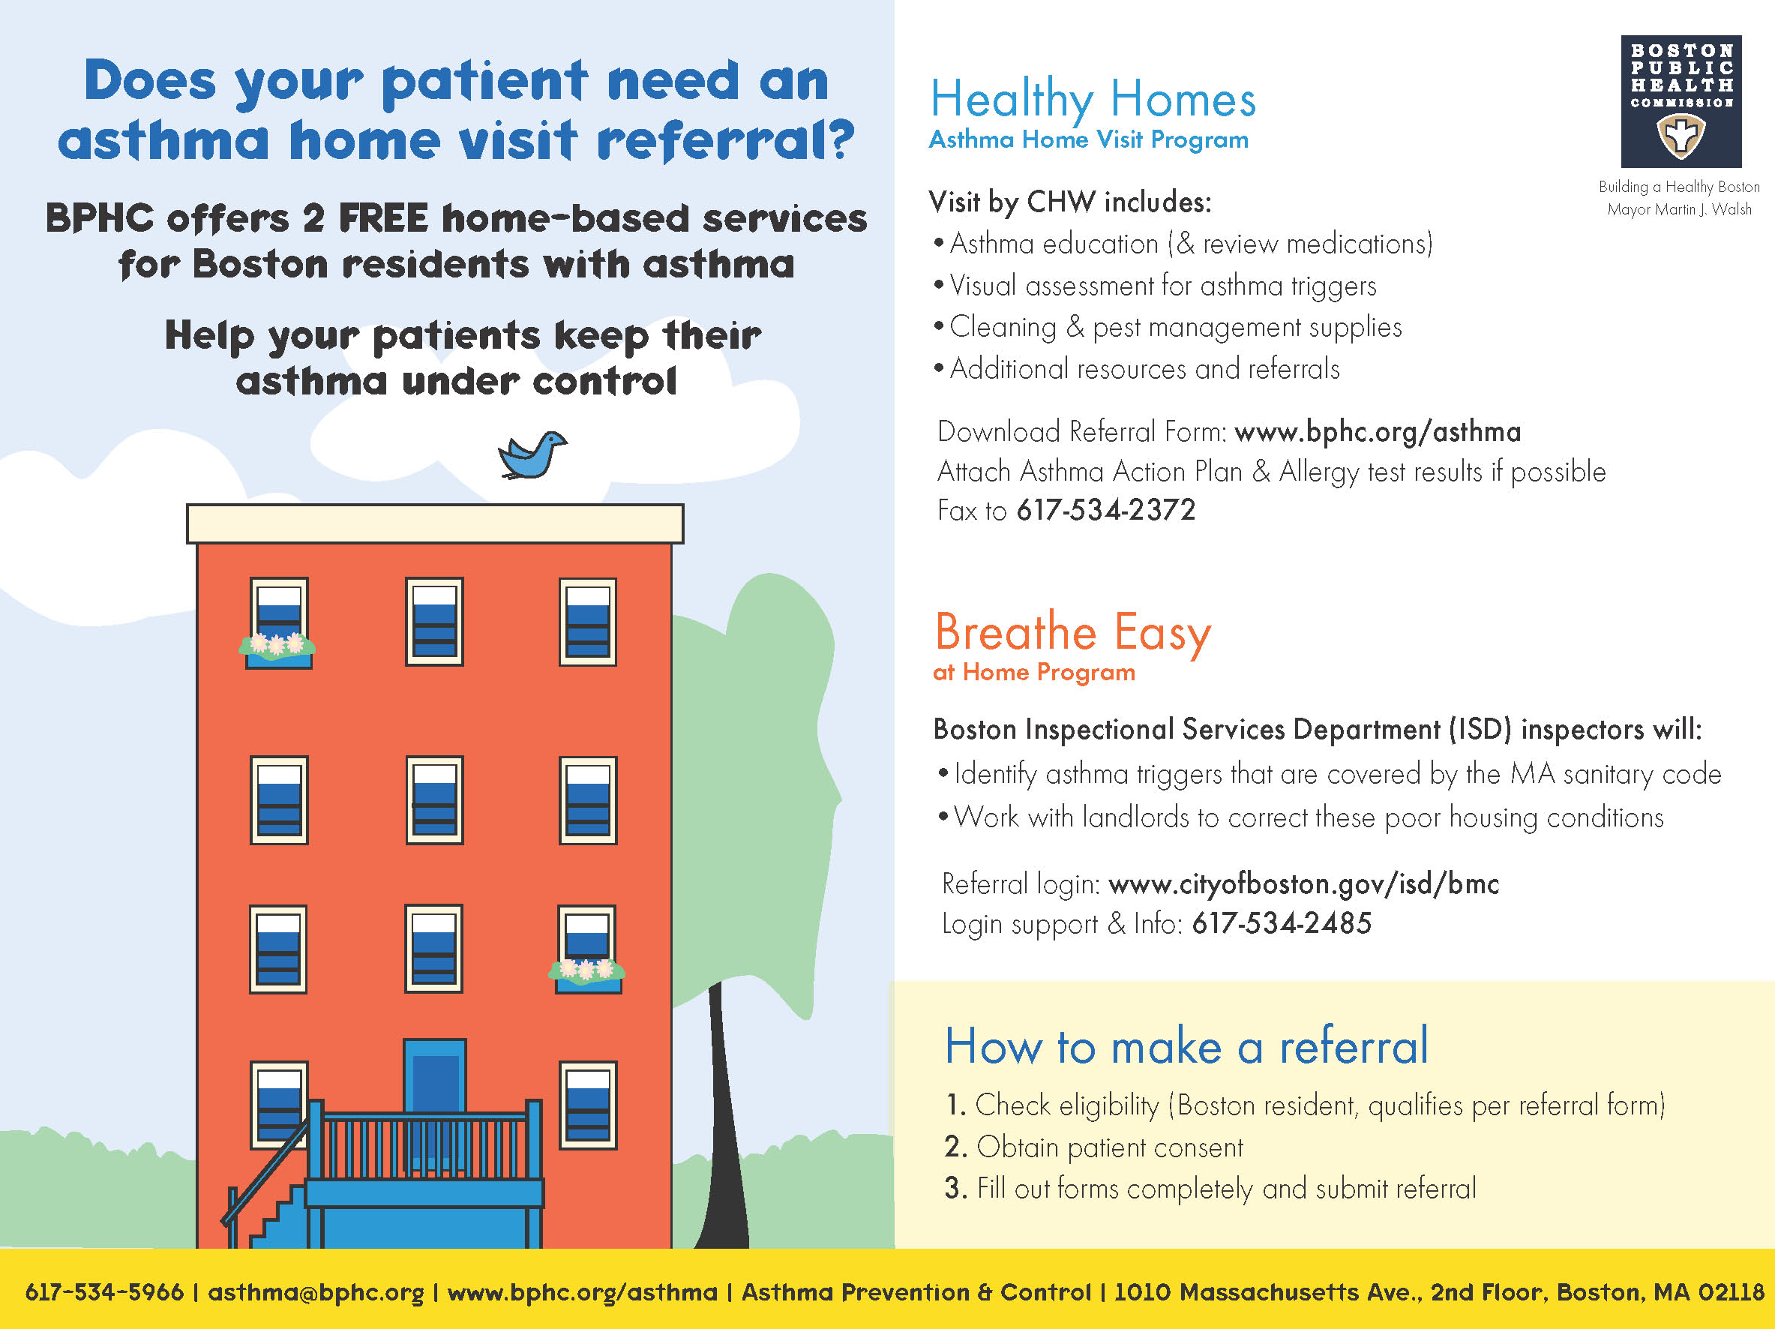
Notes:
[Anjali Nath, Speaker]
BPHC is proud to host home visiting services free to Boston residents.
Some of you may have heard or learned of these programs on previous webinars.
Healthy Homes provides home visits conducted by a trained CHW to work directly with families to provide asthma management education and support, including an environmental home assessment.
Through BEAH ISD inspectors work with landlords to address issues out of the tenant’s control that are in violation of the MA State Sanitary Code.

Slide 23
Healthy Homes
Asthma Home Visit Program
Referrals to BPHC by fax
Home visits conducted via the Boston Asthma Home Visit Collaborative (BAHVC), which
  is funded by EPA for 5 years
  standardizes asthma home visit protocols
  standardizes training and support for Asthma CHWs
  pools data for evaluation
BAHVC Members
Boston Public Health Commission*
Tufts Medical Center*
Children’s Hospital*
(Children’s Asthma Initiative)
Neighborhood Health Plan
Partners Asthma Center
(Brigham & Women’s Hospital)
EPA
*Data-pooling participants
Notes:
[Anjali Nath, Speaker]
Several partners came together to create the BAHVC and to move it toward a more effective system of support for standardizing asthma home visit protocols and training CHWs.
Standardization is also something that payers have indicated is a key priority for reimbursement. It can help us build a stronger case collectively for sustainability and reimbursement, as well as ensure a higher standard of service.

Slide 24



Breathe Easy at Home
Referrals to BPHC come via a Web-based referral and tracking system
Home visits are conducted through the Boston Inspectional Services Department, which
  identifies asthma triggers covered by the Massachusetts sanitary code
  makes results available to referring providers via database and emails
  works with landlords to correct poor housing conditions
Notes:
[Anjali Nath, Speaker]
BEAH is a novel program that systematizes referrals for these valuable services through an online referral system.

Slide 25
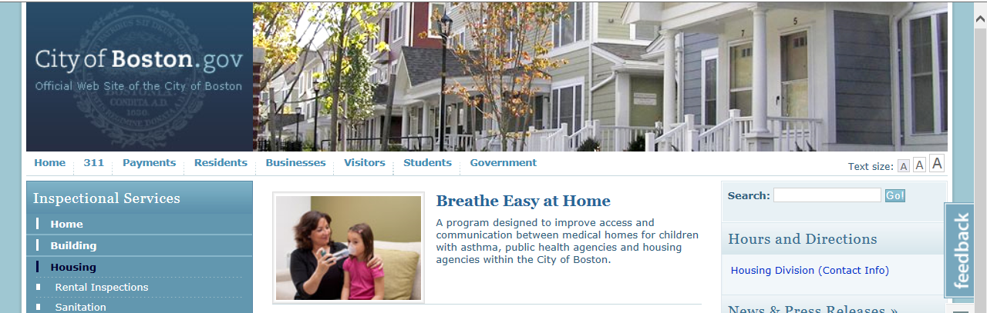
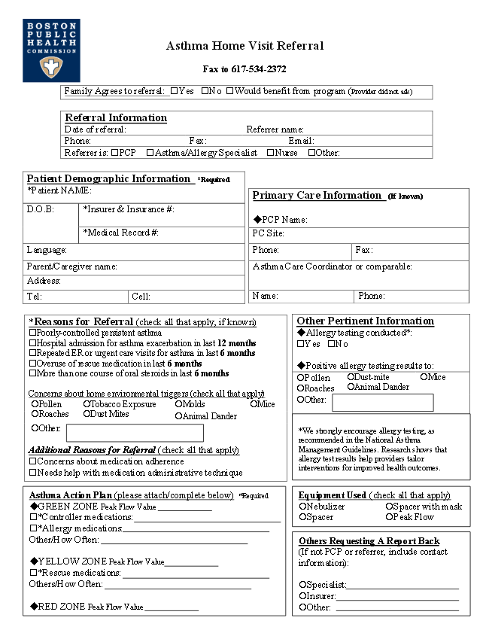
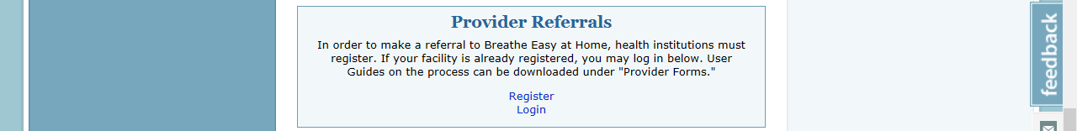
Home Visit Referrals to BPHC
Web (Breathe Easy) and Fax (Asthma Visits)
www.cityofboston.gov/isd/housing/bmc.asp
Notes:
[Anjali Nath, Speaker]
For BEAH, a provider or provider group can register to make online referrals. We have a dedicated staff person who manages and coordinates referrals.
For Home Visits, providers can refer to any of the BAHVC home visit programs through a common fax that is received in my office at BPHC. Our staff fields these referrals based on the language needed. Because of this, we are able to ensure residents have access to home visits in 8 common languages and that services and care can be coordinated. This reinforces an effective network of communication and support that serves both the residents and the home visit programs well.
Provider referrals are preferred because both programs are set up in such a way that we are able to communicate back to the referrer/provider about the home findings…
I’ll speak about this more later.

Slide 26
Breathe Easy at Home
Data Sharing and Reporting
Patients give consent, at referral and at housing code inspection.
Inspection results are added to the online referral system/database.
Providers log in for results (clinical sites are password protected per HIPAA) or sign up for automatic updates by email.
“When I make a Breathe Easy at Home referral for my patient, I am writing a prescription for a healthy home.”
— Megan Sandel, M.D., M.P.H., Co-Creator of Breathe Easy at Home
Notes:
[Anjali Nath, Speaker]
At the start of the referral process, patients are asked for provide consent for the referral. We also request patient consent at the time of the housing code inspection.
The inspectors input the results of the home visit into the Breathe Easy database. Providers can then log into the Breathe Easy system to review the results, or they can sign up for automatic updates by email. Clinical information within the system is password protected to protect patient privacy.

Slide 27
Breathe Easy at Home
Getting Results
Property owners receive a report on identified asthma triggers and code violations.
Property owners receive a compliance deadline and guidance from inspectors.
70% of cases have violations resolved without housing court!
“Now the inspectors got the landlord to fix the ceiling so there was no mold, and his asthma is better.”—Breathe Easy at Home client
Notes:
[Anjali Nath, Speaker]
Property owners receive a report on asthma triggers and code violations identified through the home inspection and a deadline for addressing those findings. The inspectors also are available to work with property owners to help them correct poor housing conditions.
Although some cases do go to court, I am happy to report that in 70% of cases the violations are resolved without having to go to housing court.
[Lisa Gilmore, Facilitator]
Thanks, Anjali, for sharing such great strategies for promoting referrals and sharing information to get results.
We will now move on to our next question.

Slide 28
How do you monitor and evaluate your program’s success?
Notes:
Lisa Gilmore, Facilitator:
Let’s discuss program evaluation, a key step in ensuring the success of a program.
How do you monitor and evaluate your program’s success?
For example: Have you used process or outcome data to improve your referral and communication processes, or to determine what return on investment, if any, has resulted from your program?
Anjali, we will start with you.

Slide 29
Breathe Easy at Home and Asthma Home Visit Evaluations
What we learned…
Effective handoff is key!
Providers and clients must understand the program.
Program can’t work if we can’t get in the door and complete the program.
Breathe Easy at Home
  Failure Modes Effects Analysis (FMEA)
Asthma Home Visit Program
  Clinician/referrer surveys (online)
  Clients (mail, incentives provided)
Notes:
[Anjali Nath, Speaker]
Both BAHVC and BEAH conducted evaluation processes to evaluate program success. BEAH conducted a Failure Modes Effects Analysis (FMEA) to identify specific areas in which the process could potentially fail each step of the way.
BAHVC conducted two rounds of surveys with clinicians and providers, as well as with clients we served. We received responses from about 30 clinicians and 30 clients.
We learned much about what was valuable and what wasn’t, and where some of the breakdowns were in ensuring that the patients/clients who need our services actually received them.
Primarily, we learned that if the provider does not properly introduce or explain the program and allay patient fears or reservations about having a home visit or inspection done, it made our work much harder. It meant that even if a client consented to the referral when with the provider, a client might decline the visit when the home visitor called to schedule, might not show up or might not follow through with the series of visits.
Though there are many compounding factors, we believe that—
Effective handoff is key!
Providers and clients must understand the program.
The program cannot work if we cannot get in the door and complete the program.

Slide 30
Selected Findings from
Program Evaluations
Areas of Progress
Clinicians/Referrers
Referrers generally understood and valued the Breathe Easy at Home and Asthma Home Visit Programs.
A third (37%) reported the home visits had reduced their patients’ symptoms.
Clients/Caregivers
A majority (97%) responded that their child’s asthma had improved.
Most (97%) said referrer very clearly or somewhat clearly explained program.
Areas for Improvement
  Help referrers distinguish between the programs and their referral processes.
  Tighten the communication and feedback loop between home visitors and referrers through progress reports.
  Include patient’s asthma action plan and allergy information in the referral.
Notes:
[Anjali Nath, Speaker]
[Read slide.] Client Bullet #2: Looks promising, but since we only surveyed clients who actually participated in the program this doesn’t reflect what might have happened for those who ended up not participating in the program. A common response when a home visitor calls a family to follow up on a referral and schedule a visit is that they don’t know what the program is and/or are not interested, despite having given consent in the office. There are many reasons for this. We did realize that most clients who were referred within a system like Children’s Hospital understood and accepted the program more than referrals that came from elsewhere. We realized we had to find a way to create more awareness and better understanding of our services and find ways to improve the chances of being able to get into the homes of those who needed our services.

Slide 31
Notes:
[Anjali Nath, Speaker]
This placard you saw earlier is the result of the feedback received to bring visibility to and clarity about the programs and their respective referral processes. This is being distributed to providers we are aware of to post in their offices.
We also created and distributed a supplemental postcard for patients/potential clients in 4 languages to help provide a connection between the provider's reference to the program and the follow-up phone call they receive to schedule their first visit. We are looking forward to seeing if this improves the referral process and increases the ratio of visits to referrals.

Slide 32
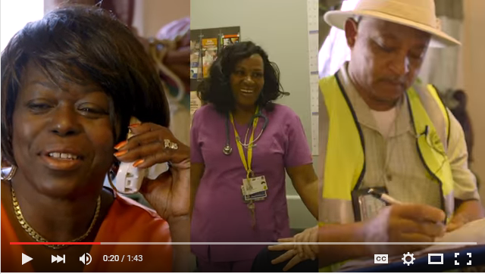
Breathe Easy at Home
Looking Ahead
Enhanced technology for communication and uptake
Online video tutorials for providers and clients
Online portal with resources for landlords and residents
Seasonal alerts/text messages
Notes:
[Anjali Nath, Speaker]
As a result of the FMEA process, BEAH is also working on the following:
[Anjali will read right from this slide]
These, of course, are not perfect systems, but we are continuously working to learn and make improvements.
[Lisa Gilmore, Facilitator]
Thank you, Anjali. It was great to hear how BPHC has gathered feedback from clients and providers and how you and your partners are using that feedback to continue to improve your referral and communication processes.
Taney, how do you monitor and evaluate your program’s success?

Slide 33
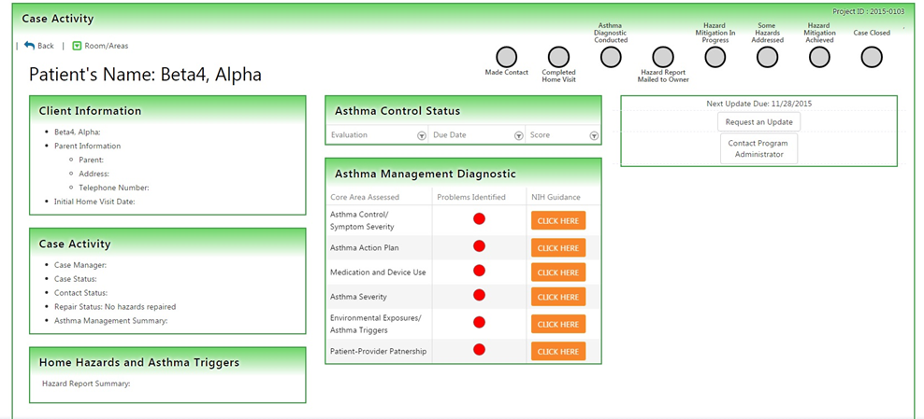

Electronic Database and
Provider/Partner Portal
New portal gives providers and partners real-time visual alerts and data access to inform their next steps in patient care.
Referral/timeline status
Hazards/asthma triggers
Home repair status
Asthma Control Test™
Asthma Diagnostic Tool
Clinical guidance
Notes:
[Taney Simon, Speaker]
We use a database along with the timeline checkpoints I mentioned earlier to track our success. When we first began, we wrote a strategic plan for our program and within a year- and-a-half accomplished those goals. We literally outgrew the Microsoft Access Database we were utilizing. So we’ve graduated to a more advanced Web-based database, which captures all sorts of environmental hazard data, demographic data, housing data and behavioral data. At the close of each case, we collect program evaluation data from our program participants.
Shortly, we’ll be launching our Provider and Partner Portal, which offers real-time feedback to physicians and health care professionals making referrals to our program. The information comes in the form of real-time visual alerts—like red lights to indicate gaps in a patient’s asthma care and green lights signaling that both provider and patient are on the same page. We envision the portal as helping to inform physicians' next steps in patient care.

Slide 34
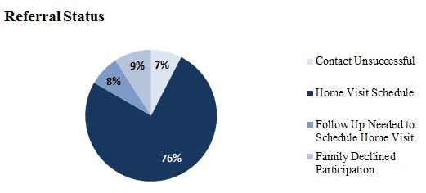
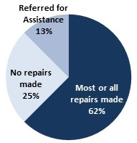
Monitoring and Evaluation
Referral Status
Provides data for quarterly reports
Ensures adherence to program standards
Informs program improvement
Demonstrates value to build case for support
d
Hazard Remediation Status
Notes:
[Taney Simon, Speaker]
We create similar visuals for other partners when we produce quarterly reports. We want our feedback to be informative, easy to capture and, most important, not too time consuming. As you see here, we report the referral status of each patient referred back to the referring health care provider, and other details like whether repairs were made and what other environmental hazards we found.
These control measures help us adhere to program standards, improve our program and build valuable case for support.
[Lisa Gilmore, Facilitator]
Thank you, Taney. It’s exciting to hear how your program created a more advanced Web-based database and is now poised to release a portal that will allow physicians and other health care professionals to receive feedback in real time.
Dr. Gates, on the provider side, how would you assess whether the referral process is effective?

Slide 35
Evaluating Collaborative In-Home Visit Referrals: Provider Perspective
Is it easy to make the referral?
What concerns do patients have about home visits?
Are providers talking with patients about home visits?
Is the physician receiving timely, actionable reports on the patient’s referral status and progress?
Notes:
[Dr. Elizabeth Gates, Speaker]
Many of our parents have concerns about home visits: allowing others into the home, feeling that the provider is making judgements about cleanliness and hygiene, fear of retaliation from landlords.
I think one part of care coordination that is often missed is not just getting the data from visits that occurred but capturing the visits that did not occur—those families who couldn’t be contacted; who initially said yes to the provider when the home visit was suggested, but declined when contacted by the home visiting agency; who weren’t able to coordinate hectic parental work schedules or had some other barrier to completing the visit. It’s obviously helpful to have this information before the family comes in to the next follow up appointment, but we don’t always get it. However, having a trusted primary care provider say, “I think this program can help your child”—sometimes over several visits—may make a family more willing work with the program.
Another barrier in a large multi-site practice is provider awareness of home visiting programs—is it part of the “culture” of the practice to refer? Do providers know enough about the service to recommend it? Time—when we have only 15-minute visits, do we spend the time counseling the family on a home visit or adding a daily controller medication?
Communication is a two-way street—if we aren’t getting actionable information, it is hard to reinforce the findings with families. However, we PCPs are not easy to get a hold of; phone messages get lost, faxes misfiled; HIPAA concerns surround email.
[Lisa Gilmore, Facilitator]
Thank you, Dr. Gates, for reminding us that providers have a larger role than just making the initial referral, and that it’s important to work collaboratively to identify and address those barriers that get in the way of successful referral and communication.

Slide 36
Poll 3
What is the main source of your organization’s funding?
Government grants
Foundation grants
Reimbursement from Medicaid or private health insurer(s)
User pays
Fundraising from private individuals
Notes:
[Lisa Gilmore, Facilitator]
Before we move into our next question, I’d like to ask one final polling question.
We know reimbursement for asthma care services is a hot topic right now. We’d like to learn more about how you fund your organization.
[Wait for webinar participants to answer the poll and make a few comments about the answers.]

Slide 37
How does your program address sustainability? Do you receive reimbursement for home visits?
Notes:
[Lisa Gilmore, Facilitator]
Let’s continue on this topic with the following questions for our speakers.
How does your program address sustainability? Does your program currently receive reimbursement for home visits? If yes, how? If not, is your program helping to build the case for sustainable financing of home visits?
Anjali, we will start with you.

Slide 38
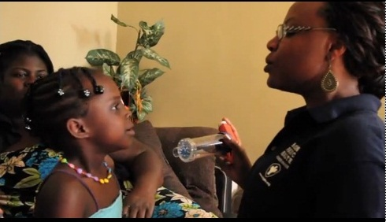
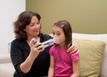
Working Toward Sustainability
Standardizing CHW trainings and mentorship
Engaging new programs serving Boston residents
Sharing standardized protocols
Working with policy partners to continue communication with payers
Notes:
[Anjali Nath, Speaker]
It’s very important that any program looking to offer home visits understands the work and needs of the CHW.
In MA, there are several programs that will be offering asthma home visit programs that we are or will be working with in some capacity. Those serving Boston residents will be invited to our Boston Asthma Home Visit Collaborative to continue to ensure certain standards are maintained and enhanced, including protocols.
We continue to support standardization of CHW skills and knowledge, as well as protocols, so we can effectively communicate and demonstrate the value of these programs to payers.
[Lisa Gilmore, Facilitator]
Thank you Anjali. Taney, is your program pursuing reimbursement opportunities?

Slide 39
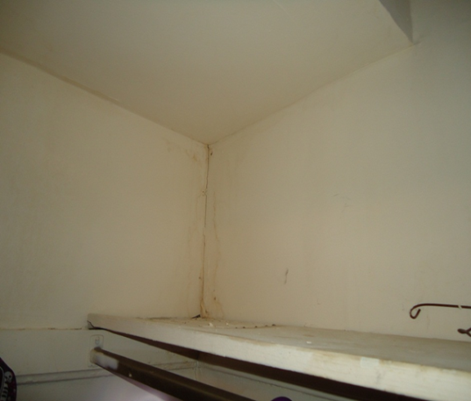

Ensuring Sustainability
  DC’s Healthy Homes Program is currently funded through the local government.
  The program is working toward making the business case for reimbursement consistent with the Affordable Care Act.
BEFORE
AFTER
Notes:
[Taney Simon, Speaker]
We are still a relatively young program and aren’t yet receiving reimbursement. The program is currently funded through the District of Columbia government.
For now, we are capturing important data supportive of reimbursement, like health care expenditures and supply and transportation expenditures. We have also captured lots of before-and-after testimonials and photographs to represent the impact of our program on the community.
Once we’ve reached a critical mass, our goal will be to make the business case for reimbursement consistent with the Affordable Care Act.
[Lisa Gilmore, Facilitator]
Thank you, Taney. And Dr. Gates, what helps to sustain a successful referral process?

Slide 40
Strategies for Sustaining a
Successful Referral Process
Keep the referral form short and simple.
Make submitting a referral easy and efficient, and incorporate it into the EMR.
Request a provider’s help, if needed, to facilitate referral with the patient.
Communicate progress, including barriers.
Notes:
[Dr. Elizabeth Gates, Speaker]
Keep the referral form short and simple.
Make submitting a referral easy and efficient and incorporate it into the EMR.
Request a provider’s help, if needed, to facilitate referral with the patient.
Communicate your progress, including any barriers.
[Lisa Gilmore, Facilitator]
Thank you, Dr. Gates.

Slide 41
If you had one piece of advice for those wanting to start or expand an in-home asthma visit program, what would it be?
Notes:
[Lisa Gilmore, Facilitator]
Our last question is—if you had one message or piece of advice to share with those wanting to start or expand an in- home asthma visit referral program, what would it be?
Dr. Gates, we will start with you.

Slide 42
Program Suggestions
Dr. Elizabeth Gates—Close the loop to ensure communication in both directions, from physician to program to patient, and from patient to program to physician.
Notes:
[Dr. Elizabeth Gates, Speaker]
Close the loop to ensure communication in both directions, from physician to program to patient, and from patient to program to physician.
[Lisa Gilmore, Facilitator]
Anjali, your thoughts?

Slide 43
Program Suggestions
Dr. Elizabeth Gates—Close the loop to ensure communication in both directions, from physician to program to patient, and from patient to program to physician.
Anjali Nath—Know your community resources—for Boston, that includes our asthma home visit and environmental inspection programs—and make them part of your team.
Notes:
[Anjali Nath, Speaker]
Know your community resources—for Boston, that includes our asthma home visit and environmental inspection programs—and make them part of your team.
[Lisa Gilmore, Facilitator]
And finally, Taney?

Slide 44
Program Suggestions
Dr. Elizabeth Gates—Close the loop to ensure communication in both directions, from physician to program to patient, and from patient to program to physician.
Anjali Nath—Know your community resources—for Boston, that includes our asthma home visit and environmental inspection programs—and make them part of your team.
Taney Simon—Partner with your code enforcement agency and public housing authority. Collaborate fully to identify funding, support patients and physicians, and capture data.
Notes:
[Taney Simon, Speaker]
Partner with your code enforcement agency and public housing authority. Collaborate fully to identify funding, support patients and physicians, and capture data.
[Lisa Gilmore, Facilitator]
[If time for an additional 1-2 questions for the speakers…]
It looks like we have time to ask a question that one of our viewers submitted in advance.
Let me ask each of you, starting with Anjali and then Taney and Dr. Gates, how can we make the medical community aware of the benefits of in-home asthma visits and environmental interventions?” Anjali?... Taney?... Dr. Gates?...
[Ask only if there’s still more time left] One of our participants asks, what steps do I take after the home visits have concluded? Should I report back to the clinic and what information should I include? How do you guard the privacy of information being shared?]
I want to thank each of our speakers—Dr. Elizabeth Gates from Unity Health Care, Taney Simon from D.C.’s Department of Energy and Environment, and Anjali Nath from the Boston Public Health Commission—for taking time from your busy schedules to share with us your experiences and lessons from the field.
Some of the key recommendations that I will take away from this informative roundtable discussion are to—
Communicate. Even the most well-designed home visit programs will not succeed if programs, physicians and patients aren’t communicating with each other to ensure successful referrals.
Create a team. Use your community’s resources to the best of your advantage by establishing strong relationships and clear processes for coordinating care.
Collaborate. Work with your partners to monitor referrals from start to finish and to ensure effective data collection. Then use the results to improve your program and to build your case for ongoing funding support and reimbursement.
So the final question I want to leave with each of you is….

Slide 45
What is Your
Take-Home Message?
Connect to resources on AsthmaCommunityNetwork.org.
Collaborate to build referral relationships in your community.
Create effective communication pathways with partners.
Coordinate patient support and care.
Close the feedback loop.
Notes:
[Lisa Gilmore, Facilitator]
What’s your take-home message? What action will you take next?
A great start is to connect to resources on AsthmaCommunityNetwork.org.

Slide 46
Program Resources on AsthmaCommunityNetwork.org
Boston Public Health Commission’s Breathe Easy at Home and Asthma Home Visit Program
  www.asthmacommunitynetwork.org/node/915
    Department of Energy and Environment's Lead-Safe and Healthy Homes program and DC Partnership for Healthy Homes www.asthmacommunitynetwork.org/node/16183
    Unity Health Care, Inc.
      www.asthmacommunitynetwork.org/node/13581
Notes:
[Lisa Gilmore, Facilitator]
For example, you can find more information about today’s featured programs on AsthmaCommunityNetwork.org.
And you can find partners in your own community by using the “Find a Program” feature on AsthmaCommunityNetwork.org. Search by ZIP code, state, program type or key words.
Now I would like to invite Sheila Brown from EPA to share with you additional resources on today’s topic and to invite you to the live Q&A session with our speakers starting in a few minutes.
Sheila…

Slide 47
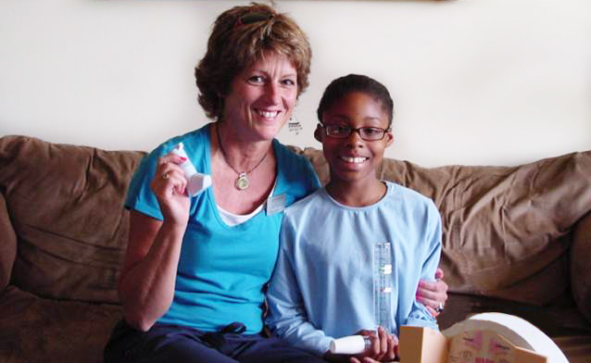
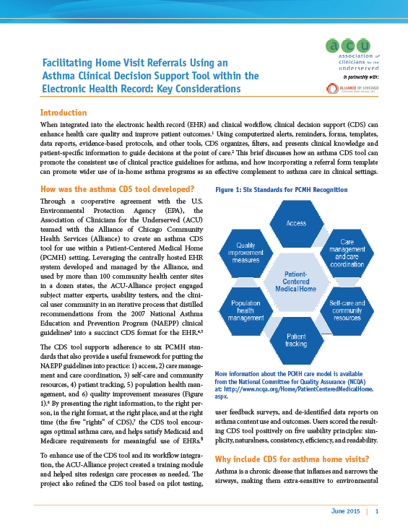
New for Home Visit Programs on AsthmaCommunityNetwork.org
Community Health Worker Training Programs
“Facilitating Home Visit Referrals” Issue Brief by Association of Clinicians for the Underserved
Visit AsthmaCommunityNetwork.org
Notes:
[Sheila Brown, Moderator]
Thank you, Lisa.
And I want to add my thanks to each of our speakers for sharing their insights with us today.
I’d like to take a moment to share with you some additional resources on AsthmaCommunityNetwork.org that may provide assistance to you.
The first resource is a new section on Community Health Worker Training Programs, which you can find under “Tools” on AsthmaCommunityNetwork.org. This section is dedicated to building your program’s workforce with a significant focus on community health workers. With new opportunities emerging within Medicaid to reimburse non-medical providers who are delivering preventive care services, programs can prepare now for reimbursement by considering the training and certification options, requirements, and possibilities for CHWs and other home visiting staff.
I also want to share information with you about a new item in the AsthmaCommunityNetwork.org Resource Bank, the Association of Clinicians for the Underserved’s issue brief entitled, Facilitating Home Visit Referrals Using an Asthma Clinical Decision Support Tool within the Electronic Health Record. The issue brief, which was developed under a cooperative agreement with EPA, defines what makes a successful referral, outlines barriers to referrals, and describes how adding automated tools to an electronic health record could encourage referrals to in-home asthma programs.

Slide 48

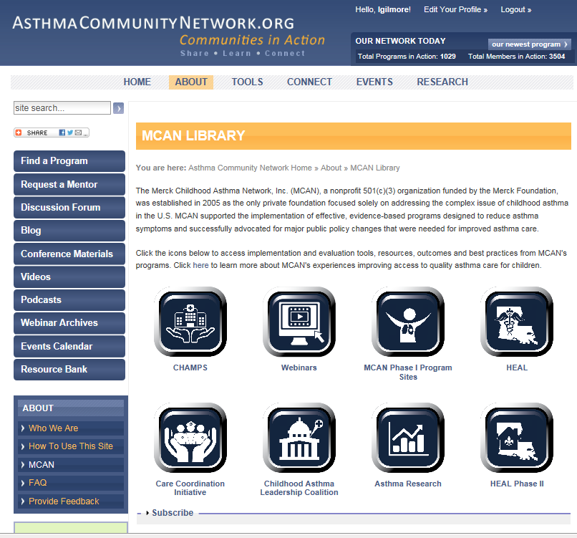
New Merck Childhood Asthma Network (MCAN) Resource Library
Find MCAN program implementation and evaluation tools and patient resources on AsthmaCommunityNetwork.org
Join MCAN webinar
MCAN Resources for Successful Asthma Interventions
Date: December 3, 2015
Time: 2:00 p.m.–3:30 p.m. EST
Info: AsthmaCommunityNetwork.org
Notes:
[Sheila Brown, Moderator]
In addition, I want to let you know that tools and resources from the Merck Childhood Asthma Network are now available in a dedicated Resource Library on AsthmaCommunityNetwork.org.
I also encourage you to view the Merck Childhood Asthma Network’s new Ten-Year Impact Report and to register now for the MCAN webinar on December 3, 2015 to learn more about the results of this groundbreaking investment in improving asthma case and reducing asthma disparities.

Slide 49
Join the Online Discussion Forum
Speakers are now available for a live Q&A Session.
Thursday, November 19, 2015, 3:00 p.m. – 3:30 p.m.
Members can submit questions via the link in the Chat pane.
Not yet a member? Joining online is quick and easy.
Go to AsthmaCommunityNetwork.org.
Click “Join Now” at the top and complete the registration process.
Post your questions as soon as your account is approved.
Notes:
[Sheila Brown, Moderator]
We know that many of you still have lingering questions that were not answered during the webinar.
We want to make this webinar as useful for you as possible. To this end, our speakers will be available to answer your questions in the Discussion Forum on AsthmaCommunityNetwork.org.
To take advantage of this opportunity you must first be a member of AsthmaCommunityNetwork.org. If you are not already a member, it is a quick, free and definitely worthwhile process.
Simply go to AsthmaCommunityNetwork.org, click “Join Now” in the top right-hand corner, and then take a couple of minutes to complete the three-step registration form. Our Site Administrator is eagerly waiting to approve your membership as soon as it is submitted.
After the Q&A period is closed, you can also go back 24-7 to visit the Discussion Forum and see other contributions as well as to make your own.
That ends the presentation portion of our webinar today. Please join us online now for questions and answers. Thank you.
---
[Note: The SCG/Cadmus Technology Facilitator will distribute a webinar post via the GoTo Chat pane in coordination with the slides so that attendees have a direct link to the Discussion Forum.]

