Slide 1

Know the Drill for Healthy IAQ:
Training Staff and Occupants to Reduce
Indoor Asthma Triggers
Thursday, June 9, 2016
Webinar: 1:00 p.m. – 2:00 p.m. EDT
Question & Answer Session: 2:00 p.m. – 2:30 p.m. EDT
Call-in: 877-887-8949
Conference ID: 65610445

Slide 2
Featured IAQ Experts
Tracy Washington Enger
Facilitator
U.S. Environmental Protection Agency
Indoor Environments Division
David Blake
Indoor Air Quality Specialist
Northwest Clean Air Agency
Francine Locke
Director, Office of Environmental Management and Services
The School District of Philadelphia

Slide 3
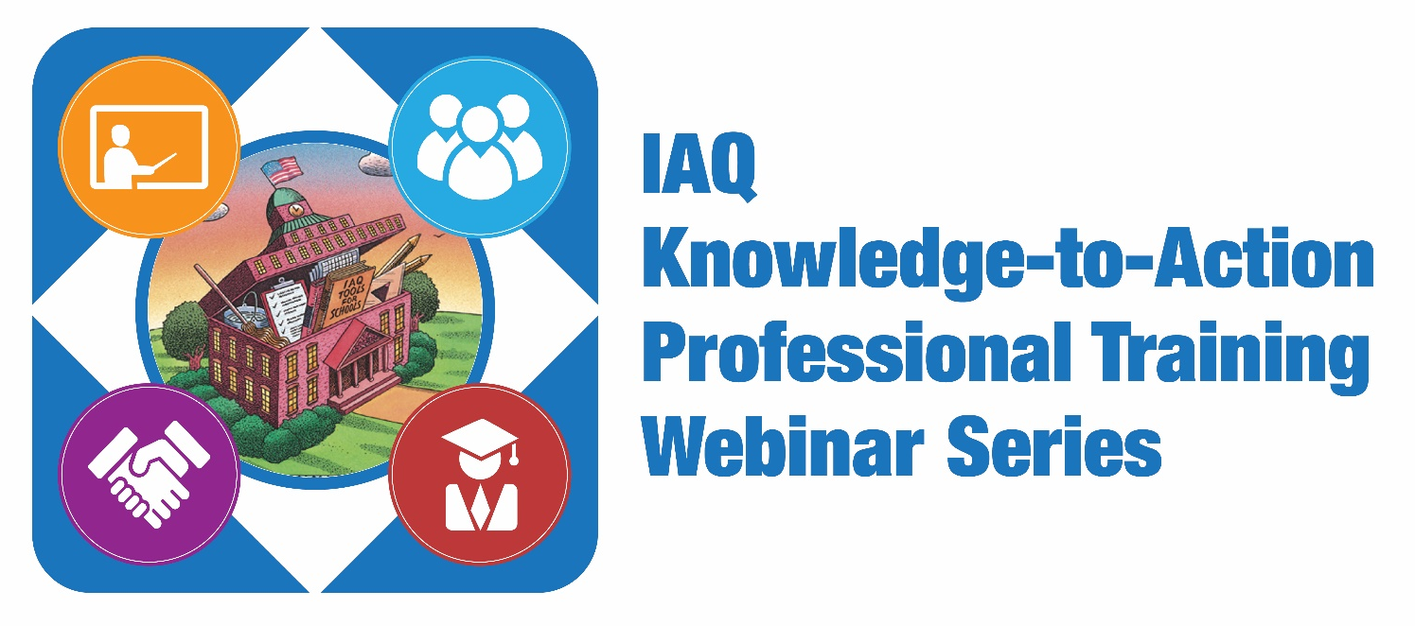
Four technical Web-based trainings designed to deepen the IAQ knowledge base of school stakeholders and prepare them to take immediate action to create healthy and productive indoor environments in schools:
    Healthy Schools, Healthy Students: Taking Action to Improve IAQ in Your School District
    Training Staff to Create Healthy Indoor Environments and Reduce Asthma
    How to Secure Funding to Address and Prevent Mold and Moisture Issues
    Gaining Buy-in to Provide Optimal Ventilation to Improve Academic Performance
  www.epa.gov/iaq-schools/iaq-knowledge-action-professional-training-webinar-series
Notes:
Tracy: The next action you can take on the way to improving IAQ in your schools is to join the 2016 IAQ Master Class by viewing 10 webinars in the IAQ Master Class Professional Training Webinar Series. Your ability to move into action more quickly will be enhanced by viewing these webinars on demand. We will be recommending specific webinars for you to view on demand in order to deepen your understanding of the content delivered in the four webinars that are part of the Knowledge-to-Action series. For this webinar, we recommend that you view the first two webinars in the MC Series, Creating Healthy Schools… and Making the Case… The other three webinars in this Knowledge to Action series
Gain recognition for your knowledge acquisition and commitment to action through certificates of completion for each training. Complete all 10 hours and you will be acknowledged with a certificate that recognizes your efforts toward IAQ Mastery as a member of the 2015 SHIELD Network IAQ Master Class (CEUs pending).

Slide 4
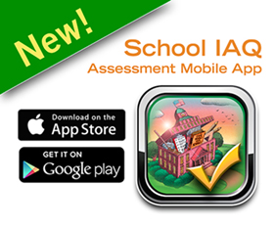
Download the App Today
Android: Google Play
Apple: iTunes
developer.epa.gov/school-iaq-assessment-tool
Notes:
Tracy: The first action I am going to ask you to take, if you haven’t already done so, is to grab your smart device and make it even smarter by downloading the Mobile App.
This one-stop shop works on any mobile device. Whether you’re just starting an IAQ program or already have one in place, the app can revolutionize the way your schools approach the complex task of IAQ management.

Slide 5
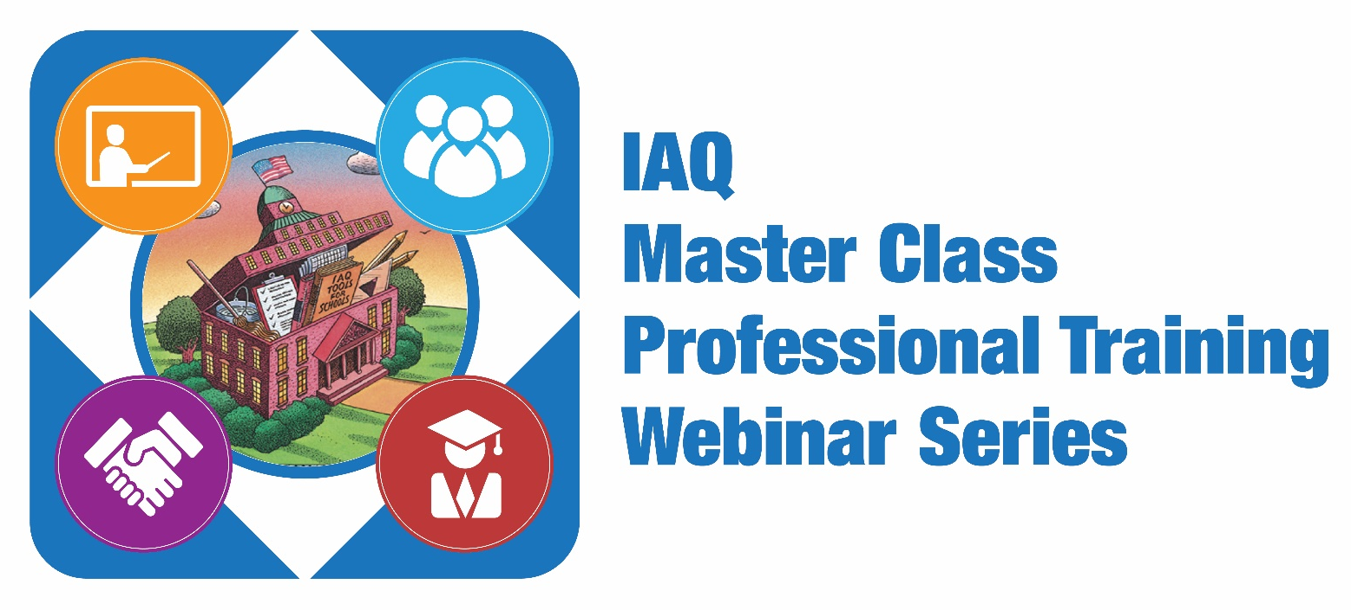
10 technical Web-based trainings designed to build the capacity of school district staff across the country to start, improve or sustain an IAQ management program:
  Creating Healthy Indoor Environments in Schools
  Making the Case
  HVAC Systems
  Moisture and Mold
  Energy Efficiency and IAQ
  Integrated Pest Management
  Asthma Management
  Cleaning and Maintenance
  Materials Selection
  Source Control
  www.epa.gov/iaq-schools/indoor-air-quality-schools-master-class-webinar-series
Notes:
Tracy: The next action you can to take on the way to improve IAQ in your schools is to join the 2016 IAQ Master Class by viewing 10 webinars in the IAQ Master Class Professional Training Webinar Series. Your ability to move into action more quickly will be enhanced by viewing these webinars on demand. We will be recommending specific webinars for you to view on demand in order to deepen your understanding of the content delivered in the four webinars that are a part of the Knowledge to Action series. For this webinar, we recommend that you view the first two webinars in the MC Series, Creating Healthy Schools… and Making the Case… The other three webinars in this Knowledge to Action series
Gain recognition for your knowledge acquisition and commitment to action through certificates of completion for each training. Complete all 10 hours and you will be acknowledged with a certificate that recognizes your efforts toward IAQ Mastery as a member of the 2015 SHIELD Network IAQ Master Class (CEUs pending).

Slide 6
Learning Objectives
Webinar participants will learn how to—
Train staff to identify, recognize and address indoor environmental asthma triggers and perform the essential actions for effective asthma management in schools.
Design and successfully implement a staff training system as part of a sustainable IAQ management program.
Effectively use the School IAQ Assessment Mobile App—new technology featuring the IAQ Tools for Schools Action Kit—as a teaching tool to identify and reduce asthma triggers in the school environment.
Replicate successful strategies to reduce asthma attacks, increase attendance and improve academic performance through an effective staff training program and implementation of the IAQ Tools for Schools Framework.

Slide 7
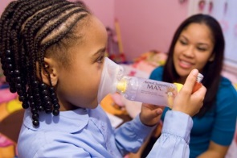
Asthma Facts
An estimated 24 million people, including more than 6 million children, have asthma.
Asthma prevalence is higher among persons whose family income is below the poverty level.
The rate of asthma among Puerto Ricans is approximately 2 times higher than among non-Hispanic Whites.
The economic cost of asthma, including lost school and work days, amounts to more than $56 billion dollars annually.
Black persons had higher rates of emergency department, hospitalizations and deaths than whites persons.
Notes:
Asthma is a serious health issues impacting millions of people, but people are not impacted equally. We know that there are lots of disparities in asthma health outcomes. Depending on the demographics of your school district asthma prevalence, morbidity and morality can look very different.

Slide 8

Asthma and IAQ in Schools
More than 10 million school days are missed each year due to asthma.
IAQ affects the health, productivity, performance and comfort of students, teachers and staff.
Poor IAQ in a school building can cause students and staff to suffer adverse health effects, including respiratory infections, asthma and allergies.
Indoor and outdoor environmental factors—including dust mites, molds, cockroaches, pet dander, secondhand smoke, and poor air quality—can trigger asthma attacks.
Notes:
Let me start with a simple review of the importance of IAQ in schools.
<The amount of detail presented in the next few slides can vary according to the audience.>
1 in 10 children in the United States has asthma.
10.6 million school days are missed every year because of asthma, which clearly affects student performance.
The estimated annual cost for treating asthma in children in this country is $8 billion.
In some states, school funding is tied to student attendance; the absenteeism caused by asthma can cost districts in those states significant amounts of money.
Because parents of younger children need to stay home when their child is sick, as many as 14 million work days are lost each year because of pediatric asthma.
The CDC School Health Policies and Practices Study is a national survey periodically conducted to assess school health policies and practices at the state, district, school and classroom levels.
The most recent data show that about 51% of school districts in the United States have an IAQ management plan—that’s 60,000 schools—and the vast majority of those schools base their plan on the IAQ Tools for Schools guidance.
This is good news, but EPA wants to reach the half that don’t have a plan and help them develop one, AND we want to make it easier for those that do have a plan to implement and improve it.

Slide 9
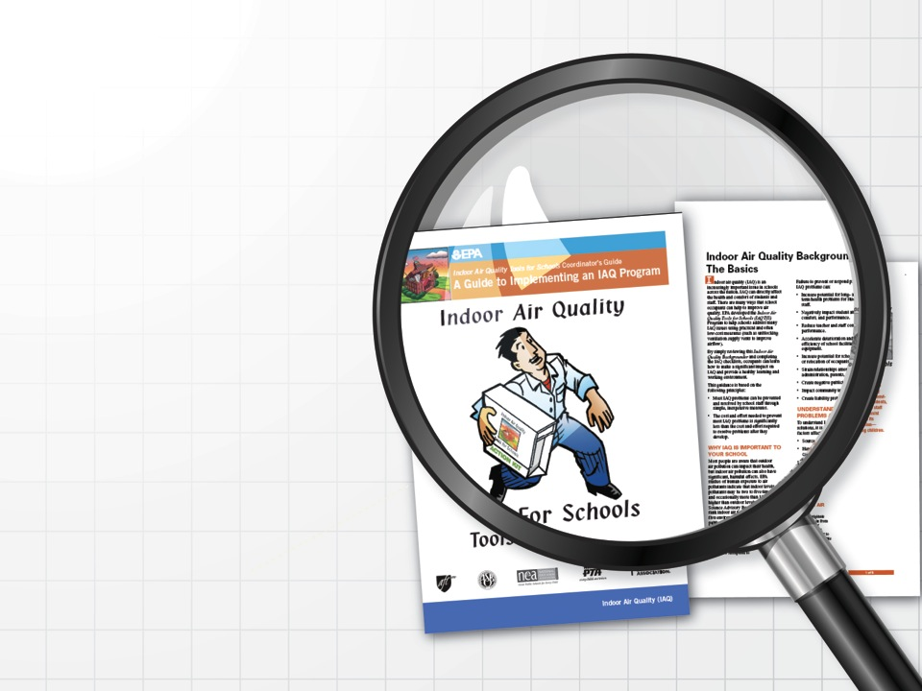
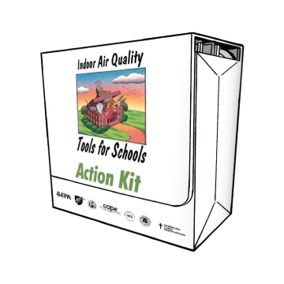
The IAQ Tools for Schools Guidance
Notes:
Our work is based on the TfS Action Kit, which really serves as the knowledge base of what schools and school districts need to do to put an IAQ management p
(Taken from the 2014 SHPPS Webinar.)
Transcript from the 2014 SHPPS Webinar:
BRENDA DOROSKI:
I’d like to take just a few minutes to review the EPA Indoor Air Quality Tools for Schools guidance that I was just referencing. This guidance and resources are available to you if you manage the indoor air quality in the schools in your community.
The action kit was first published back in the 1990s, but it’s been updated. We’ve added to it. We’ve refined it and included more and more of the best practices that we are seeing many of you implementing around the country. In addition to the best practices, it provides walk-through checklists, industry guidelines, sample policies and sample IAQ management plans to help schools and school districts take immediate action to implement effective Indoor Air Quality management programs.
The Indoor Air Quality Tools for Schools program has been implemented successfully in tens of thousands of schools nationwide. I’ve already highlighted the important improved health outcomes and performance of students and staff, but I’d also like to mention that implementing this guidance can also improve facilities and provide significant cost and time savings for maintenance and custodial services, ensure better performance and durability of HVAC systems, and, in general, have a positive impact on the physical school environment.
(lan in place. This is where it all begins.)

Slide 10
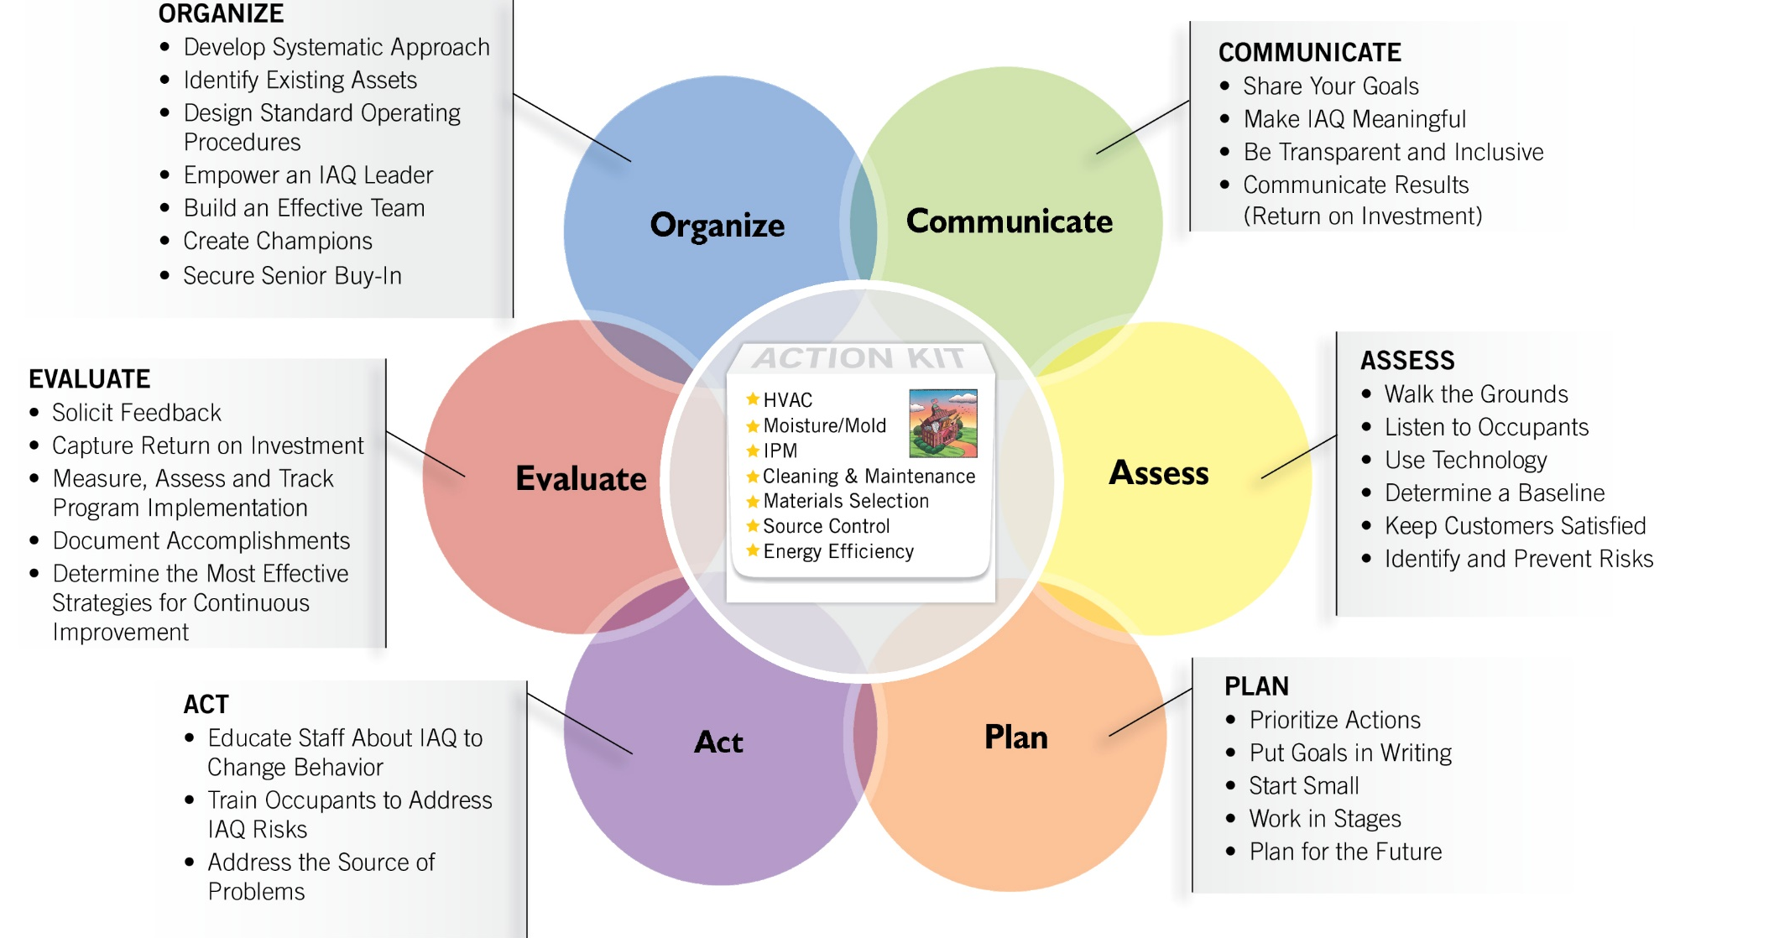
The Framework for Effective School IAQ Management:
Six Key Drivers
Notes:
But this way of looking at the Framework can make it seem more linear than it really is. Another way of looking at is like this.

Slide 11
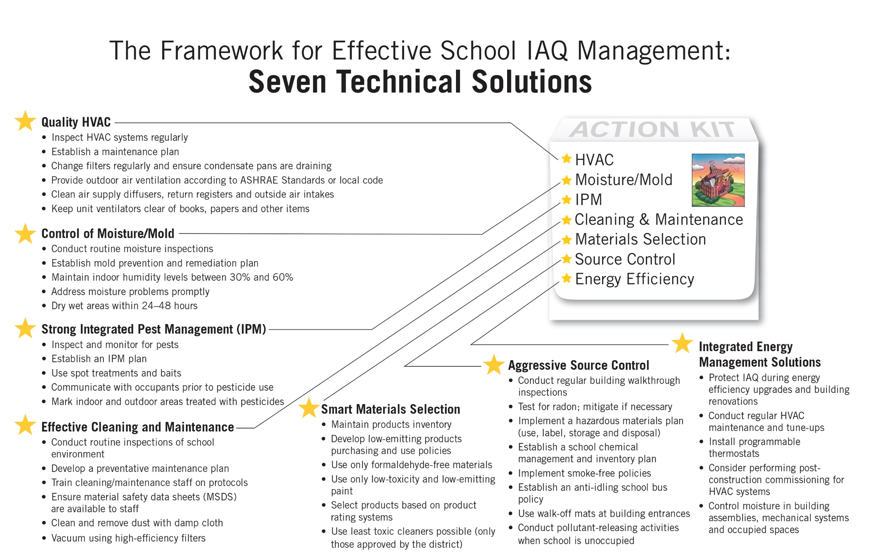
Notes:
(This slide is taken from the 2014 Making the Case Webinar slide deck because the slide presented in the “Creating Healthy Indoor Environments” webinar did not include the Integrated Energy Management Solution)
Transcript from the 2014 SHPPS Webinar. (Note: Does not include content on the Energy Efficiency Technical Solution.):
BRENDA DOROSKI:
In addition to the Framework, the Action Kit offers seven technical solutions. The first is to ensure quality inspection, operation and maintenance of your HVAC system.
The second is active, aggressive control of moisture and mold.
The third solution is strong, integrated pest management. The fourth solution is effective and consistent cleaning and maintenance activities, including routine inspections and training your cleaning and maintenance staff, as well as providing protocols. The fifth one is smart, low-emitting, low-toxicity material selection. The sixth is aggressive source control, for example through anti-idling school bus policies, radon testing or proactively managing your school’s chemical inventory.

Slide 12

The School IAQ Assessment Mobile App
Kids learn best in a healthy school environment. Now there’s an app for that! This app puts a powerful tool to protect children’s health in the hands of people at the state, district and school levels.
— Janet McCabe, Acting Assistant Administrator for EPA’s Office of Air and Radiation
Notes:
EPA developed the IAQ Tools for Schools guidance in 1994 to provide schools with a comprehensive set of materials and resources to help them identify, fix and prevent problems. Through the years, the kit has been updated, expanded and refined to help schools and school districts take immediate actions to implement effective IAQ management programs. EPA has learned from thousands of school districts across the country that are successfully implementing the guidance to develop a framework for effective IAQ school management using proven practices and approaches. The Action Kit tells you what to do, and the Framework tells you how to do it using six key drivers to deliver continuous improvement.
This mobile app is our latest effort to provide updated, user-friendly guidance to help schools identify, resolve and prevent indoor air quality problems, using low- and no-cost measures. Everything from the IAQ Tools for Schools Action Kit and Framework is pulled together for easy use on any mobile device with internet access—whether it’s a smart phone or a tablet. And it is, of course, free to download and free to use.

Slide 13
The App Is Designed for the People Who Need to Use It, When They Need to Use It
School maintenance and facilities staff School administrators, risk managers and IAQ coordinators Teachers, nurses and other school employees | During regularly scheduled walkthroughs During a walkthrough scheduled in response to a general complaint When documenting a specific problem or incident

Slide 14
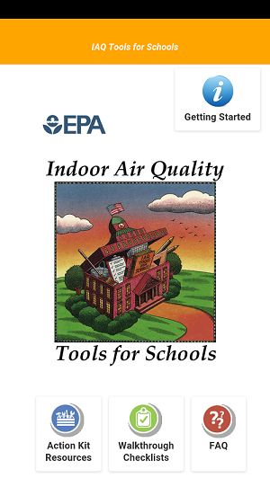
What Makes the Mobile App Such a Great Tool?
Everything you need is in one place.
Checklists help you remember to look at everything that’s important.
x
It’s easy to take notes and store pictures.
You can file a report right away.
Additional resources are available at the touch of a finger.
Notes:
As I’ve said, this app is designed to be easy to use, and as we take a closer look at it in the next slides, you’ll see that everything you need to identify, document and report on your school’s health is right there, as well as—and we think this is so important—the ability to file the report immediately, so it doesn’t get lost as just one more item on your long to-do list.
This is a shot of the home screen, and you can see that at the bottom you have access to the Action Kit, the Walkthrough Checklists, and links to Frequently Asked Questions on EPA’s website.

Slide 15

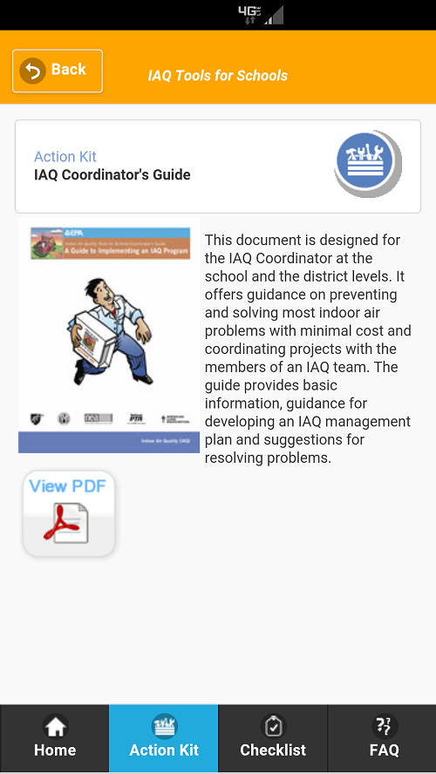
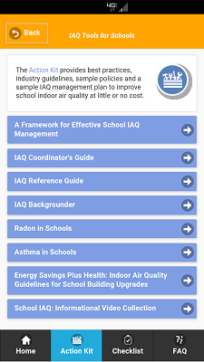
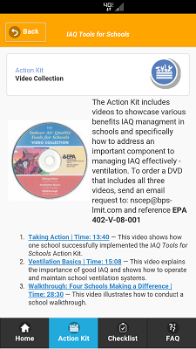
Access the IAQ Tools for Schools Action Kit
The Action Kit shows schools how to improve indoor air problems at little or
no cost. It includes—
Best practices
Industry guidelines
Sample policies
A sample IAQ management plan
Notes:
<Again, this can be tailored to the audience. Some groups will be very familiar with the Kit; others will not.>
Clicking on any of these blue menu items will take you to a description of the resource and a link to access it. The screen on the right shows the description of the School IAQ Informational Video Collection. You can see that the app describes the collection and has links for viewing the three videos on YouTube. It also includes an email address, should someone want to order the DVD.
Everything is right at your fingertips.
Here, as another example, you have the description of the IAQ Coordinators Guide and, with a tap of your finger, you can view the PDF of that Guide.

Slide 16
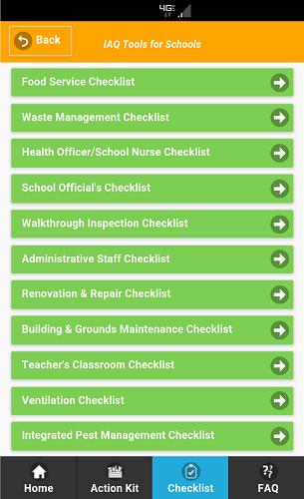
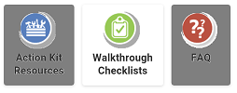
11 Walkthrough Checklists to Streamline Your Work
The app’s 11 checklists, organized by work area or staff responsibility, can help ensure that all aspects of the school’s IAQ are monitored on a regular basis.
Notes:
These checklists help break a big job into manageable pieces.
Different people complete different checklists, which means they can stay focused on the task at hand.
Some checklists are more extensive than others and will take longer; some areas of the school may not need to be surveyed as often as others. Be sure that you establish a schedule for how often each checklist should be completed and make sure that all the inspections are completed on a regular basis.
Remember: The key to maintaining good IAQ is conducting regular walkthrough assessments of your school facility.

Slide 17
Get into Action on Asthma
Choose your checklist.
Conduct your inspection.
Make notes and take pictures.
Submit your report.
Communicate your findings and set your priorities.
Take any action necessary to ensure healthy IAQ.
Notes:
Dave Blake will demonstrate how easy and helpful this tool can be.
<Review the steps> and repeat as needed!
So that’s it!
This mobile app can make the jobs of everyone involved in the IAQ program so much easier. It can help you gather all the needed information, organize it and prioritize what needs to be done to ensure good IAQ in your school buildings and improve the health and well-being of your students, teachers and staff.

Slide 18
IAQ Training to Reduce Asthma Triggers
Developing and delivering IAQ training for staff with an emphasis on health outcomes
Educating occupants on adopting good IAQ practices and behaviors and on the connection to asthma
Institutionalizing IAQ and health into the core mission of the school district
Communication techniques to deal with sensitive issues like pets in the classroom
Training and education to incorporate health issues like asthma and allergies into walkthrough assessments
Using the IAQ Tools for Schools Action Kit and Mobile App to help coordinate your training and education efforts
Notes:
During this webinar we will delve into how to activate critical components of the IAQ Tools for Schools kit, framework and mobile App train and educate staff and occupants to identify, assess and act to eliminate asthma triggers. Beginning with the Walkthough

Slide 19
Northwest Clean Air Agency
David Blake
Indoor Air Quality Specialist

Slide 20
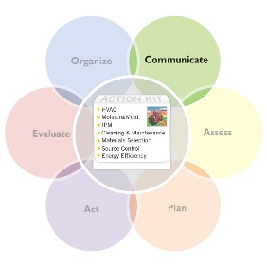
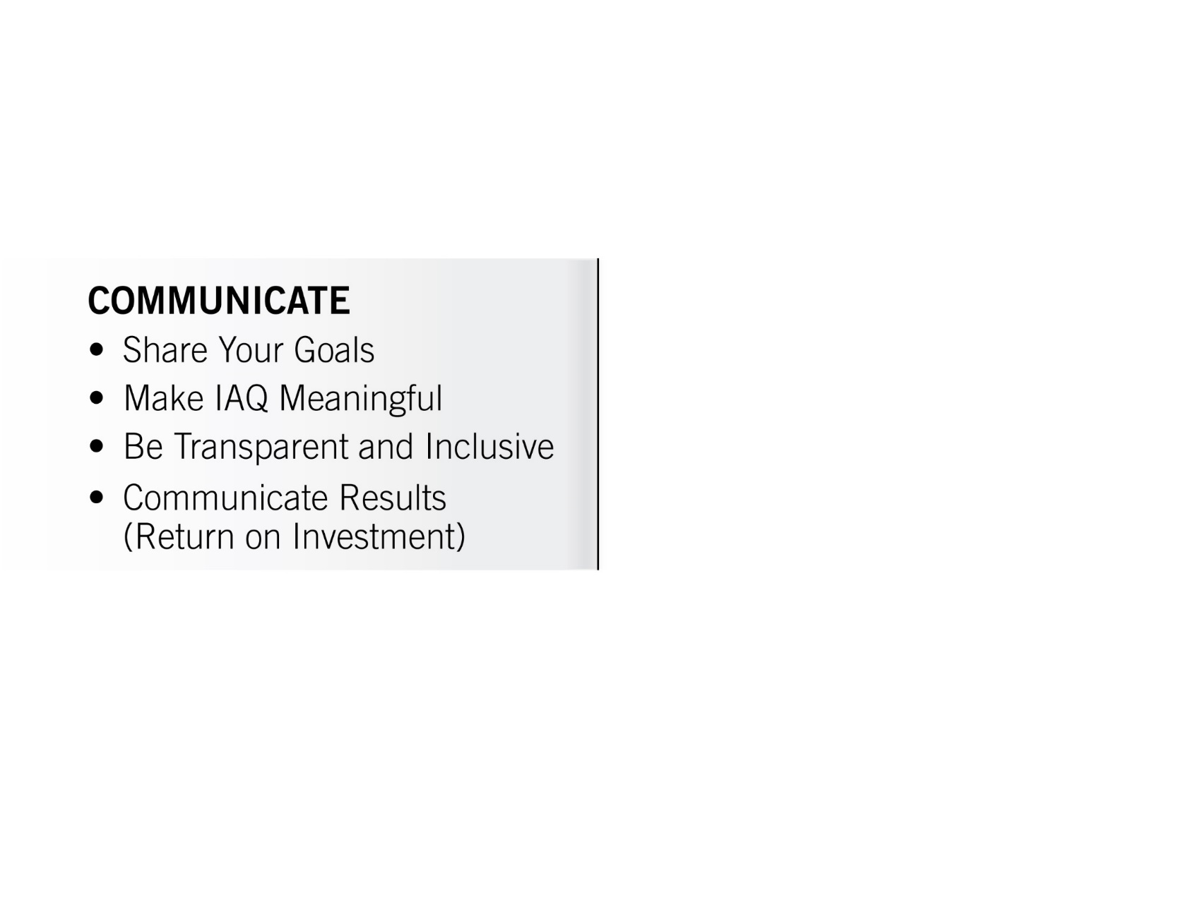

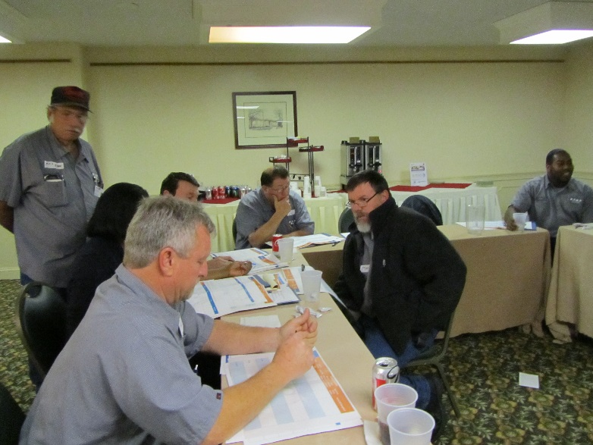
KEY DRIVER:
Communicate With Everyone, All the Time
“Discussions”
Notes:
Discussions

Slide 21
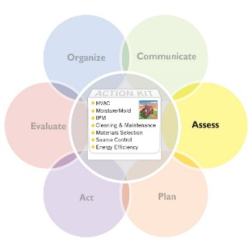
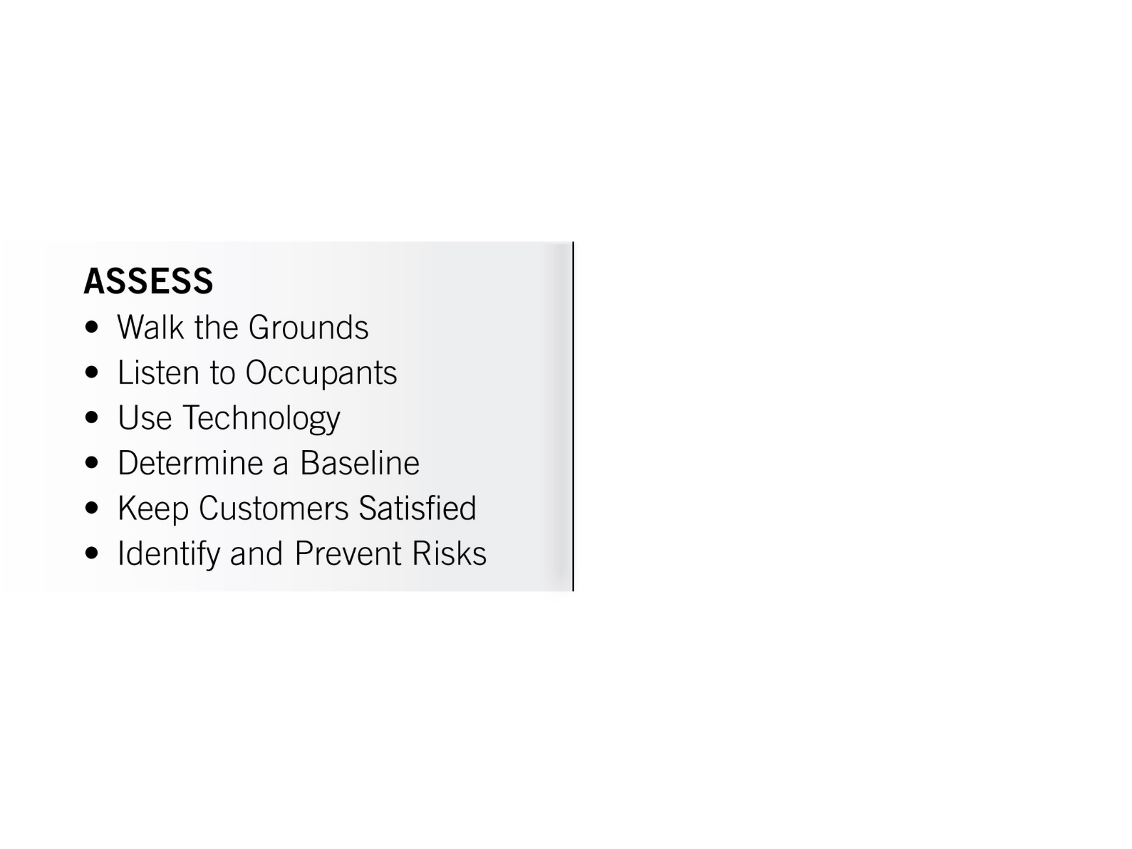
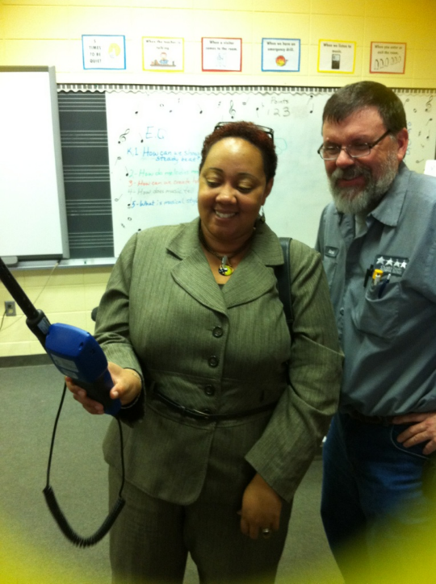
KEY DRIVER:
Assess Your Environments Continuously
“Observations”
Notes:
Observations

Slide 22
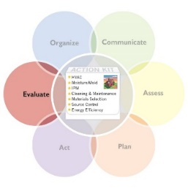
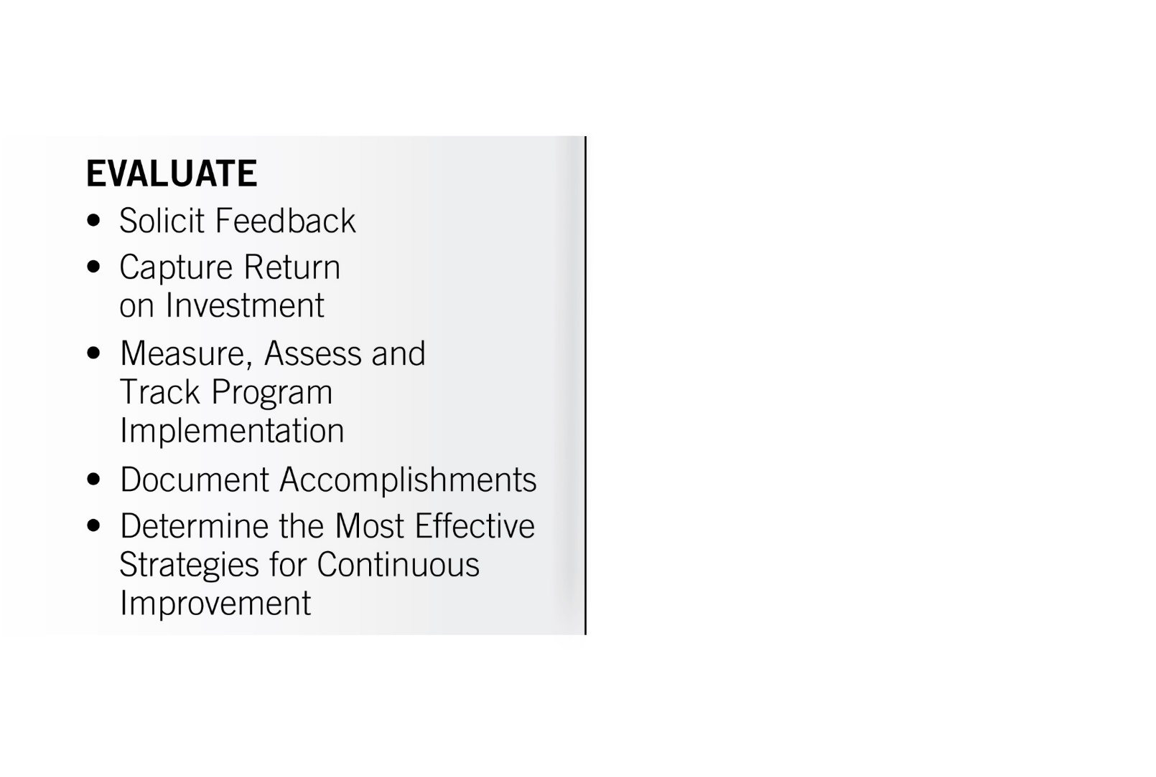
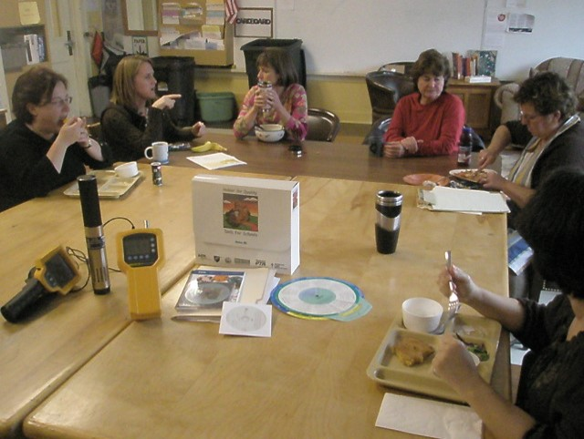

KEY DRIVER:
Evaluate Your Results
for Continuous Improvement
“Measurements”
Photo credits: Dave Blake and Rich Prill’s images from the
2013 Virtual School Walkthrough Webinar
Notes:
Measurements

Slide 23
The School District of Philadelphia
Francine Locke
Director,
Office of Environmental Management and Services

Slide 24

The School District of Philadelphia
Case Study of IAQ Training to Address Asthma
June 9, 2016
Presented by:
Francine Locke, M.S.
Environmental Director
The School District of Philadelphia

Slide 25
About Us
  The School District of Philadelphia
Large, urban school district
134,538 students enrolled
16,680 employees
218 schools and more than 300 buildings
23 million square feet of buildings
51% of our students are African-American
19.5% of our students are Latino/Hispanic
13.4% of our students are White
8% of our students are Asian
Data updated by the School District of Philadelphia as of December 2015.
www.philasd.org

Slide 26
Health Disparities in PA
Children With Asthma
29.9% of African-American children in Pennsylvania have asthma.
19.5% of Latino/Hispanic children in Pennsylvania have asthma.
11.2% of White children in Pennsylvania have asthma.
Disparities in asthma deaths were observed, with African-Americans having higher death rates (3 to 4 times greater) than Whites and females having higher death rates than males.
Source: Behavioral Risk Factor Surveillance System (BRFSS) Prevalence Data. http://www.cdc.gov/asthma/brfss
Asthma Prevalence PA. August 2015. www.Health.PA.gov

Slide 27
Absenteeism and Asthma in PA
28% of children missed one or more days of school due to asthma.
24% of adults missed one or more days of work due to asthma.
Chronic disease calculator, version 2, Retrieved at http://www.cdc.gov/chronicdisease/calculator
Pennsylvania Behavioral Risk Factor Surveillance Systems

Slide 28
School District of Philadelphia’s
Asthma Program
  Objective
  Identify, assess, control and prevent asthma in schools.
Two-Pronged Approach
Environmental Management: Conduct inspections to identify and remove/prevent environmental factors that trigger asthma.
Clinical Management: Provide medication or emergency medical care to students with asthma.

Slide 29
School District of Philadelphia’s
Asthma Program
Goals
Provide a procedure for District staff to manage asthma in schools.
Provide staff, students and parents with training to identify asthma signs and symptoms, as well as steps to take in response to same.
Provide classroom and facility staff, students and parents with training to prevent, identify and correct environmental asthma triggers in schools.

Slide 30
Asthma Program Development Committee Monthly Meetings
American Lung Association
Children’s Hospital of Philadelphia, Community Asthma Prevention Program
St. Christopher’s Hospital for Children
Healthy Schools Network
PA Department of Health
Penn State IPM—School and Community IPM Partnership
U.S. EPA
School District Staff from Student Health Services (School Nurses), Environmental Services, Facilities

Slide 31
Partnerships
PA Asthma Partnership Member—A diverse, multidisciplinary partnership of agencies, organizations and individuals in the Commonwealth concerned with asthma; committed to sharing mutual expertise and resources in addressing and reducing the burden of asthma in Pennsylvania. http://www.paasthma.org
Asthma 101 [www.lungusa.org], American Lung Association—A program that provides the public with the “basics” of asthma; tailored for our School District’s teachers with 2 hours of Act 48 Credits Professional Development.
Open Airways for Schools [www.lungusa.org], American Lung Association—An education program that empowers children (ages 8–11) to manage their asthma; tailored for our School District’s parent coordinators in Philadelphia.
Child Asthma Prevention Program [www.chop.edu/capp], Children’s Hospital of Philadelphia—A program that has worked in many Philadelphia communities to offer free asthma education, home visits and training to school personnel and primary care providers.
Integrated Pest Management [www.paipm.cas.psu.edu], Pennsylvania Integrated Pest Management—A partnership comprising public/private/nonprofit organizations to reduce health risks associated with pests and pesticides and to make indoor and outdoor environments (public buildings and private residences) safer through the widespread adoption of IPM methods.
Healthy Homes Healthy Kids, Philadelphia Department of Public Health and St. Christopher’s Hospital for Children—A program for families of children hospitalized for asthma at St. Christopher’s. Offers education, assessment and repairs of asthma triggers in the home, coordinates followup with medical care providers, and provides energy-efficiency audits and weatherization.

Slide 32
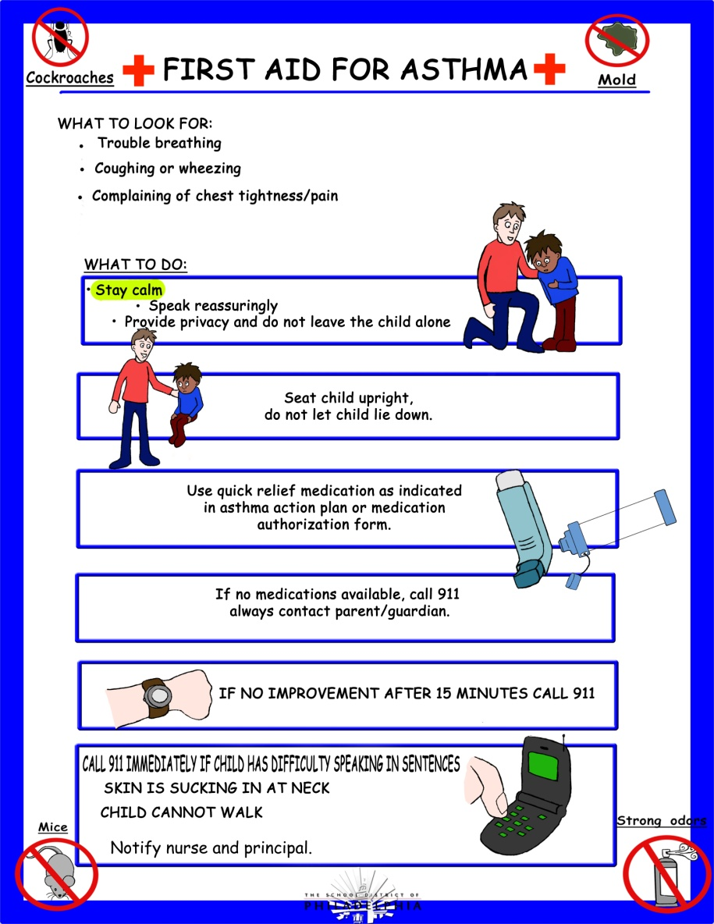
Outreach and Training
Written plan with roles and responsibilities
Posters that explain symptoms and triggers and what to do
Parent coordinators—Open Airways Training
Mentoring school districts

Slide 33
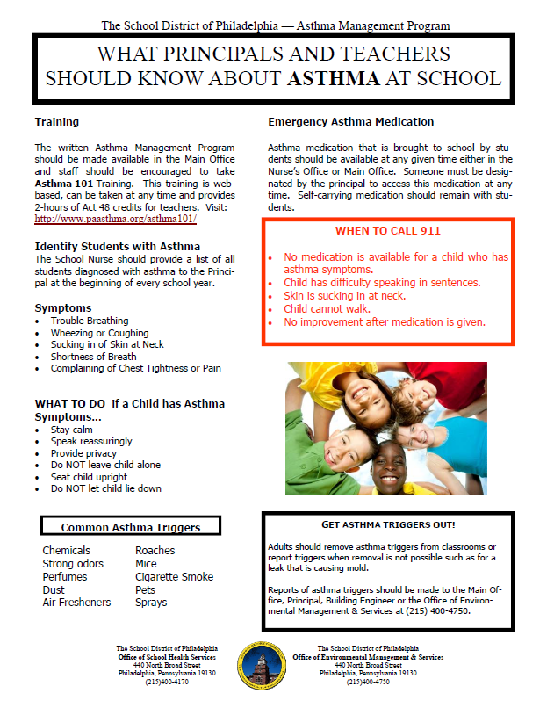
Fact Sheets and Handouts

Slide 34


Parent University

Slide 35
Teacher Training: Continuing Education Credits and/or Teaching License Certification Credits
Act 48 Hours in PA – Asthma 101
“Asthma 101” Training for Teachers
Sponsored by the Pennsylvania Asthma Partnership
http://www.paasthma.org/asthma101/
2-hours of Act 48 Credits
ATTENTION ALL TEACHERS
You can make a difference in the life of a child with asthma in your classroom.
Children with asthma are at a higher risk of chronic absenteeism, more visits to the nurse’s office for emergency inhaler medicine and have difficulty concentrating due to respiratory problems – all of which impact academic performance. With this web-based training, learn about the effective management of asthma in the classroom by viewing and listening to “Asthma 101.”
In order for you to receive your 2 hours of ACT 48 or ACT 58 credits you are required to sign in with your name, email and PPID. Your PPID is the 7 digit number issued to you by The Department of Education. You will need to enter you name, social security number and Date of Birth.
Additionally you are required to take both a pre and posttest; this is not graded but is used for internal purposes to see how much knowledge is gained from the program. After the posttest is completed you will be able to print out a Certificate of Completion, after the certificate is printed you may add your name.
If you have any questions, please contact Francine Locke, School District of Philadelphia, Environmental Director, flocke@philasd.org, 215-400-5213.

Slide 36
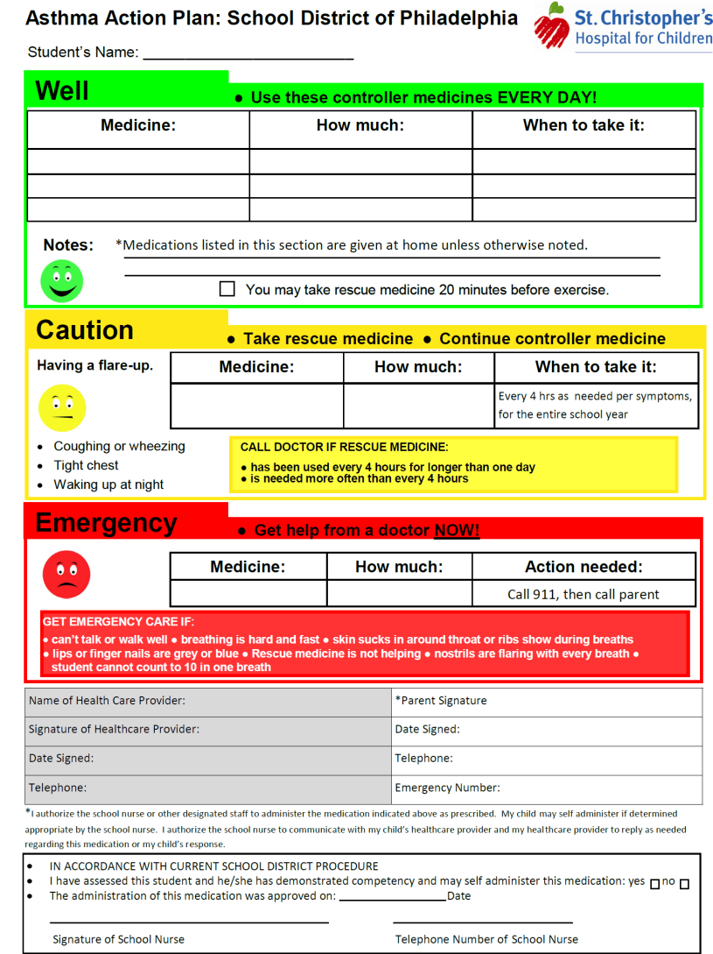
School Nurse’s Role
Identify students with asthma by reviewing medical records and emergency information.
Review triggers with students, as well as how to use their medication.
Talk to teachers about needs of students with asthma.
Maintain an asthma action plan for every student with asthma.
Ensure an emergency back-up plan is in place for times a nurse is not immediately available.
Communicate with parents and health care providers about acute episodes at school.
Link parents with provider resources.
Report asthma triggers to the principal or building engineer for remediation.

Slide 37
Environmental Office’s Role
Identify asthma triggers in schools and remove them—
Conduct indoor environmental quality (IEQ) inspections
  2 times per year, in tandem with regulatory compliance inspections
  Comprehensive or focused proactive inspections
Conduct Dashboard Committee meetings to review findings and track remediation to completion through work order system

Slide 38
Prioritizing Schools to be Assessed
Identify and target the schools with—
Highest asthma prevalence—number of students diagnosed with asthma compared to total school population; and
Most frequent student use of emergency asthma medication, not including maintenance meds or prior to activities.

Slide 39
Asthma Environmental Assessments
Assessments are conducted by the IEQ Manager and sometimes with guests from universities, nonprofits, etc.
The prioritization of schools assessed is based on the District’s 2014–2015 asthma data.
A score is assigned based upon the percentage of students with asthma compared to the percentage of emergency inhaler doses given.
The school is notified of the assessment in advance of the visit.
The assessment begins with a 20- to 30-minute opening meeting with the—
  School Principal
  School Nurse
  Custodial Assistant
  Building Engineer

Slide 40
Questions/Issues Discussed at the Opening Meeting
Are there any classrooms or areas within the building where students are frequently suffering from asthma attacks?
Are there building cleanliness issues or areas that may require more attention?
Are there processes for pest control, sighting, and reporting, and are there exterior door sweeps?
Any heating, ventilation, and air conditioning systems (HVAC) concerns?
Is there moisture intrusion associated with the building envelope, pipe leaks, or condensation?
Any other environmental building concerns?
Review and distribution of the School District’s Asthma Information Package and the Environmental Protection Agency’s (EPA) Indoor Air Quality Tools for Schools Action Kit

Slide 41
Process to Completion
Upon completion of the Assessment, an IEQ Dashboard Report summarizing the findings, corrective action recommendations, and responsible party is prepared along with a summary letter.
Corrective actions are incorporated into the District’s IEQ Program and entered into the Operations Divisions’ work order system for implementation.

Slide 42
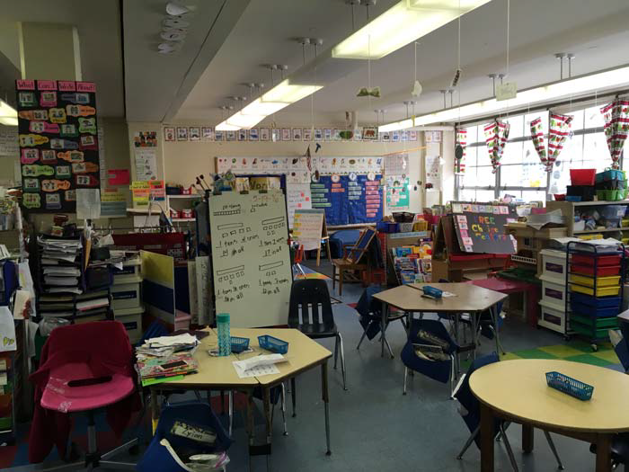
Cluttered Kindergarten Classroom

Slide 43
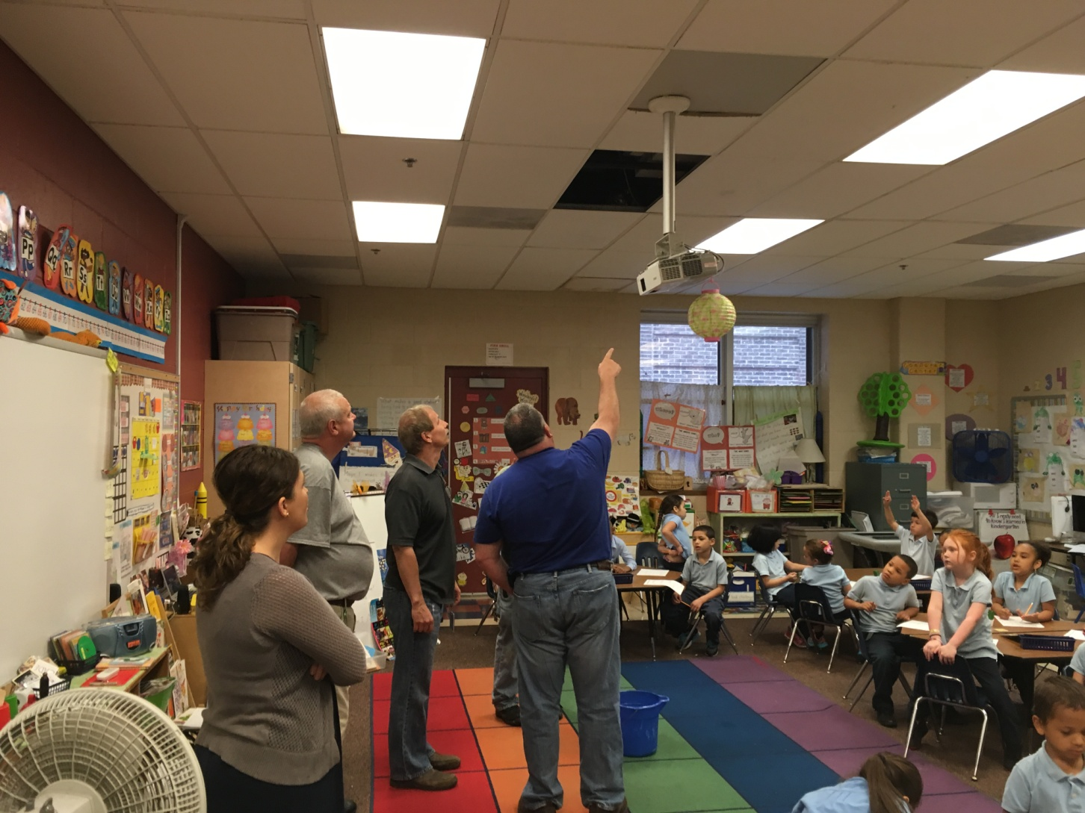
School-Based IEQ Team
The Team:
Principal
Teacher
Building Engineer
Maintenance Staff
Facility Area Coordinator
IEQ Inspector

Slide 44
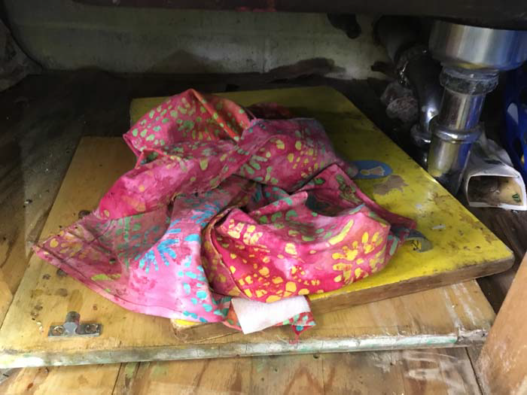
Under-Sink Water Leak, Mold, Rodent and Droppings

Slide 45

Asthma Trigger (sorry)

Slide 46
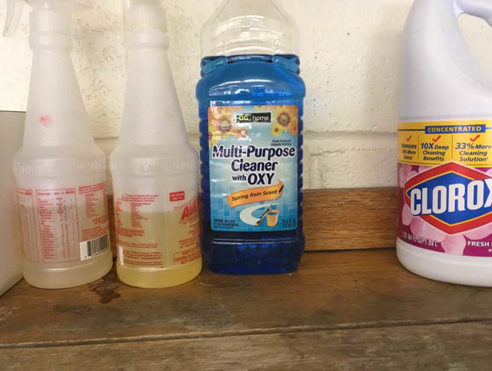
Unapproved Cleaning Chemicals

Slide 47
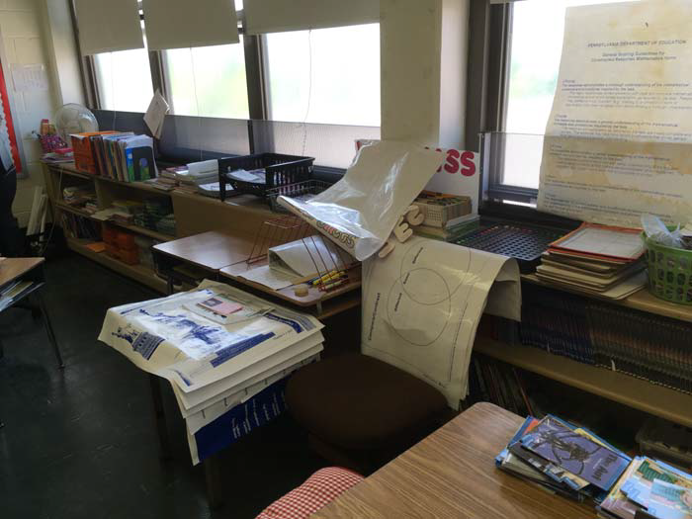
Blocked Unit Ventilator

Slide 48
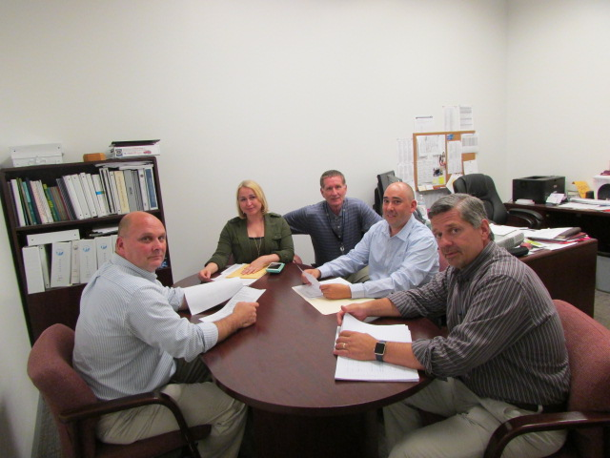
IEQ Dashboard Committee
The Team:
Maintenance Staff
Operations Staff
Environmental Staff
IEQ Manager

Slide 49
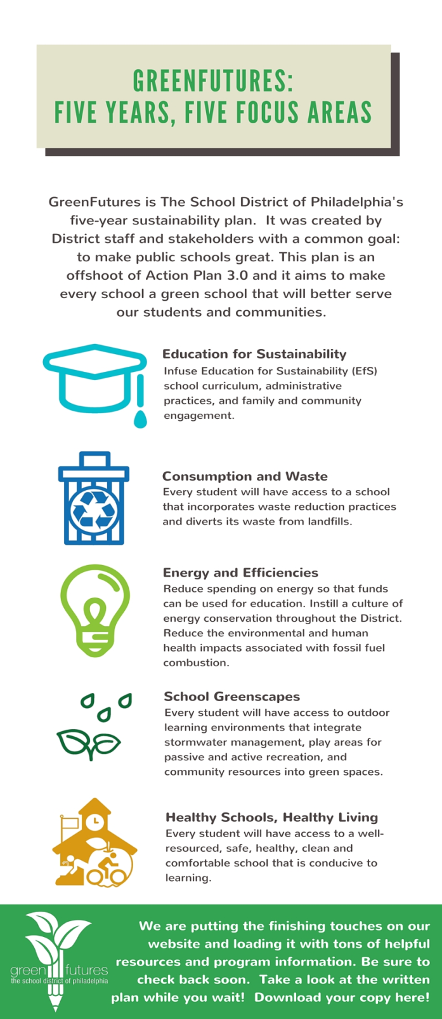

https://greenfutures.philasd.org/
@sdpgreenfutures
Facebook.com/SDPgreenfutures

Slide 50
Thank you!
Francine Locke, M.S.
Environmental Director
The School District of Philadelphia
flocke@philasd.org
@philaschoolsenv

Slide 51
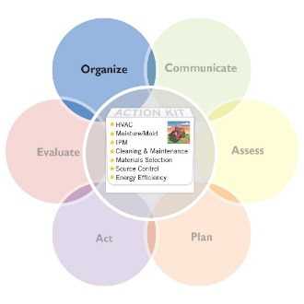
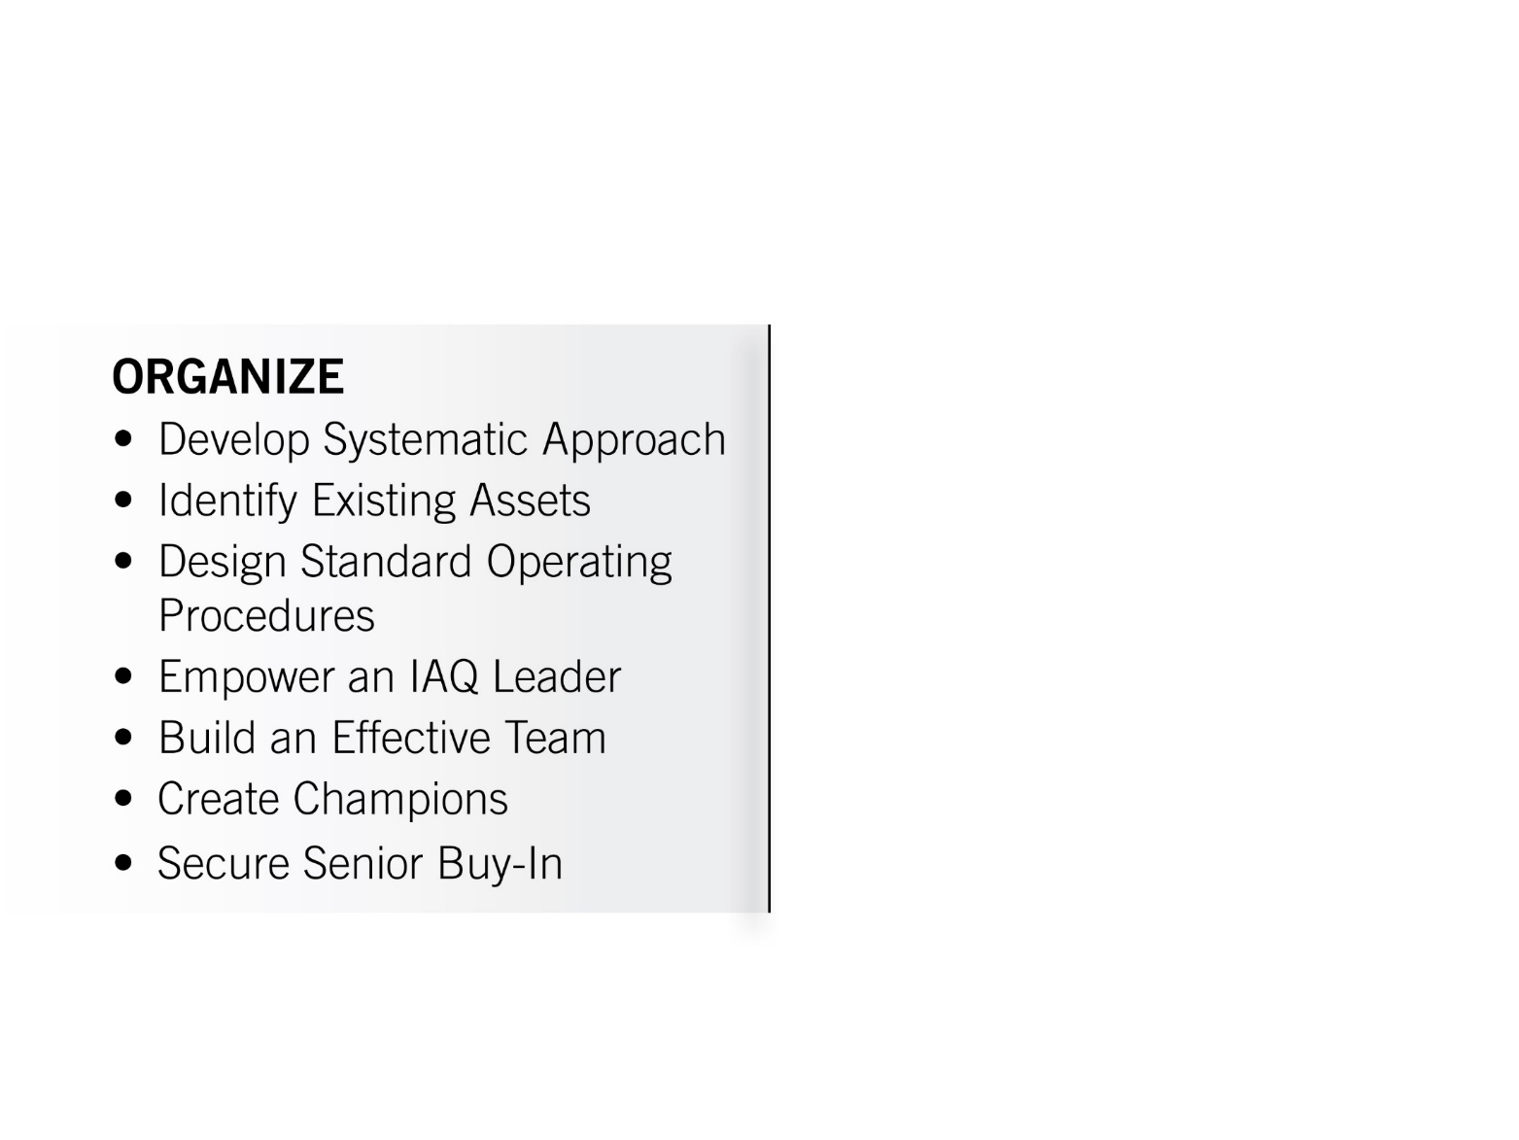
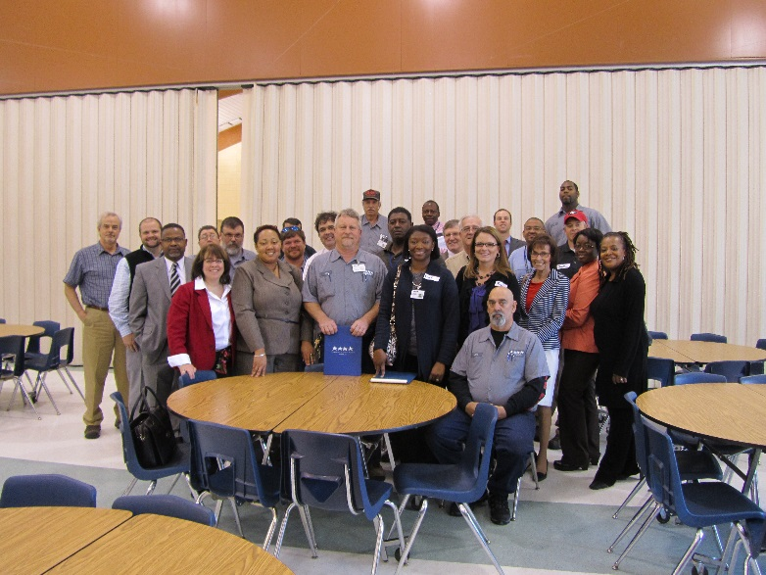
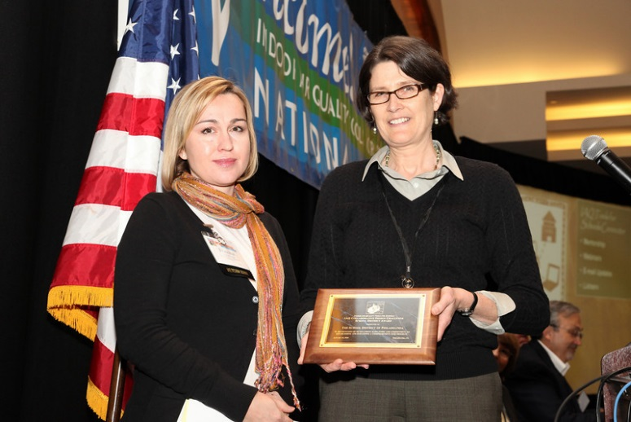
KEY DRIVER:
Organize for Success
Notes:
One of the main messages you heard from Francine was the importance of having a strong organizational component to you IAQ program that includes developing systematic approaches and standard operating procedures that are part of an established written plan.

Slide 52
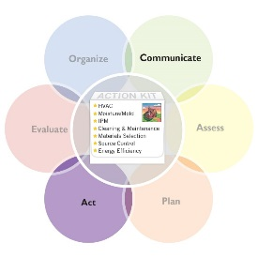
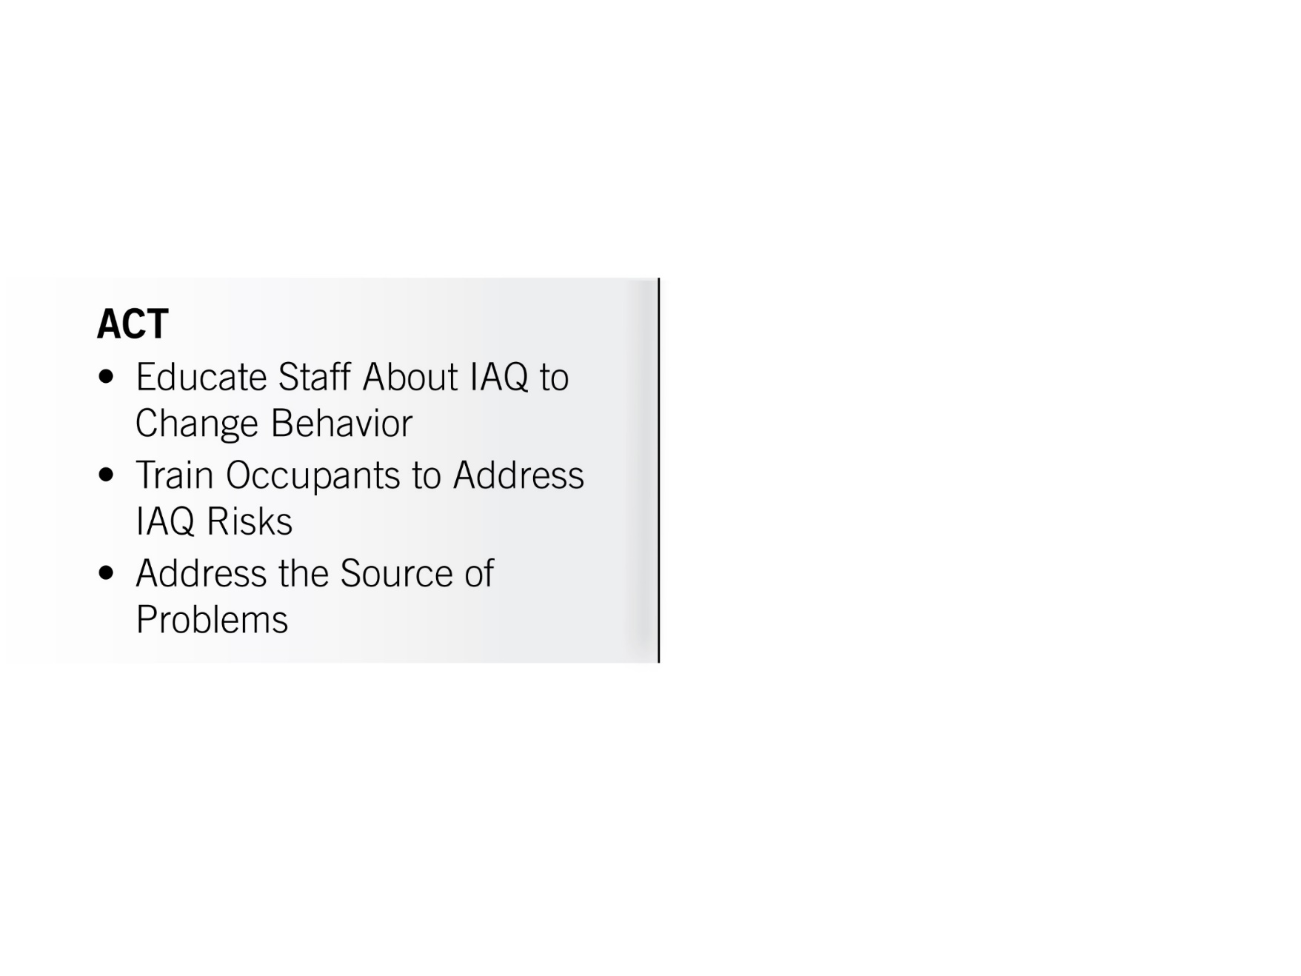
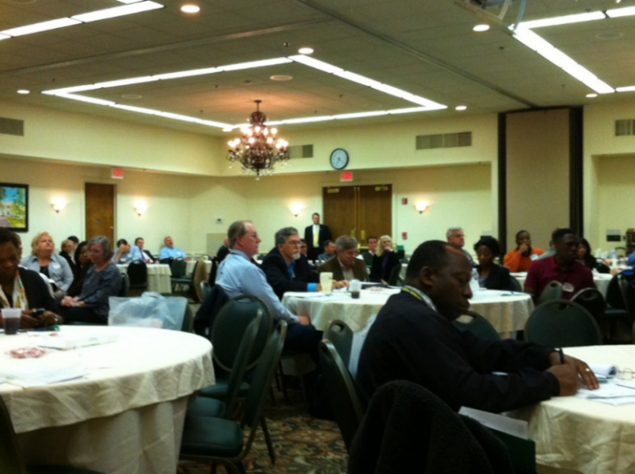
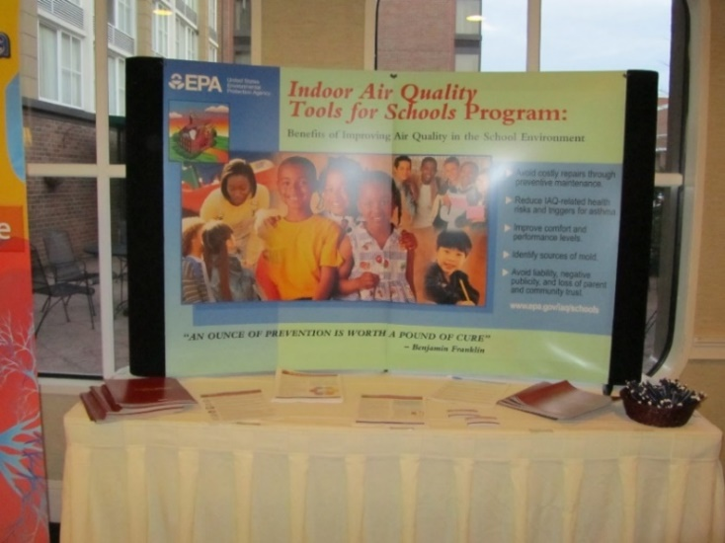
KEY DRIVER:
Act to Address Structural,
Institutional and Behavioral Issues

Slide 53
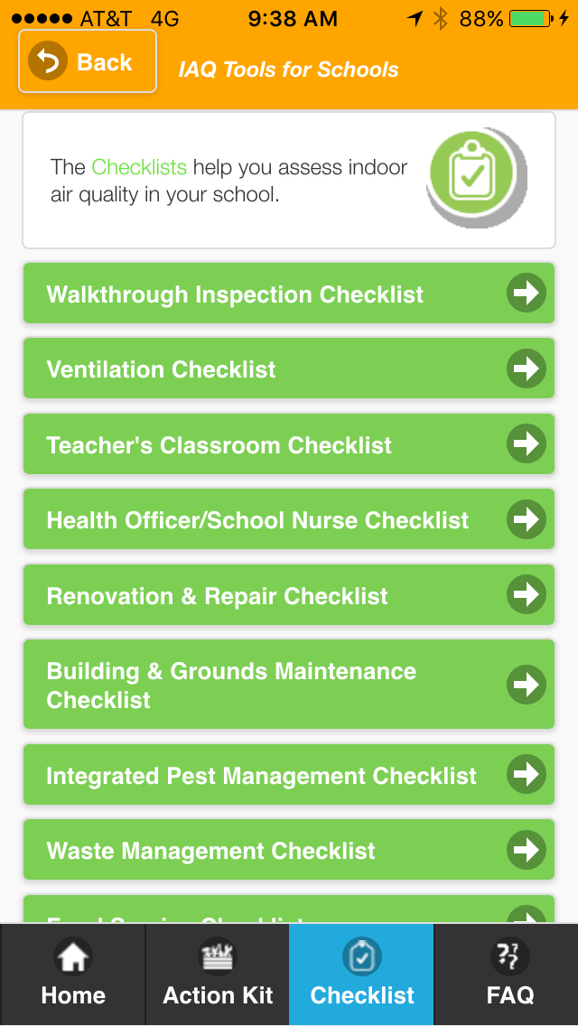
KEY DRIVER:
Act to Address Structural,
Institutional and Behavioral Issues
Notes:
The IAQ Tools for School Kit and Mobile App are designed to offer checklists that are targeted to all the staff and occupants in the schools to help coordinate actions and assist with comprehensive training that builds competency for everyone to conduct their role in reducing asthma triggers.
The checklist in the kit can be used to facilitate communication and coordinate action between all of the school IAQ stakeholders. Lets look at the roles and relationship Francine highlighted that between the teacher, the school nurse and the environmental officer.

Slide 54
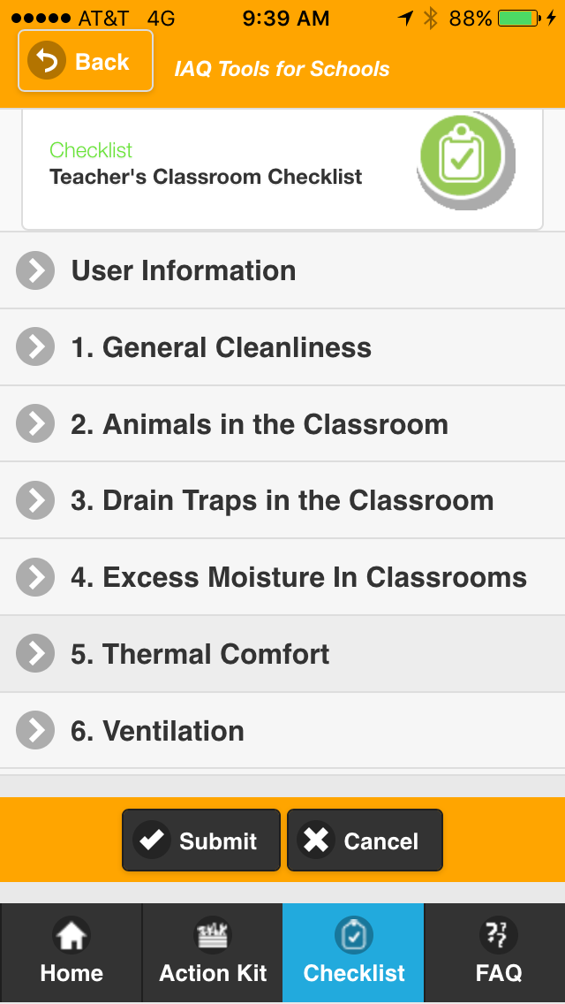
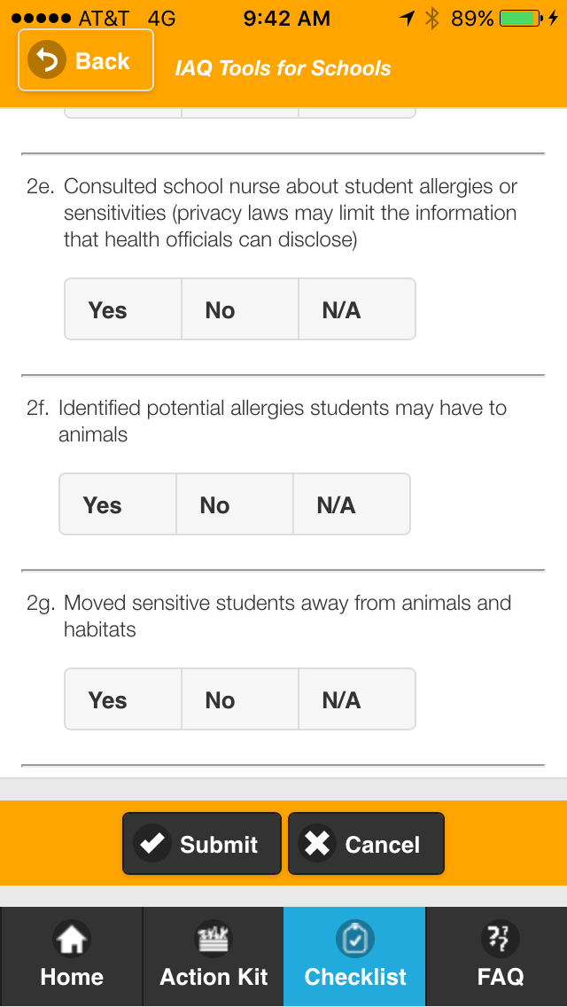
Act to Address Structural, Institutional and Behavioral Issues
Teacher’s Checklist
Notes:
The teachers checklist identifies animals in the classroom as an IAQ issue for teachers to manage and prompts the teacher to consult with the school nurse to help identify and protect potentially sensitive students.

Slide 55
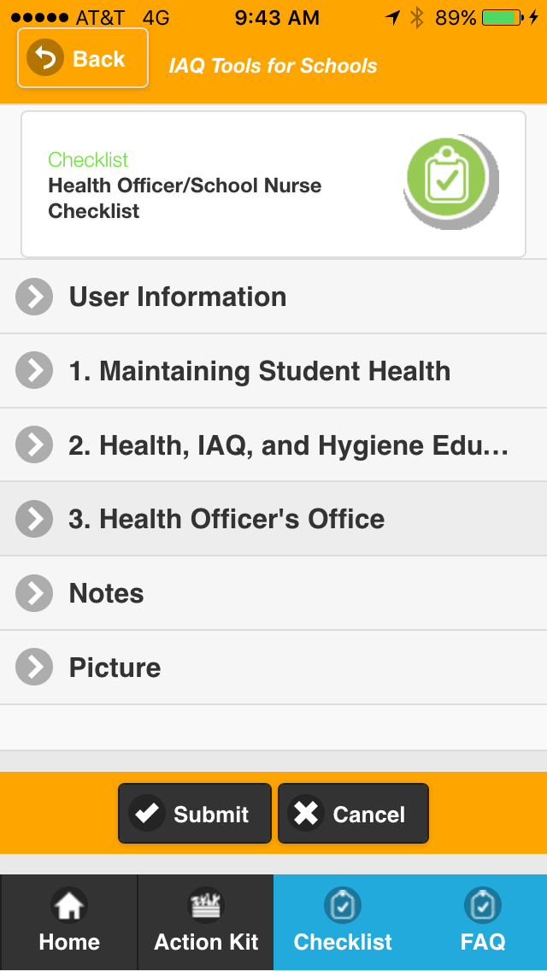
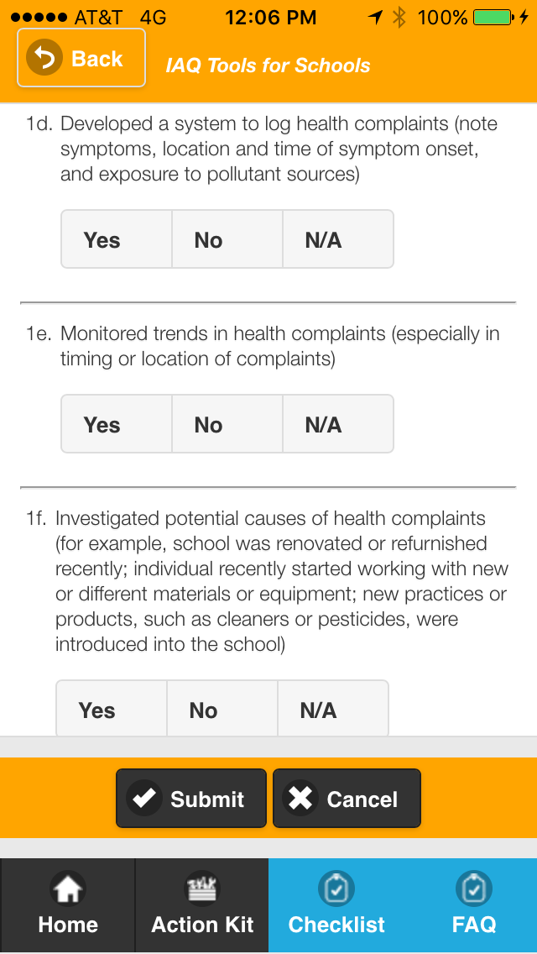
Act to Address Structural, Institutional and Behavioral Issues
Health Officer/School Nurse Checklist

Slide 56
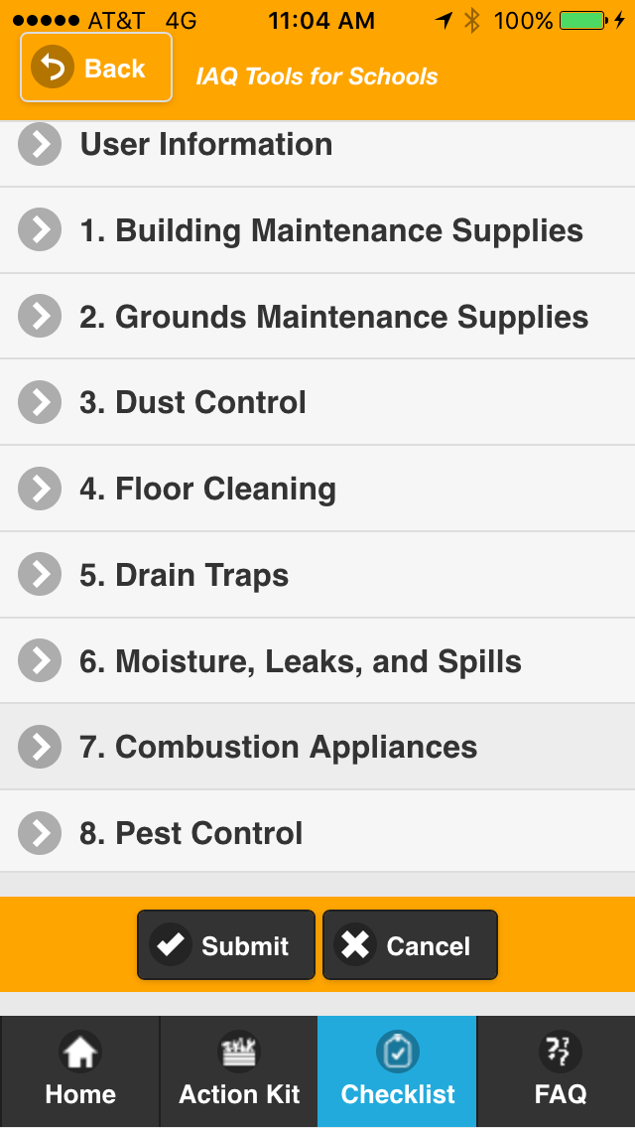
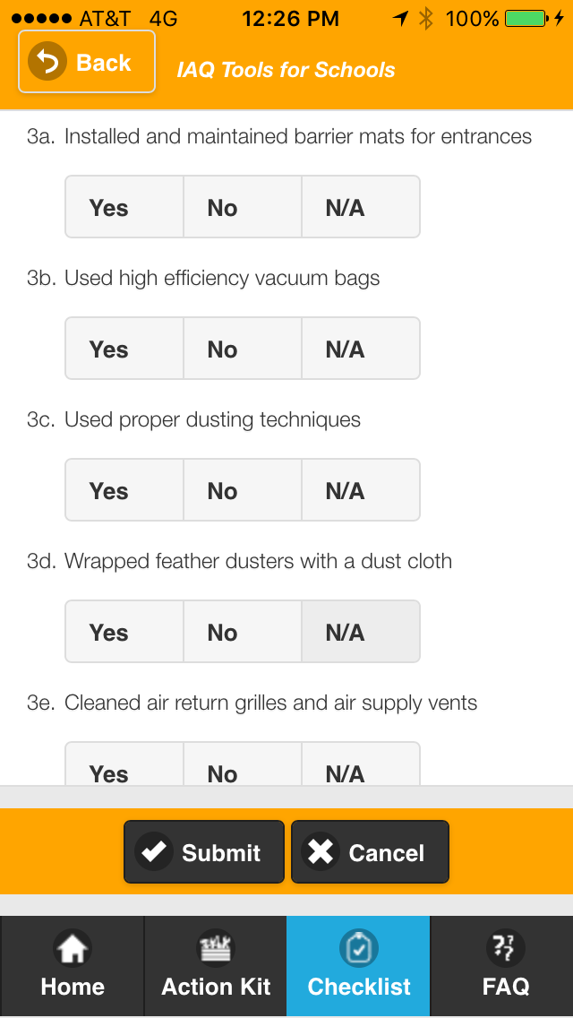
Act to Address Structural, Institutional and Behavioral Issues
Building & Grounds Checklist

Slide 57
Healthy Indoor Environments in Schools Resources
School IAQ Assessment Mobile App | www.epa.gov/iaq-schools/school-iaq-assessment-mobile-app
IAQ Tools for Schools Guidance | www.epa.gov/iaq/schools
IAQ Tools for Schools Action Kit | www.epa.gov/iaq-schools/indoor-air-quality-tools-schools-action-kit
IAQ Tools for Schools Framework and Technical Solutions | www.epa.gov/iaq-schools/framework-effective-school-indoor-air-quality-management-key-drivers
IAQ Master Class Professional Training Webinar Series | www.epa.gov/iaq-schools/indoor-air-quality-schools-master-class-webinar-series
IAQ Knowledge-to-Action Professional Training Webinar Series | www.epa.gov/iaq-schools/iaq-knowledge-action-professional-training-webinar-series
IAQ Tools for Schools Connector E-Newsletters and Emails | public.govdelivery.com/accounts/USEPAIAQ/subscriber/new?category_id=USEPAIAQ_C1
Schools IAQ Connector Listserv | Send a blank email message to schools_iaq_connector-subscribe@lists.epa.gov.

Slide 58




Other Essential Resources
Envisioning Excellence: Lessons From Effective School Indoor Air Quality Programs — A Snapshot of Profiles in IAQ Excellence.
This collection of IAQ profiles provides a comprehensive look into several very different school districts that have applied the Framework for Effective School IAQ Management to create effective and enduring IAQ programs.
Envisioning Excellence: IAQ Strategies in Action — The Framework for Effective School IAQ Management. This resource details the step-by-step strategies and actions that successful school districts can take to create healthier and safer learning environments.
Discover the Power of Effective Evaluation of IAQ Management — Key Drivers in Action. Schools that leverage the Evaluate Driver of the IAQ Tools for Schools Framework for Effective IAQ Management are better positioned to create healthier learning environments. Read examples of districts that have used evaluation to refine their programs and showcase their successes and learn how you can do the same.
Energy Savings Plus Health: Indoor Air Quality Guidelines for School Building Upgrades. Schools can protect and improve IAQ during building upgrades by controlling exposure to potential contaminants, controlling moisture, and ensuring adequate ventilation. This new Guide includes an interactive Checklist Generator to help track project processes, accomplishments and upcoming tasks.

Slide 59
Association for Learning Environments
^{F-118}
Design of Cele Middle School, Pflugerville ISD
WEB-09JUN16
Dave Blake; Francine Locke
^{June 9, 2016}

Slide 60
Credit(s) earned on completion of this course will be reported to AIA CES for AIA members. Certificates of Completion for both AIA members and non-AIA members are available upon request.
This course is registered with AIA CES for continuing professional education. As such, it does not include content that may be deemed or construed to be an approval or endorsement by the AIA of any material of construction or any method or manner of
handling, using, distributing, or dealing in any material or product.
_______________________________________
Questions related to specific materials, methods, and services will be addressed at the conclusion of this presentation.

Slide 61
Course
Description
Creating Green Clean and Healthy Schools requires mastering the indoor environment using a comprehensive approach. The U.S. Environmental Protection Agency’s (EPA) Indoor Environments Division (IED) new IAQ Knowledge-to-Action Professional Training Webinar Series will demonstrate how to translate the knowledge gained in the IAQ Master Class Professional Training Webinar Series into actions that improve IAQ in schools.
The webinar Know the Drill for Healthy IAQ: Training Staff and Occupants to Reduce Indoor Asthma Triggers will highlight EPA resources like the IAQ Tools for Schools Framework, the School IAQ Assessment Mobile App and the IAQ Tools for Schools Action Kit. It also will teach participants how to train staff to identify, recognize and address indoor environmental asthma triggers and perform the actions essential for effectively managing asthma in schools.

Slide 62
Learning
Objectives
At the end of the this course, participants will be able to—
Train staff to identify, recognize and address indoor environmental asthma triggers and perform the essential actions for effective asthma management in schools.
Design and successfully implement a staff training system as part of a sustainable IAQ management program.
Effectively use the School IAQ Assessment Mobile App—new technology featuring the IAQ Tools for Schools Action Kit— as a teaching tool to identify and reduce asthma triggers in the school environment.
Replicate successful strategies to reduce asthma attacks, increase attendance and improve academic performance through an effective staff training program and implementation of the IAQ Tools for Schools Framework.

Slide 63
This concludes The American Institute of Architects Continuing Education Systems Course.
Association for Learning Environments
(480) 391-0840

Slide 64
Thank you for attending!
Your next action steps:
Fill out the webinar evaluation form.
Access your personalized certificate of completion.

Slide 65
Question & Answer Session

