Slide 1
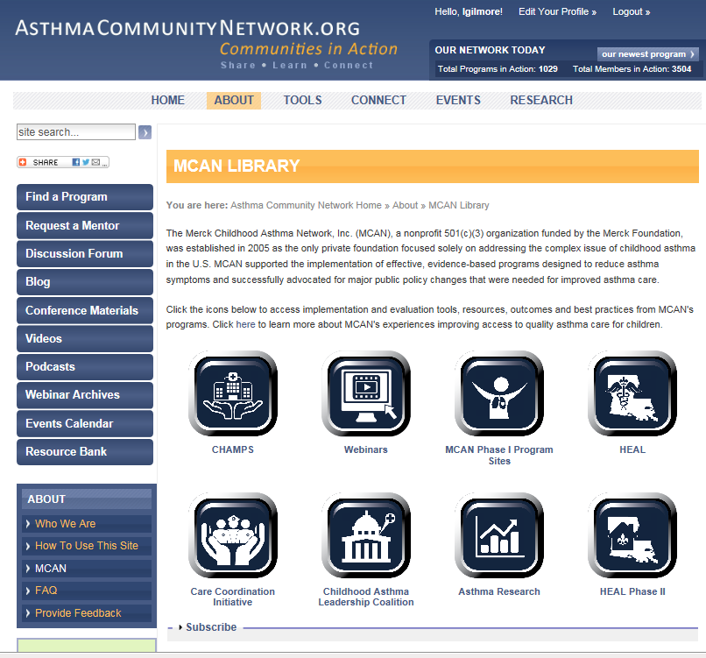
Welcome! MCAN Resources for Successful Asthma Interventions
Participant Dial-In: (800) 374-0278
Conference ID: 74828250 Thursday, December 3, 2015, Webinar: 2:00 p.m.–3:00 p.m. EST Live Online Q&A: 3:00 p.m.–3:30 p.m. EST on AsthmaCommunityNetwork.org

Slide 2
Purpose
Implement the Community Healthcare for Asthma Management and Prevention of Symptoms (CHAMPS) Program in your community by exploring a series of e-learning videos and learning about the CHAMPS intervention methodology.
Access and integrate Patient Education Handouts that provide concise, visual take-home information for your patients and their families.
Access Patient Surveys (available in both English and Spanish) and learn how to effectively administer them.
Learn about the latest in Asthma Research as well as major milestones.

Slide 3
Agenda
Introduction
Roundtable Discussion
Q&A in AsthmaCommunityNetwork.org Discussion Forum
Member? You can post questions now. Use the link in the Chat box.
Not yet a member? Joining online is quick and easy.
Go to AsthmaCommunityNetwork.org.
Click “Join Now” at the top of the screen and complete the application process.
Post questions as soon as your account is approved.

Slide 4
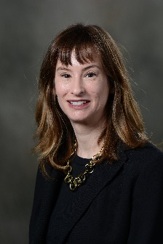
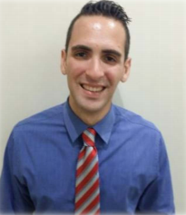
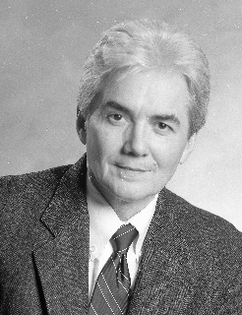
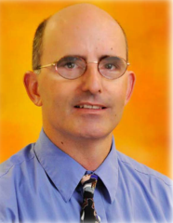
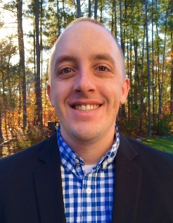
Speakers
 | Julie Kennedy Lesch, MPA Programs Manager MCAN Washington, DC
 | Dr. Herman Mitchell V.P. of Federal Operations Rho Chapel Hill, NC
 | Ryan Bailey, M.A. Business Analyst Rho Chapel Hill, NC
 | Francisco Ramirez Asthma Counselor Costa Salud Community Health Rincon, Puerto Rico
 | Dr. Andrew Arthur Associate Medical Director El Rio Community Health Center Tucson, AZ
Notes:
Julie Kennedy Lesch has over 10 years of experience in nonprofit organizations and philanthropy and is the Programs Manager at the Merck Childhood Asthma Network where she plays an active leadership role in the organization, operation, management, and evaluation of all MCAN projects and initiatives to improve the quality of life for children with asthma.
Herman E. Mitchell, PhD, is an Epidemiologist/Biostatistician, Senior Research Scientist, and Vice President of Rho, Inc. in Chapel Hill, NC. He is also adjunct Professor of Biostatistics at the University of North Carolina School of Public Health. He has over 30 years of NIH multicenter coordinating experience, and for the past 25 years has been involved in clinical research related to asthma in inner-city children.
He was on the faculty of both departments of Epidemiology and Biostatistics at University of Pittsburgh Graduate School of Public Health, where he also served as Assistant Dean. He also served as Assistant to the Secretary of Health for the State of Pennsylvania. Following this position he became Director of Research Systems and Vice President for Research Development at New England Research Institute (NERI) in Boston.
Dr. Mitchell has served as PI or co-PI for more than a dozen NIH-sponsored clinical trials and epidemiologic studies. Starting in 1990, Dr. Mitchell has served as the Coordinating Center Principal Investigator for the NIH/NIAID asthma studies among children in the inner city. Dr. Mitchell was also PI of the Coordinating Center for the NIEHS multicenter study of asthma and environmental exposures among children in post-Katrina New Orleans (HEAL – Heading off Environmental Asthma in Louisiana).
Ryan Bailey is a Project Coordinator and Business Analyst at Rho. He has over 10 years of experience conducting multicenter asthma research studies, including the Inner City Asthma Consortium (ICAC) and the CHAMPS project. Mr. Bailey also coordinates Rho’s Center for Applied Data Visualization and manages Rho’s Writing and Editing Community of Expertise.
Francisco Ramirez RN AE-C
Six years in the nursing profession primarily in ER setting with the last 3 years focused on rural asthma population on the west side of Puerto Rico. One of the Asthma counselors trained on the CHAMPS intervention. Certified Asthma Educator (AE-C) since February 2014.
Dr. Andrew Arthur is a general pediatrician and the Medical Director of Pediatrics at El Rio Community Health Center in Tucson Arizona. Dr. Arthur obtained his MD and a PhD in epidemiology from Johns Hopkins University. Dr. Arthur completed his pediatric residency at the University of Arizona. Dr. Arthur has been the closely involved with El Rio’s Asthma Program since 2001.

Slide 5
Poll Question
What type of organization do you represent?
Notes:
Before we dive into today’s presentations, I would like to take a minute to learn more about you. To help me do that I have two quick polls:
Polling Question #1

Slide 6
Poll Question
What are you most interested in learning about today?
Notes:
And now I would like to hear about what you are excited to learn more about today.
Terrific, I see that ……
Well you will be happy to know that our speakers will be covering all of these topics in their presentation today. And in instances where you feel that you still have questions, please visit the discussion forum in AsthmaCommunityNetwork.org and submit your question there.
So without further delay, let’s get started.

Slide 7
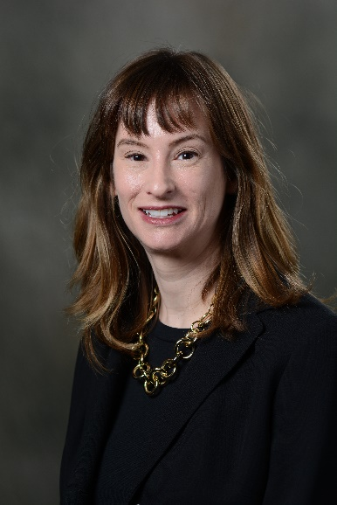
Merck Childhood Asthma Network
Julie Kennedy Lesch, MPA
Programs Manager
Notes:
Program Overview Intro Slide
Julie has over 10 years of experience in nonprofit organizations and philanthropy and is the Programs Manager at the Merck Childhood Asthma Network where she plays an active leadership role in the organization, operation, management, and evaluation of all MCAN projects and initiatives to improve the quality of life for children with asthma.

Slide 8
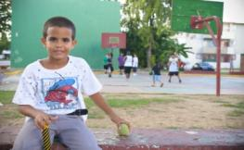
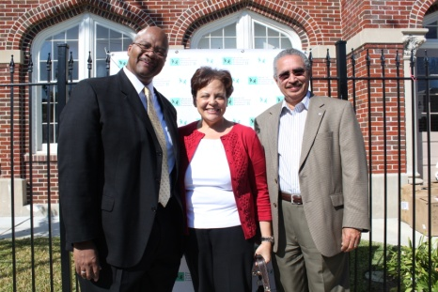
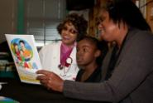
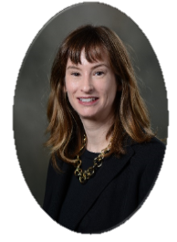
MCAN is a nonprofit 501(c)(3) organization established in 2005 and funded by The Merck Foundation.
The Merck Childhood Asthma Network, Inc. (MCAN) enhances the quality of life for children with asthma and their families and reduces the burden of the disease on them and society by
Improving access to and the quality of asthma healthcare services for children, especially the medically underserved, by funding implementation research
Advocating policies that expedite implementation, dissemination and sustainability of science-based asthma care
Increasing awareness and knowledge of asthma and quality asthma care

Slide 9
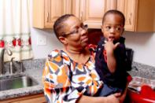
We’re Leaving Behind a Legacy That Others Will Build Upon…
Combining evidence-based science, case management and environmental control, especially in the home, yields positive results in communities where care is coordinated and children with asthma have access to high-quality health care.
Integrating asthma educators/community health workers into the health care team can bring about improved health outcomes.
Sustainable change in the quality of and access to asthma care will require continued advocacy and collaboration across key stakeholders such as payers, health care providers, the housing sector, schools, state/local environmental programs…

Slide 10
MCAN Resources Available on
AsthmaCommunityNetwork.org

Slide 11
10-Year Impact Report

Slide 13
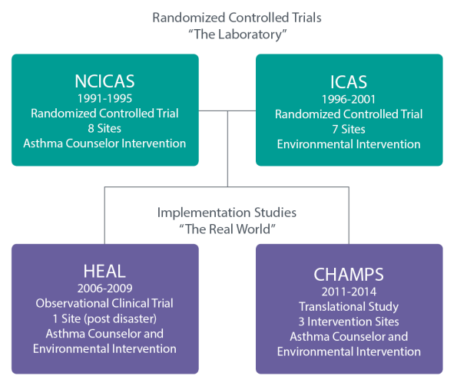
How we got to CHAMPS…

Slide 14
Thank you…

Slide 15
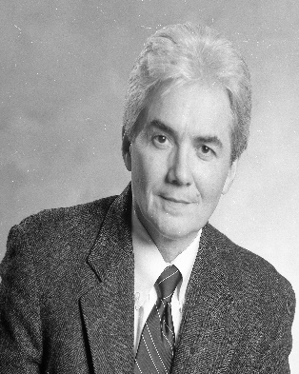
Rho
Dr. Herman Mitchell
Vice President of Federal Operations
Notes:
Program Overview Intro Slide
Herman E. Mitchell, PhD, is an Epidemiologist/Biostatistician, Senior Research Scientist, and Vice President of Rho, Inc. in Chapel Hill, NC. He is also adjunct Professor of Biostatistics at the University of North Carolina School of Public Health. He has over 30 years of NIH multicenter coordinating experience, and for the past 25 years has been involved in clinical research related to asthma in inner-city children.
He was on the faculty of both departments of Epidemiology and Biostatistics at University of Pittsburgh Graduate School of Public Health, where he also served as Assistant Dean. He also served as Assistant to the Secretary of Health for the State of Pennsylvania. Following this position he became Director of Research Systems and Vice President for Research Development at New England Research Institute (NERI) in Boston.
Dr. Mitchell has served as PI or co-PI for more than a dozen NIH-sponsored clinical trials and epidemiologic studies. Starting in 1990, Dr. Mitchell has served as the Coordinating Center Principal Investigator for the NIH/NIAID asthma studies among children in the inner city. Dr. Mitchell was also PI of the Coordinating Center for the NIEHS multicenter study of asthma and environmental exposures among children in post-Katrina New Orleans (HEAL – Heading off Environmental Asthma in Louisiana).

Slide 16
The Evidence Base for the CHAMPS Intervention
Herman Mitchell, Ph.D.
Vice President and Senior Research Scientist
Rho Federal Systems Division
Chapel Hill, NC
Notes:
Program Overview Intro Slide

Slide 17
CHAMPS Community Healthcare for Asthma Management and Prevention of Symptoms
A family-centered, patient-tailored intervention
Based upon more than two decades of
NIH research on
asthma interventions for children

Slide 18
NIH Inner-City Asthma Studies
Late 1980s, several investigators documented the rapidly increasing prevalence of asthma, especially among minority children in the inner city.
Congressionally directed funding through the NIAID
This research effort is now in its fifth competitive funding cycle.

Slide 19
The Basis of CHAMPS: A Series of Highly Tailored NIH Asthma Interventions:
NCICAS: The National Cooperative Inner-City Asthma Study
Phase I: A national multicenter epidemiology study of
1528 children with asthma
Phase II: An asthma counselor intervention to address the risk factors identified in Phase I (n=1,033)
ICAS: Inner-City Asthma Study
An environmental intervention focused on environmental risks and allergen sensitivities (n=957)
HEAL: Head-off Environmental Asthma in New Orleans
A novel combination of the asthma counselor and
environmental interventions in post-Katrina New Orleans

Slide 20
Results of NCICAS Phase I Epidemiologic Study
No “silver bullet”
Many different factors are associated with asthma morbidity and exacerbations.
Asthma is a multifaceted problem.

Slide 21
Asthma Interventions
General Tailored
General in nature
Focused on the disease
Everyone gets the same intervention.
Specific to the child
Disease X child interaction
The intervention is customized to the specific circumstance or risks.

Slide 22
Tools Tailored to Facilitate a Patient-Specific Intervention
NCICAS
CARAT: Child Asthma Risk Assessment Tool
ICAS
ERAT: Environmental Risk Assessment Tool
HEAL
Combined ERAT and CARAT

Slide 23
Among the Risk Factors Found to Affect Asthma…
Medical Risk—continuity of care, ED use, communication with PCP
Adherence—correct medication use, barriers to adherence
Asthma Responsibility—shared, diffused responsibility
Psychosocial Factors—caretaker and child psychological status
Attitudes—ability to control symptoms, attitude toward health care, medications
Allergies and exposures—skin test sensitivities, environmental triggers, ETS exposure

Slide 24
Child Asthma Risk Assessment Tool (CARAT)
Generated from clinic interviews
Identifies individual asthma risks
Provides summary of asthma risks
Provides personalized asthma education
Guides intervention activities

Slide 30
ICAS – the Inner-City Asthma Study
ICAS was designed to address the many environmental exposures and allergen sensitivities that were identified in NCICAS.
The asthma counselors were replaced with “environmental counselors.”
The CARAT was replaced with the ERAT.

Slide 31
Allergen Sensitivity by Skin Prick Test

Slide 32
Home Environmental Exposures
Tobacco smoking (≥ 1 smoker) | 47%
Dampness, water leaks, mildew | 70%
Cockroaches | 73%
Rodents | 49%
Furry pet | 30%

Slide 33
Environmental Risk Assessment Tool (ERAT)
Generated from
Clinic interviews
Home observation and sample collection
Identifies and provides a summary of environmental risks
Guides targeted environmental intervention modules

Slide 34
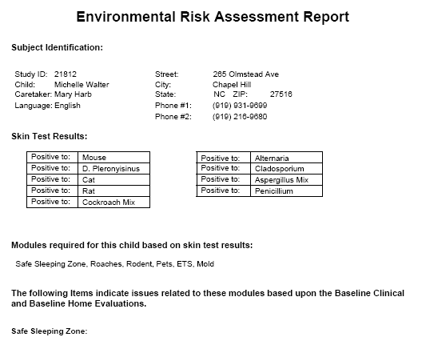

Slide 35
Participant Outcomes
Asthma symptoms and medication use
Asthma Control Test
Cost effectiveness
Home environmental allergen exposures
Lung function
Quality of life

Slide 36
Summary
NCICAS, ICAS and HEAL involved patient-tailored asthma interventions directed at risks identified for the child.
CHAMPS integrated the patient-tailored interventions into the Community Health Clinics and assessed effectiveness.

Slide 37
CHAMPS Intervention:
100 patients per site, ages 5–12 years
Baseline Clinic Evaluation
Baseline measures/questionnaires
Clinical risk assessment
Allergen sensitivity testing
Spirometry
Asthma Counselor Visit 1: Clinic
Home environmental risk Assessment visit
Asthma Counselor Visit 2: Home
Asthma Counselor Visit 3: Home
6-month outcome
Asthma Counselor Visit 4: Home
Additional asthma counselor visits
12-month outcome

Slide 38
Decrease in Asthma Symptom Days
Comparison to Past Studies at 12 Months
Change in Days of Symptoms per 2 Weeks
p<0.001
p=0.06
p=0.001
p=0.003

Slide 39
The Take-Home Message…
Asthma morbidity (symptoms and exacerbations) is caused by many different factors.
These factors vary widely within the population of those with asthma.
Risk factor assessment tools can help target appropriate asthma management.

Slide 40
Rho
Ryan Bailey
Business Analyst
Notes:
Program Overview Intro Slide
Ryan Bailey is a Project Coordinator and Business Analyst at Rho. He has over 10 years of experience conducting multicenter asthma research studies, including the Inner City Asthma Consortium (ICAC) and the CHAMPS project. Mr. Bailey also coordinates Rho’s Center for Applied Data Visualization and manages Rho’s Writing and Editing Community of Expertise.

Slide 41
How to Access and Use the CHAMPS Resources on www.asthmacommunitynetwork.org
Ryan Bailey
Business Analyst, Rho

Slide 42
Objective: Answer Two Key Questions
What resources are available on the site?
How do I access them?
Notes:
Setting the context

Slide 43
Two Key Concepts
Capacity: Preparedness and infrastructure to implement an asthma intervention
Adaptation: Ability to modify the intervention to meet unique needs of the practice
Notes:
Setting the context

Slide 44
What resources are available on the site?
Intervention overview Web pages
Intervention diagram
e-Learning videos
Procedural manual
Related asthma research
Intervention tools
Questionnaires
Patient Education Handouts

Slide 45
Getting Started
Intervention overview Web pages
Intervention diagram
e-Learning videos
Procedural manual
Related asthma research
Intervention tools
Questionnaires
Patient Education Handouts

Slide 46
Going Deeper
Intervention overview Web pages
Intervention diagram
e-Learning videos
Procedural manual
Related asthma research
Intervention tools
Questionnaires
Patient Education Handouts

Slide 47
Finding the CHAMPS Materials

Slide 48
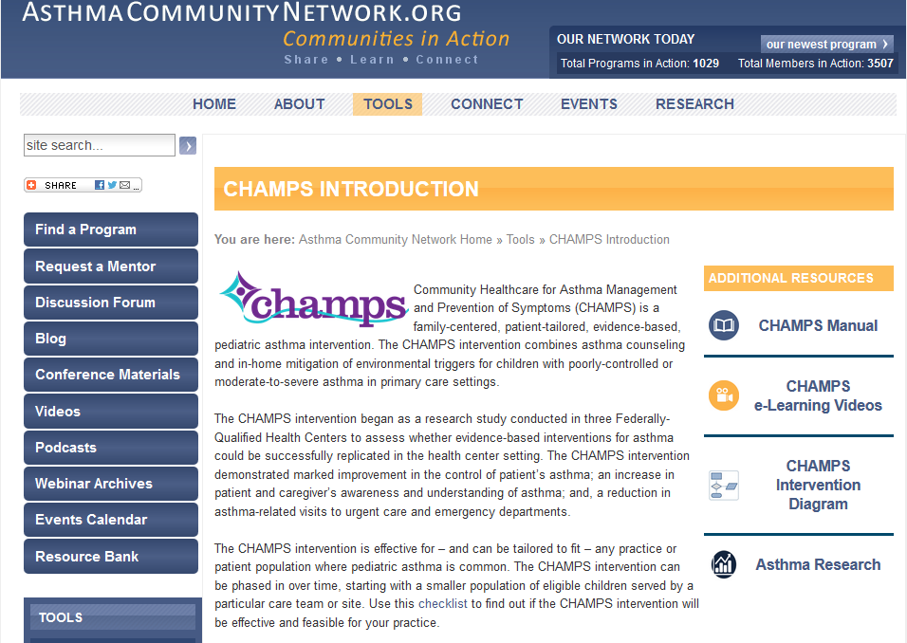

Slide 49
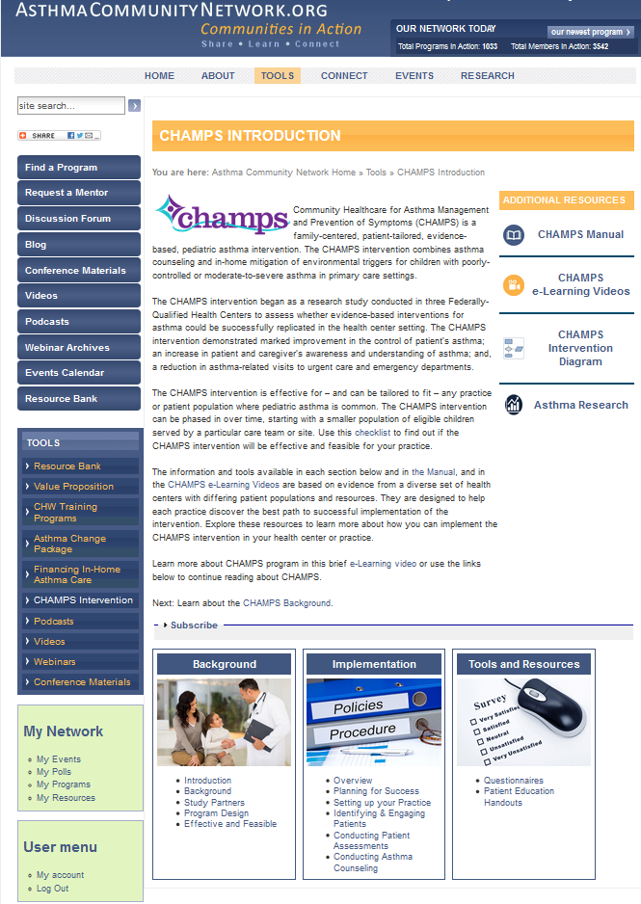

Slide 53
Getting Started
Summary information Web pages
Intervention diagram
e-Learning videos
Procedural manual
Related asthma research
Intervention tools
Questionnaires
Patient Education Handouts

Slide 55
Intervention Diagram

Slide 56
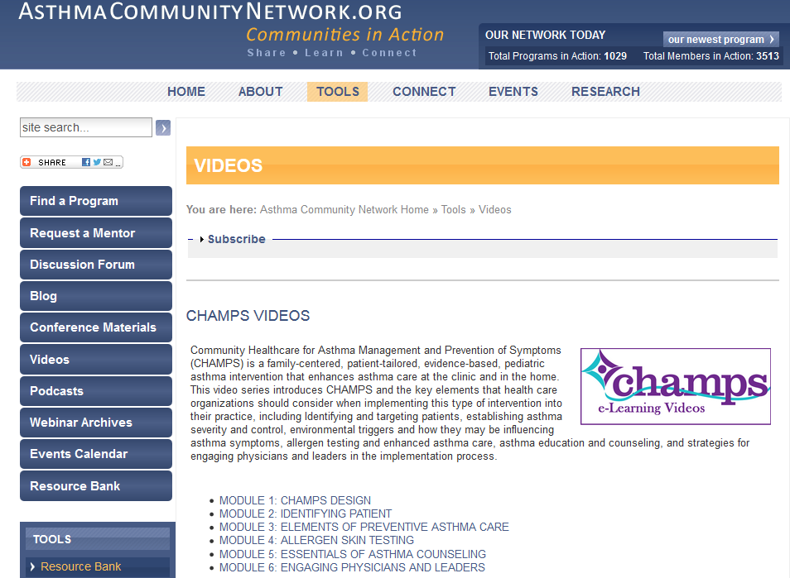
e-Learning Videos

Slide 57
Going Deeper
Intervention overview web pages
Intervention diagram
e-Learning videos
Procedural manual
Related asthma research
Intervention tools
Questionnaires
Patient Education Handouts

Slide 59
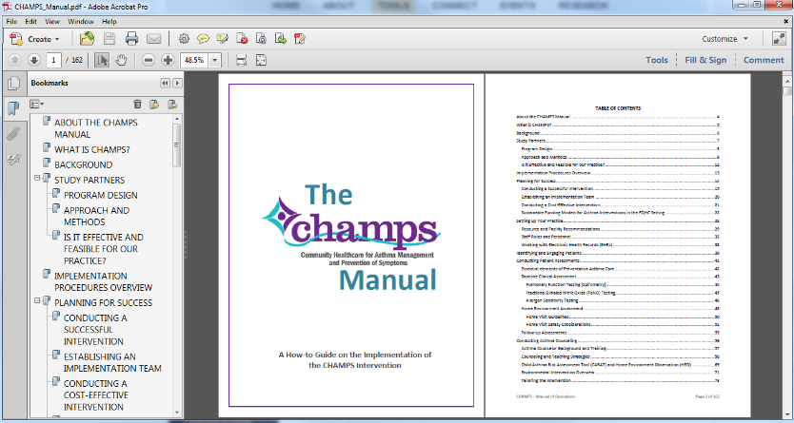
Procedural Manual

Slide 60
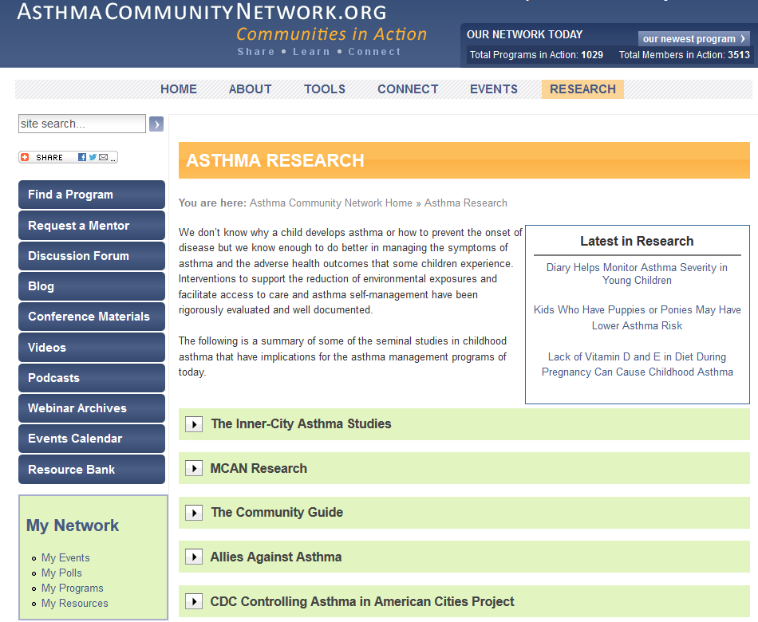
Related Asthma Research

Slide 62
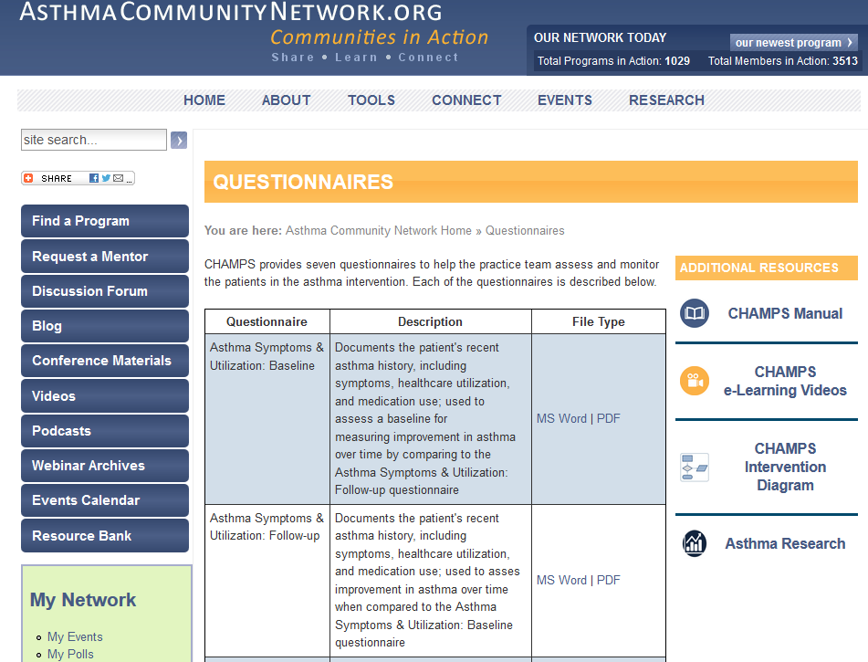
Intervention Tools

Slide 63
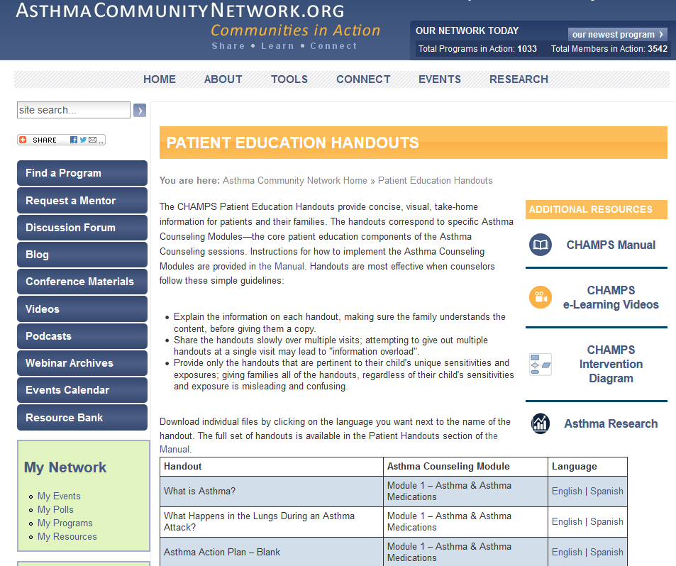
Intervention Tools

Slide 64
Take-Home Points
Tools are designed for varying capacity and intended for adaptation.
Summary and detailed resources are provided.
Navigate on the right and at the bottom.
Notes:
Setting the context

Slide 65
Roundtable Discussion
Costa Salud Community Health
Francisco Ramirez, Asthma Counselor
El Rio Community Health Center
Dr. Andrew Arthur, Associate Medical Director
Notes:
Program Overview Intro Slide
Francisco Ramirez RN AE-C
Six years in the nursing profession primarily in ER setting with the last 3 years focused on rural asthma population on the west side of Puerto Rico. One of the Asthma counselors trained on the CHAMPS intervention. Certified Asthma Educator (AE-C) since February 2014.
Dr. Andrew Arthur is a general pediatrician and the Medical Director of Pediatrics at El Rio Community Health Center in Tucson Arizona. Dr. Arthur obtained his MD and a PhD in epidemiology from Johns Hopkins University. Dr. Arthur completed his pediatric residency at the University of Arizona. Dr. Arthur has been the closely involved with El Rio’s Asthma Program since 2001.

Slide 66
Poll Question
After participating in this webinar, what will be your next steps?
Notes:
So now based on what you heard, I’d like to hear from you about what actions you will take after this webinar to further explore reimbursement for your program.
Polling Question #3

Slide 67
MCAN and CHAMPS Resources on AsthmaCommunityNetwork.org
Visit the MCAN Library:
www.asthmacommunitynetwork.org/MCAN
Dive into the CHAMPS Intervention:
www.asthmacommunitynetwork.org/CHAMPS
Download resources to help support your patient population:
Questionnaires: www.asthmacommunitynetwork.org/node/16101
Patient handouts: www.asthmacommunitynetwork.org/node/16102
Webinars: www.asthmacommunitynetwork.org/webinars
Notes:
[Sheila Brown, Moderator]
In addition, I want to let you know that tools and resources from the Merck Childhood Asthma Network are now available in a dedicated Resource Library on AsthmaCommunityNetwork.org.
I also encourage you to view the Merck Childhood Asthma Network’s new Ten-Year Impact Report and to register now for the MCAN webinar on December 3, 2015 to learn more about the results of this groundbreaking investment in improving asthma case and reducing asthma disparities.

Slide 68
Join the Online Discussion Forum
Speakers are now available for a live Q&A Session.
Thursday, December 3, 2015, 3:00 p.m. – 3:30 p.m.
Members can submit questions via the link in the Chat pane.
Not yet a member? Joining online is quick and easy.
Go to AsthmaCommunityNetwork.org.
Click “Join Now” at the top and complete the registration process.
Post your questions as soon as your account is approved.

