Slide 1
Securing Coverage for In-Home Asthma Care Services
Welcome to the Webinar
Featuring:
Amanda Reddy, National Center for Healthy Housing
Abby Hugill, U.S. Department of Housing and Urban Development
Jill Bednarek, Healthy Living Branch, Colorado Department of Public Health and Environment
Wednesday, February 18, 2015 Webinar 2:00 – 3:00 p.m. EST Live Online Q&A 3:00 – 3:30 p.m. EST on AsthmaCommunityNetwork.org
Notes:
Welcome!
We are pleased you are able to join us today for an important and very timely discussion on opportunities for Medicaid reimbursement.
I’m Tracy Enger, from EPA and I’ll be moderating today’s webinar.
This webinar is one in a series of webinars we’ve conducted over the past two years on reimbursement. Over the next hour, you will hear about the different pathways to reimbursement; what is currently going on in the states where reimbursement is already in motion; and the personal experience of a coalition that is working hard at making medicaid reimbursement a reality in their state.
We are pleased to have Amanda Reddy, from the National Center for Healthy Housing; Abby Hugill, from the U.S. Department of Housing and Urban Development; and Jill Bednarek, from the Healthy Living Branch, Colorado Department of Public Health and Environment here with us today to share their experiences and insights on the opportunities for reimbursement in today’s changing healthcare landscape.

Slide 2
Purpose of the Webinar
Learn more about the changing landscape of healthcare coverage and how to prepare your own organization for existing opportunities in sustainable financing.
Develop an understanding of Medicaid reimbursement.
See a critical path to help programs prepare for reimbursement.
Learn about the key partnerships, conversations and infrastructure needed by a program to prepare for reimbursement.
Notes:
We are in an exciting and historic time for addressing asthma disparities:
We have agreement that the impact of evidence-based interventions is critical in comprehensive asthma care;
There are new reimbursement opportunities under Medicaid and the Affordable Care Act focusing on prevention care services; and
There is greater collaboration between federal, state and local agencies, NGOs and private organizations to enable change in asthma care and reimbursement for asthma services.
At EPA, we are committed to creating opportunities to learn, share and connect around best practices that promote comprehensive community-based asthma care.
Today’s webinar is an important one for you – based on our registration questions we know that many of you are considering reimbursement for asthma services.
By the end of today’s Webinar, it is my hope that you will be one step closer to preparing your organization and program for identifying new funding opportunities that will help sustain your program.

Slide 3
Your Questions
Where do I start?
What partnerships should I focus on establishing?
How do I prepare a business case?
What types of services are covered?
Who is qualified to be reimbursed for in-home asthma services?
Which states have successfully secured sustainable coverage for in-home services?
Notes:
Many of you familiar with the structure of our webinars know that we conduct the speaker Q&A portion of our webinars in the Discussion Forum feature on AsthmaCommunityNetwork.org.
Today, I am excited to share with you that because we had such an overwhelming response to our registration question requesting you to submit ]questions you have on sustainable financing, we intend to answer as many of your questions as we can during the webinar.
We found some patterns and similarities in your questions – so we’ve identified some of the most frequent questions asked, which you can see here. As you hear our speakers present, you’ll hear answers to these questions and many more.
We also provided our speakers your questions, so be sure to listen as they identify submitted questions and provide answers to them.

Slide 4
Poll Question
What type of organization do you represent?
Notes:
Before we dive into today’s presentations, I would like to take a minute to learn more about you. To help me do that I have two quick polls:
Polling Question #1

Slide 5
Poll Question
What are you excited to learn about that will advance your efforts to secure funds for in-home asthma services?
Notes:
And now I would like to hear about what you are excited to learn more about today.
Terrific, I see that ……
Well you will be happy to know that our speakers will be covering all of these topics in their presentation today. And in instances where you feel that you still have questions, please visit the discussion forum in AsthmaCommunityNetwork.org and submit your question there.
So without further delay, let’s get started.

Slide 6
National Center for Healthy Housing
Amanda Reddy
Notes:
Ms. Amanda Reddy is an experienced public health professional with nearly a decade of experience in data management, analysis, and program evaluation. She currently directs NCHH’s program division and is responsible for advancing numerous organizational initiatives including those related to increasing healthcare financing of healthy homes services and developing training and technical assistance to support states in launching and growing sustainable asthma home visiting programs. In her prior role as Senior Analyst with NCHH and its subsidiary, Healthy Housing Solutions, Ms. Reddy led the development of indicators for the HUD Healthy Communities Index. She was previously a research scientist with the New York State Department of Health where she filled a variety of program evaluation, management, and technical support roles for a collection of programs including the Asthma Control, Healthy Homes and Lead Poisoning Prevention, Healthy Neighborhoods, and Healthy Home Environments for New Yorkers with Asthma Programs. She holds an MS in Environmental Health from the London School of Hygiene and Tropical Medicine and a BA in Neuroscience and Behavior from Mount Holyoke College.
Amanda, take it away.

Slide 7
THE REIMBURSEMENT LANDSCAPE

Slide 8
Healthy Homes and Healthcare Reform: Healthcare Financing of Healthy Homes Services
APHA/CDC funded project
What is the current reimbursement landscape?
Through lens of asthma and lead
What opportunities exist for state/local agencies or organizations interested in exploring healthcare financing of healthy homes services?
The resource library, technical briefs and survey were made possible through a contract between the American Public Health Association and the National Center for Healthy Housing, funded through cooperative agreement 1U38OT000131 between the Centers for Disease Control and Prevention and the American Public Health Association. The contents of the resource library, technical briefs and survey are solely the responsibility of the authors and do not necessarily represent the official views of the American Public Health Association or the Centers for Disease Control and Prevention.

Slide 9
Medicaid Reimbursement Policies: 2014 Survey
Online surveys
Home-based asthma services
Lead poisoning follow-up services
Sent to program contacts and Medicaid Directors in Spring 2014
Responses from 46 states for asthma and 49 states for lead

Slide 10
Reimbursement by the numbers: Home-based asthma services
13
states have some Medicaid reimbursement for home-based asthma services in place (may be on very limited scale)
3
additional states expect to have some Medicaid reimbursement for home-based asthma services in place within a year
19
states are exploring Medicaid reimbursement for home-based asthma services
(or an expansion of existing services)
37
states reported that no services are in place or the respondent was not sure whether services were in place or the state did not respond to the survey
Notes:
13=
3=KY, UT, WA

Slide 11
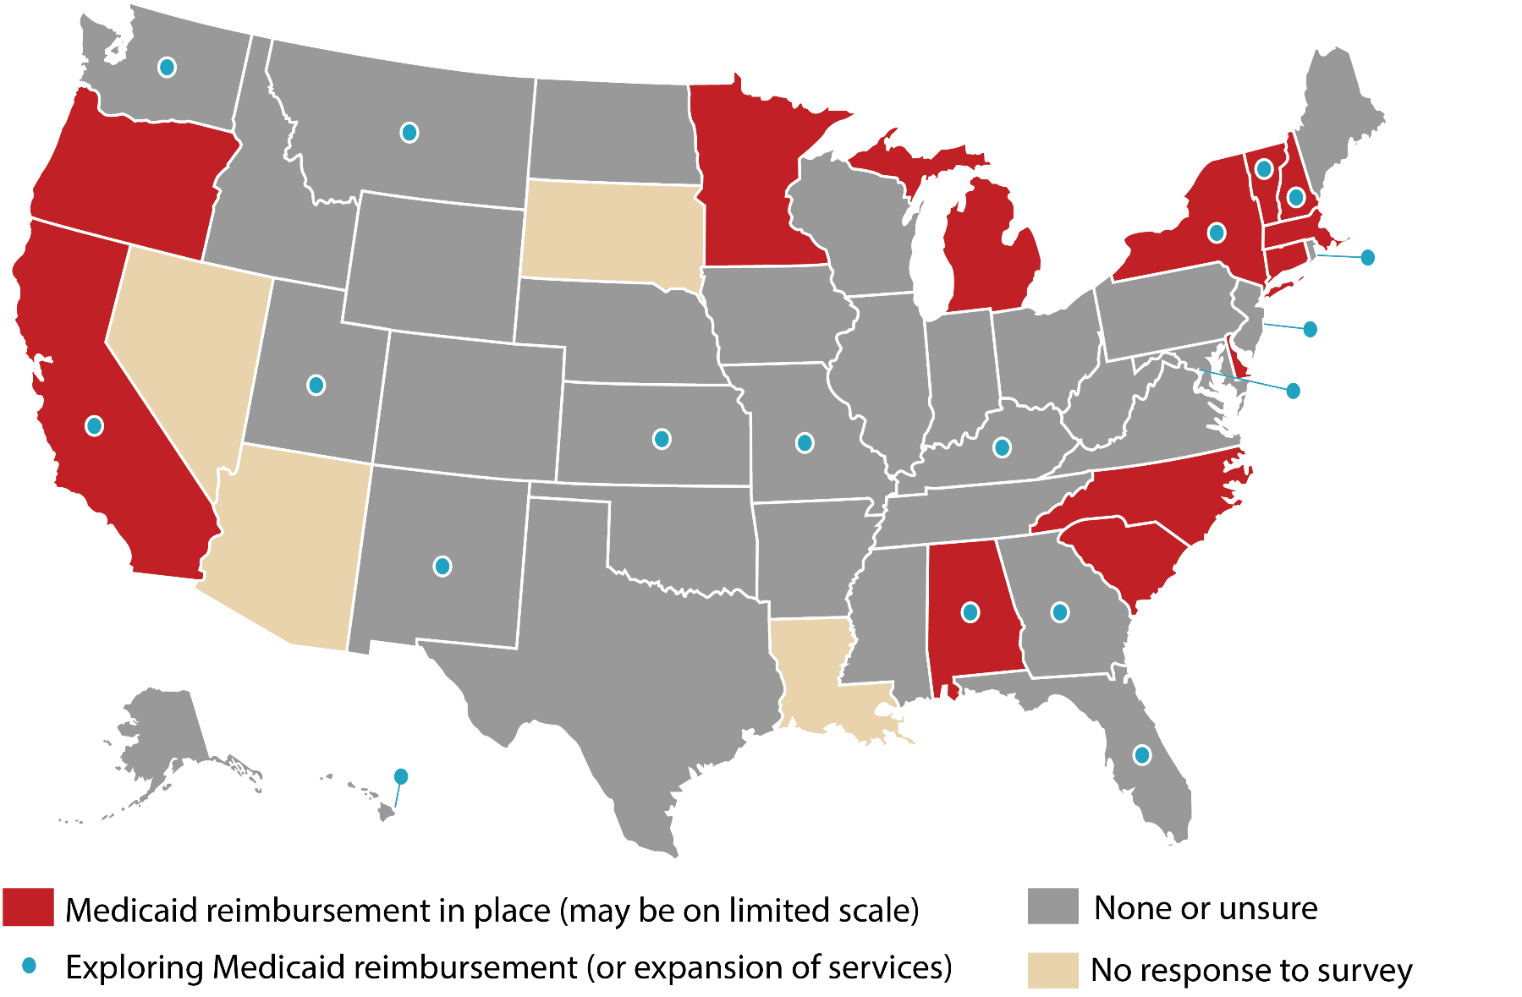
Current State of Play: ASTHMA

Slide 12
Who is eligible for these services? Among 13 states with home-based asthma services in place (select all that apply)
100%
provide services to children
69%
provide services to adults
OTHER REQUIREMENTS
Recent hospitalization or ED visit (62%)
Other healthcare utilization (38%)
ACT score (15%)
Location of patient’s residence (15%)
Allergen testing, screening questions about home environment, referral from school/daycare (8%)

Slide 13
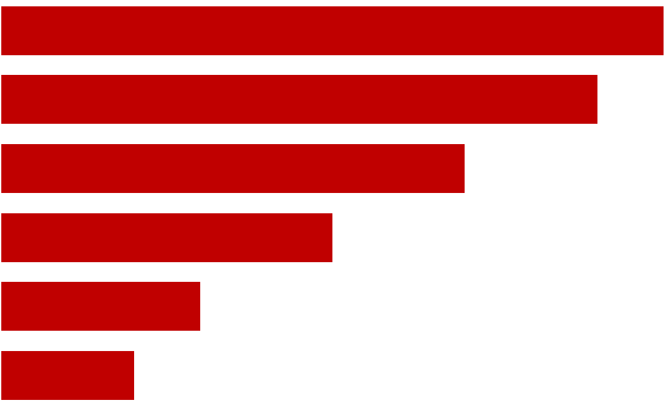
What services are reimbursable? Among 13 states with home-based asthma services in place (select all that apply)
Self-management education, 77%
Assessment of primary residence, 69%
In-home education about triggers, 54%
Low-cost supplies, 38%
Assessment of a second residence, daycare or school, 23%
Structural remediation, 15%

Slide 14
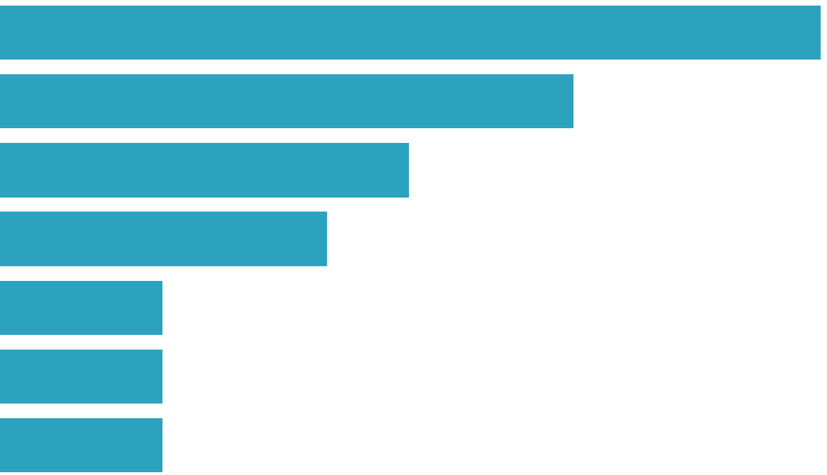
What type of staff provide services? Among 13 states with home-based asthma services in place (select all that apply)
Nurses, 77%
Certified Asthma Educators, 54%
Respiratory Therapists, 38%
CHWs, 31%
Housing Professional, 15%
Sanitarian/Environmental Health Professional, 15%
Social Workers, 15%

Slide 15
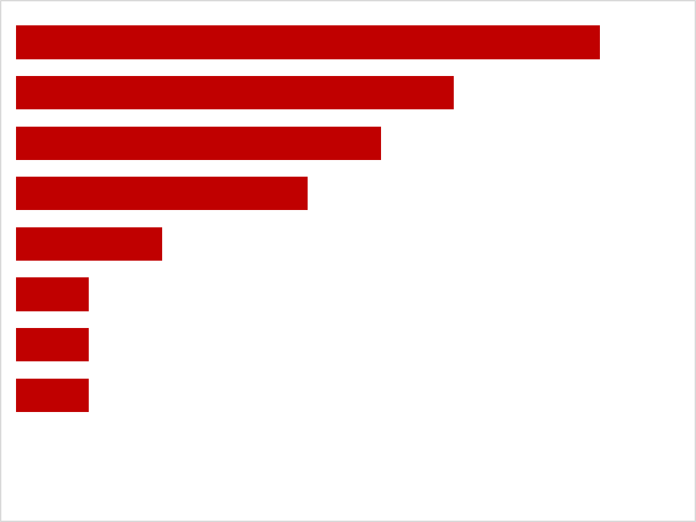
Who is billing for these services? Among 13 states with home-based asthma services in place (select all that apply)
Medicaid Managed Care Orgs, 54%
Visiting Nurse/Home Health Agencies, 46%
Hospitals/Clinics, 38%
Local Health Dept, 31%
Other Healthcare Providers, 15%
State Health Dept, 8%
Community-Based Orgs, 8%
Other, 8%
Notes:
None for housing agencies.

Slide 16
Most influential drivers (average ratings) (4=Very important, 3=Important, 2=Somewhat Important, 1=Not important)
Credible information about potential costs and savings (3.7)
Credible information about potential improvements in health outcomes (3.6)
Political will/leadership (3.5)
Federal funding for State Asthma Control program (3.4)
Relationships/partnerships to get issue on table (3.4)
Promotion of service by State Asthma Control Program (3.3)
Established workforce infrastructure to deliver services (3.3)
Information/evidence from local/regional pilots (3.3)
Credentialing infrastructure for eligible providers (3.3)
Advocacy/interest from healthcare community (3.2)
Change in EHB rule (3.2)
Healthcare reform (e.g., ACA) (3.1)
Individual champions within state agencies (3.1)
Advocacy/interest from local or external partners/stakeholders (3.0)
NAEPP clinical guidelines (3.0)
CDC Community Guide (3.0)
…

Slide 17
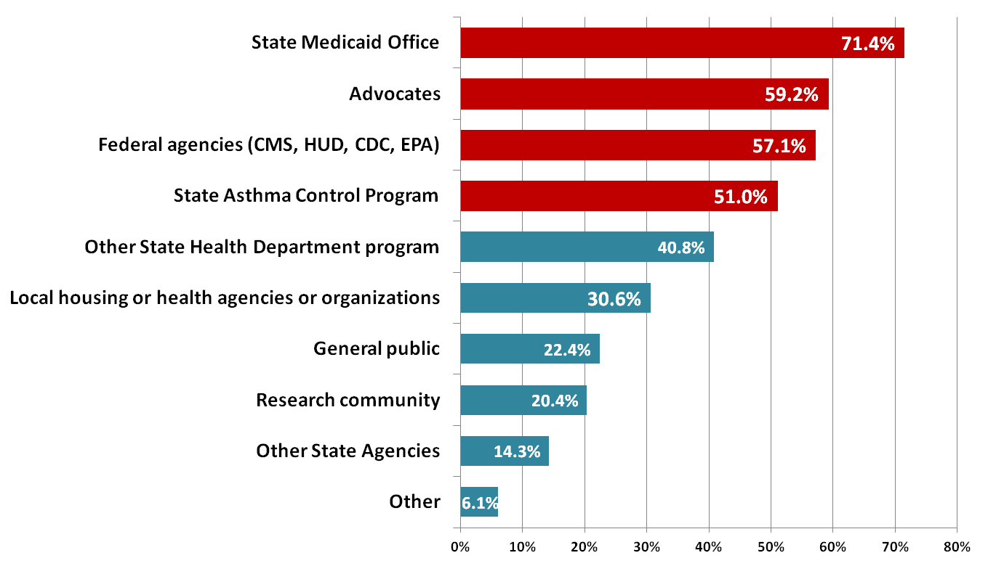
Most influential groups

Slide 18
Other healthcare financing
7 states reported at least one private/commercial payer in their state; an additional 7 are aware of pending efforts
6 Hospital Community Benefits
2 ACOs
1 Social Impact Bond
12 State-funded programs

Slide 19
Next Steps for NCHH
Year 2 of APHA/CDC funding focused on interviews with key state-level staff
Clarify questions raised by survey
Develop detailed case studies
New cooperative agreement with EPA to fund targeted technical assistance and training
Other funding in place to support advocacy and dissemination
E.g., clarifying EPSDT, Bright Futures, Preventive Services and Community Guide to Preventive services guidance

Slide 20
If you’re interested in learning more:
Read about the project: www.nchh.org/Program/EquippingStatesforReimbursement.aspx
Keep your relevant agencies in the loop (e.g., CDC project officer, EPA Regional Office)

Slide 21
Next Steps for You?
Start (or advance) a conversation in your community
What are some unique features about the administrative or regulatory landscape in your state?
Who is working on or might be interested in this issue in your state?
What would an ideal program look like for your state?
What needs to happen to make this a reality?
What is the first step? What can you do within the next month?

Slide 22
Considerations
Translating a program/project into a service
Who can order the service? Who can provide the service? What additional training/certification do they need? Who will be eligible for the service? Will you stratify services? What activities will be covered? How will supplies and services be paid for or provided? How will patients get connected to other community resources? How will the service deal with special situations (e.g., lifetime limits, multiple residences, multiple patients in the same residence)? Who can bill/be reimbursed for the service? How will reimbursement rates be determined?
Building the business case
Perspective (e.g., payer, societal); impact of targeting, intensity, staffing, scope, number of visits; timeframe of measurement; benefit structure (e.g., lifetime limit, multiple residences, multiple patients in same residence); some costs may go up, but net benefit likely to be savings; role of cost-neutral/cost-effective interventions in achieving the triple aim; ability to leverage other funding
The process takes time, but every conversation is an opportunity to refine your pitch!

Slide 23
Some Useful Tools
NCHH Healthcare Financing Resource Library
CDC Community Guide to Preventive Services
CDC Approaches to Reimbursement Report
ARC Business Case
EPA Award Winners Hall of Fame
EPA’s Value Proposition Toolkit
AHRQ’s Asthma ROI Calculator
Expert reports +
real-world examples +
these tools +
your own program’s information/experience =
A compelling (and fundable) story

Slide 24
Amanda Reddy
Director of Programs and Impact
National Center for Healthy Housing
areddy@nchh.org
www.nchh.org/resources/healthcarefinancing.aspx
www.nchh.org/Resources/HealthcareFinancing/Snapshot.aspx

Slide 25
U.S. Department of Housing and Urban Development
Abby Hugill
Jill Bednarek
Healthy Living Branch,
Colorado Department of Public Health and Environment
Notes:
Thank you Amanda! It is great to learn more about the landscape of reimbursement and what some programs have already achieved, but to also learn that it is still a new concept for many others. I think a takeaway for our audience is that it is a complex and time intensive process that benefits from many hands sharing the work – because in the end the effort can reap huge rewards.
So with that, let me introduce our next two speakers who can share their experiences about how they are right in the middle of bringing reimbursement to the state of Colorado.
Jill Bednarek directs secondhand smoke initiatives of the tobacco program at the Colorado Department of Public Health and Environment. She has served in this capacity since 2008. She has nearly twenty years of professional experience in positive youth involvement, alcohol, and tobacco and other drug prevention and health promotion. She received her Master's Degree in Social Work from the University of Denver. She has served as a member of the board of directors for several nonprofit organizations and is the proud mother to three children ages 18, 18 and 14.
Following Jill, you will hear from Abby Hugill.
Abby Hugill joined the U.S. Department of Housing and Urban Development in 2008 through the MBA Fellows Program, an intensive two-year program which focuses on professional and personal growth through a number of developmental program components, including assignments in various HUD offices. Upon successful completion of the program in the spring of 2010, Abby accepted a position as a Healthy Homes Representative within HUD’s Office of Healthy Homes and Lead Hazard Control. In this role, she is the Regions V and VIII liaison tasked with furthering the Office mission to reduce health and safety hazards in housing in a comprehensive and cost effective manner, with a particular focus on protecting the health of children and other sensitive populations in low-income households.
Prior to joining HUD, Abby spent seven years working in the housing industry in the Denver area. She has a Business degree from Michigan State University and an MBA from University of Colorado at Denver.
Jill would you like to take it from here?

Slide 26
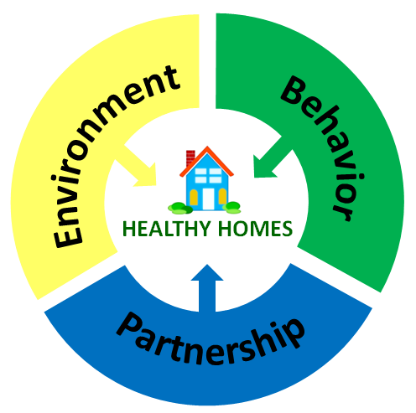
Colorado Healthy Housing Coalition
Jill Bednarek
Colorado Department of Public Health and Environment
Abby Hugill
U.S Department of Housing and Urban Development
Actions to promote healthy housing can yield dramatic improvements in the health and safety for individuals and families in Colorado.
Notes:
Introduce self as rep of Healthy Housing Coalition coordinator

Slide 27
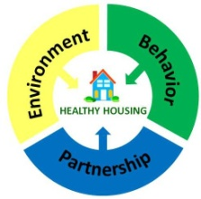
Colorado Healthy Housing Coalition
Our Beliefs:
Low-income families – especially children and the elderly – suffer disproportionately from substandard housing.
Policy makers and environmental and public health advocates can address this inequity by taking action to ensure healthier, safer homes.
Investments to improve the quality of housing can save billions in health care costs.
Notes:
SLIDE ADDRESSES: What brought us together
A call to Action across topic areas
Environmental hazards in the home harm millions each year.
Millions of U.S. homes have moderate to severe physical and environmental housing problems, including: water leaks; roofing problems; pests; damaged walls; radon; peeling paint; asbestos; and heating, plumbing, and electrical deficiencies.
These health hazards expose residents to a variety of incidents and illnesses, including: burns, lung cancer, asthma and other respiratory problems, and lead poisoning.
For communities, substandard housing means wealth depletion, abandoned properties, housing instability and poor health.

Slide 28
Purpose:
Colorado Healthy Housing Coalition:
A Call to Action
Mission:
Working together to promote strategies that advance healthy housing
Goals:
Promote the incorporation of healthy homes principles into ongoing programs and practices
Focus attention on the relationships between housing and health impacts
Coordinate and leverage state-wide healthy homes activities
Outcome:
Reduce public health inequities and improve health outcomes related to housing
Notes:
What do we do:
Webinars:
Kids Run Better Unleaded – Lead Prevention
Detect to Protect – Radon Awareness
Hiding in Plain Sight – Asbestos Awareness
Asthma and Secondhand Smoke - Recommendations for Reducing Asthma Triggers
Home Modification
Fact Sheets
Policy Goal

Slide 29
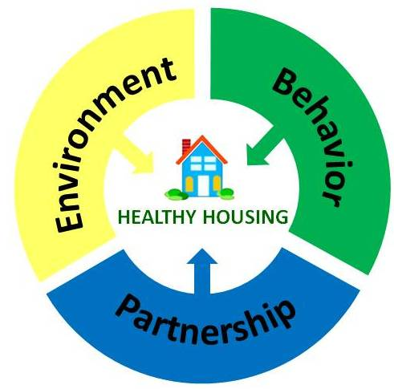
Colorado Healthy Housing Coalition
Colorado Department of Public Health and Environment
Colorado Division of Housing
Colorado Energy Office
Colorado Health Care Policy and Financing
U.S. Environmental Protection Agency
U.S. Housing and Urban Development
U.S. Department of Health and Human Services
Local Public and Environmental Health
Local Community Representatives
Notes:
Not grant focused or funded
Lead, Asbestos, SHS (Colorado that means tobacco and marijuana), radon, mold, weatherization, pest management

Slide 30
Colorado Healthy Homes Coalition: A Call to Action
Overview of Collaboration
Collaborations and Healthier Homes
Top 3 housing related health issues (Asthma/Childhood Lead Poisoning/Unintentional Injuries) are preventable and can be mitigated through home repairs/corrections
The economic burden of hazards in lower-income homes is significant (costs from asthma due to home dampness and mold was estimated at over several billion $ annually)
Targeted interventions based on household health issues result in measurable/repeatable outcomes
All in-home programs shall encourage staff to maximize relationships/referrals enhance customer service
Notes:
Top 5 Collaboration Conditions:
Common Agenda – a shared vision
Shared Measurement Systems – agreement on how success is measured
Mutually Reinforcing Activities – recognize individual agency strengths in reaching overall collaborative goals
On-going Communication – new vocabulary, schedules, trust development need time and reinforcement
Lead Support Organization – collaboratives need a lead organization to oversee and move ideas forward

Slide 31
Guiding resources
Colorado Healthy Housing Coalition:
A Call to Action
Notes:
If it was relevant to you, you could add the Asthma Disparities Action Plan http://www.epa.gov/childrenstaskforce/federal_asthma_disparities_action_plan.pdf
Trends in Collaboration
Federal Programs (HUD, RD, DOE, EPA, HHS) are charged with better aligning programs and resources to improve accountability and results
Programs are deliberately accelerating the pace of program interactions/changes in response to trends with an increased targeting of resources and less “all” be served delivery model
Simplicity of program access and use from the customer perspective is key to successful collaborations

Slide 32
Notes:
7/15 CMS revised 42 CFR 440.130© interpretation
Colorado Hospital Discharge data looked at Hospitalization and ED separately
And each of those indicators by age 18 and under and 18 and older.
These data showed us where to start.

Slide 33
Cost for Asthma Related ED visits
CDC estimates the national average cost for Medicaid/Children’s Health Insurance Program (CHIP) asthma-related pediatric Emergency Department (ED) visit at $433 and estimated in 2010, Colorado spent approximately $4,451,000 for such visits for children aged 0–17 Years

Slide 34
Colorado Healthy Housing Coalition:
A Call to Action
Starting a Coalition
Build Relationships
State and Local Environmental Health Programs – find a few champions with each agency that are passionate about providing evidenced-based services to this population
State and Local Affordable Housing Entities – link addressing health to their fiscal bottom line
Medical providers and hospitals – improve health outcomes and reduce duplication
Insurers – explain how your efforts can save them money
Notes:
Jill use your relationships, Network with agencies with similar interests
re
Learn their priorities and frame your work to help meet their priorities

Slide 35
Colorado Landscape
Colorado Healthy Housing Coalition:
A Call to Action
Colorado Department of Healthcare Policy and Financing (HCPF)
Accountable Care Collaborative (ACC)
Managed Care Organizations (MCO)
Fee for Service (FFS)
7 Regional Care Collaborative Organizations (RCCO)

Slide 37
How do we bring reimbursement to Colorado?
Colorado Healthy Housing Coalition:
A Call to Action
To date, we have:
Determined the key players & gauged interest
Identified existing approaches, evidence base, and business case
Brought the players together - Asthma Summit
Created actionable next steps with partners identified
Documented the value proposition, logic model, and evaluation tools
Notes:
Lessons learned from past Summits: There is a national appetite to expand reimbursement, Every state has unique challenges, Effective collaboration between federal, state, and local agencies and organizations is imperative, There is an evidence-base supporting the importance of home assessments, interventions, and education in comprehensive asthma care
Summit: brought together a multi-disciplinary group of health providers, health insurers, public health administrators, housing agencies, health and housing policy makers and researchers together around a single idea; with the knowledge we have about the effectiveness of in-home interventions in the homes of children with asthma, how do we create, promote and support sustainable programs that implement that model?
Post Summit next steps: Take the Summit output and continue the momentum, Strengthen the necessary partnerships, Identify challenges and start working to overcome them

Slide 38
Where we are now
Colorado Healthy Housing Coalition:
A Call to Action
In talks with the Accountable Care Collaborative to gain approval for reimbursement
Working with Children’s Hospital Colorado to as they begin a 3 year pilot which includes home visits
Discussing home assessment capacity with local health departments

Slide 39
What we have yet to do
Colorado Healthy Housing Coalition:
A Call to Action
Obtain approval for reimbursement
Determine training/certification of home assessors that will be acceptable to the ACC
Determine what reimbursement will cover
Expand partnerships with CDBG/other funding sources to refer extensive home remediations
Scale model to entire state
Notes:
Mention Fort Collins Healthy Homes Program as an example of a program that does low level remediations with very little dollars – may be a model that can be replicated; ACC has indicated potential reimbursements may cover low level intervention items.

Slide 40
Tools, Resources and Processes we are using
Colorado Healthy Housing Coalition:
A Call to Action
Value Proposition – using Asthma Community Network’s example as our guide
Assessment plan
Logic Model

Slide 42
Lessons Learned
Colorado Healthy Housing Coalition:
A Call to Action
Be proactive, but allow the process to be organic
Engage the right people
Utilize the evidence base and best practices already out there
Allow for variability based on unique state structures
Maximize windows of opportunity
Build effective coalitions

Slide 43
Colorado Healthy Housing Coalition:
A Call to Action
Coalition Contact Information
Jill Bednarek – jill.bednarek@state.co.us
Abby Hugill - Abby.D.Hugill@hud.gov
Colorado Healthy Housing Coalition – cohealthyhousing@googlegroups.com
Investments to improve the quality of housing can save billions in health care costs and improve quality of life.
Notes:
Abby

Slide 44
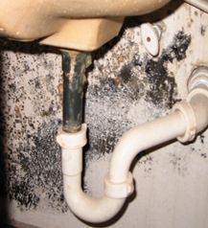
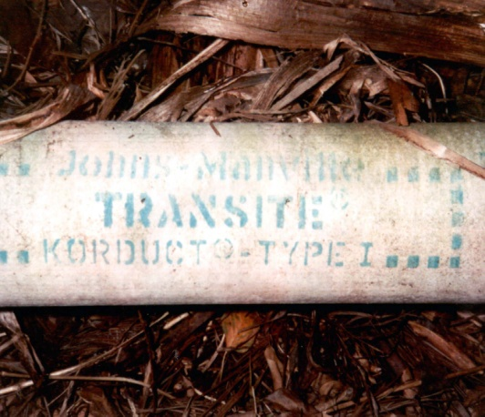
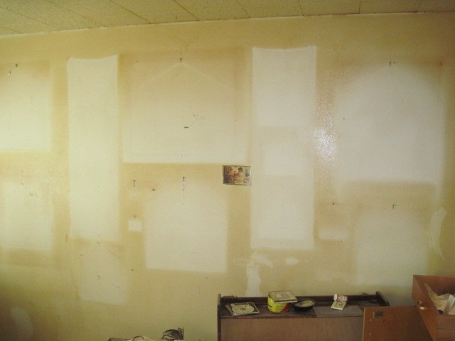
Colorado Healthy Housing Coalition:
A Call to Action
Thank You!
“The connection between the health and the dwelling of the population is one of the most important that exists.” – Florence Nightingale

Slide 45
Speaker Insights
Notes:
Thank you, Abby and Jill for sharing your story and experiences to date on how you’re making reimbursement happen in Colorado.
So let’s jump in to the next portion of our webinar – Speaker Insights – and ask our speakers some of your questions.
AMANDA: You talked about services covered in your presentation. We had a number of people submit questions about what services were covered in their state. Could you expand on this?
ABBY: I’m going to combine two questions for you: If Medicaid pays for this service, is the health care home the only one who can charge for it? What about CHW? And are county health departments reimbursable?
ABBY: Another follow up to that – How can a respiratory therapist qualify and become listed as a possible provider for these services?
AMANDA: How can state Medicaid agencies encourage and/or mandate that managed care organizations provide in-home asthma services?
ABBY: One of our webinar participants said the following: “Our biggest 'chicken and egg' problem is developing the workforce/infrastructure for DOING the home visits and integrating Healthy Homes.” Abby, what advice can you suggest?
AMANDA: I THINK WE HAVE TIME FOR ONE MORE: How should programs approach projecting costs?
Thank you speakers for sharing your insights to our participants’ questions. Remember, our speakers will continue to answer questions through the Discussion Forum on AsthmaCommunityNetwork.org in just a couple of minutes.

Slide 46
Poll Question
What actions will you take to secure coverage
for your program?
Notes:
So now based on what you heard, I’d like to hear from you about what actions you will take after this webinar to further explore reimbursement for your program.
Polling Question #3

Slide 47
Securing Coverage for In-Home Asthma Care Services
Conclusion of the Webinar
Moderator: Tracy Washington Enger, U.S. Environmental Protection Agency
Presenters:
Amanda Reddy, National Center for Healthy Housing
Abby Hugill, U.S. Department of Housing and Urban Development
Jill Bednarek, Healthy Living Branch, Colorado Department of Public Health and Environment

